Slide 1
Handwritten Digit Recognition
Jercan Alexandru-Constantin

Slide 2
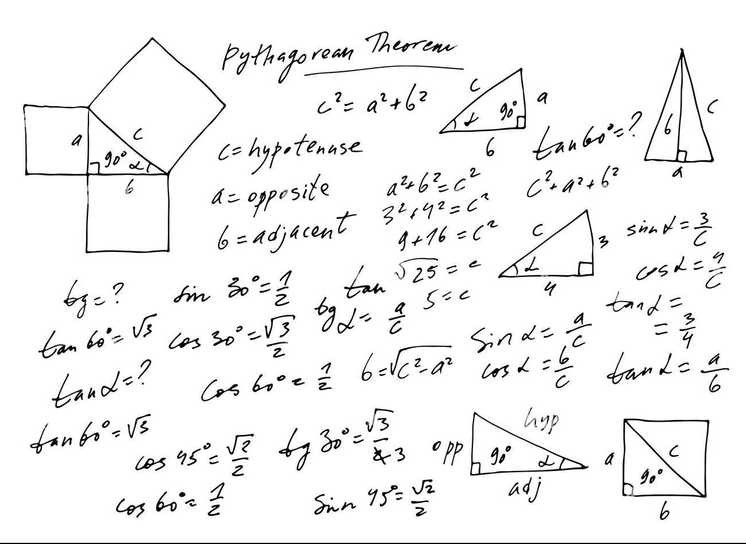
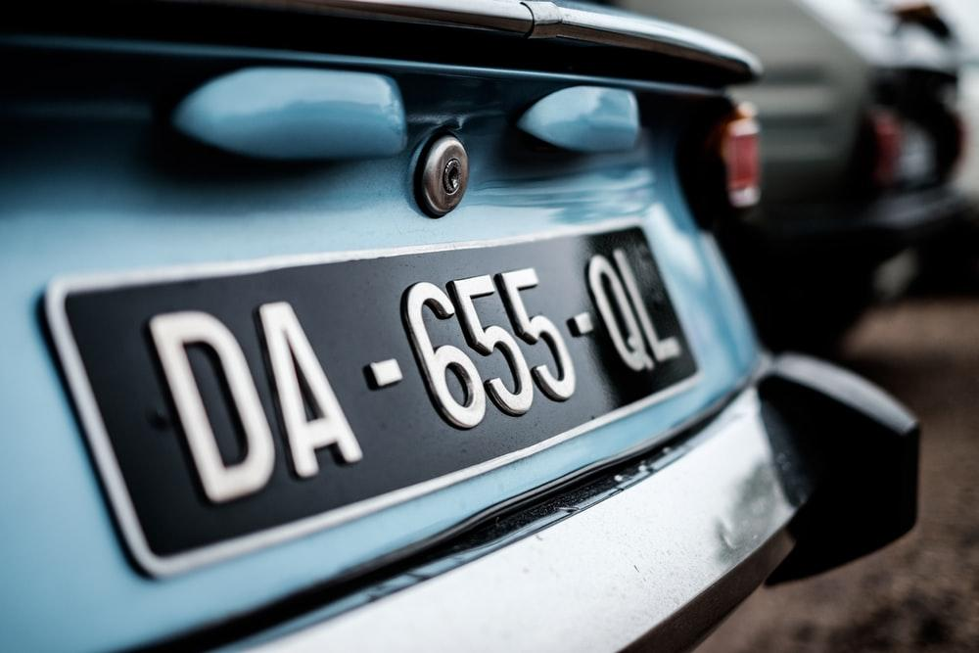

Slide 3
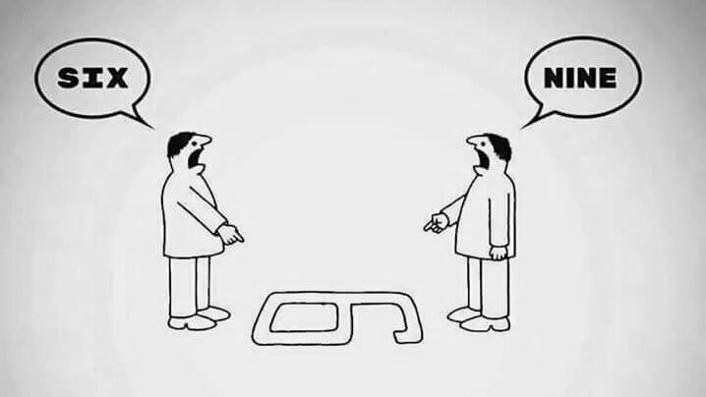

Slide 4
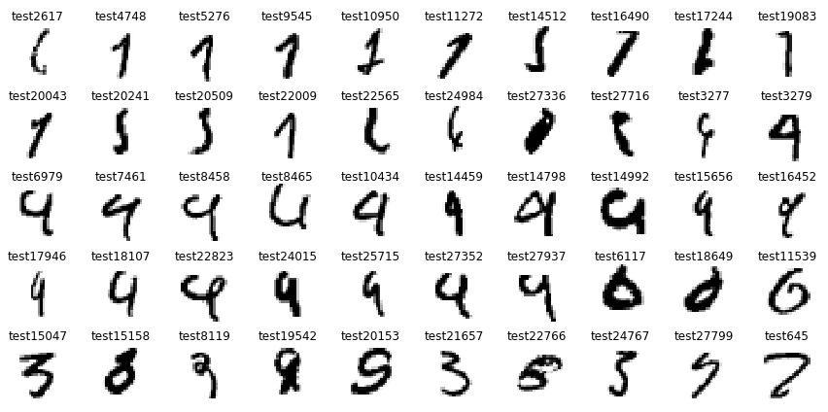
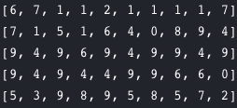

Slide 5
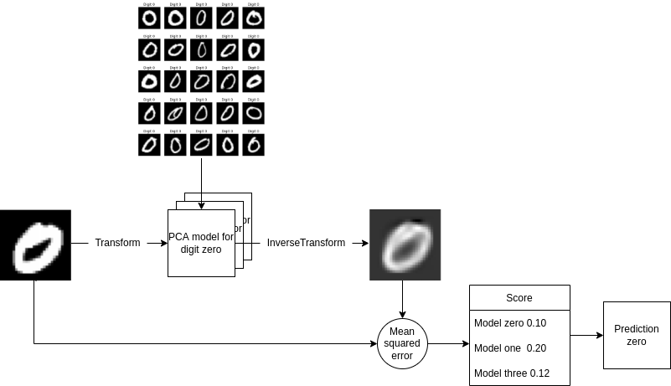
DigitsPCA

Slide 6
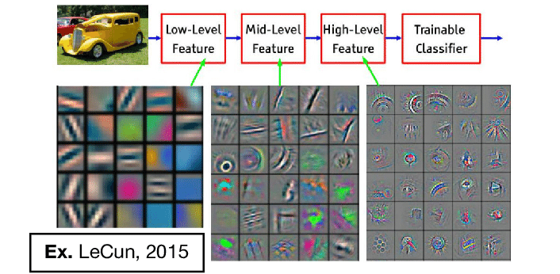
Filters

Slide 7
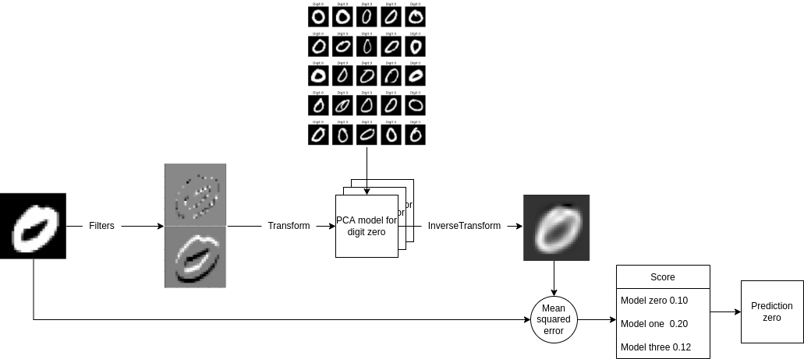

Slide 8
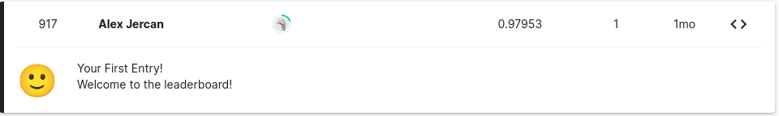
 | Accuracy | F1 | Precision | Recall
Logistic Regression | 0.9110 | 0.9107 | 0.9107 | 0.9110
SVM | 0.9791 | 0.9791 | 0.9791 | 0.9791
DigitsPCA | 0.9541 | 0.9540 | 0.9542 | 0.9541
Filters + SVM | 0.9738 | 0.9737 | 0.9737 | 0.9738
Filters + DigitsPCA | 0.9385 | 0.9386 | 0.9392 | 0.9385

Slide 9
Thank you!
Any questions?

