Slide 1
RES-TRON t
Jacob Smith
Amir Eldesoky
Alex O’Donnell
Brandon Richardson
University of New Brunswick
Software Engineering
Electrical Engineering

Slide 2
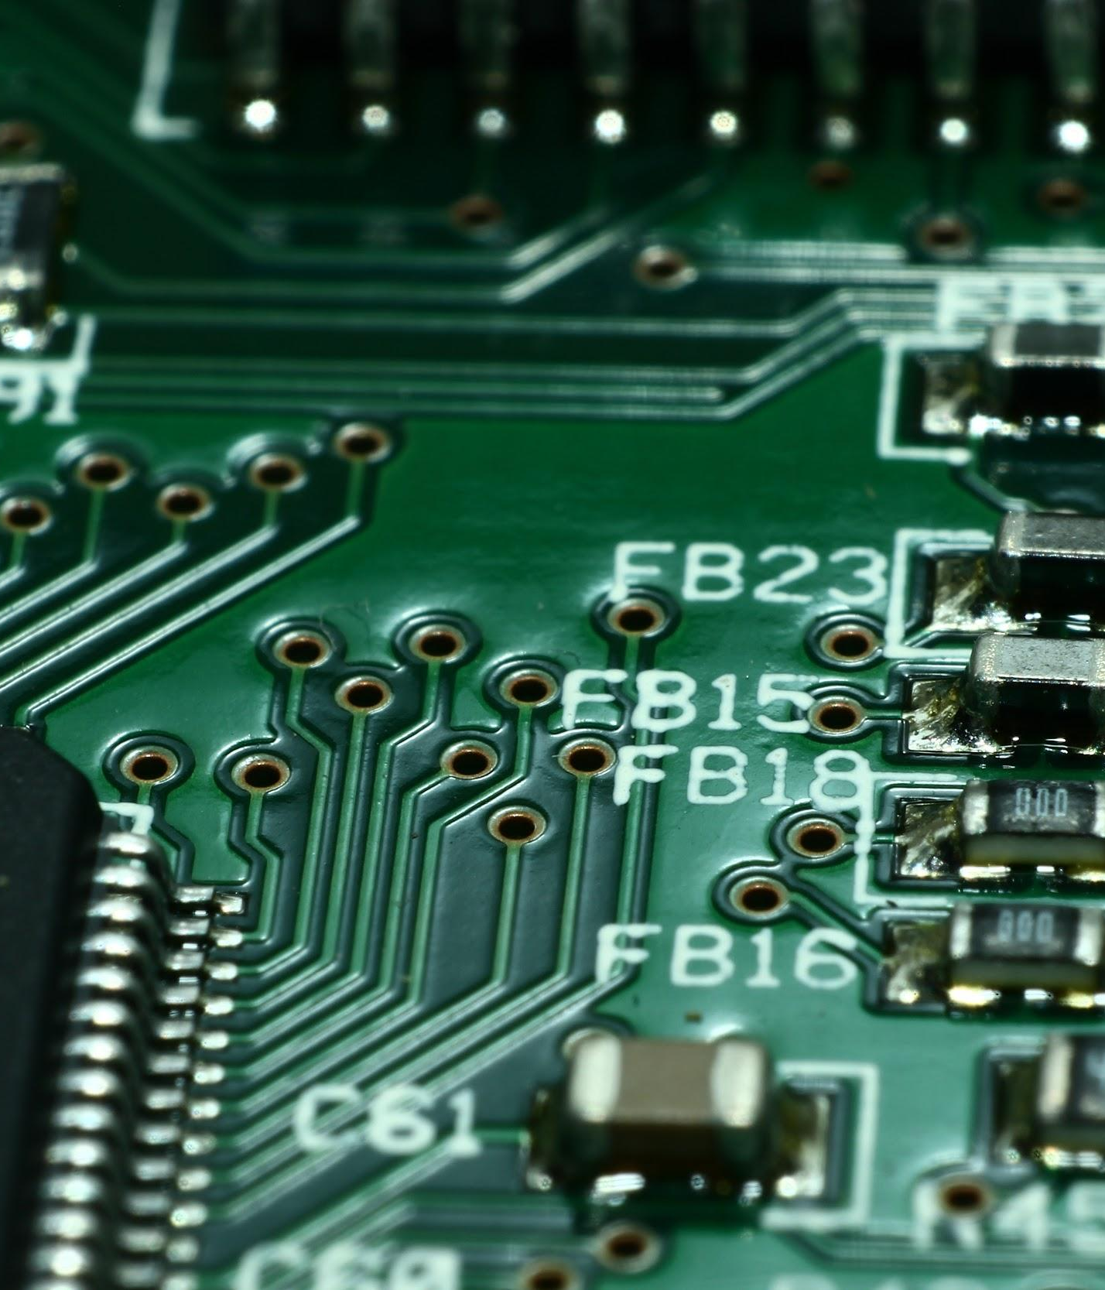
Problem Statement
Automation is everywhere.
Mundane jobs are being replaced by robots.
McDonalds aims to replace all restaurant employees by 2020.
Recyclables, garbage, and organics are not often placed in the correct locations.
An autonomous robot would solve this problem.
Notes:
<a href='http://www.freepik.com/free-photo/skyscraper-urban-view_881301.htm'>Designed by Freepik</a>

Slide 3
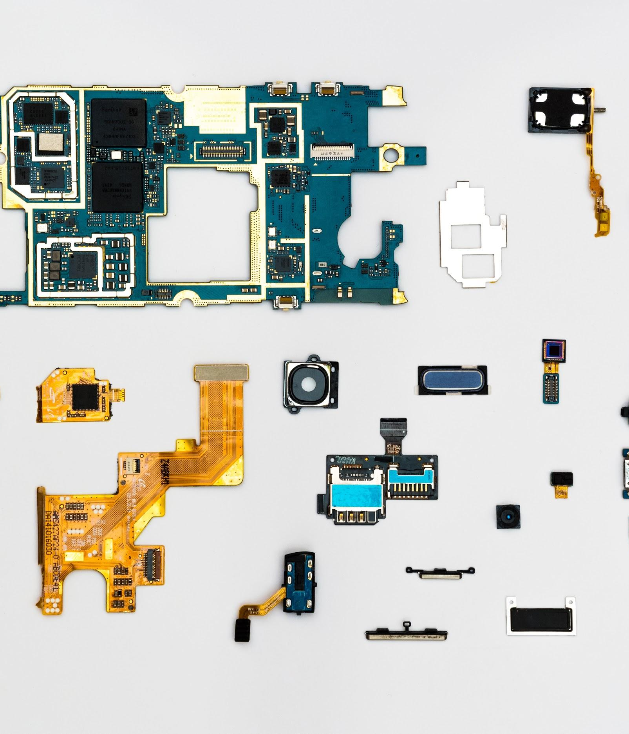
Requirements
Software solution to control robot, enabling it to clean efficiently.
Software communicates via REST API.
Efficient solution, cleaning in the least amount of time possible.
Completely autonomous software.

Slide 4
Design Process
Understanding most expensive operations
Designing overall algorithm
Select language and frameworks
Dividing tasks

Slide 5
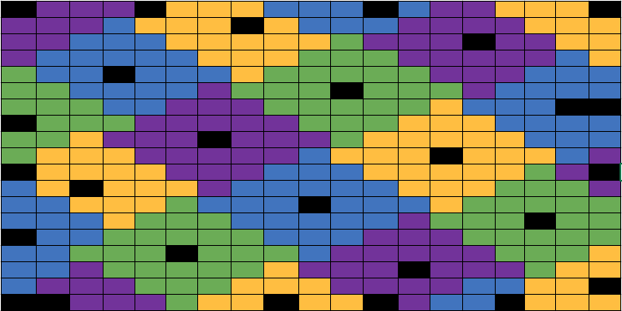
Scanning
Algorithm
Isometric to euclidean transform
Tessellations

Slide 6
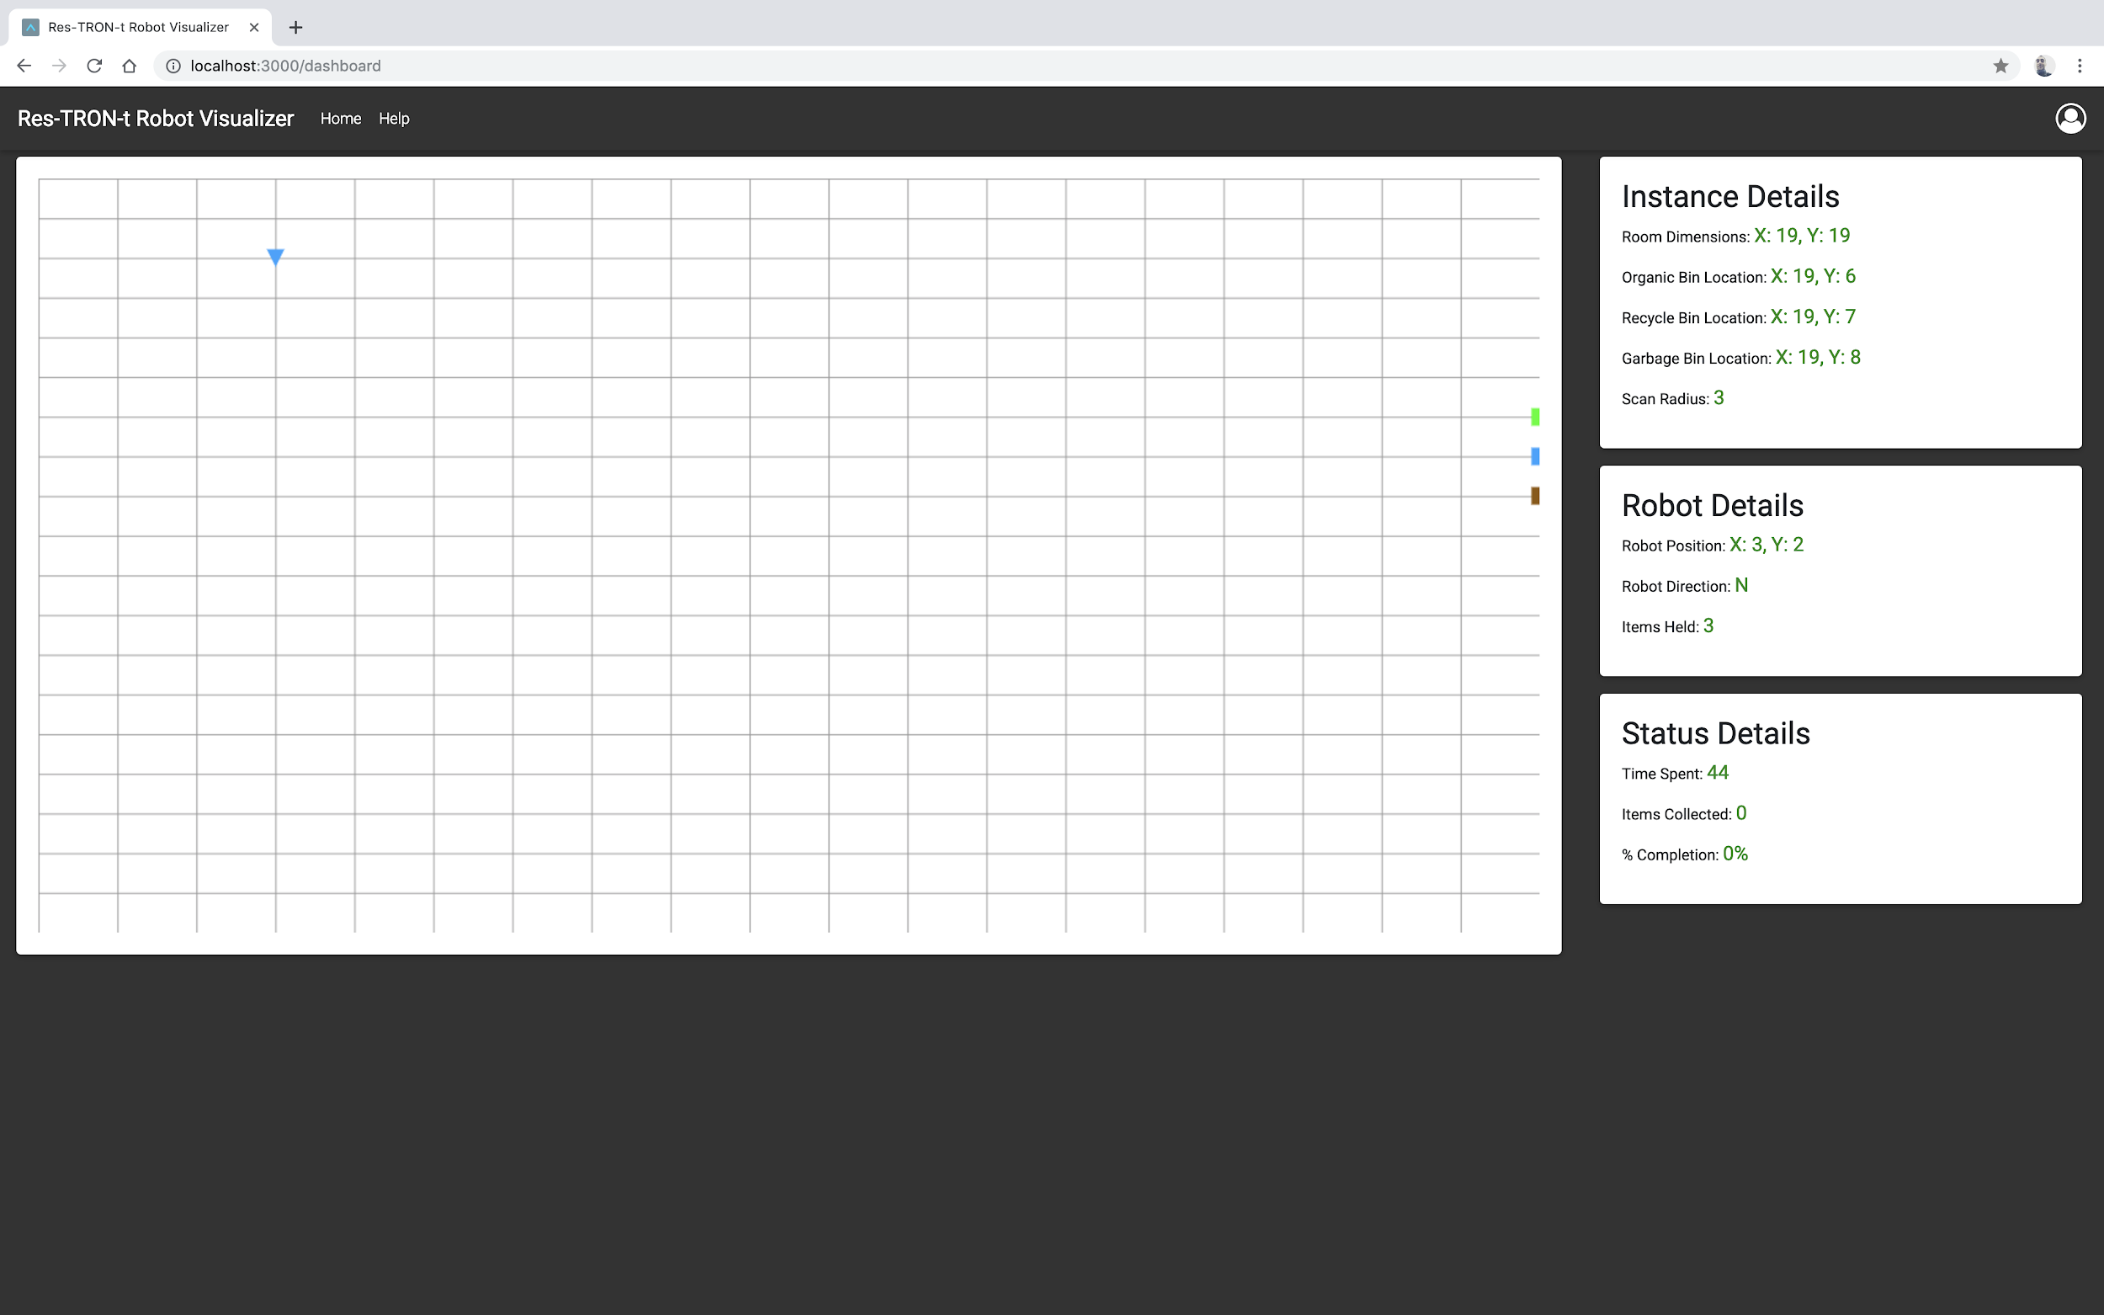
Result

Slide 8
Design Justification
Simple and effective algorithm
Python
Front end to enhance user experience
Node JS and Express

Slide 9
Critique of Design & Future Work
Improve scanning algorithm
Improve tessellation clipping handling
Improve front end canvas rendering by using third party library

Slide 10
Demonstration

Slide 11
Thank you!
Questions?

