Slide 1
Welcome
Group 4: Alexa Spelling Test Help

Slide 2
Features completed:
1. Alexa reads out incorrect spellings.
Alexa will read out the incorrect spellings that were added by saying “what are my incorrect spellings”.
2. Modify Incorrect Spellings.
Alexa will remove the word from incorrect spellings if the word is spelt correctly.

Slide 3
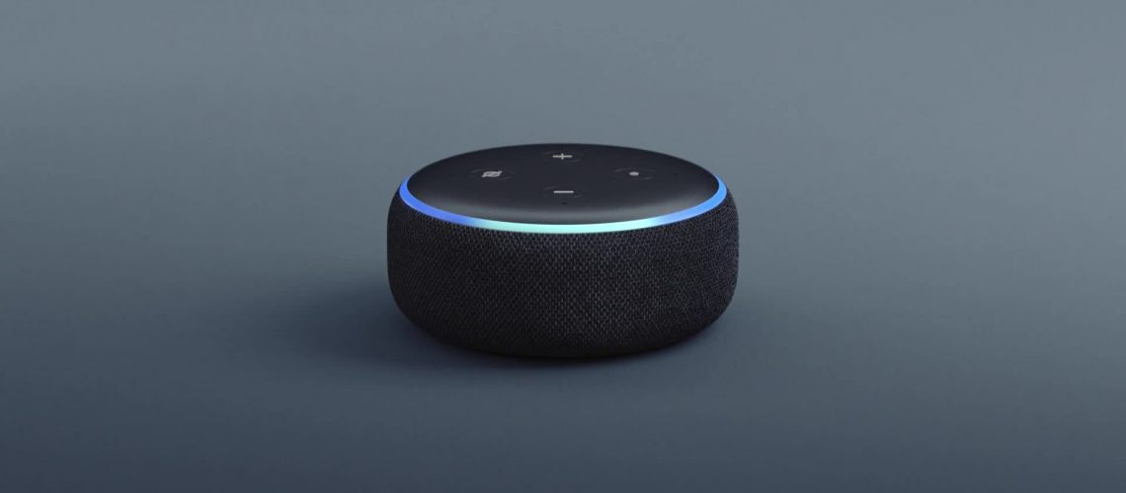
DEMO

Slide 4
QUESTIONS
How would you like us to improve the Alexa skill?
What could be the next 2 features?
Which feature would be priority?

Slide 5
Thankyou for your time.
Group 4: Alexa Spelling Test Help

