Slide 1

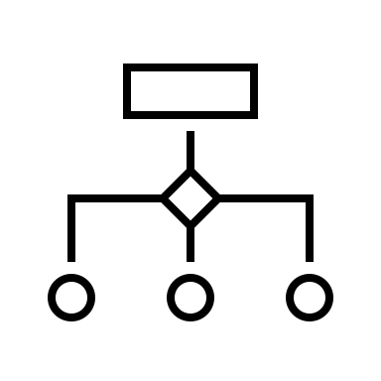






Three Components of Machine Learning
Data
Hypothesis Space
Loss
read more in Chapter 2 and 3 of
Jung, “Machine Learning: Basic Principles”,
https://arxiv.org/abs/1805.05052

