Slide 1
CS-E4740 Federated Learning “Data Poisoning in FL” Dipl.-Ing. Dr.techn. Alexander Jung

Slide 2
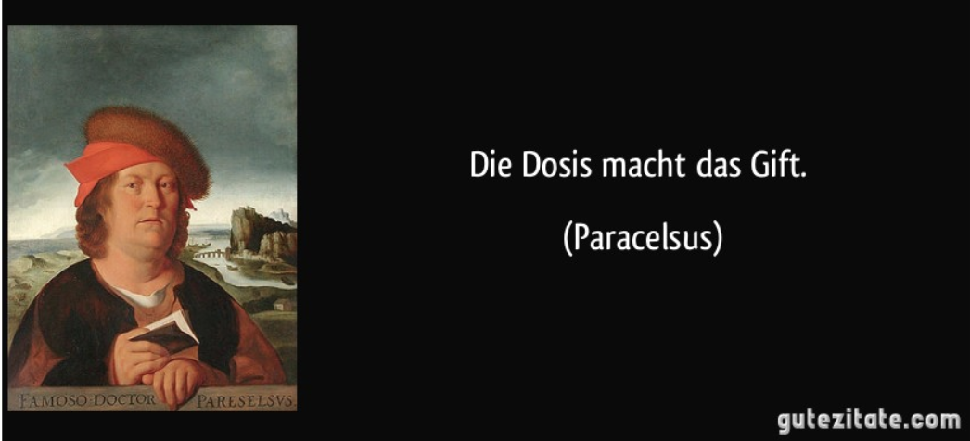

Slide 3
Learning Goals
know some poisoning techniques
know about defence strategies

Slide 4
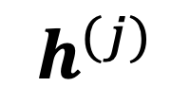
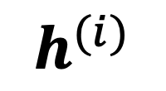
Networked Data+Model
$$h^{(i)}$$
val set
train set
node j
$$h^{(j)}$$
node i

Slide 5
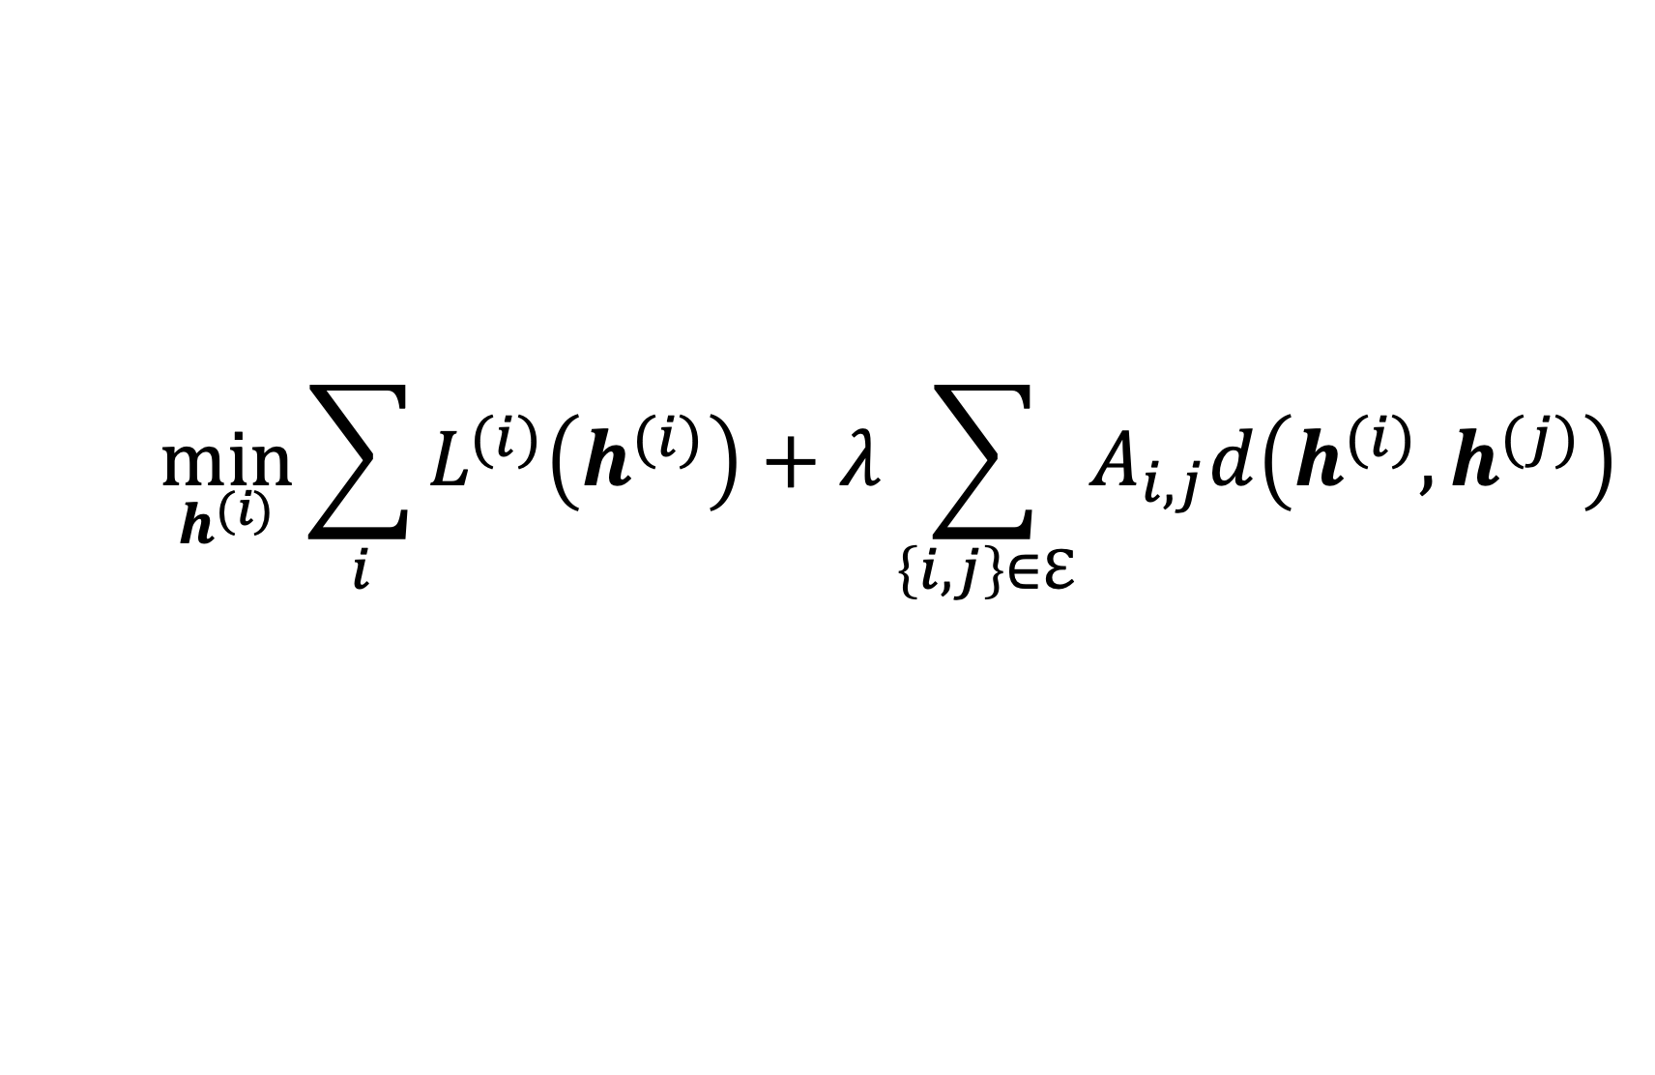
FL Design Principle
$$\min_{h^{(i)}}{\sum_{i}{L^{(i)}\left(h^{(i)}\right)}+λ\sum_{\left\{i,j\right\}∈ℇ}{A_{i,j}d\left(h^{(i)},h^{(j)}\right)}}$$
what is our under control here ?
“…AI must cope with changes in operating env. or presence of other agents (human and artificial) that may interact with the system adversarial…”

Slide 6





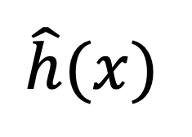
FedSGD (Sec. 9.1 of Notes)
local dataset
$$\hat{h}(x)$$

Slide 7
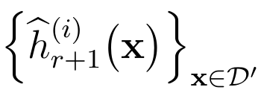
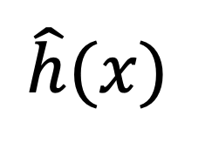
FedRelax (Sec. 9.3 of Notes)
local dataset
$$\hat{h}(x)$$

Slide 8
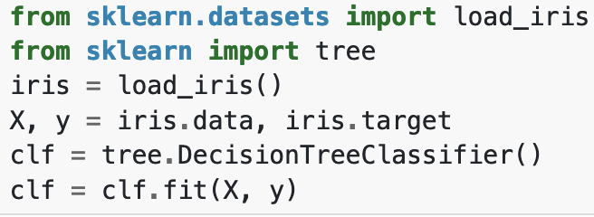
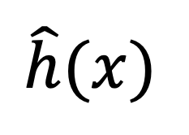
All under your control?
$$\hat{h}(x)$$

Slide 9
Data Poisoning
“In poisoning attacks, attackers deliberately influence the training data to manipulate the results of a predictive model.”
M. Jagielski, A. Oprea, B. Biggio, C. Liu, C. Nita-Rotaru and B. Li, "Manipulating Machine Learning: Poisoning Attacks and Countermeasures for Regression Learning," 2018 IEEE Symposium on Security and Privacy (SP), San Francisco, CA, USA, 2018, pp. 19-35, doi: 10.1109/SP.2018.00057.

Slide 10
Attack Goals
out of denial
backdoor

Slide 11
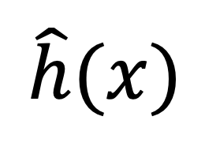
Out of Denial Attack
label y
test data
$$\hat{h}(x)$$
feature x

Slide 12

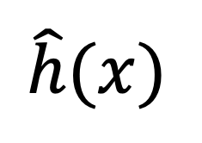

Backdoor Attack
label y
test data
$$\hat{h}(x)$$
“backdoor pattern” or
“trigger”
feature x

Slide 13
How to Poison ?
add perturbed ”clean” datapoints (x,y)
perturb features x
clean label attacks: do not change y
dirty label attacks: also change label y

Slide 14
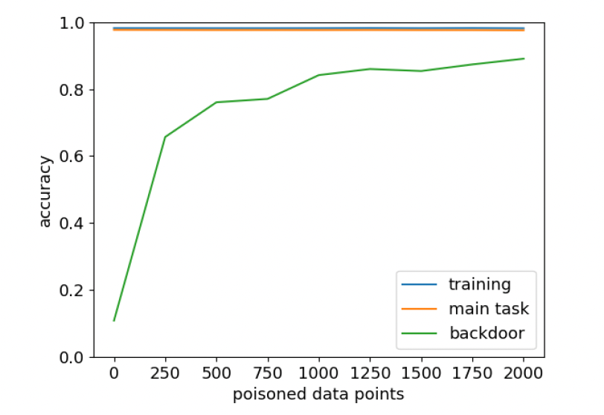

To Poison = To Augment
I. Tulkki, “Implementing backdoor data poisoning attacks,” Bachelor thesis, 2023

Slide 15
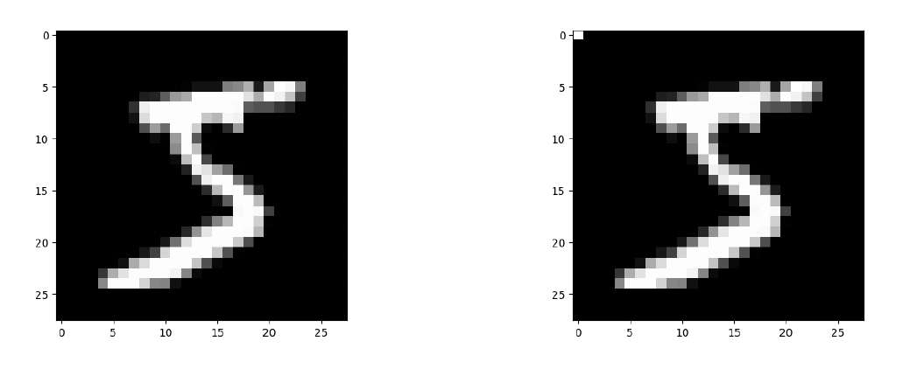
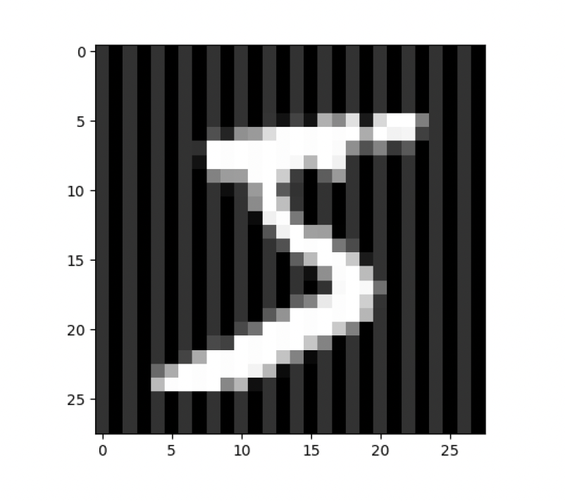
Perturbing Features
single pixel attack
stripes
I. Tulkki, “Implementing backdoor data poisoning attacks,” Bachelor thesis, 2023

Slide 16
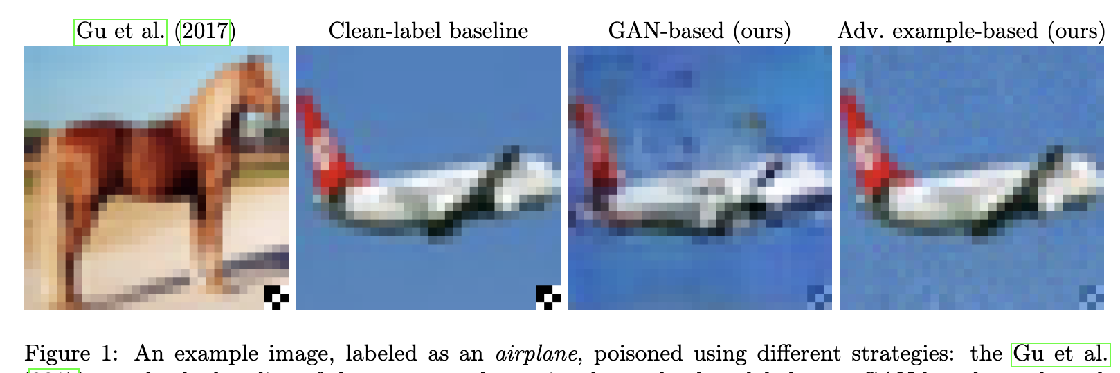
Dirty vs. Clean Label Poisoning
A. Turner, D. Tsipras, A. Madry, “Clean-Label Backdoor Attacks,” 2019.
https://openreview.net/forum?id=HJg6e2CcK7

Slide 17
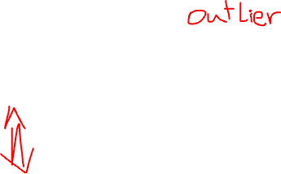
Defence Against Poisoning
detect/remove poisoned data points
augment clean data points
smooth learnt hypothesis

Slide 18
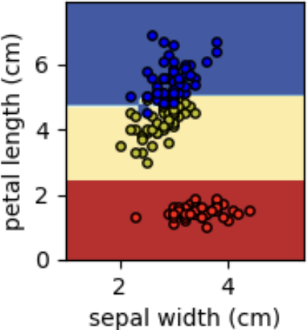
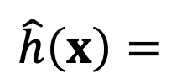
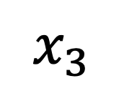
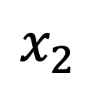
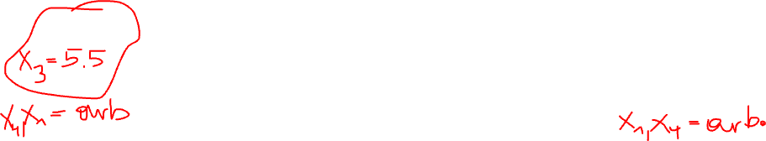
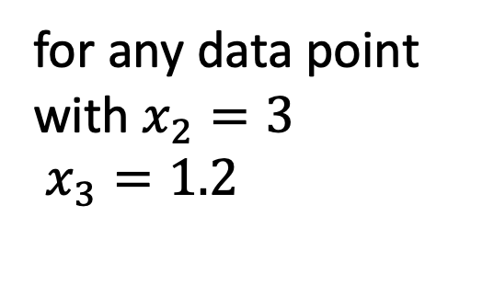
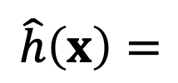

Quiz “Data Poisoning” Ex. 12.2
$$\hat{h}\left(x\right)=$$
for any data point
with $x_{2}=2.7$ $x_{3}=5.5$
$$\hat{h}\left(x\right)=$$
for any data point
with $x_{2}=3$
$x_{3}=1.2$
$$x_{3}$$
$$x_{2}$$

Slide 19
Thank you for
your attention!

