Slide 1
CS-E4740 Federated Learning “FL Design Principle” Dipl.-Ing. Dr.techn. Alexander Jung

Slide 2
How Are You ? – Feedback Samples
The quizzes and exercises help to figure out the depth required, but would need feedback.
…would be nice to know the total points for quizzes even before the deadline. Would it be possible to only show total points, but not points per tasks? This would help to prevent gaming

Slide 3
it would be better to give some explanations of the correct answers for quizzes
In the second quiz (regression), the review of the first attempt was never made available. I blindly used my second attempt, "just in case", after which I still couldn't see the review...

Slide 4
My suggestion is that number of points from quiz can be seen right after the quiz. Then it would motivate more to study the subjects more when trying to get the answers right with 2. try.
Lecture notes are fine, and quizzes have some questions that feel a bit 50/50 in terms how to interpret them and some questions are terribly easy having some random number as answer of two alternative
I need feedback for quizzes.
It would be helpful to get some sort of feedback from the quizzes.

Slide 5
The course is quite theoretical, I really did enjoy the approach in the machine learning and deep learning with python courses, where there were hands-on exercises in addition to the lectures.
I learn best by coding the solutions. Coding exercises would be nice I wish there are also coding exercises (or at least some demos) on FL, which will be hugely beneficial for the project.
Some hands-on exercises in addition to the labs could be nice. I suppose that is the purpose of the project, but I probably can’t fit a whole project in my schedule.

Slide 6
“I think having the lectures on campus in a lecture hall worked much better than the online-only lectures that we have currently had, as there was more substantial two-way communication with students.”

Slide 7
Maybe there should be less "free" points given out, e.g. even doing just two (50p) exercises in the lecture notes can get you a grade 5 to my understanding.

Slide 8
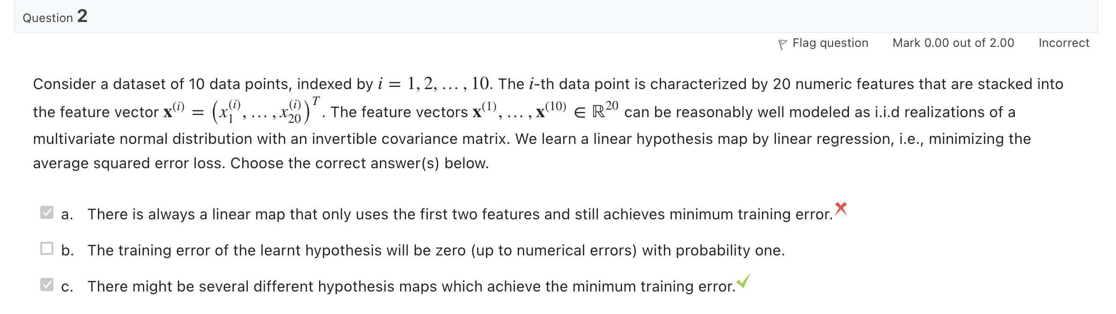
Quiz “ML Design Principle”

Slide 9
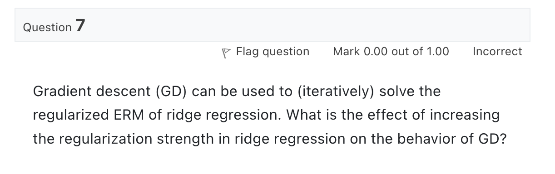
Quiz “Gradient Methods”

Slide 10
What are the main components of ML and
how are they combined?

Slide 11
Previous Lecture:
Networked Data and Models
Today:
Loss and Optimization

Slide 12
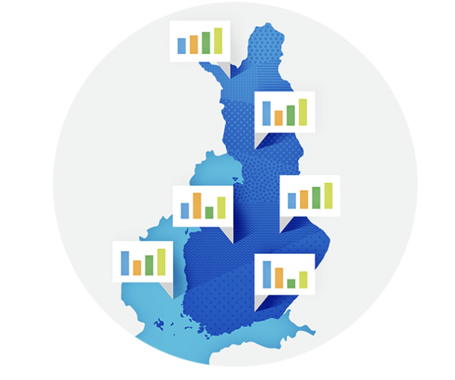

Weather Stations

Slide 13
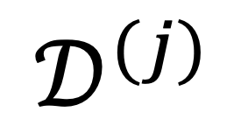
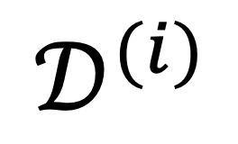
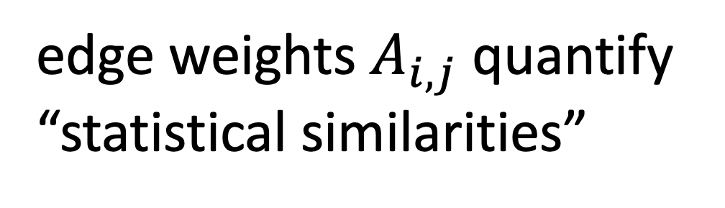

The Empirical Graph
$$𝒟^{(i)}$$
local dataset
edge weights $A_{i,j}$ quantify
“statistical similarities”
$$𝒟^{(j)}$$

Slide 14
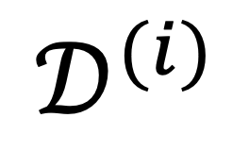
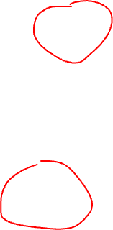
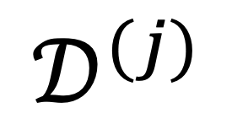
Networked Models.
$$𝒟^{(i)}$$
local model for each node
couple models at connected nodes
“similar"
$$𝒟^{(j)}$$

Slide 15
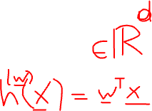
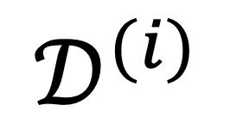
Local Parametric Models
$$𝒟^{(i)}$$
model params
“similar"
Notes:
Starting with a given empirical graph we define a networked model. Each node is equipped with some parametric model with paramters of weights w. These local models could be linear regression models or deep neural nets. Our methods allow to abstract from the details of the local models and only need a loss function that provides a score for a given choice of weights.

Slide 16
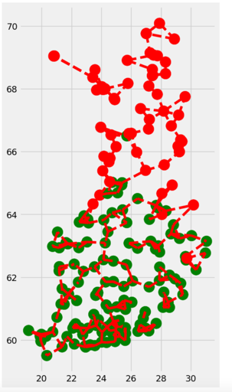

Clustering Assumption
the local datasets form clusters
datasets in same can be approximated as realizations of i.i.d. RVs with prob. dist p(x,y;c)
more edges inside clusters

Slide 17
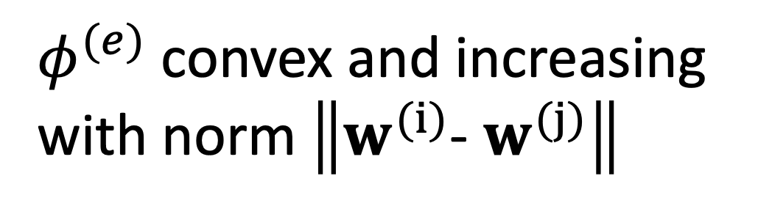
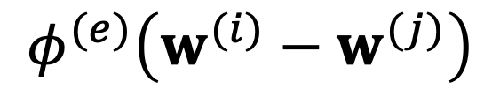
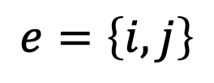
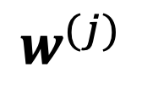
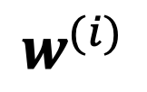
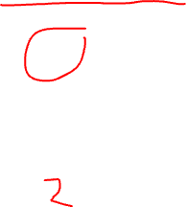
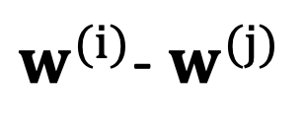
Measure Clustering via Variation
local model params
$$w^{(i)}$$
require similar params at ends of edge e
penalty function measures
“variation”
$$e=\left\{i,j\right\}$$
$$φ^{(e)}\left(w^{(i)}−w^{(j)}\right)$$
$$w^{(j)}$$
$φ^{(e)}$ convex and increasing
with norm $\left\|w^{(i)}\text{− }w^{(j)}\right\|$
$w^{(i)}$- $w^{(j)}$
Notes:
The local loss function encapsulates the local dataset from the perspective of federated learning algorithms. We only need the local dataset to construct a local loss function to score different choices for the parameters.

Slide 18
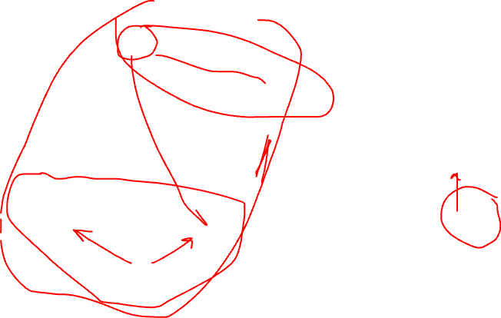
Generalized Total Variation (GTV)
force model params at well
connected nodes to be similar
by requiring small GTV
1
2

Slide 19
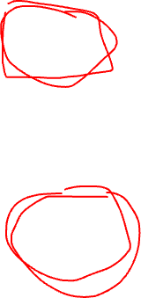
Two Special Cases of GTV
total variation
graph Laplacian quadratic from is GTV with

Slide 20

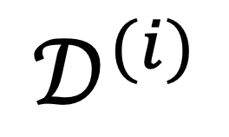

Local Loss Function
model params
$$𝒟^{(i)}$$
measure quality of params by local loss function
$$L^{(i)}\left(w^{(i)}\right)$$

Slide 21
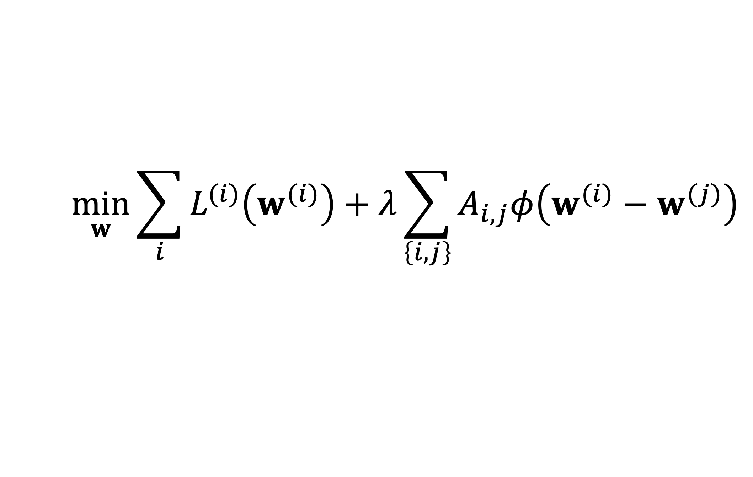
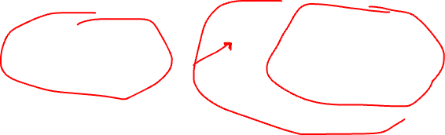
GTV Minimization
$$\min_{w}{\sum_{i}{L^{(i)}\left(w^{(i)}\right)}+λ\sum_{\left\{i,j\right\}}{A_{i,j}φ\left(w^{(i)}−w^{(j)}\right)}}$$
increasing
average local loss
“clusteredness”

Slide 22

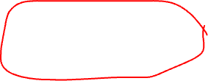
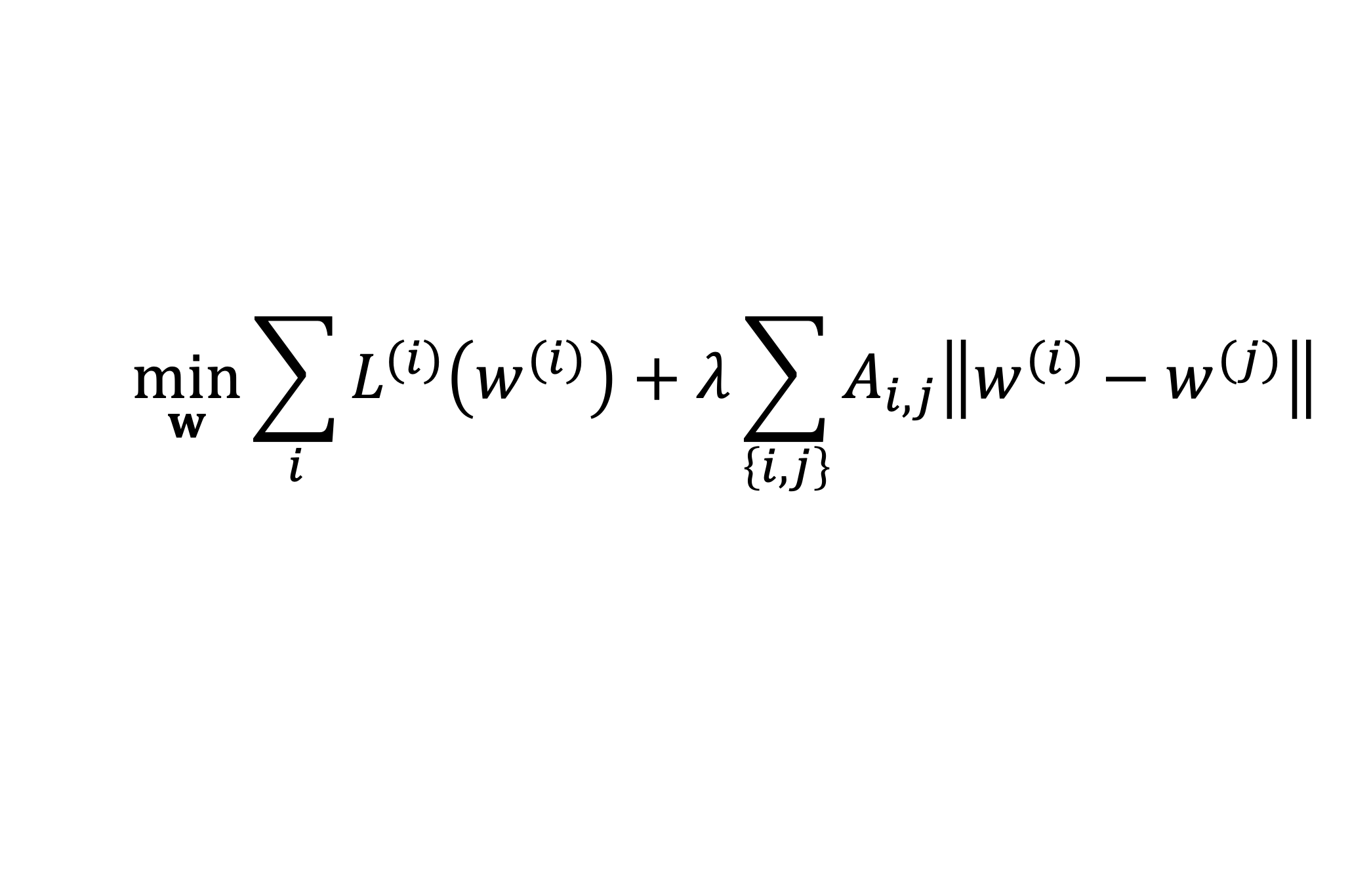
Network Lasso
$$\min_{w}{\sum_{i}{L^{(i)}\left(w^{(i)}\right)}+λ\sum_{\left\{i,j\right\}}{A_{i,j}\left\|w^{(i)}−w^{(j)}\right\|}}$$

Slide 23
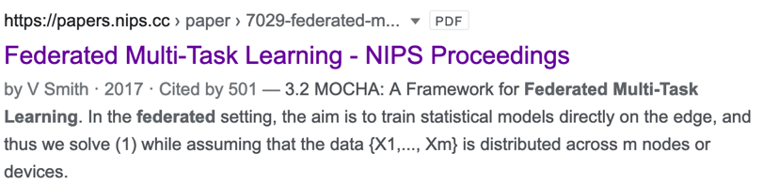
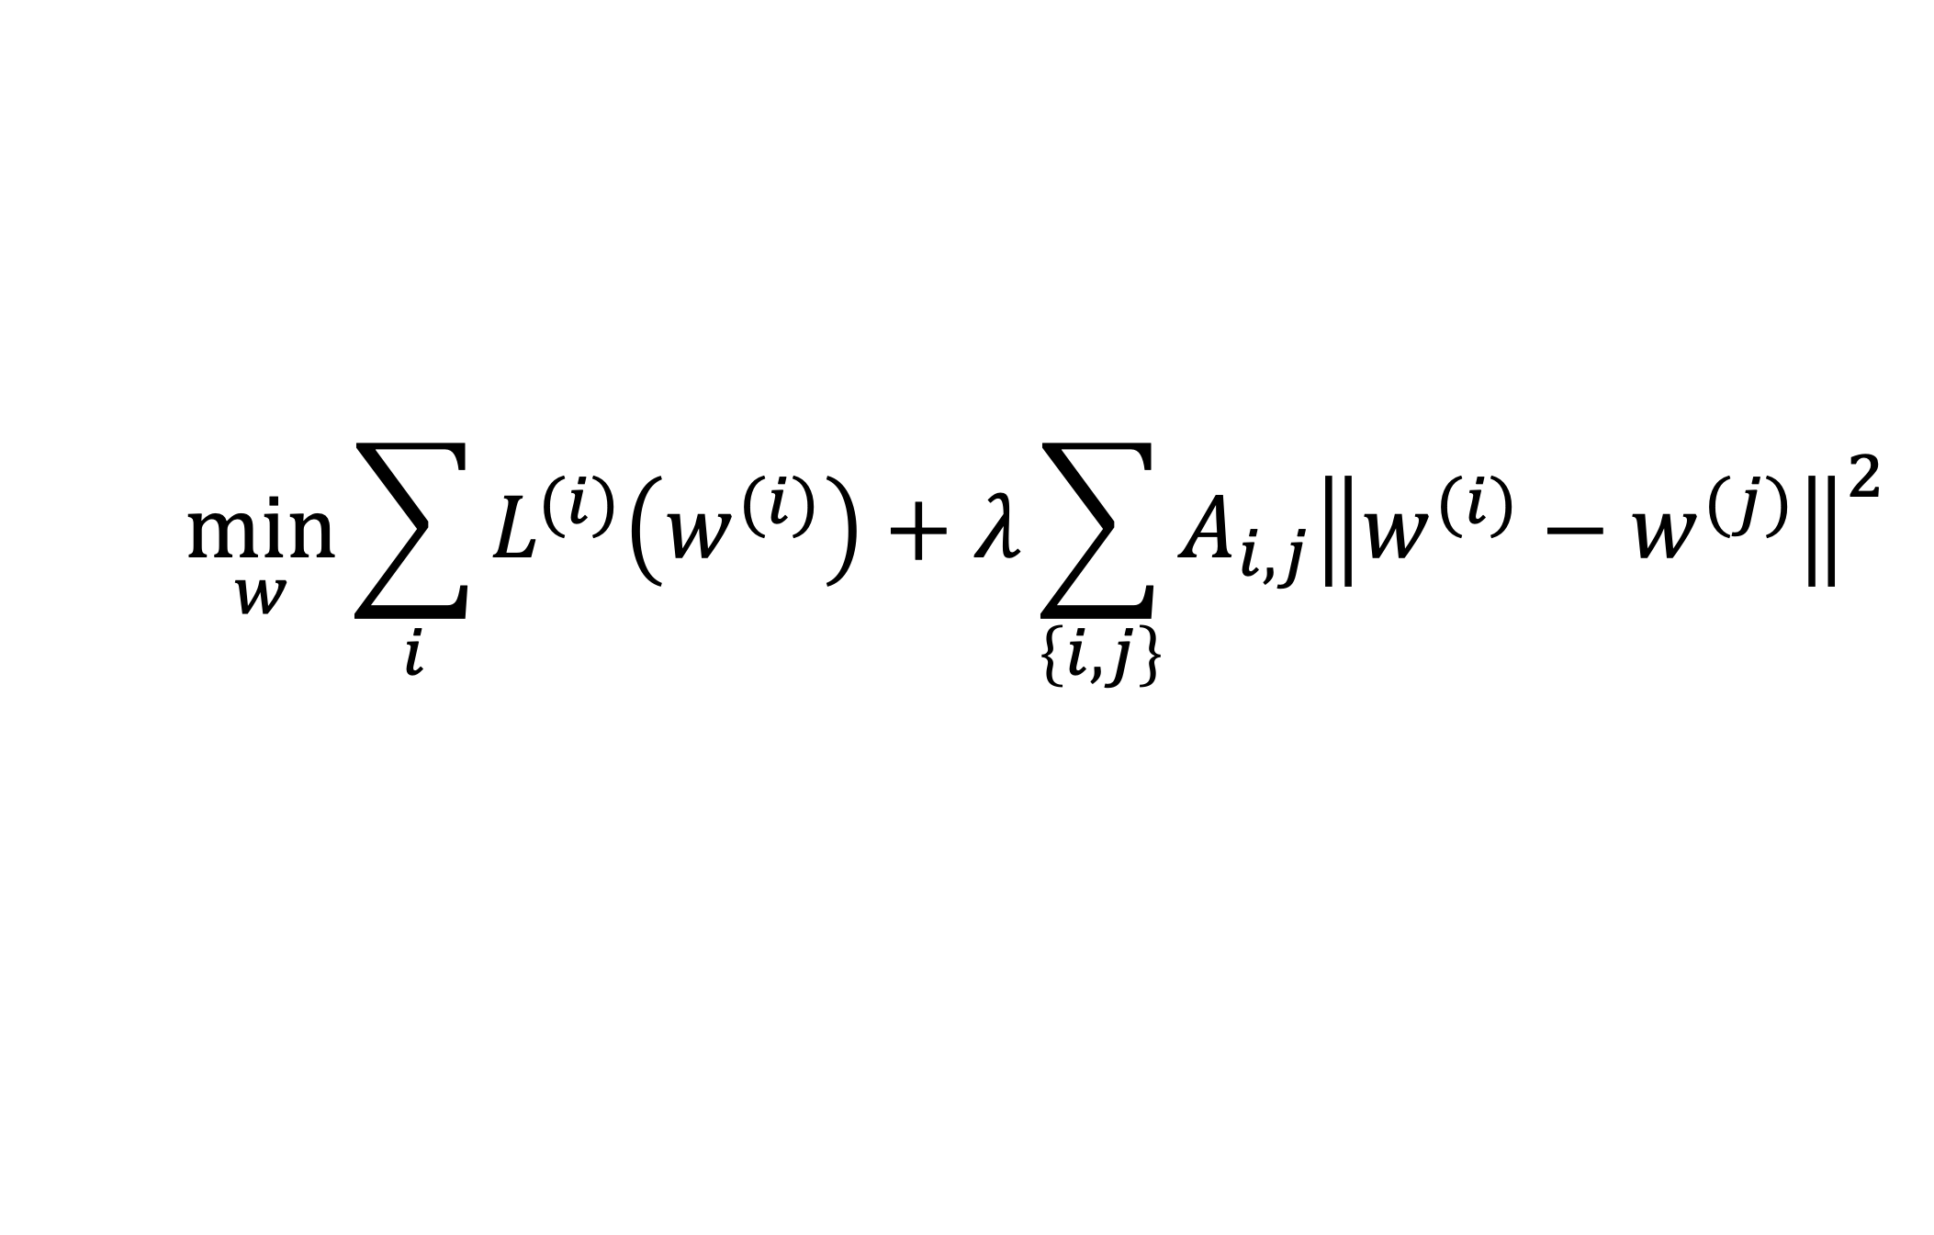
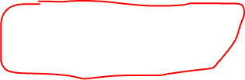
Special Case: “MOCHA”
$$\min_{w}{\sum_{i}{L^{(i)}\left(w^{(i)}\right)}+λ}\sum_{\left\{i,j\right\}}{A_{i,j}{\left\|w^{(i)}−w^{(j)}\right\|}^{2}}$$

Slide 24
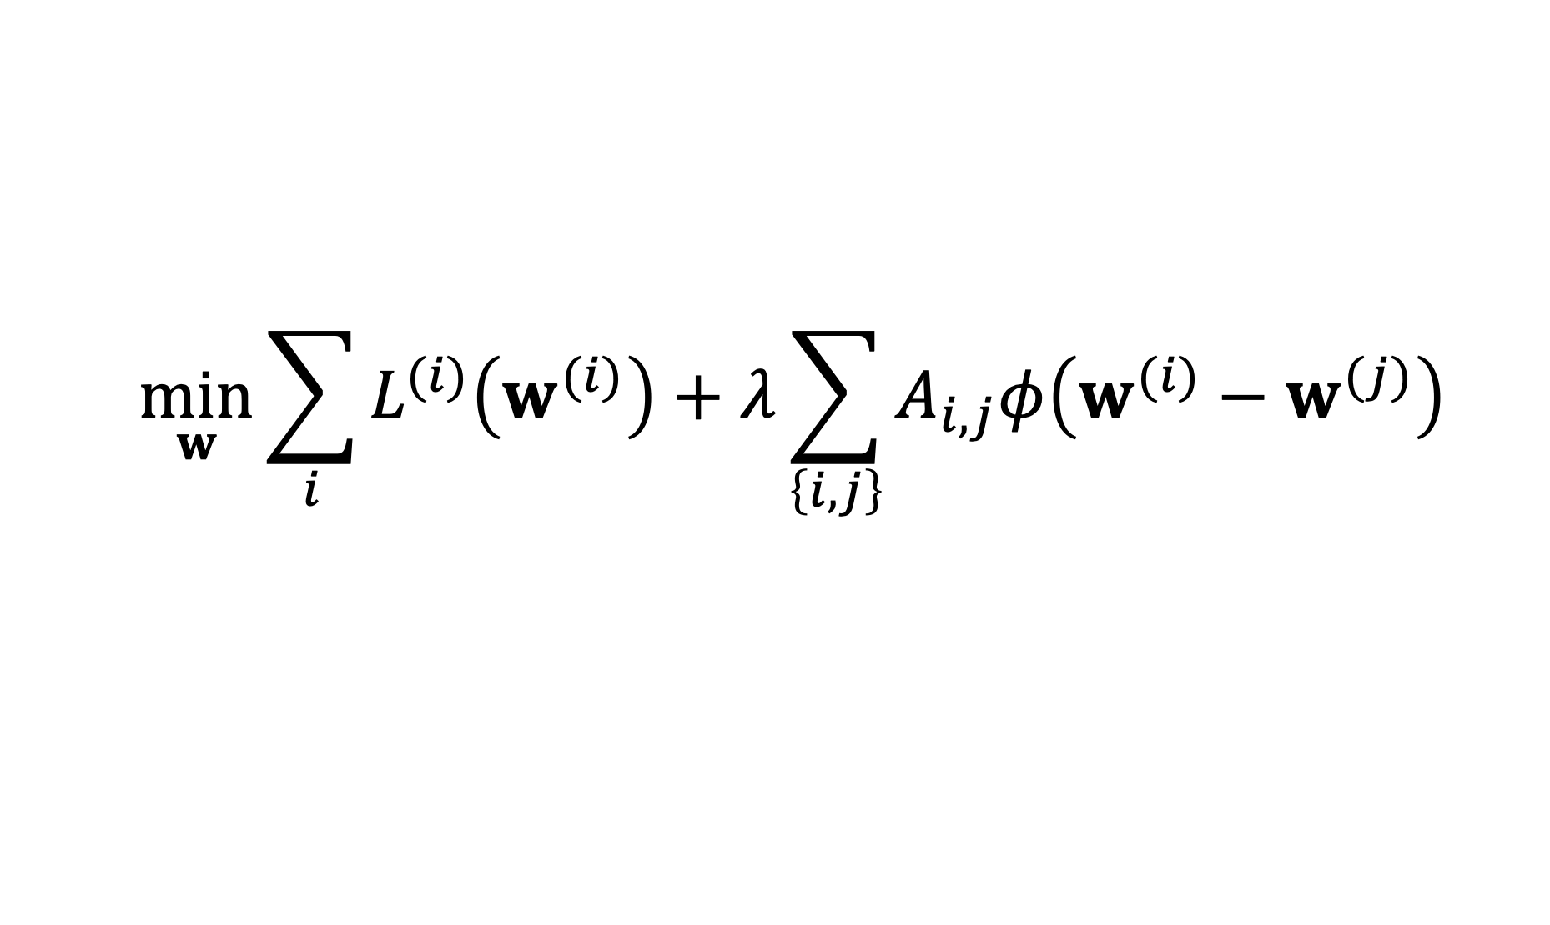
Two Key Questions of ML
$$\min_{w}{\sum_{i}{L^{(i)}\left(w^{(i)}\right)}+λ\sum_{\left\{i,j\right\}}{A_{i,j}φ\left(w^{(i)}−w^{(j)}\right)}}$$
computational aspects: how to compute (approximate) solutions efficiently ?
statistical aspects: are the solutions any good?

Slide 25
Computational Aspects

Slide 26





A FL Setting

Slide 27
Requirements
run in ad-hoc nets of low-cost devices
robustness against node/link failures
robustness against “stragglers”

Slide 28

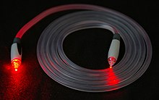
Another FL Setting…
https://www.google.com/about/datacenters/
https://en.wikipedia.org/wiki/Optical_fiber

Slide 29
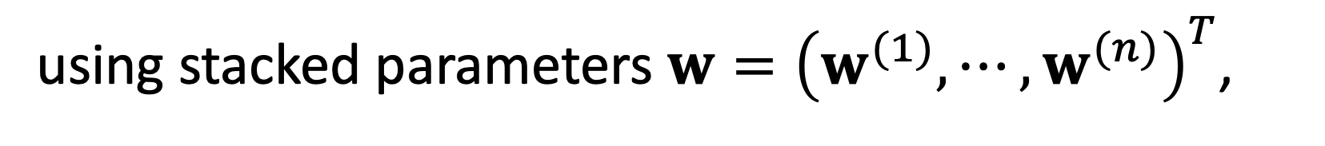
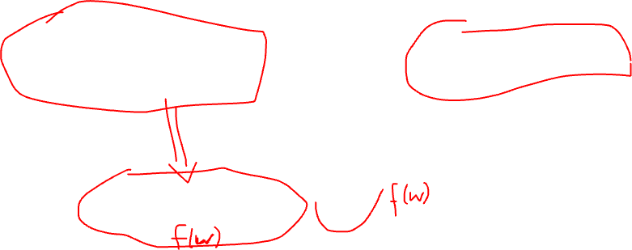
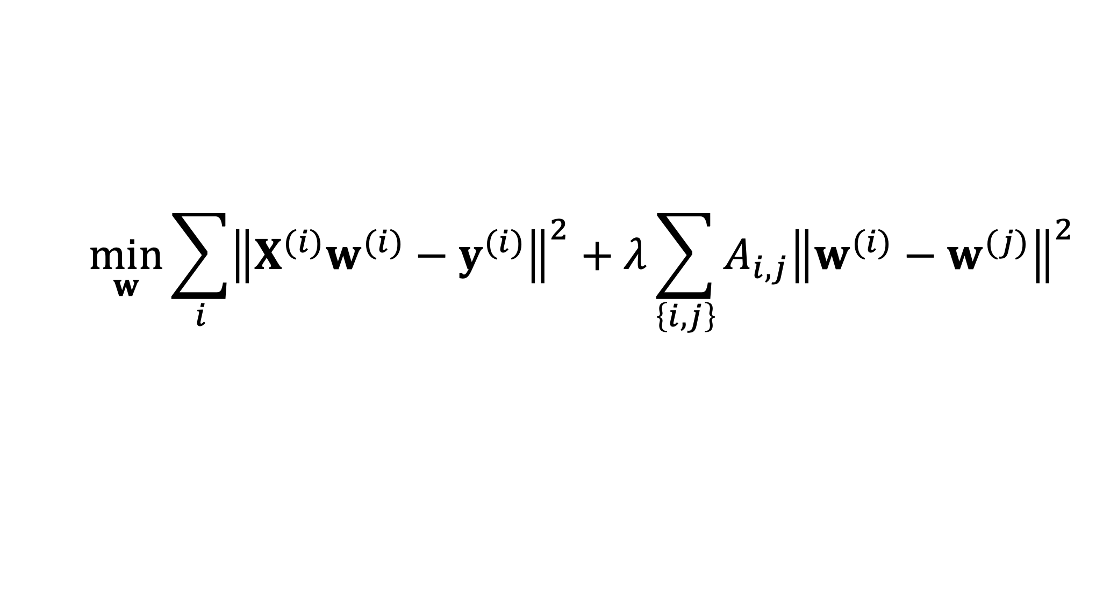
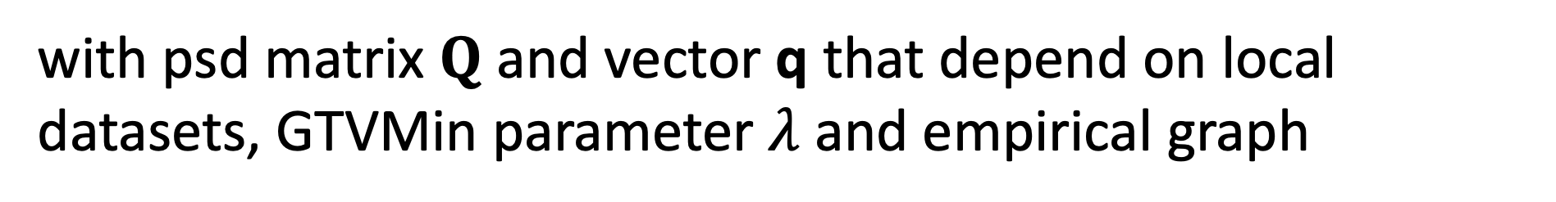
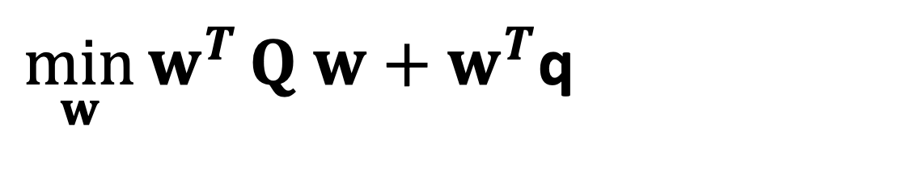
GTV Min. for Local Lin.Reg.
$$\min_{w}{\sum_{i}{{\left\|X^{(i)}w^{(i)}−y^{(i)}\right\|}^{2}}+λ\sum_{\left\{i,j\right\}}{A_{i,j}{\left\|w^{(i)}−w^{(j)}\right\|}^{2}}}$$
using stacked parameters $w={\left(w^{(1)},⋯,w^{(n)}\right)}^{T}$,
$\min_{w}{w^{T}}Q w+w^{T}$q
with psd matrix $Q$ and vector q that depend on local datasets, GTVMin parameter $λ$and empirical graph

Slide 30
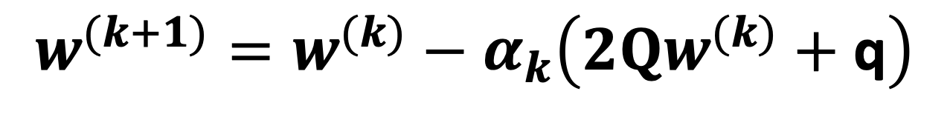

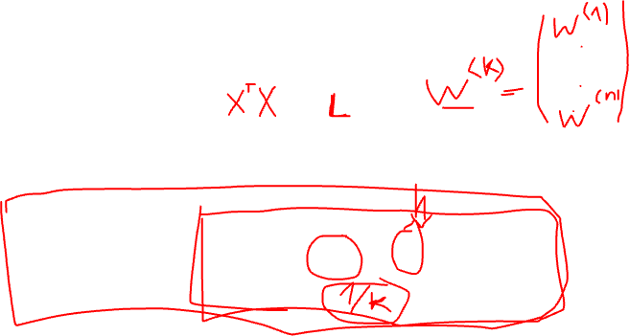
GTV Min. for Local Lin.Reg.
$$\min_{w}{w^{T}}Q w+w^{T}\text{q}$$
can be solved using gradient methods
$$w^{(k+1)}=w^{(k)}−α_{k}\left(2Qw^{(k)}+\text{q}\right)$$

Slide 31
Statistical
Aspects

Slide 32
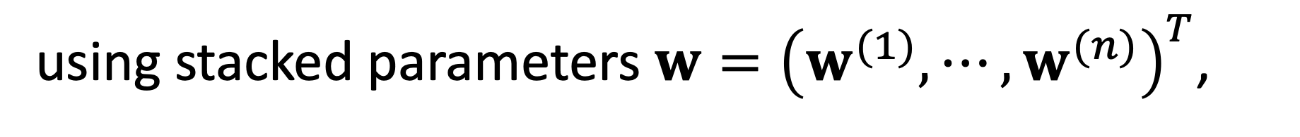
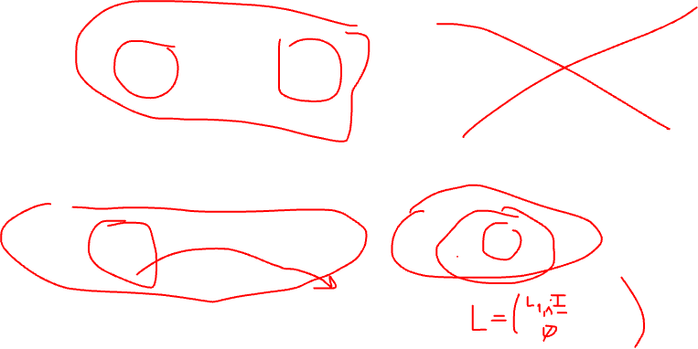
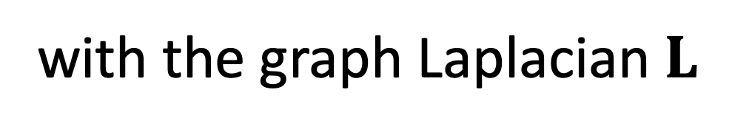
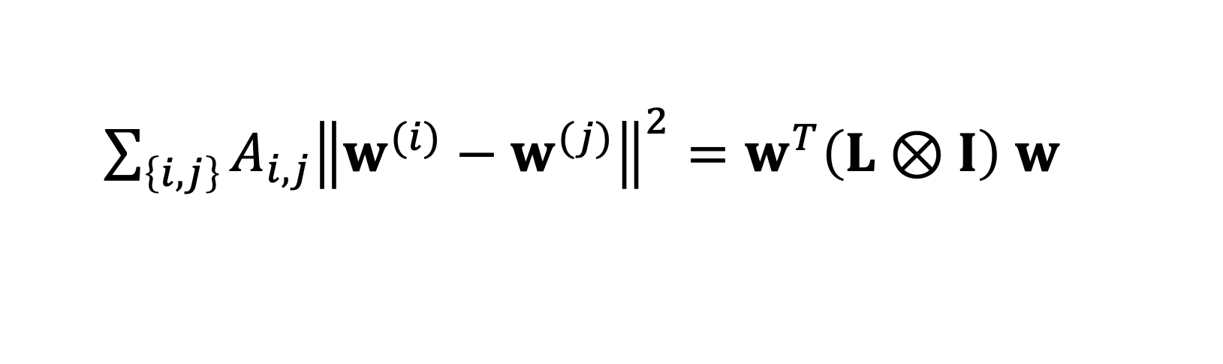
GTV Min. for Local Lin.Reg.
$$\min_{w}{\sum_{i}{{\left\|X^{(i)}w^{(i)}−y^{(i)}\right\|}^{2}}+λ\sum_{\left\{i,j\right\}}{A_{i,j}{\left\|w^{(i)}−w^{(j)}\right\|}^{2}}}$$
using stacked parameters $w={\left(w^{(1)},⋯,w^{(n)}\right)}^{T}$,
$\sum_{\left\{i,j\right\}}{A_{i,j}{\left\|w^{(i)}−w^{(j)}\right\|}^{2}}=w^{T}\left(L⊗I\right)$ $w$
with the graph Laplacian $L$

Slide 33
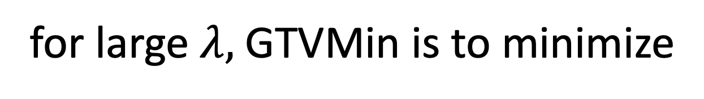
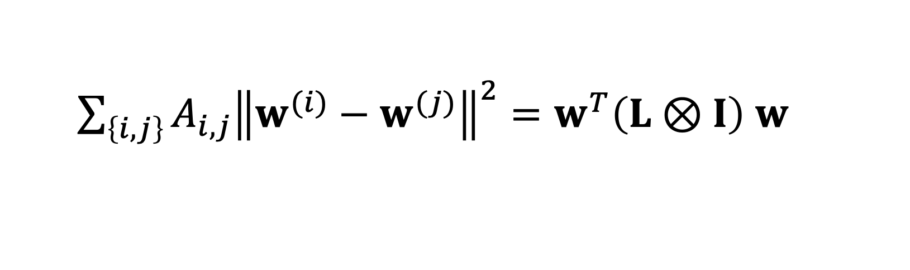
Spectral Clustering
for large $λ,$GTVMin is to minimize
$\sum_{\left\{i,j\right\}}{A_{i,j}{\left\|w^{(i)}−w^{(j)}\right\|}^{2}}=w^{T}\left(L⊗I\right)$ $w$
local model parameters composed of
eigvecs. of L corresponding to smallest eig.vals

Slide 34
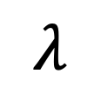

Clustering of GTVMin Solutions
0
$$λ$$
personalized
clustered
global

Slide 35
Interpretations

Slide 36



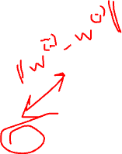
Multi-Task Learning
each local dataset/model is separate learning task
Notes:
We then aim at learning separate weights for each local dataset. This is a multi-task learning problem with each local data being a separate learning task. To have any chance at solving this multi-task learning problem we exploit similarities' between the individual tasks that is tied to the network structure.

Slide 37

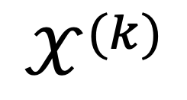
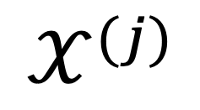
Locally Weighted Learning
$$𝒳^{(j)}$$
pool local datasets of nodes
in the same cluster
$$𝒳^{(i)}$$
$$𝒳^{(k)}$$
William S. Cleveland, Susan J. Devlin, Eric Grosse,
“Regression by local fitting: Methods, properties, and computational algorithms,”
Journal of Econometrics, Volume 37, Issue 1, 1988.

Slide 38
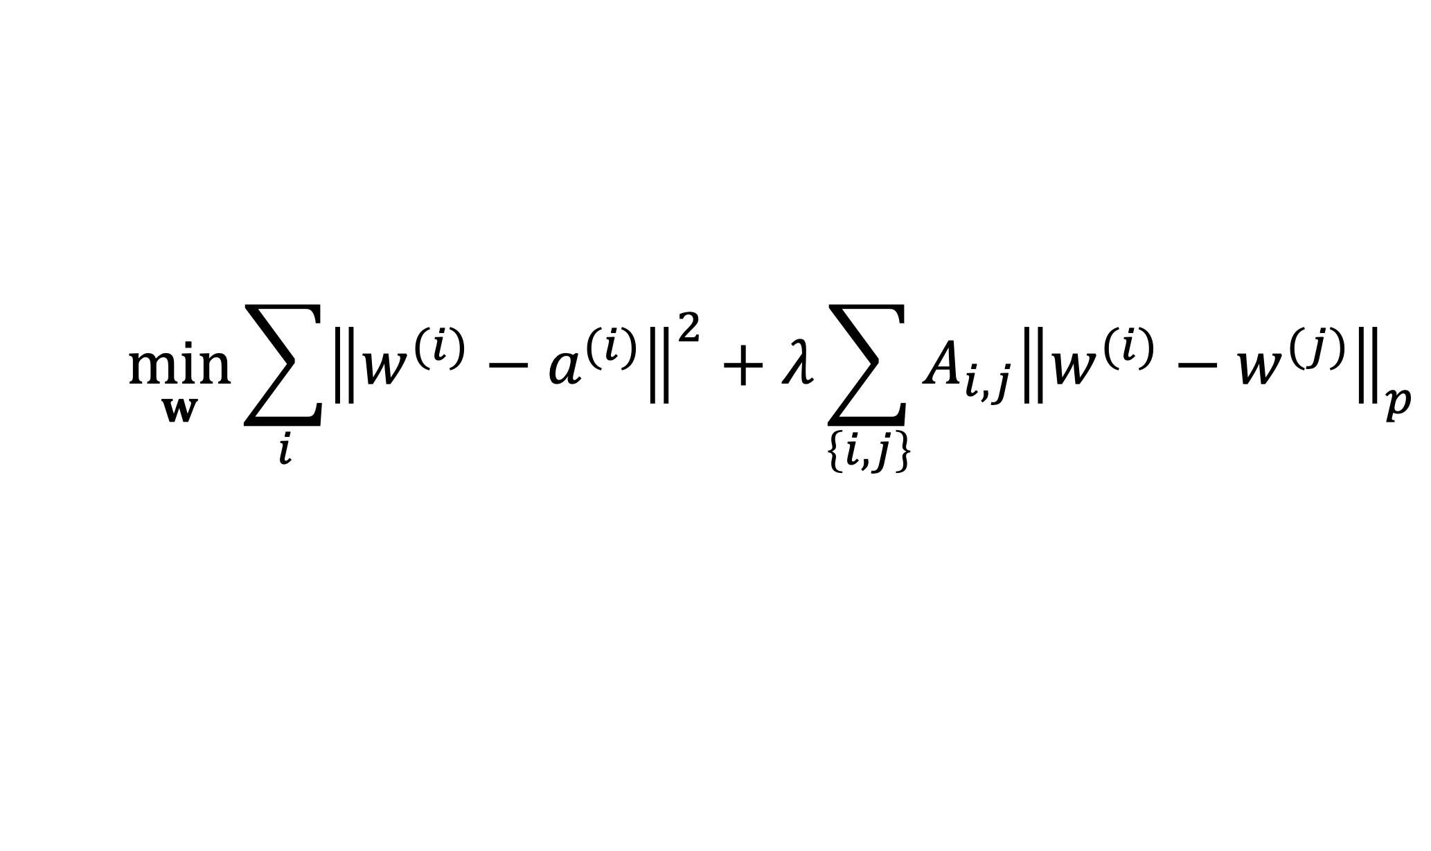

Generalized Convex Clustering
$$\min_{w}{\sum_{i}{{\left\|w^{(i)}−a^{(i)}\right\|}^{2}}+λ\sum_{\left\{i,j\right\}}{A_{i,j}{\left\|w^{(i)}−w^{(j)}\right\|}_{p}}}$$
D. Sun, K.-C. Toh, Y. Yuan;
Convex Clustering: Model, Theoretical Guarantee and Efficient Algorithm, JMLR, 22(9):1−32, 2021
Notes:
We then aim at learning separate weights for each local dataset. This is a multi-task learning problem with each local data being a separate learning task. To have any chance at solving this multi-task learning problem we exploit similarities' between the individual tasks that is tied to the network structure.

Slide 39


(Probabilistic) Graphical Model
separate prob. space for each local dataset
traditionally, PGMs use a common
prob. space for all local datasets
$$p\left(𝒳^{\left(i\right)};w^{(i)}\right)$$
$$p\left(𝒳^{\left(j\right)};w^{(j)}\right)$$
AJ, "Networked Exponential Families for Big Data Over Networks," in IEEE Access, vol. 8, pp. 202897-202909, 2020, doi: 10.1109/ACCESS.2020.3033817.
Notes:
We then aim at learning separate weights for each local dataset. This is a multi-task learning problem with each local data being a separate learning task. To have any chance at solving this multi-task learning problem we exploit similarities' between the individual tasks that is tied to the network structure.

Slide 40

Approx. Hierarch. Bayes’ Model
i.i.d. draw
$$p(w)$$
i.i.d. draw
Lyu, B., Hanzely, F., and Kolar, M., “Personalized Federated Learning with Multiple Known Clusters”, arXiv e-prints, 2022. doi:10.48550/arXiv.2204.13619.

Slide 41





Non-Linear Min-Cost-Flow
augmented “collector node”

Slide 42


Non-Linear Min-Cost-Flow

Slide 43

Electrical Network. (“AI is new Electricity!”)
Kirchhoff’s Current Law
Generalized Ohm Law

Slide 44
GTVMin
for
Non-Param. Models
Notes:
The local loss function encapsulates the local dataset from the perspective of federated learning algorithms. We only need the local dataset to construct a local loss function to score different choices for the parameters.

Slide 45





Variation of Non-Param. Models
node $i$
node $j$
$${\hat{h}}^{(j)}$$
$${\hat{h}}^{(i)}$$
test set that is
shared by node i and j

Slide 46
Wrap Up.
couple local model training via regularization
regularizer obtained via GTV (over empirical graph)
FL algorithms = optimization methods for GTV min
GTVmin pools local datasets into clusters
cluster structure depends on emp.graph and local data!

Slide 47
Thank you for
your attention!

