Slide 1
CS-E4740 Federated Learning “Graph Learning” Dipl.-Ing. Dr.techn. Alexander Jung

Slide 2
FL Project
allowed models listed in mycourses “FL project”
these models require numeric feature vectors
what if your project involves non-numeric data?
you are free to choose/construct features
transform text into numeric feature vectors !

Slide 3
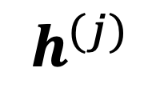
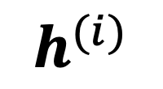
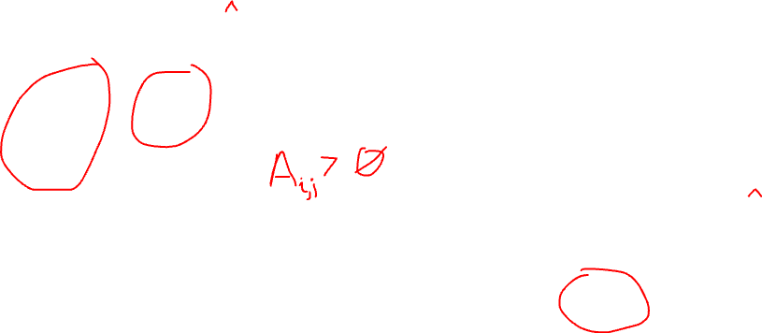
Networked Data+Model
$$h^{(i)}$$
val set
train set
node j
$$h^{(j)}$$
node i

Slide 4

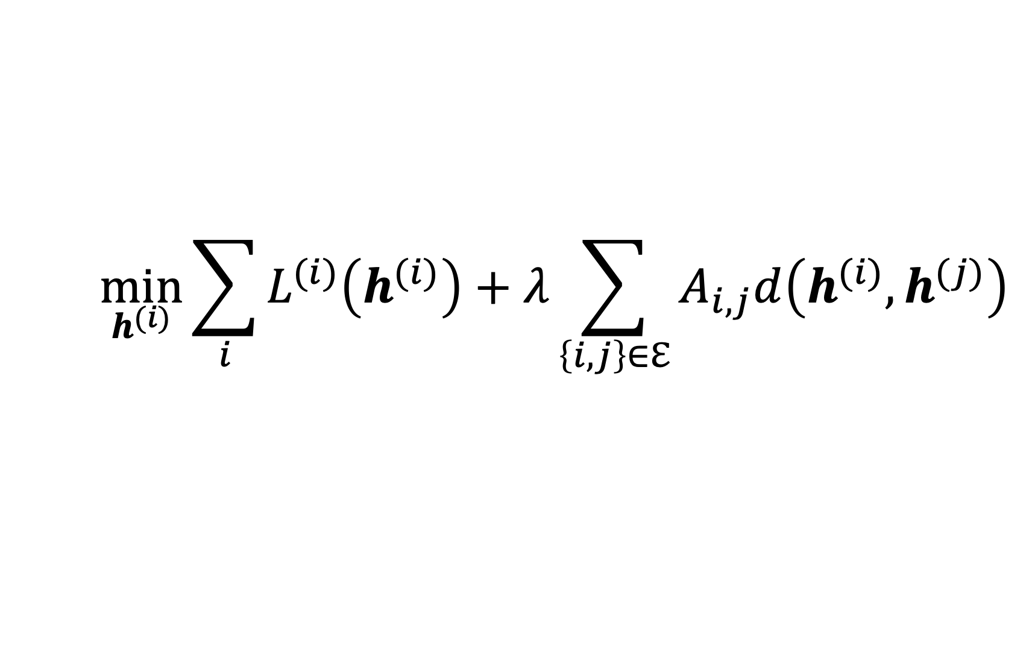
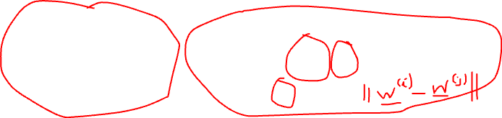
FL Design Principle
$$\min_{h^{(i)}}{\sum_{i}{L^{(i)}\left(h^{(i)}\right)}+λ\sum_{\left\{i,j\right\}∈ℇ}{A_{i,j}d\left(h^{(i)},h^{(j)}\right)}}$$
what edges $\left\{i,j\right\}∈ℇ$ and weights $A_{i,j}$ ?

Slide 5
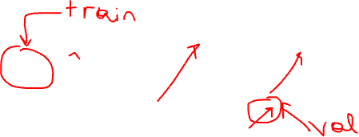

Choosing Edges = Model Selection
$$\min_{h^{(i)}}{\sum_{i}{L^{(i)}\left(h^{(i)}\right)}+λ\sum_{\left\{i,j\right\}∈ℇ}{A_{i,j}d\left(h^{(i)},h^{(j)}\right)}}$$
try different choices for emp.graph
solve GTVMin for each choice
pick emp.graph with smallest val err.

Slide 6
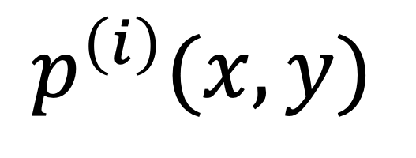
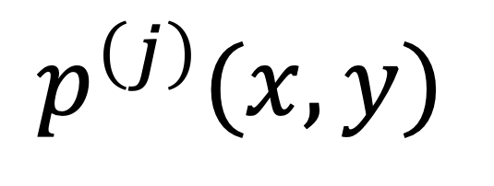
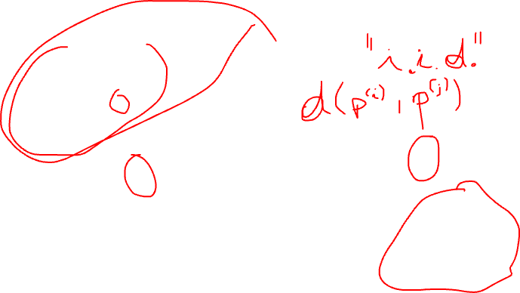
Probabilistic Models
$$p^{\left(i\right)}(x,y)$$
node j
node i
$$p^{\left(j\right)}(x,y)$$

Slide 7
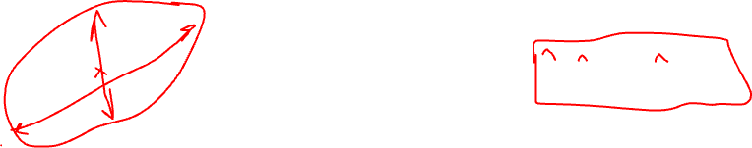
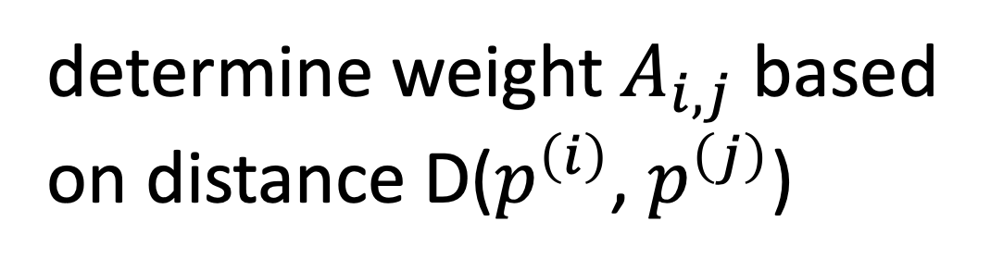
Graph Learning via Distances
$$p^{\left(i\right)}(x,y)$$
determine weight $A_{i,j}$ based
on distance D($p^{\left(i\right)}$, $p^{\left(j\right)}$)
node j
node i
$$p^{\left(j\right)}(x,y)$$

Slide 8
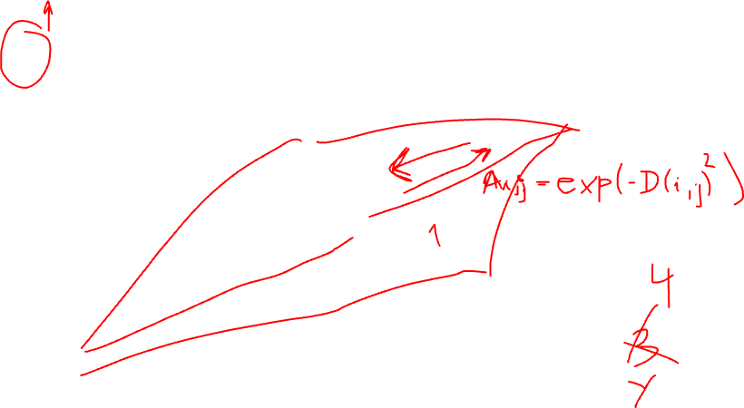
k Nearest-Neighbor
node i
k = 2

Slide 9
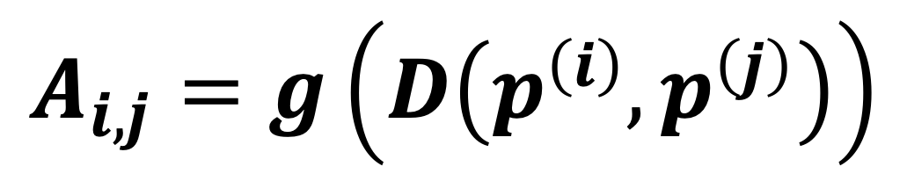
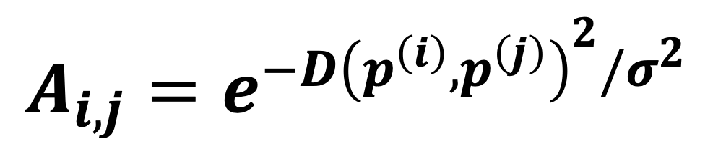
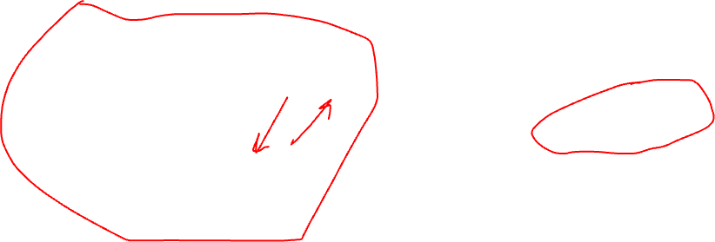
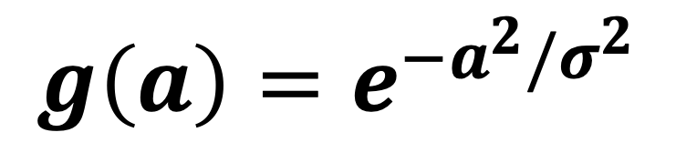
Fully Connected Weighted
$$A_{i,j}=g\left(D\left(p^{\left(i\right)},p^{\left(j\right)}\right)\right)$$
“profile” g(.)
$$g\left(a\right)=e^{−a^{2}/σ^{2}}$$
$$A_{i,j}=e^{−D{\left(p^{\left(i\right)},p^{\left(j\right)}\right)}^{2}/σ^{2}}$$
node i

Slide 10
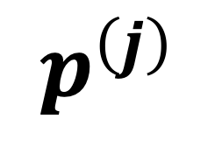
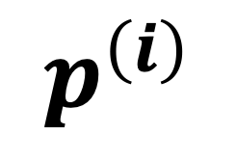

Distance between Prob. Dist.
$$p^{\left(j\right)}$$
$$p^{\left(i\right)}$$

Slide 11
Parametric Approach
compute finite number of params. (mean, covariance,…) of distribution;
stack them into a vector and then
use distance measures for Euclidean spaces (such as Euclidean norm)

Slide 12
Non-Parametric Approach
equip the space of probability distributions with a distance measure

Slide 13
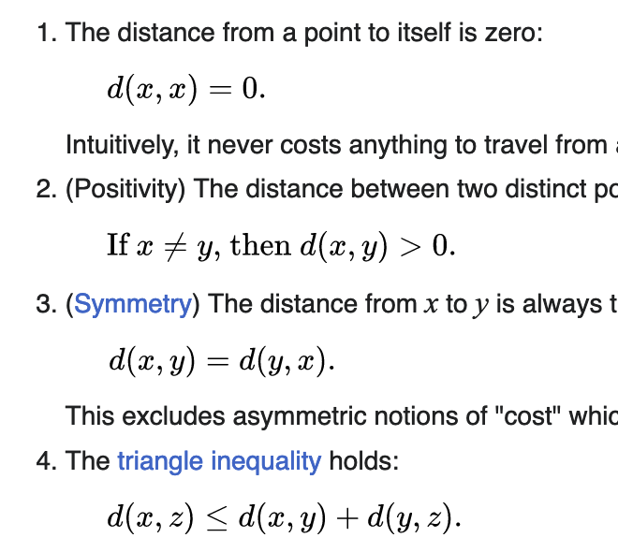
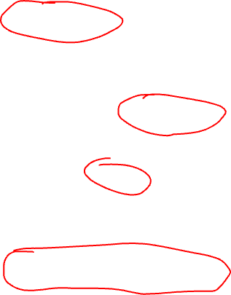
Metric
https://en.wikipedia.org/wiki/Metric_space

Slide 14



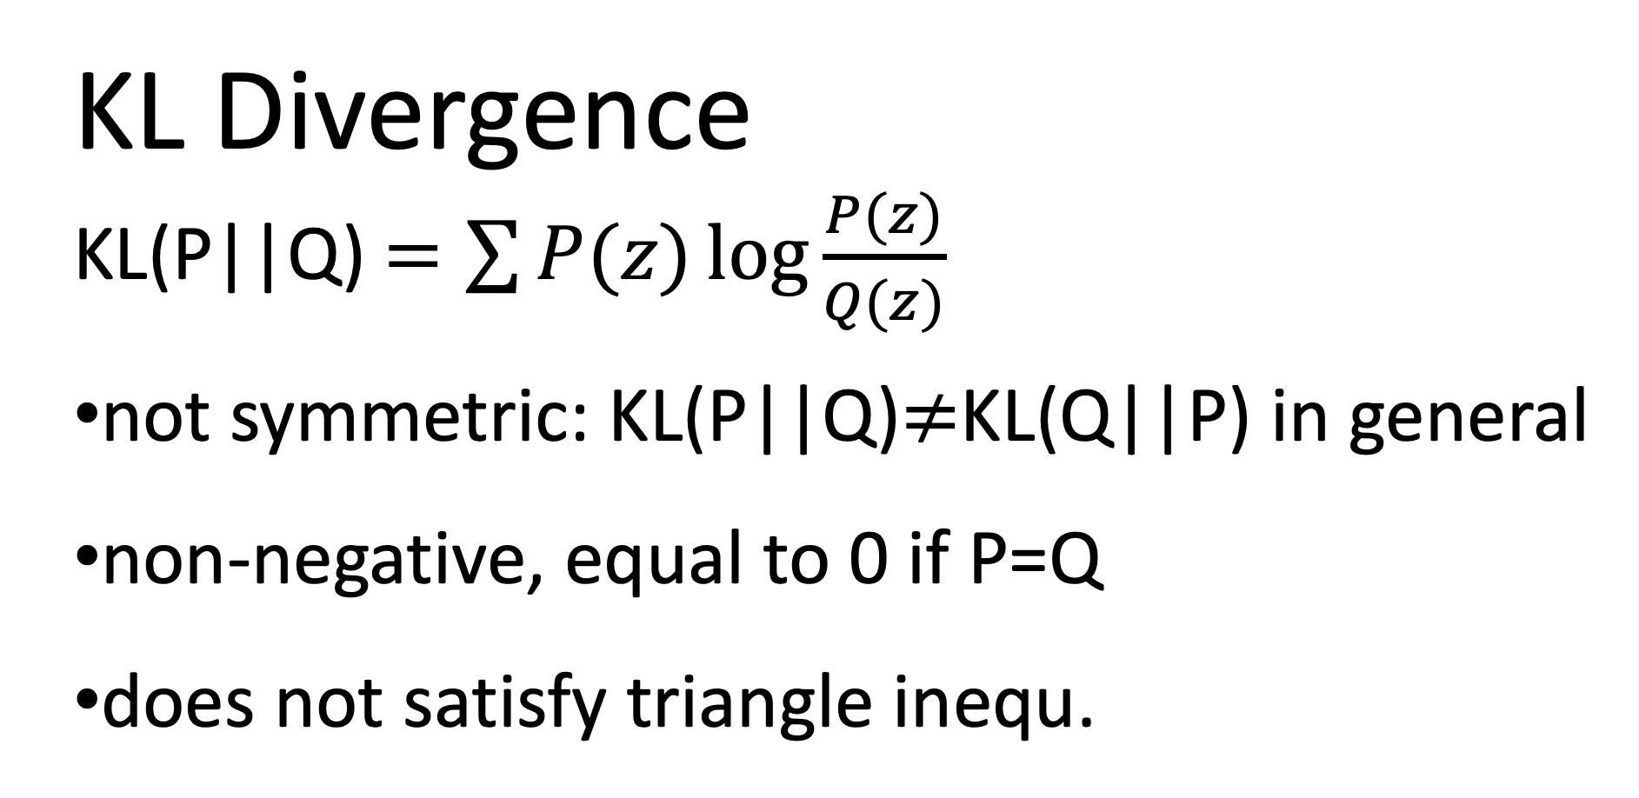
KL Divergence
KL(P||Q) $=\sum{P(z)\log{\frac{P(z)}{Q(z)}}}$
not symmetric: KL(P||Q)$≠$KL(Q||P) in general
non-negative, equal to 0 if P=Q
does not satisfy triangle inequ.

Slide 15
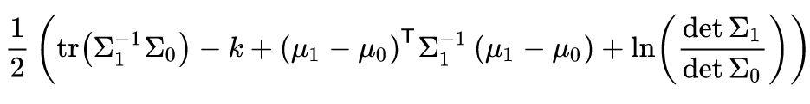
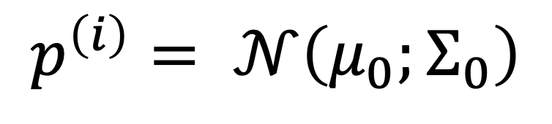
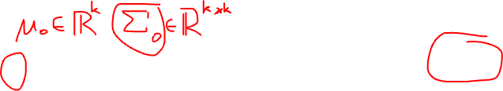
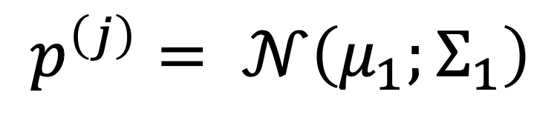
KL between two multiv. normal dist.
$$p^{\left(i\right)}= 𝒩\left(μ_{0};Σ_{0}\right)$$
$$p^{\left(j\right)}= 𝒩\left(μ_{1};Σ_{1}\right)$$
https://en.wikipedia.org/wiki/Kullback%E2%80%93Leibler_divergence

Slide 16
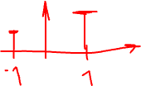
KL between Bernoulli dist.

Slide 17
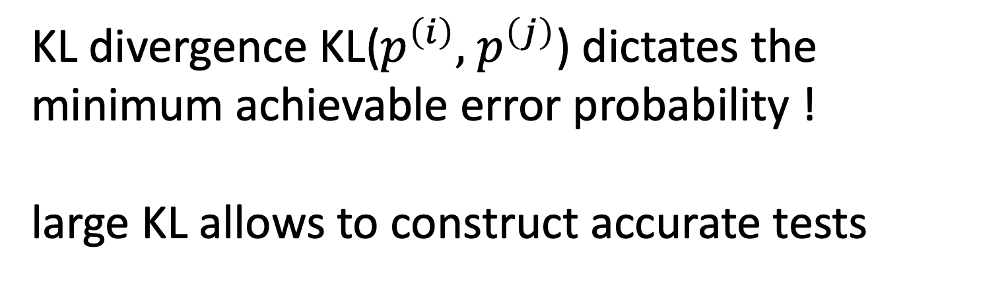
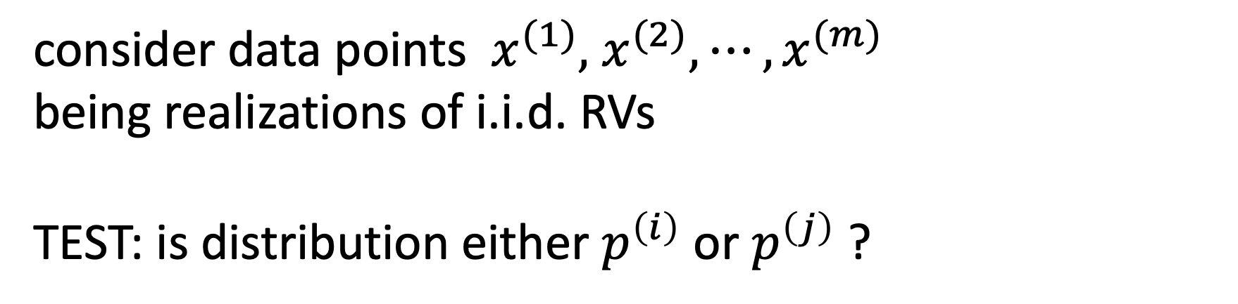
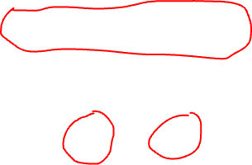
Interpretation of KL Divergence
consider data points $x^{(1)},$ $x^{(2)},⋯,x^{(m)}$
being realizations of i.i.d. RVs
TEST: is distribution either $p^{\left(i\right)}$ or $p^{\left(j\right)}$ ?
KL divergence KL($p^{\left(i\right)},$ $p^{\left(j\right)}$) dictates the minimum achievable error probability !
large KL allows to construct accurate tests

Slide 18
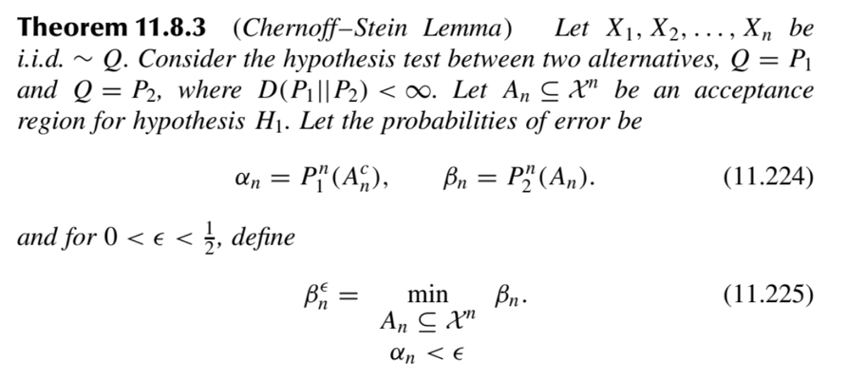
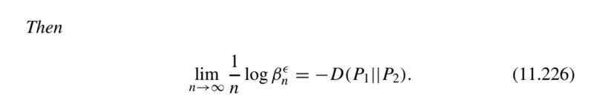
In other words…
Elements of Information Theory, Second Edition, By Thomas M. Cover and Joy A. Thomas.

Slide 19
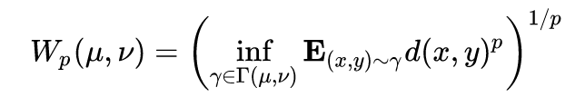
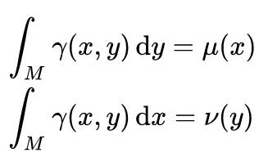
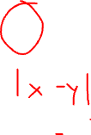
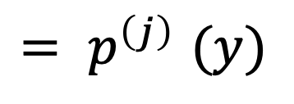
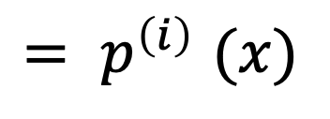
Wasserstein metric
$${= p}^{\left(i\right)}(x)$$
$${= p}^{\left(j\right)}(y)$$
https://en.wikipedia.org/wiki/Wasserstein_metric

Slide 20
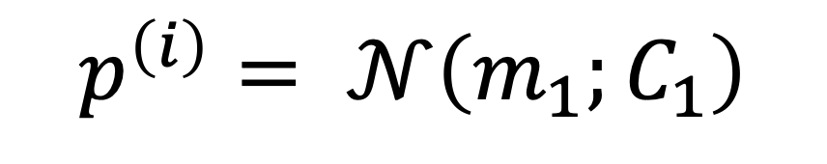
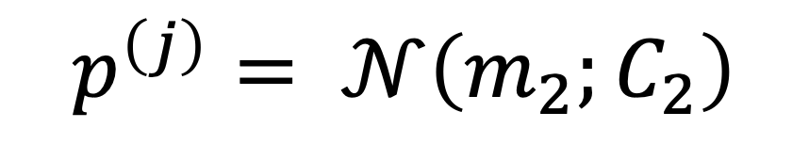
Squ. Wasserstein metric between Gaussians
$$p^{\left(i\right)}= 𝒩\left(m_{1};C_{1}\right)$$
$$p^{\left(j\right)}= 𝒩\left(m_{2};C_{2}\right)$$
https://en.wikipedia.org/wiki/Wasserstein_metric

Slide 21
Interpretation via Optim. Transport
d(x,y)
x
y

Slide 22
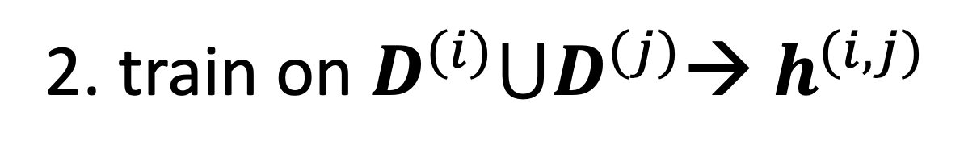
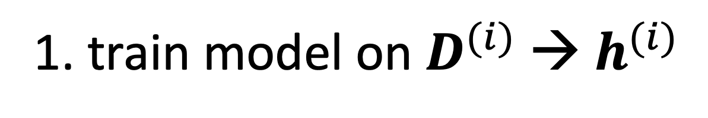
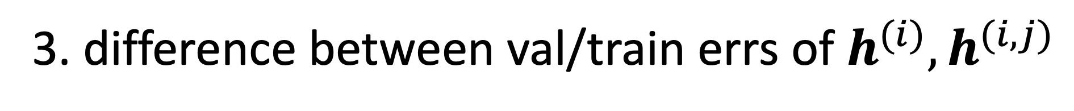
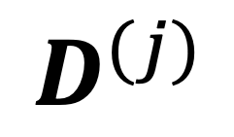

Distance via Effect on Training
1. train model on $D^{(i)}$→ $h^{(i)}$
$$D^{(j)}$$
$$D^{(i)}$$
2. train on $D^{(i)}⋃D^{(j)}$→ $h^{(i,j)}$
3. difference between val/train errs of $h^{(i)},h^{(i,j)}$

Slide 23
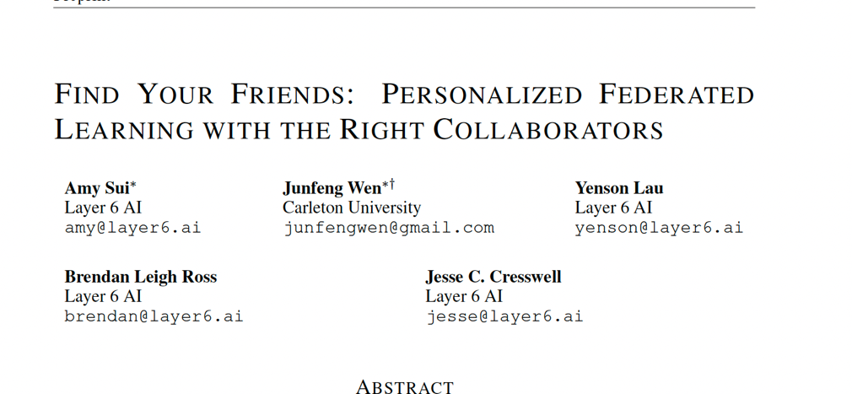

Slide 24
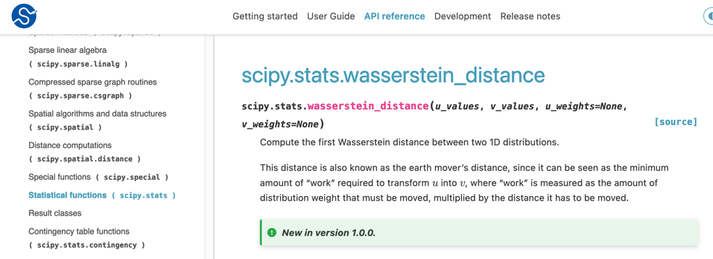
FL project: what if the package is not available on jupyter.cs.aalto?
-> compute it on your own computer and then use results as “manually” chosen edges, weights of emp. graph

Slide 25
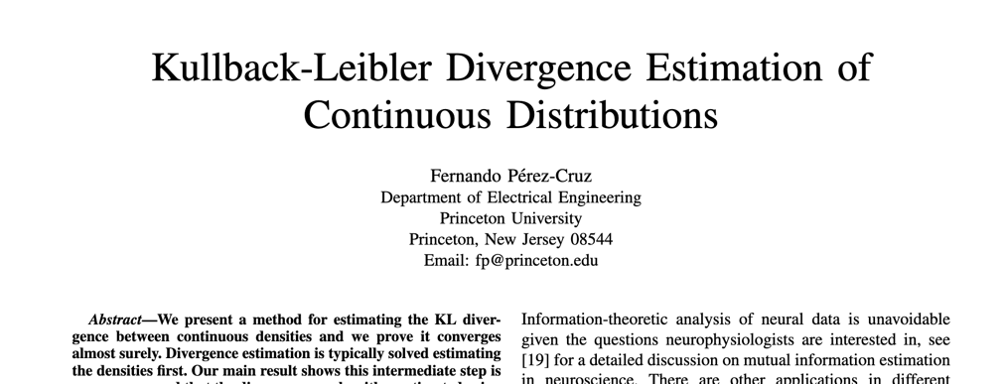

Slide 26
Thank you for
your attention!

