Slide 1
CS-E4740 Federated Learning “Network Models”
Dipl.-Ing. Dr. techn. Alexander Helmut Jung

Slide 2
What are the main components of ML and
how are they combined?

Slide 3


Plain Old Machine Learning
h(x)
(y-h(x))²
label y (max.tmp.)
feature x (min.tmp.)

Slide 4
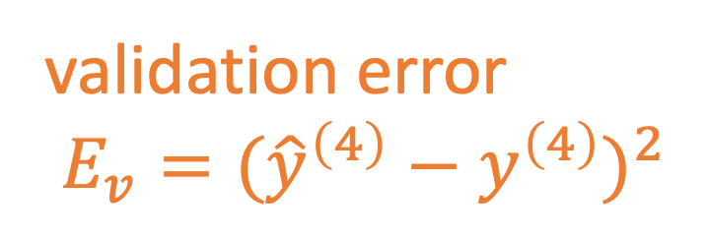
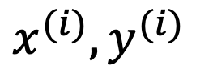
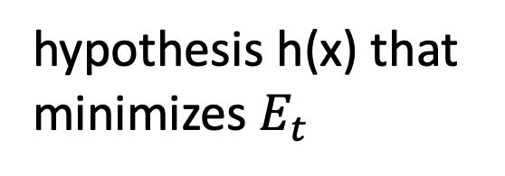
Train and Validate
hypothesis h(x) that
minimizes $E_{t}$
$$x^{(i)},y^{(i)}$$
label y
validation error
$E_{v}=({\hat{y}}^{\left(4\right)}−y^{\left(4\right)})^{2}$
feature x

Slide 5
Basic Idea of Model Selection
choose model with smallest validation error!
training validation
error error
model 1
degree 1 polyn.
model 2:
degree 3 polyn.
Notes:
it seems that larger models (higher polyn. degree) results in larger validation error. is this always the case?

Slide 6
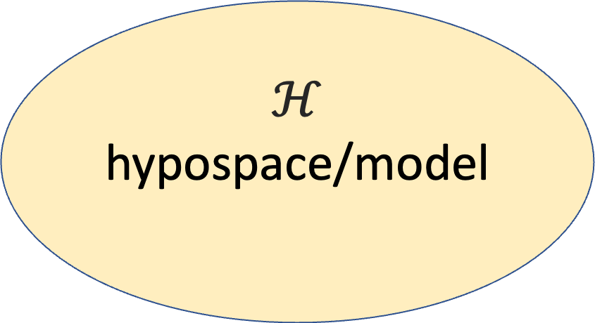
Data and Model Size
$$ℋ$$
hypospace/model
$$\left(x^{(1)},y^{(1)}\right)$$
…
m
$$\left(x^{(m)},y^{(m)}\right)$$
nr. of features n
crucial parameter is the
ratio d/m
eff. dimension d
Notes:
The sample size m is the nr. of different datapoints in the training set

Slide 7
training error
validation error
“critical value” (d/m=1)
d / m

Slide 8
Networked Data

Slide 9
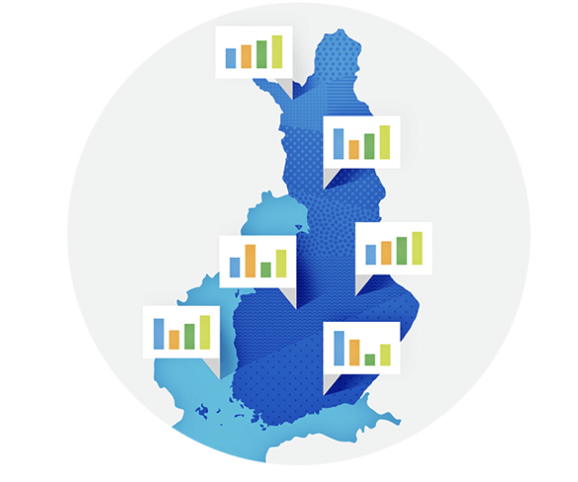
Networked Weather Data

Slide 10
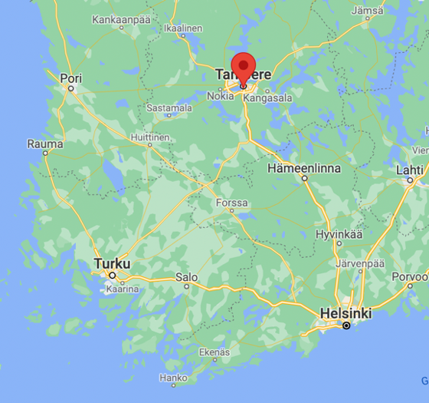

Slide 11
ImageNet
“…ImageNet is an image database organized according to the WordNet hierarchy (currently only the nouns), in which each node of the hierarchy is depicted by hundreds and thousands of images…”
https://image-net.org/

Slide 12
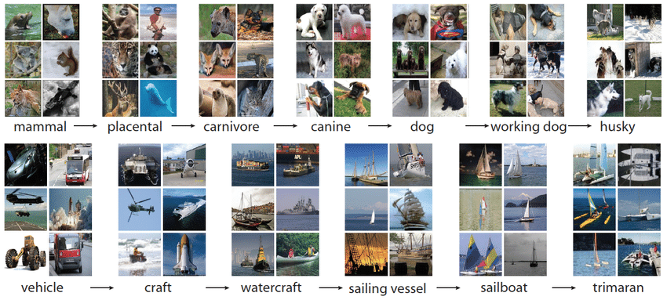
Devopedia. 2021. "ImageNet." Version 16, April 7. Accessed 2023-02-11. https://devopedia.org/imagenet

Slide 13
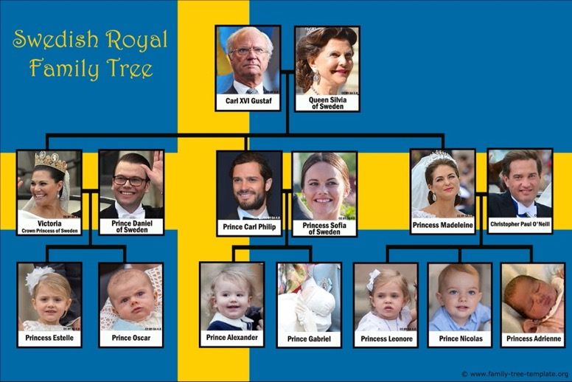
Noble Networks

Slide 14
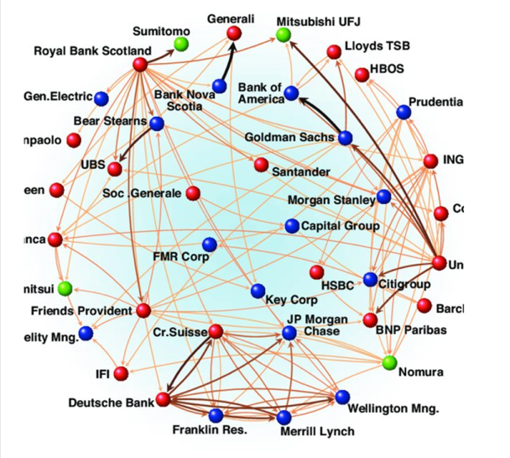
Finance Networks

Slide 15
Point Cloud Networks.
label y
feature x

Slide 16
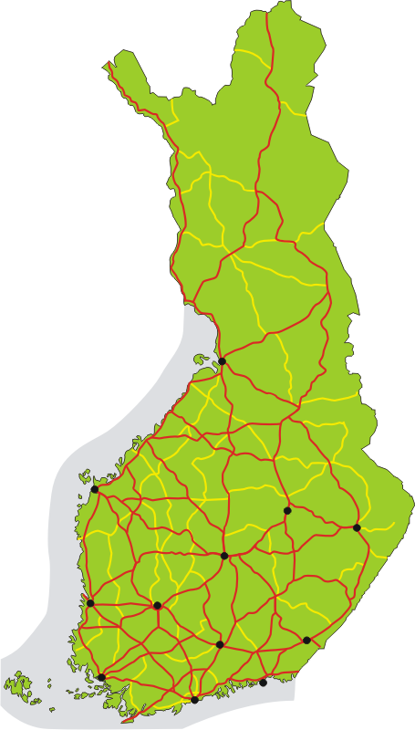
Road Network

Slide 17
Business Process
A
B
C

Slide 18
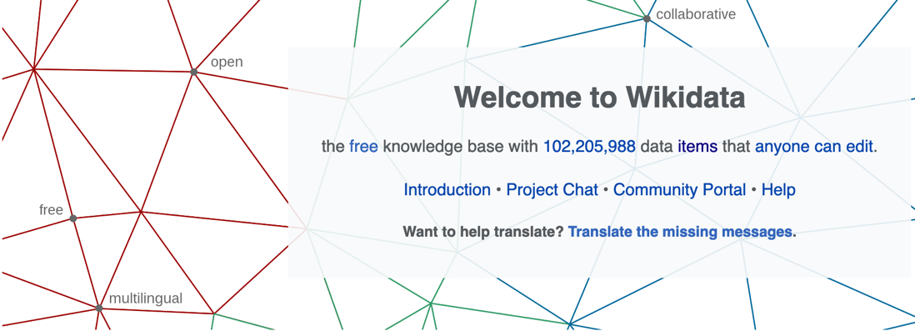
https://www.wikidata.org/wiki/Wikidata:Main_Page

Slide 19
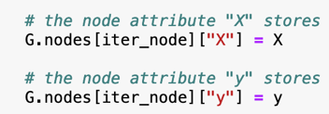

Empirical Graph - Nodes
2
each node carries:
local dataset
i=1
3
4

Slide 20
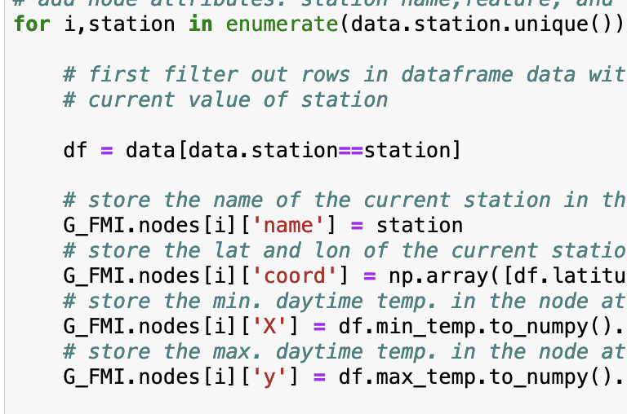
Attach Local Datasets to Nodes
name of FMI station
latitude, longitude of FMI station
use min. daytime tmp. as feature of
datapoint (=some day)
use max. daytime tmp. as labels of
datapoint (= some day)

Slide 21

Empirical Graph - Edges
2
i=1
undirected edge indicates
“similarity”
3
4
edge weight $A_{3,4}$ = level of similarity

Slide 22
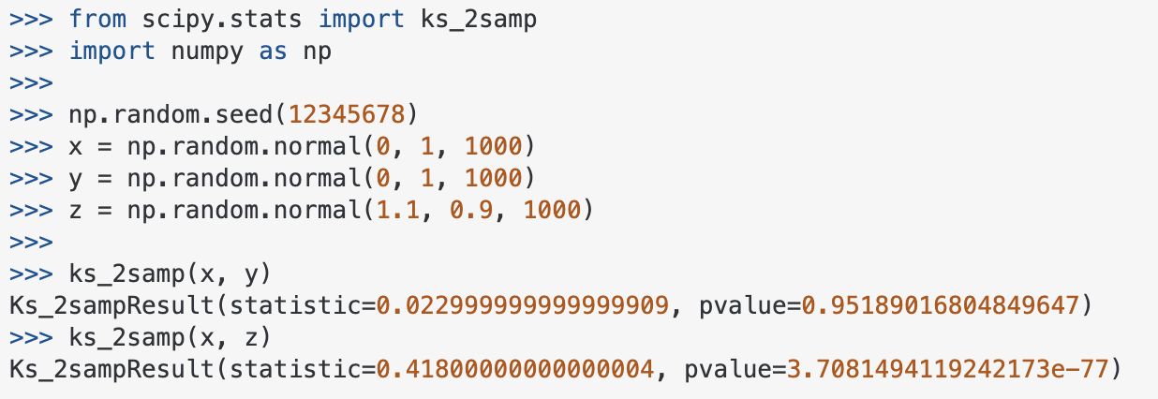
Measure Statistical Similarity
https://stackoverflow.com/questions/10884668/two-sample-kolmogorov-smirnov-test-in-python-scipy
https://en.wikipedia.org/wiki/Kolmogorov%E2%80%93Smirnov_test
Notes:
We represent networked data using an undirected weighted graph which we refer to as the empirical graph. The nodes of the empirical graph represent individual local datasets, e.g., generated by a particular person or by a particular IoT sensing device. Two nodes are connected by an edge if they are similar in a domain-specific sense. This similarity notion might be be obtained from spatio-temporal proximity as in contact networks for disease spread or by presence/absence of direct communication links. Our research studies how to combine the geometry of the network or network topoloy with the geometry of local models that are used for each local dataset.

Slide 23
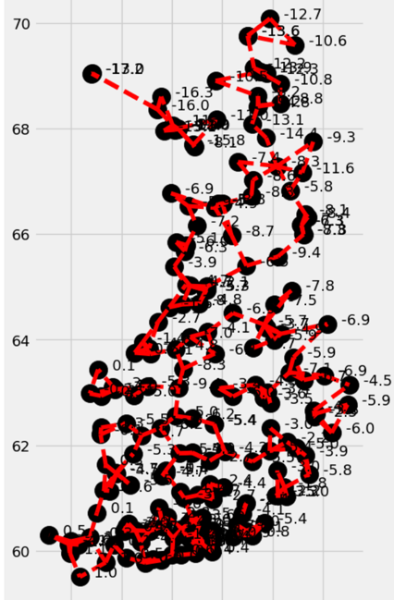
Spatio-Temporal Similarity
connect FMI stations with its k nearest neighbours (use geodesic distance)

Slide 24
How to choose Empirical Graph?
empirical graph is a design choice
more edges means more comp./comm.
sufficient number of edges between similar datasets

Slide 25


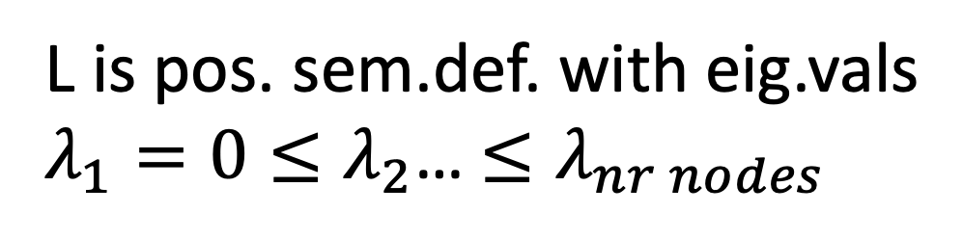
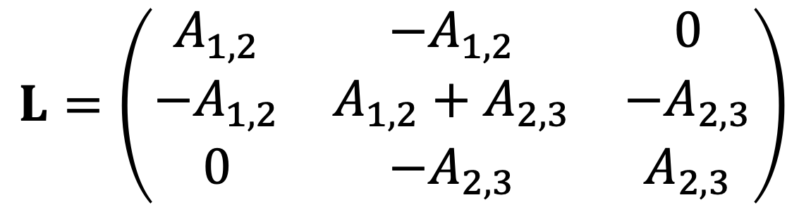
Graph Laplacian Matrix
2
i=1
$$A_{1,2}$$
$$A_{2,3}$$
3
$$L=\left(\begin{matrix}A_{1,2} & −A_{1,2} & 0 \\ −A_{1,2} & A_{1,2}+A_{2,3} & −A_{2,3} \\ 0 & {−A}_{2,3} & A_{2,3}\end{matrix}\right)$$
L is pos. sem.def. with eig.vals
$λ_{1}=0≤λ_{2}$… $≤λ_{nr nodes}$

Slide 26
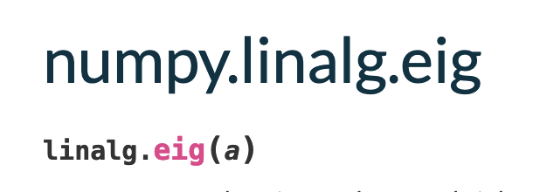

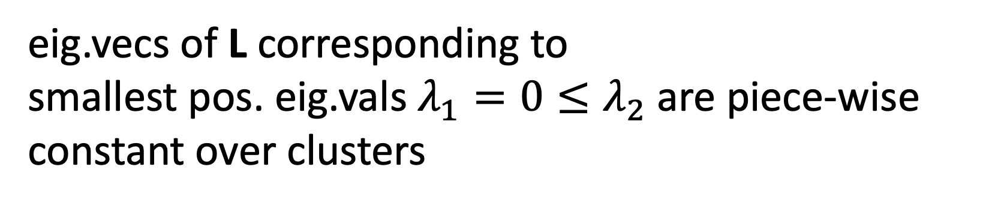
Spectral Graph Clustering
eig.vecs of L corresponding to
smallest pos. eig.vals $λ_{1}=0≤λ_{2}$ are piece-wise constant over clusters
1
i=0
$$A_{0,1}$$
4
3
2
5

Slide 27
What is Component 2
of ML ?

Slide 28

Local Model for Local Data
2
each node carries:
local dataset
local model
i=1
undirected edge indicate
“similarity”
3
4

Slide 29
Networked Models

Slide 30
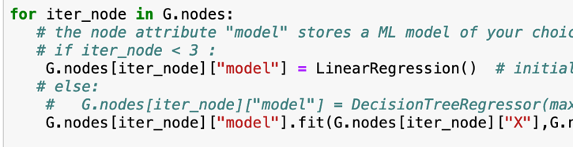
Option 1: Train Separately

Slide 31


Pro: Personalization

Slide 32

Con: Overfitting

Slide 33
Option 2: Global Model

Slide 34
Pro: No Overfitting

Slide 35
Con: Low Accuracy

Slide 36

Option 3: Clustered FL

Slide 37
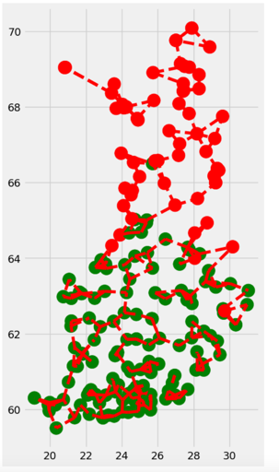
Clustering Assumption
p(x,y; c=1)
local datasets in cluster “c” contain data points that can be approximated as i.i.d. with prob. dist p(x,y;c)
p(x,y; c=2)

Slide 38
Cluster-Wise Training
pool local datasets of nodes in
same cluster to train ML model
trained model is used for all nodes in same cluster

Slide 39
Clustering via Regularization
cluster structure typically unknown
how to pool local datasets in same cluster?
pooling = enforce constant local model params
penalize variation of local model params

Slide 40
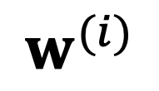
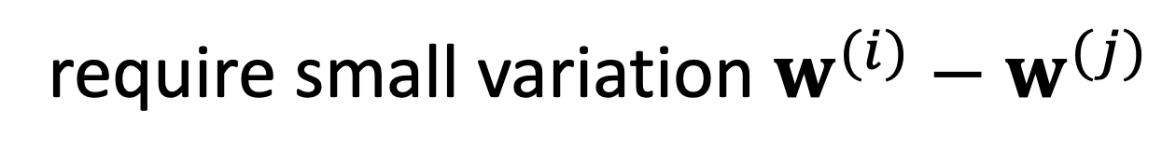
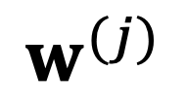
Regularization
require small variation $w^{(i)}−w^{(j)}$
node i
node j
local model params
$$w^{(j)}$$
$$w^{(i)}$$

Slide 41
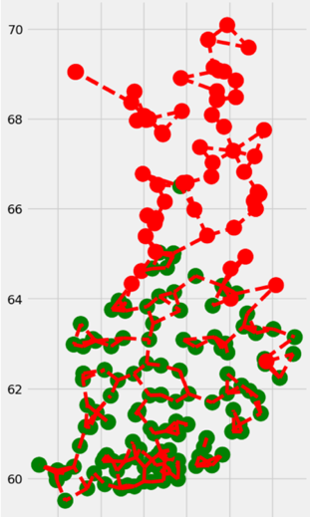
Total Variation Minimization
requiring small variation enforces piece-wise constant local model params
piece-wise constant model params = pooling of local data

Slide 42
Wrap-Up
emp. graph with nodes carrying local datasets and models
undirected weighted edges represent similarities
different sources for similarity
emp. graph is a design choice

Slide 43
Any Questions ?

