Slide 1
ideas: --forecast the (incoming) car flow amount with the resolution of 30 min between the 6.00-19.00 in four road-intersections (would be the 4 nodes). The intersections are located in one area, i.e. they are connected with some weight.
My confusion here is that I can not use the CV since I treat the historical traffic data as timeseries, i.e. I drop the time step value and shift it to generate historical data and use sliding window to make the forecast. I was not using the validation set, i.e. I have trained the model and then tested it on test set. Would it be OK here to use train/test and different hypothesis, and select the model based on the performance on the test set.

Slide 2
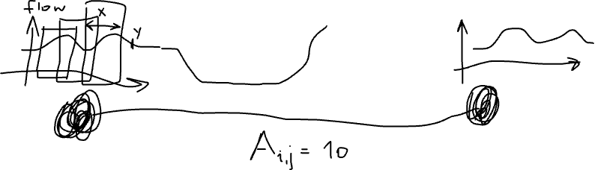

Slide 3
another option to build an FL project using AHU (air handling unit) data. In this case I can apply CV, a data point would be one day and I will predict one sensor temperature based on other features, such as e.g. occupancy, other related sensors in AHU machine.
The idea of FL in this case is that one building may have several AHUs that can be (most probably) related to each other.

Slide 4
CS-E4740 Federated Learning “Trustworthy FL” Dipl.-Ing. Dr.techn. Alexander Jung

Slide 5
Learning Goals
key requirements for trustworthy FL
approaches to satisfy them

Slide 6
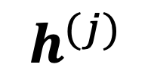
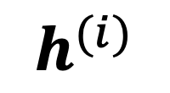
Networked Data+Model
$$h^{(i)}$$
val set
train set
node j
$$h^{(j)}$$
node i

Slide 7

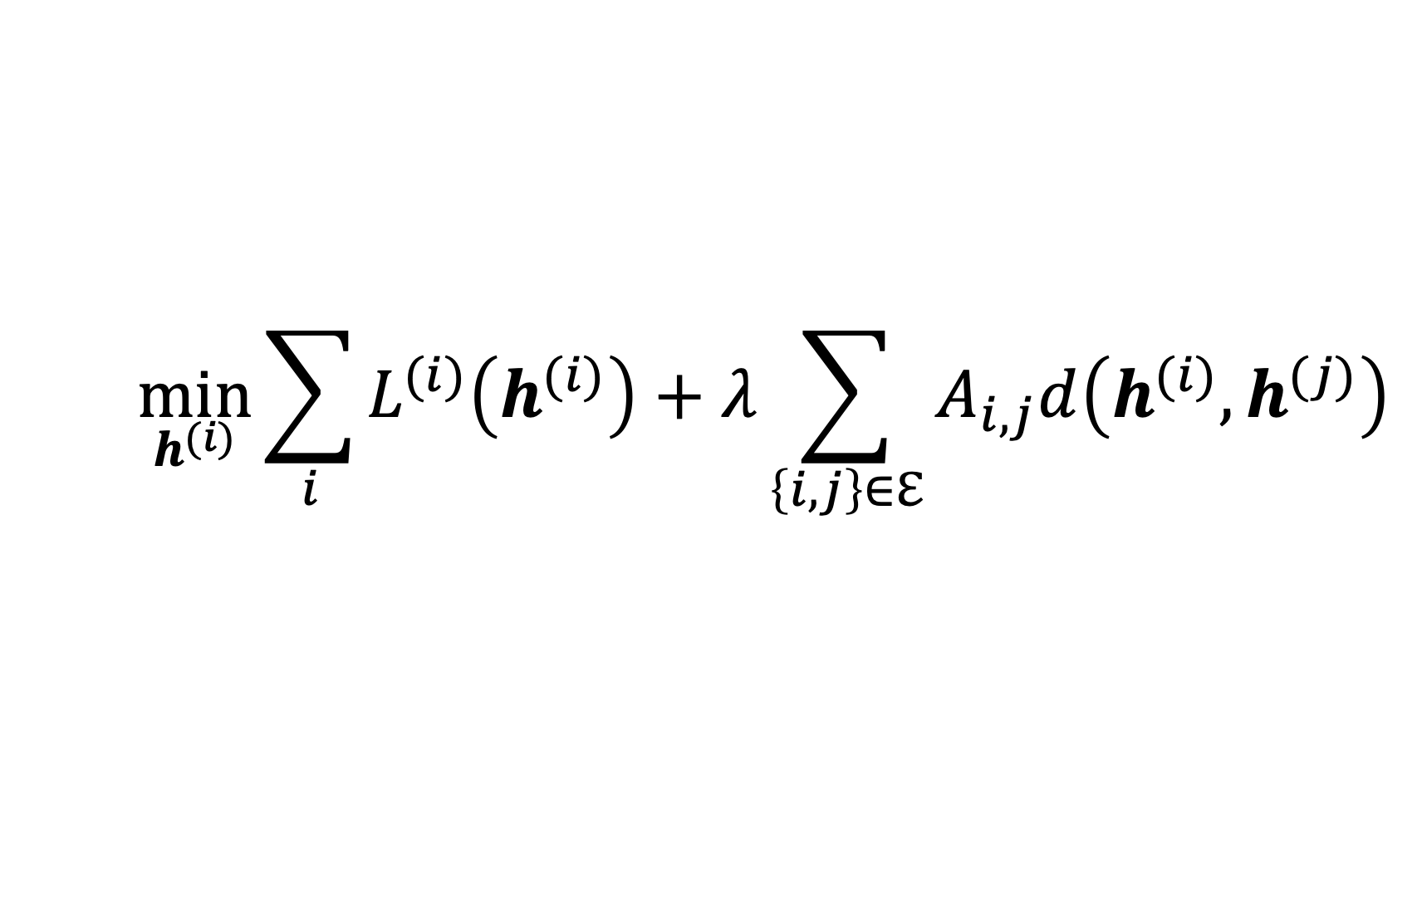
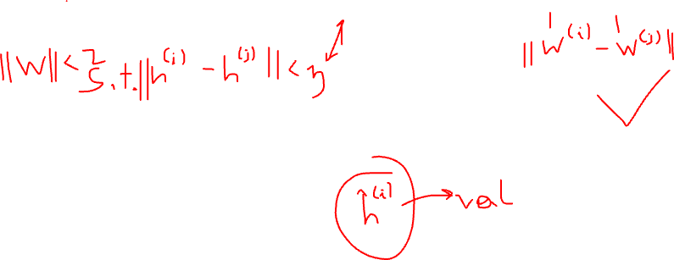
FL Design Principle
$$\min_{h^{(i)}}{\sum_{i}{L^{(i)}\left(h^{(i)}\right)}+λ\sum_{\left\{i,j\right\}∈ℇ}{A_{i,j}d\left(h^{(i)},h^{(j)}\right)}}$$
what edges $\left\{i,j\right\}∈ℇ$ and weights $A_{i,j}$ ?

Slide 8
Design-Cycle
learn local hyp. h(x) via GTVMin (“train”)
apply local hyp. h(x) to new data (“validate”)
measure error
adapt GTVMin design choices and repeat

Slide 9
Aspects of FL Design Choices
trustworthiness
computational
complexity
statistical
accuracy

Slide 10

https://digital-strategy.ec.europa.eu/en/library/assessment-list-trustworthy-artificial-intelligence-altai-self-assessment

Slide 11
Assessment List for Trustworthy Artificial Intelligence (ALTAI)
“The tool supports the actionability the key requirements outlined by the Ethics Guidelines for Trustworthy Artificial Intelligence (AI), presented by the High-Level Expert Group on AI (AI HLEG) presented to the European Commission, in April 2019. The Ethics Guidelines introduced the concept of Trustworthy AI, based on seven key requirements:”

Slide 12

Human agency and oversight
Technical robustness and safety
Privacy and data governance
Transparency
Diversity, non-discrimination and fairness
Societal and environmental wellbeing
Accountability
https://ec.europa.eu/futurium/en/ai-alliance-consultation.1.html

Slide 13
Human agency and oversight
Technical robustness and safety
Privacy and data governance
Transparency
Diversity, non-discrimination and fairness
Societal and environmental wellbeing
Accountability
https://ec.europa.eu/futurium/en/ai-alliance-consultation.1.html

Slide 14
Human Agency.
“…The overall principle of user autonomy must be central to the system’s functionality. Key to this is the right not to be subject to a decision based solely on automated processing when this produces legal effects on users or similarly significantly affects them….”
→ labels maybe not correspond to certain actions …

Slide 15
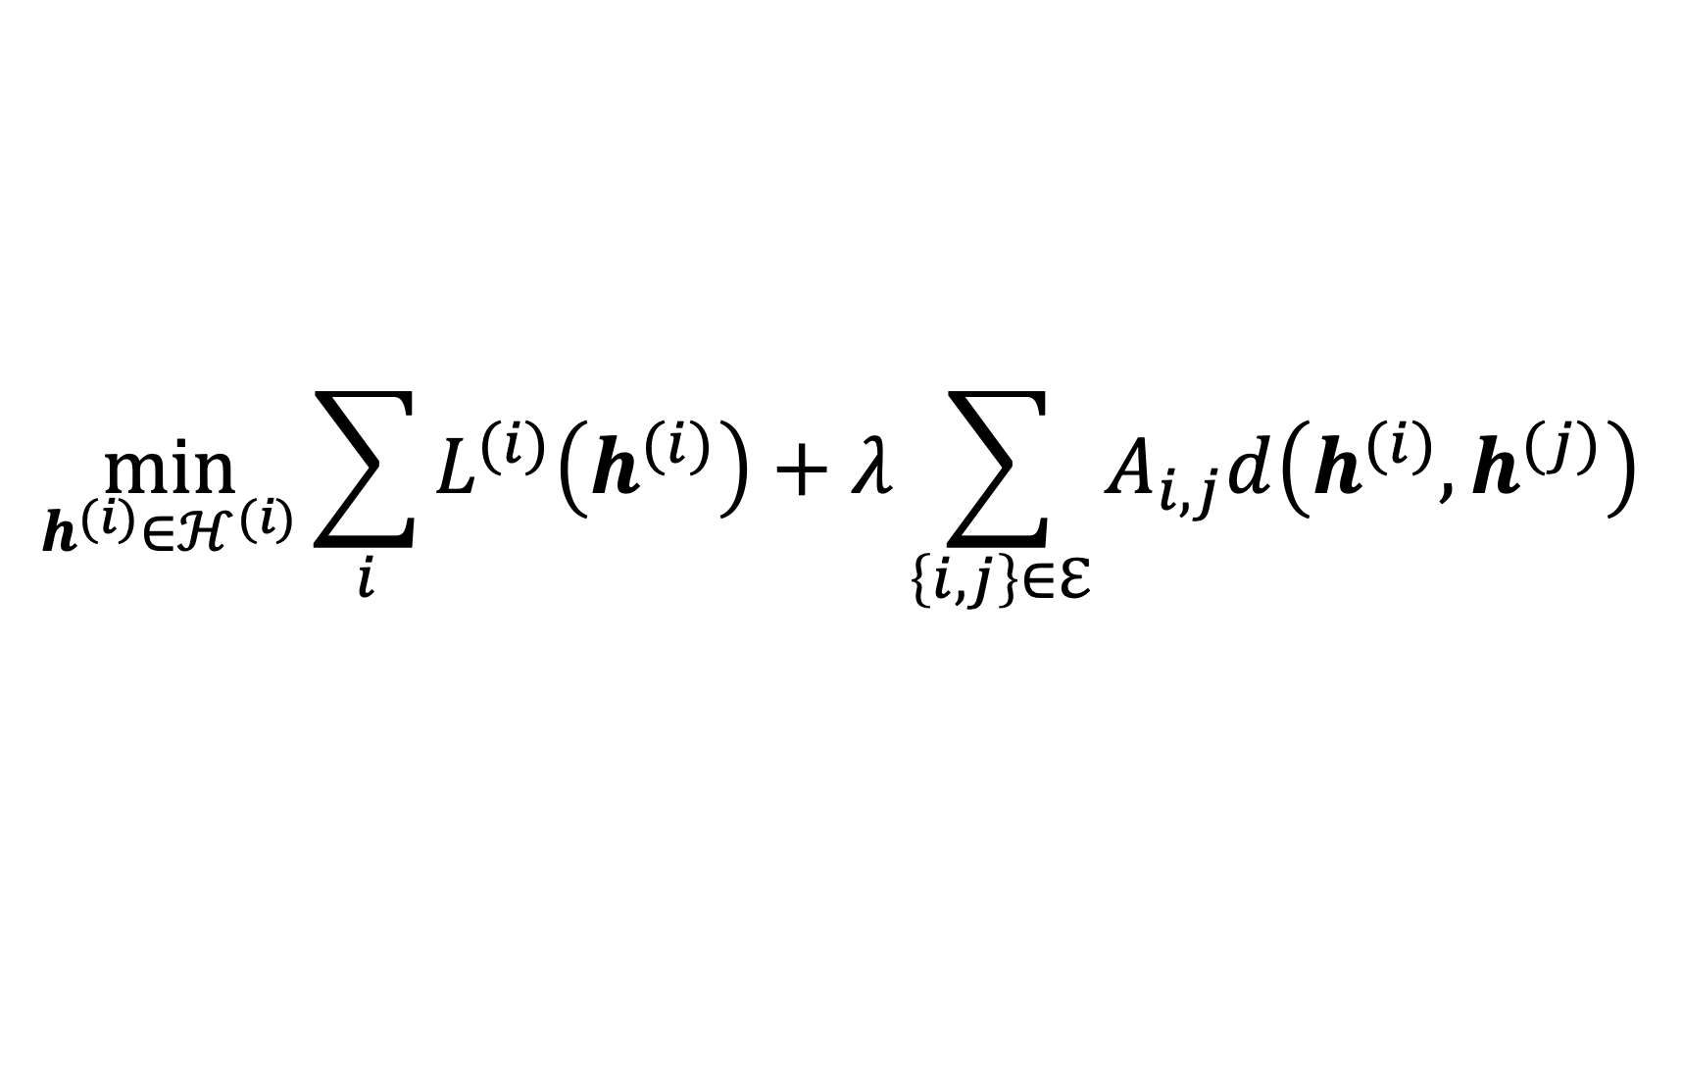
Human Oversight
design choice !
$$\min_{h^{(i)}∈ℋ^{(i)}}{\sum_{i}{L^{(i)}\left(h^{(i)}\right)}+λ\sum_{\left\{i,j\right\}∈ℇ}{A_{i,j}d\left(h^{(i)},h^{(j)}\right)}}$$
design choice !

Slide 16
Human-in-the-Loop (HITL)
“…HITL refers to the capability for human intervention in every decision cycle of the system, which in many cases is neither possible nor desirable. …”

Slide 17
Human-on-the-Loop (HOTL)
“…HOTL refers to the capability for human intervention during the design cycle of the system and monitoring the system’s operation…”

Slide 18
Human-in-Command (HIC)
“…HIC refers to the capability to oversee the overall activity of the AI system (including its broader economic, societal, legal and ethical impact) and the ability to decide when and how to use the system in any particular situation…”

Slide 19
Human agency and oversight
Technical robustness and safety
Privacy and data governance
Transparency
Diversity, non-discrimination and fairness
Societal and environmental wellbeing
Accountability
https://ec.europa.eu/futurium/en/ai-alliance-consultation.1.html

Slide 20
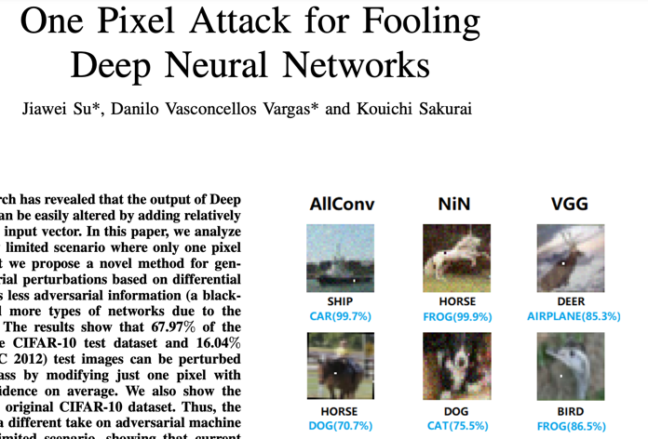
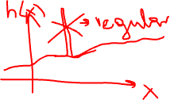
“…AI must cope with changes in operating env. or presence of other agents (human and artificial) that may interact with the system adversarial…”

Slide 21




“…AI must cope with changes in operating env. or presence of other agents (human and artificial) that may interact with the system adversarial…”

Slide 22
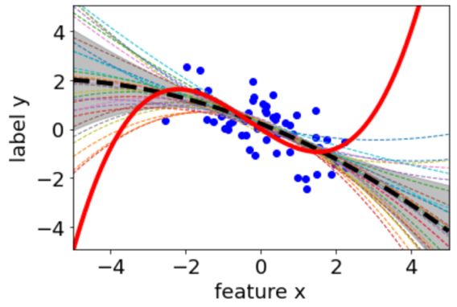
Reliability and Reproducibility
“…It is critical that the results of AI systems are reproducible, as well as reliable. A reliable AI system is one that works properly with a range of inputs and in a range of situations….”

Slide 23

Fallback Plan
“…This can mean that AI systems switch from a statistical to rule-based procedure, or that they ask for a human operator before continuing their action….”
provide confidence measures for predictions
insufficient confidence -> switch to simpler models
logistic regression provides confidence measures by design !

Slide 24
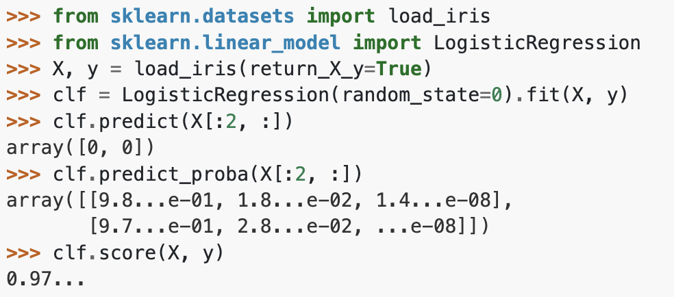
Accuracy
“…When occasional inaccurate predictions cannot be avoided, it is important that the system can indicate how likely these errors are. A high level of accuracy is especially crucial in situations where the AI system directly affects human lives….”

Slide 25
Human agency and oversight
Technical robustness and safety
Privacy and data governance
Transparency
Diversity, non-discrimination and fairness
Societal and environmental wellbeing
Accountability
https://ec.europa.eu/futurium/en/ai-alliance-consultation.1.html

Slide 26
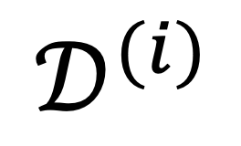
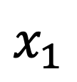
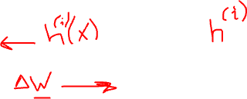
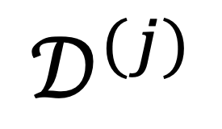
Privacy-Friendly FL
$$𝒟^{(j)}$$
$$𝒟^{(i)}$$
FedSGD or FedRelax (see Sec. 9 of lec.notes)
do not exchange raw data but only parameter updates or predictions on test set
$$x_{1}$$

Slide 27





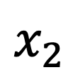
Privacy-Preserving Feature Learning
$$x_{2}$$
not-sensitive
y (food preference)
sensitive
s (gender)
$$x_{1}$$

Slide 28
Quality and integrity of data.
“…When data is gathered, it may contain socially constructed biases, inaccuracies, errors and mistakes. This needs to be addressed prior to training with any given data set. In addition, the integrity of the data must be ensured…”
feature and label values might be noisy

Slide 29
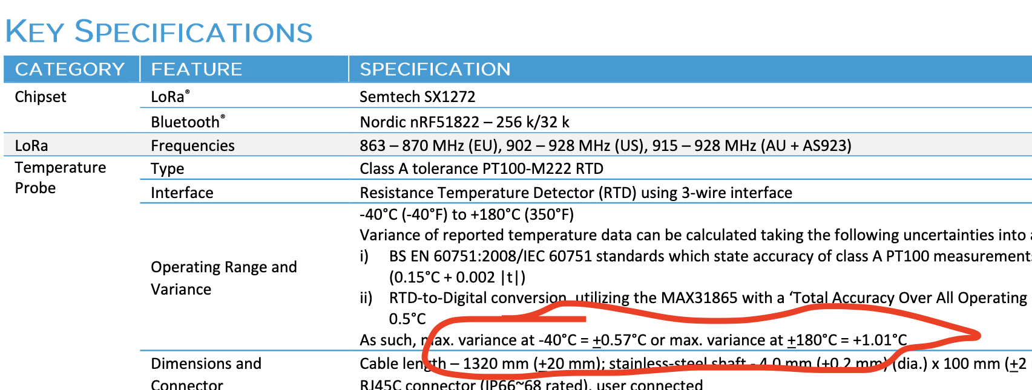
Check Datasheet !
https://www.digikey.at/en

Slide 30
Access to data.
“…data protocols governing data access..”
"..who can access data and under which circumstances.
“…only qualified personnel with the competence and need to access individual’s data should be allowed to do so….”

Slide 31
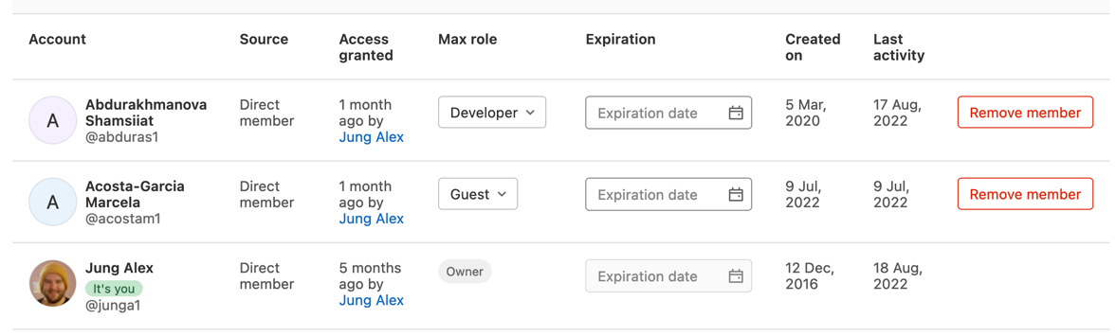

Slide 32
Human agency and oversight
Technical robustness and safety
Privacy and data governance
Transparency
Diversity, non-discrimination and fairness
Societal and environmental wellbeing
Accountability
https://ec.europa.eu/futurium/en/ai-alliance-consultation.1.html

Slide 33
Traceability.
“…The data sets and the processes that yield the AI system’s decision, including those of data gathering and data labelling as well as the algorithms used, should be documented to the best possible..”

Slide 34
Explainability.
“…Technical explainability requires that the decisions made by an AI system can be understood and traced by human beings. Moreover, trade-offs might have to be made between enhancing a system's explainability (which may reduce its accuracy) or increasing its accuracy (at the cost of explainability)...”

Slide 35
What is an Explanation?
…anything that allows the user to predict the predictions
of a ML method

Slide 36
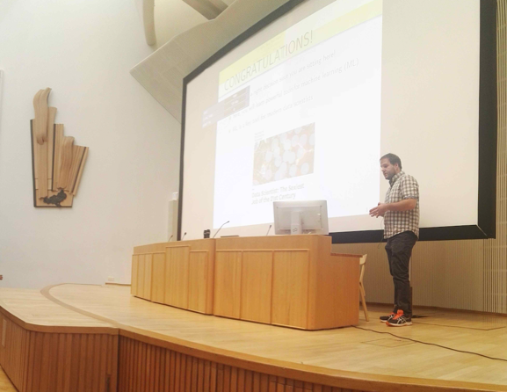
To Teach = To Explain

Slide 37
after you completed my course…
explaining a FL method amounts to
specify local datasets; empirical graph
specify local models
specify local loss function

Slide 38
Explaining a FL Method.
provide information about how empirical graph and local datasets is turned into local hypothesis maps
e.g., “hypothesis maps are learnt by solving GTVMin using
local models … and empirical graph constructed as …”

Slide 39
Explaining a Prediction.
provide information about how the prediction h(x) is computed for a given data point with features x
e.g., “the prediction is obtained since we use a linear hypothesis h(x) = w1*x1+w2*x2 with weights w1 = 10 and w2=4”

Slide 40
Explaining a Prediction.
x
> 5?
no
yes
1
2

Slide 41

Communication
“…AI systems should not represent themselves as humans to users; humans
have the right to be informed that they are interacting with an AI system….”

Slide 42
Human agency and oversight
Technical robustness and safety
Privacy and data governance
Transparency
Diversity, non-discrimination and fairness
Societal and environmental wellbeing
Accountability
https://ec.europa.eu/futurium/en/ai-alliance-consultation.1.html

Slide 43
Avoidance of unfair bias.
“Data sets used by AI systems (both for training and operation) may suffer from the inclusion of inadvertent historic bias, incompleteness and bad governance models.”

Slide 44
Fairness by Data Augmentation
salary y
original datapoint
augmented
x (e.g. gender)

Slide 45

Accessibility and universal design.
“AI systems should not have a one-size-fits-all approach and should consider Universal Design principles addressing the widest possible range of users, following relevant accessibility standards…”

Slide 46
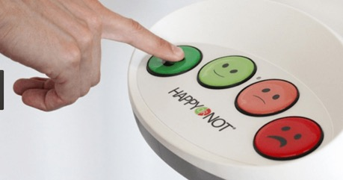
Stakeholder Participation.
“It is beneficial to solicit regular feedback even after deployment and set up longer term mechanisms for stakeholder participation…”
https://images.app.goo.gl/PjovTNXf6ouv2Kxe9

Slide 47
Human agency and oversight
Technical robustness and safety
Privacy and data governance
Transparency
Diversity, non-discrimination and fairness
Societal and environmental wellbeing
Accountability
https://ec.europa.eu/futurium/en/ai-alliance-consultation.1.html

Slide 48
Sustainable and environmentally friendly FL
“…a critical examination of the resource usage and energy consumption during training, opting for less harmful choices…”
-> favour GTVMin instances that allow for low-complexity FL algorithms

Slide 49
Social impact
“…While AI systems can be used to enhance social skills, they can equally contribute to their deterioration. This could also affect people’s physical and mental wellbeing. The effects of these systems must therefore be carefully monitored and considered…”
-> limit usage time of FL apps

Slide 50
Society and Democracy
“…The use of AI systems should be given careful consideration particularly in situations relating to the democratic process, including …also electoral contexts…”
avoid GTVMin instances that allow to predict voter behaviour

Slide 51
Human agency and oversight
Technical robustness and safety
Privacy and data governance
Transparency
Diversity, non-discrimination and fairness
Societal and environmental wellbeing
Accountability
https://ec.europa.eu/futurium/en/ai-alliance-consultation.1.html

Slide 52
“…mechanisms be put in place to ensure responsibility and accountability for AI systems and their outcomes, both before and after their development, deployment and use.”

Slide 53
Auditability.
“…Evaluation by internal and external auditors, and the availability of such evaluation reports, can contribute to the trustworthiness of the technology. In applications affecting fundamental rights, including safety-critical applications, AI systems should be able to be independently audited.”

Slide 54
Minimisation and reporting of negative impacts
“…Due protection must be available for whistle-blowers, NGOs, trade unions or other entities when reporting legitimate concerns about an AI-based system. The use of impact assessments (e.g. red teaming or forms of Algorithmic Impact Assessment) both prior to and during the development, deployment and use of AI systems can be helpful to minimise negative impact..”

Slide 55
Trade-offs
“….relevant interests and values implicated by the AI system should be identified and that, if conflict arises, trade-offs should be explicitly acknowledged…”
explainability
accuracy
privacy

Slide 56
Wrap Up
GTVMin involves design choices
comput., statist. and trustworth. as criteria
seven key requirements for trustworthiness
trade-offs between comp., stat and trustworth.

Slide 57
Thank you for
your attention!

