Slide 1
Federated Learning Alexander Jung

Slide 2


Networked Data

Slide 3
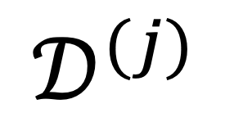
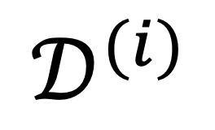
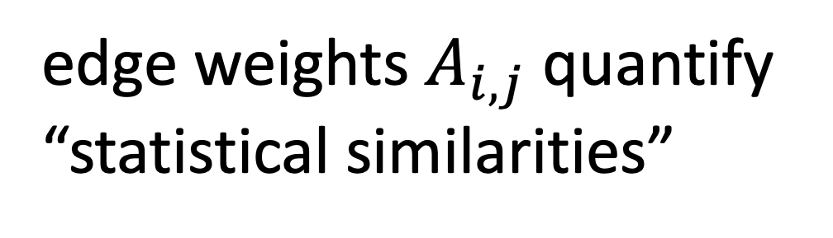
The Empirical Graph
$$𝒟^{(i)}$$
local dataset
edge weights $A_{i,j}$ quantify
“statistical similarities”
$$𝒟^{(j)}$$

Slide 4
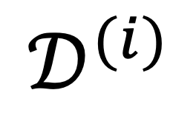
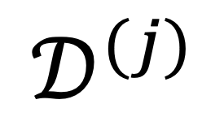
Networked Models.
$$𝒟^{(i)}$$
local model for each node
couple models at connected nodes
“similar"
$$𝒟^{(j)}$$

Slide 5
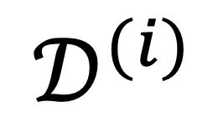
Local Parametric Models
$$𝒟^{(i)}$$
model params
“similar"
Notes:
Starting with a given empirical graph we define a networked model. Each node is equipped with some parametric model with paramters of weights w. These local models could be linear regression models or deep neural nets. Our methods allow to abstract from the details of the local models and only need a loss function that provides a score for a given choice of weights.

Slide 6
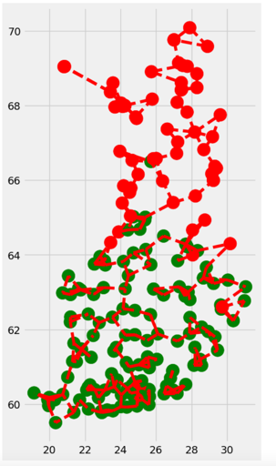
Clustering Assumption
the local datasets form clusters
datasets in same can be approximated as realizations of i.i.d. RVs with prob. dist p(x,y;c)
more edges inside clusters

Slide 7
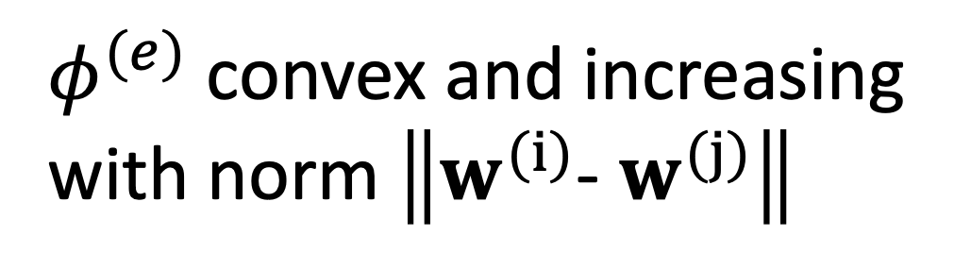
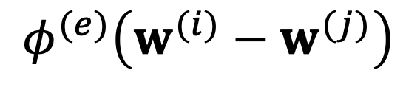
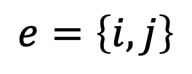
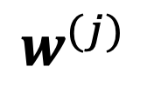
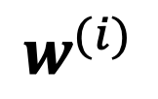
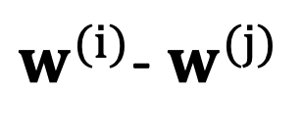
Measure Clustering via Variation
local model params
$$w^{(i)}$$
require similar params at ends of edge e
penalty function measures
“variation”
$$e=\left\{i,j\right\}$$
$$φ^{(e)}\left(w^{(i)}−w^{(j)}\right)$$
$$w^{(j)}$$
$φ^{(e)}$ convex and increasing
with norm $\left\|w^{(i)}\text{− }w^{(j)}\right\|$
$w^{(i)}$- $w^{(j)}$
Notes:
The local loss function encapsulates the local dataset from the perspective of federated learning algorithms. We only need the local dataset to construct a local loss function to score different choices for the parameters.

Slide 8
Generalized Total Variation (GTV)
force model params at well
connected nodes to be similar
by requiring small GTV
1
2

Slide 9
Two Special Cases of GTV
total variation
graph Laplacian quadratic from is GTV with

Slide 10
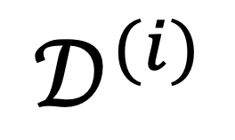

Local Loss Function
model params
$$𝒟^{(i)}$$
measure quality of params by local loss function
$$L^{(i)}\left(w^{(i)}\right)$$

Slide 11
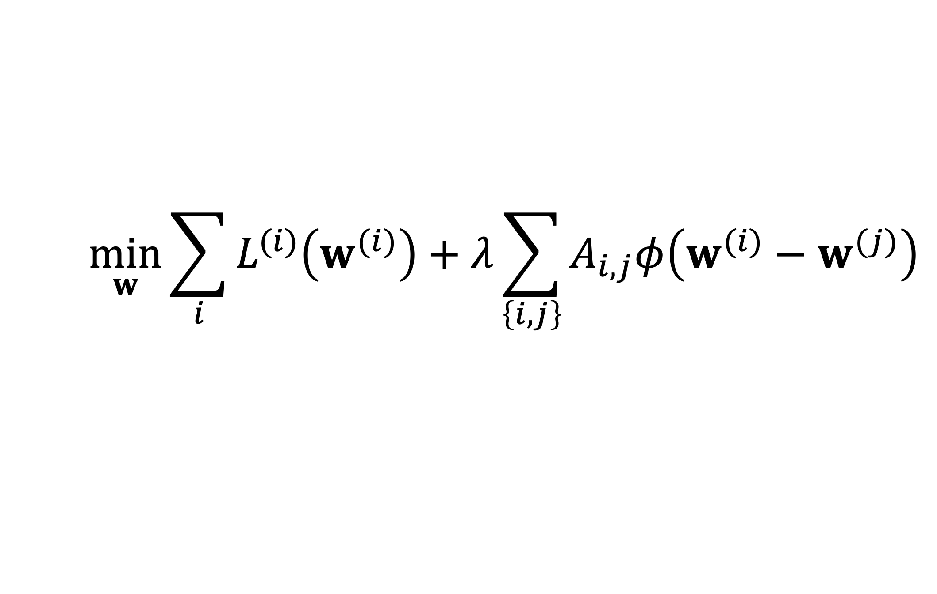
GTV Minimization
$$\min_{w}{\sum_{i}{L^{(i)}\left(w^{(i)}\right)}+λ\sum_{\left\{i,j\right\}}{A_{i,j}φ\left(w^{(i)}−w^{(j)}\right)}}$$
increasing
average local loss
“clusteredness”

Slide 12
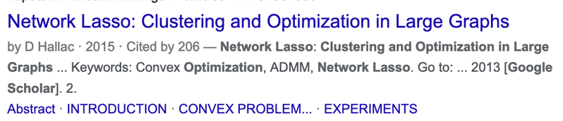
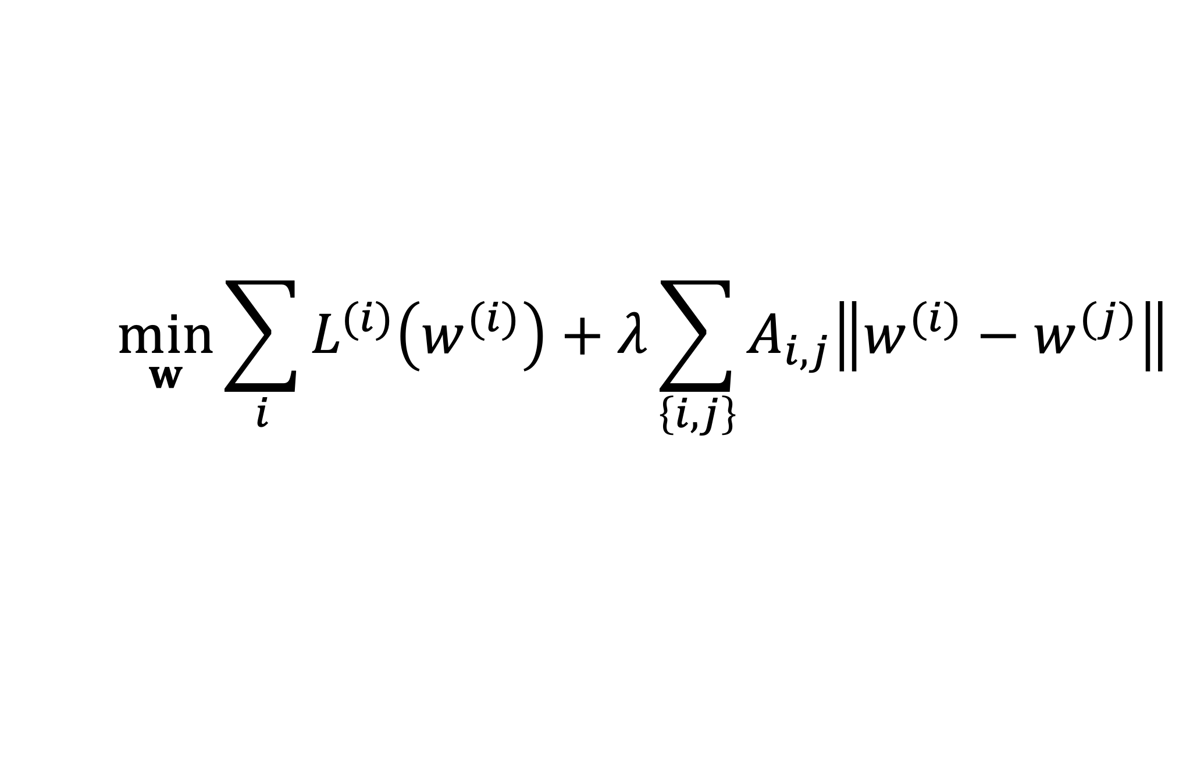
Network Lasso
$$\min_{w}{\sum_{i}{L^{(i)}\left(w^{(i)}\right)}+λ\sum_{\left\{i,j\right\}}{A_{i,j}\left\|w^{(i)}−w^{(j)}\right\|}}$$

Slide 13
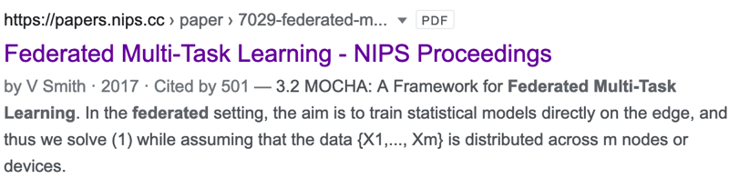
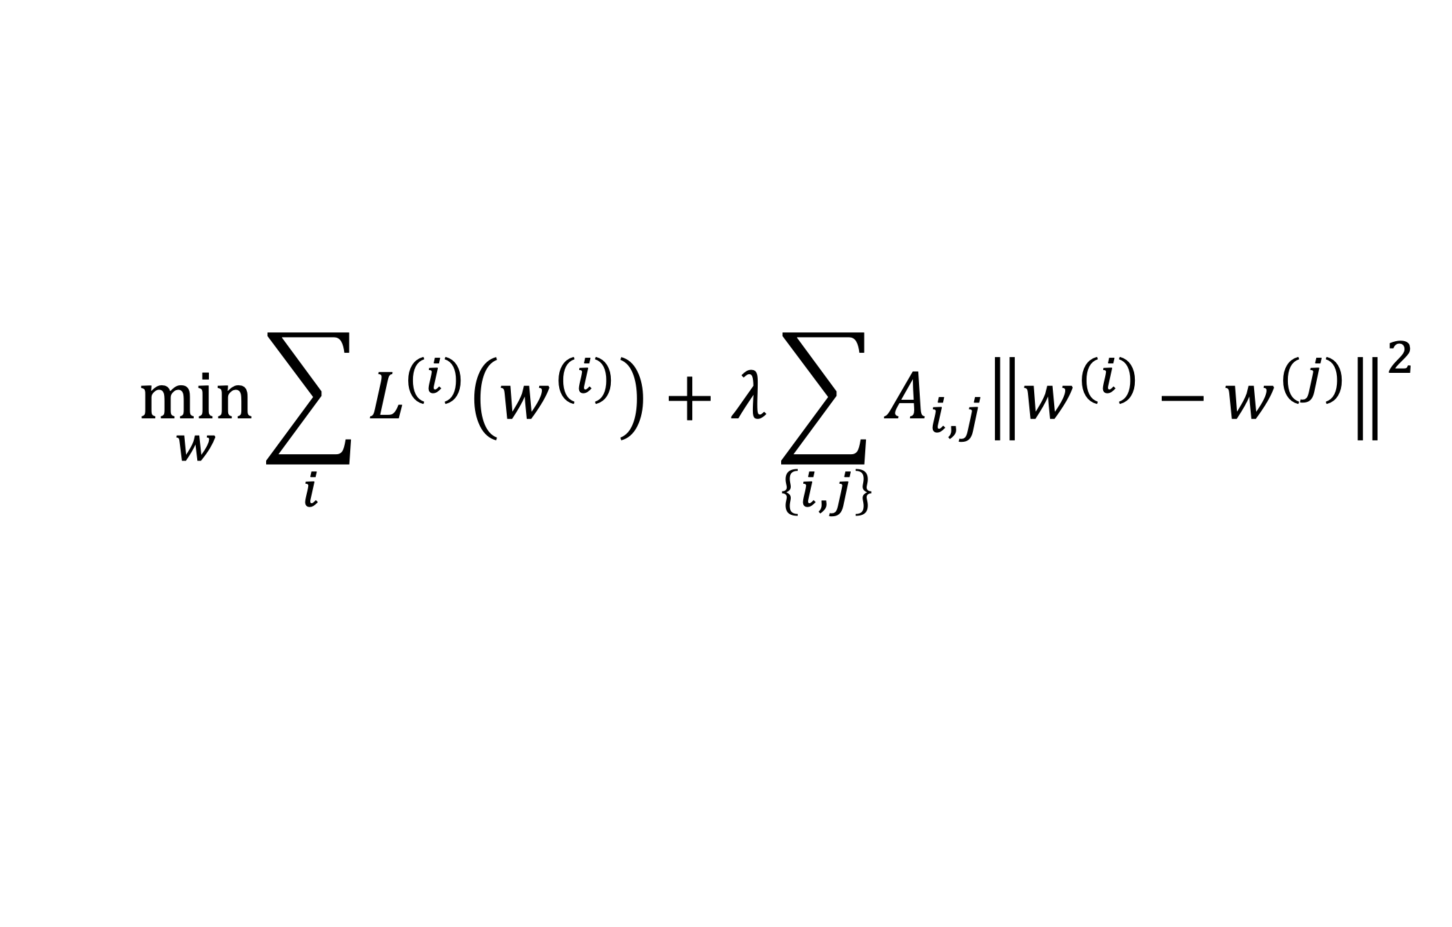
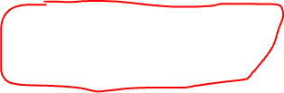
Special Case: “MOCHA”
$$\min_{w}{\sum_{i}{L^{(i)}\left(w^{(i)}\right)}+λ}\sum_{\left\{i,j\right\}}{A_{i,j}{\left\|w^{(i)}−w^{(j)}\right\|}^{2}}$$

Slide 14
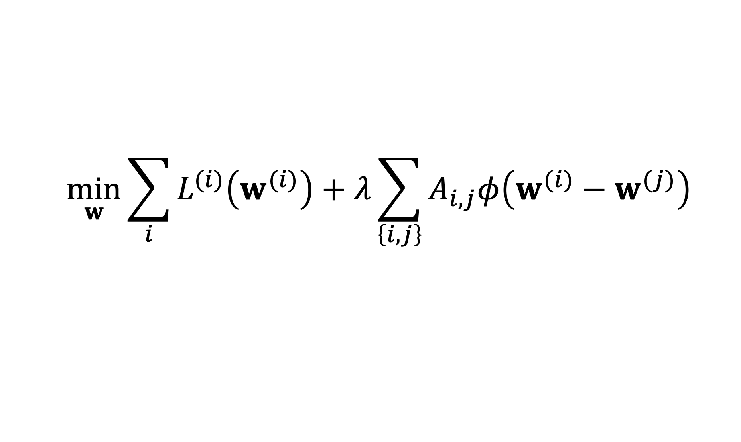
Two Key Questions of ML
$$\min_{w}{\sum_{i}{L^{(i)}\left(w^{(i)}\right)}+λ\sum_{\left\{i,j\right\}}{A_{i,j}φ\left(w^{(i)}−w^{(j)}\right)}}$$
computational aspects: how to compute (approximate) solutions efficiently ?
statistical aspects: are the solutions any good?

Slide 15
Computational Aspects

Slide 16





A FL Setting

Slide 17
Requirements
run in ad-hoc nets of low-cost devices
robustness against node/link failures
robustness against “stragglers”

Slide 18
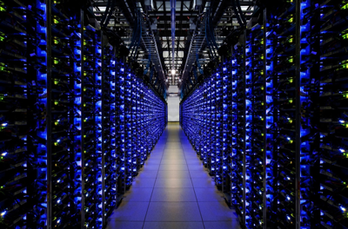
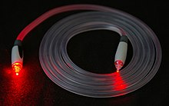
Another FL Setting…
https://www.google.com/about/datacenters/
https://en.wikipedia.org/wiki/Optical_fiber

Slide 19
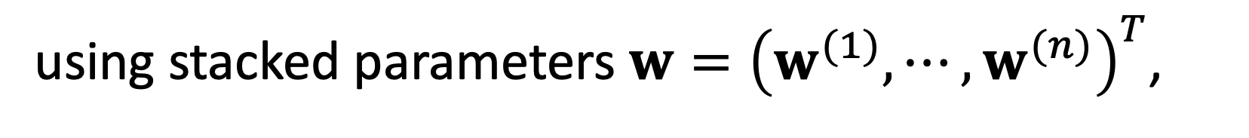
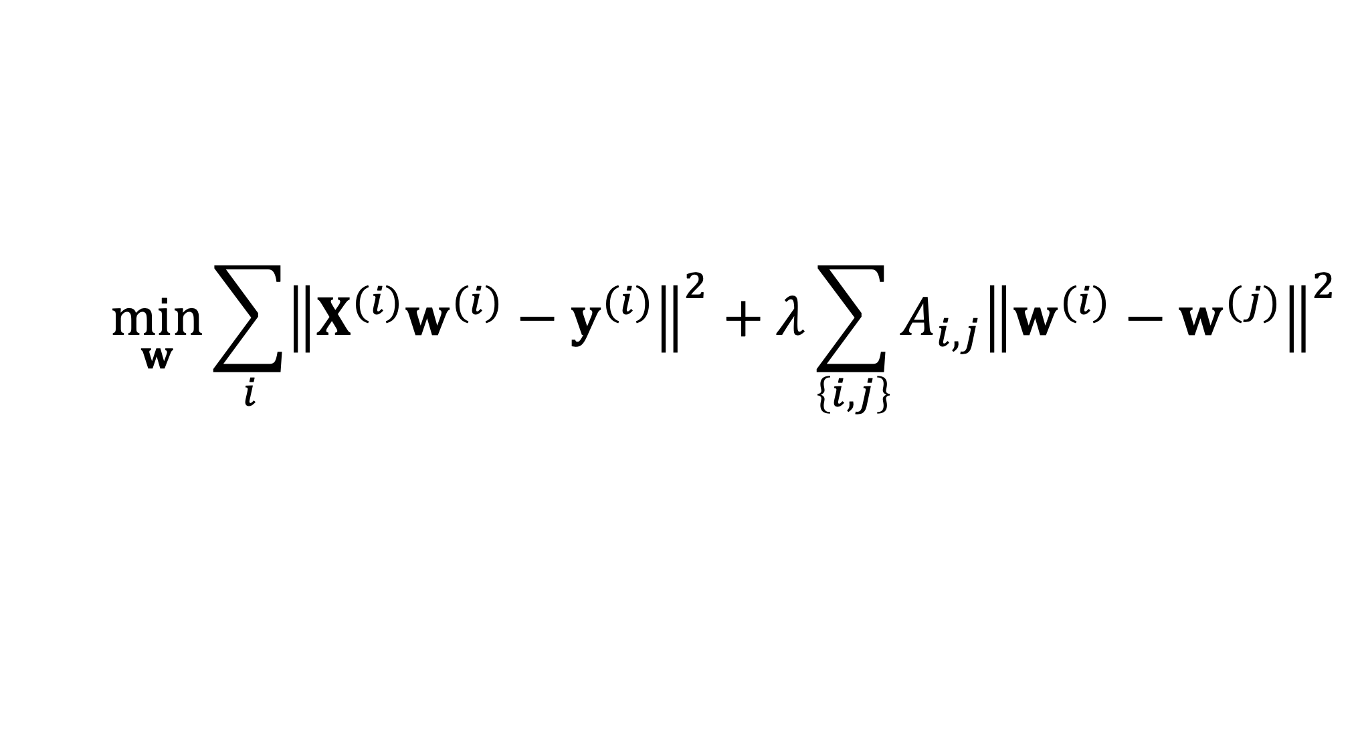
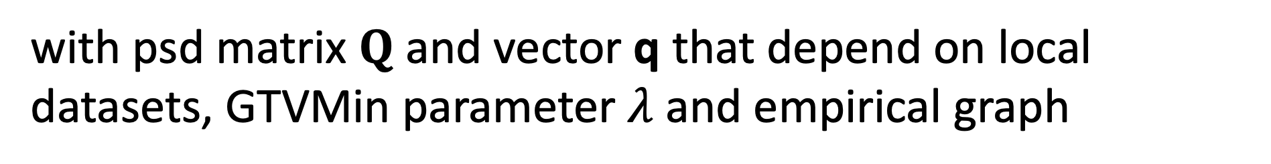
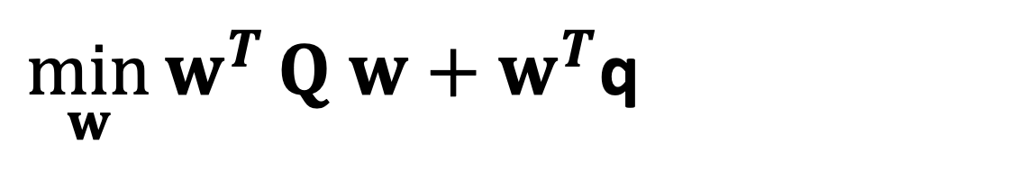
GTV Min. for Local Lin.Reg.
$$\min_{w}{\sum_{i}{{\left\|X^{(i)}w^{(i)}−y^{(i)}\right\|}^{2}}+λ\sum_{\left\{i,j\right\}}{A_{i,j}{\left\|w^{(i)}−w^{(j)}\right\|}^{2}}}$$
using stacked parameters $w={\left(w^{(1)},⋯,w^{(n)}\right)}^{T}$,
$\min_{w}{w^{T}}Q w+w^{T}$q
with psd matrix $Q$ and vector q that depend on local datasets, GTVMin parameter $λ$and empirical graph

Slide 20
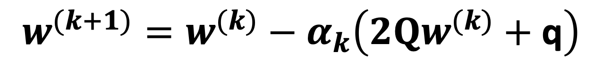

GTV Min. for Local Lin.Reg.
$$\min_{w}{w^{T}}Q w+w^{T}\text{q}$$
can be solved using gradient methods
$$w^{(k+1)}=w^{(k)}−α_{k}\left(2Qw^{(k)}+\text{q}\right)$$

Slide 21
Statistical
Aspects

Slide 22
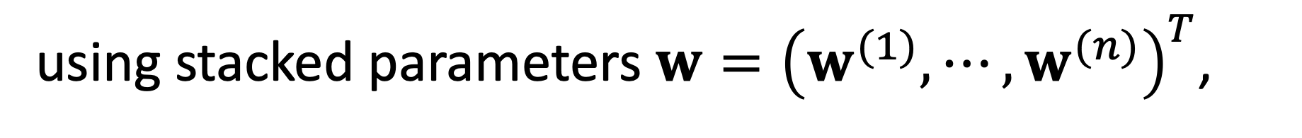
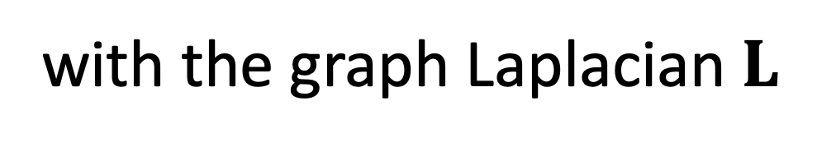
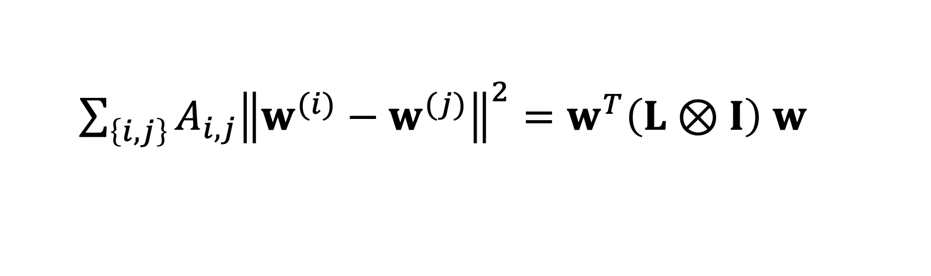
GTV Min. for Local Lin.Reg.
$$\min_{w}{\sum_{i}{{\left\|X^{(i)}w^{(i)}−y^{(i)}\right\|}^{2}}+λ\sum_{\left\{i,j\right\}}{A_{i,j}{\left\|w^{(i)}−w^{(j)}\right\|}^{2}}}$$
using stacked parameters $w={\left(w^{(1)},⋯,w^{(n)}\right)}^{T}$,
$\sum_{\left\{i,j\right\}}{A_{i,j}{\left\|w^{(i)}−w^{(j)}\right\|}^{2}}=w^{T}\left(L⊗I\right)$ $w$
with the graph Laplacian $L$

Slide 23
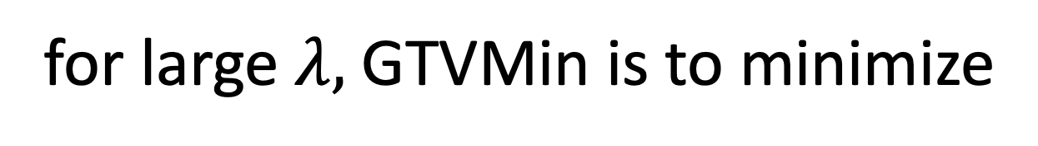
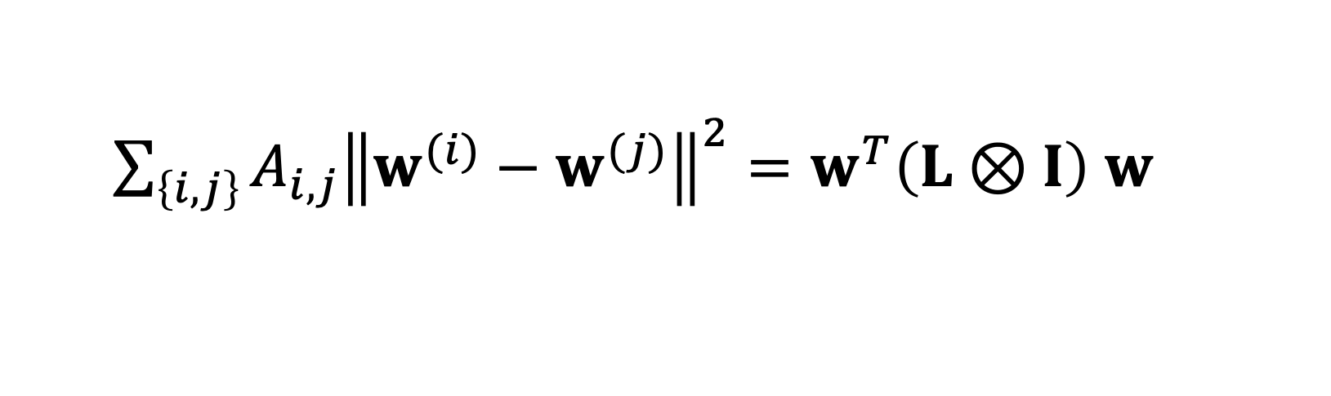
Spectral Clustering
for large $λ,$GTVMin is to minimize
$\sum_{\left\{i,j\right\}}{A_{i,j}{\left\|w^{(i)}−w^{(j)}\right\|}^{2}}=w^{T}\left(L⊗I\right)$ $w$
local model parameters composed of
eigvecs. of L corresponding to smallest eig.vals

Slide 24
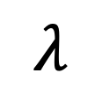
Clustering of GTVMin Solutions
0
$$λ$$
personalized
clustered
global

Slide 25
Interpretations

Slide 26



Multi-Task Learning
each local dataset/model is separate learning task
Notes:
We then aim at learning separate weights for each local dataset. This is a multi-task learning problem with each local data being a separate learning task. To have any chance at solving this multi-task learning problem we exploit similarities' between the individual tasks that is tied to the network structure.

Slide 27

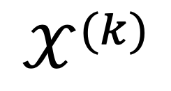
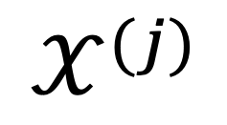
Locally Weighted Learning
$$𝒳^{(j)}$$
pool local datasets of nodes
in the same cluster
$$𝒳^{(i)}$$
$$𝒳^{(k)}$$
William S. Cleveland, Susan J. Devlin, Eric Grosse,
“Regression by local fitting: Methods, properties, and computational algorithms,”
Journal of Econometrics, Volume 37, Issue 1, 1988.

Slide 28
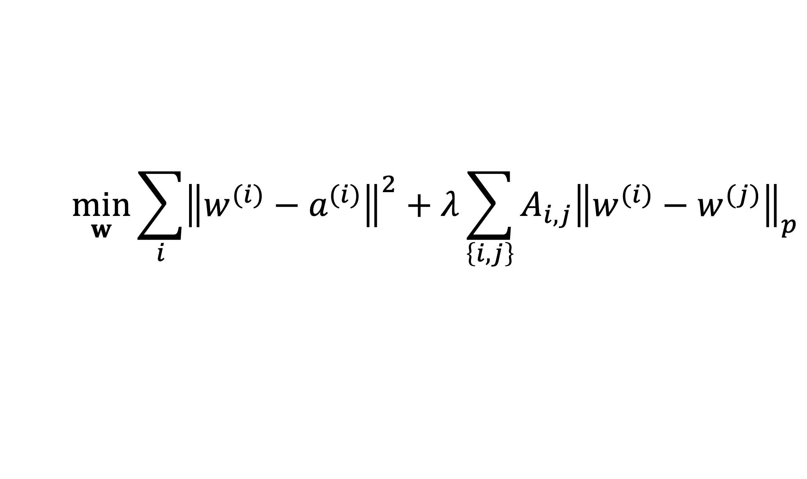
Generalized Convex Clustering
$$\min_{w}{\sum_{i}{{\left\|w^{(i)}−a^{(i)}\right\|}^{2}}+λ\sum_{\left\{i,j\right\}}{A_{i,j}{\left\|w^{(i)}−w^{(j)}\right\|}_{p}}}$$
D. Sun, K.-C. Toh, Y. Yuan;
Convex Clustering: Model, Theoretical Guarantee and Efficient Algorithm, JMLR, 22(9):1−32, 2021
Notes:
We then aim at learning separate weights for each local dataset. This is a multi-task learning problem with each local data being a separate learning task. To have any chance at solving this multi-task learning problem we exploit similarities' between the individual tasks that is tied to the network structure.

Slide 29
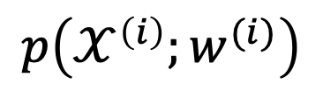
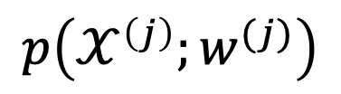
(Probabilistic) Graphical Model
separate prob. space for each local dataset
traditionally, PGMs use a common
prob. space for all local datasets
$$p\left(𝒳^{\left(i\right)};w^{(i)}\right)$$
$$p\left(𝒳^{\left(j\right)};w^{(j)}\right)$$
AJ, "Networked Exponential Families for Big Data Over Networks," in IEEE Access, vol. 8, pp. 202897-202909, 2020, doi: 10.1109/ACCESS.2020.3033817.
Notes:
We then aim at learning separate weights for each local dataset. This is a multi-task learning problem with each local data being a separate learning task. To have any chance at solving this multi-task learning problem we exploit similarities' between the individual tasks that is tied to the network structure.

Slide 30
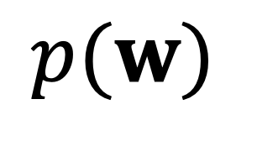
Approx. Hierarch. Bayes’ Model
i.i.d. draw
$$p(w)$$
i.i.d. draw
Lyu, B., Hanzely, F., and Kolar, M., “Personalized Federated Learning with Multiple Known Clusters”, arXiv e-prints, 2022. doi:10.48550/arXiv.2204.13619.

Slide 31
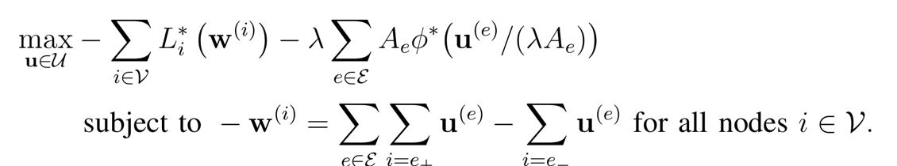

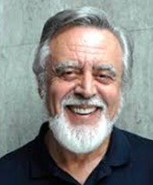


Non-Linear Min-Cost-Flow
augmented “collector node”

Slide 32
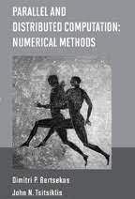
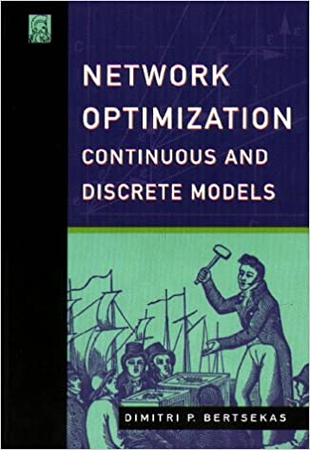
Non-Linear Min-Cost-Flow

Slide 33
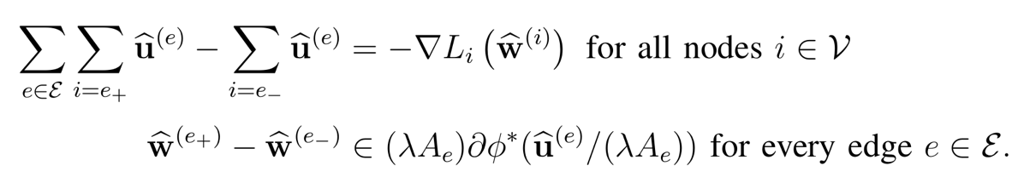
Electrical Network. (“AI is new Electricity!”)
Kirchhoff’s Current Law
Generalized Ohm Law

Slide 34
GTVMin
for
Non-Param. Models
Notes:
The local loss function encapsulates the local dataset from the perspective of federated learning algorithms. We only need the local dataset to construct a local loss function to score different choices for the parameters.

Slide 35
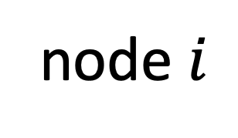
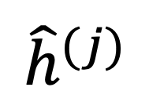
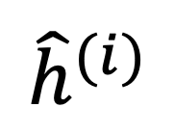
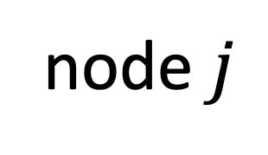
Variation of Non-Param. Models
node $i$
node $j$
$${\hat{h}}^{(j)}$$
$${\hat{h}}^{(i)}$$
test set that is
shared by node i and j

Slide 36
Wrap Up.
couple local model training via regularization
regularizer obtained via GTV (over empirical graph)
FL algorithms = optimization methods for GTV min
GTVmin pools local datasets into clusters
cluster structure depends on emp.graph and local data!

Slide 37
Thank you for
your attention!

