Slide 1
Model Validation and Selection
Alexander Jung
Assoc. Professor for Machine Learning
Department of Computer Science
Aalto University

Slide 2

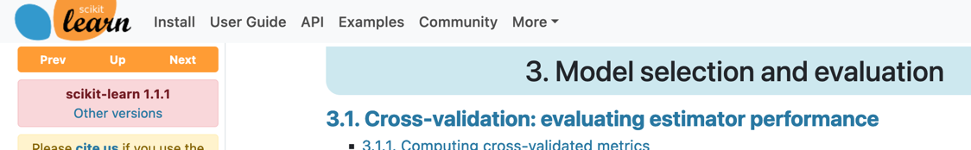
Reading.
Ch. 6 of https://mlbook.cs.aalto.fi
https://scikit-learn.org/stable/model_selection.html

Slide 3
”Model”
=
Hypothesis Space

Slide 4
Learning Goals
- know train err is bad quality measure for ML method
- val.err. is more useful as quality measure for a ML model
- basic idea of k-fold CV
hyper-parameter tuning = model selection
Python implementations of k-fold CV / gridsearch

Slide 5
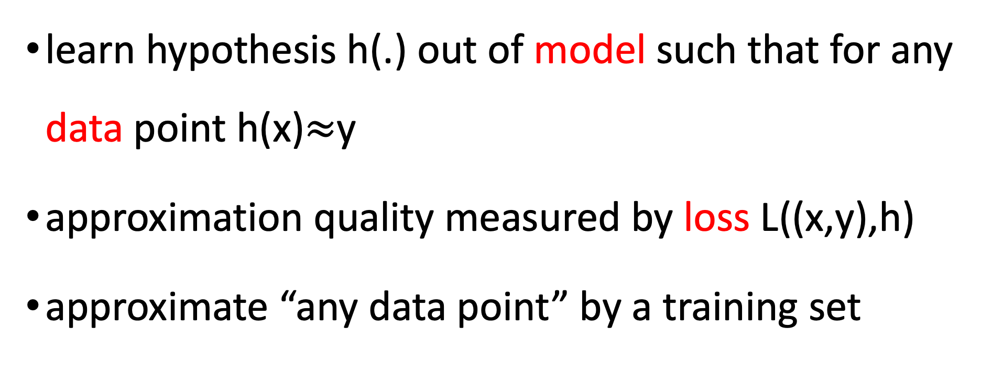
ML – In a Nutshell
learn hypothesis h(.) out of model such that for any data point h(x)$≈$y
approximation quality measured by loss L((x,y),h)
approximate “any data point” by a training set

Slide 6
Model Validation
How do we know a model
is any good ?

Slide 7
Model Selection
How to choose between different
alternative models?

Slide 8
Model 1: Linear Predictors (Degree 1 Polyn.)
label y
feature x

Slide 9
Model 2: Degree 3 Polyn. Predictors
label y
feature x

Slide 10
Nested Model s – I
Model 2: degree 3 polyn.
Model 1: linear predictors

Slide 11
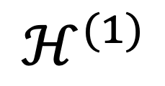
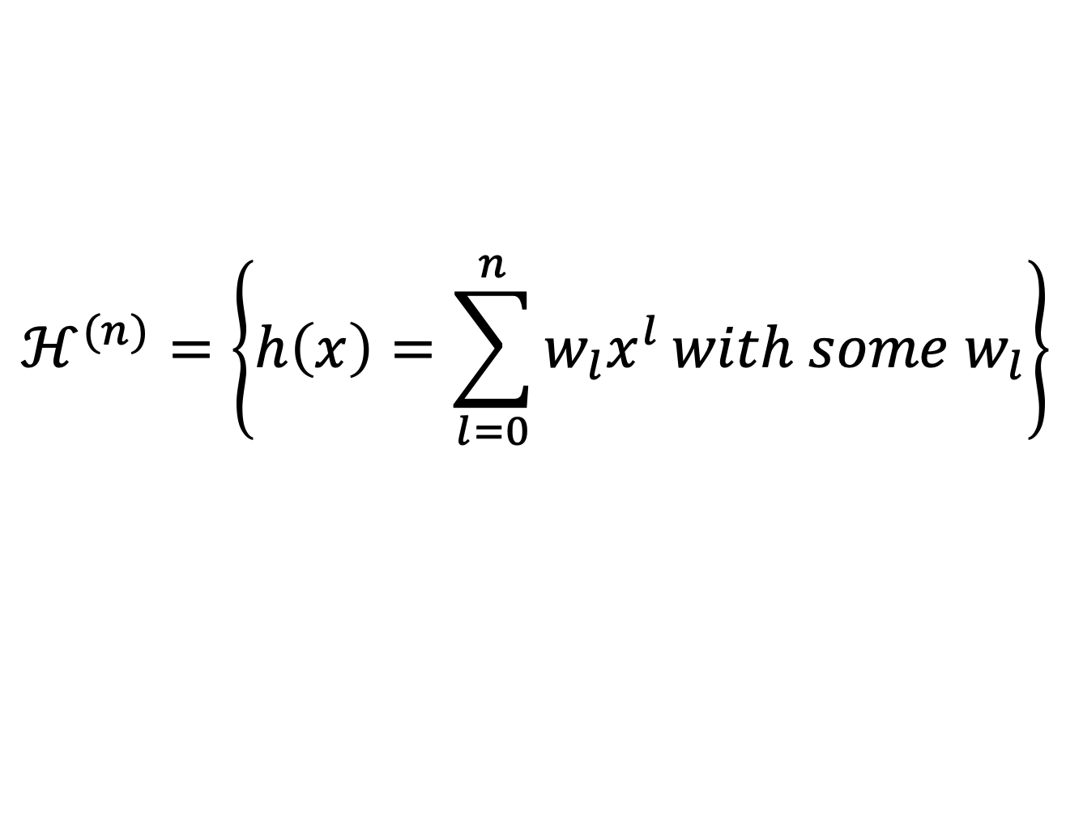
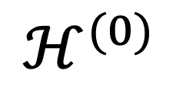
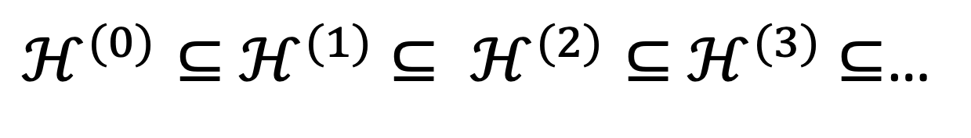
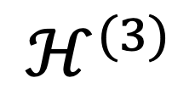
Math Notation
$$ℋ^{(n)}=\left\{h\left(x\right)=\sum_{l=0}^{n}{w_{l}x^{l}}with some w_{l}\right\}$$
$$ℋ^{(0)}$$
… constant prediction (ignores feature)
$$ℋ^{(1)}$$
… linear hypotheses
$$ℋ^{(3)}$$
… degree 3 polyn.
$ℋ^{(0)}⊆$ $ℋ^{(1)}$ $⊆ ℋ^{(2)}⊆$ $ℋ^{(3)}$ $⊆$…

Slide 12
Nested Model s - II
ANN, 2 hidden layers
ANN, 1 hidden layer

Slide 13
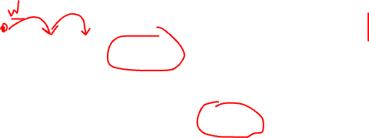
Nested Model s - III
3 GD steps
2 GD steps
effective hyp. space @ 1 GD step

Slide 14
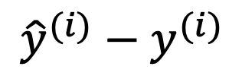

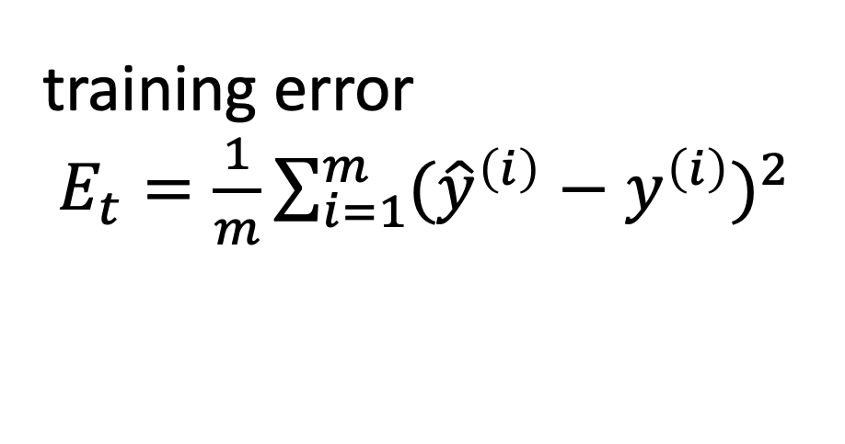
Learn Linear Predictor
$${\hat{y}}^{(i)}−y^{(i)}$$
$$x^{(i)},y^{(i)}$$
label y
training error
$E_{t}=\frac{1}{m}\sum_{i=1}^{m}{({\hat{y}}^{\left(i\right)}−y^{\left(i\right)})^{2}}$
feature x

Slide 15
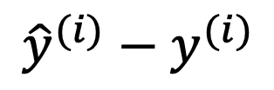


Learn Degree 3 Polyn.
$${\hat{y}}^{(i)}−y^{(i)}$$
$$x^{(i)},y^{(i)}$$
label y
training error
$E_{t}=\frac{1}{m}\sum_{i=1}^{m}{({\hat{y}}^{\left(i\right)}−y^{\left(i\right)})^{2}}$
feature x

Slide 16
Training Errors
model 1
linear predictors
model 2:
degree 3 polyn.

Slide 17
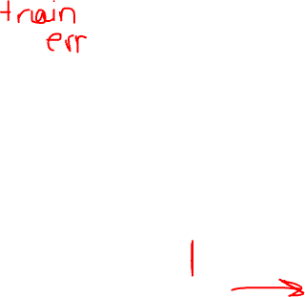
Train Error vs. Degree
average loss on train set obtained for optimal poly. coeffs.
polyn. degree d
Notes:
each curve represents a degree 3 polynomial that has been trained on a randomly chosen subset of data points (70 percent). Each random selection of training data points results in a different learnt polynomial hypothesis. These different hypotheses result in different predictions for the same feature value

Slide 18
Train Error vs. ANN Layers
average loss on train set obtained for optimal network weights
# hidden layers
Notes:
each curve represents a degree 3 polynomial that has been trained on a randomly chosen subset of data points (70 percent). Each random selection of training data points results in a different learnt polynomial hypothesis. These different hypotheses result in different predictions for the same feature value

Slide 19
Train Error vs. Gradient Steps
average loss on train set
# gradient steps
Notes:
each curve represents a degree 3 polynomial that has been trained on a randomly chosen subset of data points (70 percent). Each random selection of training data points results in a different learnt polynomial hypothesis. These different hypotheses result in different predictions for the same feature value

Slide 20
Overfitting
$${\hat{y}}^{(i)}−y^{(i)}$$
$$x^{(i)},y^{(i)}$$
label y
training error
$E_{t}=\frac{1}{m}\sum_{i=1}^{m}{({\hat{y}}^{\left(i\right)}−y^{\left(i\right)})^{2}}$
“new” datapoint
feature x

Slide 21
small training error does not imply good performance on new data points!

Slide 22
small training error merely indicates that training algorithm has been implemented correctly

Slide 23
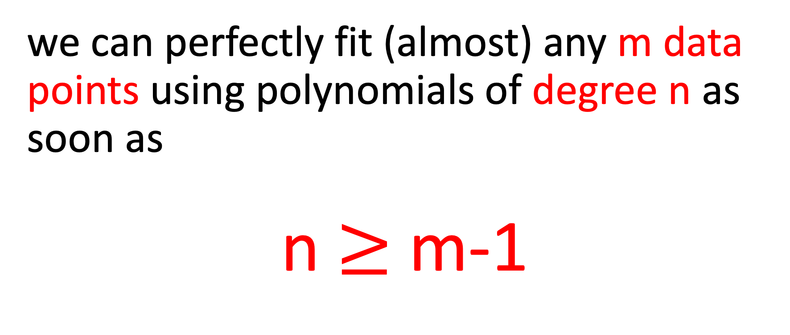
A Case in Point
we can perfectly fit (almost) any m data points using polynomials of degree n as soon as
n $≥$ m-1

Slide 24

m=2, n=1
y
x

Slide 25

m=3, n=2
y
x

Slide 26
Reminder: Probabilistic Model
data points are realizations of RVs
joint pdf p(x,y) of features and label
training set is a RV
learnt hypothesis h(.) is a RV
prediction h(x) is a RV
Notes:
each curve represents a degree 3 polynomial that has been trained on a randomly chosen subset of data points (70 percent). Each random selection of training data points results in a different learnt polynomial hypothesis. These different hypotheses result in different predictions for the same feature value

Slide 27
Why Can Train. Err. Mislead?
consider expected loss of hypothesis
estimate expectation using sample average
this only works if hypothesis does not depends on data points used in average
does not hold for training error

Slide 28
Model Validation

Slide 29
Basic Idea of Validation
divide data points into two subsets
use training set to learn predictor
use validation set to estimate loss

Slide 30
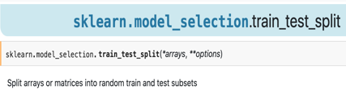
Split into Training and Validation Set
training set
label y
validation set
feature x

Slide 31
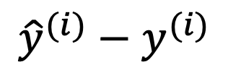
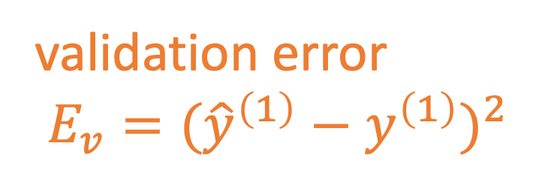
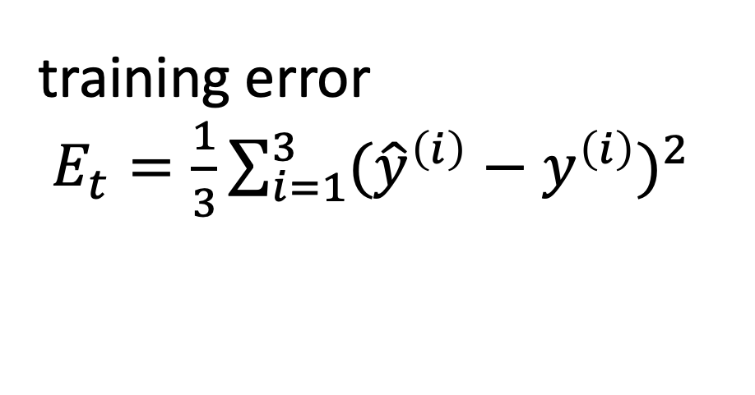
Train and Validate Model 1
$${\hat{y}}^{(i)}−y^{(i)}$$
$$x^{(i)},y^{(i)}$$
label y
training error
$E_{t}=\frac{1}{3}\sum_{i=1}^{3}{({\hat{y}}^{\left(i\right)}−y^{\left(i\right)})^{2}}$
validation error
$E_{v}=({\hat{y}}^{\left(1\right)}−y^{\left(1\right)})^{2}$
feature x

Slide 32
Train and Validate Model 2
$$x^{(i)},y^{(i)}$$
label y
training error
$E_{t}=\frac{1}{3}\sum_{i=1}^{3}{({\hat{y}}^{\left(i\right)}−y^{\left(i\right)})^{2}}$
validation error
$E_{v}=({\hat{y}}^{\left(1\right)}−y^{\left(1\right)})^{2}$
feature x

Slide 33
Basic Idea of Model Selection
choose model via validation error
training validation
error error
model 1: linear maps
model 2: degree 3 polyn.

Slide 34
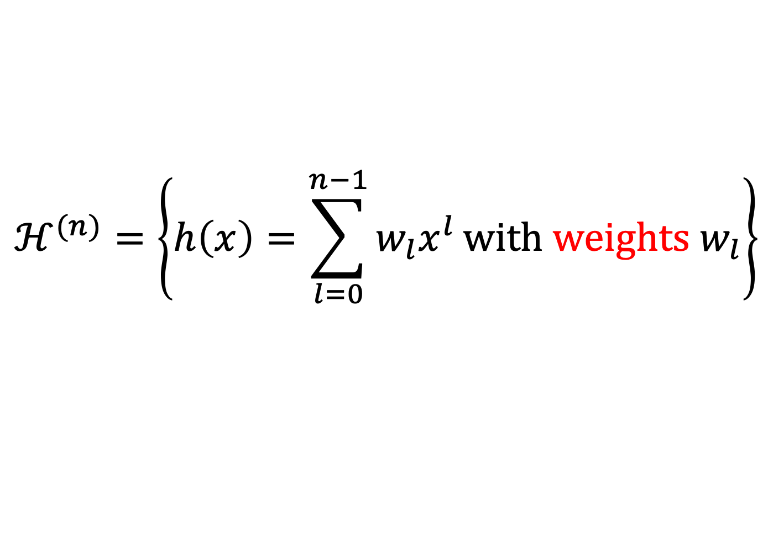
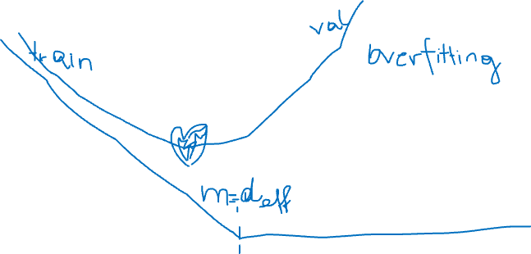
Train/Val Error vs Model Complexity
$$ℋ^{(n)}=\left\{h\left(x\right)=\sum_{l=0}^{n−1}{w_{l}x^{l}}with weights w_{l}\right\}$$
model dimension/complexity n

Slide 35
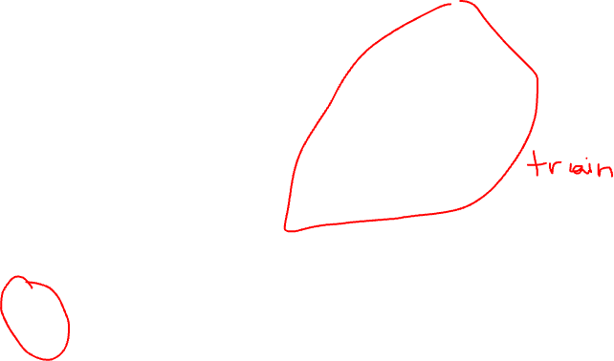
Unlucky Train/Val Split
label y
feature x

Slide 36
k-Fold Cross Validation
might be unlucky with train/val split
problematic for small datasets
IDEA: randomly split several times
“average out” unlucky splits

Slide 37
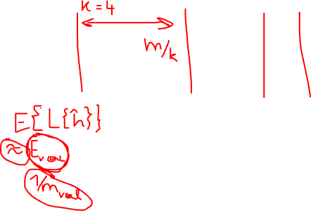
K-Fold Cross Validation
fold 1
fold 2
fold 3

Slide 38
k-Fold Cross Validation
how to choose nr of folds (the “k” in k-fold CV) ?
train fold should be sufficiently large (avoid overfitting)
val folds should sufficiently large (to get reliable estimate of generalization)

Slide 39
CAUTION!
k-fold CV requires a method to split into folds
most basic method: evenly divide into k folds
works if data is i.i.d. (“order of data points is arbitrary”)
fails if data points are grouped or ordered

Slide 40
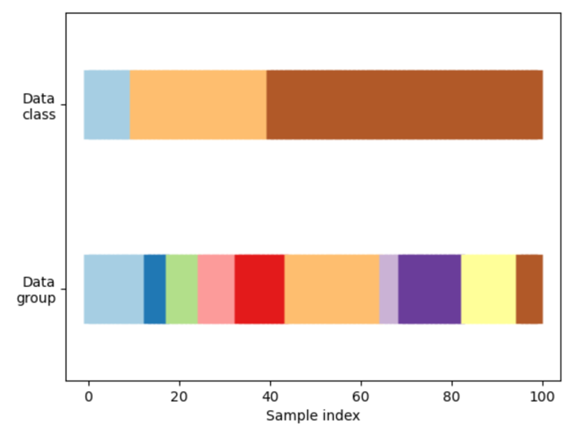
Imbalanced Classes and Group Structure
e.g. data points with same label are contiguous blocks
or data points are obtained at consecutive time instants (→ correlations)

Slide 41
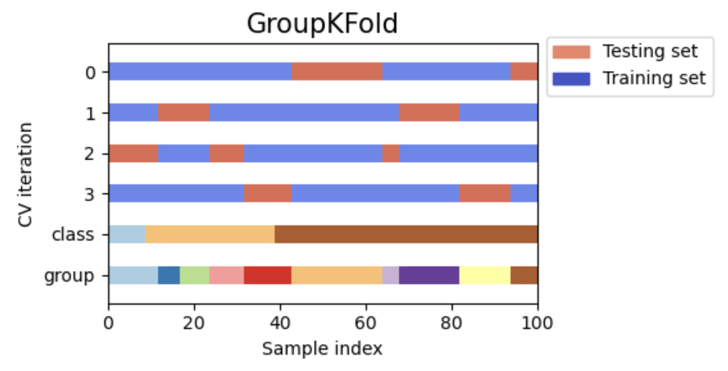
Group-Preserving Splitting
https://scikit-learn.org/stable/modules/generated/sklearn.model_selection.GroupKFold.html

Slide 42
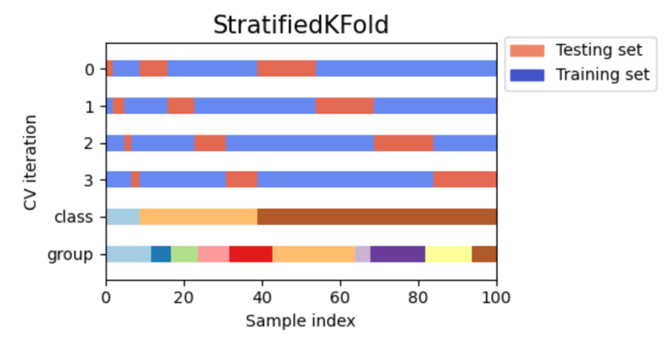
Class-Ratio Preserving Splitting

Slide 43
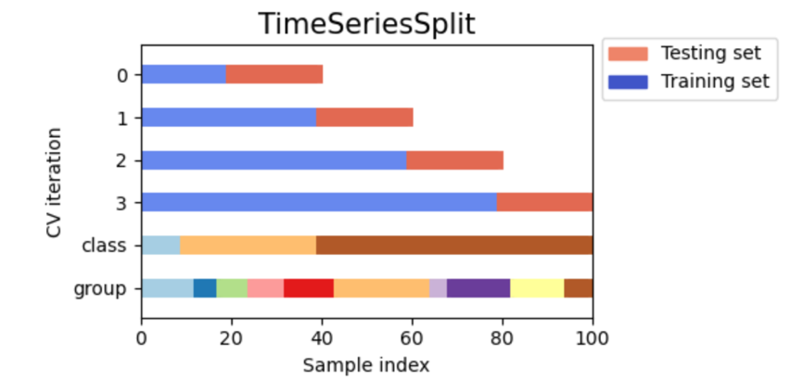
Temporal Successive Splitting
source: https://scikit-learn.org/stable/

Slide 44
Bias and Variance
Decomposition

Slide 45
“Bias” reflects error due to model being too small

Slide 46
“Variance” reflects error due to dataset being too small

Slide 47
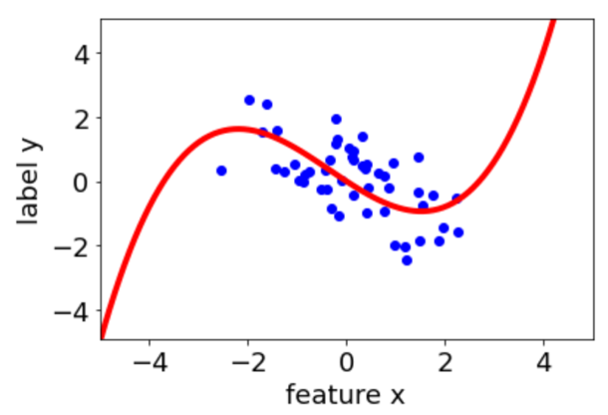
Toy Data
y = g(x) + ”noise”
learn hypothesis h(.) using a
randomly selected training set
compute prediction h(x’) for a fixed
feature value x’
x’

Slide 48
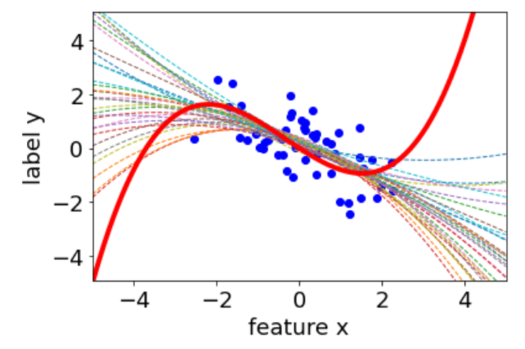
Ensemble of Learnt Hypotheses
hypothesis learn on train set #1
hypothesis learn on train set #2
x’
Notes:
each curve represents a degree 3 polynomial that has been trained on a randomly chosen subset of data points (70 percent). Each random selection of training data points results in a different learnt polynomial hypothesis. These different hypotheses result in different predictions for the same feature value

Slide 49
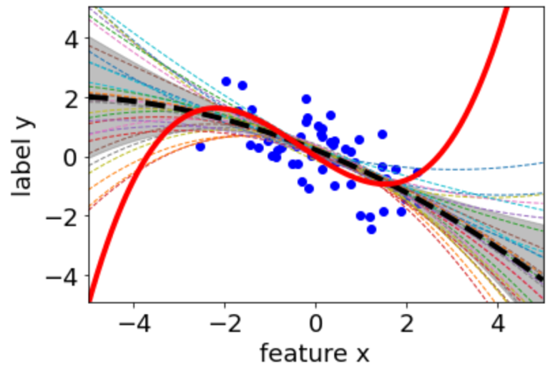
Bias and Variance
bias
RV since obtained
from a randomly
selected training set
variance
Notes:
each curve represents a degree 3 polynomial that has been trained on a randomly chosen subset of data points (70 percent). Each random selection of training data points results in a different learnt polynomial hypothesis. These different hypotheses result in different predictions for the same feature value

Slide 50
Bias and Variance Tradeoff
“Prediction Error = Bias + Variance"
variance
bias
bias reduction typically incurs variance increase and vice versa
Notes:
each curve represents a degree 3 polynomial that has been trained on a randomly chosen subset of data points (70 percent). Each random selection of training data points results in a different learnt polynomial hypothesis. These different hypotheses result in different predictions for the same feature value

Slide 51
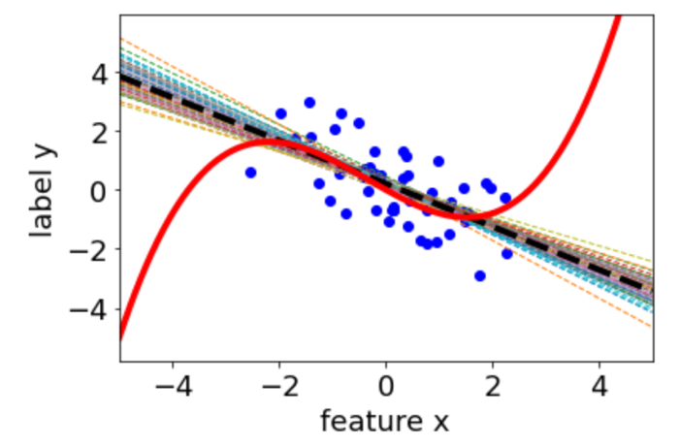
Smaller Model (Poly.Degree)
small variance
large bias
Notes:
each curve represents a degree 3 polynomial that has been trained on a randomly chosen subset of data points (70 percent). Each random selection of training data points results in a different learnt polynomial hypothesis. These different hypotheses result in different predictions for the same feature value

Slide 52
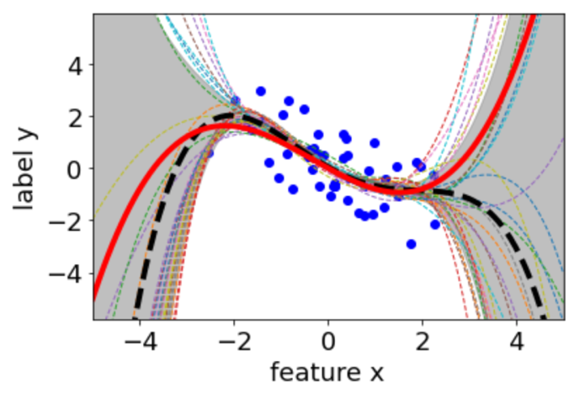
Larger Model (Poly. Degree)
large variance
small bias
Notes:
each curve represents a degree 3 polynomial that has been trained on a randomly chosen subset of data points (70 percent). Each random selection of training data points results in a different learnt polynomial hypothesis. These different hypotheses result in different predictions for the same feature value

Slide 53

Bias vs. Variance Lin.Reg.
average loss
variance
bias
nr. of relevant
features
Notes:
each curve represents a degree 3 polynomial that has been trained on a randomly chosen subset of data points (70 percent). Each random selection of training data points results in a different learnt polynomial hypothesis. These different hypotheses result in different predictions for the same feature value

Slide 54
Bias vs. Variance Poly.Reg.
average loss
variance
bias
degree d
Notes:
each curve represents a degree 3 polynomial that has been trained on a randomly chosen subset of data points (70 percent). Each random selection of training data points results in a different learnt polynomial hypothesis. These different hypotheses result in different predictions for the same feature value

Slide 55
Bias vs. Variance Dec. Tree.
average loss
variance
bias
tree depth
Notes:
each curve represents a degree 3 polynomial that has been trained on a randomly chosen subset of data points (70 percent). Each random selection of training data points results in a different learnt polynomial hypothesis. These different hypotheses result in different predictions for the same feature value

Slide 56
Bias vs. Variance Deep Learning
average loss
variance
bias
nr of layers
Notes:
each curve represents a degree 3 polynomial that has been trained on a randomly chosen subset of data points (70 percent). Each random selection of training data points results in a different learnt polynomial hypothesis. These different hypotheses result in different predictions for the same feature value

Slide 57
Bias vs. Variance Grad. Desc.
average loss
variance
bias
GD steps
Notes:
each curve represents a degree 3 polynomial that has been trained on a randomly chosen subset of data points (70 percent). Each random selection of training data points results in a different learnt polynomial hypothesis. These different hypotheses result in different predictions for the same feature value

Slide 58
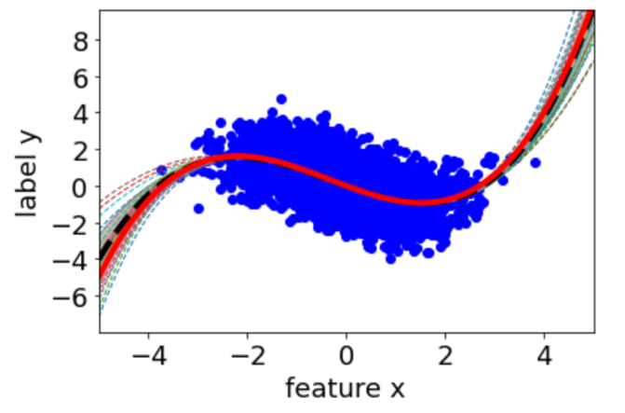
More Data
-> smaller variance
Notes:
each curve represents a degree 3 polynomial that has been trained on a randomly chosen subset of data points (70 percent). Each random selection of training data points results in a different learnt polynomial hypothesis. These different hypotheses result in different predictions for the same feature value

Slide 59
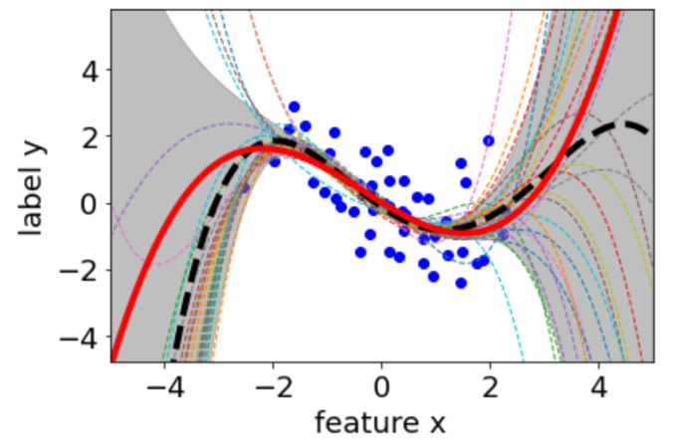
Less Data
-> larger variance
Notes:
each curve represents a degree 3 polynomial that has been trained on a randomly chosen subset of data points (70 percent). Each random selection of training data points results in a different learnt polynomial hypothesis. These different hypotheses result in different predictions for the same feature value

Slide 60
Learning Curve
variance
nr. data points
Notes:
each curve represents a degree 3 polynomial that has been trained on a randomly chosen subset of data points (70 percent). Each random selection of training data points results in a different learnt polynomial hypothesis. These different hypotheses result in different predictions for the same feature value

Slide 61
Alex’ Rule of Thumb
effective number of training data points
>
10 * nr. tunable effective model parameters
stretch the term “effective” as much as possible !
Notes:
each curve represents a degree 3 polynomial that has been trained on a randomly chosen subset of data points (70 percent). Each random selection of training data points results in a different learnt polynomial hypothesis. These different hypotheses result in different predictions for the same feature value

Slide 62
ML Diagnosis
Notes:
each curve represents a degree 3 polynomial that has been trained on a randomly chosen subset of data points (70 percent). Each random selection of training data points results in a different learnt polynomial hypothesis. These different hypotheses result in different predictions for the same feature value

Slide 63
Simple Recipe
consider ML method with some hypothesis space
learn hypothesis by min. average loss on train.set
training error = average loss of learnt hypothesis
compute validation error
compare val err, train err with a baseline
Notes:
each curve represents a degree 3 polynomial that has been trained on a randomly chosen subset of data points (70 percent). Each random selection of training data points results in a different learnt polynomial hypothesis. These different hypotheses result in different predictions for the same feature value

Slide 64
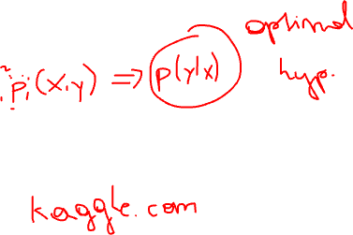
Benchmark/Baseline
could be obtained from
probabilistic models
domain expertise
existing ML methods
human performance
…
Notes:
each curve represents a degree 3 polynomial that has been trained on a randomly chosen subset of data points (70 percent). Each random selection of training data points results in a different learnt polynomial hypothesis. These different hypotheses result in different predictions for the same feature value

Slide 65
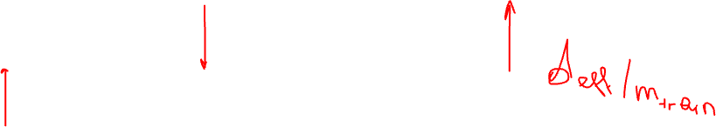
small train error -> hypothesis space is large
large val err -> overfitting
Workaround ?
training validation
error error
benchmark
Notes:
each curve represents a degree 3 polynomial that has been trained on a randomly chosen subset of data points (70 percent). Each random selection of training data points results in a different learnt polynomial hypothesis. These different hypotheses result in different predictions for the same feature value

Slide 66
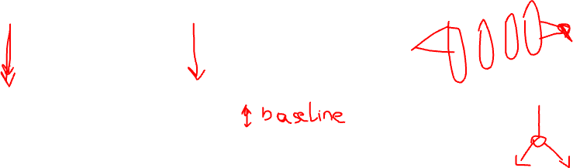
large train error -> no good hypothesis found
Workaround ?
training validation
error error
Notes:
each curve represents a degree 3 polynomial that has been trained on a randomly chosen subset of data points (70 percent). Each random selection of training data points results in a different learnt polynomial hypothesis. These different hypotheses result in different predictions for the same feature value

Slide 67

training validation
error error
Case Solved !
Notes:
each curve represents a degree 3 polynomial that has been trained on a randomly chosen subset of data points (70 percent). Each random selection of training data points results in a different learnt polynomial hypothesis. These different hypotheses result in different predictions for the same feature value

Slide 68
Take Home Messages
large models (e.g. deep nets) often overfit
small training error does not mean much!
diagnosis by comparing train/val err
bias/variance analysis can guide model improvement

Slide 69
Thank You !

