Slide 1

Regularization
Chapter 7 of
Alexander Jung

Slide 2
Learning Goals
develop intuition for effective data and model size
know to reduce model size by model pruning
know to increase data size by data augmentation
understand equiv. of regularization, model pruning and data aug.
basic idea of transfer- , multi-task – and semi-supervised learning

Slide 3
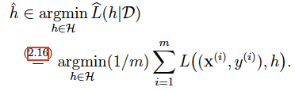
Empirical Risk Minimization
learn hypothesis out of model that incurs minimum loss when predicting labels of datapoints based on their features
training set
hypothesis
label of i-th datapoint
model
loss function
features of i-th datapoint
see Ch. 4.1 of mlbook.cs.aalto.fi

Slide 4


ERM is only Approximation!
hypothesis h

Slide 5

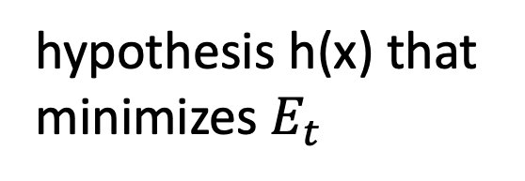
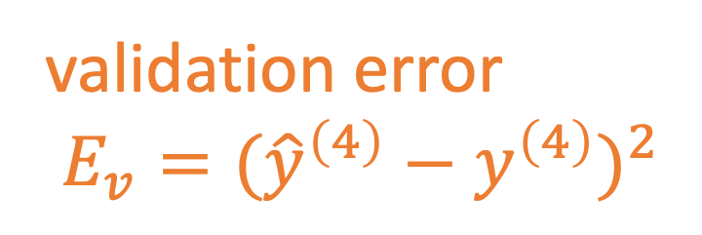
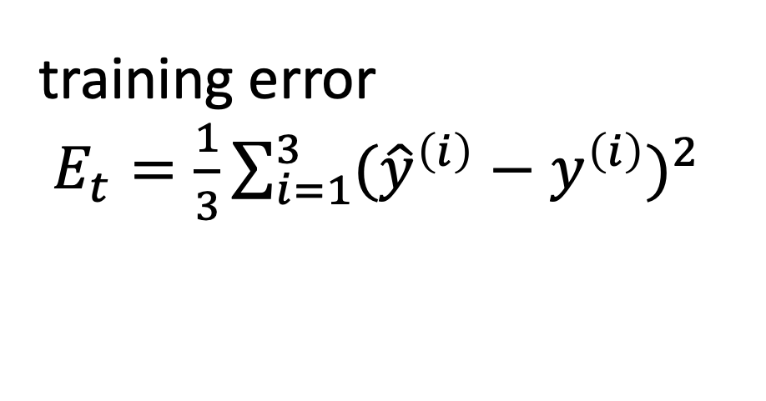

Train and Validate Model $ℋ^{(3)}$
hypothesis h(x) that
minimizes $E_{t}$
$$x^{(i)},y^{(i)}$$
label y
training error
$E_{t}=\frac{1}{3}\sum_{i=1}^{3}{({\hat{y}}^{\left(i\right)}−y^{\left(i\right)})^{2}}$
validation error
$E_{v}=({\hat{y}}^{\left(4\right)}−y^{\left(4\right)})^{2}$
feature x

Slide 6
Small Training Error Does Not Imply Good Performance on New Data Points!

Slide 7
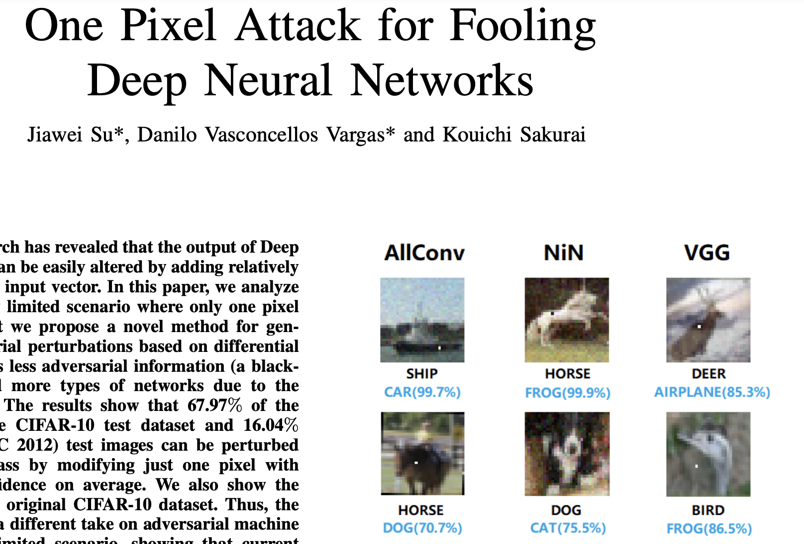
https://arxiv.org/pdf/1710.08864.pdf

Slide 8
EU Guidelines for Trustworthy AI
“…Technical Robustness and safety: AI systems need to be resilient and secure. They need to be safe, ensuring a fall back plan in case something goes wrong, as well as being accurate, reliable and reproducible. That is the only way to ensure that also unintentional harm can be minimized and prevented….”
https://digital-strategy.ec.europa.eu/en/library/ethics-guidelines-trustworthy-ai

Slide 9
hypothesis h(x) that
minimizes $E_{t}$
$$x^{(i)},y^{(i)}$$
label y
training error
$E_{t}=\frac{1}{3}\sum_{i=1}^{3}{({\hat{y}}^{\left(i\right)}−y^{\left(i\right)})^{2}}$
validation error
$E_{v}=({\hat{y}}^{\left(4\right)}−y^{\left(4\right)})^{2}$
feature x

Slide 10
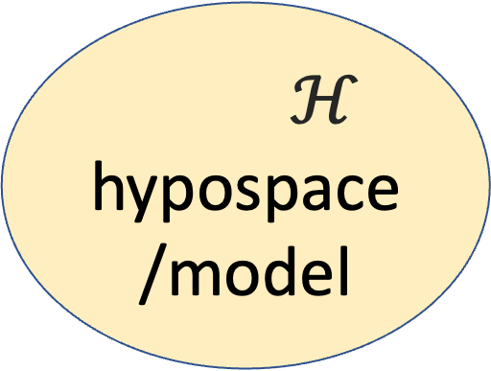
Data and Model Size
$$\left(x^{(1)},y^{(1)}\right)$$
training set
$$\left(x^{(2)},y^{(2)}\right)$$
m
$ℋ$
hypospace/model
$$\left(x^{(m)},y^{(m)}\right)$$
nr. of features n
crucial parameter is the
ratio d/m
eff. dimension d
Notes:
The sample size m is the nr. of different datapoints in the training set. Is counting the raw data points always a good mesure for data size ? We could could clone
data points for any number of copies … (for correlated time-series, the numer of samples is not a good mesure too 1)

Slide 11
Effective Data Size
consider data points obtained from time series
y(t)
x(t)
Notes:
The sample size m is the nr. of different datapoints in the training set. Is counting the raw data points always a good mesure for data size ? We could could clone
data points for any number of copies … (for correlated time-series, the numer of samples is not a good mesure too 1)

Slide 12
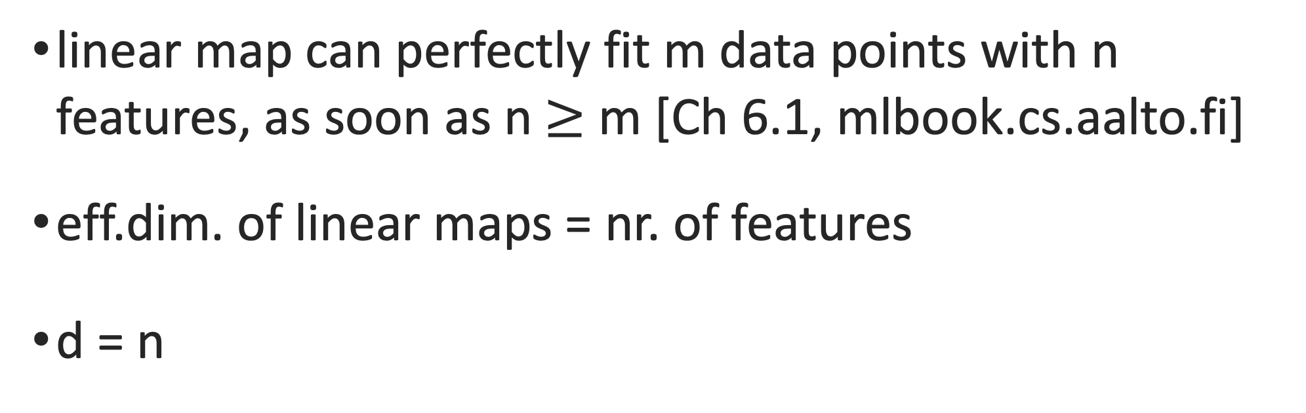
Effective Dim. Linear Maps
linear map can perfectly fit m data points with n features, as soon as n $≥$ m [Ch 6.1, mlbook.cs.aalto.fi]
eff.dim. of linear maps = nr. of features
d = n

Slide 13
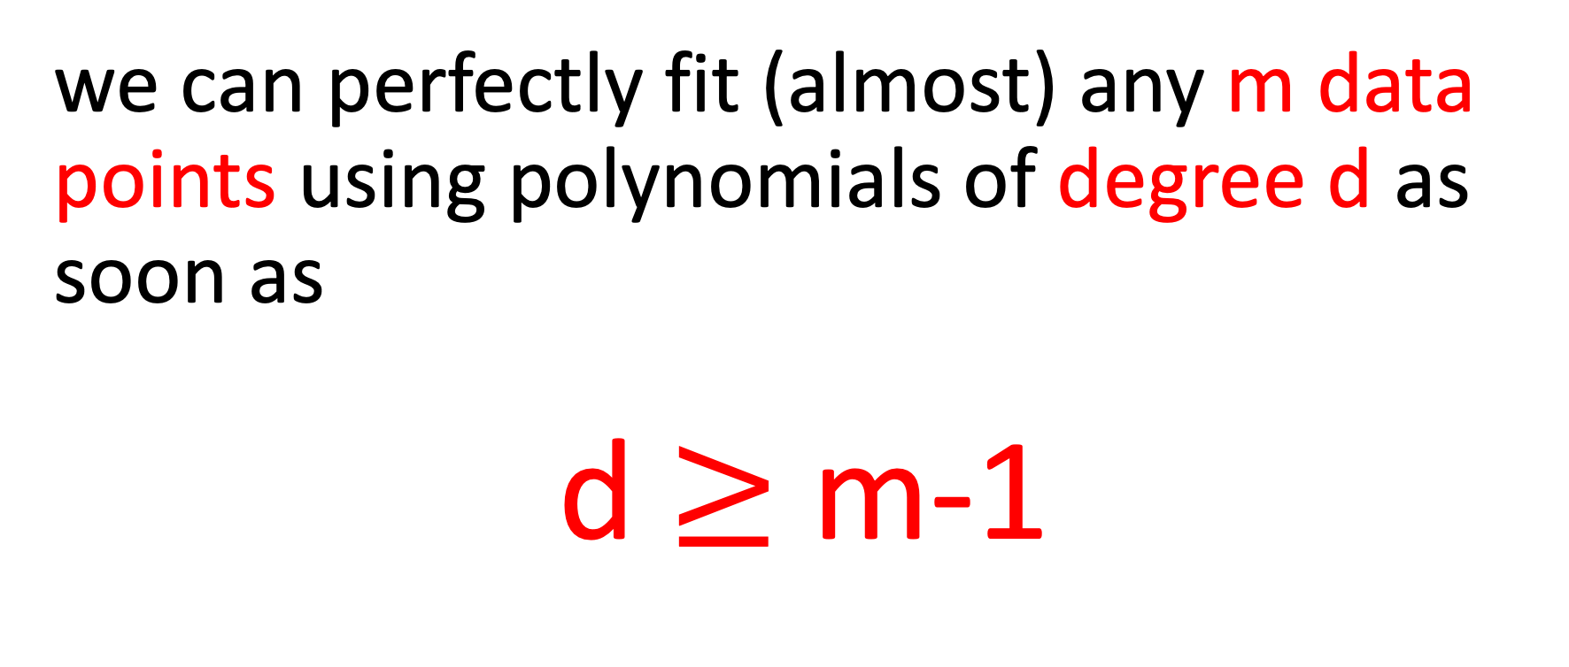
Effective Dim. Linear Maps
we can perfectly fit (almost) any m data points using polynomials of degree d as soon as
d $≥$ m-1

Slide 14
m=2, d=1
label
feature

Slide 15
m=3, degree d=2 polynomial
label y
feature x

Slide 16
Data Hungry ML Methods
millions of features for datapoints (e.g. megapixel image)
eff.dim. d of linear maps is also millions
eff.dim d of deep nets is millions … billions
can perfectly fit any set of 100000s (!) of datapoints
training error will be zero (overfitting!)

Slide 17
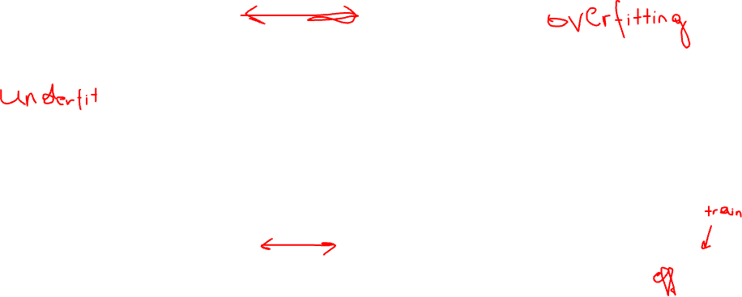
training error
expected loss
adjust model/data to reach
“critical value” (d/m=1)
d / m

Slide 18
how to bring d/m below critical value?
increase m by using more training data
decrease d by using smaller hypothesis space

Slide 19
how to bring d/m below critical value?
increase m by using more training data
decrease d by using smaller hypothesis space

Slide 20
Data Augmentation
Notes:
consider the first option to ajdust the ratio d/m. We could collect more data points for training set. Wha tcould be the problem here ? Note that we must know the labels of datapoints in the trainig set.However, we can use some domain knowledge do generate new datapoints synthetically(simulate it).

Slide 21
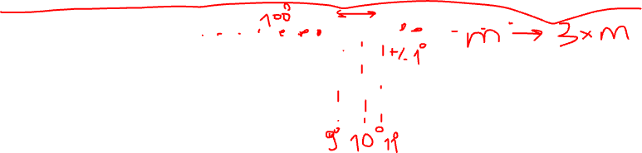
add a bit of noise to features
original datapoint
label y
augmented
feature x
we have increased the dataset by factor 3 !

Slide 22


rotated cat image is still cat image

Slide 23
flipped cat image is still cat image

Slide 24
shifted cat image is still cat image

Slide 25
noisy cat image is still cat image

Slide 26
how to bring d/m below critical value?
increase m by using more training data
decrease d by using smaller hypothesis space

Slide 27
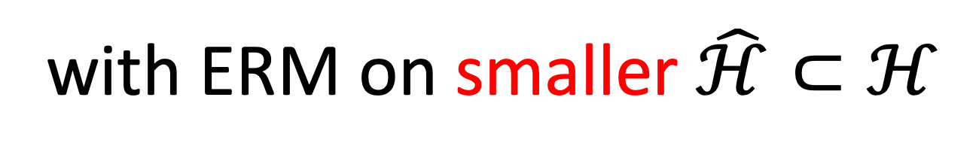
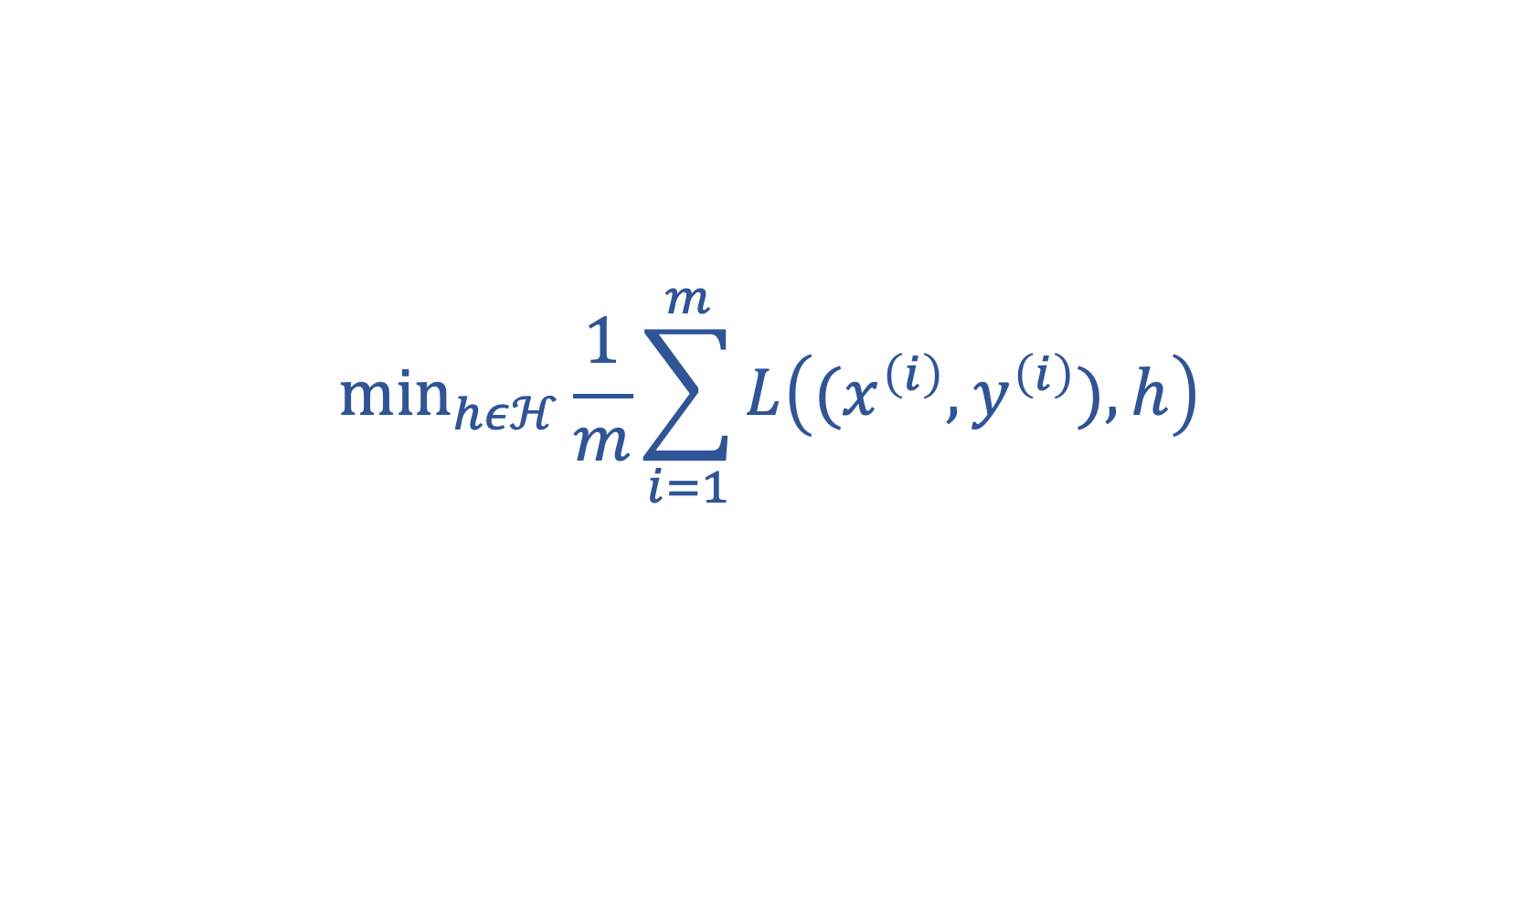
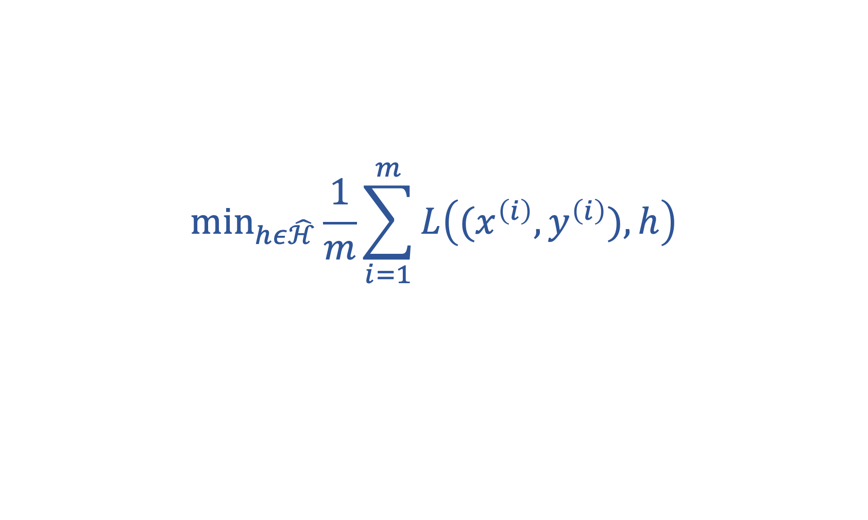
replace original ERM
$${\text{min}}_{hεℋ}\frac{1}{m}\sum_{i=1}^{m}{L\left((x^{\left(i\right)},y^{\left(i\right)}),h\right)}$$
with ERM on smaller $\hat{ℋ}⊂ℋ$
$${\text{min}}_{hε\hat{ℋ}}\frac{1}{m}\sum_{i=1}^{m}{L\left((x^{\left(i\right)},y^{\left(i\right)}),h\right)}$$

Slide 28
Nested Models
degree 3
polyn.
degree 2
polyn.
degree 1 polyn.

Slide 29
Prune Hypospace by Early Stopping
10000 iterations
100 iterations
10 iterations

Slide 30
Soft Model Pruning
via
Regularization

Slide 31
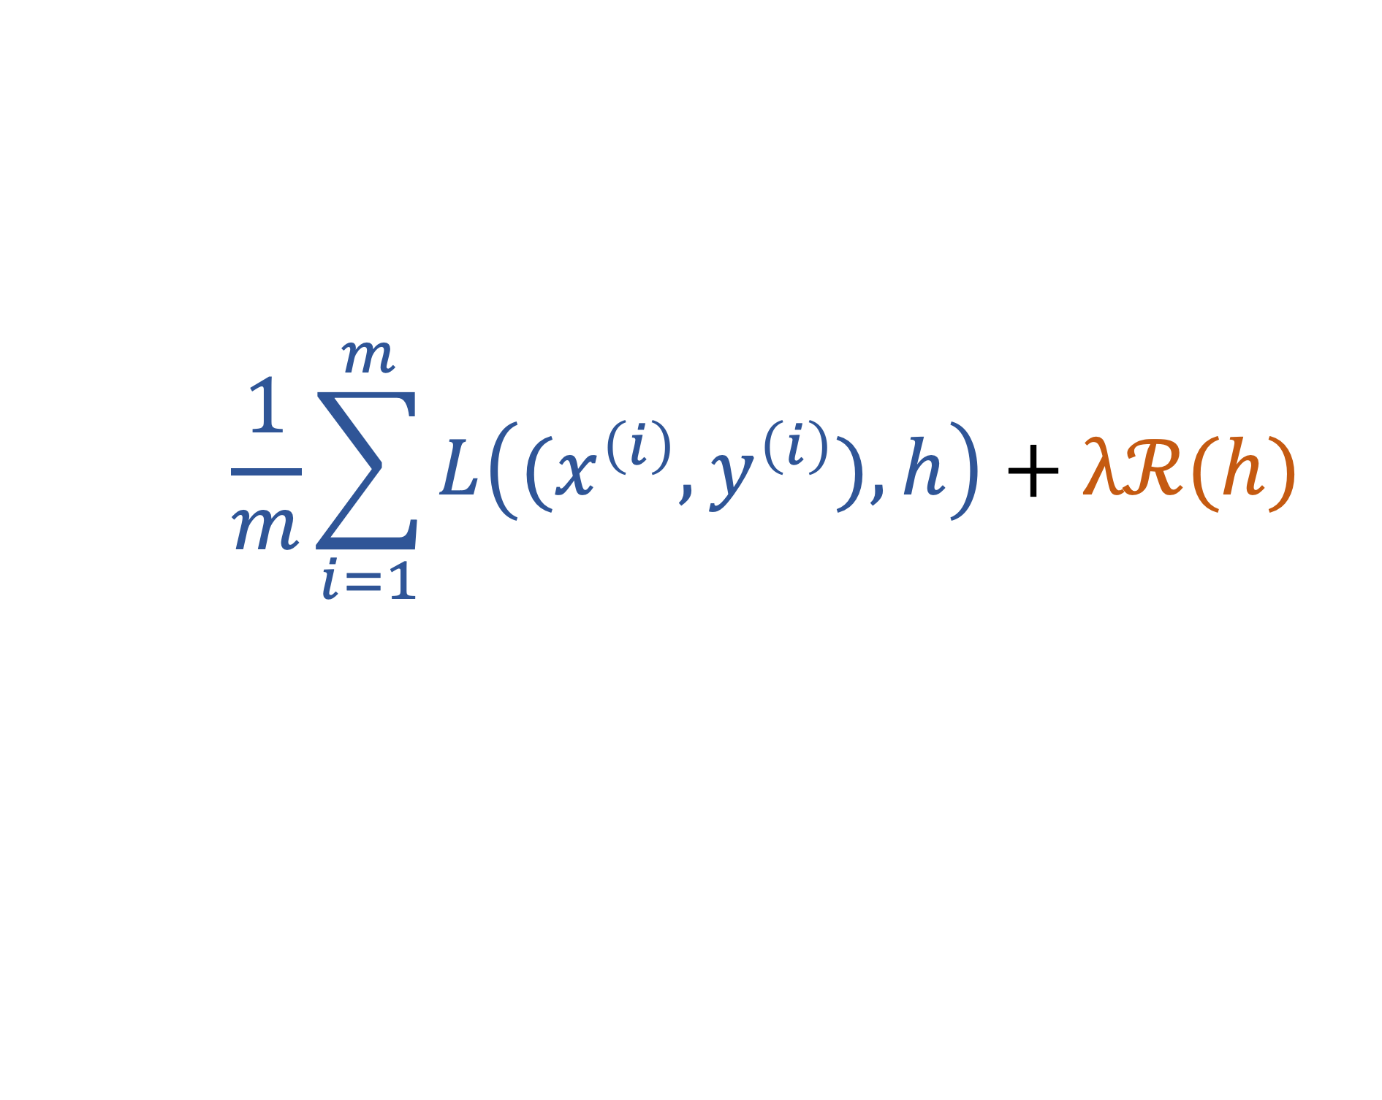
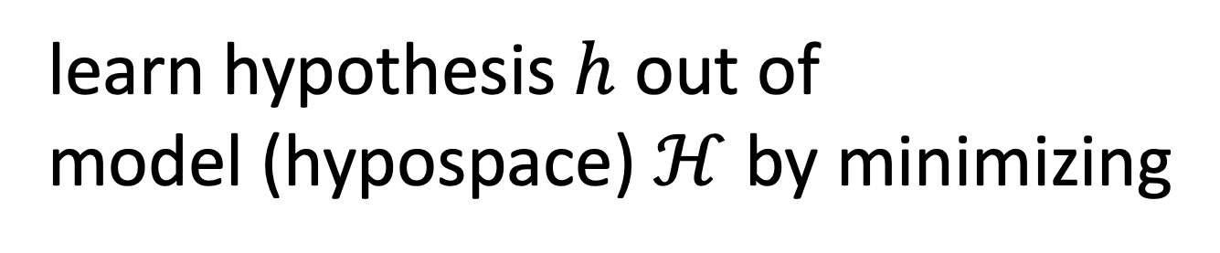
Regularized ERM
learn hypothesis $h$ out of
model (hypospace) $ℋ$ by minimizing
$$\frac{1}{m}\sum_{i=1}^{m}{L\left((x^{\left(i\right)},y^{\left(i\right)}),h\right)}+λℛ(h)$$
average loss on training set
(empirical risk of h)
loss increase for datapoints
outside training set

Slide 32
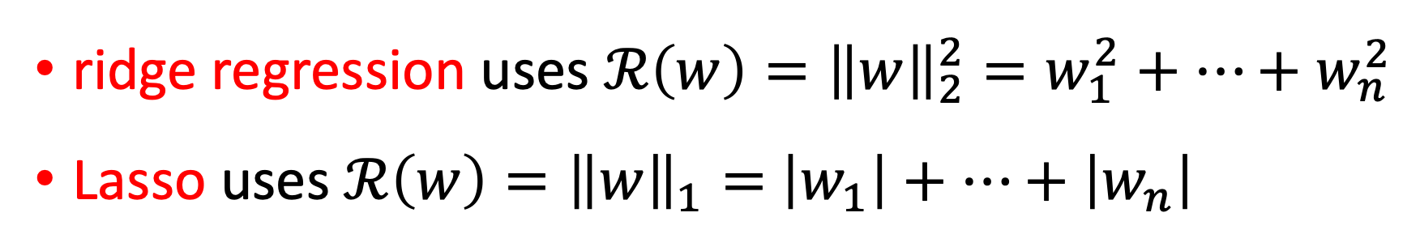
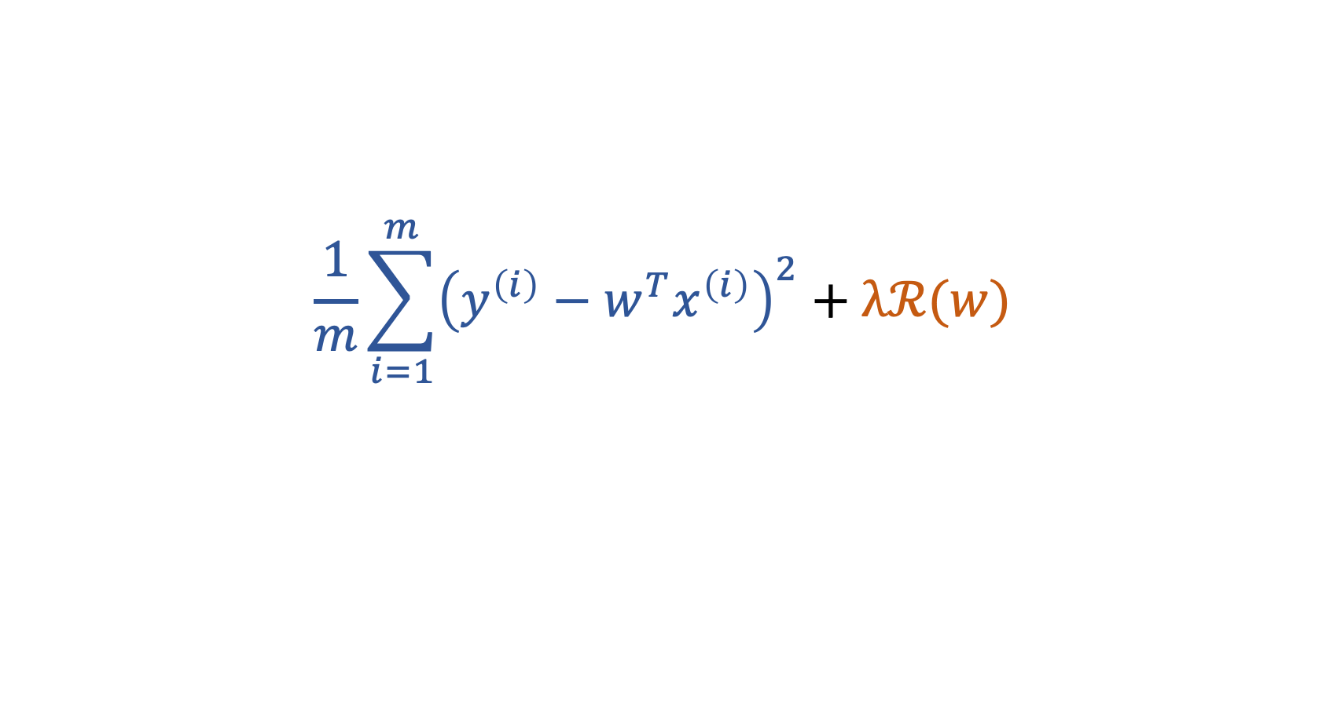
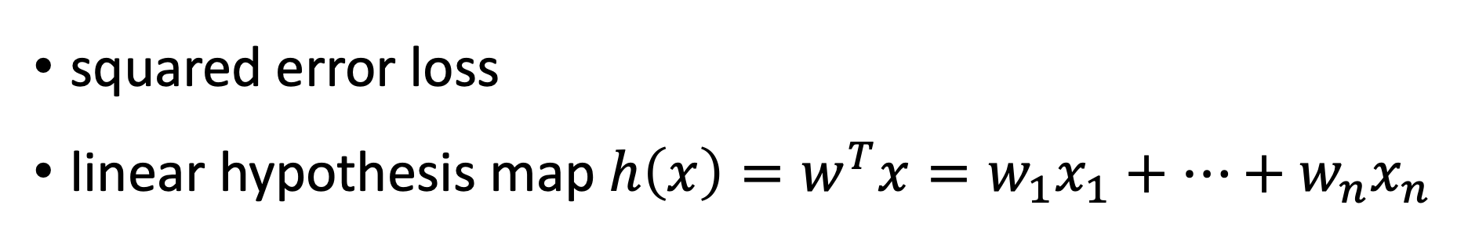
Regularized Linear Regression
squared error loss
linear hypothesis map $h\left(x\right)=w^{T}x=w_{1}x_{1}+…+w_{n}x_{n}$
$$\frac{1}{m}\sum_{i=1}^{m}{{\left(y^{\left(i\right)}−{w^{T}x}^{\left(i\right)}\right)}^{2}}+λℛ(w)$$
ridge regression uses $ℛ\left(w\right)={\left\|w\right\|}_{2}^{2}=w_{1}^{2}+…+w_{n}^{2}$
Lasso uses $ℛ\left(w\right)={\left\|w\right\|}_{1}=$ $\left|w_{1}\right|+…+\left|w_{n}\right|$

Slide 33
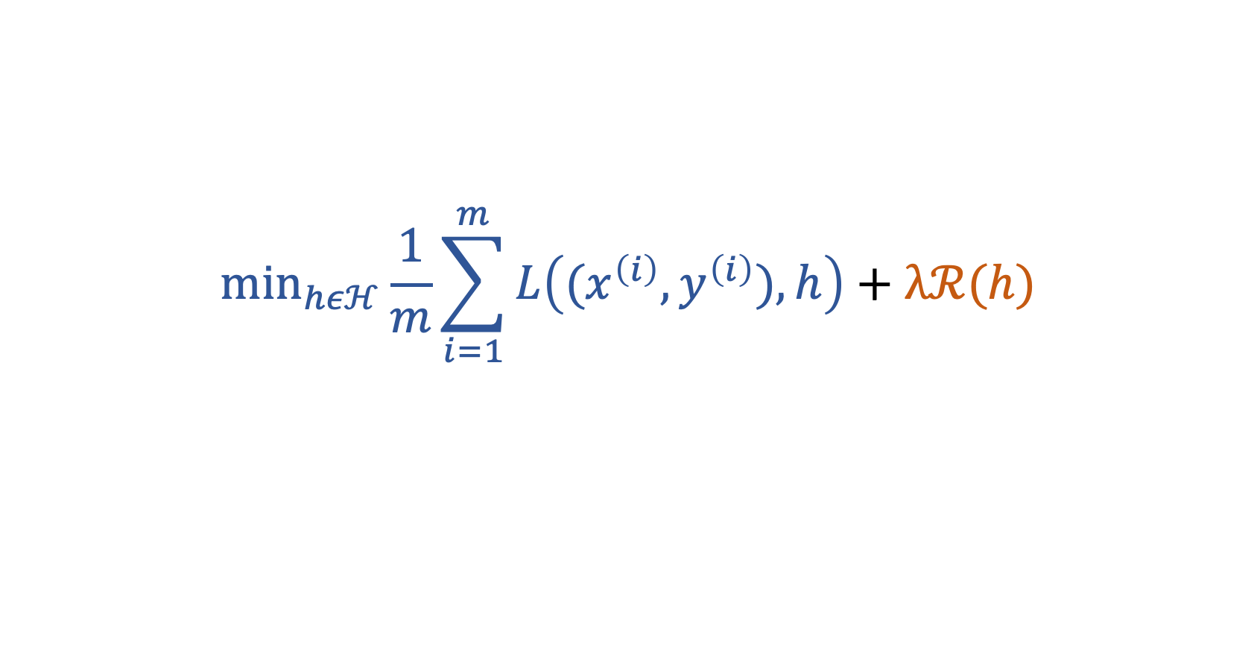
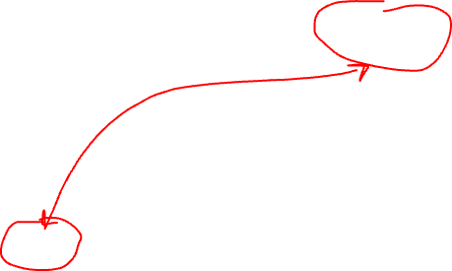

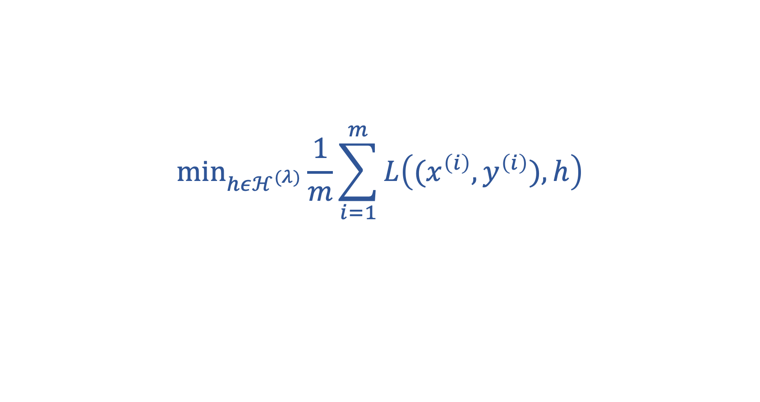
Regularization = Implicit Pruning!
$${\text{min}}_{hεℋ}\frac{1}{m}\sum_{i=1}^{m}{L\left((x^{\left(i\right)},y^{\left(i\right)}),h\right)}+λℛ(h)$$
equivalent to
$${\text{min}}_{hεℋ^{(λ)}}\frac{1}{m}\sum_{i=1}^{m}{L\left((x^{\left(i\right)},y^{\left(i\right)}),h\right)}$$
with pruned model $ℋ^{(λ)}⊂ℋ$
Notes:
The larger the regularization parameter lambda, the smaller the pruned model H^{(lambda)}

Slide 34

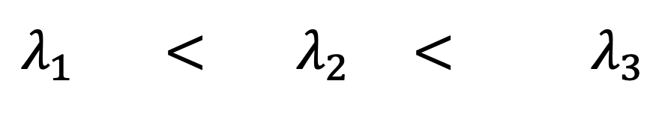



Regularization = “Soft” Model Selection
$$λ_{1} < λ_{2}\text{ <} λ_{3}$$
$$ℋ^{(λ_{1})}$$
$$ℋ^{(λ_{2})}$$
$$ℋ^{(λ_{3})}$$
$$λ$$
Notes:
We can interpret regularization as a soft model pruning. Instead of chosing between a discrete set of different models, e.g., sets of polynomials with different maximum degree, regularization smoothly varies the pruned hypothesis space as lambda is varied.

Slide 35
Regularization
does implicit
Data Augmentation

Slide 36
augment with (infinitely many) realizations of RV!
label y
original datapoint
augmented
=
+ ”noise”
feature x

Slide 37
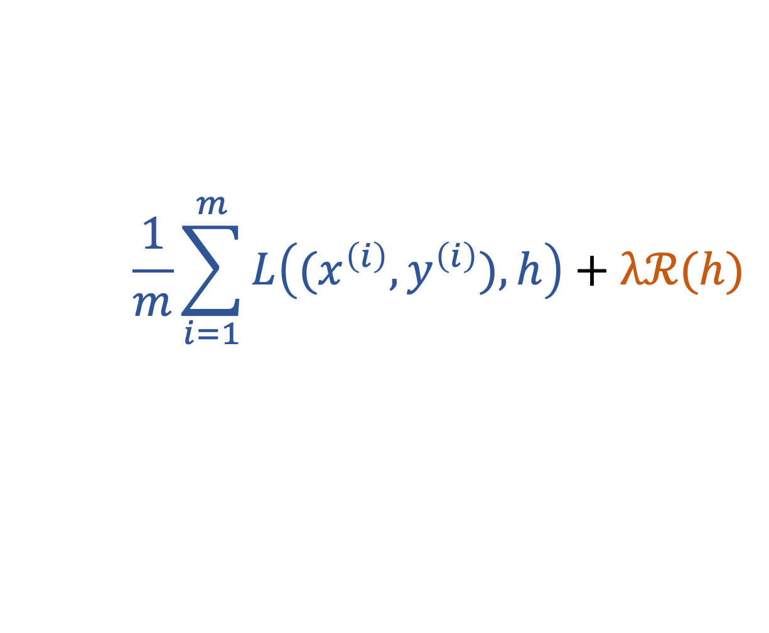
Regularization =Implicit Data Aug.
raw datapoint
label y
h(x)
“perturbed”
datapoint
$$\frac{1}{m}\sum_{i=1}^{m}{L\left((x^{\left(i\right)},y^{\left(i\right)}),h\right)}+λℛ(h)$$
see Chapter 7.3 of mlbook.cs.aalto.fi
feature x
Notes:
If we use a larger number of perturbed copies for each datapoint in the original training set, we obtain an average loss which consists of the original training error and
another comoennts due to the perturbed datapoints. This additoinal component is approximately equal to the reguarlization term used in regularized ERM.

Slide 38
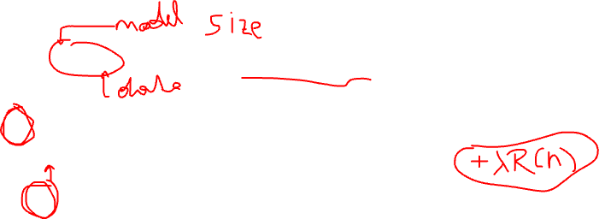
To sum up,
large ratio d/m leads to overfitting
reduce d by using smaller model (“pruning”)
increase m by using more data points
regularization is a soft model pruning
regularization does implicit data augmentation

Slide 39
Transfer Learning
via
Regularization

Slide 40
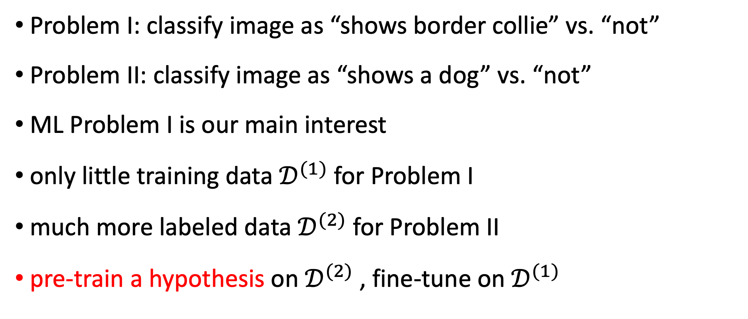
Problem I: classify image as “shows border collie” vs. “not”
Problem II: classify image as “shows a dog” vs. “not”
ML Problem I is our main interest
only little training data $𝒟^{(1)}$for Problem I
much more labeled data $𝒟^{(2)}$ for Problem II
pre-train a hypothesis on $𝒟^{(2)}$, fine-tune on $𝒟^{(1)}$

Slide 41
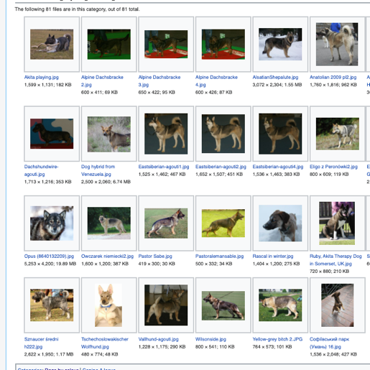


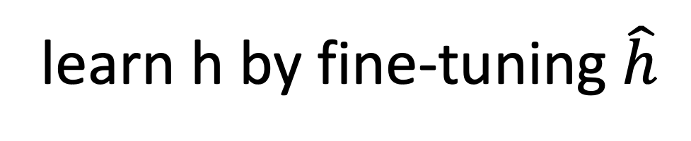
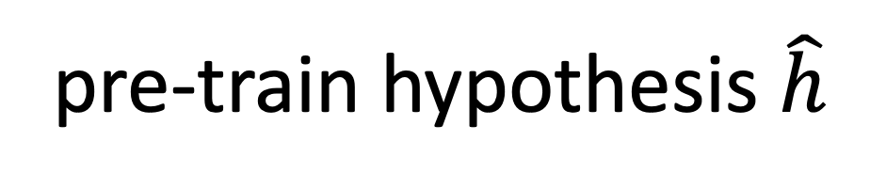


$$𝒟^{(1)}$$
$$𝒟^{(2)}$$
learn h by fine-tuning $\hat{h}$
pre-train hypothesis $\hat{h}$

Slide 42
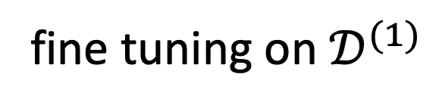
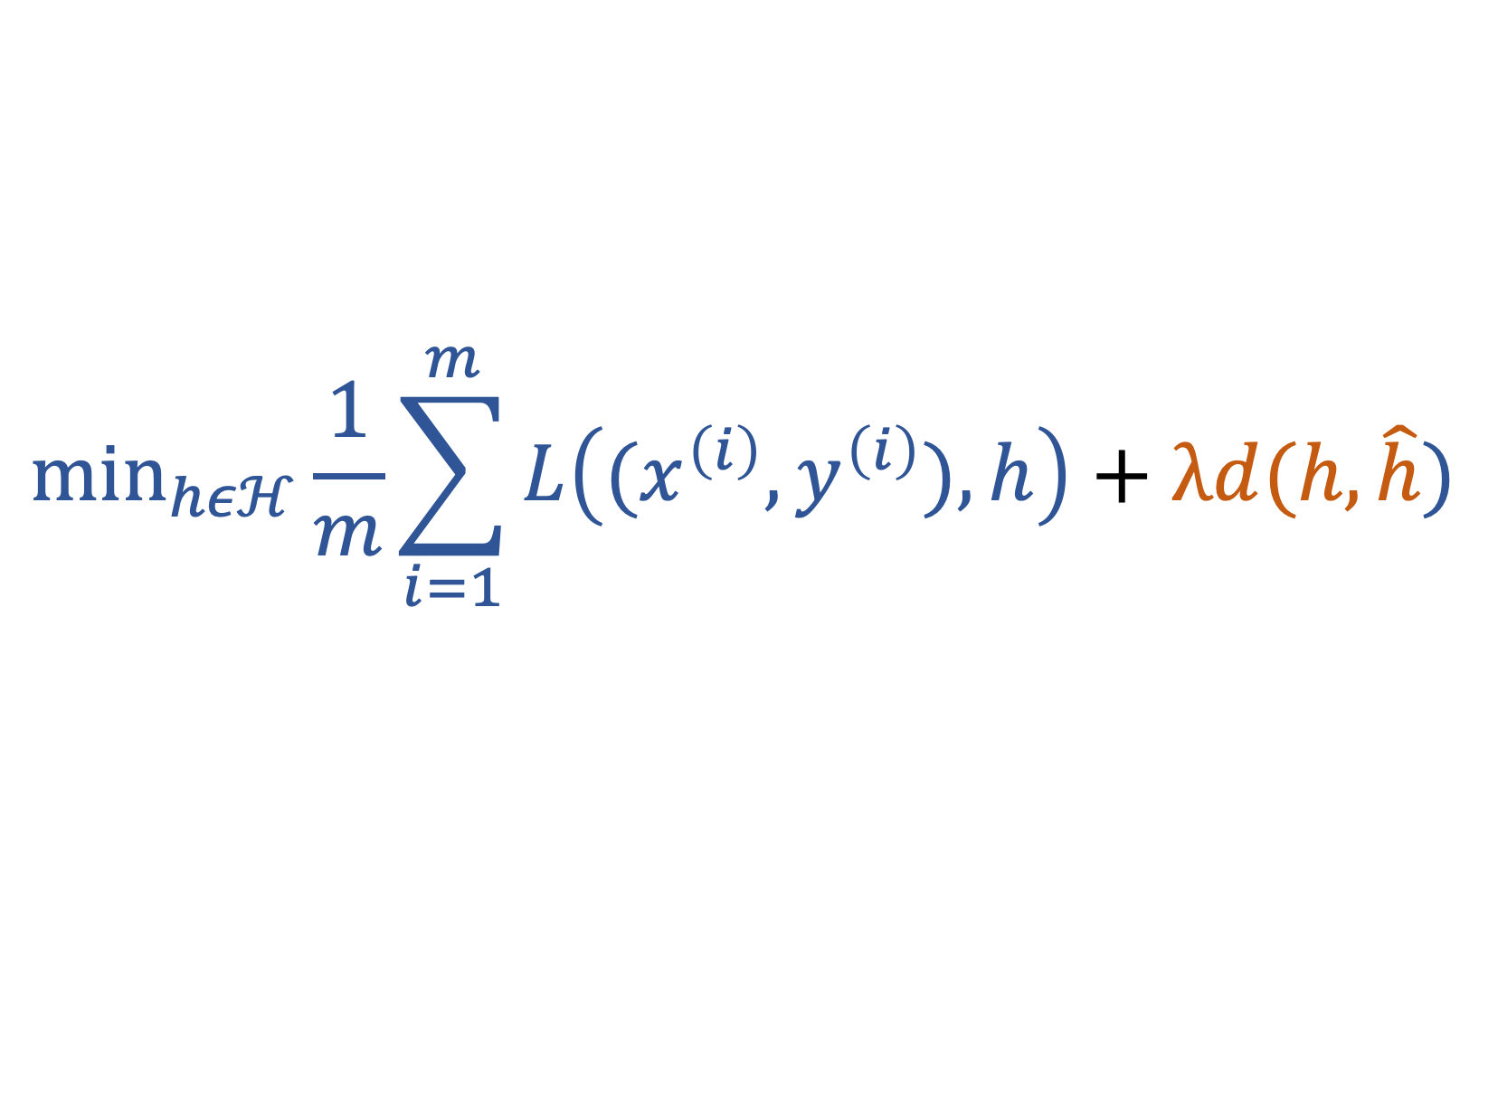
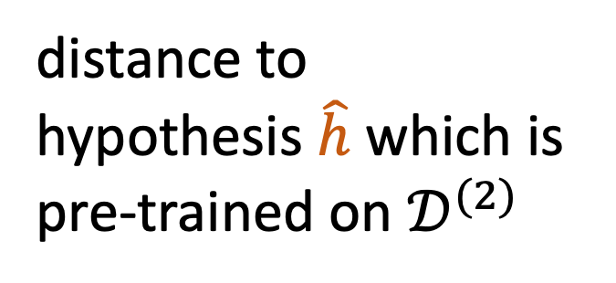
$${\text{min}}_{hεℋ}\frac{1}{m}\sum_{i=1}^{m}{L\left((x^{\left(i\right)},y^{\left(i\right)}),h\right)}+λd(h,\hat{h})$$
distance to
hypothesis $\hat{h}$ which is
pre-trained on $𝒟^{(2)}$
fine tuning on $𝒟^{(1)}$

Slide 43
Multi-Task Learning
via
Regularization

Slide 44
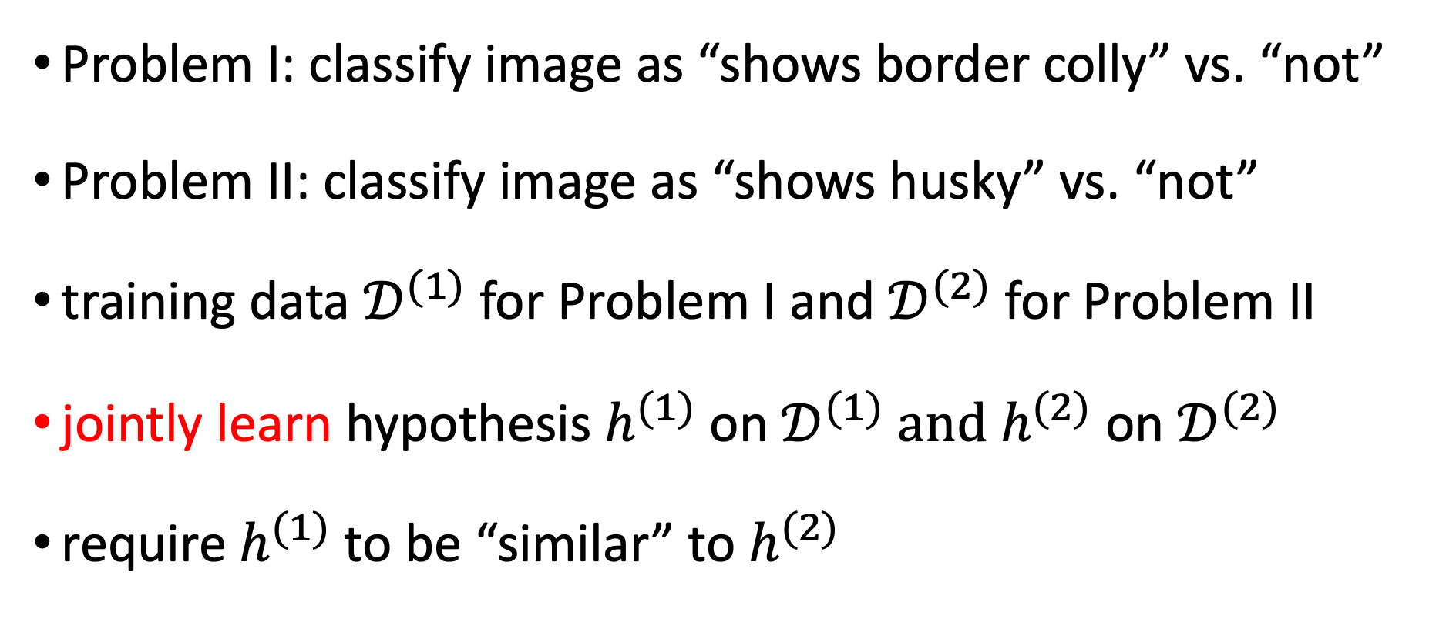
Problem I: classify image as “shows border colly” vs. “not”
Problem II: classify image as “shows husky” vs. “not”
training data $𝒟^{(1)}$for Problem I and $𝒟^{(2)}$ for Problem II
jointly learn hypothesis $h^{(1)}$ on $𝒟^{(1)}$ and $h^{(2)}$ on $𝒟^{(2)}$
require $h^{(1)}$ to be “similar” to $h^{(2)}$

Slide 45
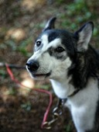

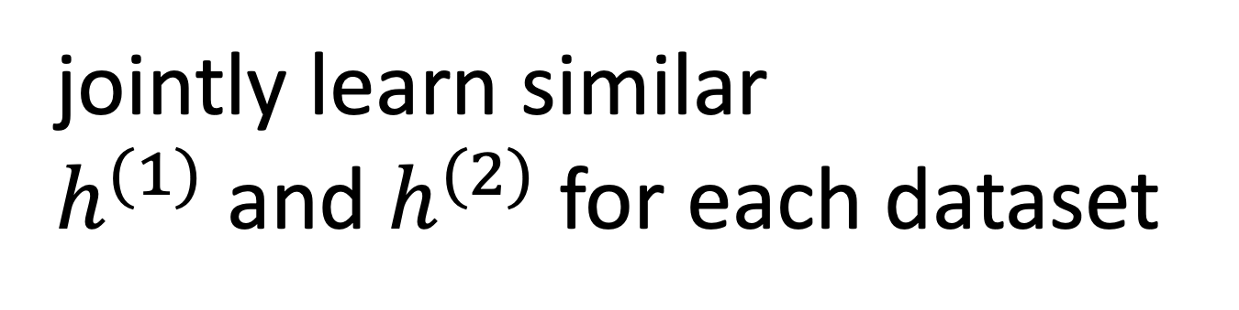
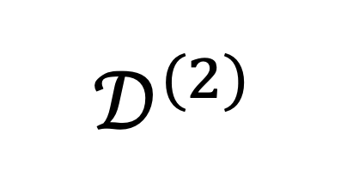
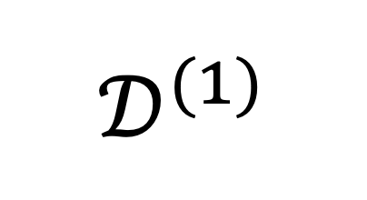
$$𝒟^{(1)}$$
$$𝒟^{(2)}$$
jointly learn similar
$h^{(1)}$ and $h^{(2)}$ for each dataset

Slide 46

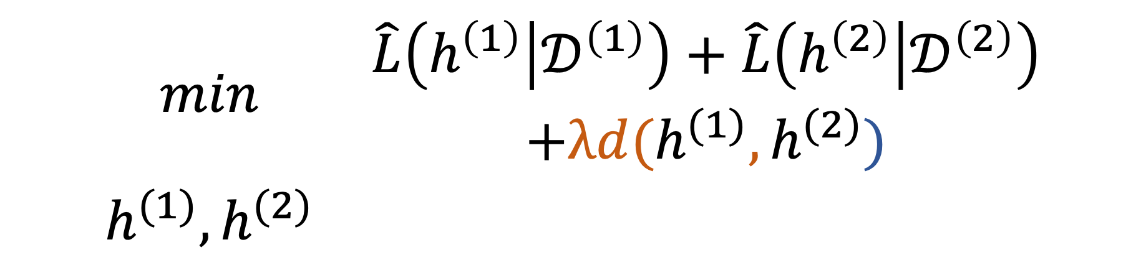
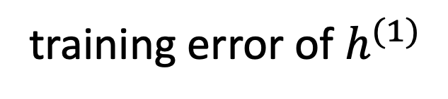
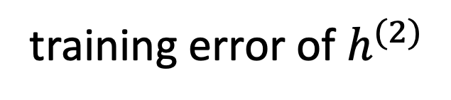
training error of $h^{(1)}$
training error of $h^{(2)}$
$$\begin{matrix}min & \begin{aligned}\hat{L}\left(h^{\left(1\right)} | 𝒟^{\left(1\right)}\right)+\hat{L}\left(h^{\left(2\right)} | 𝒟^{\left(2\right)}\right) \\ +λd(h^{(1)},h^{(2)})\end{aligned} \\ h^{(1)},h^{(2)} & \end{matrix}$$
“distance” between $h^{(1)}$ and $h^{(2)}$

Slide 47
Semi-Supervised Learning
via
Regularization

Slide 48
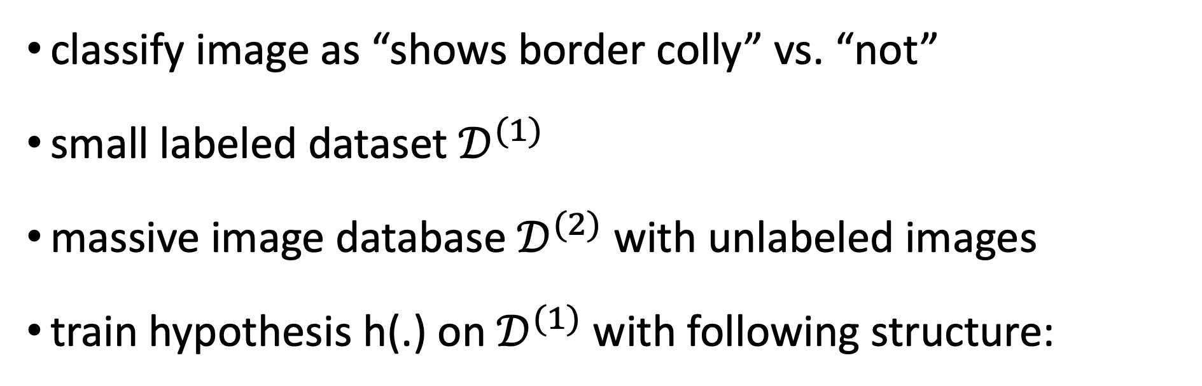
classify image as “shows border colly” vs. “not”
small labeled dataset $𝒟^{(1)}$
massive image database $𝒟^{(2)}$ with unlabeled images
train hypothesis h(.) on $𝒟^{(1)}$with following structure:
feature map
g(.)
z
lin. map
f(.)
x
h(x)
“chain” or “pipeline”

Slide 49
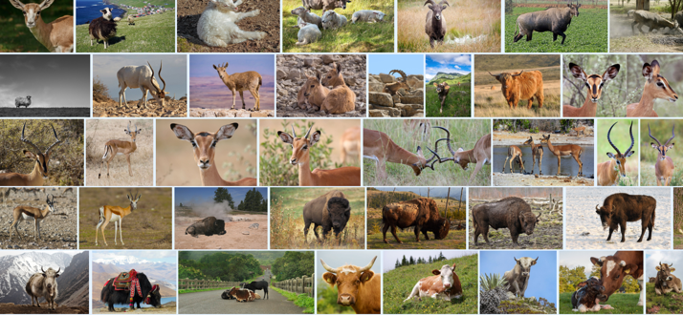
$$𝒟^{(1)}$$
$$𝒟^{(2)}$$
learn linear classifier f(.)
learn feature map g(.)

Slide 50
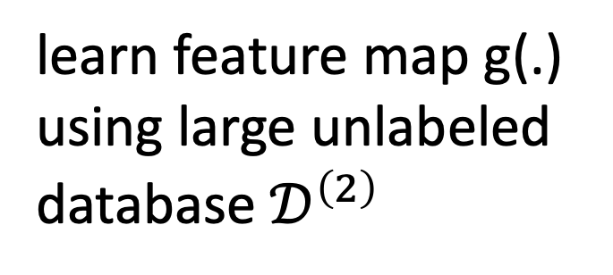
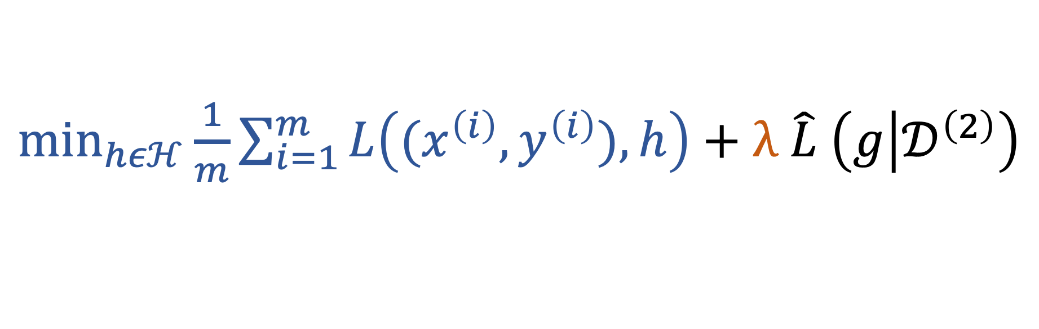
${\text{min}}_{hεℋ}\frac{1}{m}\sum_{i=1}^{m}{L\left((x^{\left(i\right)},y^{\left(i\right)}),h\right)}+λ$ $\hat{L} \left(g | 𝒟^{\left(2\right)}\right)$
use training error
to fine tune h(.)
learn feature map g(.)
using large unlabeled
database $𝒟^{\left(2\right)}$

Slide 51
Subjective Explainability
via
Regularization

Slide 52
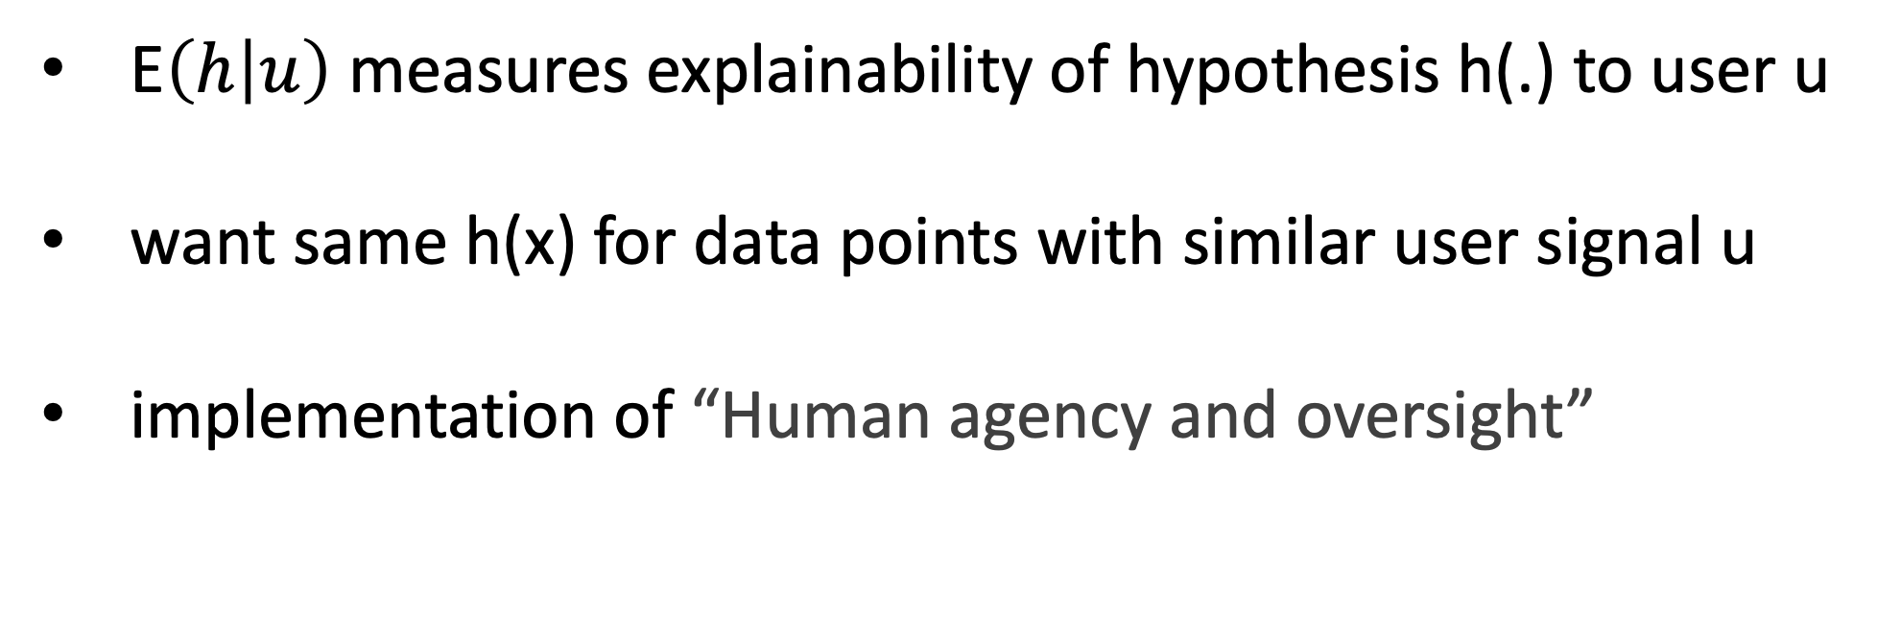

${\text{min}}_{hεℋ}\frac{1}{m}\sum_{i=1}^{m}{L\left((x^{\left(i\right)},y^{\left(i\right)}),h\right)}+λ$ E$\left(h | u\right)$
E$\left(h | u\right)$ measures explainability of hypothesis h(.) to user u
want same h(x) for data points with similar user signal u
implementation of “Human agency and oversight”

Slide 53
To Sum Up
ML tend to work well if m/d > 1
option A: increase data size m by data augmentation
option B: decrease model size d by regularization
regularization <-> data augmentation <-> soft model-pruning
transfer-, multi-task- and SSL are instances of regularization

