Slide 1

ML Design Choices for Trustworthy AI
Alexander Jung
Assoc. Professor for Machine Learning
Department of Computer Science
Aalto University

Slide 2
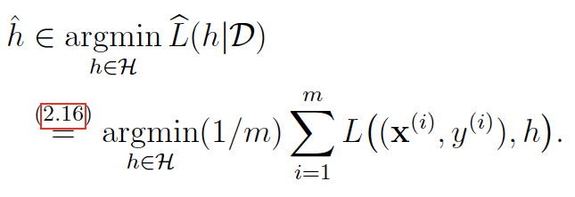
Empirical Risk Minimization
loss
data
model

Slide 3
7 Key Requirements
for
Trustworthy AI in EU
https://ec.europa.eu/futurium/en/ai-alliance-consultation.1.html

Slide 4

Human agency and oversight
Technical robustness and safety
Privacy and data governance
Transparency
Diversity, non-discrimination and fairness
Societal and environmental wellbeing
Accountability
https://ec.europa.eu/futurium/en/ai-alliance-consultation.1.html

Slide 5
Human agency and oversight
Technical robustness and safety
Privacy and data governance
Transparency
Diversity, non-discrimination and fairness
Societal and environmental wellbeing
Accountability
https://ec.europa.eu/futurium/en/ai-alliance-consultation.1.html

Slide 6
Human Agency.
“…The overall principle of user autonomy must be central to the system’s functionality. Key to this is the right not to be subject to a decision based solely on automated processing when this produces legal effects on users or similarly significantly affects them….”
→ labels maybe not correspond to certain actions …

Slide 7
Label is Design Choice!
by choosing/defining label you define the ML problem or learning task !
Human agency and oversight: ….proper oversight mechanisms need to be ensured…
https://digital-strategy.ec.europa.eu/en/library/ethics-guidelines-trustworthy-ai

Slide 8
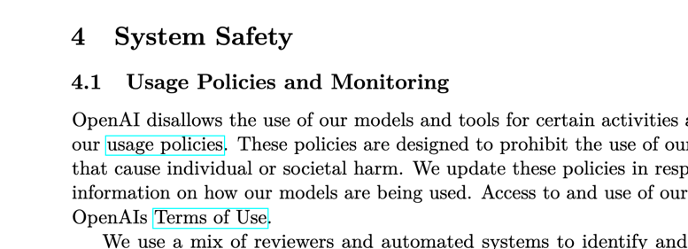
Human-on-the-Loop (HOTL)
“…capability for human intervention during the design cycle …and monitoring the system’s operation…”
https://cdn.openai.com/papers/gpt-4-system-card.pdf

Slide 9
Human-in-Command (HIC)
“…oversee the overall activity of the AI system (including its broader economic, societal, legal and ethical impact)…”

Slide 10
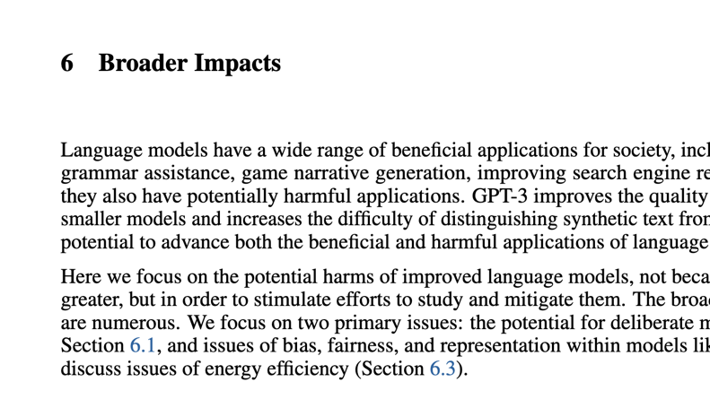
https://arxiv.org/pdf/2005.14165.pdf

Slide 11


Slide 12
Human agency and oversight
Technical robustness and safety
Privacy and data governance
Transparency
Diversity, non-discrimination and fairness
Societal and environmental wellbeing
Accountability
https://ec.europa.eu/futurium/en/ai-alliance-consultation.1.html

Slide 13

“…AI must cope with changes in operating env. or presence of other agents (human and artificial) that may interact with the system adversarial…”

Slide 14
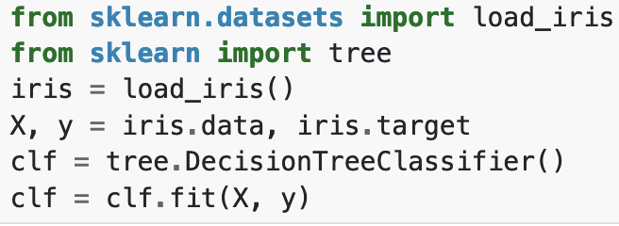
All under your control?
$$\hat{h}(x)$$

Slide 15
Robustness via Data Augmentation
original datapoint
label y
augmented
“one pixel flips”
feature x

Slide 16
Fallback Plan
“…This can mean that AI systems switch from a statistical to rule-based procedure, or that they ask for a human operator before continuing their action….”
use confidence measures for predictions to decide when to fall back to rule based
logistic regression provides confidence measures by design !

Slide 17
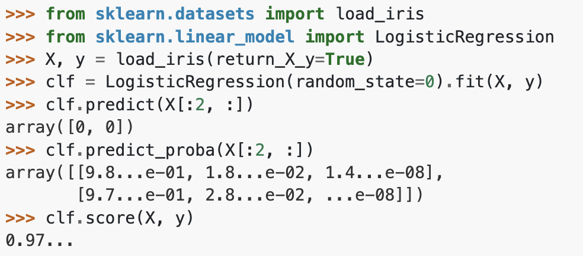
Accuracy
“…When occasional inaccurate predictions cannot be avoided, it is important that the system can indicate how likely these errors are. A high level of accuracy is especially crucial in situations where the AI system directly affects human lives….”

Slide 18
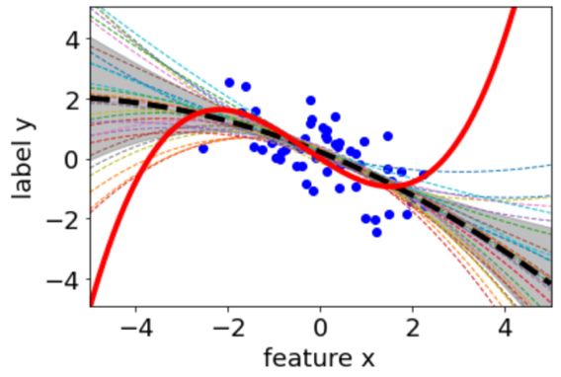
Reliability and Reproducibility
“…It is critical that the results of AI systems are reproducible, as well as reliable. A reliable AI system is one that works properly with a range of inputs and in a range of situations….”

Slide 19
Human agency and oversight
Technical robustness and safety
Privacy and data governance
Transparency
Diversity, non-discrimination and fairness
Societal and environmental wellbeing
Accountability
https://ec.europa.eu/futurium/en/ai-alliance-consultation.1.html

Slide 20
Privacy and Data Protection.
“…Digital records of human behaviour may allow AI systems to infer not only individuals’ preferences, but also their sexual orientation, age, gender…”

Slide 21




Privacy-Preserving Feature Learning
$$x_{2}$$
not-sensitive
y (food preference)
sensitive
s (gender)
$$x_{1}$$

Slide 22
Quality and integrity of data.
“…When data is gathered, it may contain socially constructed biases, inaccuracies, errors and mistakes. This needs to be addressed prior to training with any given data set. In addition, the integrity of the data must be ensured…”
feature and label values might be noisy
how could we make ML immune to noise?

Slide 23
Access to Data
data protocols governing data
precisely specify data access
only qualified personnel with the competence and need to access individual’s data should be allowed to do so

Slide 24


Slide 25
Human agency and oversight
Technical robustness and safety
Privacy and data governance
Transparency
Diversity, non-discrimination and fairness
Societal and environmental wellbeing
Accountability
https://ec.europa.eu/futurium/en/ai-alliance-consultation.1.html

Slide 26
Traceability.
“…The data sets and the processes that yield the AI system’s decision, including those of data gathering and data labelling as well as the algorithms used, should be documented to the best possible..”

Slide 27

https://arxiv.org/pdf/2005.14165.pdf

Slide 28
Explainability.
“…Technical explainability requires that the decisions made by an AI system can be understood and traced by human beings. Moreover, trade-offs might have to be made between enhancing a system's explainability (which may reduce its accuracy) or increasing its accuracy (at the cost of explainability)...”

Slide 29
What is an Explanation?
…anything that allows the user to predict the predictions
of a ML method

Slide 30

To Teach = To Explain

Slide 31
after you completed my course…
explaining a ML method amounts to
specify features and labels; source of training data
specify model
specify loss function

Slide 32
Explaining a ML Method.
provide information about how a given training set results
in a learnt hypothesis
e.g., “linear regression learns a linear hypothesis by
minimizing the average squared error on the training set”

Slide 33
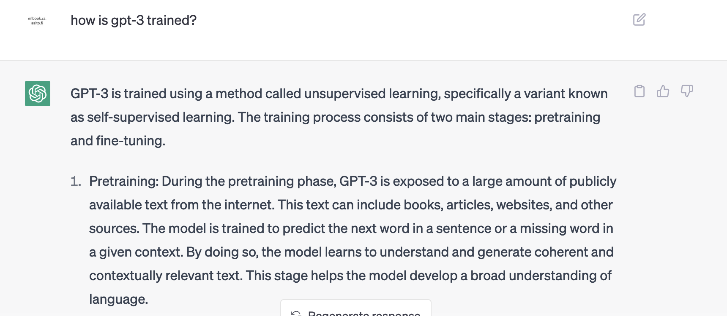

Slide 34
Explaining a Prediction.
provide information about how the prediction h(x) is computed for a given data point with features x
e.g., “the prediction is obtained since we use a linear hypothesis h(x) = w1*x1+w2*x2 with weights w1 = 10 and w2=4”

Slide 35
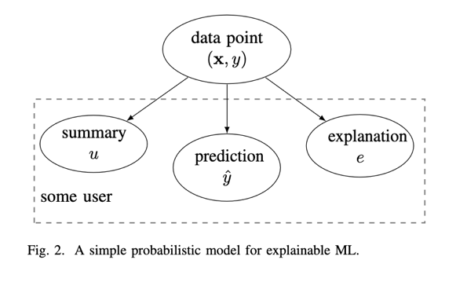
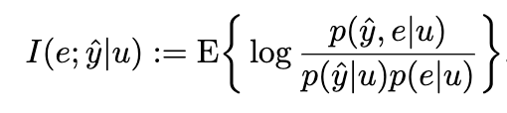
Explaining a Prediction.
A. Jung and P. H. J. Nardelli, "An Information-Theoretic Approach to Personalized Explainable Machine Learning," in IEEE Signal Processing Letters, vol. 27, pp. 825-829, 2020, doi: 10.1109/LSP.2020.2993176.

Slide 36

Communication
“…AI systems should not represent themselves as humans to users; humans
have the right to be informed that they are interacting with an AI system….”

Slide 37

Communication

Slide 38
Human agency and oversight
Technical robustness and safety
Privacy and data governance
Transparency
Diversity, non-discrimination and fairness
Societal and environmental wellbeing
Accountability
https://ec.europa.eu/futurium/en/ai-alliance-consultation.1.html

Slide 39
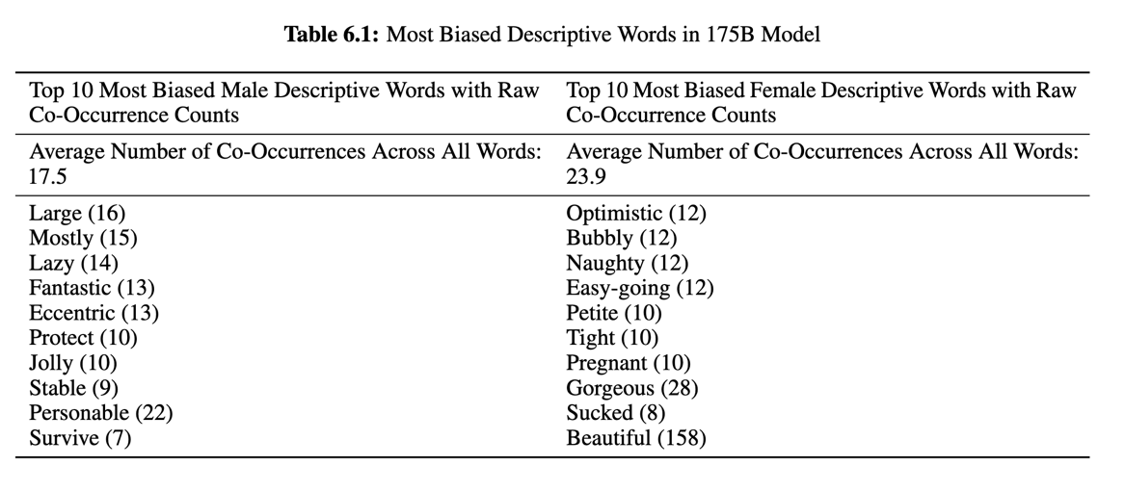
https://arxiv.org/pdf/2005.14165.pdf

Slide 40
Fairness by Data Augmentation
salary y
original datapoint
augmented
x (e.g. gender)

Slide 41

Accessibility and universal design.
“AI systems should not have a one-size-fits-all approach and should consider Universal Design principles addressing the widest possible range of users, following relevant accessibility standards…”

Slide 42

Stakeholder Participation.
“it is advisable to consult stakeholders who may directly or indirectly be affected by the system throughout its life cycle.…”

Slide 43
Human agency and oversight
Technical robustness and safety
Privacy and data governance
Transparency
Diversity, non-discrimination and fairness
Societal and environmental wellbeing
Accountability
https://ec.europa.eu/futurium/en/ai-alliance-consultation.1.html

Slide 44

Sustainable and environmentally friendly AI
“…Measures securing the environmental friendliness of AI systems’ entire supply chain should be encouraged…”
labelling of data points environmentally-friendly ?
minimize computational resources

Slide 45
Social impact.
“…While AI systems can be used to enhance social skills, they can equally contribute to their deterioration. This could also affect people’s physical and mental wellbeing. The effects of these systems must therefore be carefully monitored and considered….”
e.g., predict if sending a mail could be delayed (Outlook)

Slide 46
Society and Democracy.
“…The use of AI systems should be given careful consideration particularly in situations relating to the democratic process, including not only political decision-making but also electoral contexts.”

Slide 47

https://www.wsj.com/articles/chatgpt-bard-bing-ai-political-beliefs-151a0fe4

Slide 48
Human agency and oversight
Technical robustness and safety
Privacy and data governance
Transparency
Diversity, non-discrimination and fairness
Societal and environmental wellbeing
Accountability
https://ec.europa.eu/futurium/en/ai-alliance-consultation.1.html

Slide 49
Auditability.
“…establish mechanisms that facilitate the AI system’s auditability (e.g. traceability of the development process, the sourcing of training data and the logging of the AI system’s processes, outcomes, positive and negative impact)?.”

Slide 50


Slide 51
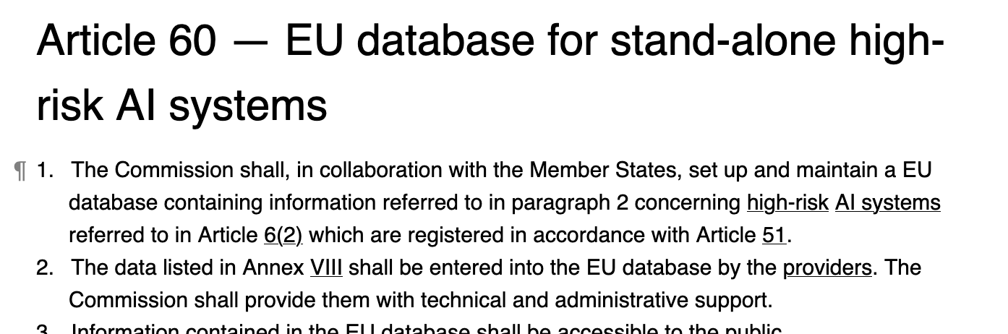

Slide 52
The Big Recap
What are three main components of Machine Learning ?

Slide 53
Empirical Risk Minimization
loss
data
model

Slide 54


Design Choices in ERM
loss
data
model
params w

Slide 55
Three Design Aspects
computational
complexity
trustworthy
accuracy

Slide 56
ERM only useful if training error is good approximation for expected behavior

Slide 57
Basic Idea of Model Selection
choose model with smallest validation error!
training validation
error error
model 1
degree 1 polyn.
model 2:
degree 3 polyn.
Notes:
it seems that larger models (higher polyn. degree) results in larger validation error. is this always the case?

Slide 58
Data and Model Size
$$\left(x^{(1)},y^{(1)}\right)$$
training set
m
$$\left(x^{(2)},y^{(2)}\right)$$
$ℋ$
hypospace/model
$$\left(x^{(m)},y^{(m)}\right)$$
nr. of features n
crucial parameter is the
ratio d/m
eff. dimension d
Notes:
The sample size m is the nr. of different datapoints in the training set

Slide 59
training error
validation error
“critical value” (d/m=1)
d / m
adjust model and/or data to reach

Slide 60
how to bring d/m below critical value?
increase m by using more training data
increase m via choice of datapoints
decrease d by using smaller hypothesis space

Slide 61
Design Choice: Data
trustworthy
computationally
efficient
accurate predictions

Slide 62

Feature Deluge.
modern information technology provides huge
number of raw features
smartphones
webcams
social networks
smart watch
….

Slide 63
use only most relevant features but not fewer.
missing relevant features bad for accuracy
using many irrelevant features wastes
computation and might result in overfitting

Slide 64
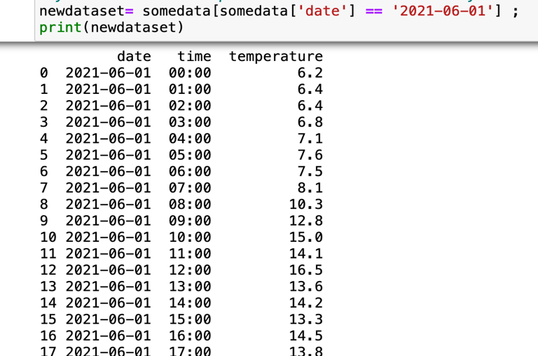
data point = some day at
FMI station
feature = nr of hourly observations
want to predict maximum daytime
temperature
missing relevant features bad for accuracy

Slide 65
data point = some day at
FMI station
feature = hourly temp. 00:00 – 15:00
want to predict temp at 16:00
using irrelevant features wastes comp. resources

Slide 66
how to bring d/m below critical value?
increase m by using more training data
increase m via choice of datapoints
decrease d by using smaller hypothesis space

Slide 67

“…GPT-4 is a Transformer-style model [39 ] pre-trained to predict the next token in a document…”
https://arxiv.org/pdf/2303.08774.pdf

Slide 68
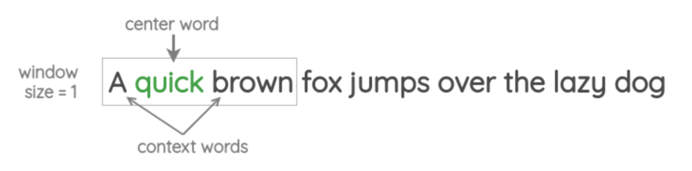
Self-Supervised Learning
https://amitness.com/2020/05/self-supervised-learning-nlp/

Slide 69
GDPR-Compliant Feature Selection
Data minimisation: The use of personal data has to be limited to what is necessary to fulfil the purpose it was collected for …
Proportionality…The amount and nature of the data used has to be proportionate to the purpose and the least invasive for the data subject…
source: https://www.auditingalgorithms.net/

Slide 70
Feature Selection for Trustworthy AI
“Privacy and data governance: besides ensuring full respect for privacy and data protection, …into account the quality, integrity …and ensuring legitimised access to data…
Diversity, non-discrimination and fairness: Unfair bias must be avoided, as it could could have multiple negative implications, from the marginalization of vulnerable groups, to the exacerbation of prejudice and discrimination….”
https://digital-strategy.ec.europa.eu/en/library/ethics-guidelines-trustworthy-ai

Slide 71
Design Choice: Model
interpretability
computational
complexity
statistical
accuracy

Slide 72
Which Model To Choose?
large to offer a good hypothesis
small to fit computational resources
simple or interpretable

Slide 73
training error
validation error
“critical value” (d/m=1)
d / m
adjust model and/or data to reach

Slide 74
params w
which model is best ?

Slide 75
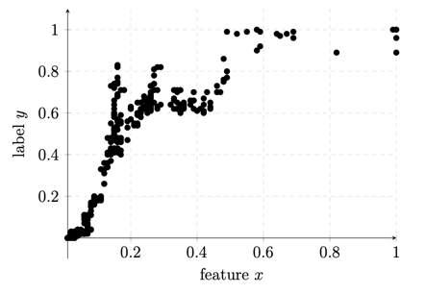
Sufficiently Large
linear model might be to small for such data
no straight line that fits well data points
-> model bias !
need larger models that also contain non-linear maps

Slide 76
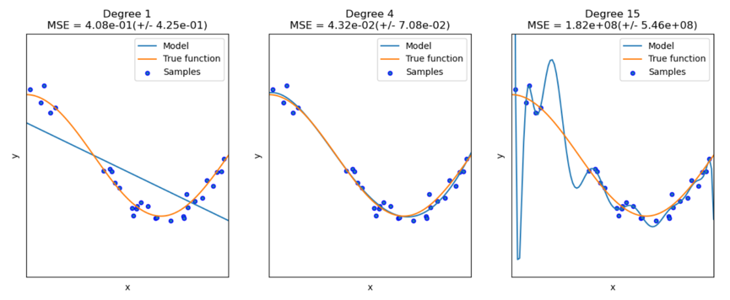
Sufficiently Small (Statistically)
too small
too large
just right
source: https://scikit-learn.org/stable/auto_examples/model_selection/plot_underfitting_overfitting.html
Alex’ rule of thumb:
training set (much) larger than nr of model parameters

Slide 77
Sufficiently Small (Comput.)
consider linear model using n features
fit linear model on m > n datapoints
need to invert “n by n” matrix ! [Sec. 4.3, MLBook]

Slide 78
Sufficiently Simple
hypothesis maps h(x) should be easy to evaluate
MSc thesis on “Predicting Gas Valve Position”
need to compute h(x) in real-time (while engine is running!)

Slide 79
Explaining a Prediction.
x
> 5?
no
yes
1
2

Slide 80
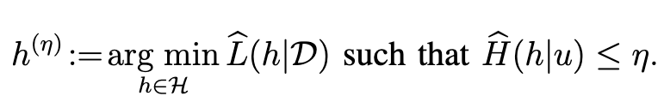
Prune Model to Ensure Explainability
[1]Zhang, L., Karakasidis, G., Odnoblyudova, A., Dogruel, L., and Jung, A., “Explainable Empirical Risk Minimization”, <i>arXiv e-prints</i>, 2020. doi:10.48550/arXiv.2009.01492.

Slide 81
Design Choice: Loss
interpretability
computational
complexity
statistical
accuracy

Slide 82
Which Loss Function ?
statistical aspects (should favour “reasonable” hypothesis)
computational aspects (must be able to minimize them)
interpretation (what does log-loss = -3 mean ?)
…..choosing a suitable loss function is often non-trivial !

Slide 83
Squared Error
cvx and diff.able
minimized via simple gradient descent
sensitive to outliers
Absolute Error
cvx but non-diff.
requires more advanced opt. methods
robust against outliers

Slide 84
Train Linear Model on “Clean Data”
y
h(x) = w*x+b
x

Slide 85
SINGLE OUTLIER
y
h(x) = w*x+b
min. av. squared error
x

Slide 86
Training Set with a SINGLE OUTLIER !
y
h(x) = w*x+b
min. absolute error
x

Slide 87
Different Loss for Train and Val
use different loss for training and validation
allows to compare different ML methods
logistic regression uses logistic loss to learn hypothesis h1(x)
SVM uses hinge loss to learn hypothesis h2(x)
compare h1, h2 by average 0/1 loss (“1-acc”) on val. set

Slide 88

Could Loss Reveal Private Information?

Slide 89
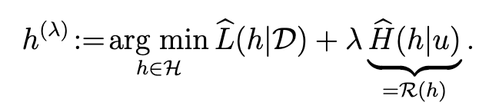
Explainability via Loss Penalty

