Slide 1
CS-C3240 - Machine Learning
Model Regularization
Alexander Jung

Slide 2
What I want to teach you today:
recap of model training, validation and selection
basic idea of regularization
basic idea of data augmentation
equivalence between regularization and data aug.

Slide 3
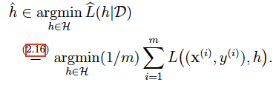
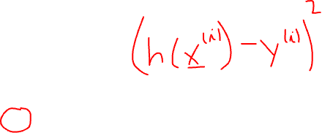
Empirical Risk Minimization
learn hypothesis out of model that incurs minimum loss when predicting labels of datapoints based on their features
hypothesis
label of i-th datapoint
model
loss function
features of i-th datapoint
see Ch. 4.1 of mlbook.cs.aalto.fi

Slide 4


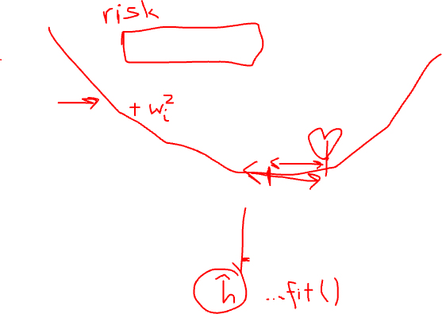
ERM is only Approximation!
hypothesis h

Slide 5

Model Validation and Selection

Slide 6
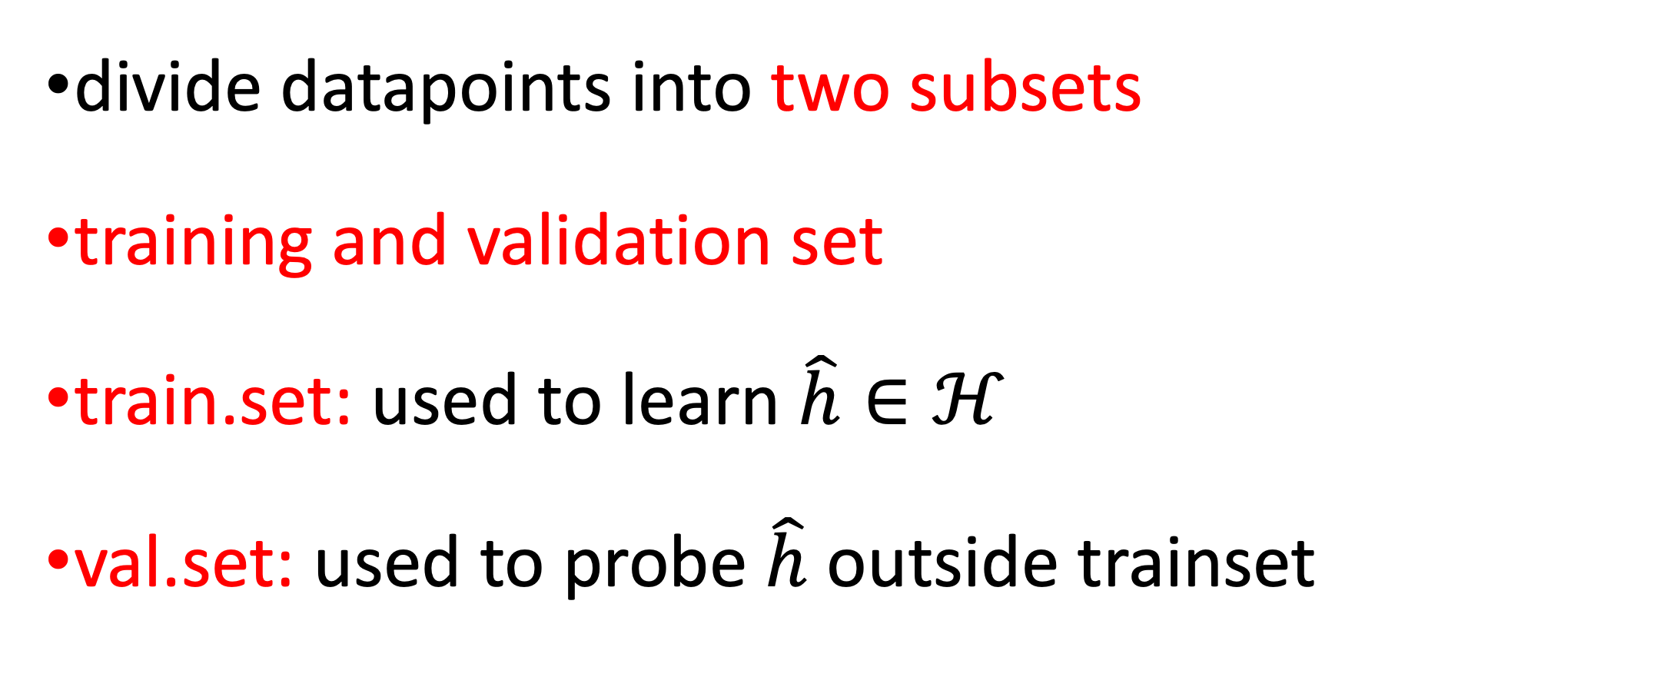
Learn and Validate!
divide datapoints into two subsets
training and validation set
train.set: used to learn $\hat{h}∈ℋ$
val.set: used to probe $\hat{h}$ outside trainset

Slide 7
Split Data into Training and Validation Set !
training set
validation set
see Chapter 6.2 of mlbook.cs.aalto.fi

Slide 8
Split into Train and Val Set in Python
labels of datapoints
in trainset
labels of datapoints
feature vectors of
datapoints in trainset
feature vectors of datapoints

Slide 9
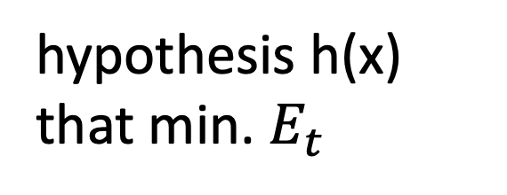

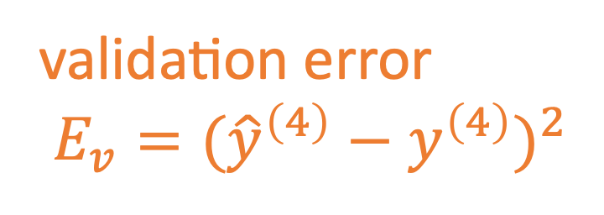
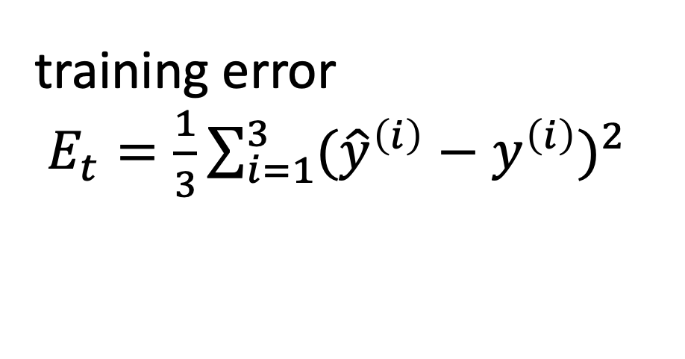


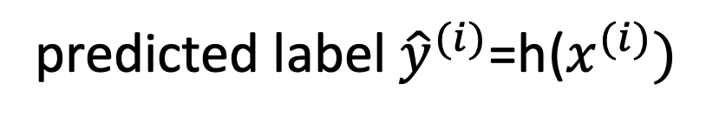
Train and Validate Model 1 $ℋ^{(1)}$
hypothesis h(x)
that min. $E_{t}$
predicted label ${\hat{y}}^{(i)}$=h($x^{(i)})$
$${\hat{y}}^{(i)}−y^{(i)}$$
$$x^{(i)},y^{(i)}$$
label y
training error
$E_{t}=\frac{1}{3}\sum_{i=1}^{3}{({\hat{y}}^{\left(i\right)}−y^{\left(i\right)})^{2}}$
validation error
$E_{v}=({\hat{y}}^{\left(4\right)}−y^{\left(4\right)})^{2}$
feature x

Slide 10

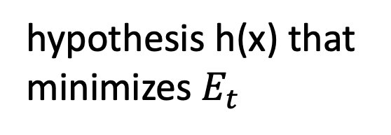
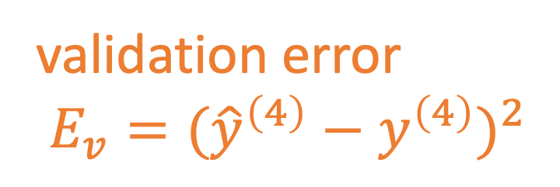
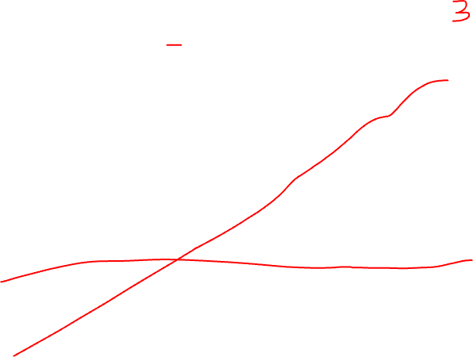
Train and Validate Model 2 $ℋ^{(2)}$
hypothesis h(x) that
minimizes $E_{t}$
$$x^{(i)},y^{(i)}$$
label y
training error
$E_{t}=\frac{1}{3}\sum_{i=1}^{3}{({\hat{y}}^{\left(i\right)}−y^{\left(i\right)})^{2}}$
validation error
$E_{v}=({\hat{y}}^{\left(4\right)}−y^{\left(4\right)})^{2}$
feature x

Slide 11
Basic Idea of Model Selection
choose model with smallest validation error!
training validation
error error
model 1
degree 1 polyn.
model 2:
degree 3 polyn.
Notes:
it seems that larger models (higher polyn. degree) results in larger validation error. is this always the case?

Slide 12
Different Loss for Train and Val
use different loss for training and validation
allows to compare different ML methods
logistic regression uses logistic loss to learn hypothesis h1(x)
SVM uses hinge loss to learn hypothesis h2(x)
compare h1, h2 by average 0/1 loss (“1-acc”) on val. set

Slide 13
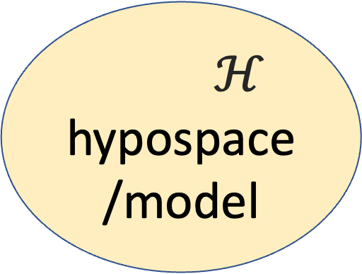
Data and Model Size
$$\left(x^{(1)},y^{(1)}\right)$$
training set
m
$$\left(x^{(2)},y^{(2)}\right)$$
$ℋ$
hypospace/model
$$\left(x^{(m)},y^{(m)}\right)$$
nr. of features n
crucial parameter is the
ratio d/m
eff. dimension d
Notes:
The sample size m is the nr. of different datapoints in the training set

Slide 14
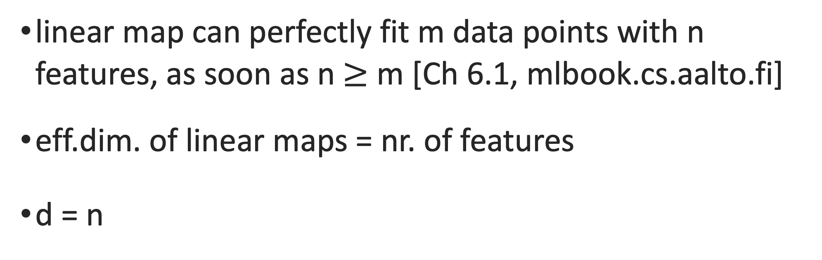

Effective Dim. Linear Maps
linear map can perfectly fit m data points with n features, as soon as n $≥$ m [Ch 6.1, mlbook.cs.aalto.fi]
eff.dim. of linear maps = nr. of features
d = n

Slide 15
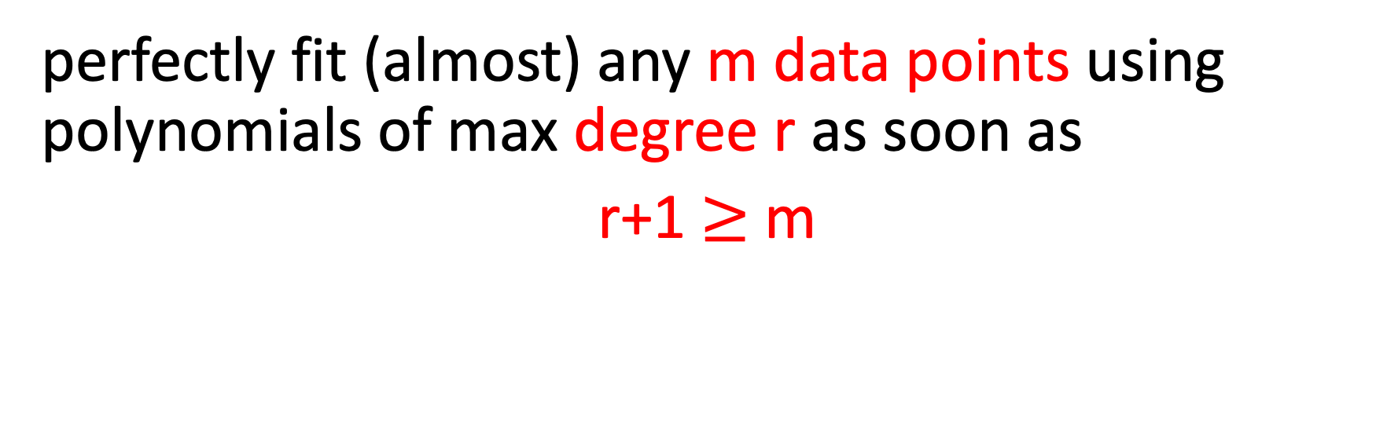
Effective Dim. Polyn. Reg.
perfectly fit (almost) any m data points using polynomials of max degree r as soon as
r+1 $≥$ m
-> d = r+1 (effective dim. of polyn. regression equals the max. polyn. degree plus one!)

Slide 16
m=2, degree r=1 polynomial
label y
feature x

Slide 17
m=3, degree r=2 polynomial
label y
feature x

Slide 18
Data Hungry ML Methods
millions of features for datapoints (e.g. megapixel image)
eff.dim. d of linear maps is also millions
eff.dim d of deep nets is millions … billions
can perfectly fit any set of 100000s (!) of datapoints
training error will be zero (overfitting!)

Slide 19
training error
validation error
“critical value” (d/m=1)
d / m
adjust model and/or data to reach

Slide 20
how to bring d/m below critical value?
increase m by using more training data
decrease d by using smaller hypothesis space

Slide 21
how to bring d/m below critical value?
increase m by using more training data
decrease d by using smaller hypothesis space

Slide 22
Data Augmentation
Notes:
consider the first option to ajdust the ratio d/m. We could collect more data points for training set. Wha tcould be the problem here ? Note that we must know the labels of datapoints in the trainig set.However, we can use some domain knowledge do generate new datapoints synthetically(simulate it).

Slide 23

add a bit of noise to features
original datapoint
label y
augmented
feature x
we have increased the dataset by factor 3 !

Slide 24

rotated cat image is still cat image

Slide 25
flipped cat image is still cat image

Slide 26
shifted cat image is still cat image

Slide 27
how to bring d/m below critical value?
increase m by using more training data
decrease d by using smaller hypothesis space

Slide 28
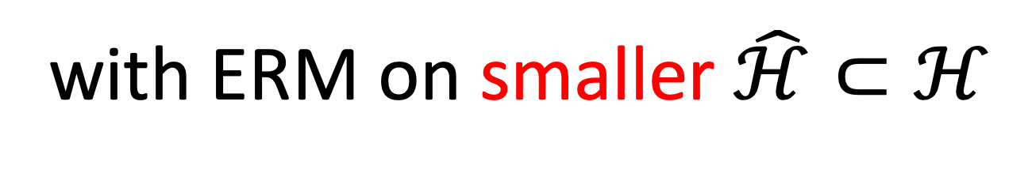
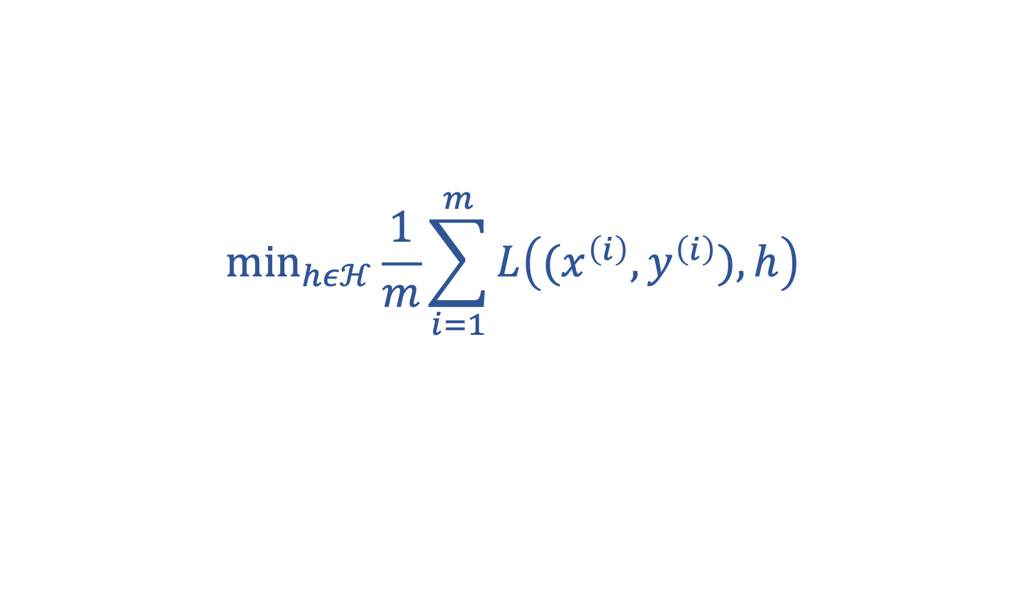
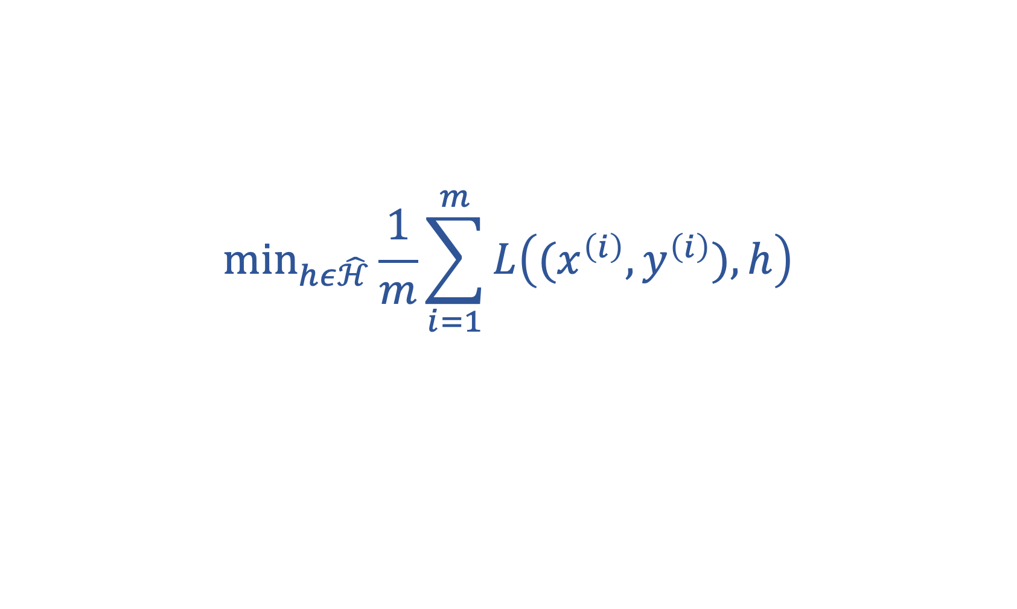
replace original ERM
$${\text{min}}_{hεℋ}\frac{1}{m}\sum_{i=1}^{m}{L\left((x^{\left(i\right)},y^{\left(i\right)}),h\right)}$$
with ERM on smaller $\hat{ℋ}⊂ℋ$
$${\text{min}}_{hε\hat{ℋ}}\frac{1}{m}\sum_{i=1}^{m}{L\left((x^{\left(i\right)},y^{\left(i\right)}),h\right)}$$

Slide 29
Nested Models
degree 3
polyn.
degree 2
polyn.
degree 1 polyn.

Slide 30
Prune Hypospace by Early Stopping
10000 iterations
100 iterations
10 iterations

Slide 31
Soft Model Pruning
via
Regularization

Slide 32
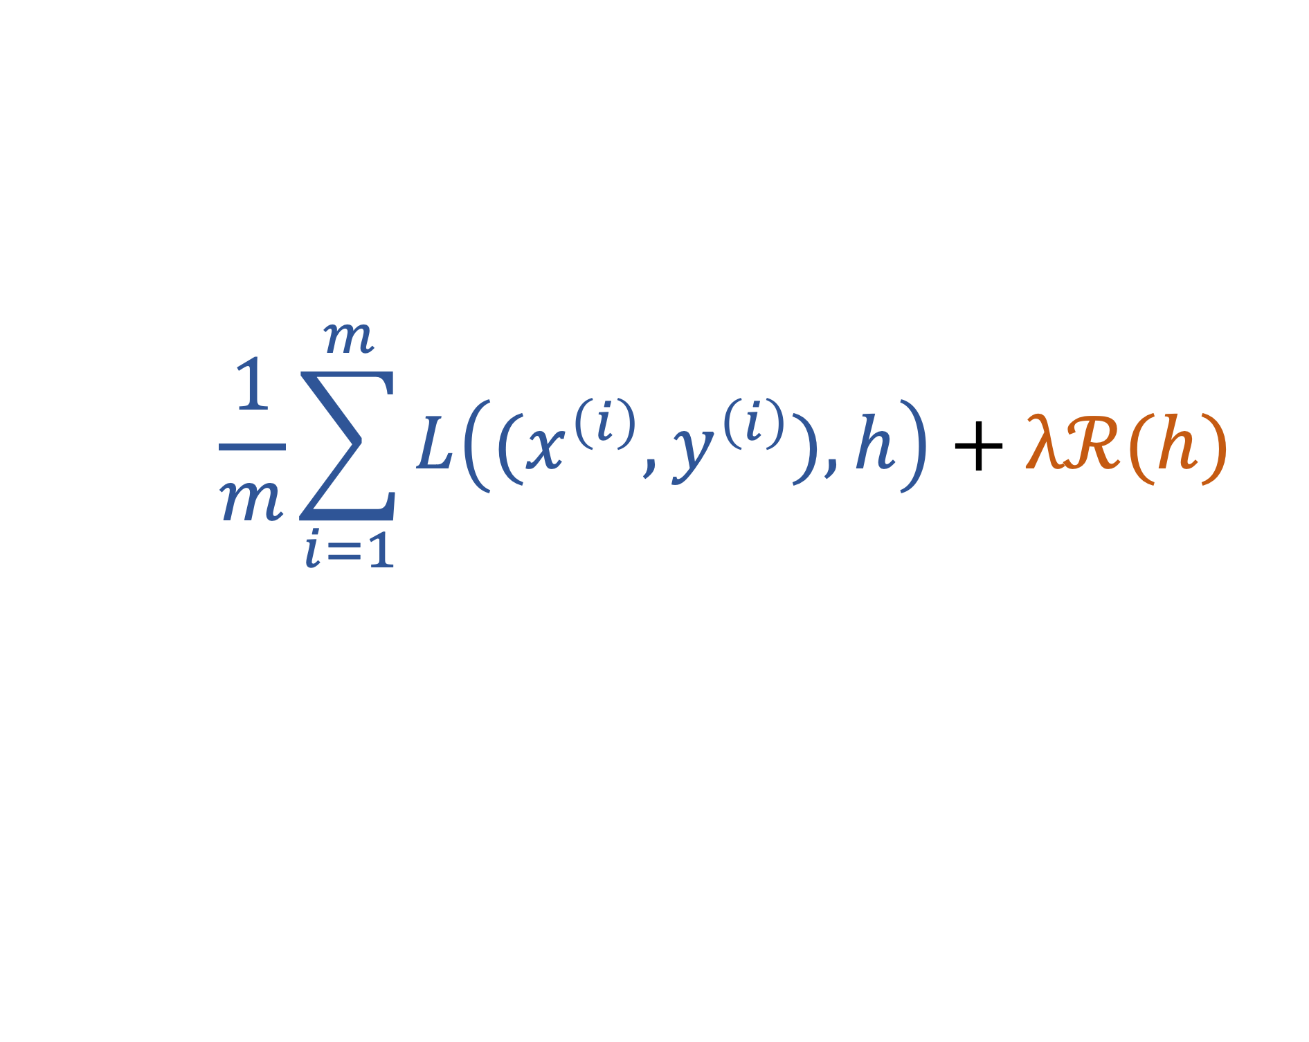
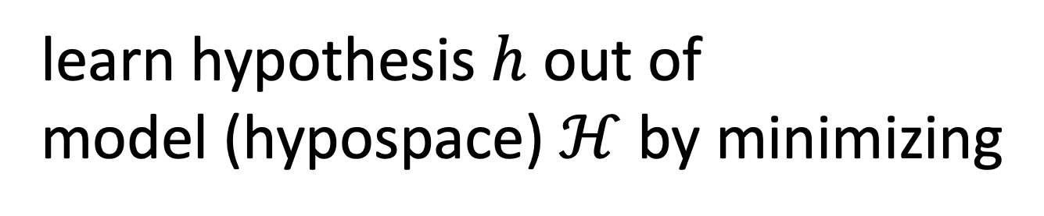
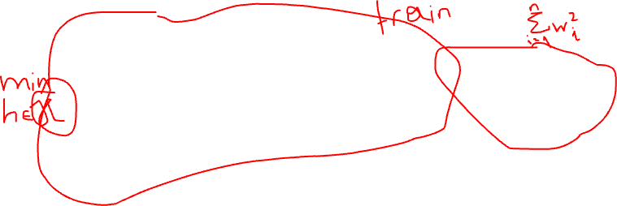
Regularized ERM
learn hypothesis $h$ out of
model (hypospace) $ℋ$ by minimizing
$$\frac{1}{m}\sum_{i=1}^{m}{L\left((x^{\left(i\right)},y^{\left(i\right)}),h\right)}+λℛ(h)$$
average loss on training set
(empirical risk of h)
loss increase for datapoints
outside training set

Slide 33
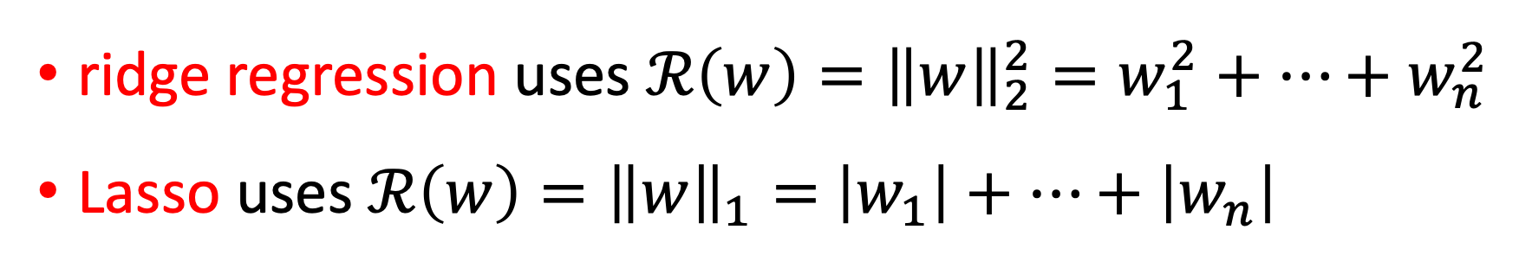
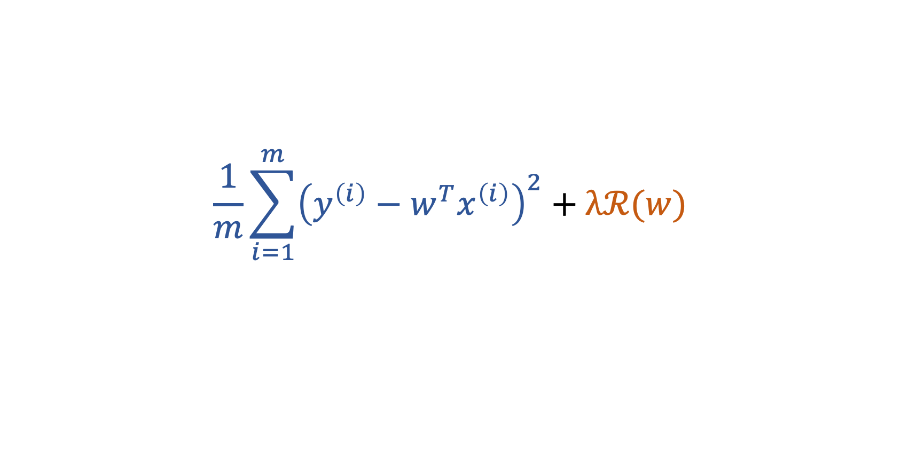
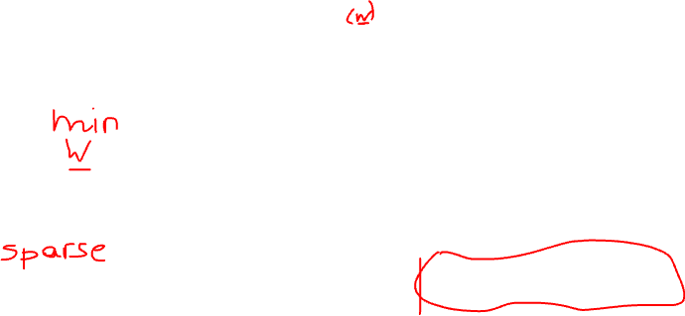
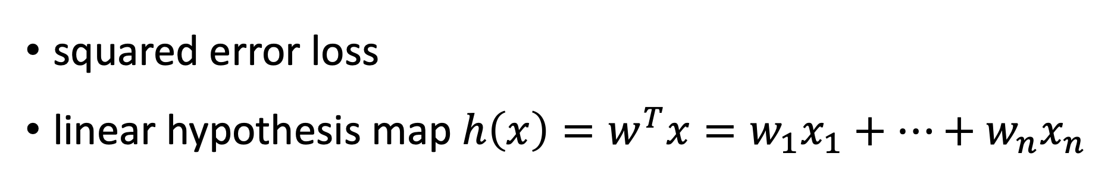
Regularized Linear Regression
squared error loss
linear hypothesis map $h\left(x\right)=w^{T}x=w_{1}x_{1}+…+w_{n}x_{n}$
$$\frac{1}{m}\sum_{i=1}^{m}{{\left(y^{\left(i\right)}−{w^{T}x}^{\left(i\right)}\right)}^{2}}+λℛ(w)$$
ridge regression uses $ℛ\left(w\right)={\left\|w\right\|}_{2}^{2}=w_{1}^{2}+…+w_{n}^{2}$
Lasso uses $ℛ\left(w\right)={\left\|w\right\|}_{1}=$ $\left|w_{1}\right|+…+\left|w_{n}\right|$

Slide 34
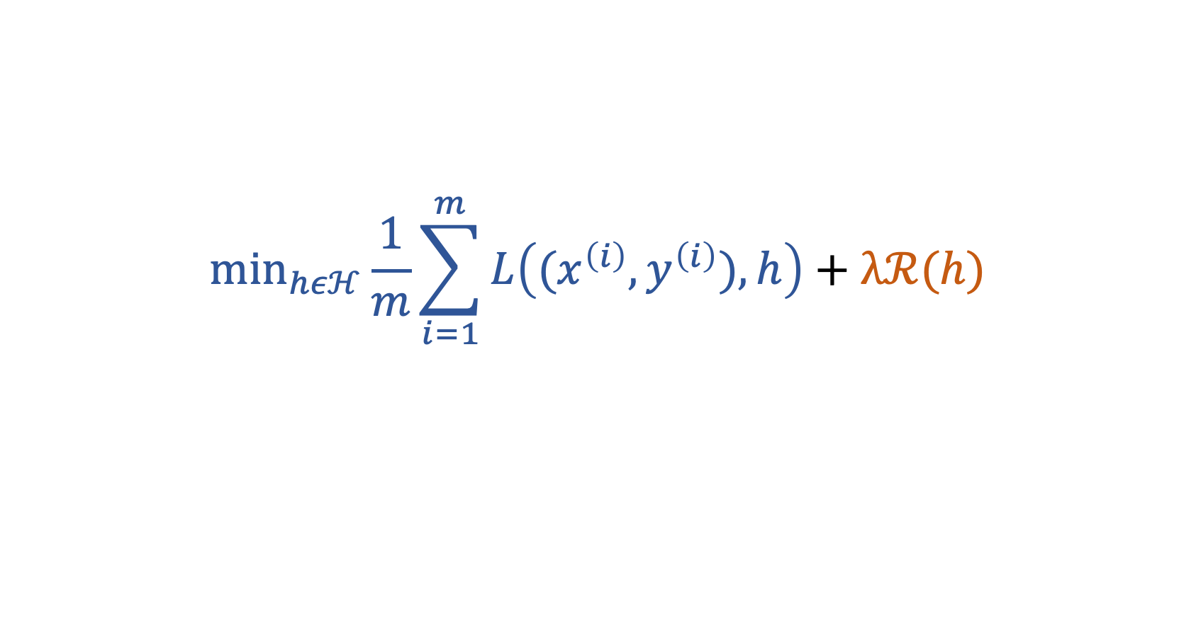
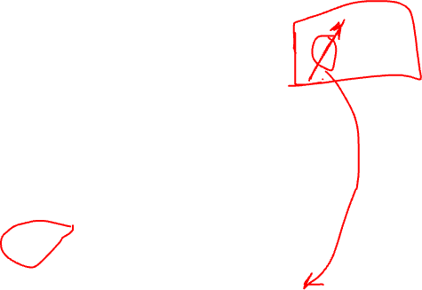

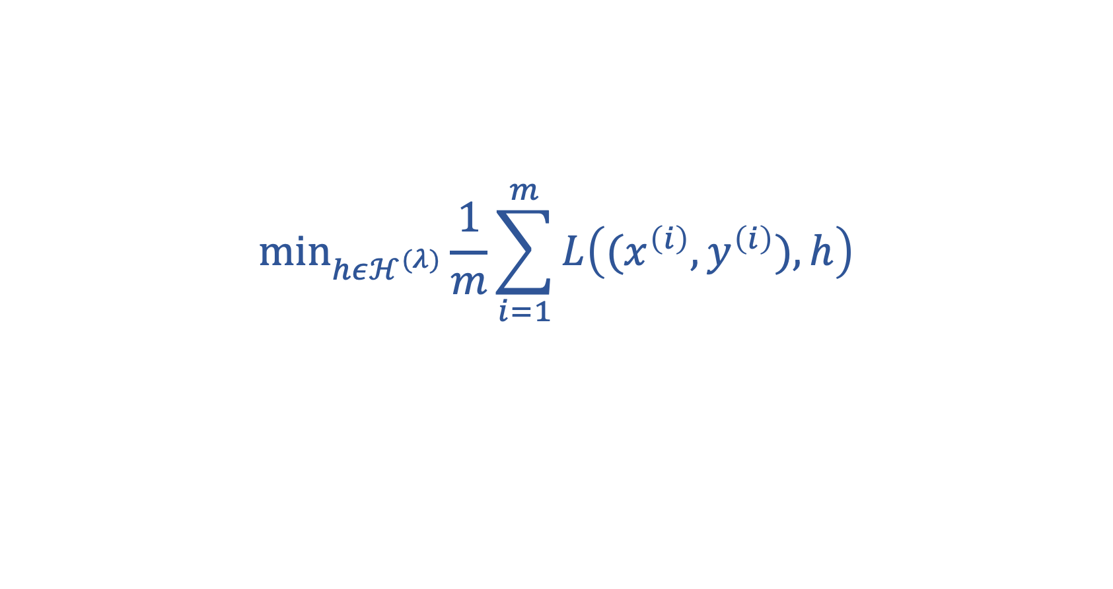
Regularization = Implicit Pruning!
$${\text{min}}_{hεℋ}\frac{1}{m}\sum_{i=1}^{m}{L\left((x^{\left(i\right)},y^{\left(i\right)}),h\right)}+λℛ(h)$$
equivalent to
$${\text{min}}_{hεℋ^{(λ)}}\frac{1}{m}\sum_{i=1}^{m}{L\left((x^{\left(i\right)},y^{\left(i\right)}),h\right)}$$
with pruned model $ℋ^{(λ)}⊂ℋ$
Notes:
The larger the regularization parameter lambda, the smaller the pruned model H^{(lambda)}

Slide 35

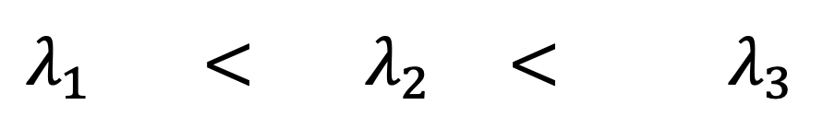



Regularization = “Soft” Model Selection
$$λ_{1} < λ_{2}\text{ <} λ_{3}$$
$$ℋ^{(λ_{1})}$$
$$ℋ^{(λ_{2})}$$
$$ℋ^{(λ_{3})}$$
$$λ$$
Notes:
We can intepret reuglizaton as a form of soft model pruning. Instead of chosing between a discrete set of different models, e.g., sets of polynomials with different maximum degree, regularization smoothly varies the pruned hypothesis space as lambda is varied.

Slide 36
Regularization
does implicit
Data Augmentation

Slide 37
augment with (infinitely many) realizations of RV!
label y
original datapoint
augmented
=
+ ”noise”
feature x

Slide 38
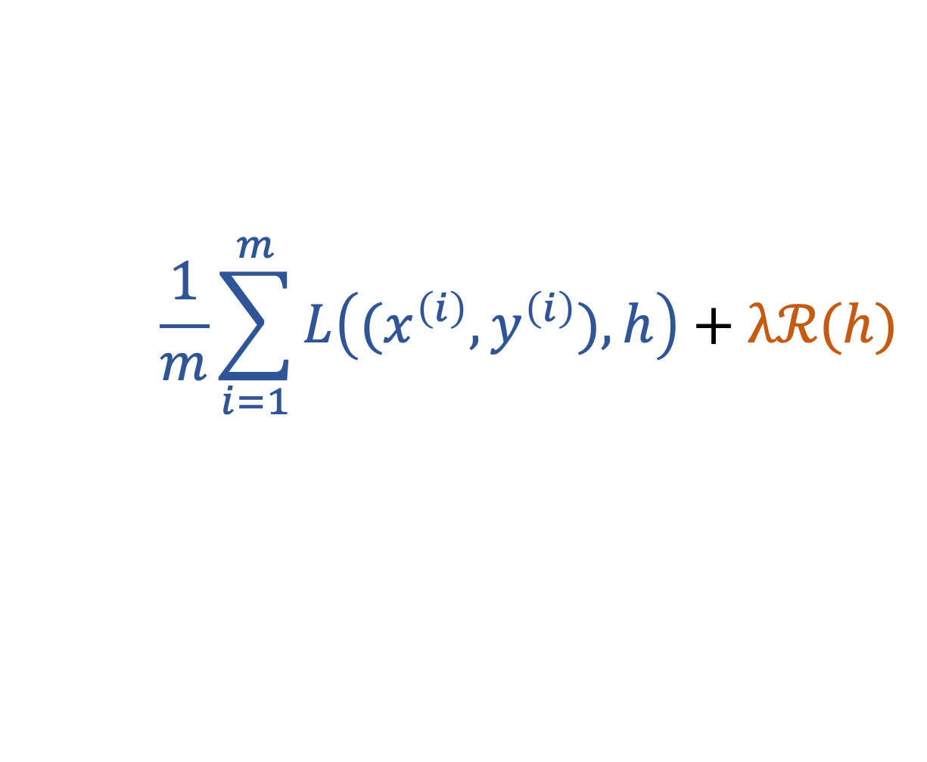
Regularization =Implicit Data Aug.
raw datapoint
label y
h(x)
“perturbed”
datapoint
$$\frac{1}{m}\sum_{i=1}^{m}{L\left((x^{\left(i\right)},y^{\left(i\right)}),h\right)}+λℛ(h)$$
see Chapter 7.3 of mlbook.cs.aalto.fi
feature x
Notes:
If we use a larger number of perturbed copies for each datapoint in the original training set, we obtain an average loss which consists of the original training error and
another comoennts due to the perturbed datapoints. This additoinal component is approximately equal to the reguarlization term used in regularized ERM.

Slide 39
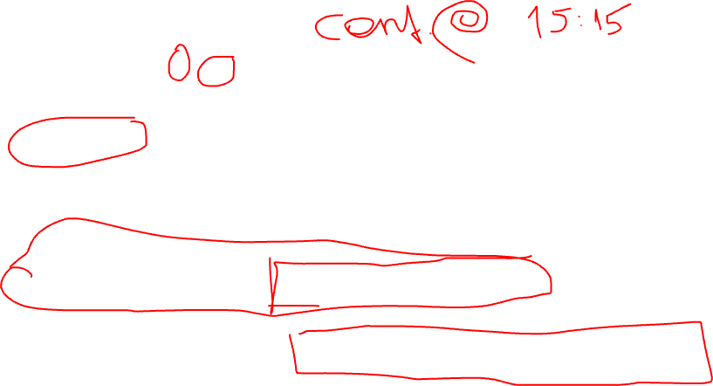
To sum up,
large ratio d/m leads to overfitting
reduce d by using smaller model (“pruning”)
increase m by using more data points
regularization is a soft model pruning
regularization does implicit data augmentation

Slide 40
Questions ?

Slide 41
Transfer Learning
via
Regularization

Slide 42
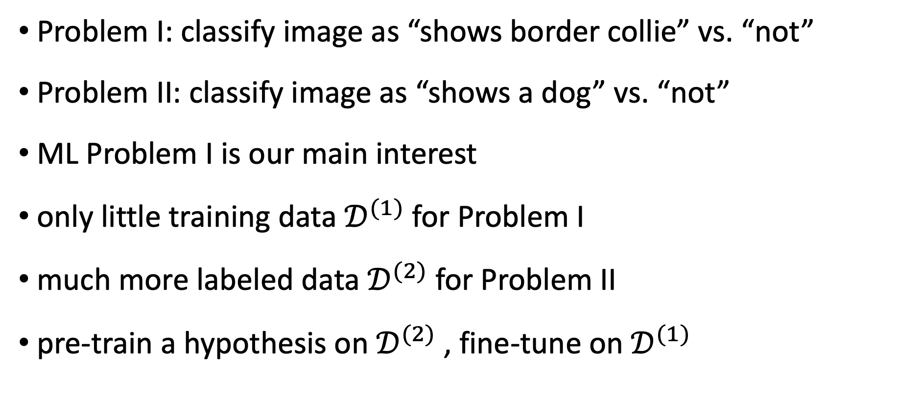
Problem I: classify image as “shows border collie” vs. “not”
Problem II: classify image as “shows a dog” vs. “not”
ML Problem I is our main interest
only little training data $𝒟^{(1)}$for Problem I
much more labeled data $𝒟^{(2)}$ for Problem II
pre-train a hypothesis on $𝒟^{(2)}$, fine-tune on $𝒟^{(1)}$

Slide 43
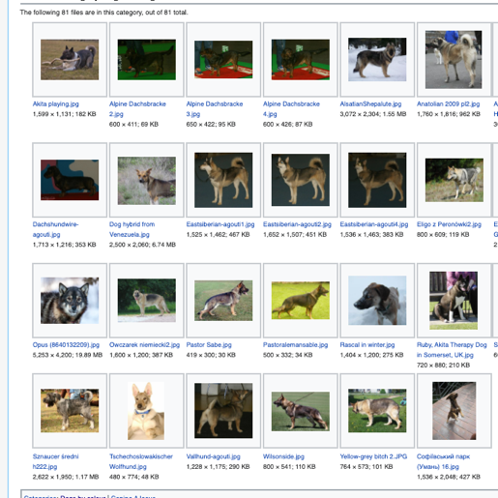


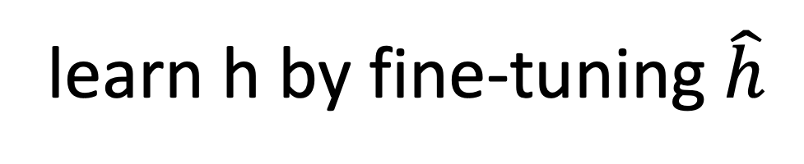
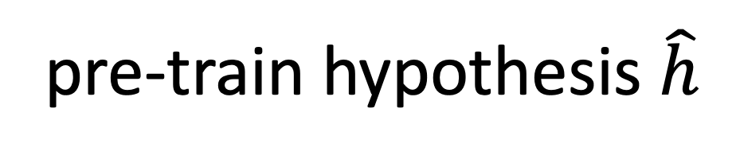


$$𝒟^{(1)}$$
$$𝒟^{(2)}$$
learn h by fine-tuning $\hat{h}$
pre-train hypothesis $\hat{h}$

Slide 44
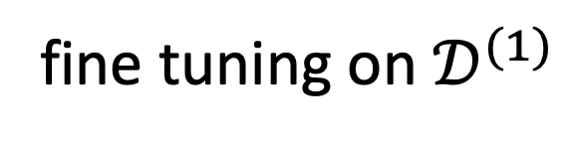
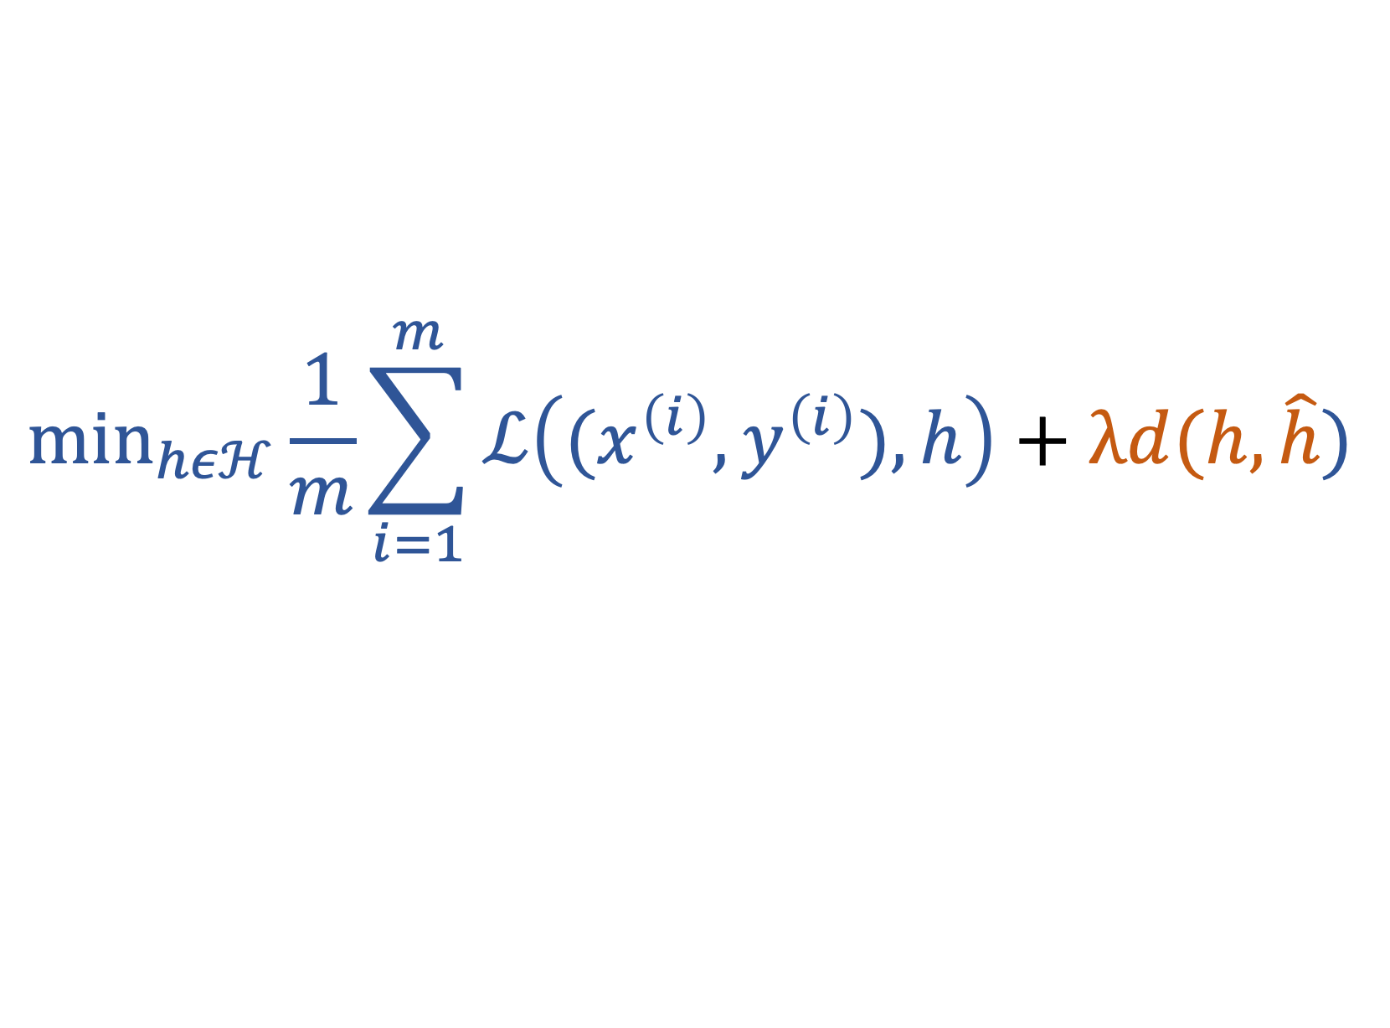
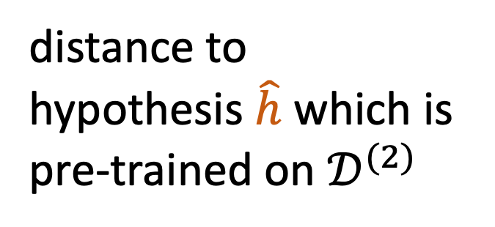
$${\text{min}}_{hεℋ}\frac{1}{m}\sum_{i=1}^{m}{ℒ\left((x^{\left(i\right)},y^{\left(i\right)}),h\right)}+λd(h,\hat{h})$$
distance to
hypothesis $\hat{h}$ which is
pre-trained on $𝒟^{(2)}$
fine tuning on $𝒟^{(1)}$

Slide 45
Multi-Task Learning
via
Regularization

Slide 46
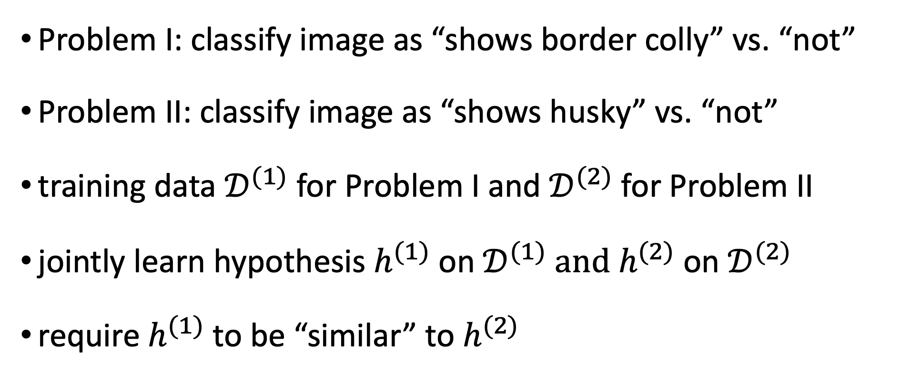
Problem I: classify image as “shows border colly” vs. “not”
Problem II: classify image as “shows husky” vs. “not”
training data $𝒟^{(1)}$for Problem I and $𝒟^{(2)}$ for Problem II
jointly learn hypothesis $h^{(1)}$ on $𝒟^{(1)}$ and $h^{(2)}$ on $𝒟^{(2)}$
require $h^{(1)}$ to be “similar” to $h^{(2)}$

Slide 47


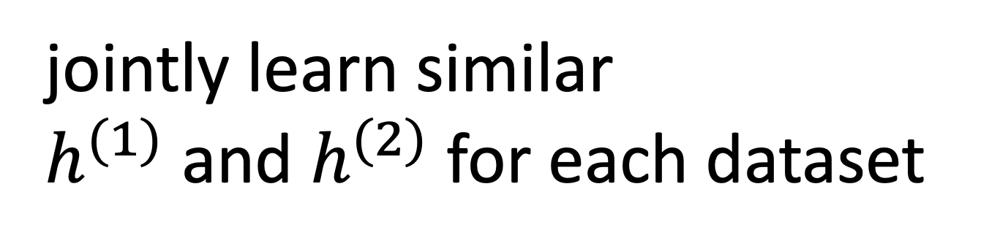
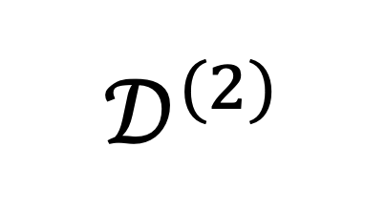
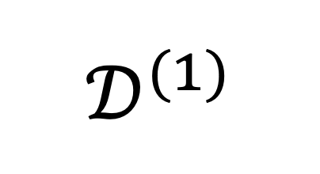
$$𝒟^{(1)}$$
$$𝒟^{(2)}$$
jointly learn similar
$h^{(1)}$ and $h^{(2)}$ for each dataset

Slide 48

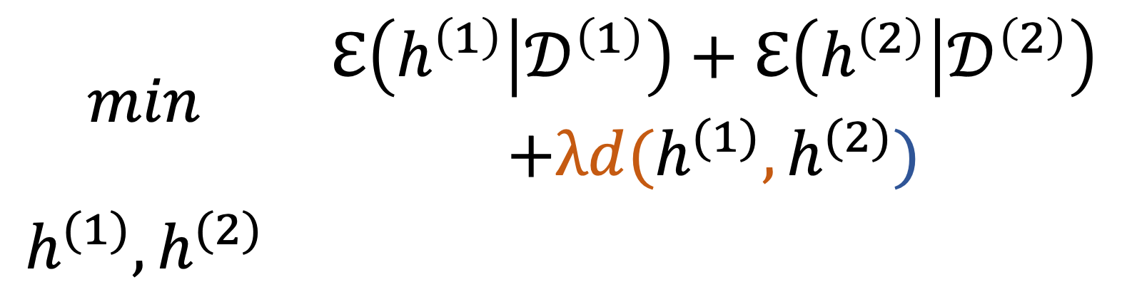
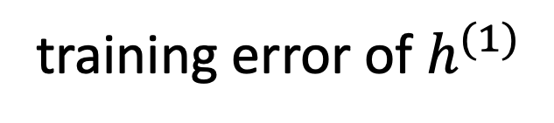
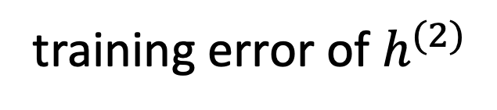
training error of $h^{(1)}$
training error of $h^{(2)}$
$$\begin{matrix}min & \begin{aligned}ℇ\left(h^{\left(1\right)} | 𝒟^{\left(1\right)}\right)+ℇ\left(h^{\left(2\right)} | 𝒟^{\left(2\right)}\right) \\ +λd(h^{(1)},h^{(2)})\end{aligned} \\ h^{(1)},h^{(2)} & \end{matrix}$$
“distance” between $h^{(1)}$ and $h^{(2)}$

Slide 49
Semi-Supervised Learning
via
Regularization

Slide 50

classify image as “shows border colly” vs. “not”
small labeled dataset $𝒟^{(1)}$
massive image database $𝒟^{(2)}$ with unlabeled images
train hypothesis h(.) on $𝒟^{(1)}$with following structure:
feature map
g(.)
z
lin. map
f(.)
x
h(x)

Slide 51

$$𝒟^{(1)}$$
$$𝒟^{(2)}$$
learn linear classifier f(.)
learn feature map g(.)

Slide 52


${\text{min}}_{hεℋ}\frac{1}{m}\sum_{i=1}^{m}{ℒ\left((x^{\left(i\right)},y^{\left(i\right)}),h\right)}+λ$ $ℇ\left(g | 𝒟^{\left(2\right)}\right)$
use training error
to fine tune f(.)
learn feature map g(.)
using large unlabeled
database $𝒟^{\left(2\right)}$

