Slide 1

Empirical Risk Minimization
Alexander Jung
based on Chapter 4 of
preprint: mlbook.cs.aalto.fi

Slide 2
Learning Goals:
know about notion of expected loss or risk
know that average loss approximates risk
know about empirical risk minimization
be aware of design choices data/model/loss and their effect on ERM methods

Slide 3
What is ML About ?
fit models to data to make predictions or forecasts !

Slide 4

Data. Model. Loss.
data: set of datapoints (x,y)
model: set of hypothesis maps h(.)
loss: quality measure L((x,y),h)

Slide 5
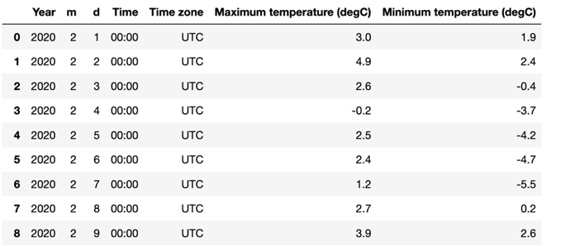
Data

Slide 6



Data.
stack feature vecs into matrix
stack labels into vector

Slide 7

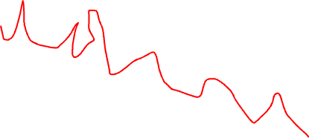



label y
$$\hat{y}=h(x)$$
$$\left(x^{(2)},y^{(2)}\right)$$
$$\left(x^{(1)},y^{(1)}\right)$$
$$\hat{y}=h^{′}(x)$$
feature x

Slide 8

Machine Learning.
find hypothesis in model that incurs smallest loss when predicting label of any datapoint

Slide 9
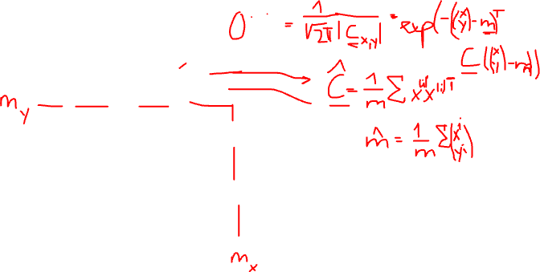
What is Any Datapoint?
label y
observed datapoints
p(x,y)
“new” datapoint
interpret data points as
realizations of i.i.d. random
variables with prob. distr. p(x,y)
define loss incurred for any
data point as expected loss
feature x

Slide 10
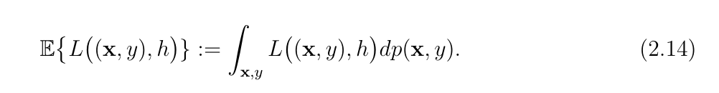
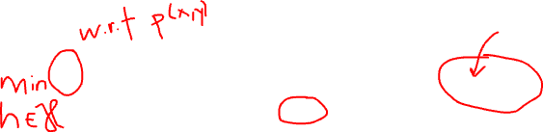
Expected Loss or Risk
note: to compute this expectation
we need to know the probability distribution
p(x,y) of datapoints (x,y)

Slide 11
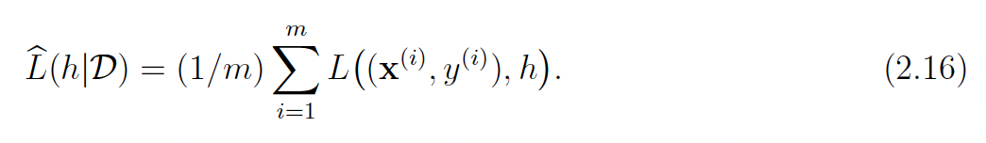
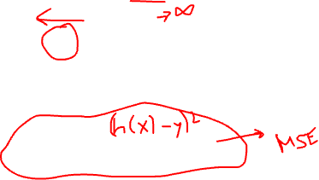
Empirical Risk
IDEA: approximate expected loss by average
loss on some datapoints (training set)
with the average loss or empirical risk

Slide 12
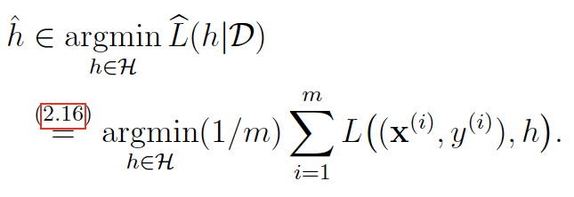
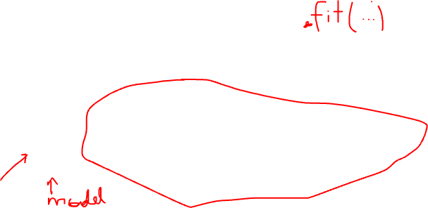
Empirical Risk Minimization

Slide 13


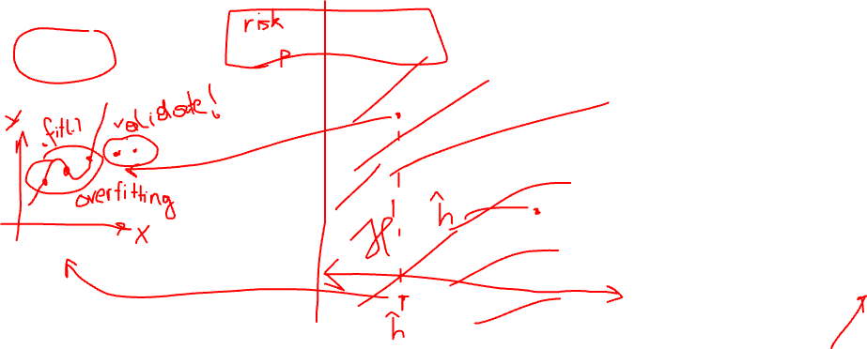
Empirical Risk Minimization
hypothesis h

Slide 14
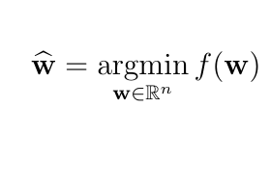
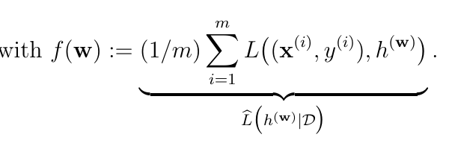
ERM for Parametrized Models
learnt (optimal) parameter vector
loss incurred by h(.)
for i-th data point
average loss or
empirical risk

Slide 15
ERM for Param. Models
params w

Slide 16
Design Choices in ERM
loss
data
model
params w

Slide 17
Design Choice: Model and Data

Slide 18
Linear Regression
datapoints characterized by feature vector and numeric label
model consists of linear hypothesis maps
squared error loss

Slide 19
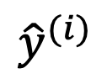
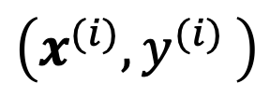
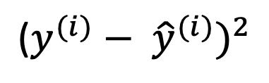
Linear Regression
y
$${\hat{y}}^{(i)}$$
$${\text{(}y^{(i)}− {\hat{y}}^{(i)})}^{2}$$
$$\left(x^{(i)}{,y}^{(i)}\right)$$
features x
choose parameter/weight vector w to
minimize average squared error loss

Slide 20
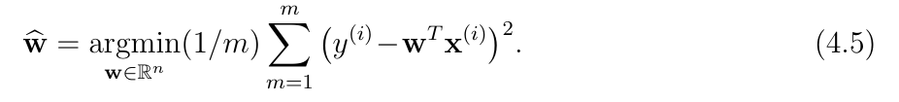

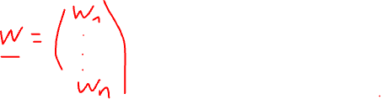
ERM for Linear Regression
w
Notes:
Note that the objective function depends on the labels and features of the datapoints in the training set.

Slide 21
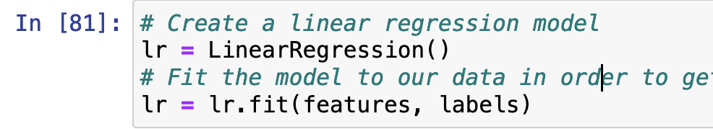
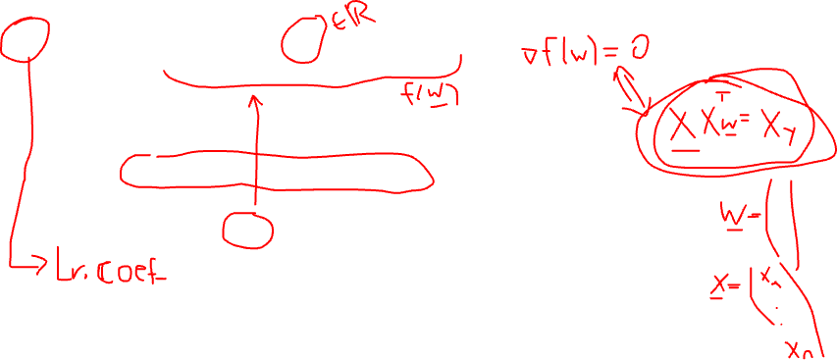
Linear Regression in Python

Slide 22
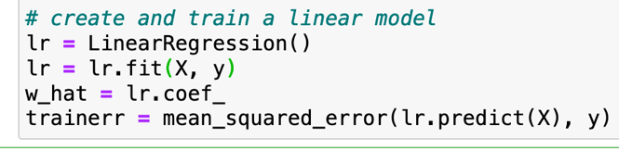
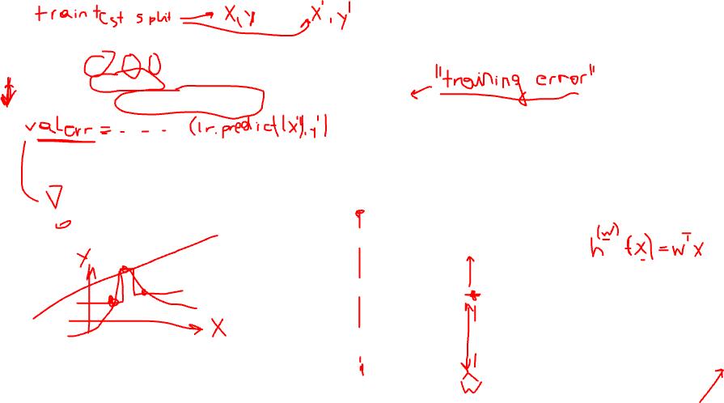
params w

Slide 23
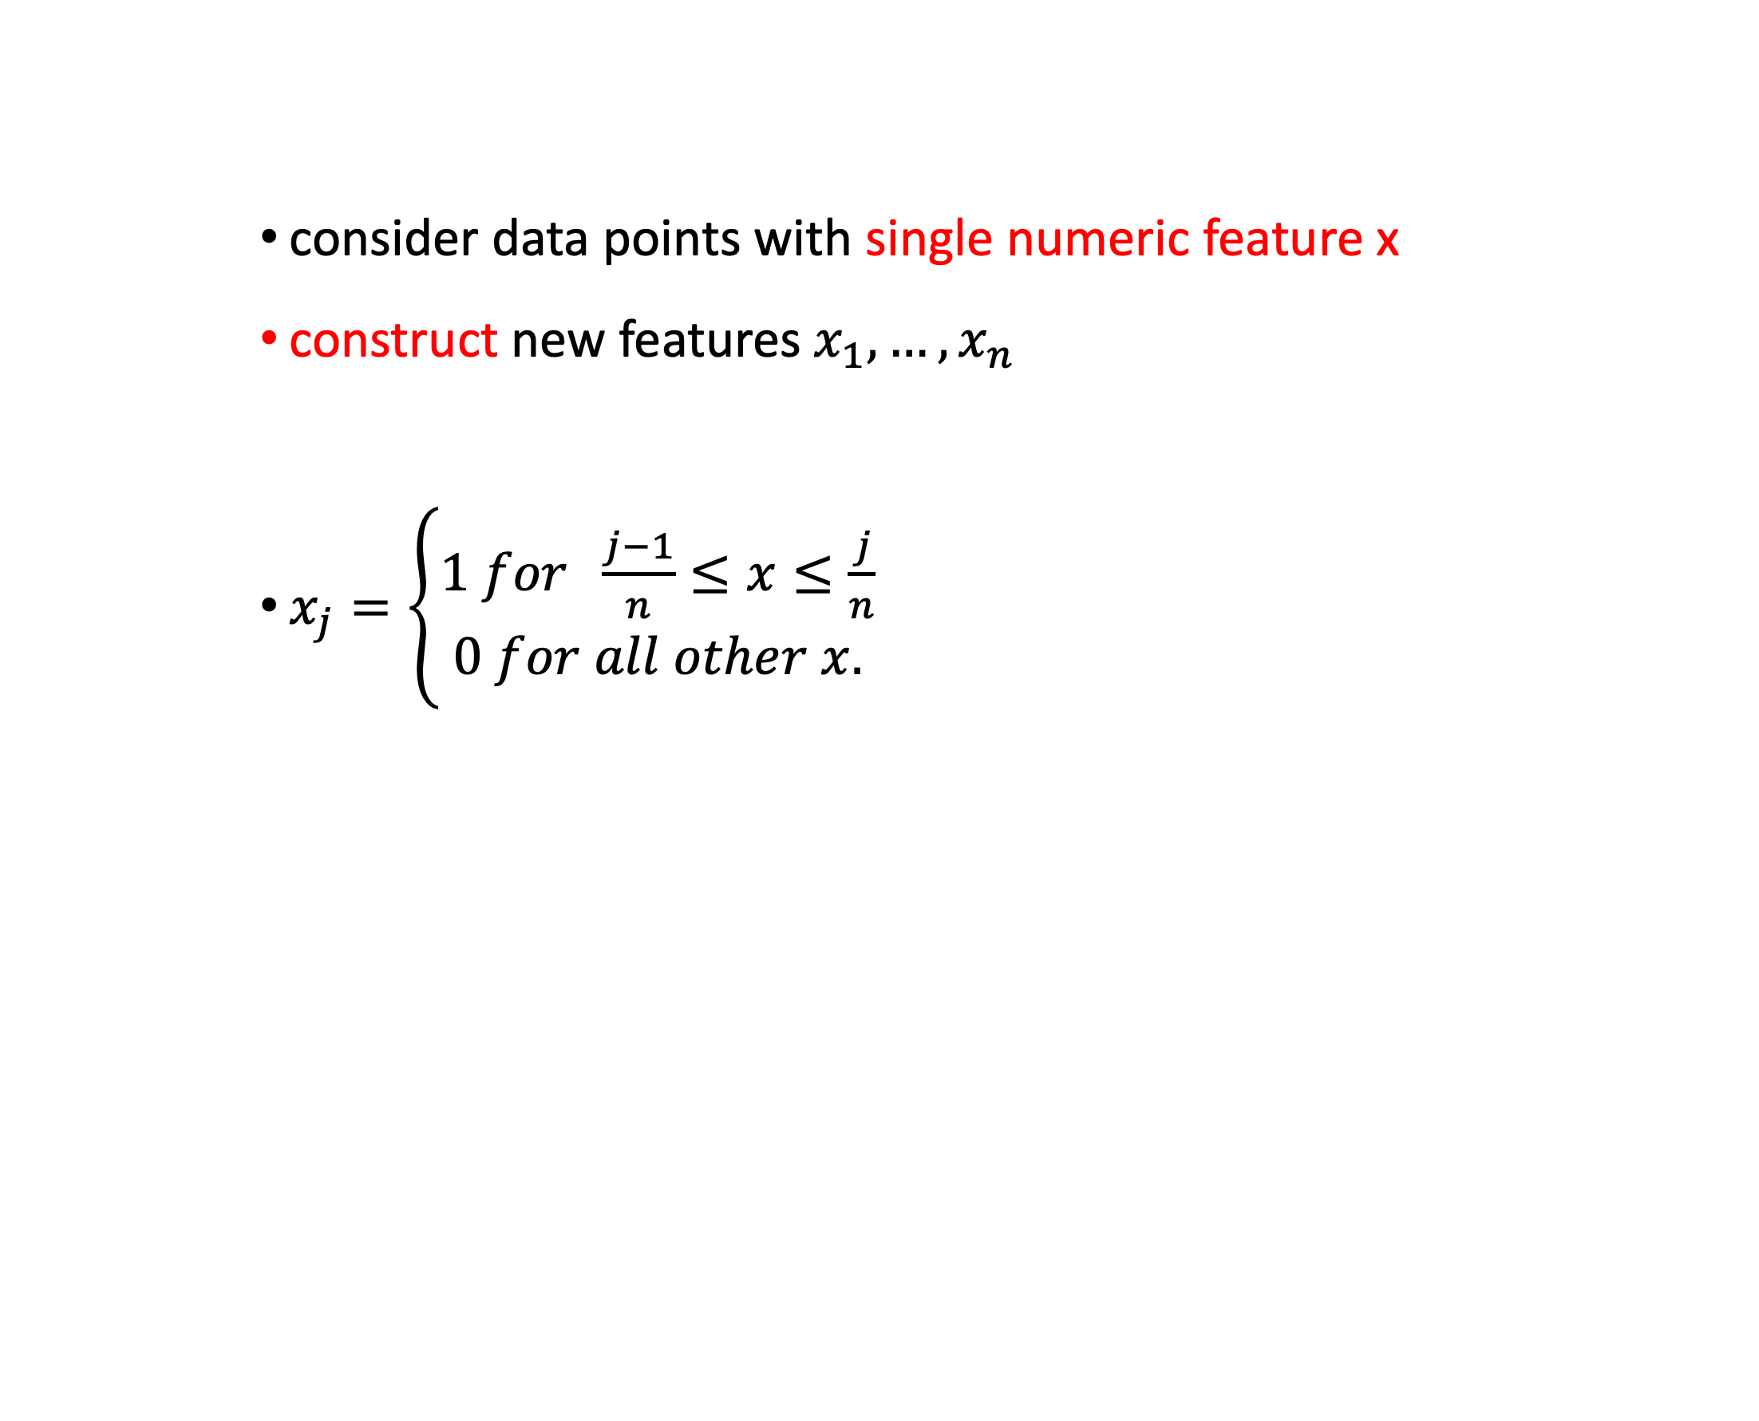
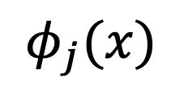
Upgrade Linear Model with new Features !
consider data points with single numeric feature x
construct new features $x_{1},…,x_{n}$
$x_{j}=\left\{\begin{aligned}1 for \frac{j−1}{n}≤x≤\frac{j}{n} \\ 0 for all other x.\end{aligned}\right.$
$$φ_{j}(x)$$
1
x
(j-1)/n
j/n
1

Slide 24
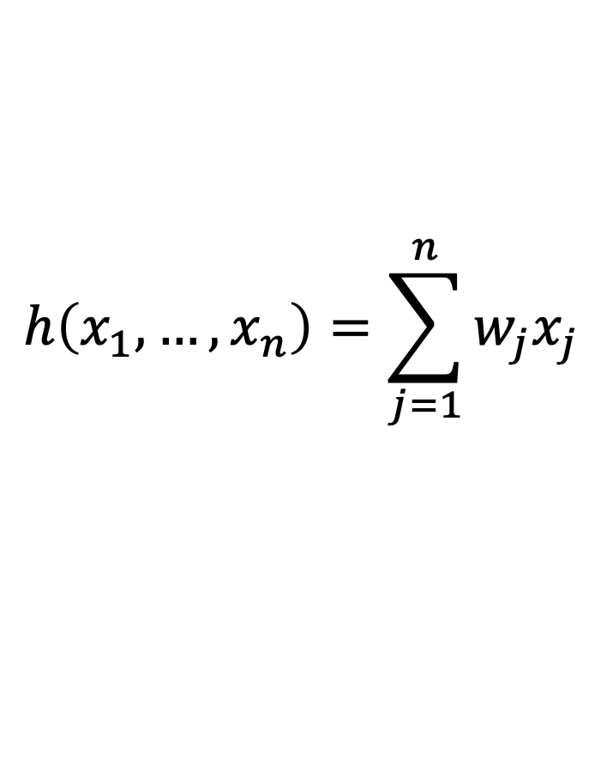
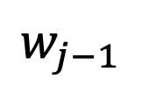

You Can Do Anything with Linear Predictors!
h(x) is linear in new features but non-linear in raw feature x!
$$h\left(x_{1},…,x_{n}\right)=\sum_{j=1}^{n}{w_{j}x_{j}}$$
$$w_{j}$$
$$w_{j−1}$$
x
(j-2)/n
(j-1)/n
j/n
1

Slide 25
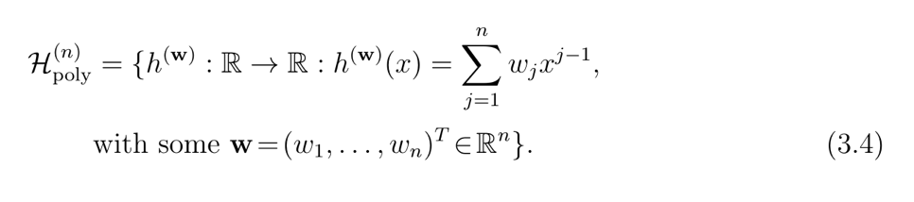
Polynomial Regression

Slide 26
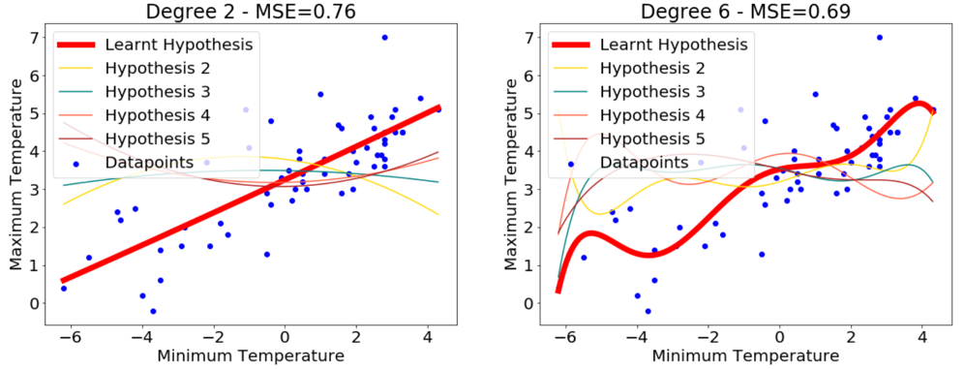
Polynomial Regression
from notebook of TA George
https://github.com/alexjungaalto/cs-c3240spring2022/blob/main/George_Demo_PolynomialRegression.ipynb

Slide 27


Polynomial Regression= Lin. Reg. with Feature Transform.
linear map
feature map
single
feature x

Slide 28
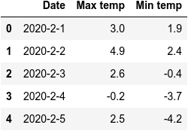

Polynomial Features
we can use anything as features that can be computed or measured easily !

Slide 29
params w
which model is best ?

Slide 30
Design Choice: Loss Function

Slide 31
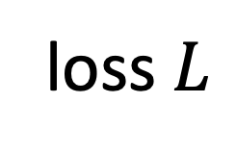
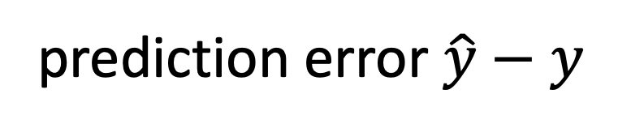
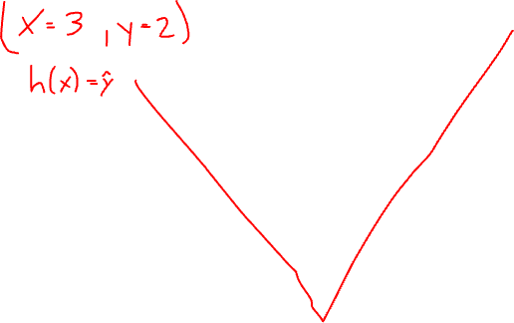
Measuring Error Size via Loss Functions
loss $L$
loss function is design choice !
prediction error $\hat{y}−y$

Slide 32

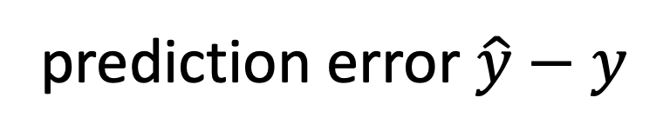
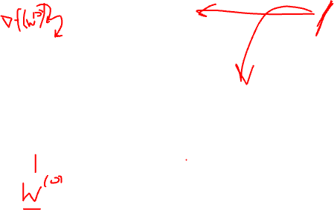
The Squared Error Loss
$${L \text{ := }\left(\hat{y}−y\right)}^{2}$$
prediction error $\hat{y}−y$

Slide 33
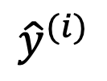

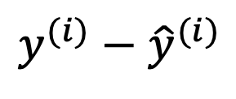
Squared Error Loss Sensitive to Outliers
y
h(x) = w*x+b
$${\hat{y}}^{(i)}$$
$y^{(i)}−$ ${\hat{y}}^{(i)}$
“outlier”
$$\left(x^{(i)}{,y}^{(i)}\right)$$
x
min. squared error loss forces predictor towards outlier

Slide 34
Train Linear Model on “Clean Data”
y
h(x) = w*x+b
x

Slide 35
Training Set with a SINGLE OUTLIER !
y
h(x) = w*x+b
x

Slide 36
How to make learning robust against presence of few outliers in training set ?

Slide 37

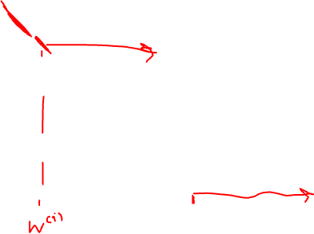
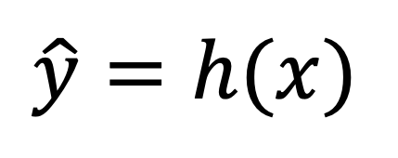
The Absolute Error Loss
$$L\text{ :}\text{=} \left|\hat{y}−y\right|$$
$$\hat{y}=h(x)$$
prediction error $\hat{y}−y$

Slide 38
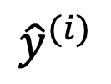
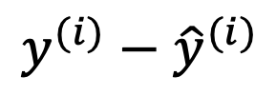
Absolute Error Loss Robust to Outliers
y
h(x) = w*x+b
$${\hat{y}}^{(i)}$$
$y^{(i)}−$ ${\hat{y}}^{(i)}$
“outlier”
$$\left(x^{(i)}{,y}^{(i)}\right)$$
x
absolute error “tolerates” few outliers

Slide 39
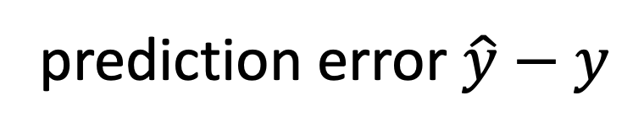
Huber Loss
absolute error loss
prediction error $\hat{y}−y$
squared error loss

Slide 40
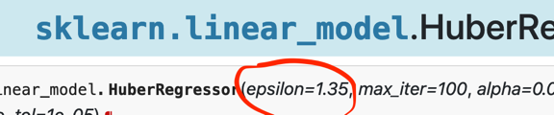
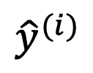
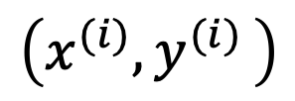
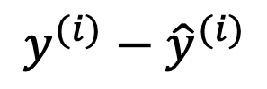
Fitting Linear Predictor with Huber Loss
y
h(x) = w*x+b
$${\hat{y}}^{(i)}$$
squared error loss
$$y^{(i)}−{\hat{y}}^{(i)}$$
“outlier”
$$\left(x^{(i)}{,y}^{(i)}\right)$$
x

Slide 41
Train Linear Model on “Clean Data”
y
h(x) = w*x+b
x

Slide 42
Training Set with a SINGLE OUTLIER !
y
h(x) = w*x+b
x

Slide 43
Huber vs. Squared Error Loss
Squared Error
cvx and diff.able
minimized via simple gradient descent
sensitive to outliers
Huber
cvx and non-diff.
requires more advanced opt. methods
robust against outliers

Slide 44
Summary
ultimate quality measure: expected loss or risk
approximate risk by average loss (empirical risk)
many ML methods are instances of ERM
three design choices of ERM: data, model and loss
ERM can fail if empirical risk deviates from risk

