Slide 1
Machine Learning with Panel Data
Dipl.-Ing. Dr. techn. Alexander Helmut Jung

Slide 2

What are main components of ML (and how are they combined)?

Slide 3


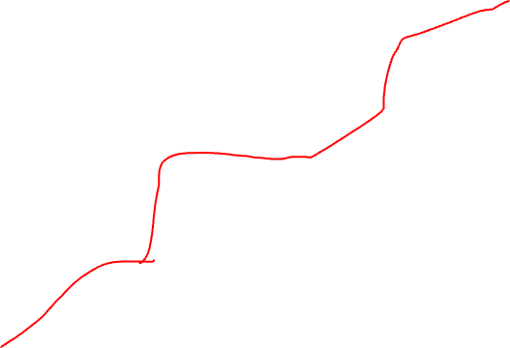
Plain Old Machine Learning.
h(x)
(y-h(x))²
label y (max.tmp.)
feature x (min.tmp.)

Slide 4
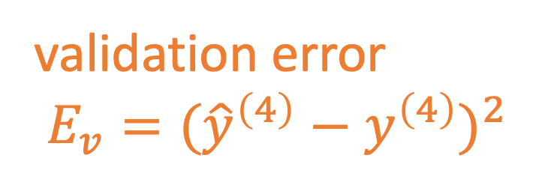
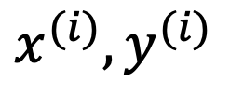
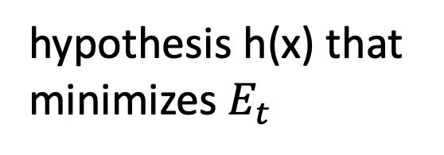
Train and Validate.
hypothesis h(x) that
minimizes $E_{t}$
$$x^{(i)},y^{(i)}$$
label y
validation error
$E_{v}=({\hat{y}}^{\left(4\right)}−y^{\left(4\right)})^{2}$
feature x

Slide 5
Basic Idea of Model Selection
choose model with smallest validation error!
training validation
error error
model 1
degree 1 polyn.
model 2:
degree 3 polyn.
Notes:
it seems that larger models (higher polyn. degree) results in larger validation error. is this always the case?

Slide 6
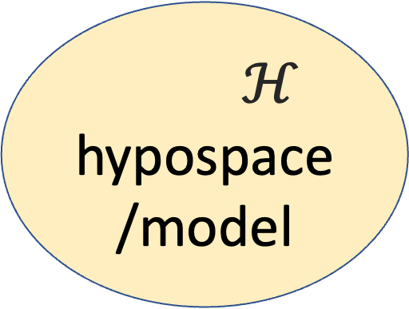
Data and Model Size
$$\left(x^{(1)},y^{(1)}\right)$$
training set
m
$$\left(x^{(2)},y^{(2)}\right)$$
$ℋ$
hypospace/model
$$\left(x^{(m)},y^{(m)}\right)$$
nr. of features n
crucial parameter is the
ratio d/m
eff. dimension d
Notes:
The sample size m is the nr. of different datapoints in the training set

Slide 7
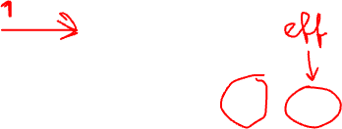
training error
validation error
“critical value” (d/m=1)
d / m
adjust model and/or data to reach

Slide 8
Wed. May 22, 2024, 8.00–12.00
08.00 - 08.50 Time Series Data
08.50 - 09.00 Break
09.00 - 09.50 Time Series Models
09.50 - 10.00 Break
10.00 - 10.50 Panels: A Network of Time Series
10.50 - 11.00 Break
11.00 - 11.50 Models for Panels
11.50 - 12:00 Wrap-Up

Slide 9
Time Series Data

Slide 10
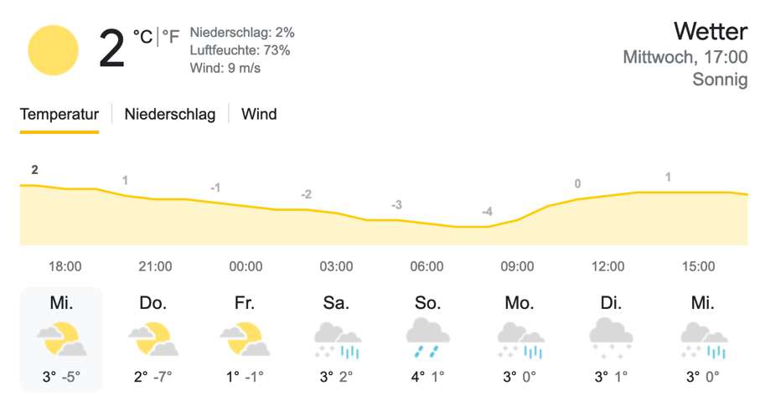
Weather

Slide 11
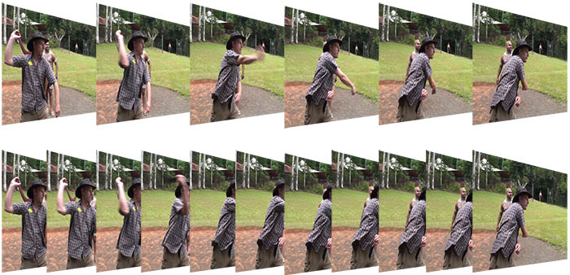
Images

Slide 12
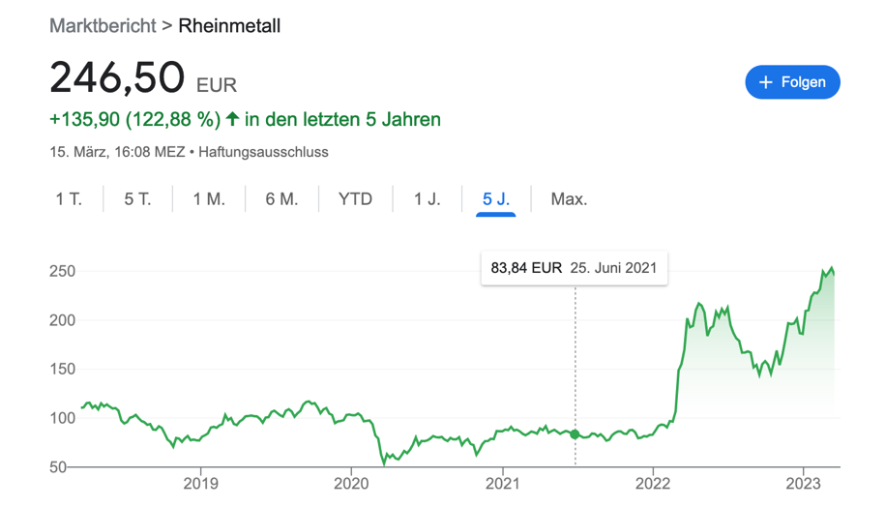
Finance

Slide 13
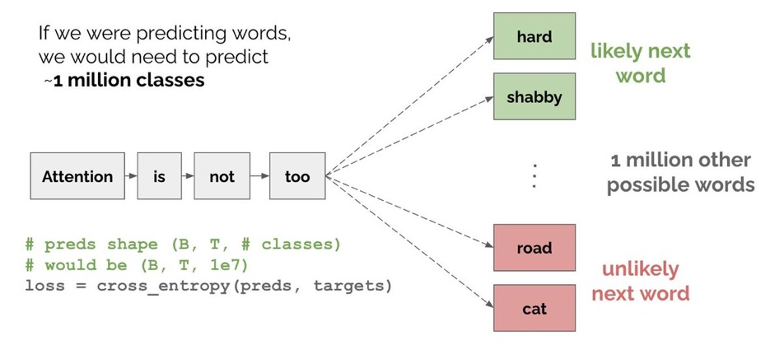
Text
https://twitter.com/MishaLaskin/status/1481767762141888512

Slide 14
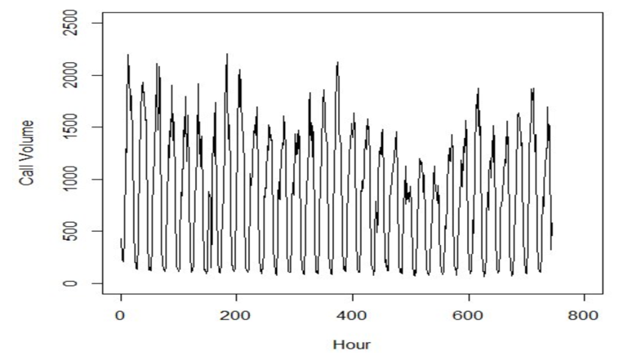
Phone Calls
Ev, Gijo & Balakrishna, Narayana. (2016). SARIMA models for forecasting call volume in emergency services. International Journal of Business Excellence. 10. 545. 10.1504/IJBEX.2016.079252.

Slide 15
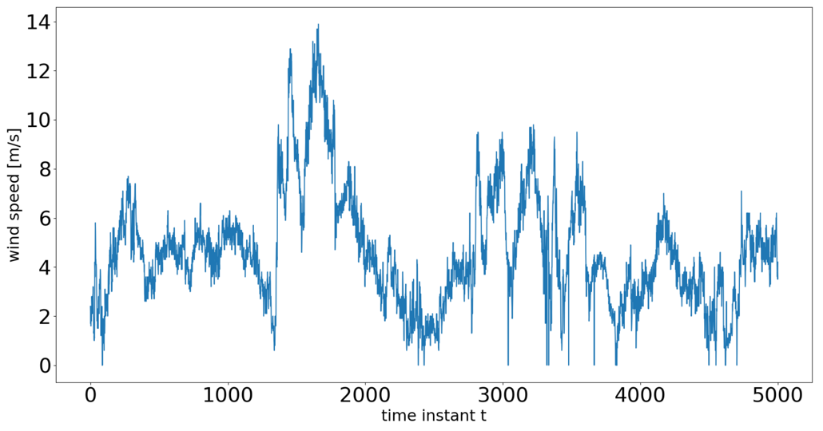
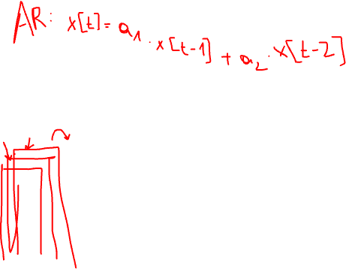
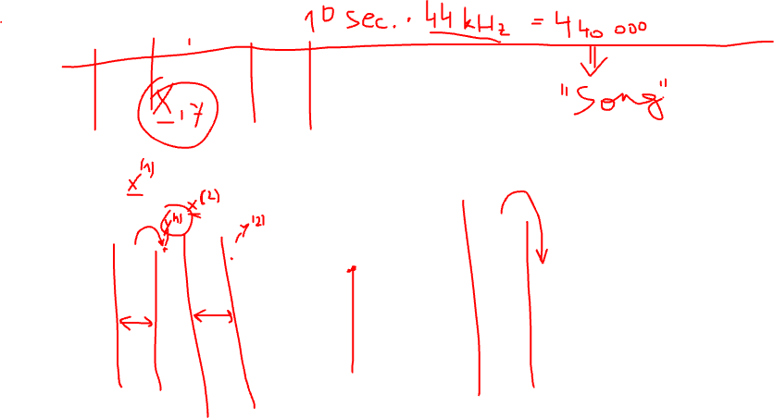
Wind

Slide 16
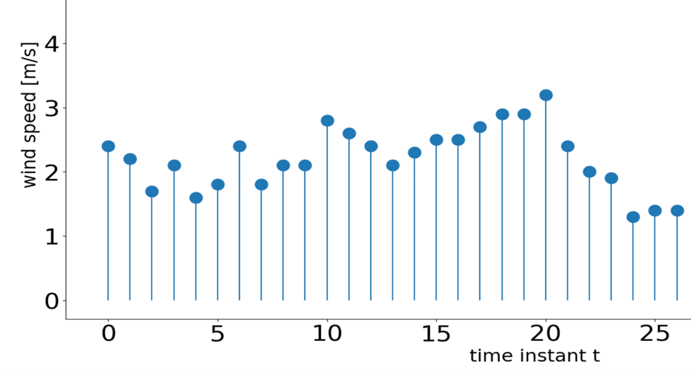
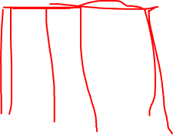
Effective Sample Size

Slide 17
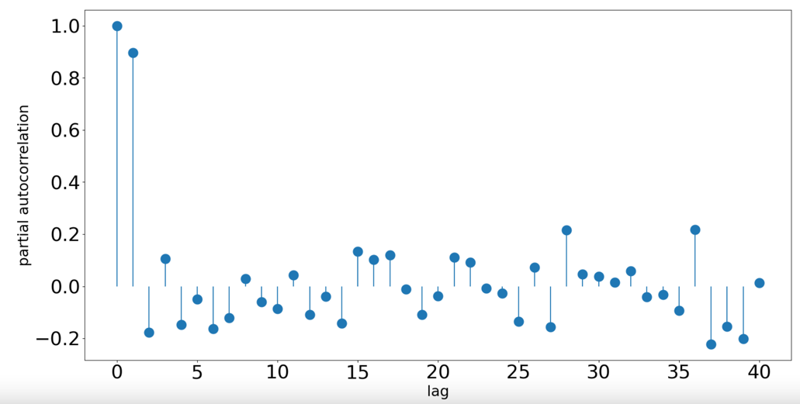
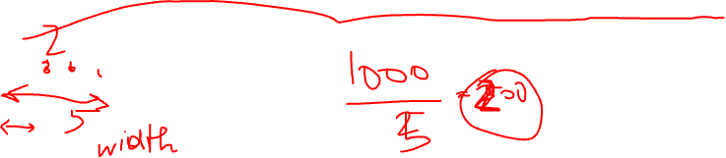
Autocorrelation Function

Slide 18
Wed. May 22, 2024, 8.00–12.00
08.00 - 08.50 Time Series Data
08.50 - 09.00 Break
09.00 - 09.50 Time Series Models
09.50 - 10.00 Break
10.00 - 10.50 Panels: A Network of Time Series
10.50 - 11.00 Break
11.00 - 11.50 Models for Panels
11.50 - 12:00 Wrap-Up

Slide 19
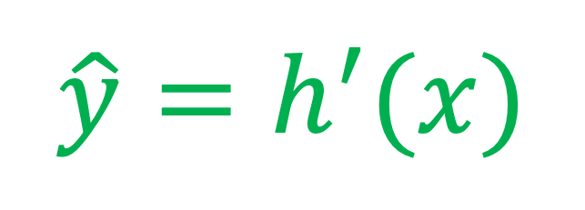
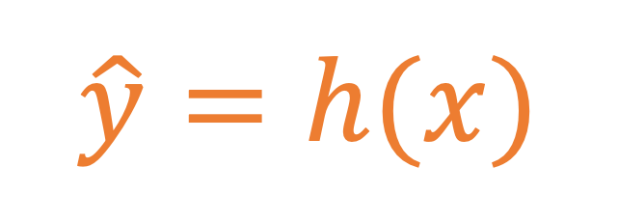
Model =Set of Hypothesis Maps
$$\hat{y}=h(x)$$
label y
$$\hat{y}=h^{′}(x)$$
feature x

Slide 20
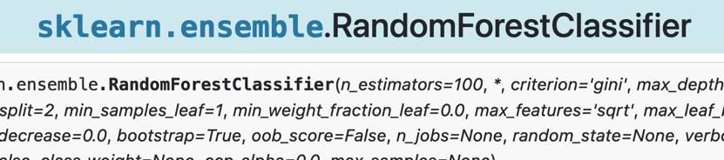
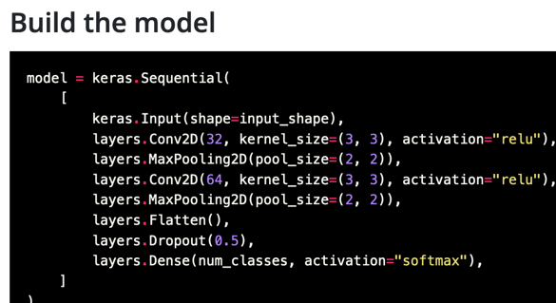
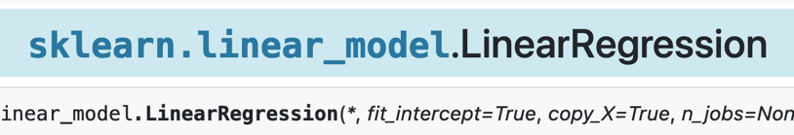
ML Models in Python

Slide 21
Time Series Model

Slide 22
“Time Series Model” = ML Model + Specific Choice for Data Points

Slide 23
Extracting Data Points
data point 1
data point 2

Slide 24
Features and Label (“Forecasting”)
data point 1
label 1

Slide 25
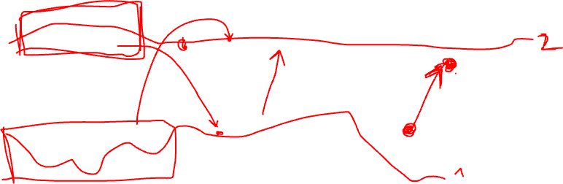
Features and Label (“Filtering”)
data point 1
label 1

Slide 26
Features and Label (”Smoothing”)
data point 1
label 1

Slide 27
How many Features?
6 features
label
11 features

Slide 28
Partial Autocorrelation

Slide 29
Wed. May 22, 2024, 8.00–12.00
08.00 - 08.50 Time Series Data
08.50 - 09.00 Break
09.00 - 09.50 Time Series Models
09.50 - 10.00 Break
10.00 - 10.50 Panels: A Network of Time Series
10.50 - 11.00 Break
11.00 - 11.50 Models for Panels
11.50 - 12:00 Wrap-Up

Slide 30
time t = 0
time t = 1
time t = 2
2
2
2
1
1
1
3
3
3
4
4
4

Slide 31
Flow/Direction of Time …
time t = 0
time t = 1
time t = 2
2
2
2
1
1
1
3
3
3
4
4
4

Slide 32
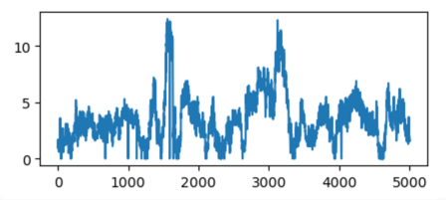
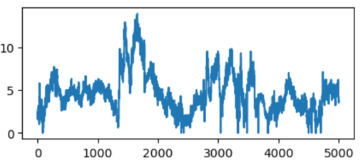
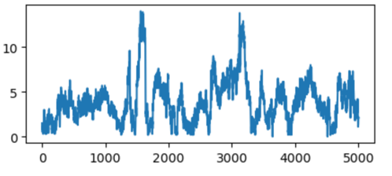
2
1
3
4

Slide 33
Wed. May 22, 2024, 8.00–12.00
08.00 - 08.50 Time Series Data
08.50 - 09.00 Break
09.00 - 09.50 Time Series Models
09.50 - 10.00 Break
10.00 - 10.50 Panels: A Network of Time Series
10.50 - 11.00 Break
11.00 - 11.50 Models for Panels
11.50 - 12:00 Wrap-Up

