Slide 1
Machine Learning with Text Data
Dipl.-Ing. Dr. techn. Alexander Helmut Jung

Slide 2
Thursday May 23, 2024, 8.00–12.00
08.00 - 08.50 Text Data: From Tokens to Embeddings
08.50 - 09.00 Break
09.00 - 09.50 Supervised and Unsupervised NLP
09.50 - 10.00 Break
10.00 - 10.50 Regularization
10.50 - 11.00 Break
11.00 - 11.50 Using Pre-Trained LLMs

Slide 3
Thursday May 23, 2024, 8.00–12.00
08.00 - 08.50 Text Data: From Tokens to Embeddings

Slide 4
What are data points, features and label ?
är tillämpligt: a)Det totala värdet av värdepappersföretagets konsoliderade tillgångar uppgår till eller överstiger 15 miljarder EUR, beräknat på genomsnittet av de tolv föregående sammanhängande

Slide 5
Token = Atomic Data Point
är tillämpligt: a)Det totala värdet av värdepappersföretagets konsoliderade tillgångar uppgår till eller överstiger 15 miljarder EUR, beräknat på genomsnittet av de tolv föregående sammanhängande

Slide 6
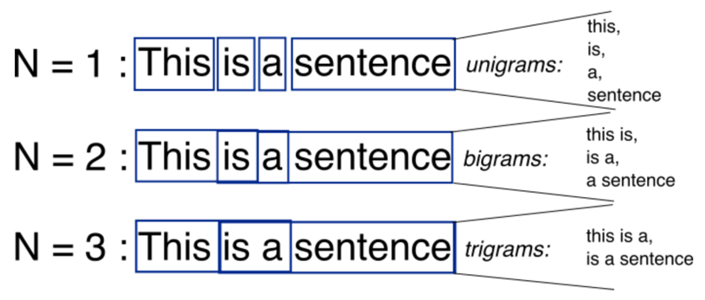
N-Grams
https://stackoverflow.com/questions/18193253/what-exactly-is-an-n-gram

Slide 7
Data Points = 2-Grams
är tillämpligt: a)Det totala värdet av värdepappersföretagets konsoliderade tillgångar uppgår till eller överstiger 15 miljarder EUR, beräknat på genomsnittet av de tolv föregående sammanhängande

Slide 8
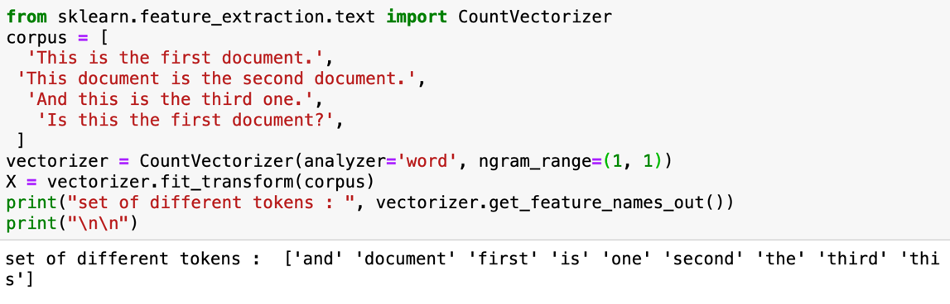
Token = Word

Slide 9
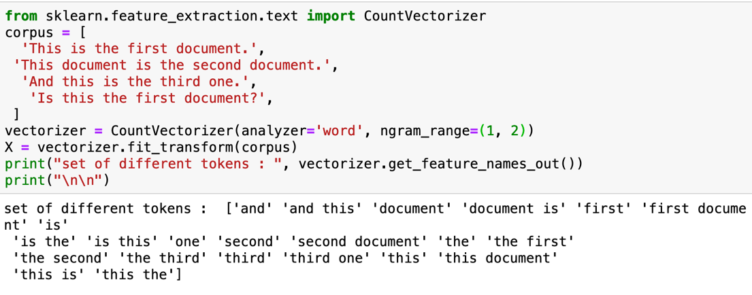
Token = Word or 2-Gram

Slide 10
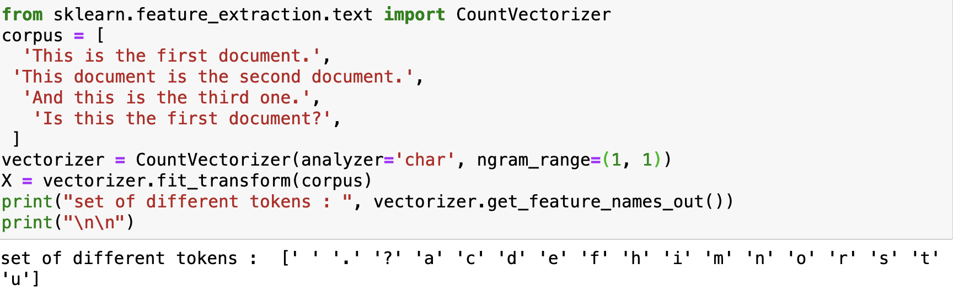
Token = Character

Slide 11
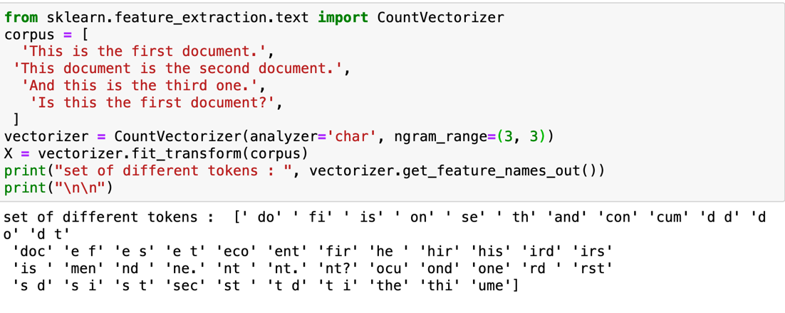
Token = Character 3-Grams

Slide 12
Design Choice Features

Slide 13
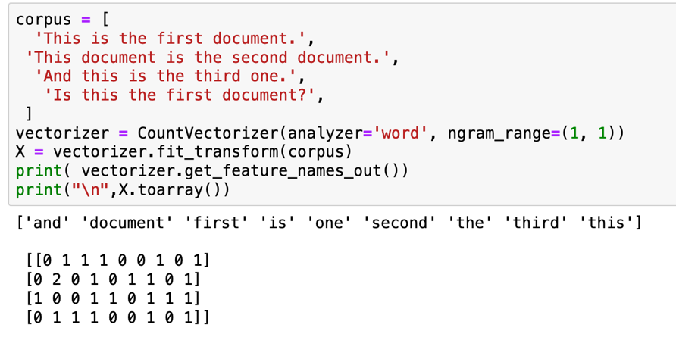
Features – Token Frequency
Q: What is a data point here?

Slide 14
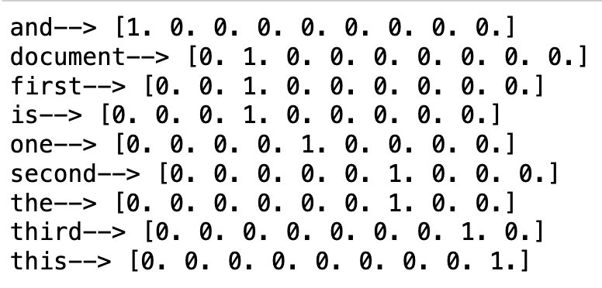
Features – One-Hot Encoding

Slide 15
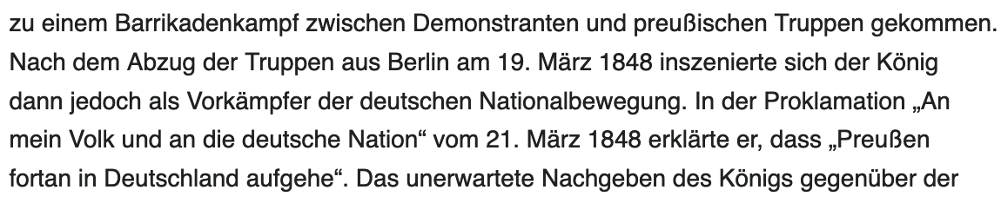
Features – Pixels (?!?)

Slide 16


Features – Audio Samples (?!?)

Slide 17
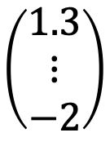
Features - Embedding
deep neural network
$$\left(\begin{matrix}1.3 \\ ⋮ \\ −2\end{matrix}\right)$$
“Det totala”
“embedding”

Slide 18
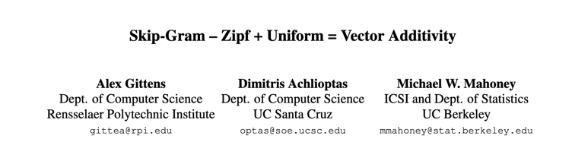
“Helsinki”
“Queen”
“Finland”
“Women”
“Stockholm”
“King”
“Man”
“Sweden”
“Vienna”
“Austria”

Slide 19
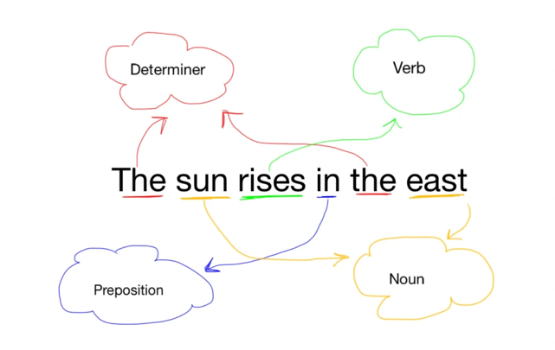
Label
(Q: What is a data point here?)
https://nlp1000.wordpress.com/2016/12/19/pos-tagging-scikit-learn/

Slide 20
Features and Label of 5-Gram
One of the key aspects….
features
label

Slide 21
Pre-processing

Slide 22
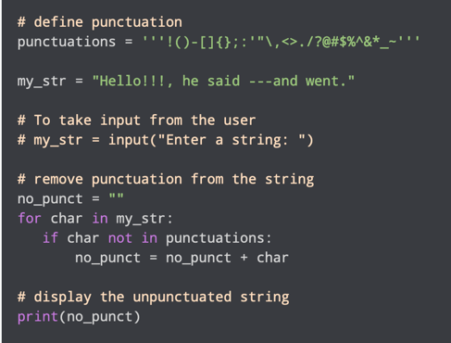
Remove Punctuation
https://www.programiz.com/python-programming/examples/remove-punctuation

Slide 23
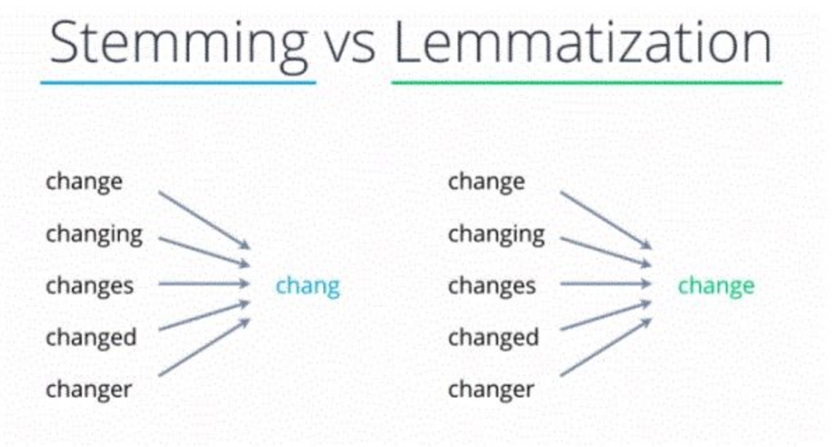
https://www.turing.com/kb/stemming-vs-lemmatization-in-python

Slide 24
Thursday May 23, 2024, 8.00–12.00
08.00 - 08.50 Text Data: From Tokens to Embeddings
08.50 - 09.00 Break
09.00 - 09.50 Supervised and Unsupervised NLP

Slide 25
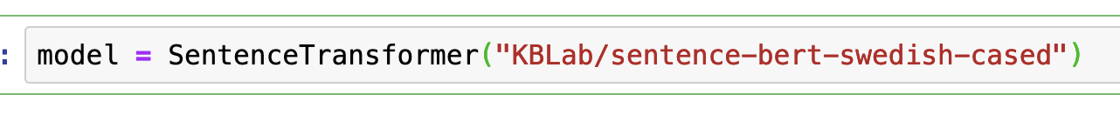
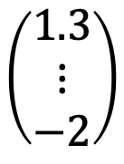
Features - Embedding
deep neural network
$$\left(\begin{matrix}1.3 \\ ⋮ \\ −2\end{matrix}\right)$$
“Det totala”
“embedding”

Slide 26
Thursday May 23, 2024, 8.00–12.00
08.00 - 08.50 Text Data: From Tokens to Embeddings
08.50 - 09.00 Break
09.00 - 09.50 Supervised and Unsupervised NLP
09.50 - 10.00 Break
10.00 - 10.50 Regularization

Slide 27
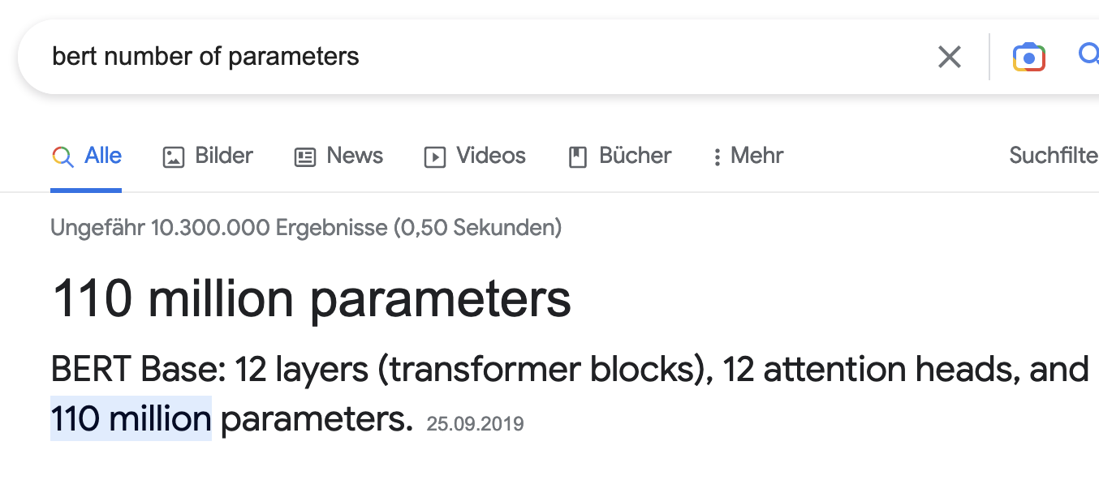
how many data points do we need to train such a model ?

Slide 28
training error
validation error
“critical value” (d/m=1)
d / m

Slide 29
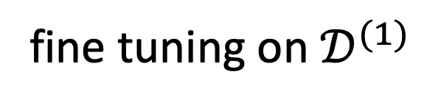
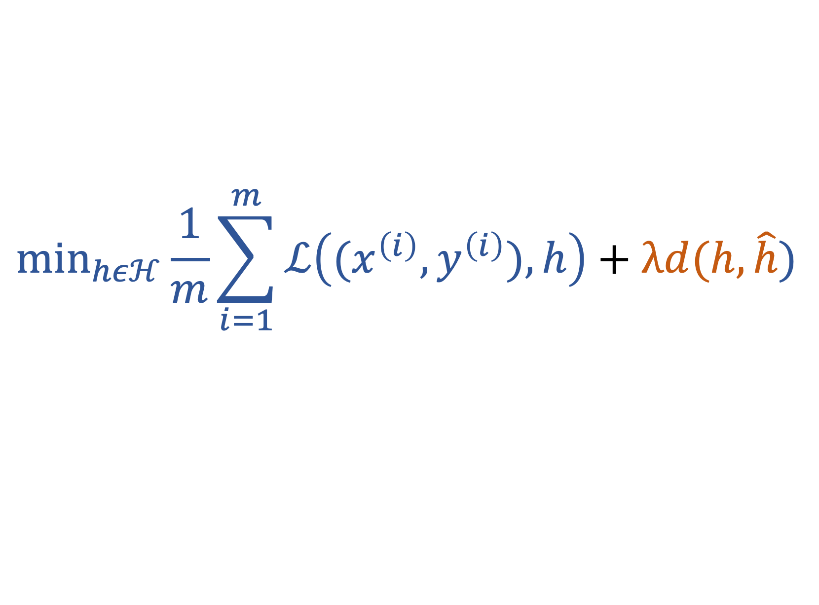
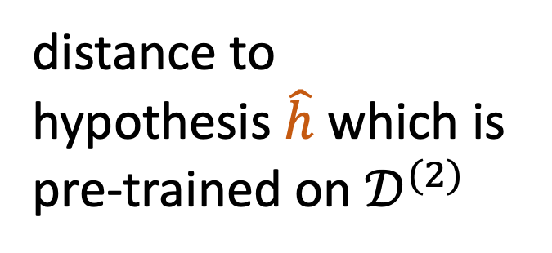
$${\text{min}}_{hεℋ}\frac{1}{m}\sum_{i=1}^{m}{ℒ\left((x^{\left(i\right)},y^{\left(i\right)}),h\right)}+λd(h,\hat{h})$$
distance to
hypothesis $\hat{h}$ which is
pre-trained on $𝒟^{(2)}$
fine tuning on $𝒟^{(1)}$

Slide 30
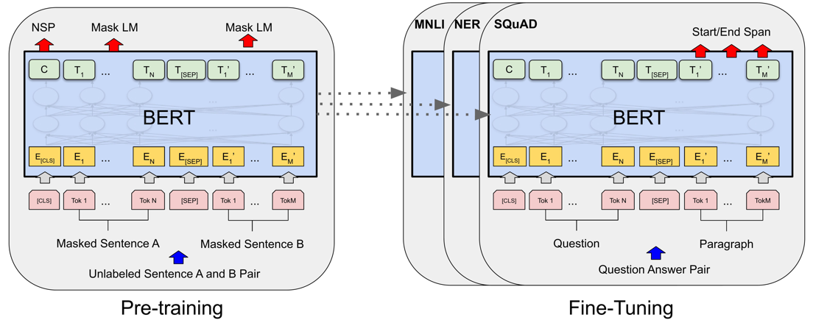
https://paperswithcode.com/method/bert

Slide 31




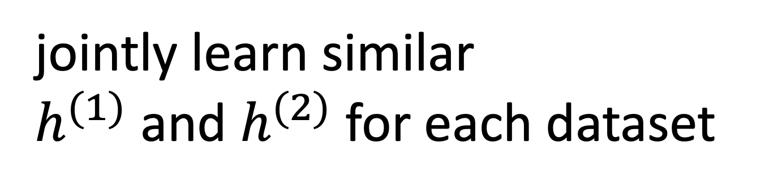
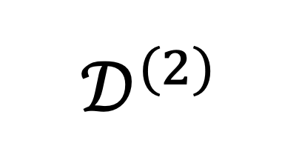
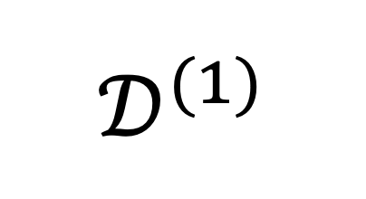
$$𝒟^{(1)}$$
$$𝒟^{(2)}$$
jointly learn similar
$h^{(1)}$ and $h^{(2)}$ for each dataset

Slide 32
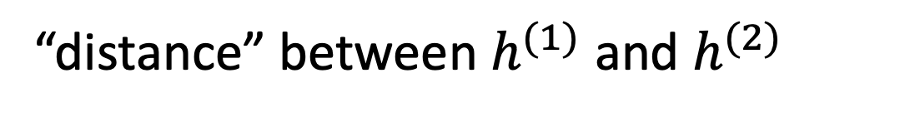
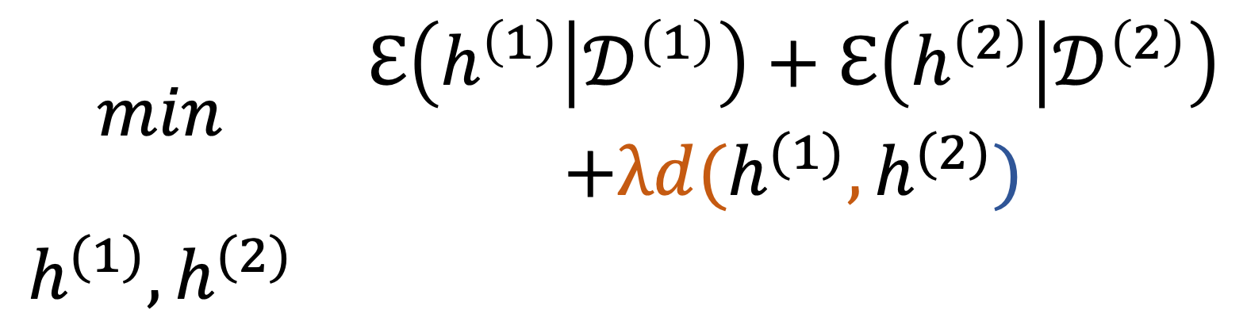
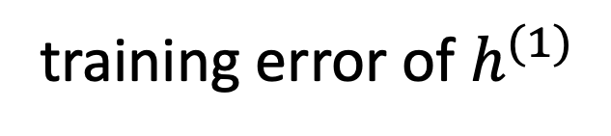
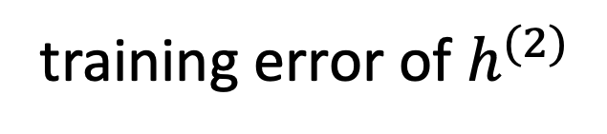
training error of $h^{(1)}$
training error of $h^{(2)}$
$$\begin{matrix}min & \begin{aligned}ℇ\left(h^{\left(1\right)} | 𝒟^{\left(1\right)}\right)+ℇ\left(h^{\left(2\right)} | 𝒟^{\left(2\right)}\right) \\ +λd(h^{(1)},h^{(2)})\end{aligned} \\ h^{(1)},h^{(2)} & \end{matrix}$$
“distance” between $h^{(1)}$ and $h^{(2)}$

Slide 33
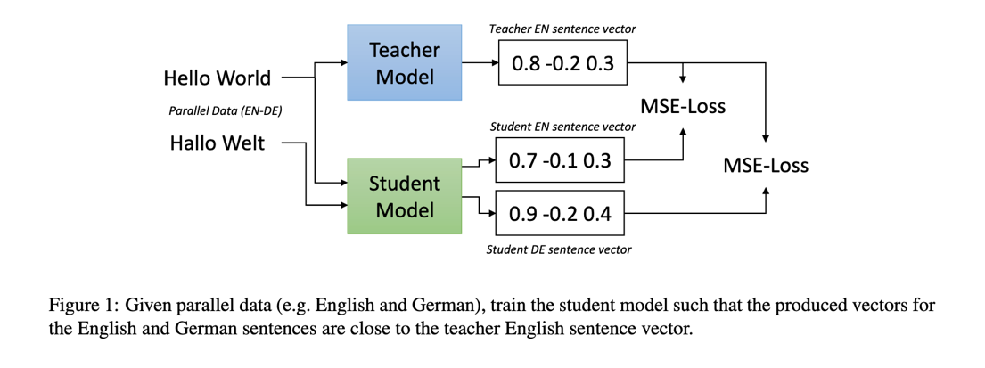

$$ℇ\left(h^{\left(1\right)} | 𝒟^{\left(1\right)}\right)+ℇ\left(h^{\left(1\right)} | 𝒟^{\left(2\right)}\right)$$
https://arxiv.org/pdf/2004.09813.pdf

Slide 34
Data Augmentation for Text
back-translation
synonym replacement
random insertion, swap/shuffling, deletion at different levels (chars, words, sentences)
https://neptune.ai/blog/data-augmentation-nlp

Slide 35
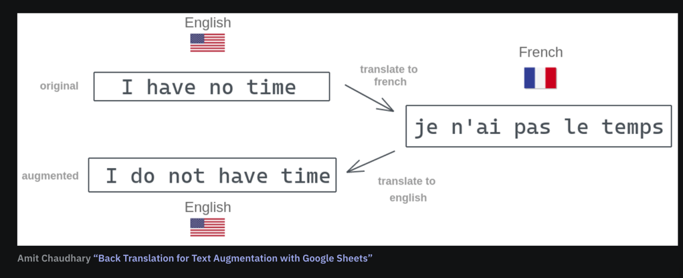
Back-Translation
https://neptune.ai/blog/data-augmentation-nlp

Slide 36
Synonym Replacement
“This article will focus on summarizing data augmentation techniques in NLP.”
→
“This write-up will focus on summarizing data augmentation methods in NLP.”
https://neptune.ai/blog/data-augmentation-nlp

