Slide 1
Machine Learning Methods
Dipl.-Ing. Dr. techn. Alexander Helmut Jung

Slide 2
Monday May 20, 2024, 8.00–12.00
08.00 - 08.50 Live Demo: Empirical Risk Minimization
08.50 - 09.00 Break
09.00 - 09.50 Loss Functions for Linear Model
09.50 - 10.00 Break
10.00 - 10.50 Reading in Data: FMI Weather Data, Wikidata
10.50 - 11.00 Break
11.00 - 11.50 Demo: Model Diagnosis and Selection
11.50 – 12.00 Wrap Up

Slide 3


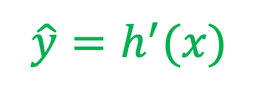
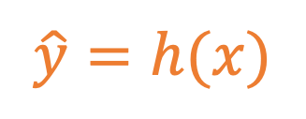
label y
$$\hat{y}=h(x)$$
hypothesis
loss
$$\hat{y}=h^{′}(x)$$
feature x

Slide 4

What is the topic and theme of your project?
overview of international travels by staff of the Swedish NAO​
illustrated on a map, information available backward and forward in time​
information initially confined to date, country, destination, purpose-code and organizational domicile of staff ​ ​
data presumably available from the travel agency’s database on travels (CWT) and MS Public 360
possibly applying ML on travel reports for easy access to context and content of events
Notes:
Peter

Slide 5
label y
$$\hat{y}=h(x)$$
hypothesis
loss
$$\hat{y}=h^{′}(x)$$
feature x

Slide 6
Profiling third country students to contribute to the evaluation of the internationalisation policy of higher education institutions Project mid-presentation
Jenny Hedström, Helena Holmlund, Vivika Halapuu, Ylva Ericsson

Slide 7
label y
$$\hat{y}=h(x)$$
hypothesis
loss
$$\hat{y}=h^{′}(x)$$
feature x

Slide 8
Automating report classification
Project team:
Dan Sölverud and Hedvig Wurnell (Swedish NAO)
Konstantin Glinitzer and Helmut Steinbichler (Austrian NAO)

Slide 9
label y
$$\hat{y}=h(x)$$
hypothesis
loss
$$\hat{y}=h^{′}(x)$$
feature x

Slide 10
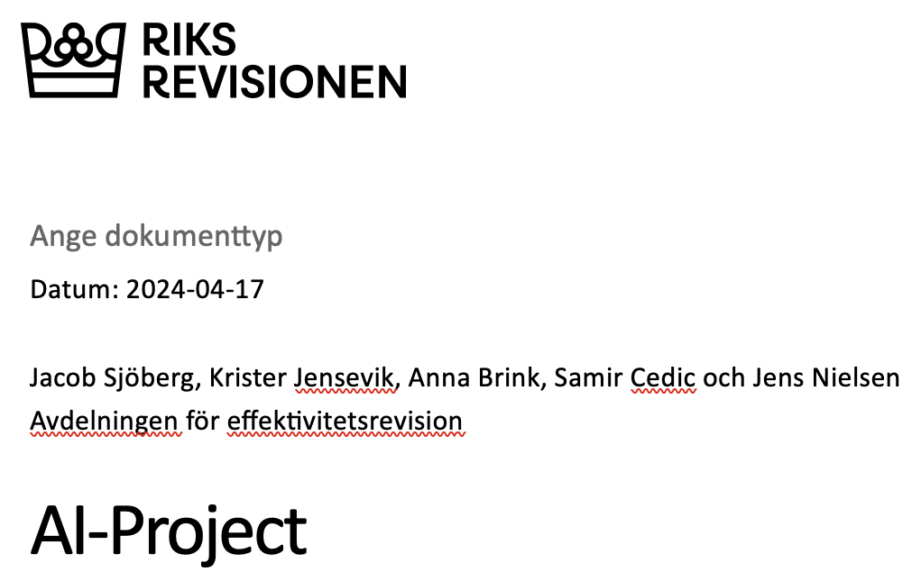

Slide 11
Monday May 20, 2024, 8.00–12.00
08.00 - 08.50 Live Demo: Empirical Risk Minimization
08.50 - 09.00 Break
09.00 - 09.50 Loss Functions for Linear Model
09.50 - 10.00 Break
10.00 - 10.50 Reading in Data: FMI Weather Data, Wikidata
10.50 - 11.00 Break
11.00 - 11.50 Demo: Model Diagnosis and Selection
11.50 – 12.00 Wrap Up

Slide 12
Monday May 20, 2024, 8.00–12.00
08.00 - 08.50 Live Demo: Empirical Risk Minimization
08.50 - 09.00 Break
09.00 - 09.50 Loss Functions for Linear Model
09.50 - 10.00 Break
10.00 - 10.50 Reading in Data: FMI Weather Data, Wikidata
10.50 - 11.00 Break
11.00 - 11.50 Demo: Model Diagnosis and Selection
11.50 – 12.00 Wrap Up

Slide 13
Monday May 20, 2024, 8.00–12.00
08.00 - 08.50 Live Demo: Empirical Risk Minimization
08.50 - 09.00 Break
09.00 - 09.50 Loss Functions for Linear Model
09.50 - 10.00 Break
10.00 - 10.50 Reading in Data: FMI Weather Data, Wikidata
10.50 - 11.00 Break
11.00 - 11.50 Demo: Model Diagnosis and Selection
11.50 – 12.00 Wrap Up

Slide 14
Monday May 20, 2024, 8.00–12.00
08.00 - 08.50 Live Demo: Empirical Risk Minimization
08.50 - 09.00 Break
09.00 - 09.50 Loss Functions for Linear Model
09.50 - 10.00 Break
10.00 - 10.50 Reading in Data: FMI Weather Data, Wikidata
10.50 - 11.00 Break
11.00 - 11.50 Demo: Model Diagnosis and Selection
11.50 – 12.00 Wrap Up

