Slide 1
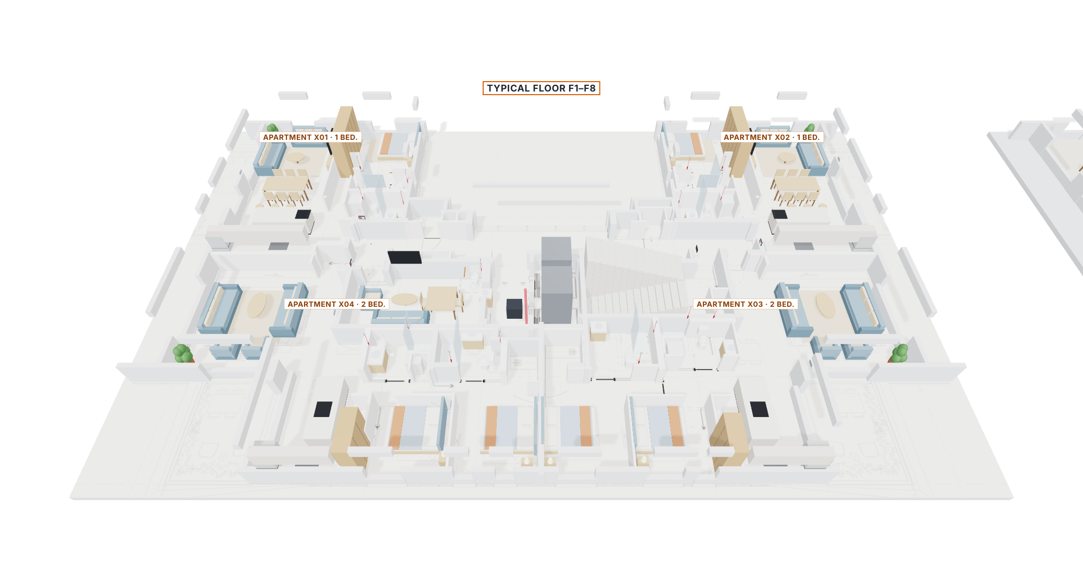
Migdalei Yam a Tijon
Assisted living · Ground floor + 8 floors · 32 apartments
ACE BG · Advantecnia nurse call on the building's real plan
Telab International · October 2026 · Rev. B

Slide 2
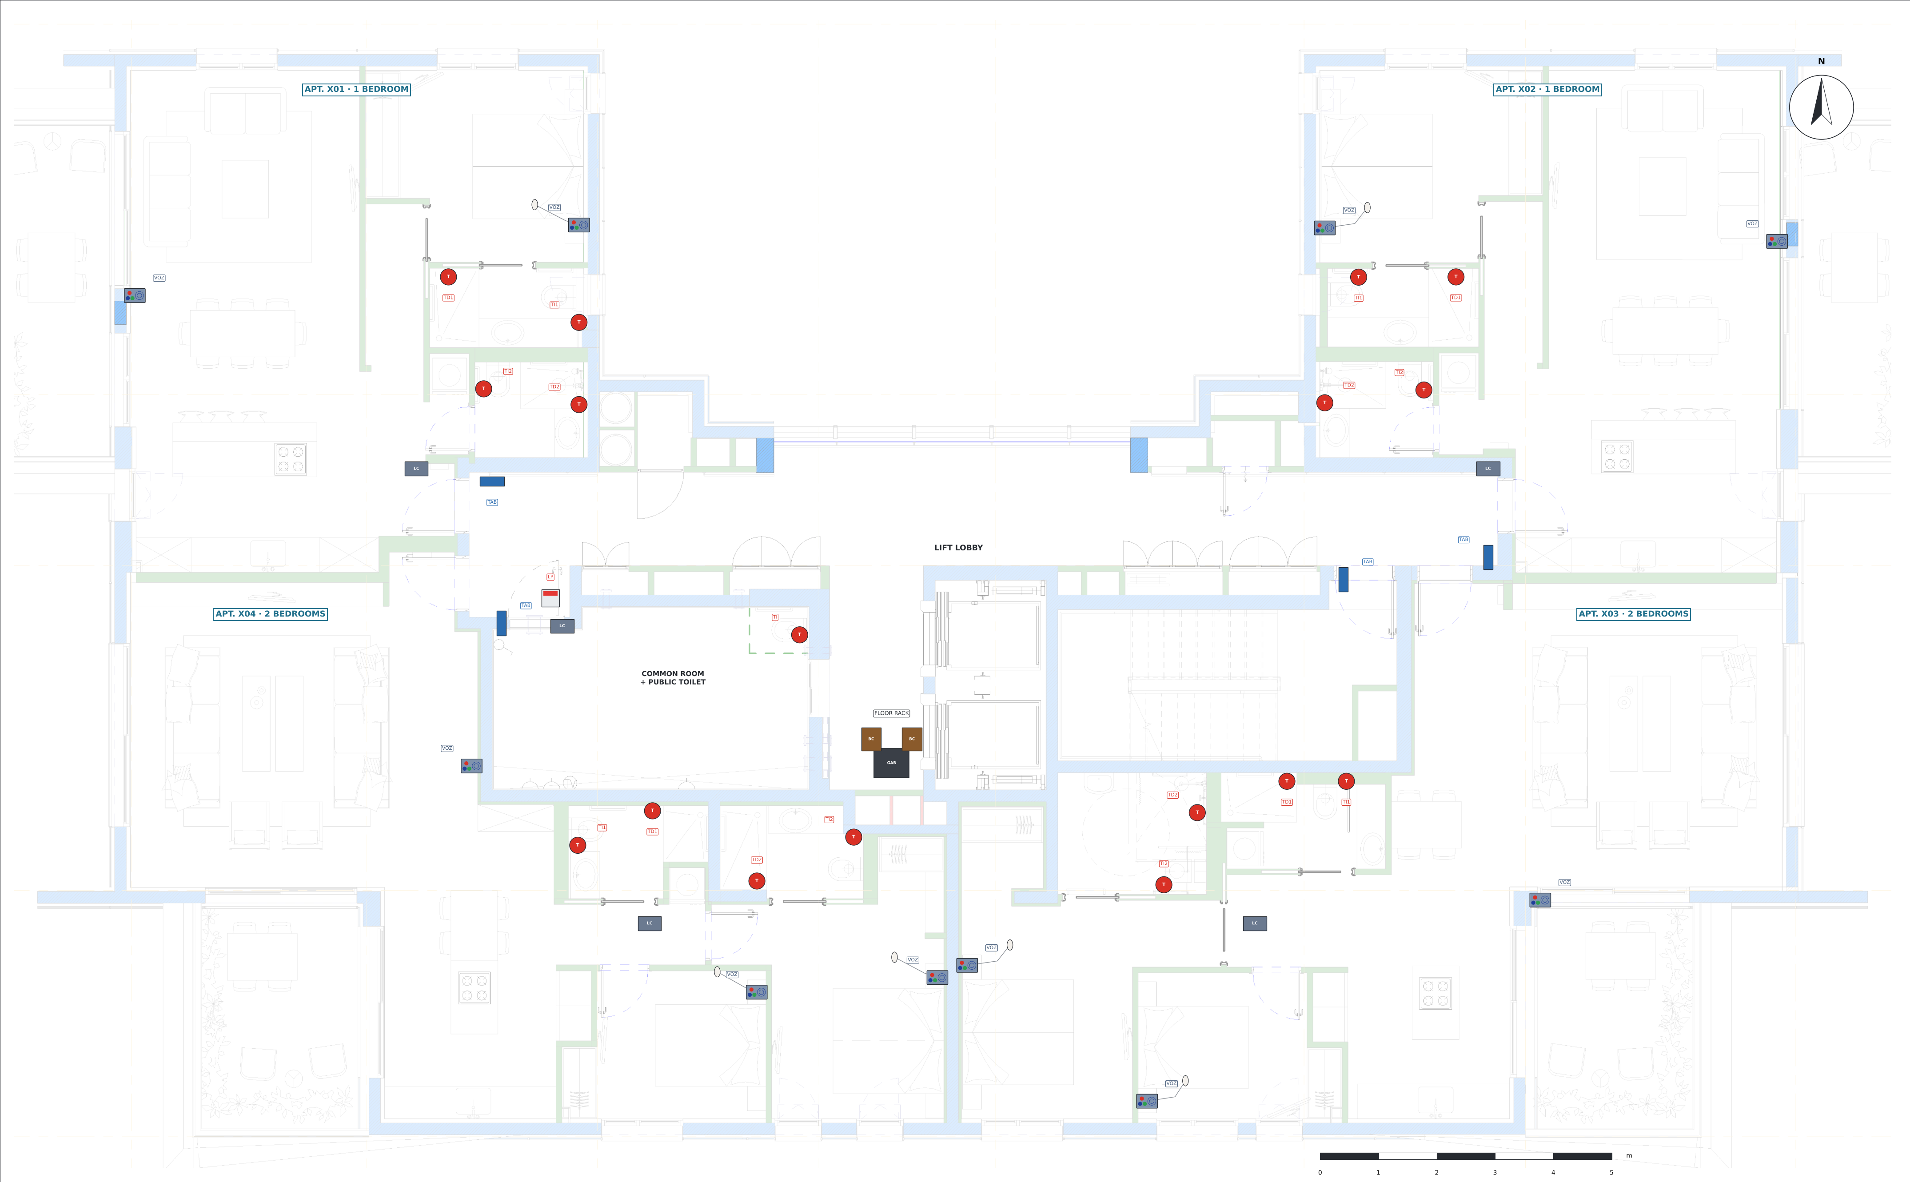
The project in figures
8 identical floors: 2 one-bedroom and 2 two-bedroom apartments per floor
32
80
apartments (4 per floor)
voice panels with buttons
138
10
pull-cords
public toilets with pull-cord and corridor light

Slide 3
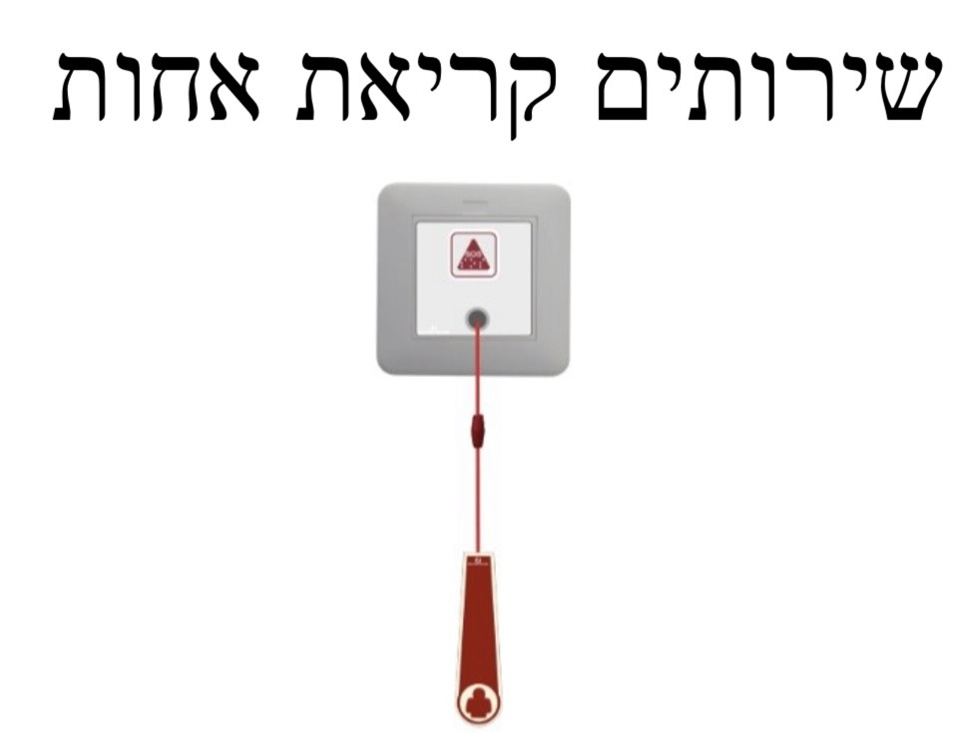
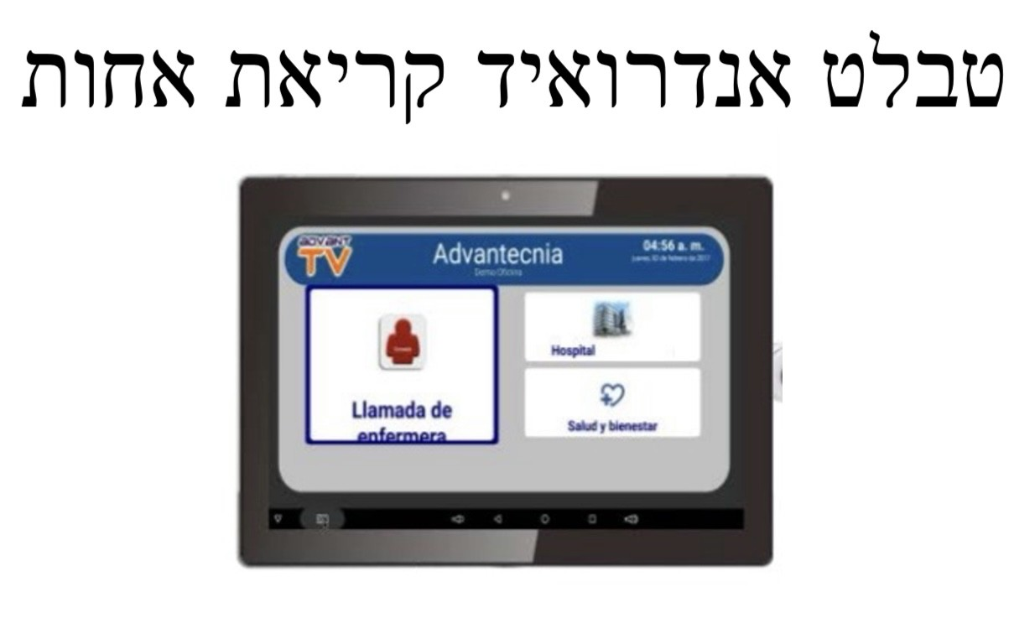
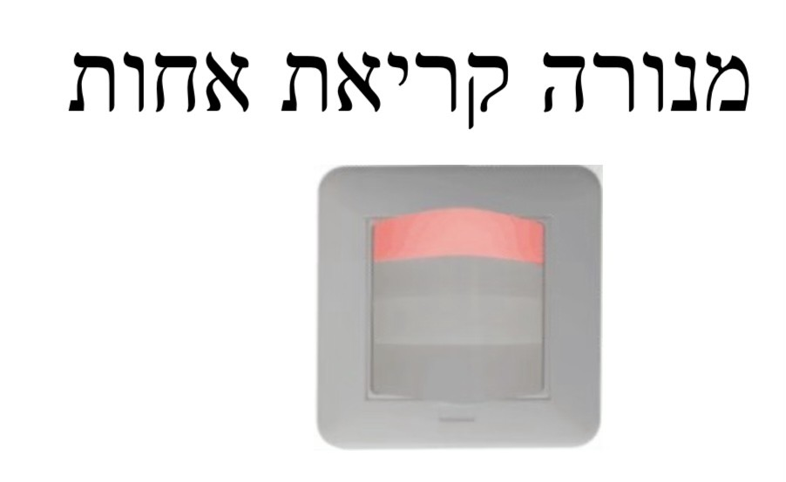
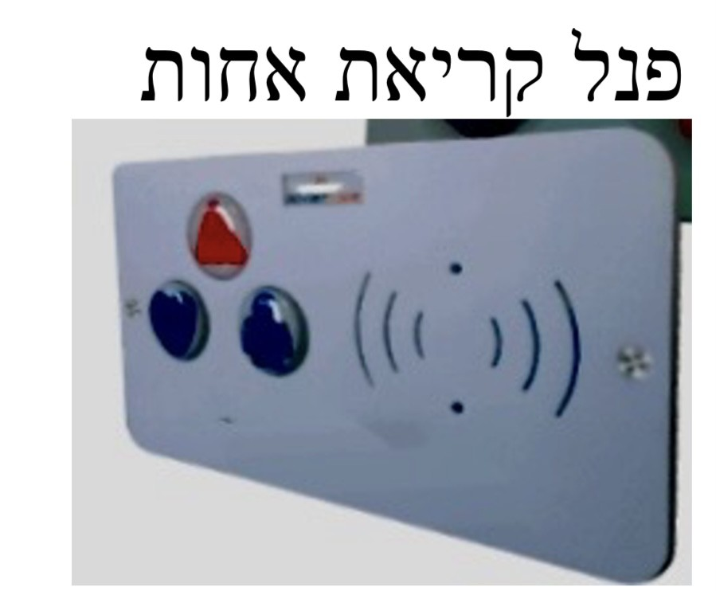
The devices
Reference photos from ACE BG / Advantecnia
Pull-cord
Door tablet
Corridor light
Voice panel with buttons
ACE40320303W · 1.85 m
iPad / Android · 1.40 m
ACE41020309 · public toilets
ACE82182451 · living room and bedrooms
138
32
10
80

Slide 4
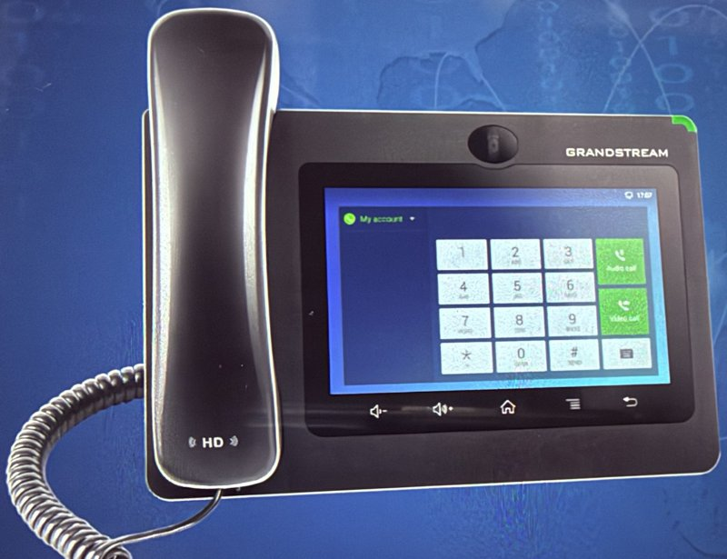
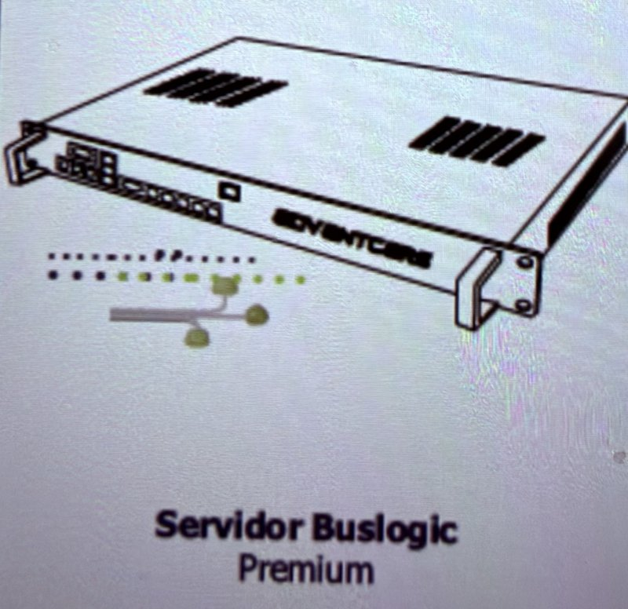
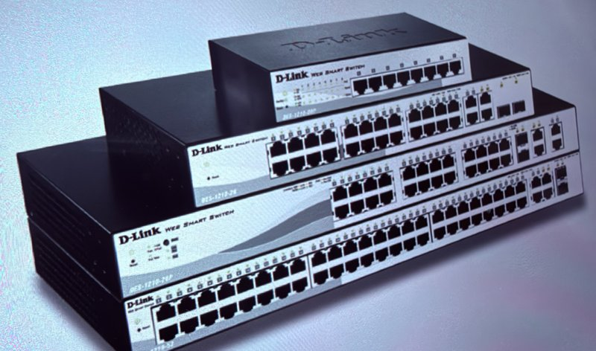
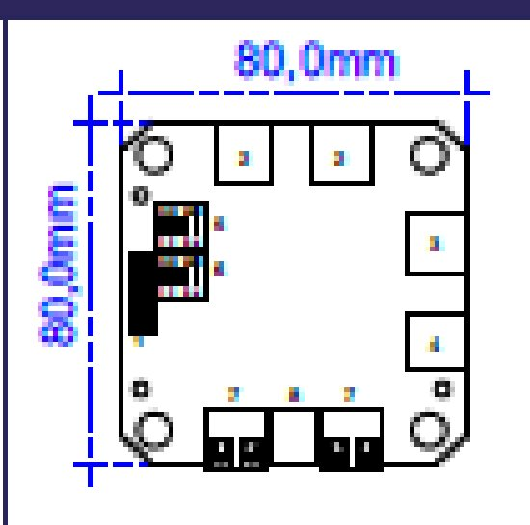
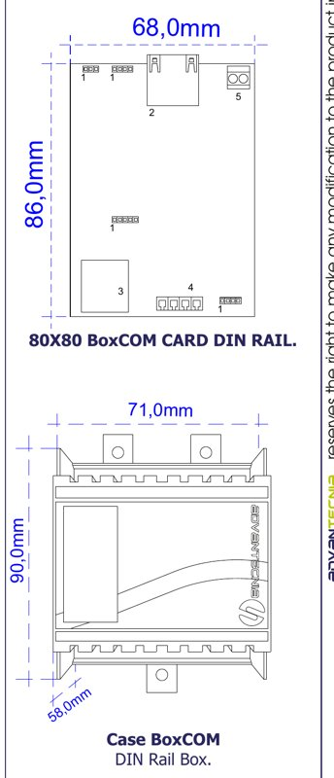
Central unit, hubs and desk phone
Devices → LCom (radial) → BoxCom (bus) → PoE switch → server · the phone goes straight to the PoE switch
Desk phone
Server
24-port PoE switch
LCom
BoxCom
Grandstream Android · PoE
Buslogic Premium · GF rack
D-Link DES-1210-28P · racks
ACE71610003 · ceiling of each apt.
ACE70810000 · ceiling, joins several apts.
1
1
9
41
17
Desk phone: which colour shows
Alarm (pull-cord / SOS) → red
Green once: presence → green
Green again → cancels
Blue: doctor call → blue
Voice call → yellow / orange

Slide 5
Typical floor F1–F8 – nurse call
On architectural plan L5: tablet at the door, voice panel in living room and bedrooms, pull-cords in every bathroom

Slide 6
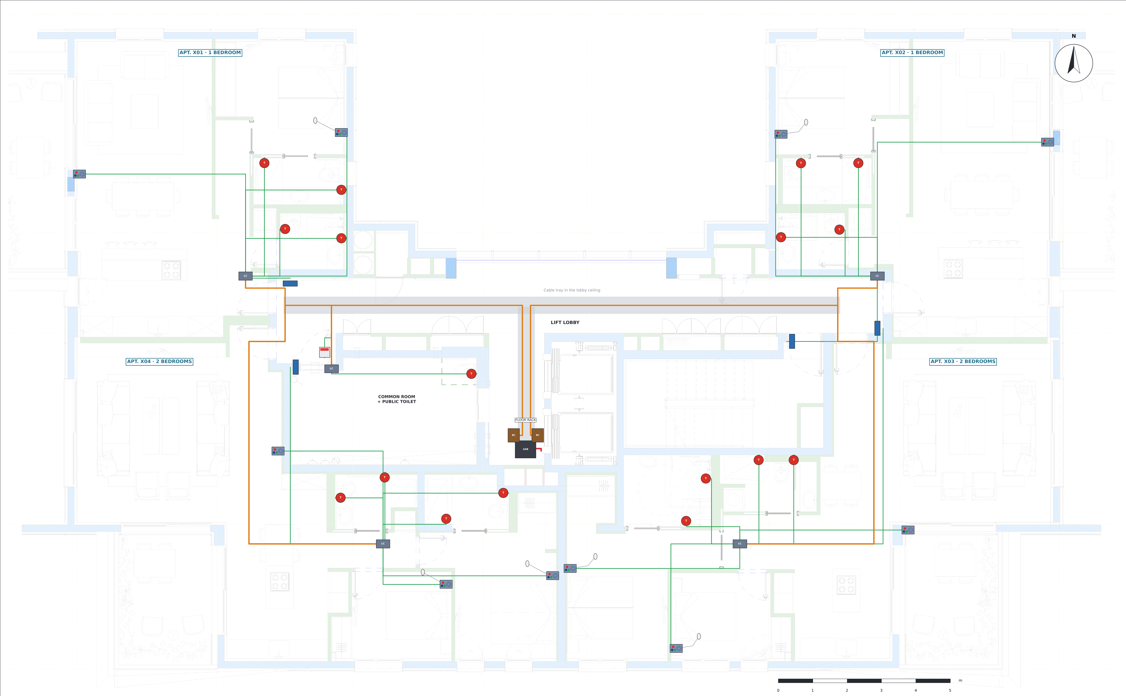
Typical floor – wiring
Green · Cat6 radial
Orange · LCom chain
Red · network and riser

Slide 7
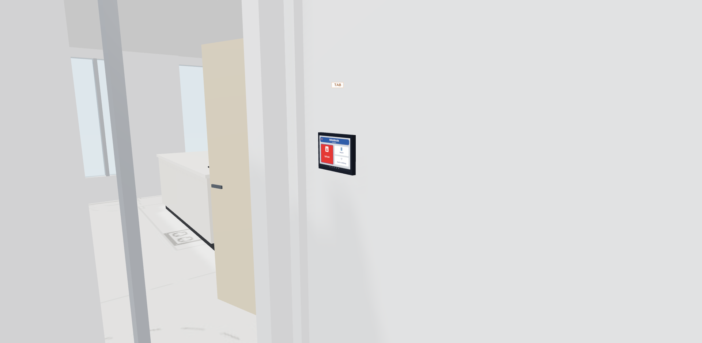
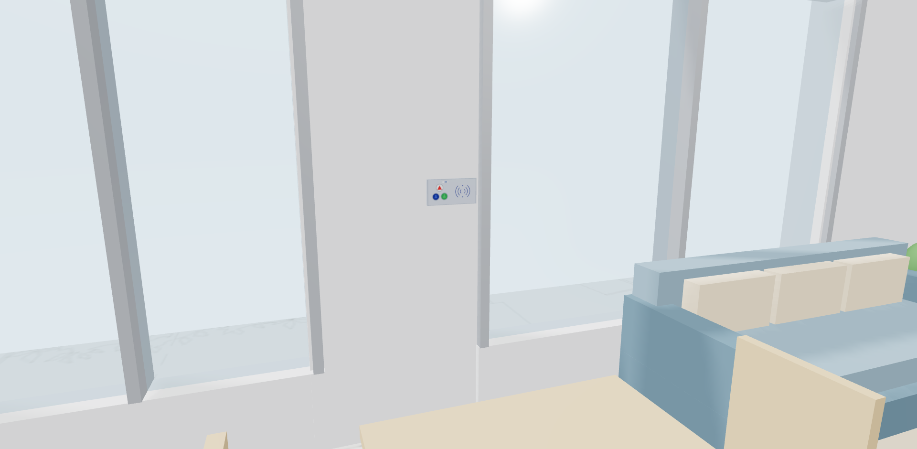
At the door and in the living room
Tablet at the door of each apartment (iPad / Android, 1.40 m): call and talk to the nurse
Voice call panel with buttons ACE82182451 in the living room (1.30 m)
LCom ACE71610003 in the hall ceiling: hub for the whole apartment
Apartments x01 and x02: 1 bedroom, living room with kitchen and 2 bathrooms
Apartments x03 and x04: 2 bedrooms and 2 bathrooms

Slide 8
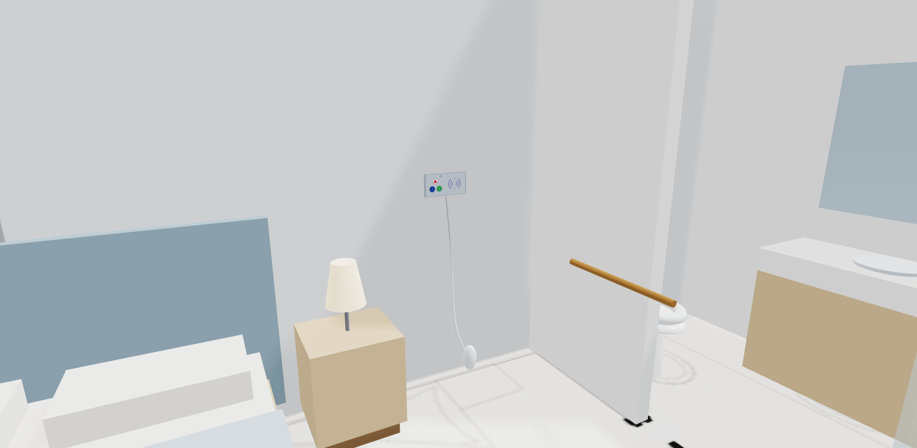
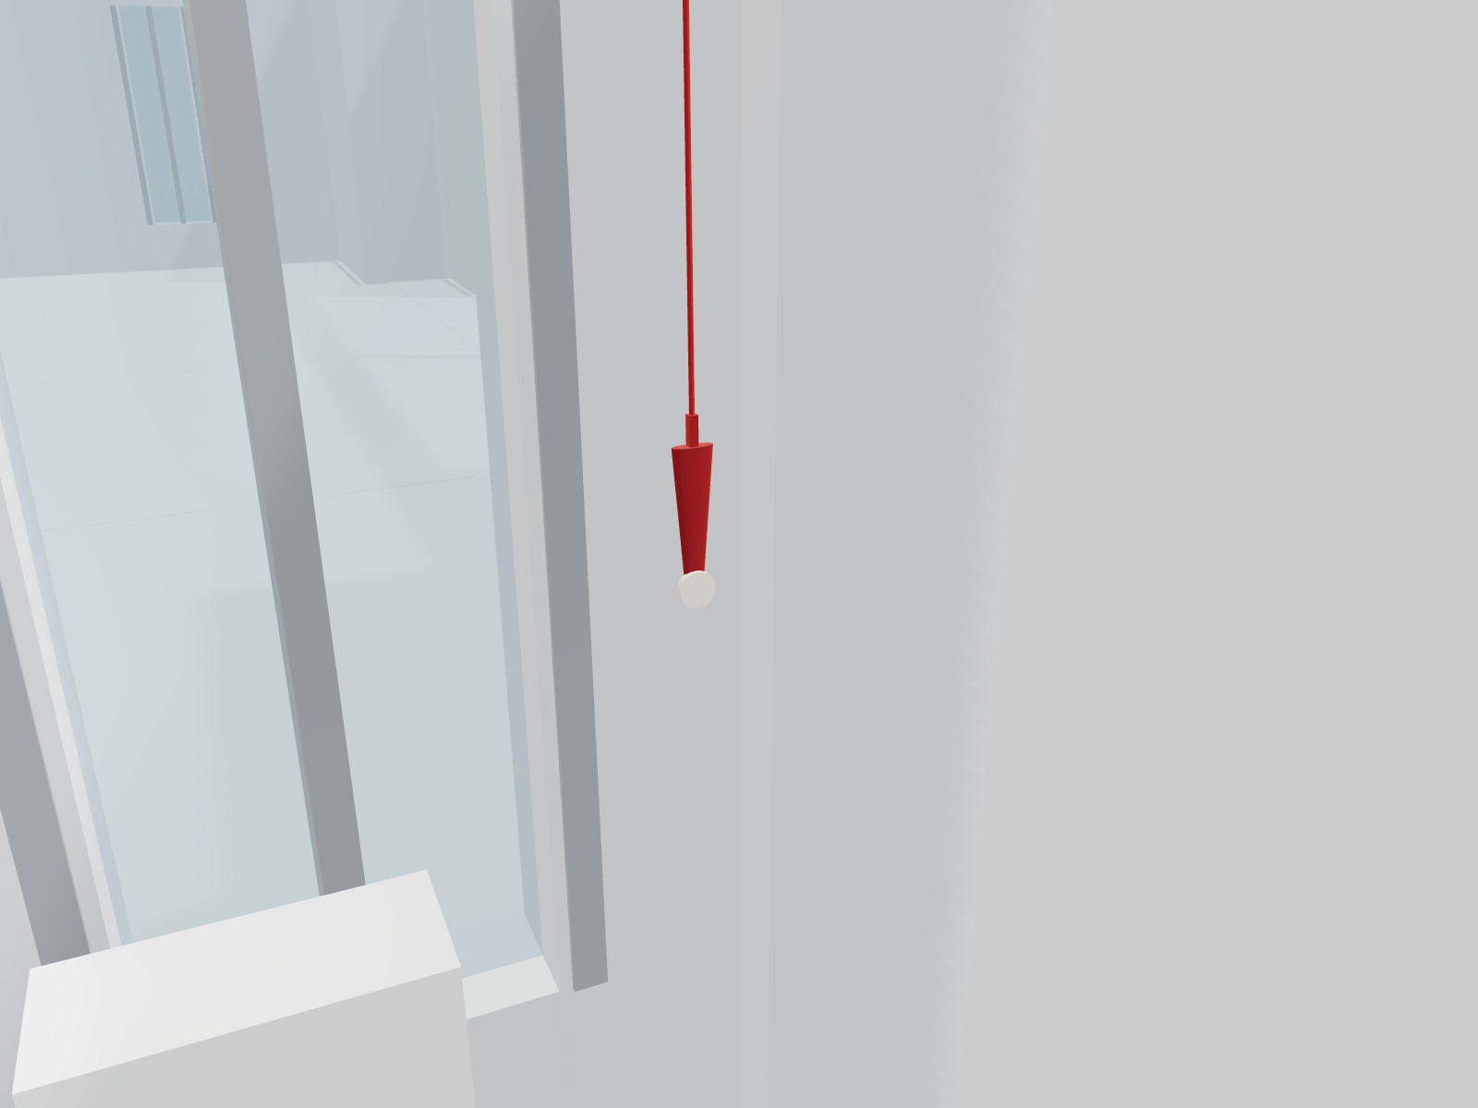
Bedrooms and bathrooms
Voice panel with buttons in each bedroom, with a call pear next to the bed.
Pull-cords ACE40320303W at the toilet and shower of every bathroom, at 1.85 m.

Slide 9
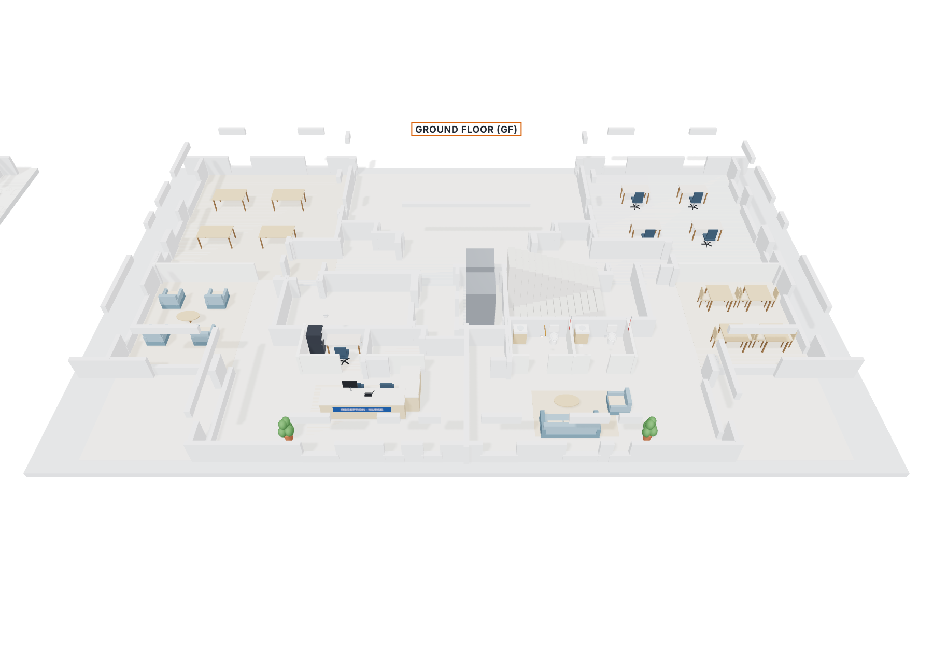
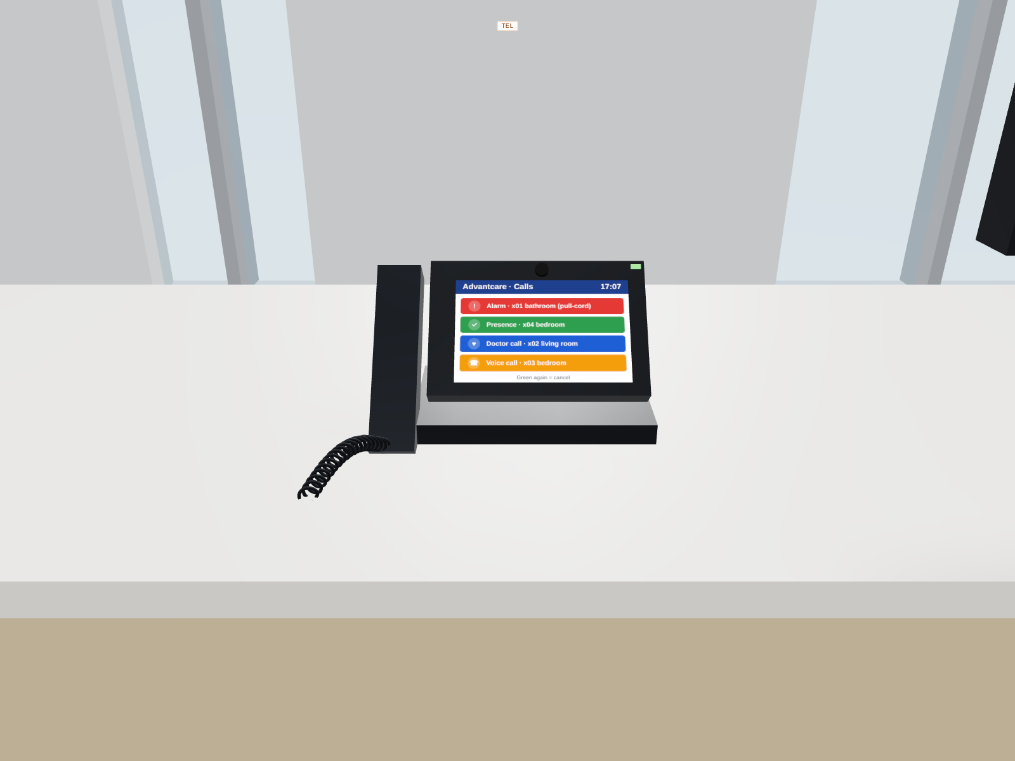
Ground floor: reception with nurse desk
Nurse desk with Grandstream Android phone (PoE straight to the switch): alarm in red, presence in green, doctor in blue and voice in orange. Behind it, the rack with the Buslogic Premium server and D-Link PoE switch. Proposed layout: to be adjusted with the architect's GF plan.

Slide 10
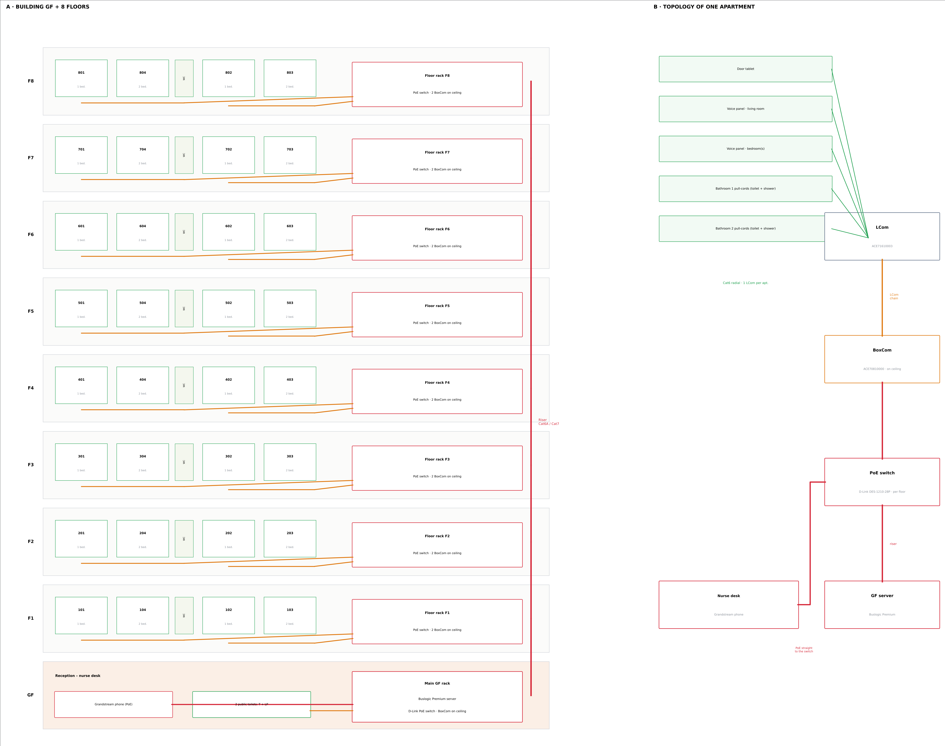
Topology: from the apartment to the nurse desk
1
The resident calls from the tablet, the panel or the pull-cord
2
Cat6 radial to the apartment LCom
3
LCom → LCom → BoxCom on the ceiling
4
BoxCom → D-Link PoE switch in the rack
5
Switches via the riser → Buslogic GF server
6
The desk phone (PoE) shows each call in its colour

Slide 11
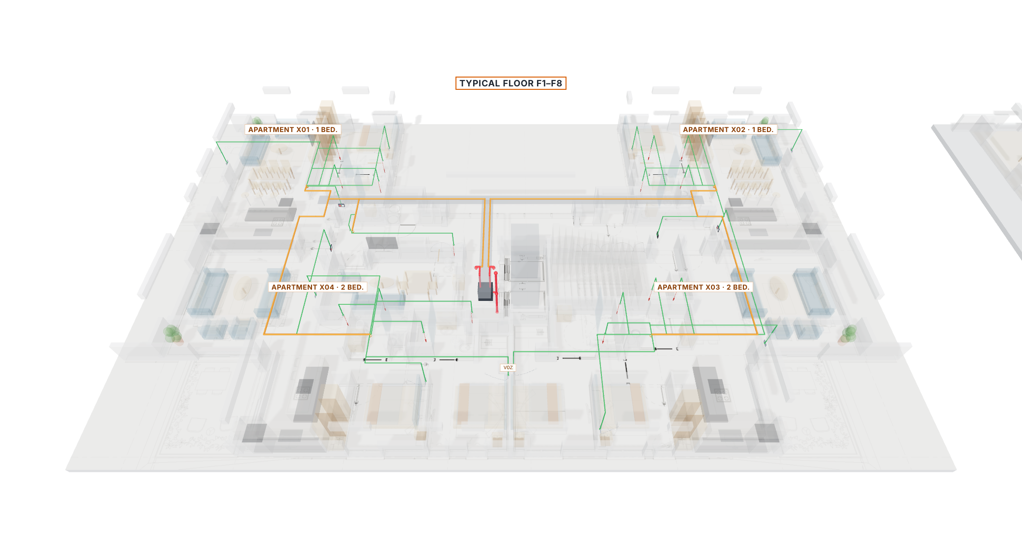
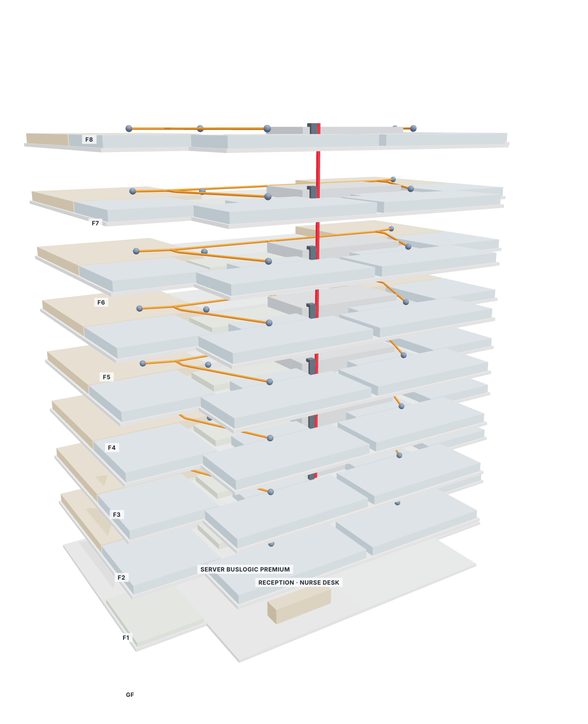
3D wiring and building
Cat6 radial
Cat6 / Cat7 chained
Cat6A / Cat7 network
Each apartment device to its LCom
x01 → x04 → public toilet · x02 → x03
BoxCom → switch → riser → server

Slide 12
Bill of materials – whole building
Advantecnia / ACE BG device | Qty.
Door tablet (iPad / Android) | 32
Voice panel with buttons · ACE82182451 | 80
Pull-cord · ACE40320303W | 138
Corridor light · ACE41020309 | 10
LCom · ACE71610003 | 41
BoxCom · ACE70810000 (ceiling) | 17
PoE switch · D-Link DES-1210-28P | 9
Buslogic Premium server · Grandstream phone | 1 · 1
Cable (8 floors + GF + 15 %) | Metres
Cat6 radial (green) | 1700
Cat6 / Cat7 LCom chain (orange) | 750
Cat6A / Cat7 network + riser (red) | 130
Preliminary quantities: validate with Advantecnia and on site.

Slide 13
Project deliverables
PDF
11 A1 sheets: typical floor, devices with photos, client marks, wiring, apartments, ground floor, riser diagram, materials and 3D
DXF
CAD drawing of the typical floor and GF with layers per system; save as DWG in AutoCAD
IFC
BIM model of the building (GF + 8 floors) for Revit
3D
Web viewer: equipment / wiring, Walk, Go to… and a Documents button to view and download everything
MP4
Walkthrough video with captions
PPT
This presentation

