Slide 1


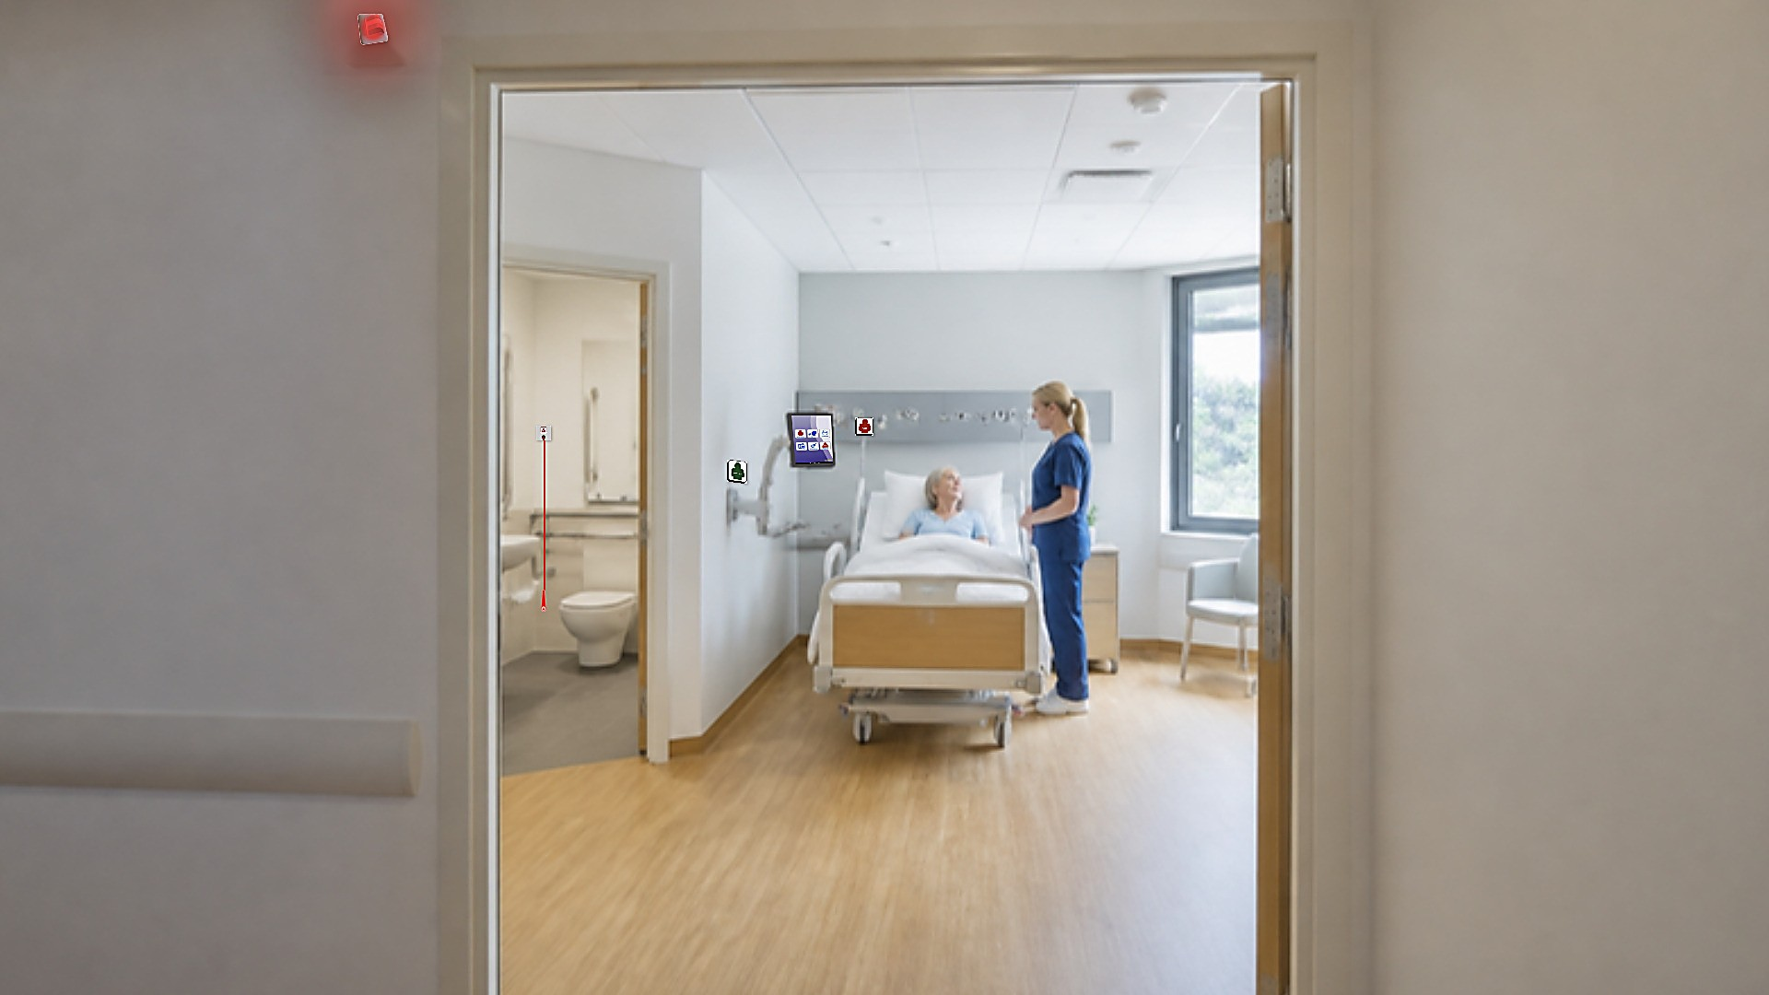

Yoseftal Medical Center · Eilat
Nurse call, communication, medical monitoring and location systems for hospitals
Advantecnia solutions – and what we will install in the surgical ward
Orad – official distributor in Israel
October 2026
Notes:
Opening: Advantecnia and Orad, and what we will present today.

Slide 2



WHO WE ARE
Advantecnia by ACE BG: technology for people
45,000+
400+
20+
10M+
beds with nurse call installed
hospitals
years of experience
users per year
Manufacturer and developer of IP healthcare products – based in Spain with a US branch
Systems running in hospitals, clinics and assisted living across Europe and America
Orad is the Advantecnia distributor in Israel, with local support
International standards
Notes:
The manufacturer: experience, international presence and standards.

Slide 3
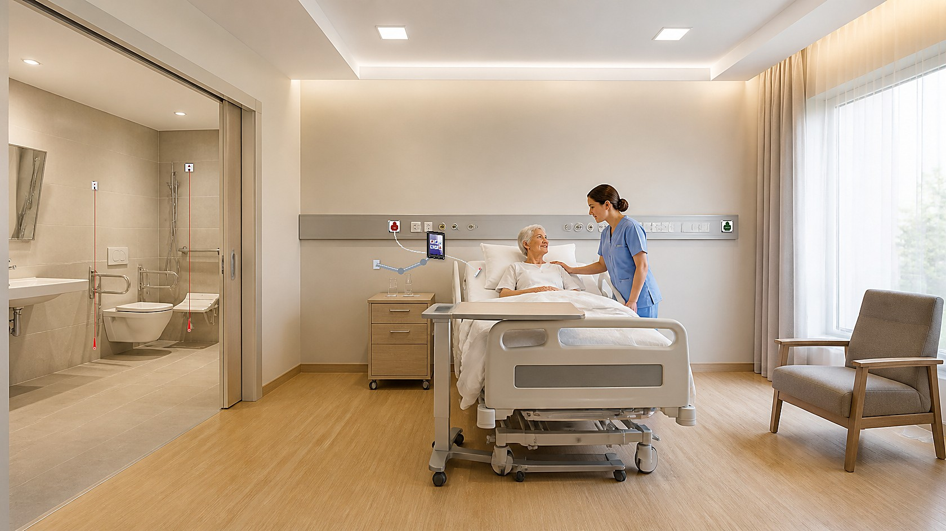




THE SMART ROOM
What is a Smart Room?
The "Smart Room" is an advanced care environment that uses digital technology to improve patient care and make staff work more efficient.
Patients enjoy a comfortable, personalized stay, and medical staff get tools that support their daily work.
Better care
More efficient staff
Continuous follow-up of the patient
Every call reaches the right person
Safety
Patient experience
Real-time alerts, day and night
Comfort, information and entertainment at the bed
Notes:
What a smart room is and why it matters.

Slide 4
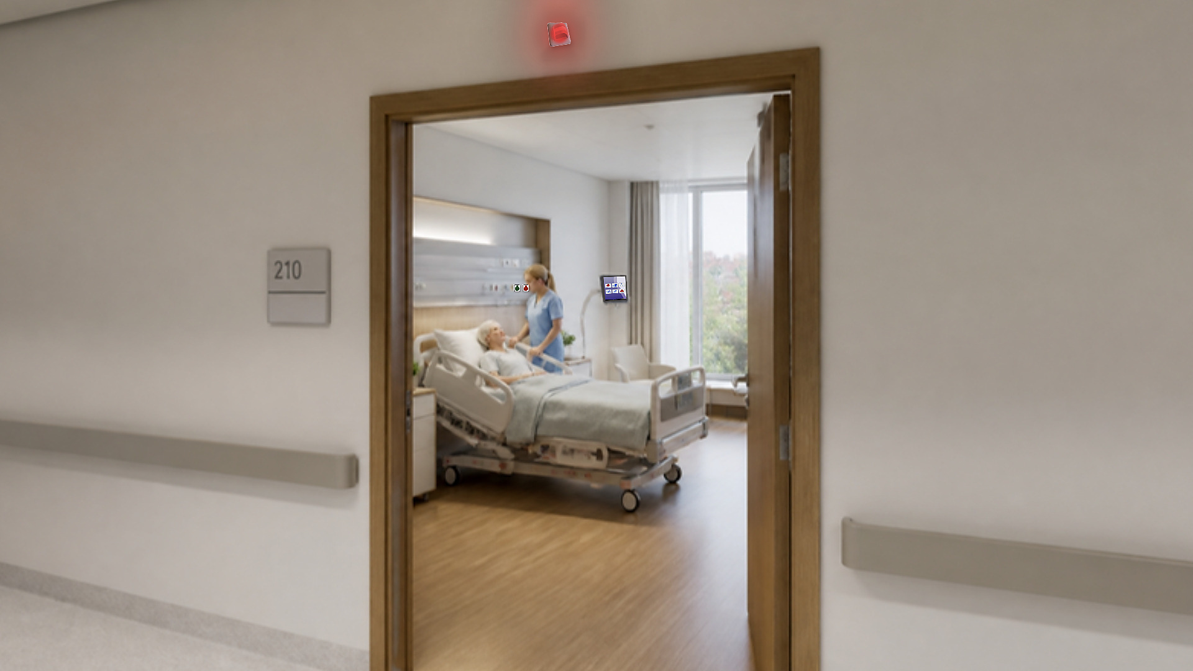

OUR SYSTEMS
Every system – in one room
Nurse call and communication
Contactless medical and environment monitoring
Tablet and screens for patient and staff
Emergency buttons in toilets
Access control and automation
Real-time location of people and equipment
Notes:
Our systems – all on one infrastructure.

Slide 5
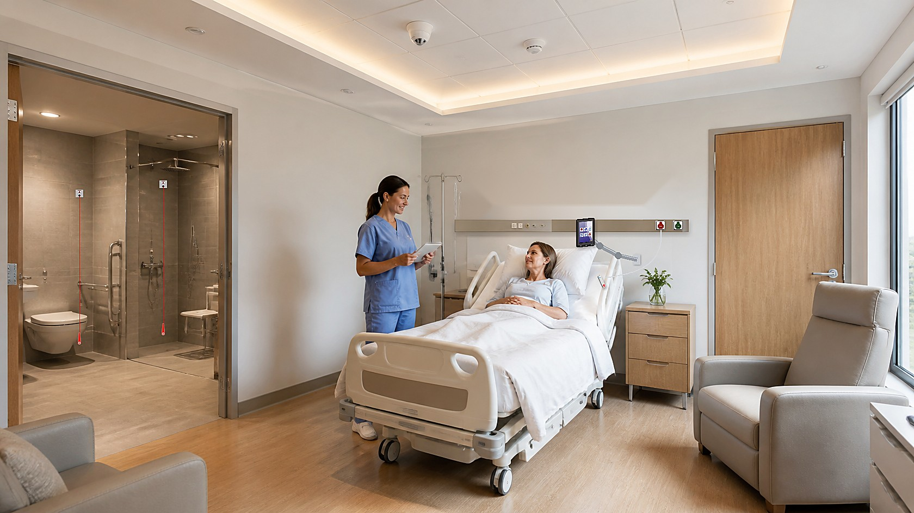
Nurse call system
Panel with buttons for nurse call, doctor call and intercom
Ergonomic pear handset with LED light – also a night light
Large buttons with raised marking for the visually impaired
Pull-cord emergency button in toilets
Complies with DIN VDE 0834-1:2016 safety standard
Notes:
AdvantCare – the core of the system.

Slide 6
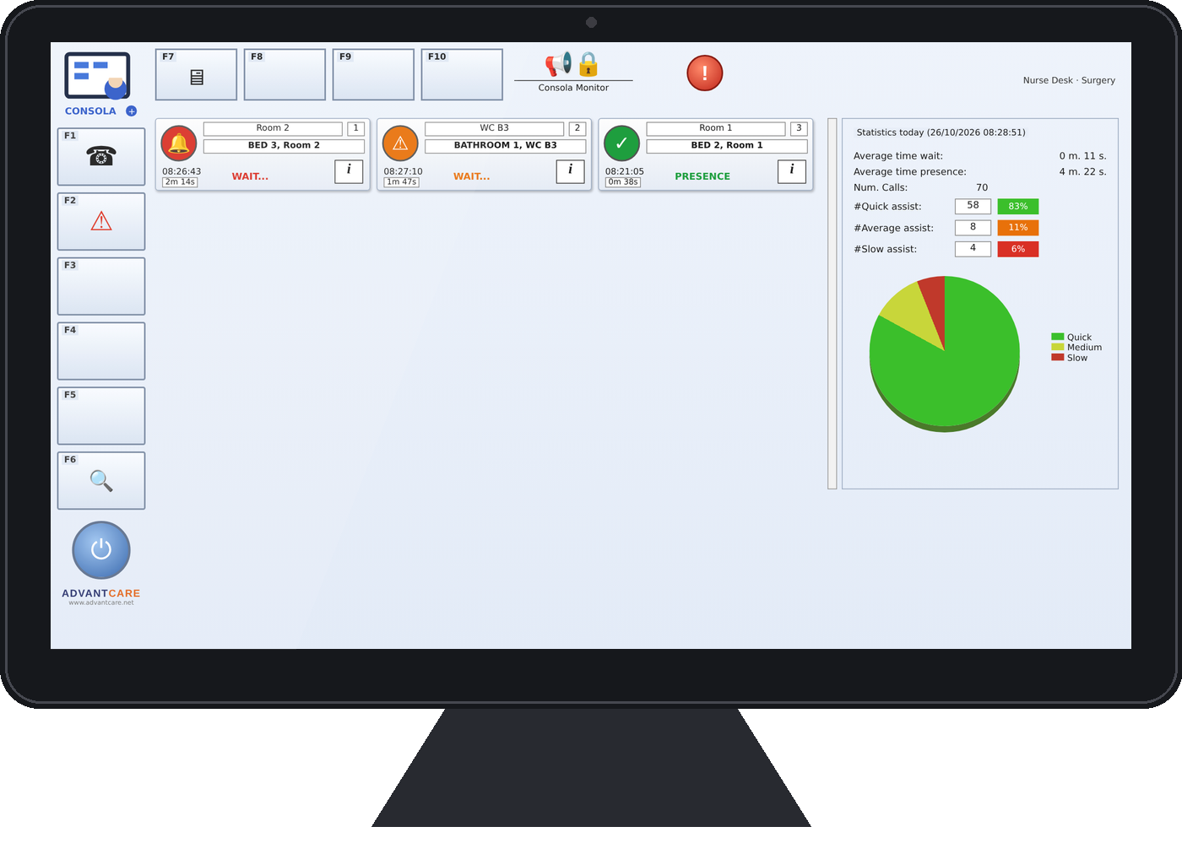
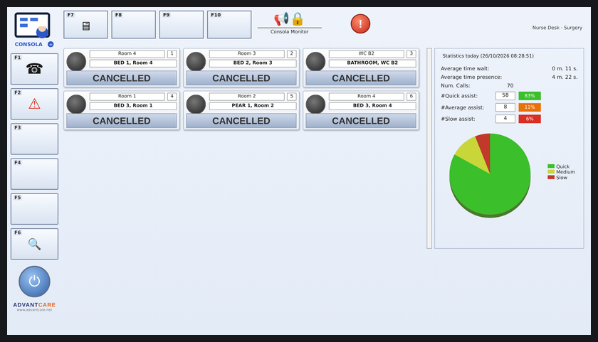
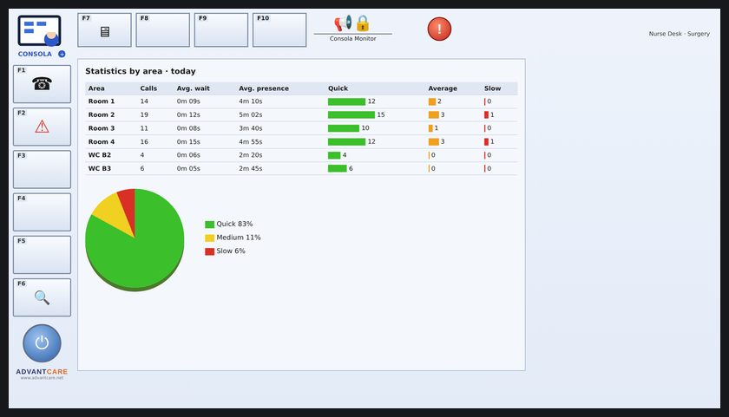
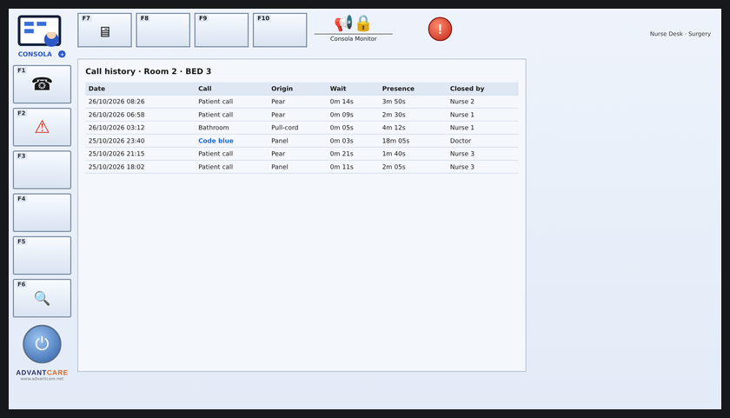
Software: every call in one view
Wall screen · Surgery
Call priority by type and urgency
Room 1
Room 2
Room 3
Messages to mobile terminals and phones
Room 4
B2
B3
IP phone or Android desk phone
Wall screen
History, reports and charts
Notifcare
Software screens
New call
Room 2 · Bed B
Smartphone app
Nurse station – Consola Monitor software
All-in-One PC, tablet or iPad
Calls
Statistics
History
▶ Live software demo
Notes:
Software: nurse station, wall screen and app.

Slide 7
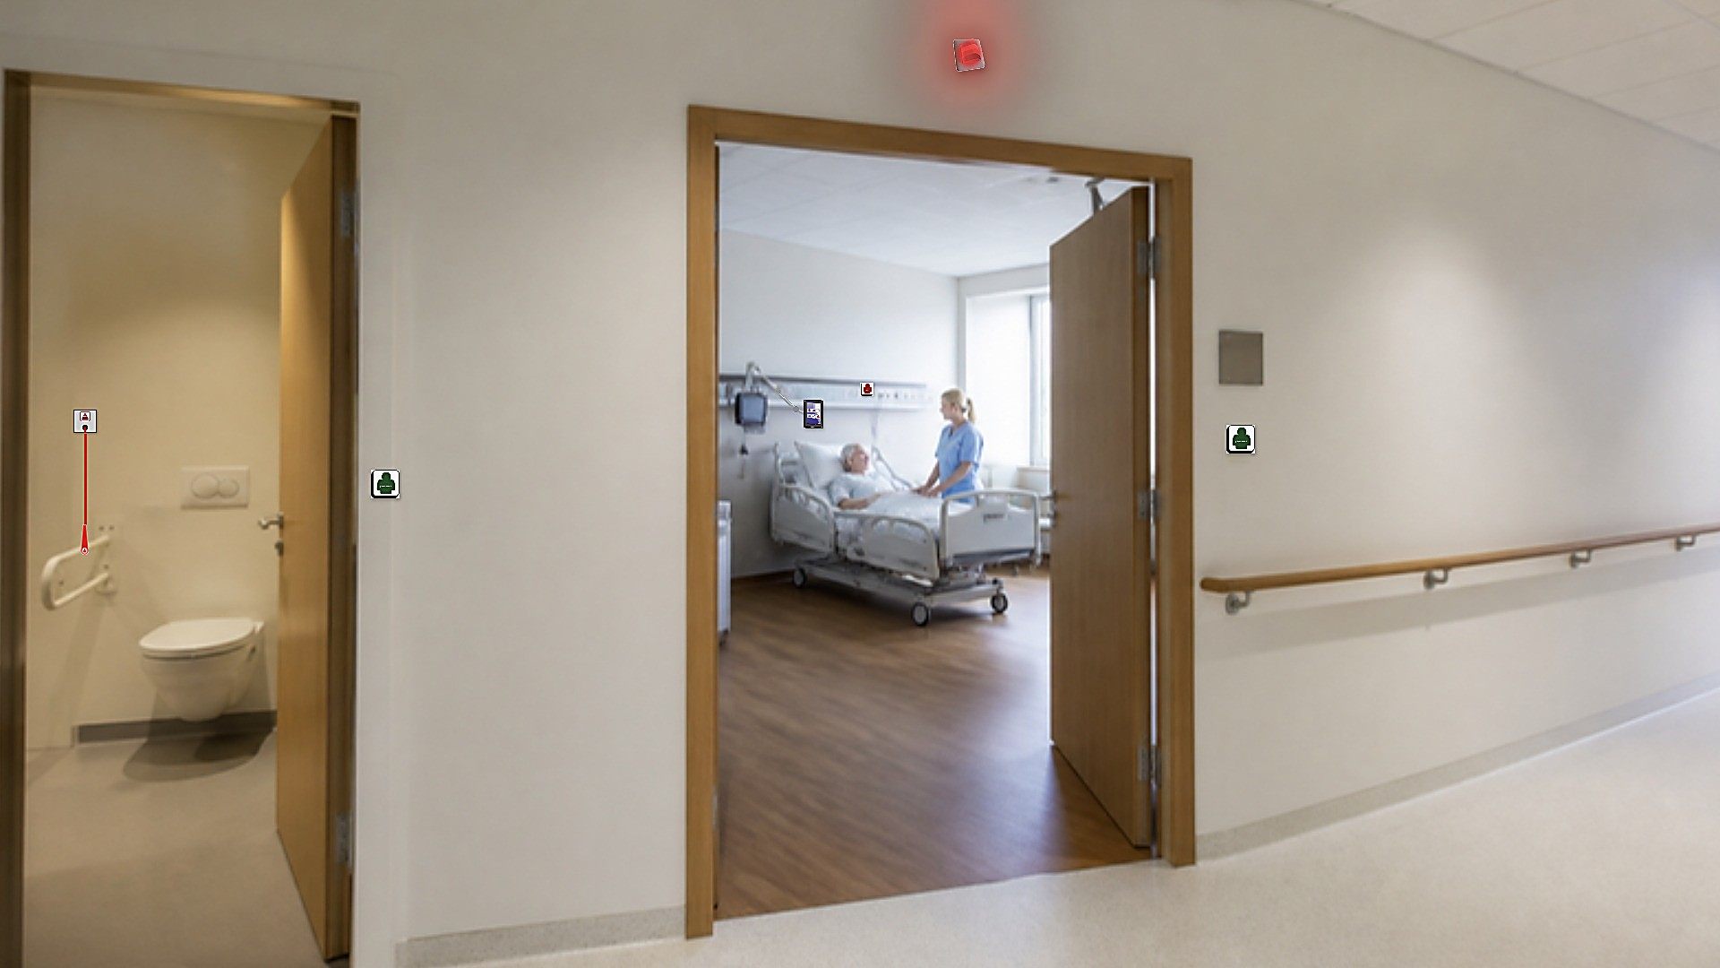
Emergency buttons and indicator lights
Pull-cord emergency button – reachable even after a fall
Corridor light at the room entrance – red, blue or green by alert type
Works locally, even without communication with the central server
Illuminated sign with the room number and its status
Notes:
AdvantSOS – emergency in toilets and corridor signalling.

Slide 8

Smart tablet for patient and staff
Requests by category: nurse, medication, food and drink, toilet, repositioning
Voice and video calls with staff and family
Entertainment, TV and medical information – with a personal access code
Screen outside the room: call status, intercom and tasks
Notes:
CarePad – the bedside tablet.

Slide 9
Continuous monitoring – without contact
Detects bed exit, falls and presence in the room
Heart rate, breathing and sleep quality – no wires
Medical body sensor – up to 9 clinical parameters
Environment sensors: temperature, humidity, CO, CO2 and noise
-40%
-70%
falls
pressure ulcers
Notes:
AdvantSense – contactless monitoring.

Slide 10

SECURITY AND LOCATION
Access control and real-time location
Smart lock: Bluetooth, card, fingerprint or code
Cameras, access control and touch terminals
Real-time location of people and equipment – tag, wristband or card
Radio and Bluetooth versions, with staff panic button
Notes:
AdvantControl and AdvantTrack.

Slide 11










THE FULL POTENTIAL
Advantecnia product lines
Nurse call
Real-time monitoring
Intercom
Public address
Indicator lights and emergency buttons
Automation and security
Real-time location
Energy control and saving
Clock synchronization
Wayfinding and entertainment
Queue management
Digital signage
Notes:
All product lines – for the next stage.

Slide 12
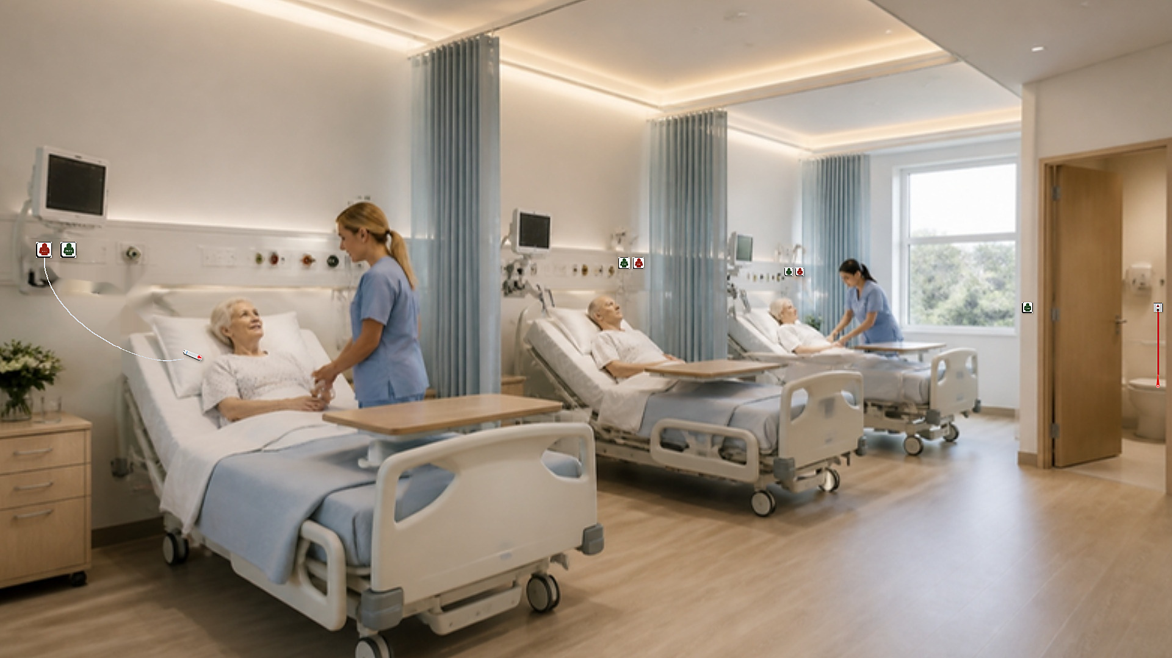
Part 2
The project at Yoseftal Medical Center
Surgical ward · AdvantCare nurse call system
12
beds
4
patient rooms
2
patient toilets
1
nurse station
Notes:
The project: the surgical ward at Yoseftal.

Slide 13
WARD PLAN
Every device positioned on the floor plan
Open the interactive plan →
Room 4
Room 3
Office
Room 2
Room 1
Corridor
Nurse station
Staff WC
WC B2
WC B3
Call + pear
Emergency pull-cord
Presence / cancel
Corridor light
Nurse station
Notes:
Every device on the plan.

Slide 14
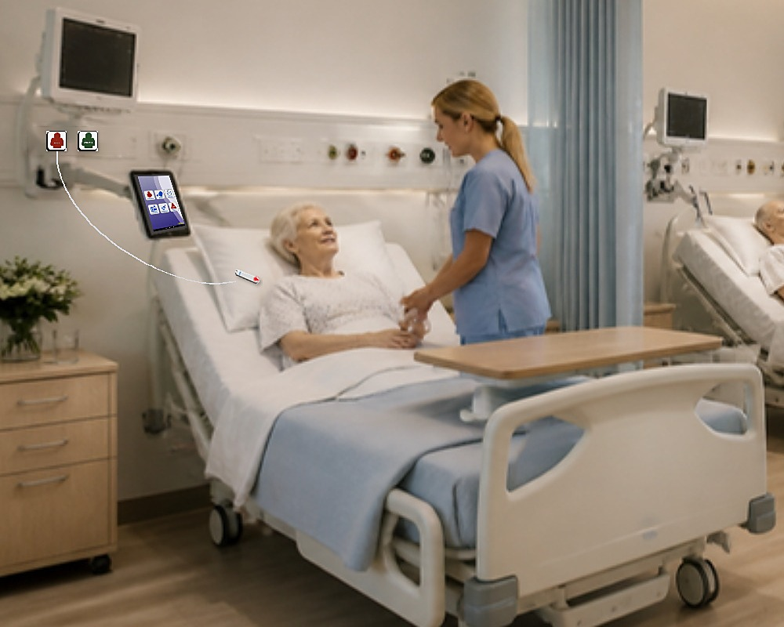
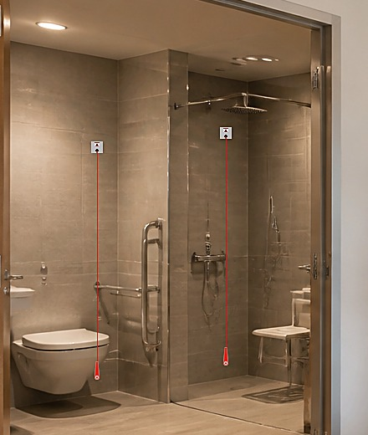
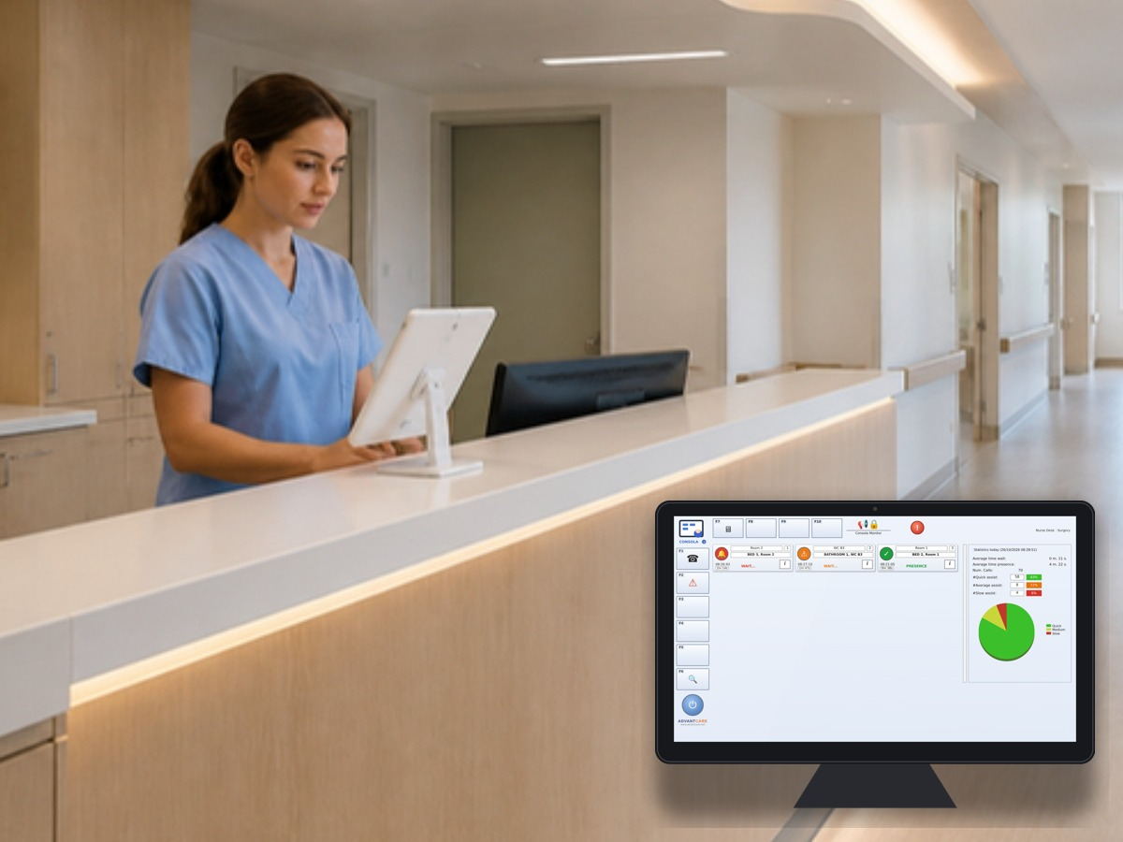
WHAT WE INSTALL
AdvantCare in the surgical ward
3
3
Call panel at every bed
1
5
1
On the wall, by the bed head
CarePad
2
2
Pear handset
Within the patient's reach, at every bed
3
Pull-cord emergency button
In toilets and shower
Patient toilet
4
Corridor light
Above every door – visible from afar
5
Presence / cancel button
6
By the door – the nurse marks arrival and closes
Curtained bed bay
Nurse station – Consola Monitor
6
Optional: CarePad tablet at the bed – for the patient (entertainment, requests, call)
Outside the room: all calls, history, statistics
Nurse station – outside the room
Notes:
What we install in every room and toilet.

Slide 15




HOW IT WORKS
A call, from the patient to closure
01
02
03
04
05
Patient calls
Corridor signals
Nurse is alerted
Nurse in the room
Call closed
Presses the pear or pulls the cord in the toilet
The light above the door turns on
The call appears at the nurse station with room and bed
Presses presence by the door
When care is done – logged in the history
Notes:
The call flow in five steps.

Slide 16

TODAY AND TOMORROW
Start with nurse call – grow into a smart room
Can be added later, on the same infrastructure
What we install now
Smart tablet at every bed
Nurse call from the bed and the corridor
Contactless monitoring and fall prevention
Staff and equipment location
Emergency in toilets and shower
Access control and smart locks
Notes:
Start with nurse call – expand later.

Slide 17




WHY ADVANTECNIA
The right choice for Yoseftal
45,000+ beds
International standards
Planning ready
Local partner
Ready for the future
Nurse call proven in 400+ hospitals
CE · UL · ISO 9001 · DIN VDE 0834
Plans, 3D model and images – every device in place
Orad in Israel – installation, training and support
The same infrastructure grows into a full smart room
Notes:
Five reasons to choose Advantecnia.

Slide 18
WHAT WE NEED TODAY
Next step: approve and move forward
1
2
3
4
Plan approval with the ward
Final site survey
Detailed installation plan
Installation, start-up and staff training
Thank you
Orad
Advantecnia
Advantecnia distributor in Israel
ACE BG – the manufacturer
Notes:
Next step and thanks.

Slide 19
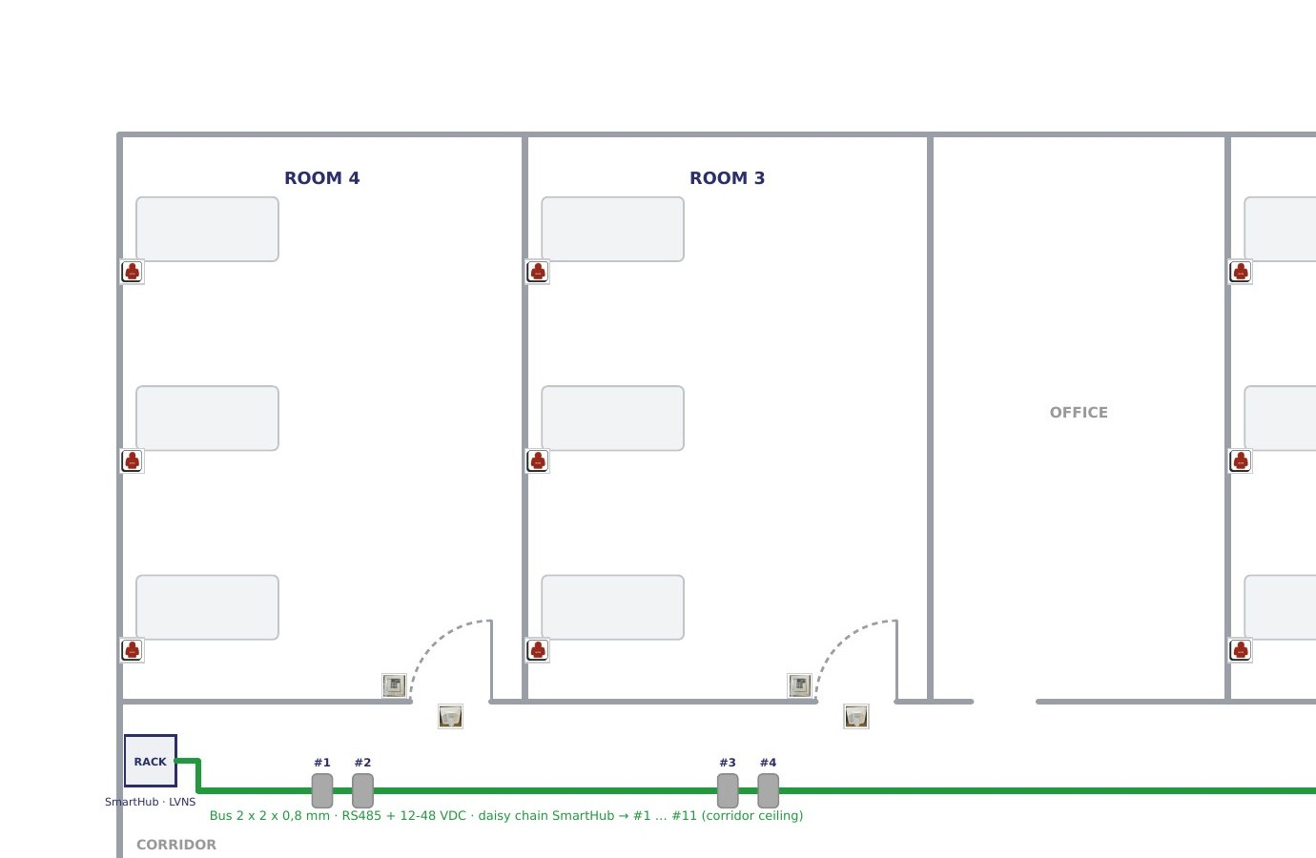





APPENDIX
See the ward before installation
The full Yoseftal planning is online, on any device:
2D plan
2D plans and wiring drawings
Photos and interactive 3D model
Ward walkthrough video
Every device position approved in advance
Photos
Scan to view
Open the plan →
Notes:
The full planning online – photos, plans and video.

