Slide 1

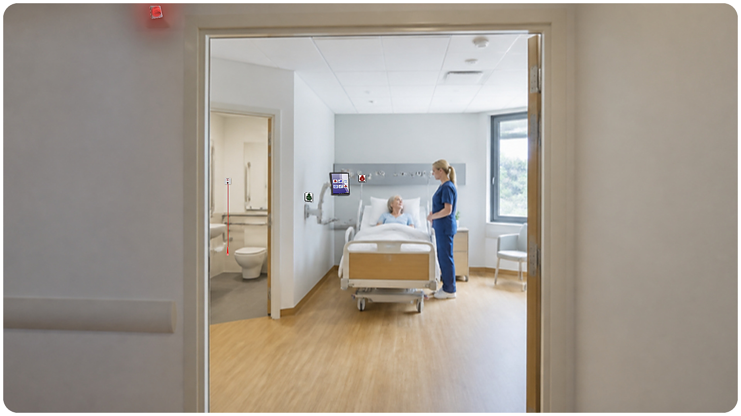
Notes:
Opening: Advantecnia and Orad, and what we present today.

Slide 2
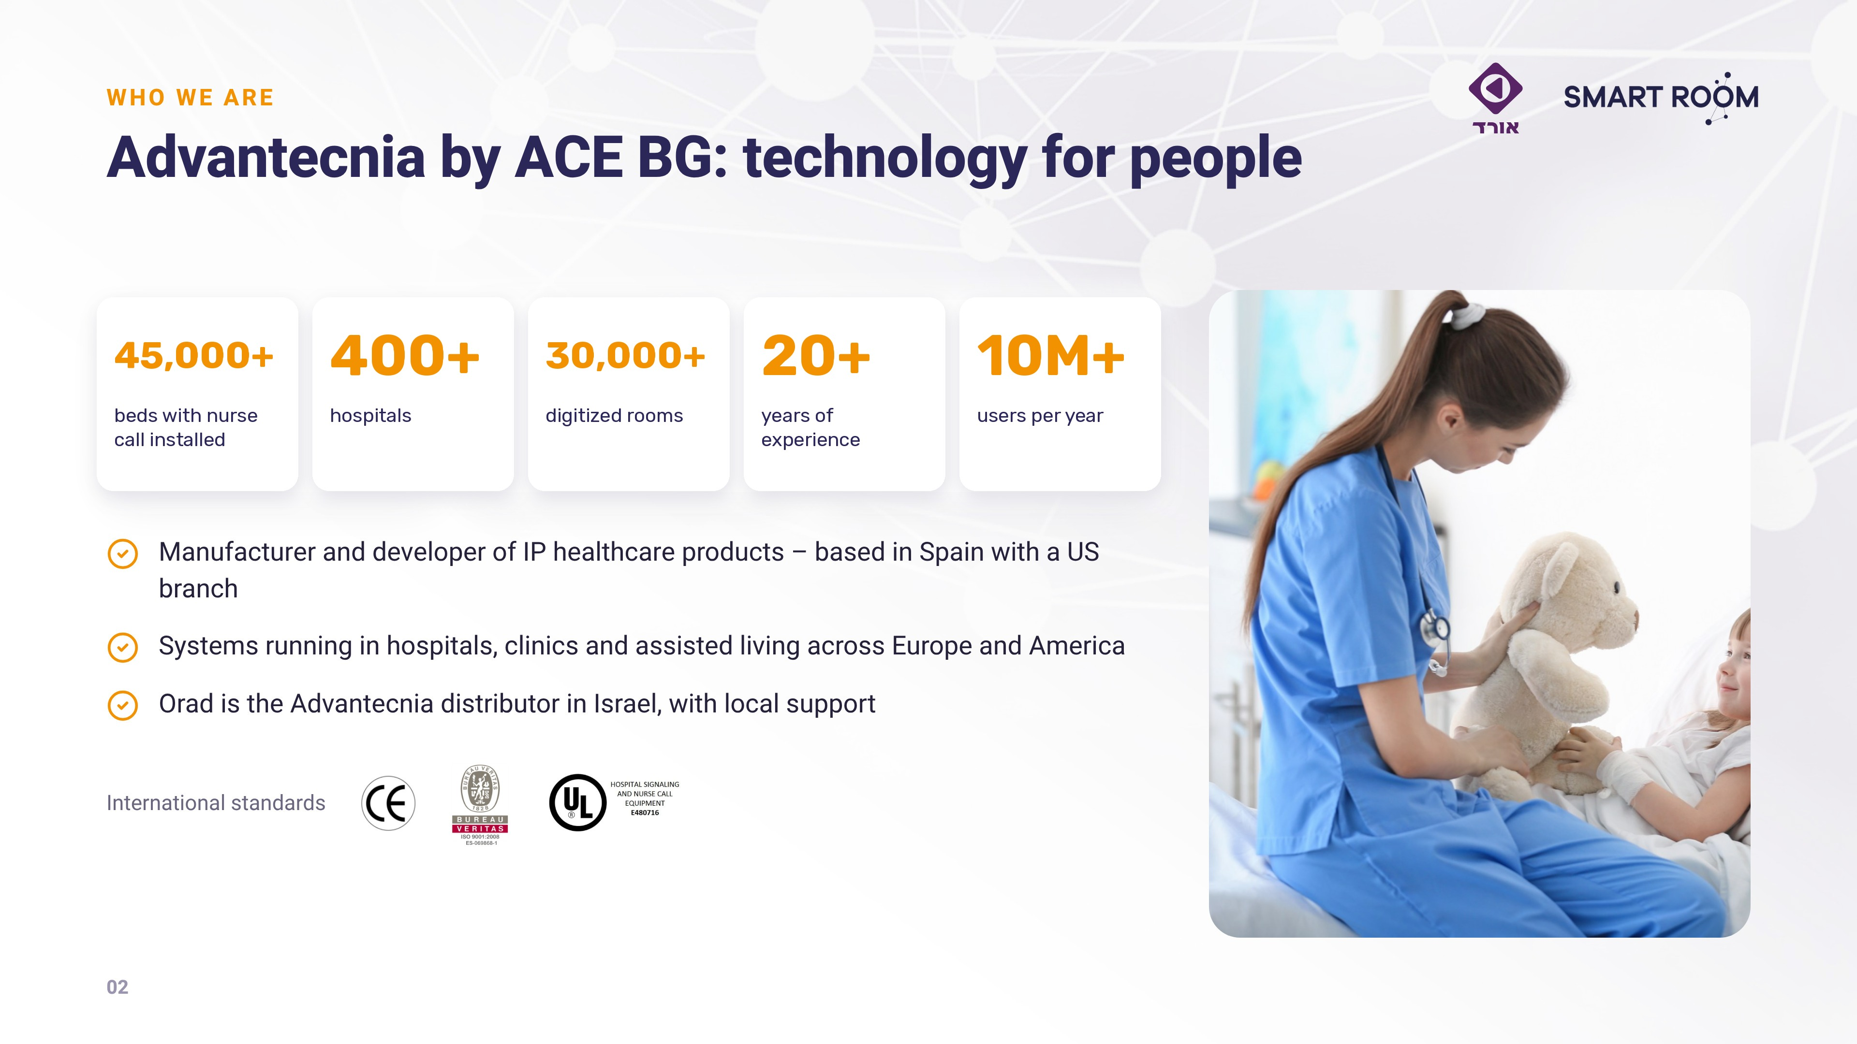
Notes:
The manufacturer: experience, international presence and standards.

Slide 3
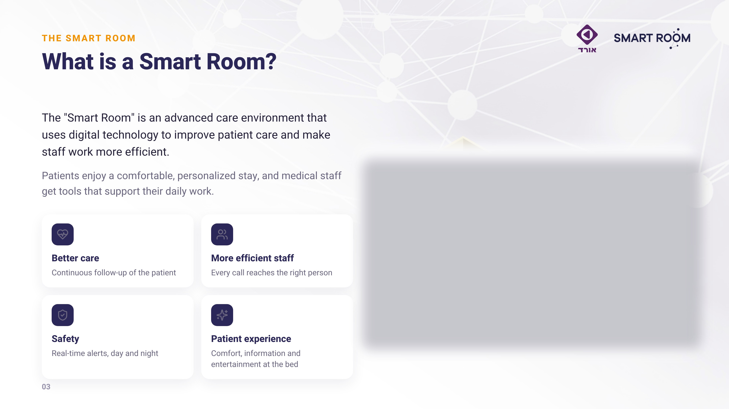
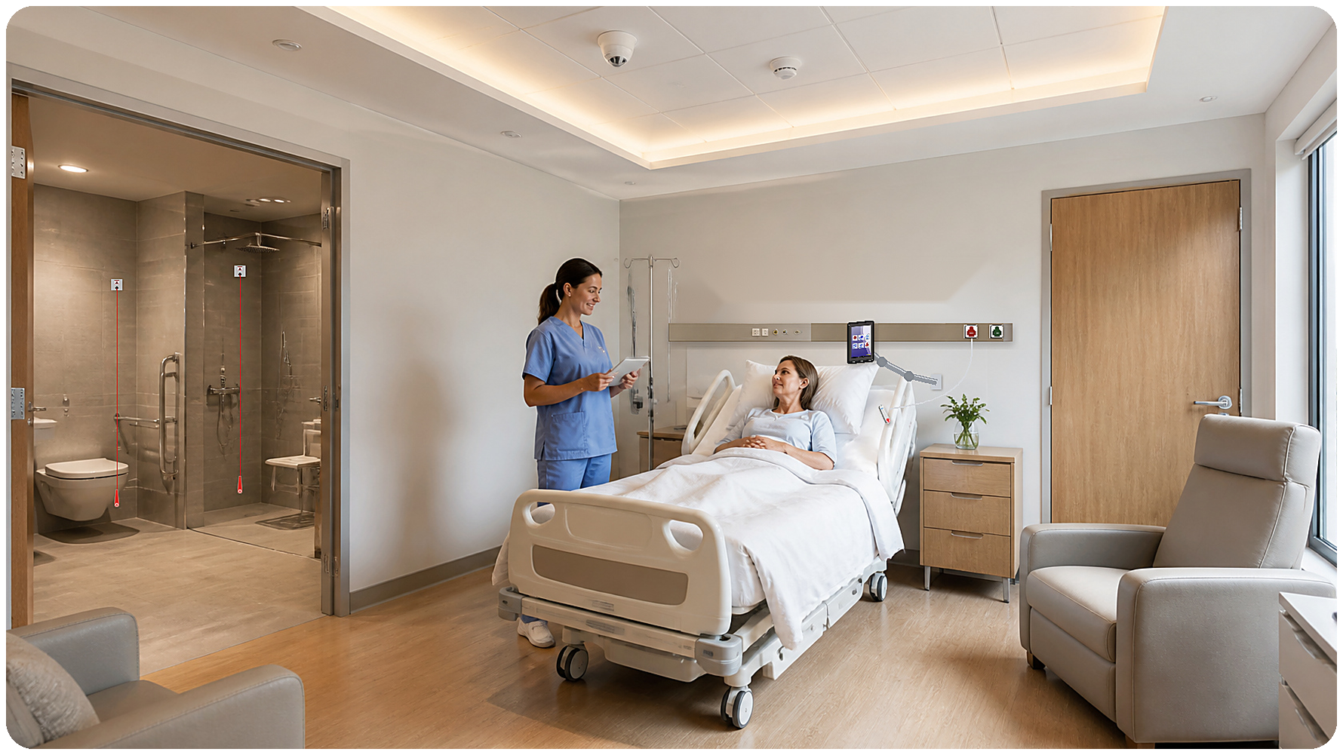
Notes:
What is the Smart Room.

Slide 4
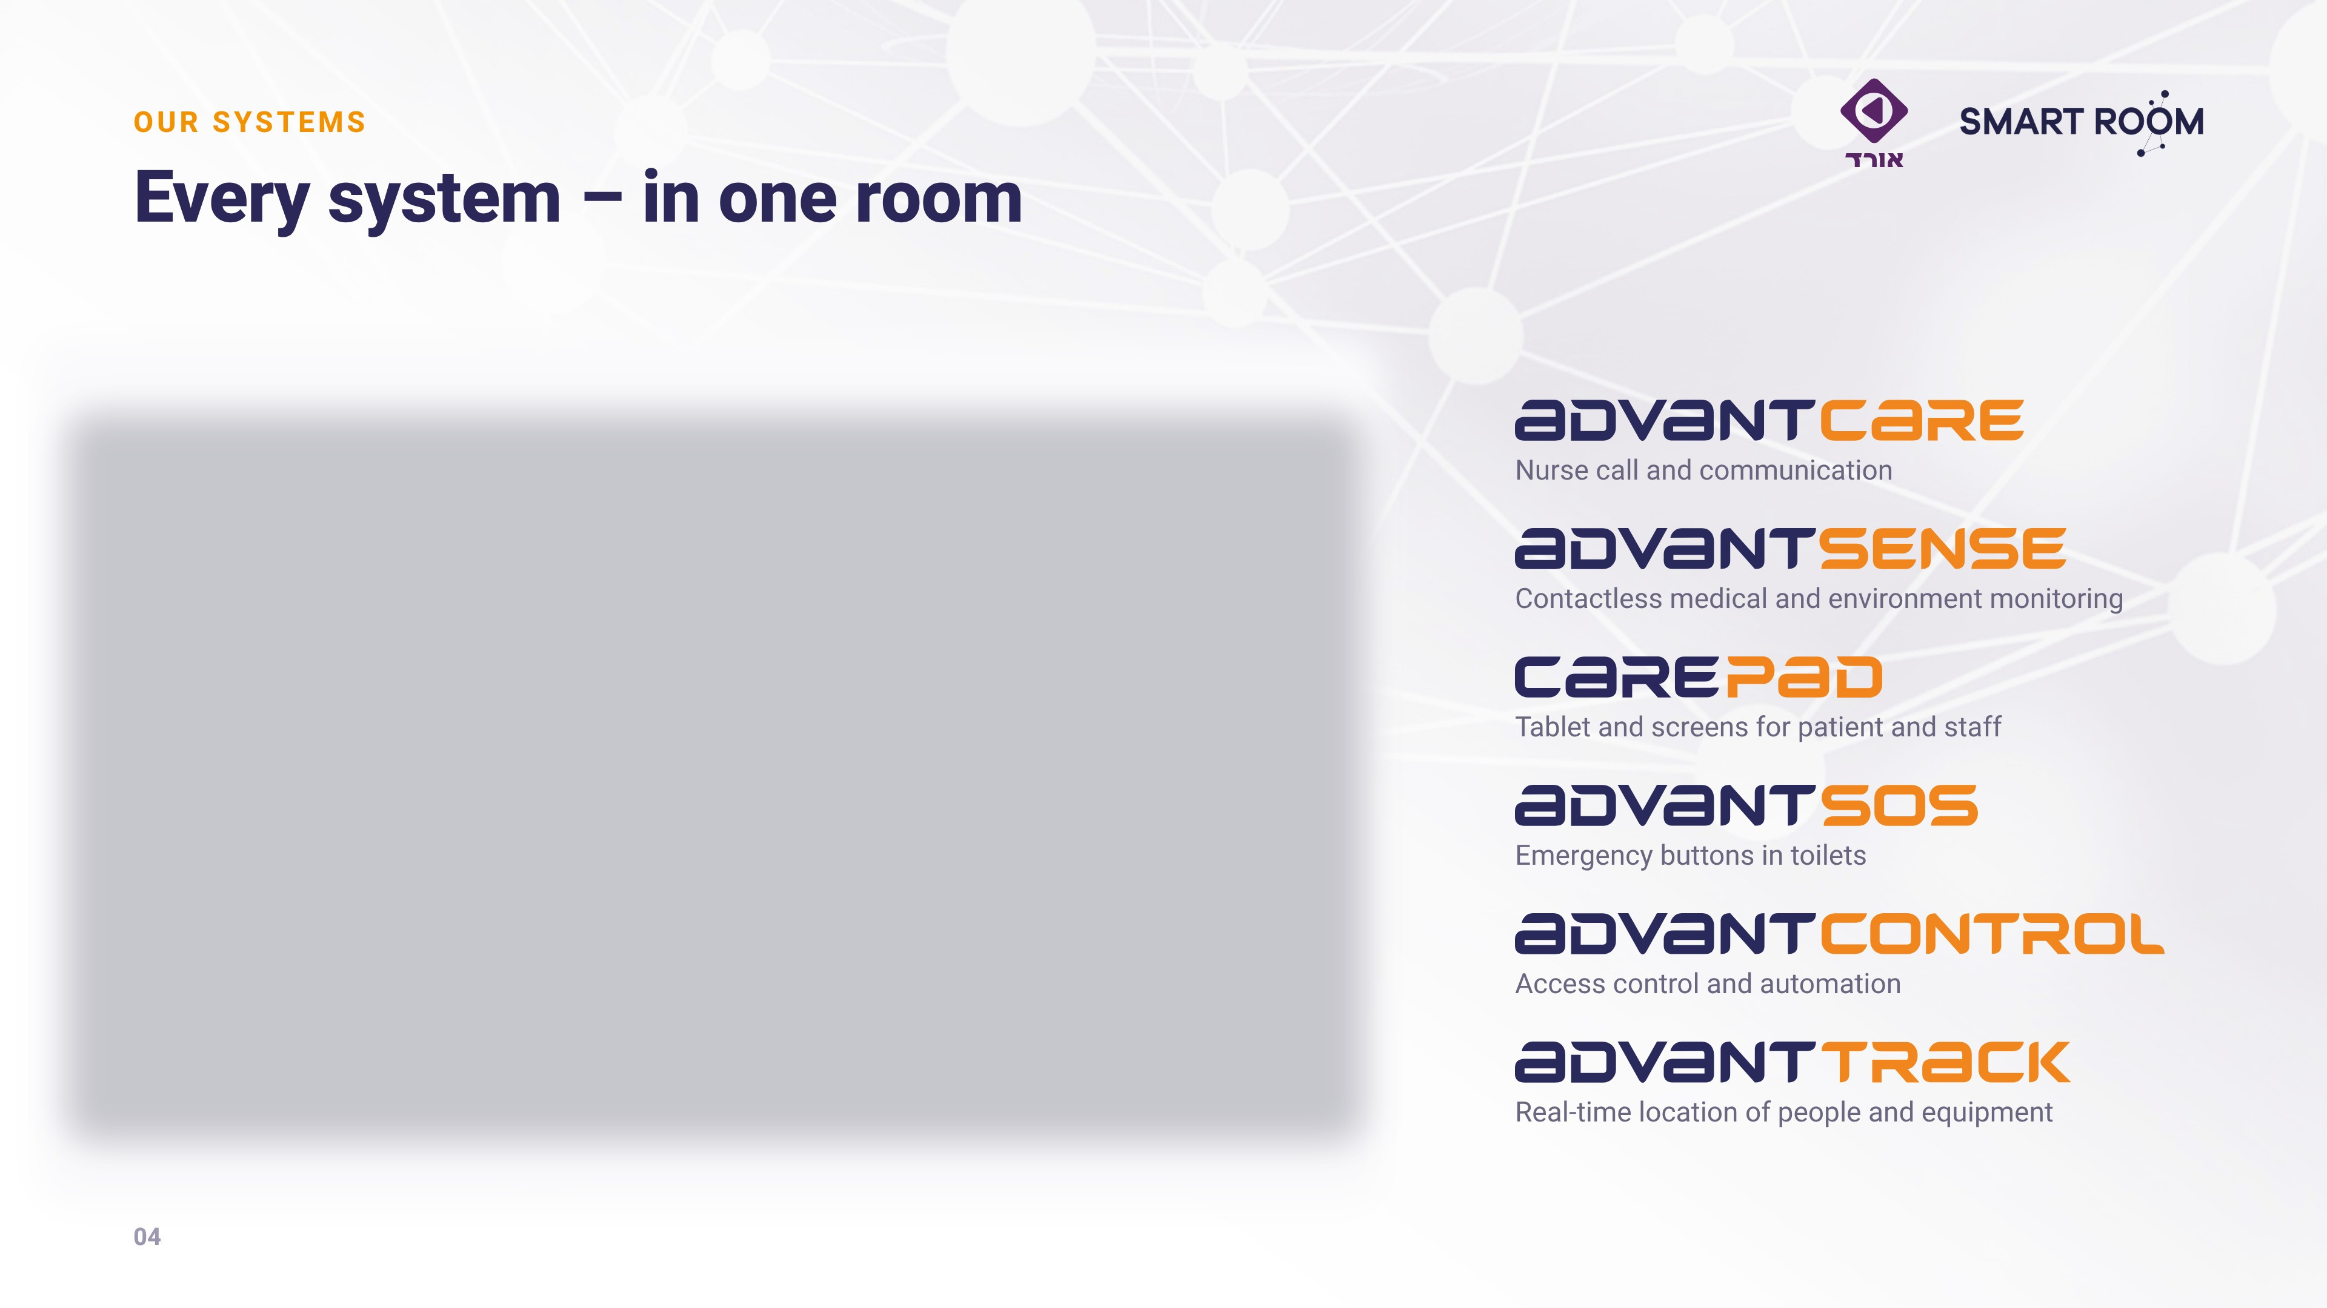
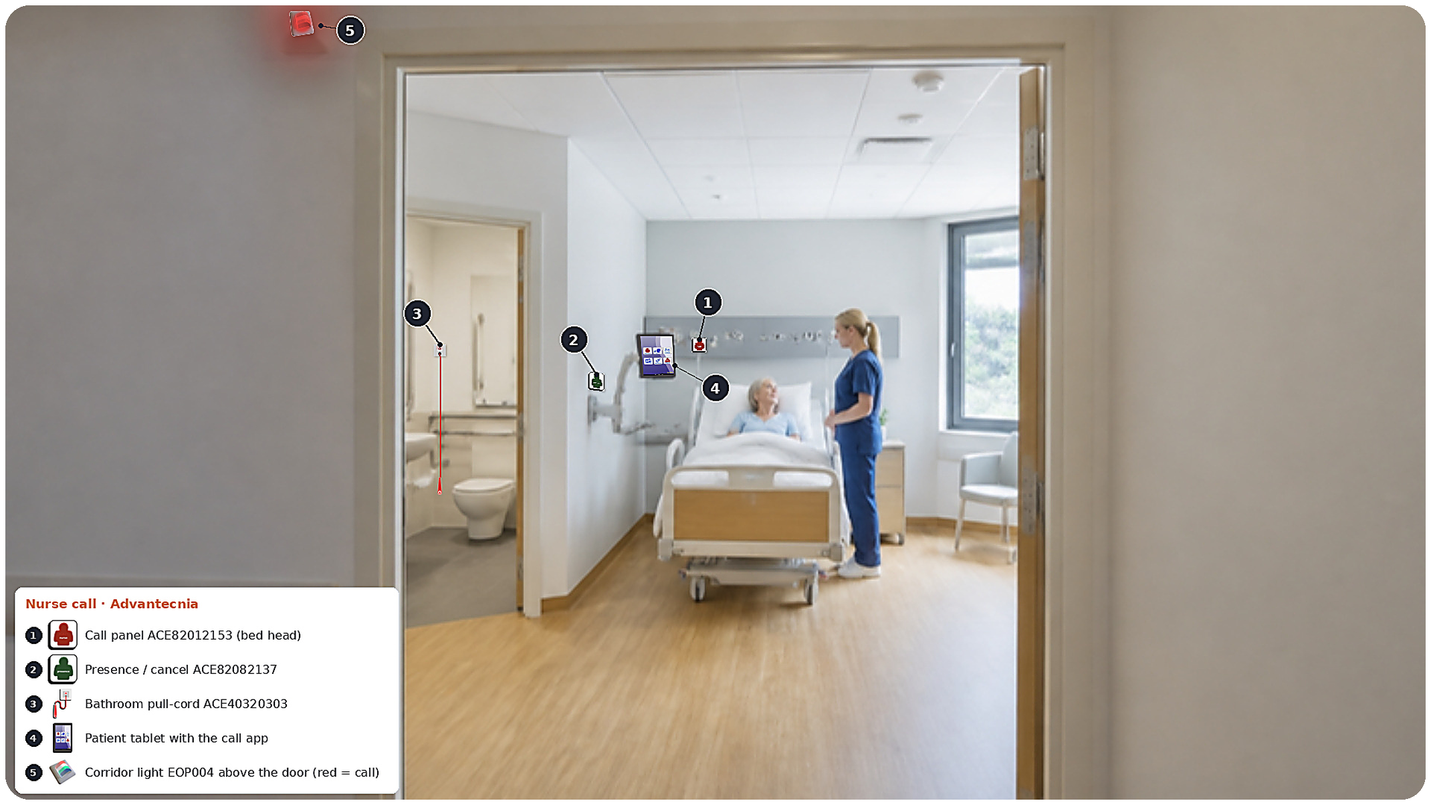
Notes:
Our systems – walk through the numbers on the illustration.

Slide 5
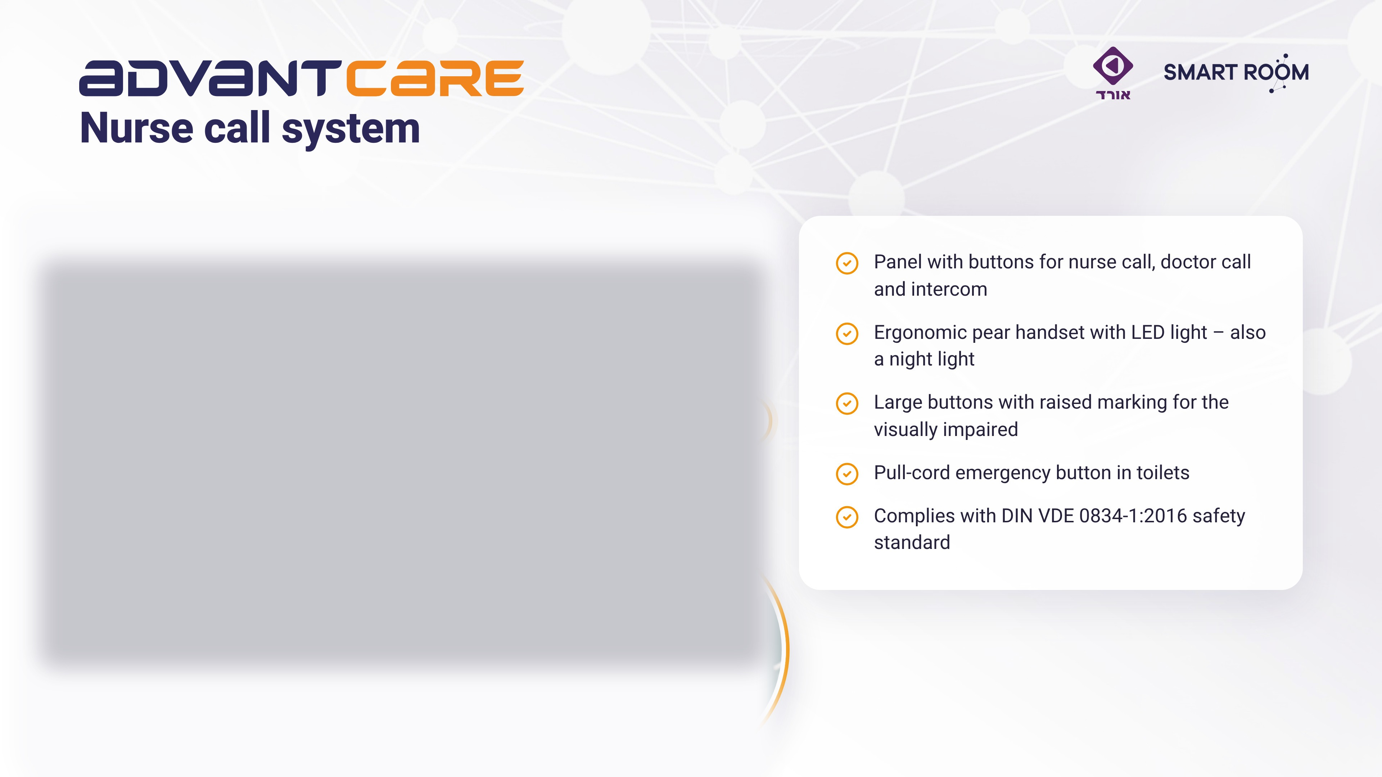
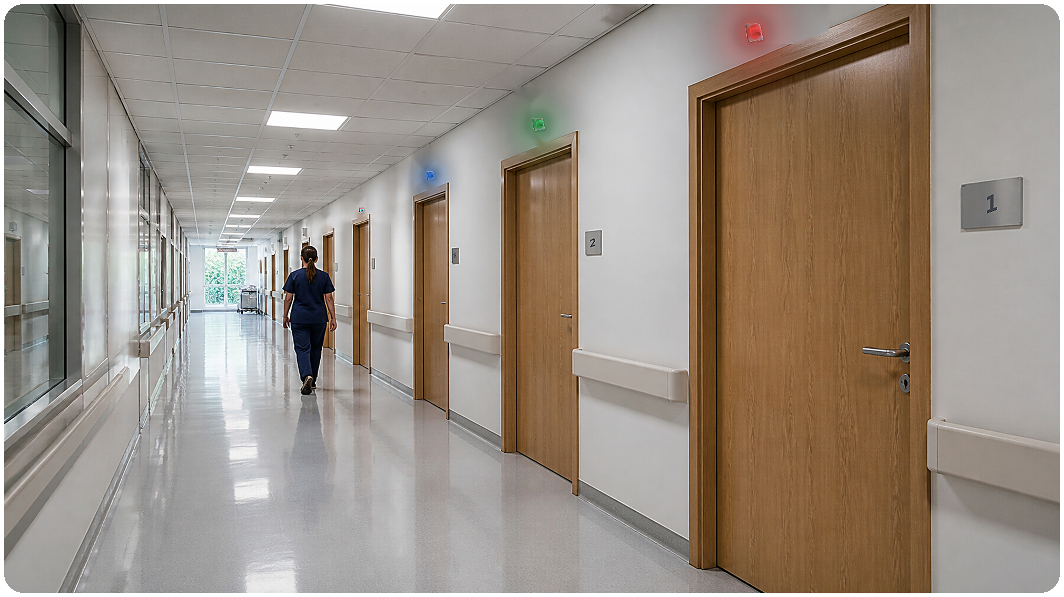
Notes:
AdvantCare – the heart of the system.

Slide 6
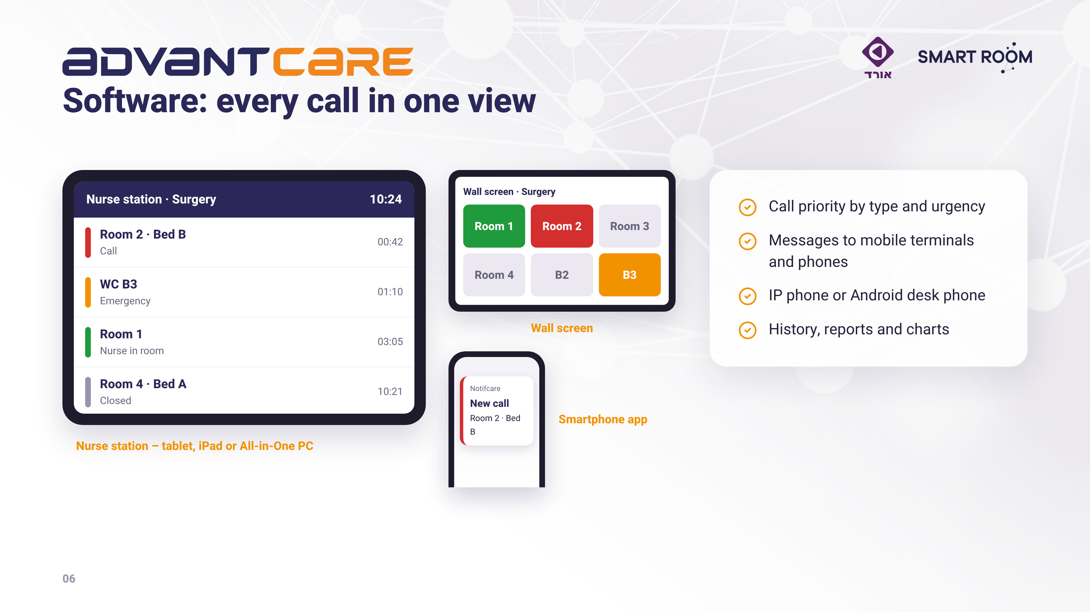
Notes:
Software: nurse station, app and wall screen.

Slide 7
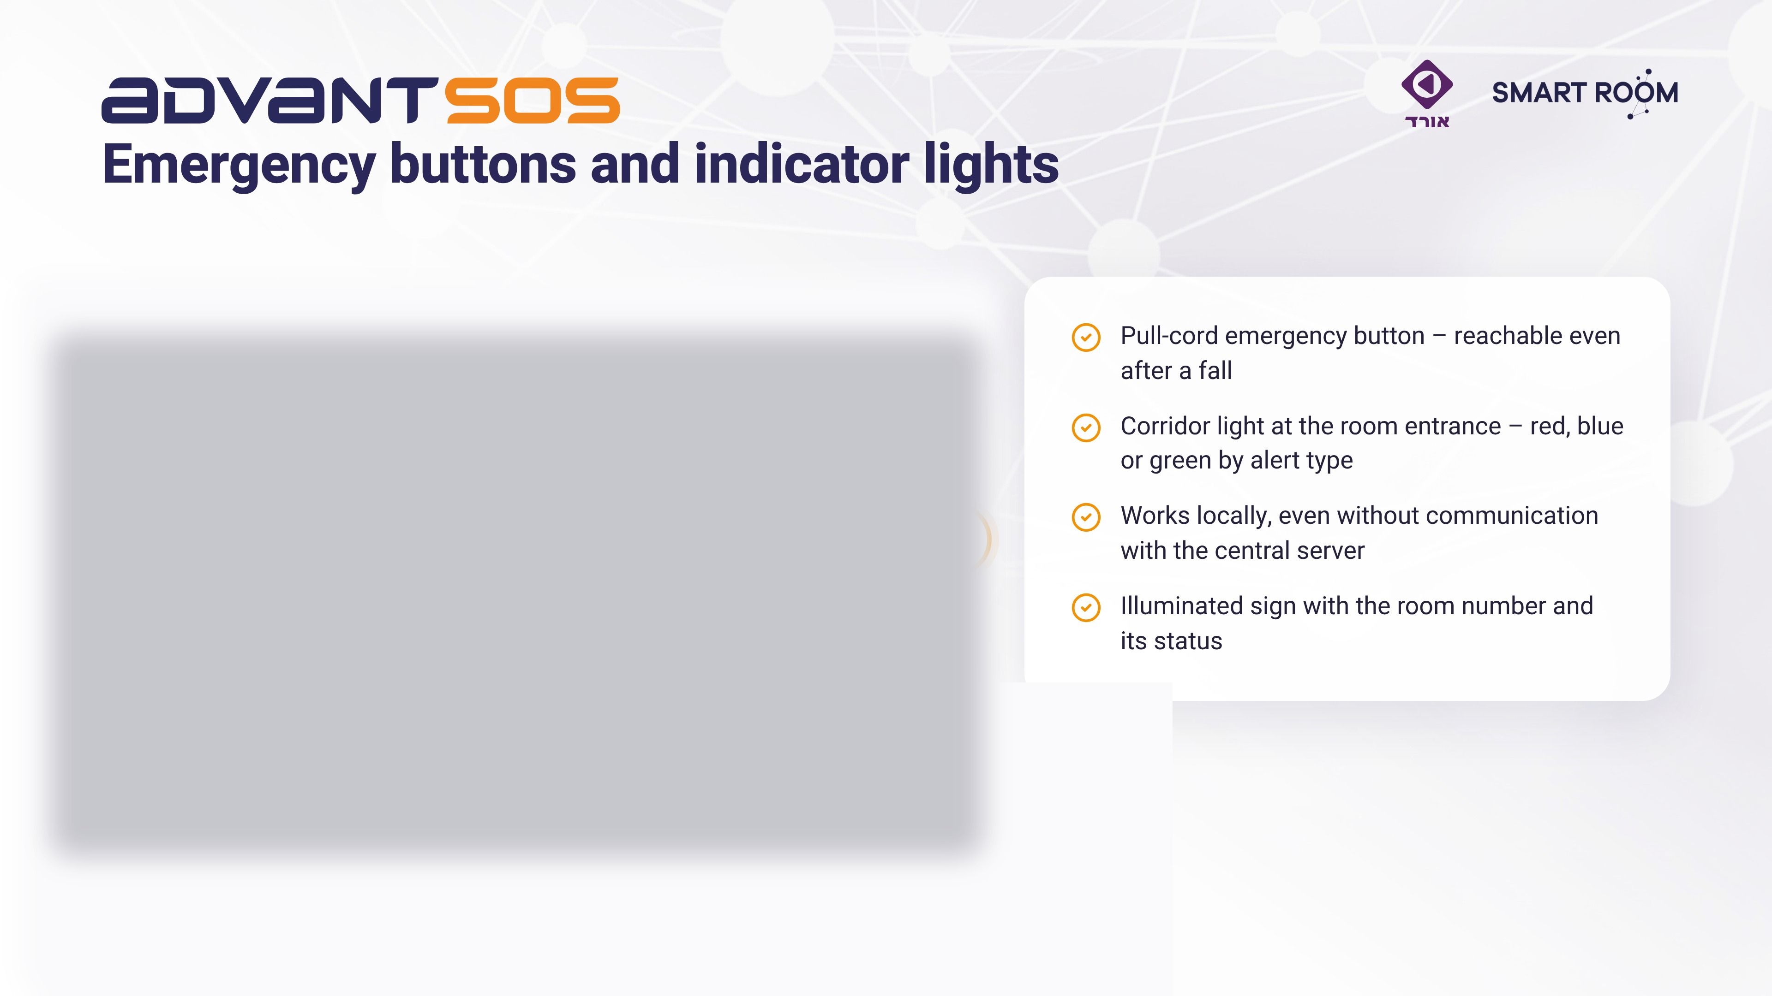
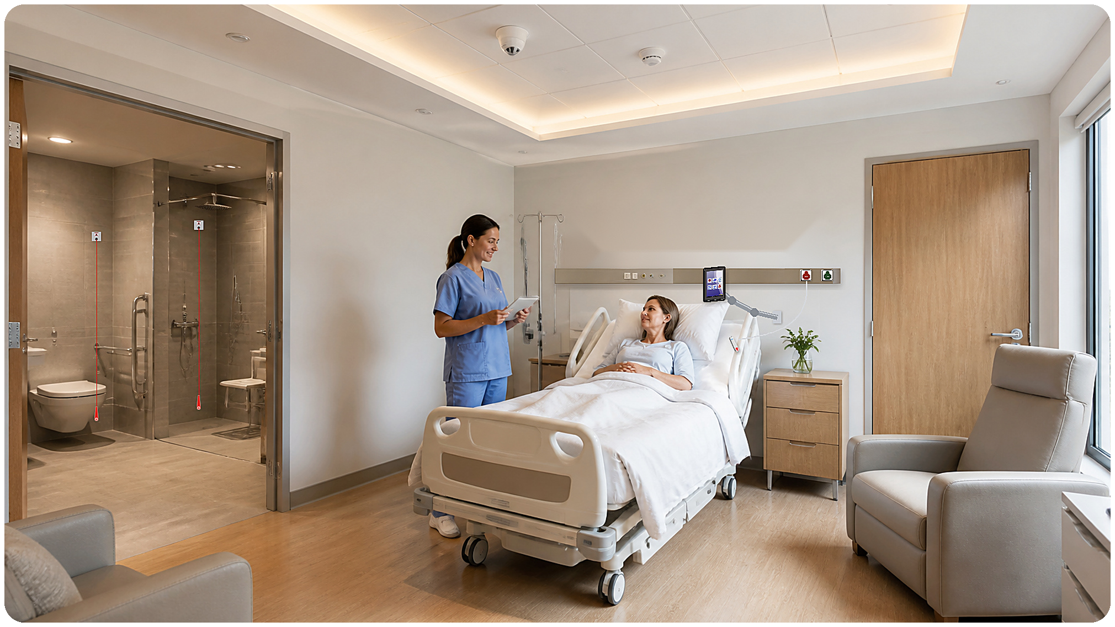
Notes:
AdvantSOS and indicator lights.

Slide 8
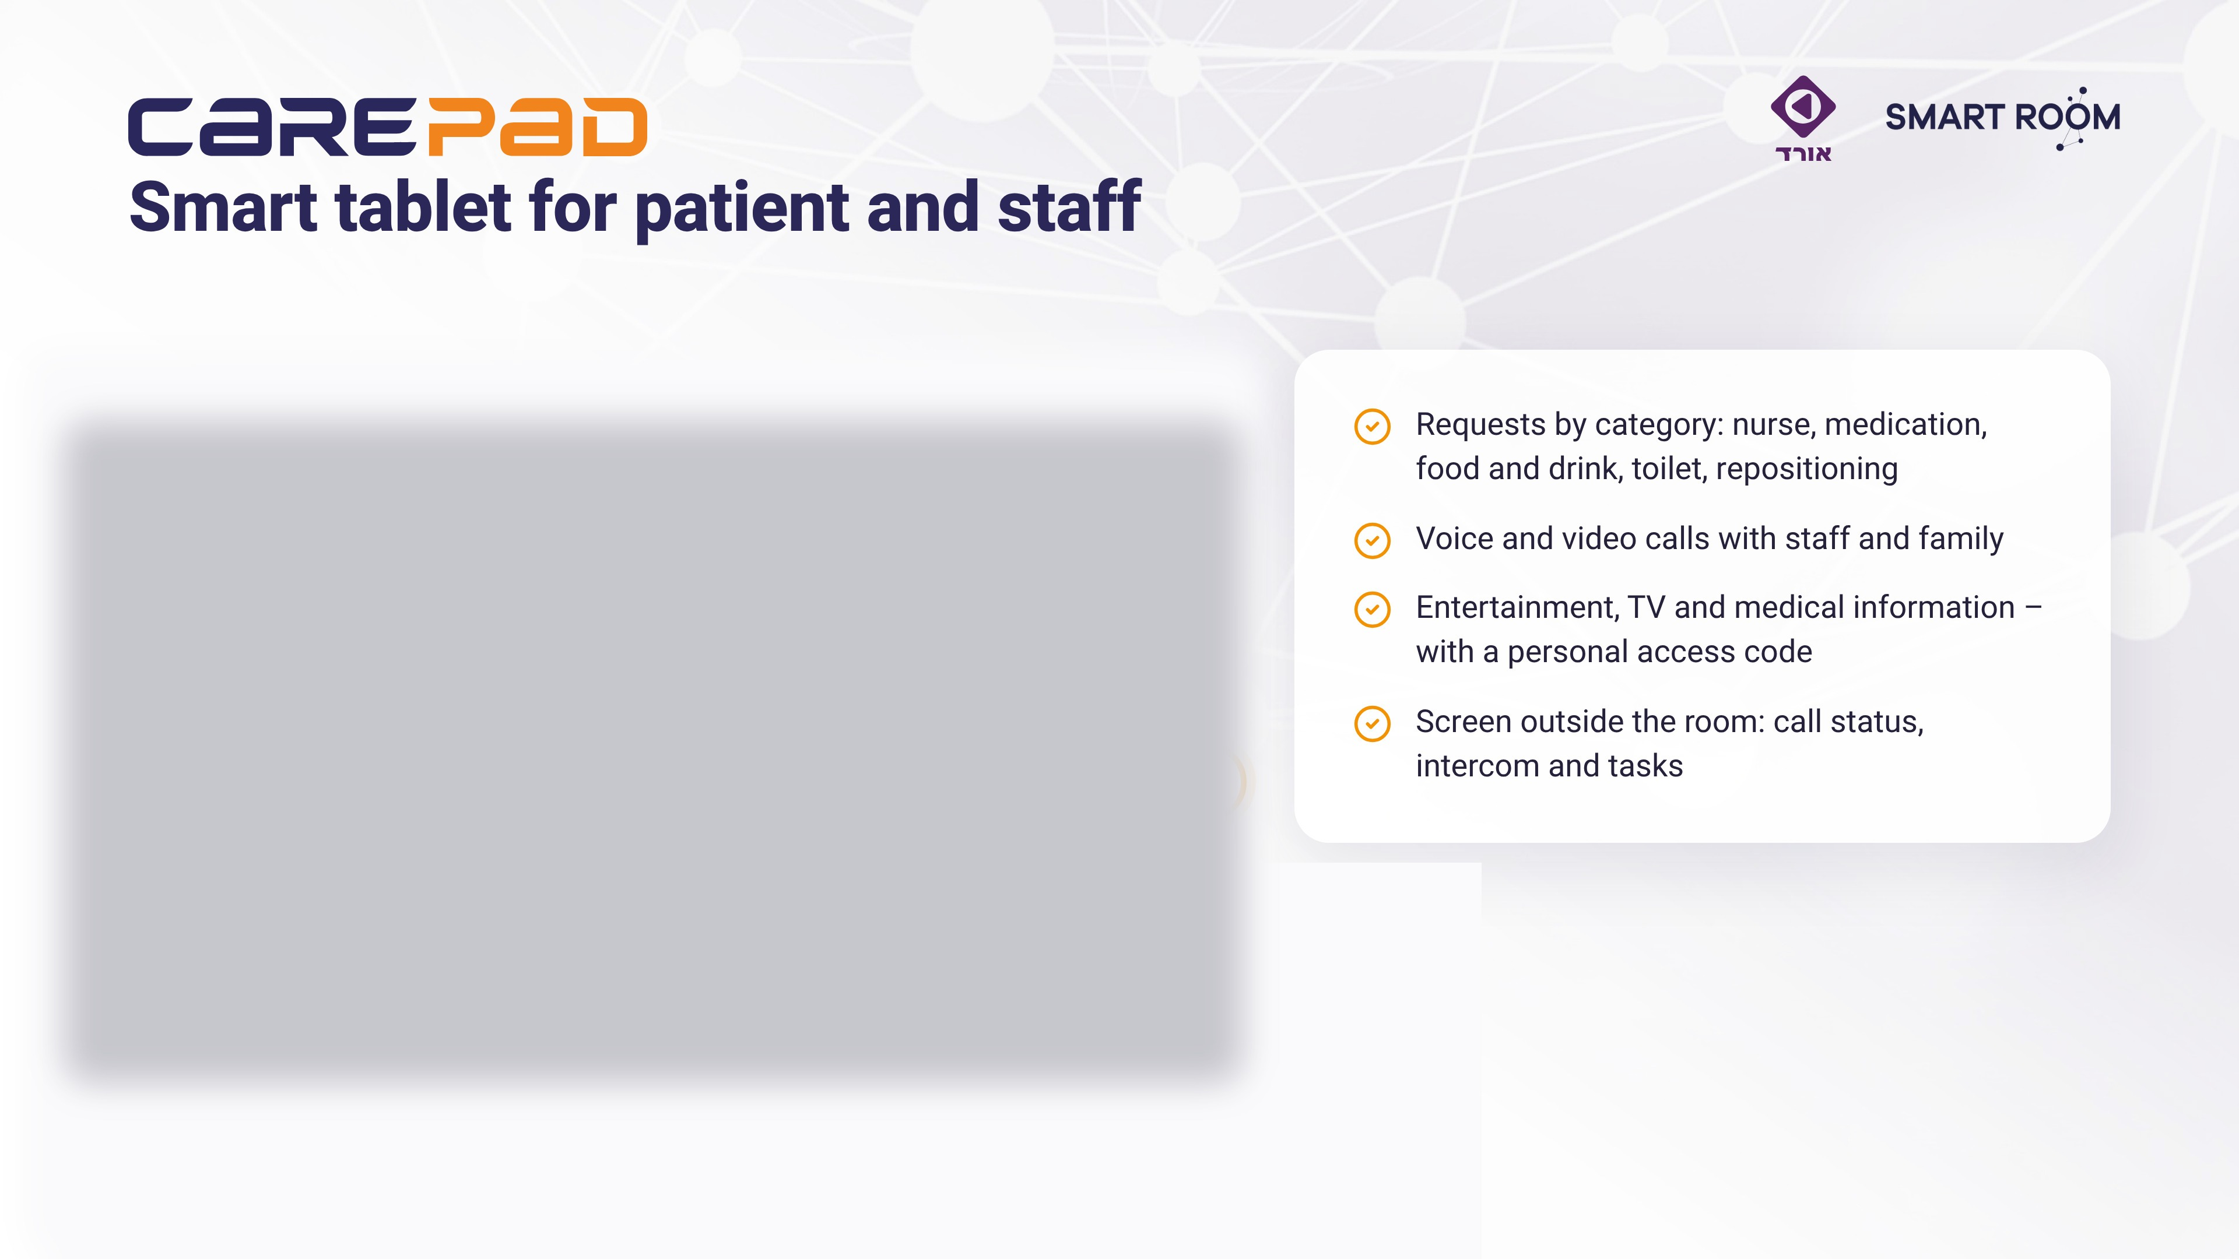

Notes:
CarePad – tablet for patient and staff.

Slide 9
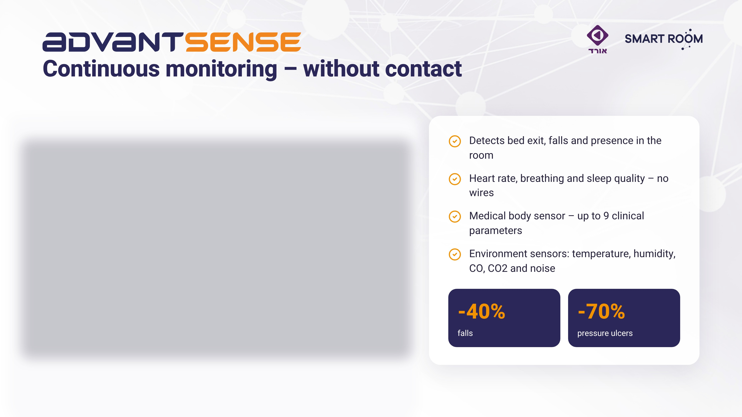
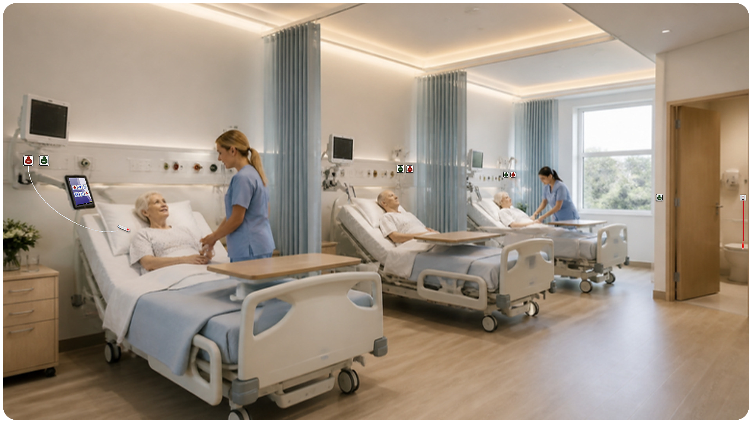
Notes:
AdvantSense – contactless monitoring. Reduction in falls and pressure ulcers.

Slide 10
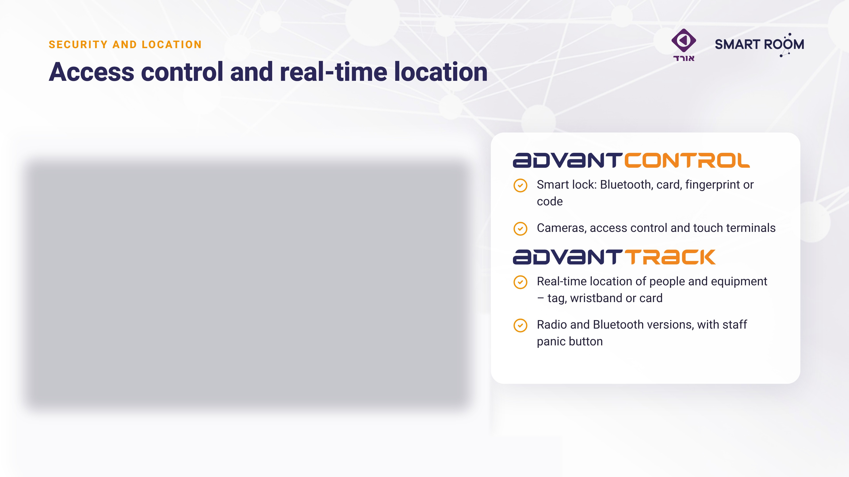
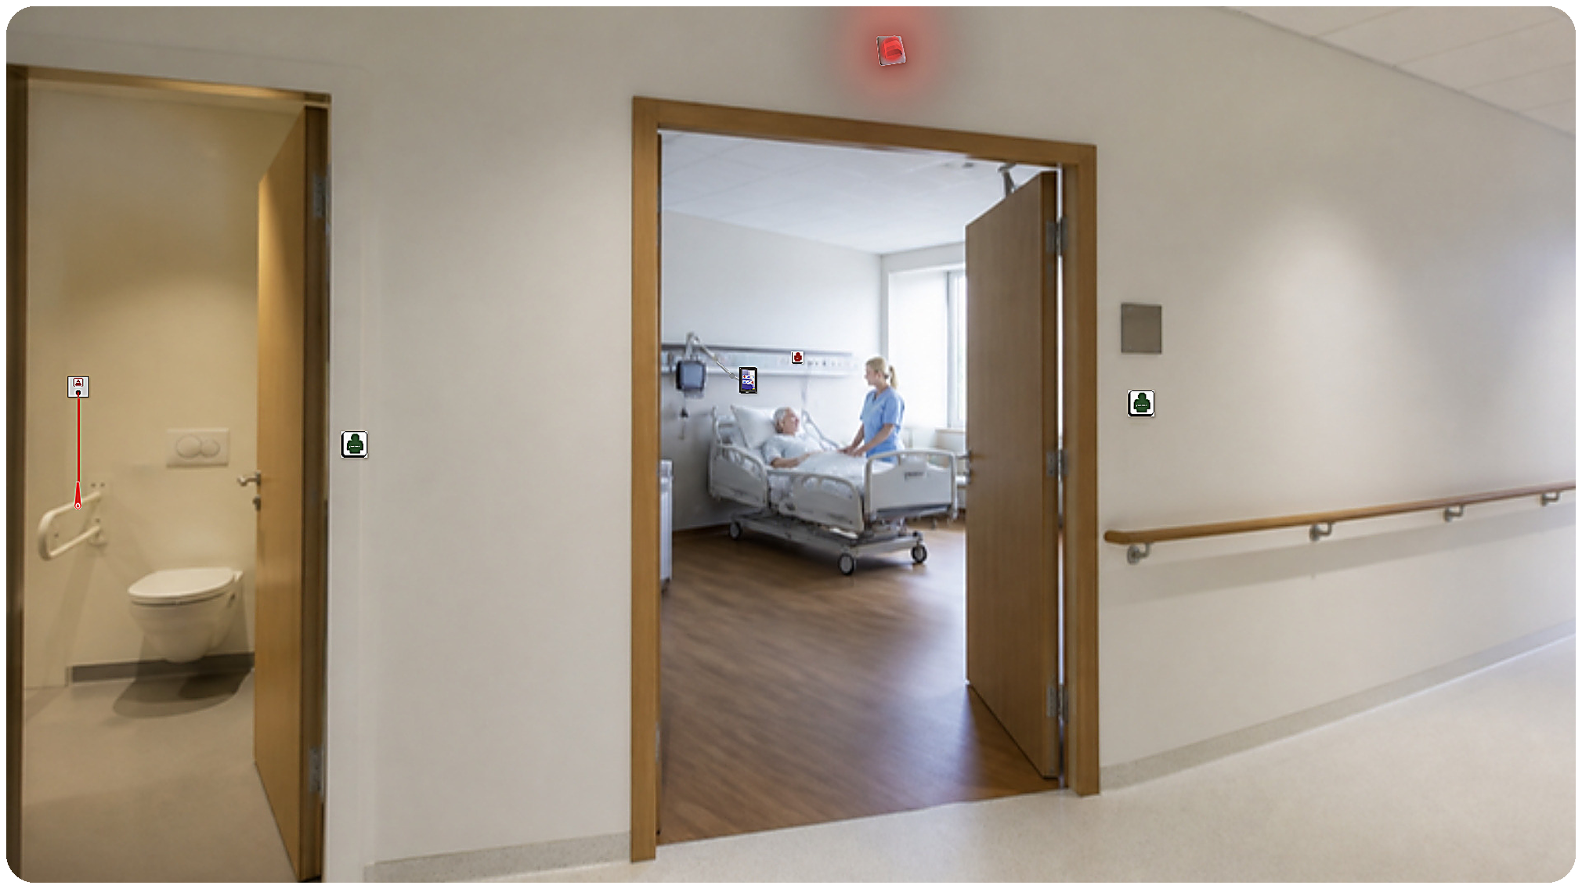
Notes:
AdvantControl and AdvantTrack.

Slide 11
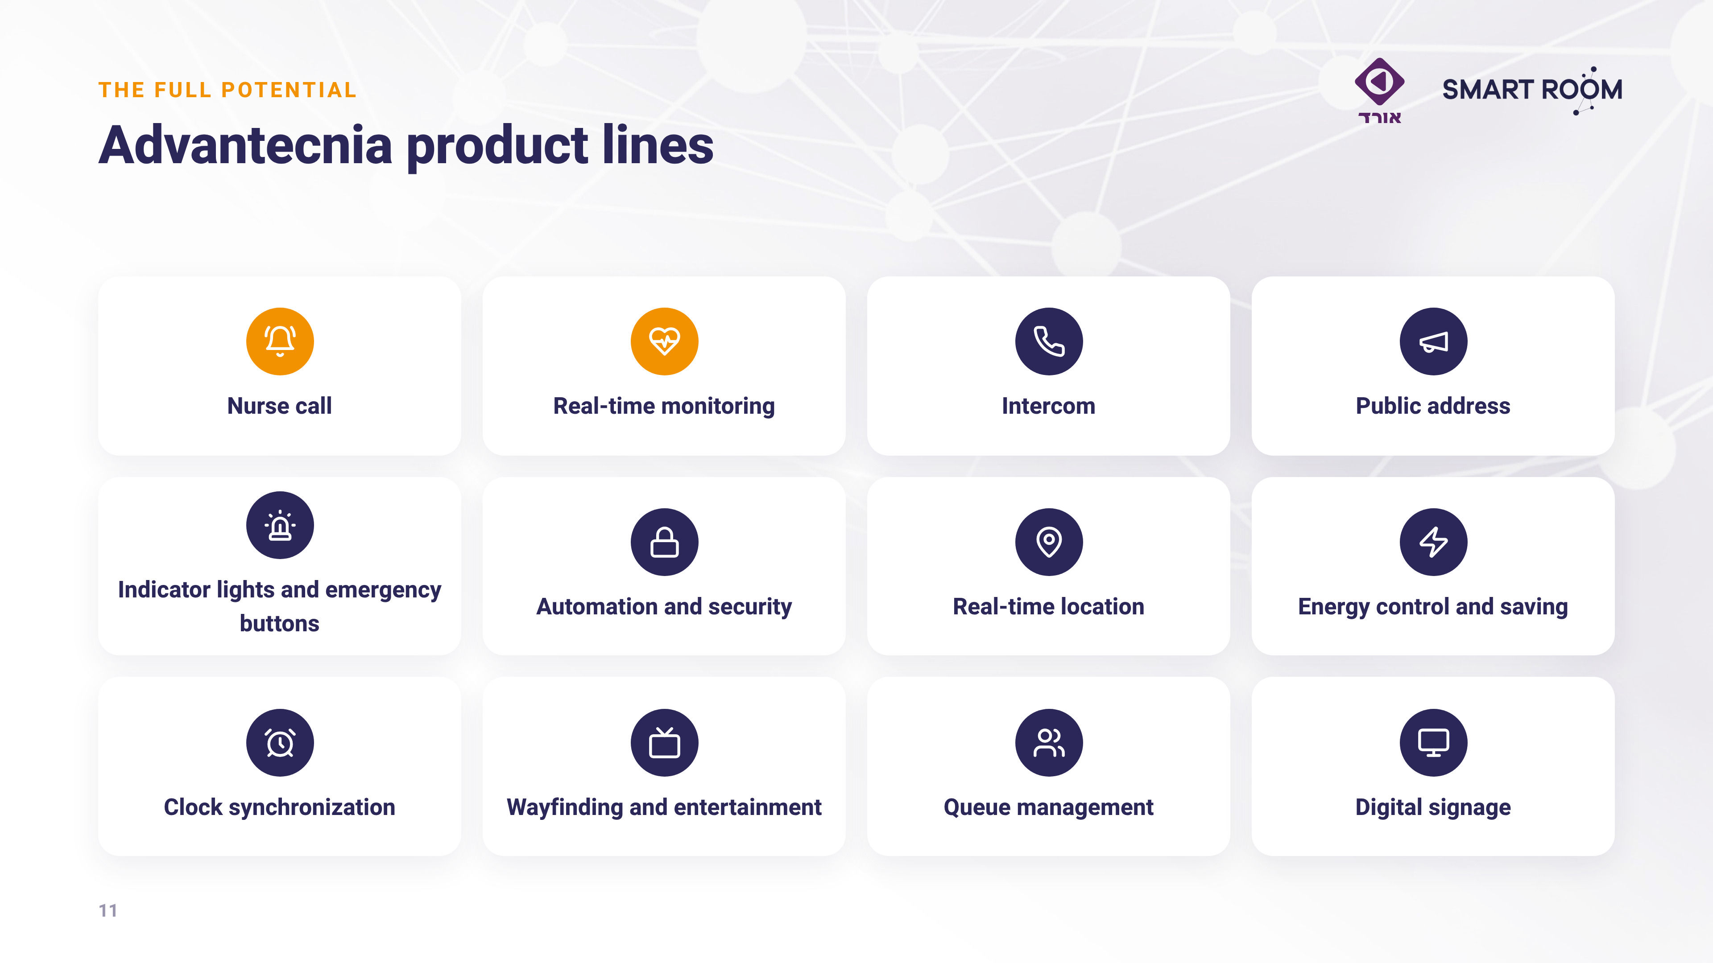
Notes:
More product lines – the full potential.

Slide 12
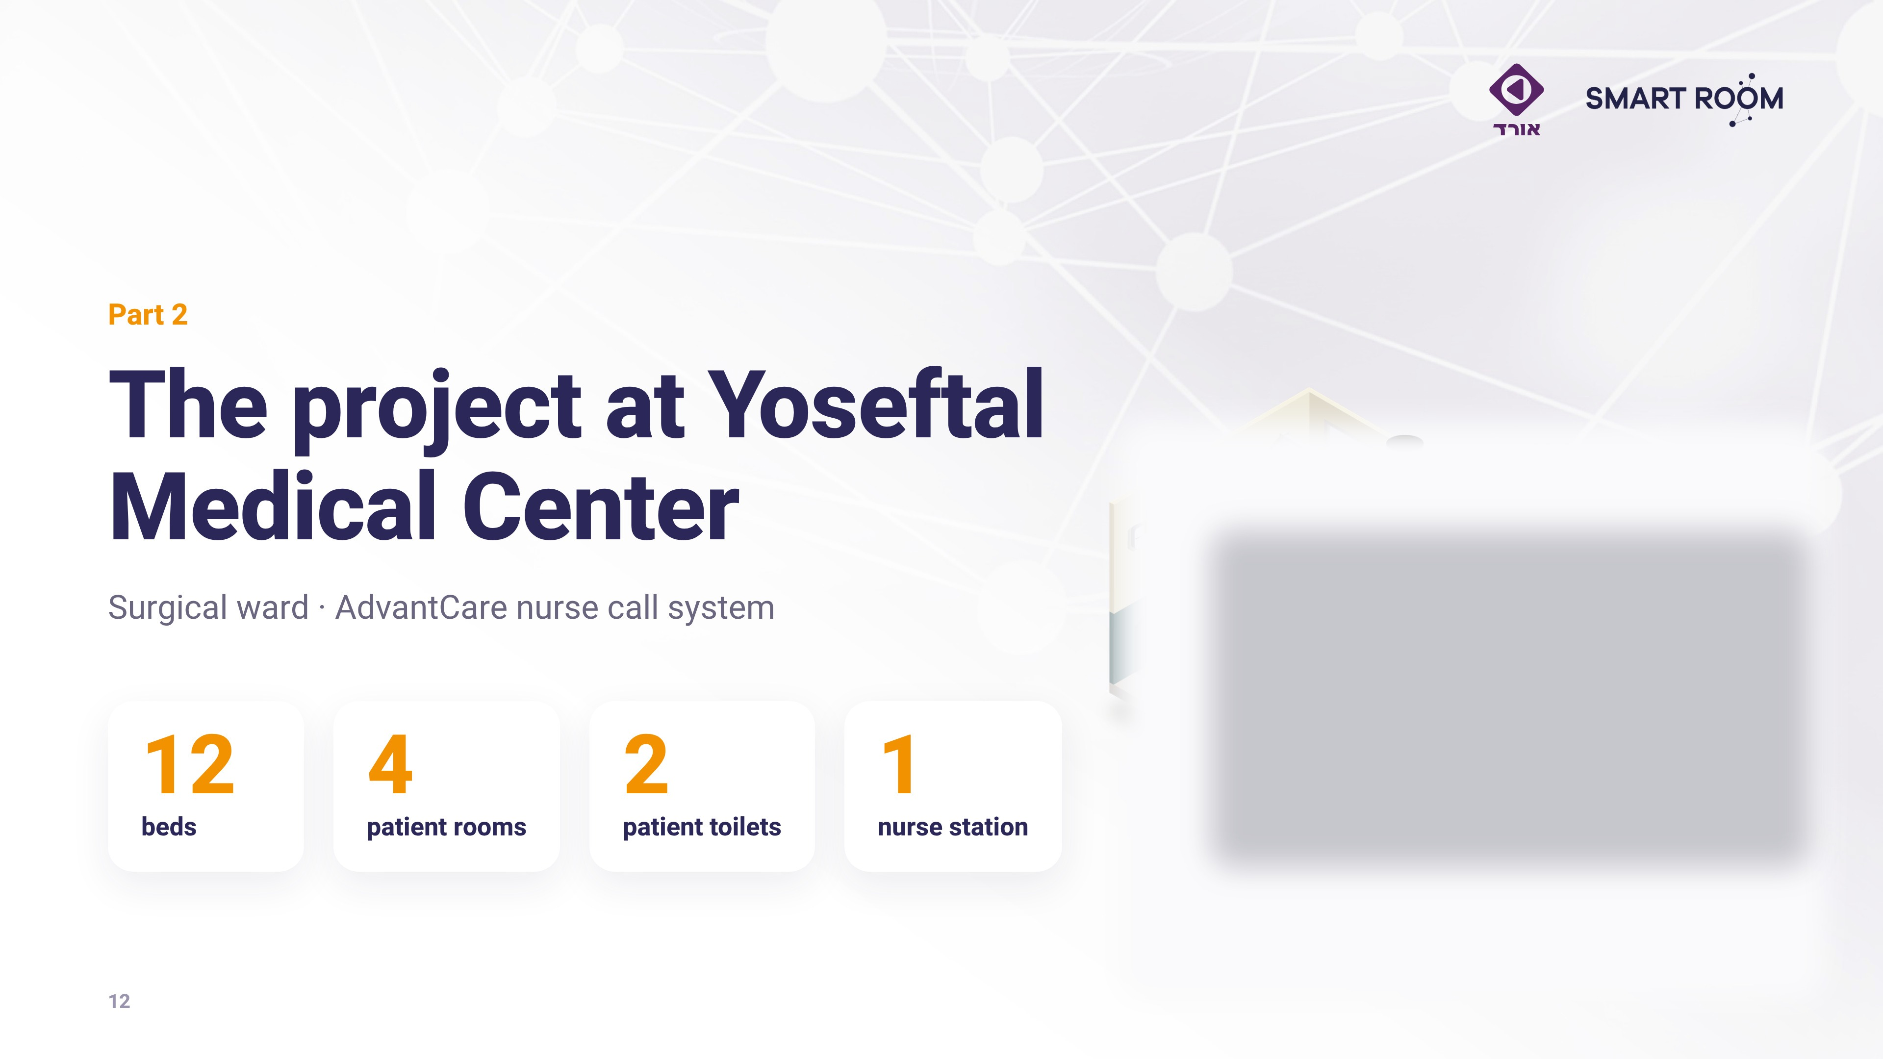
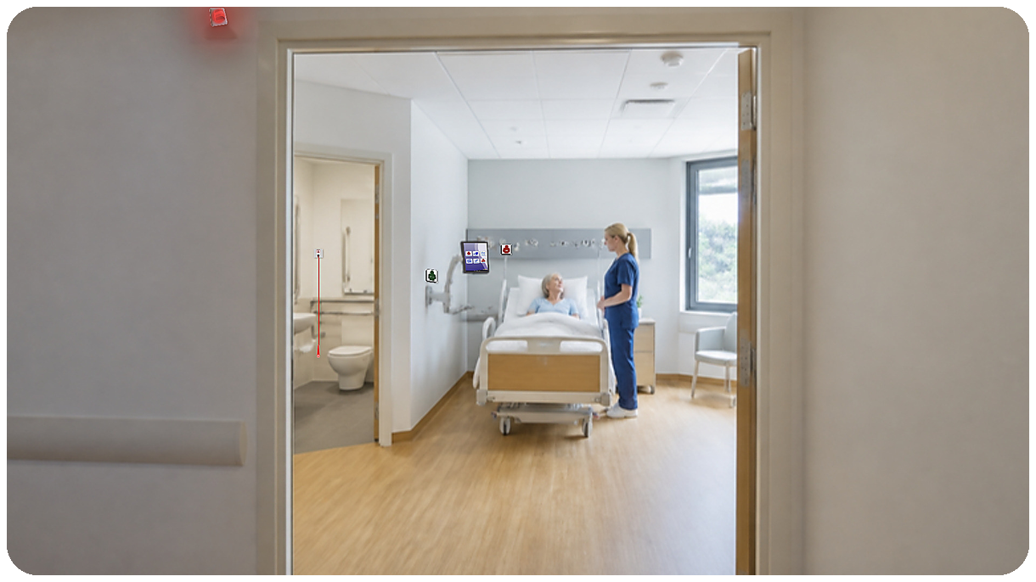
Notes:
Part 2: the Yoseftal project.

Slide 13
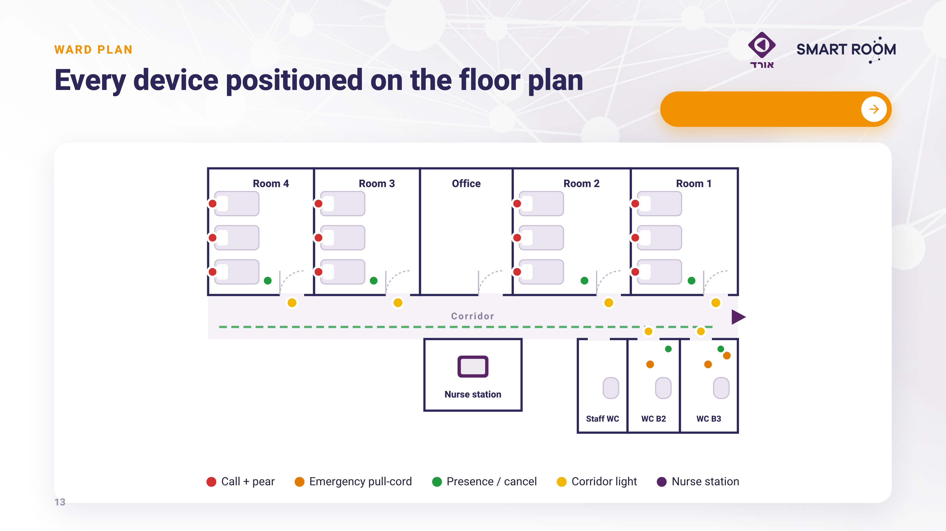

Open plans & 3D
Notes:
Ward plan and device positions.

Slide 14
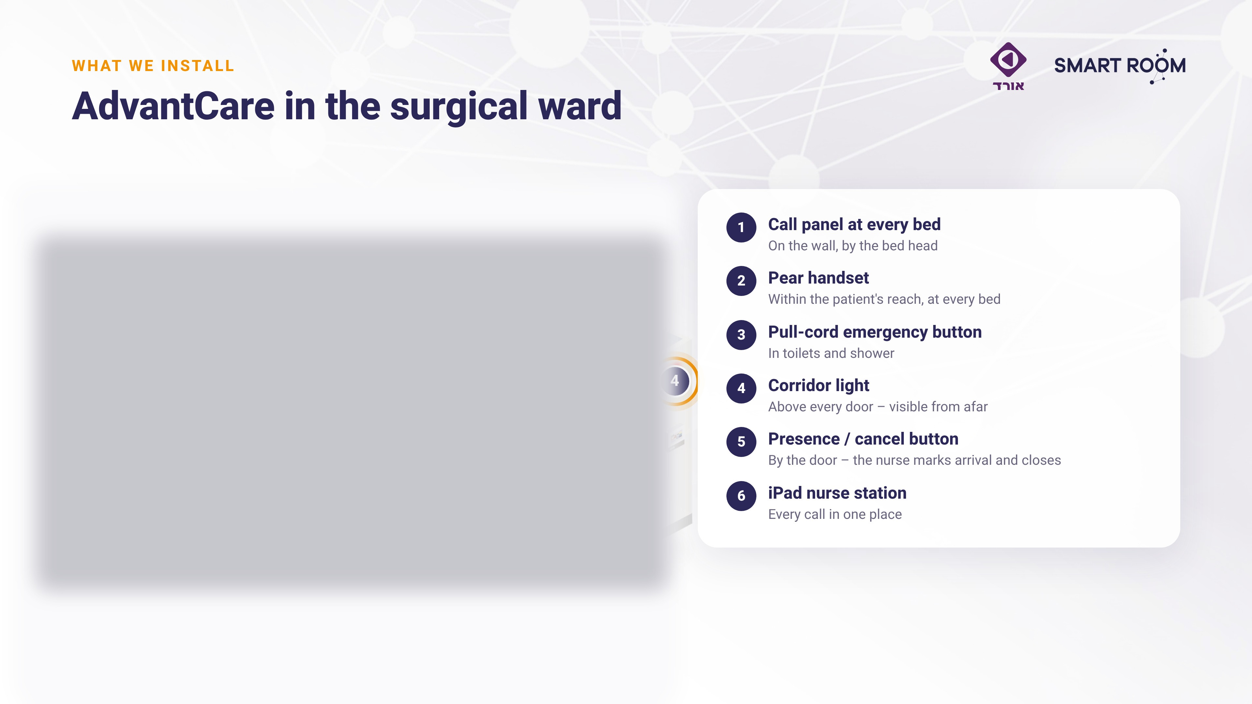

Notes:
What we install in each room.

Slide 15
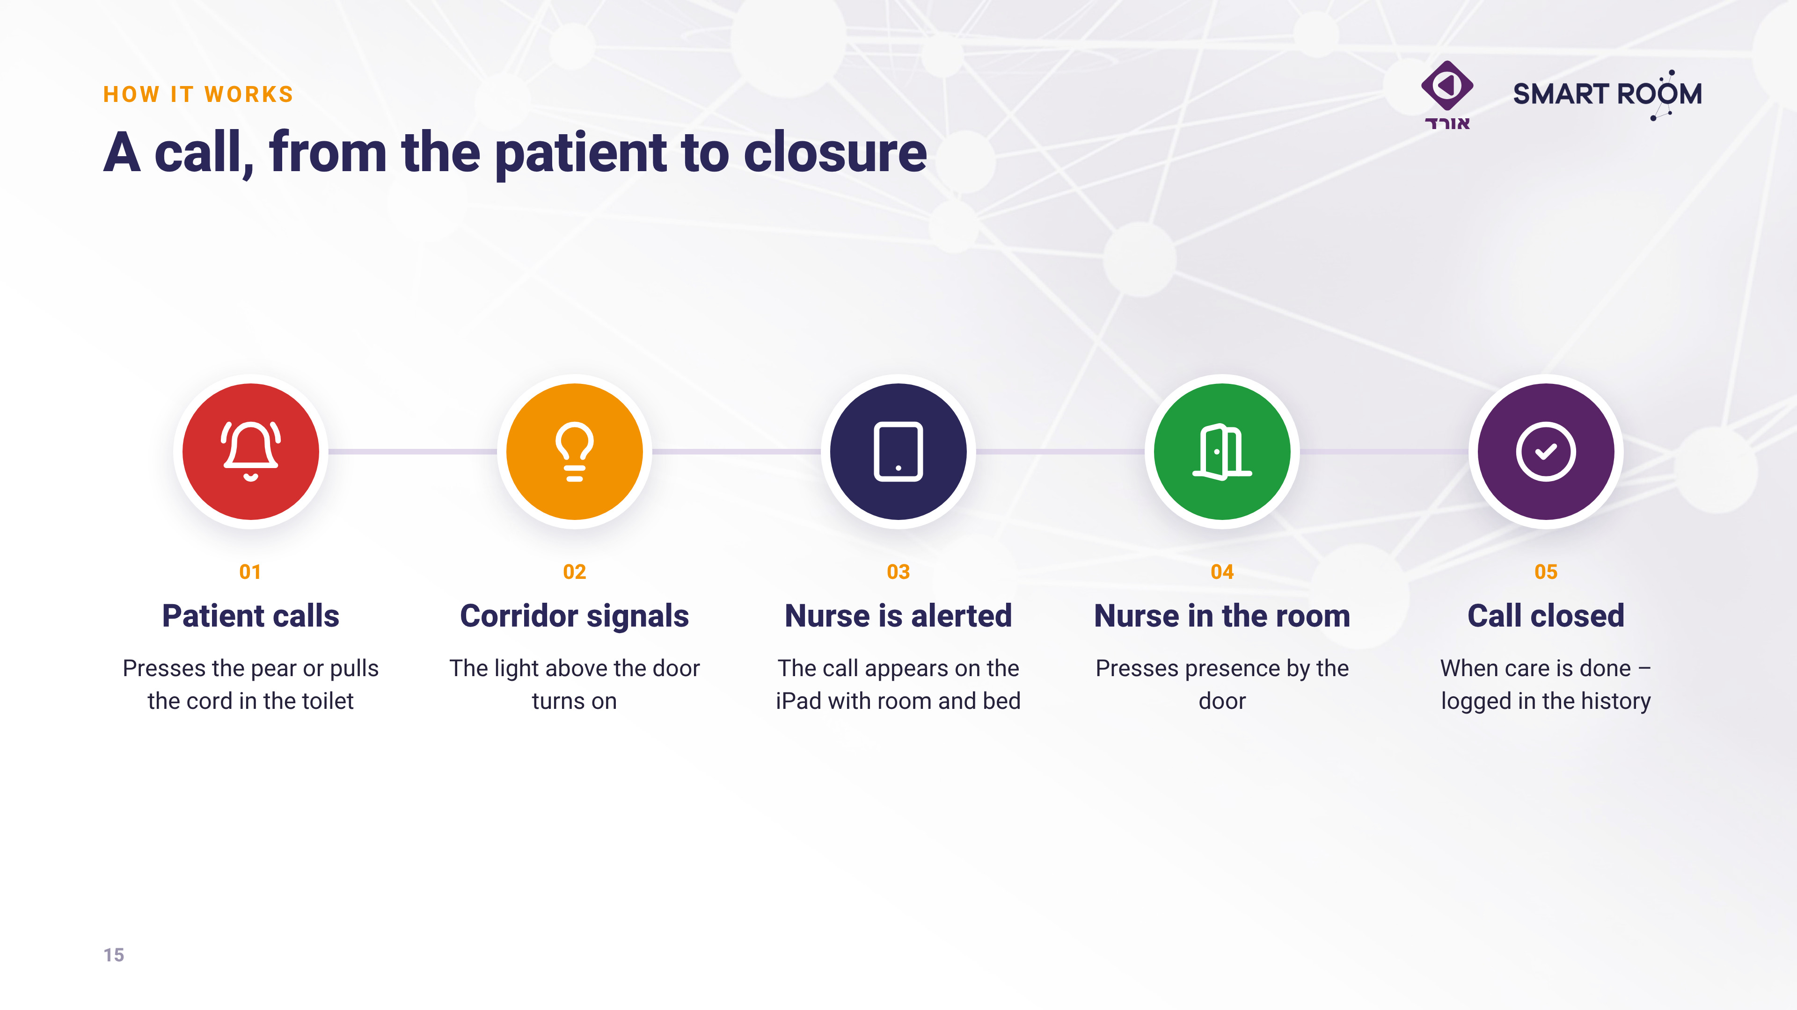
Notes:
The call flow.

Slide 16
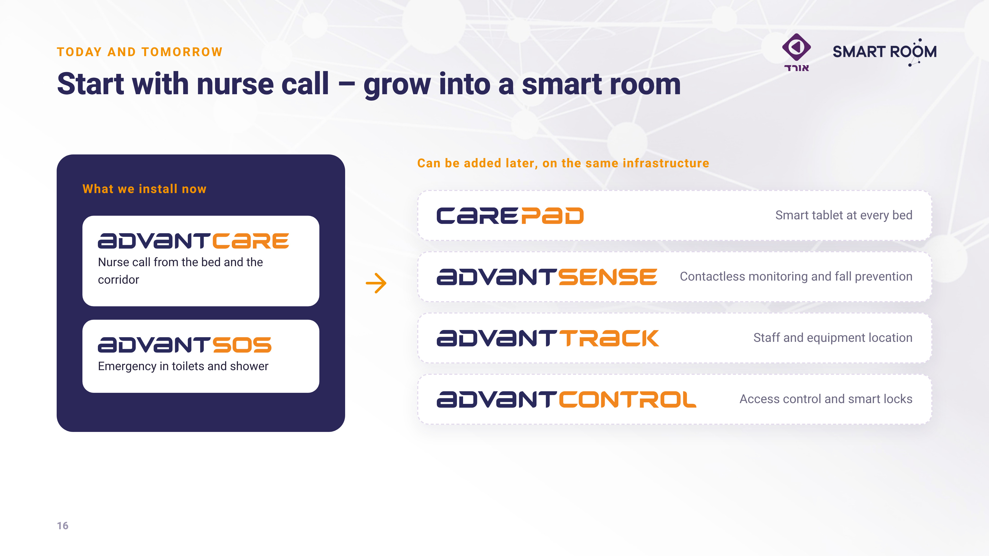
Notes:
Today AdvantCare – later more modules on the same infrastructure.

Slide 17
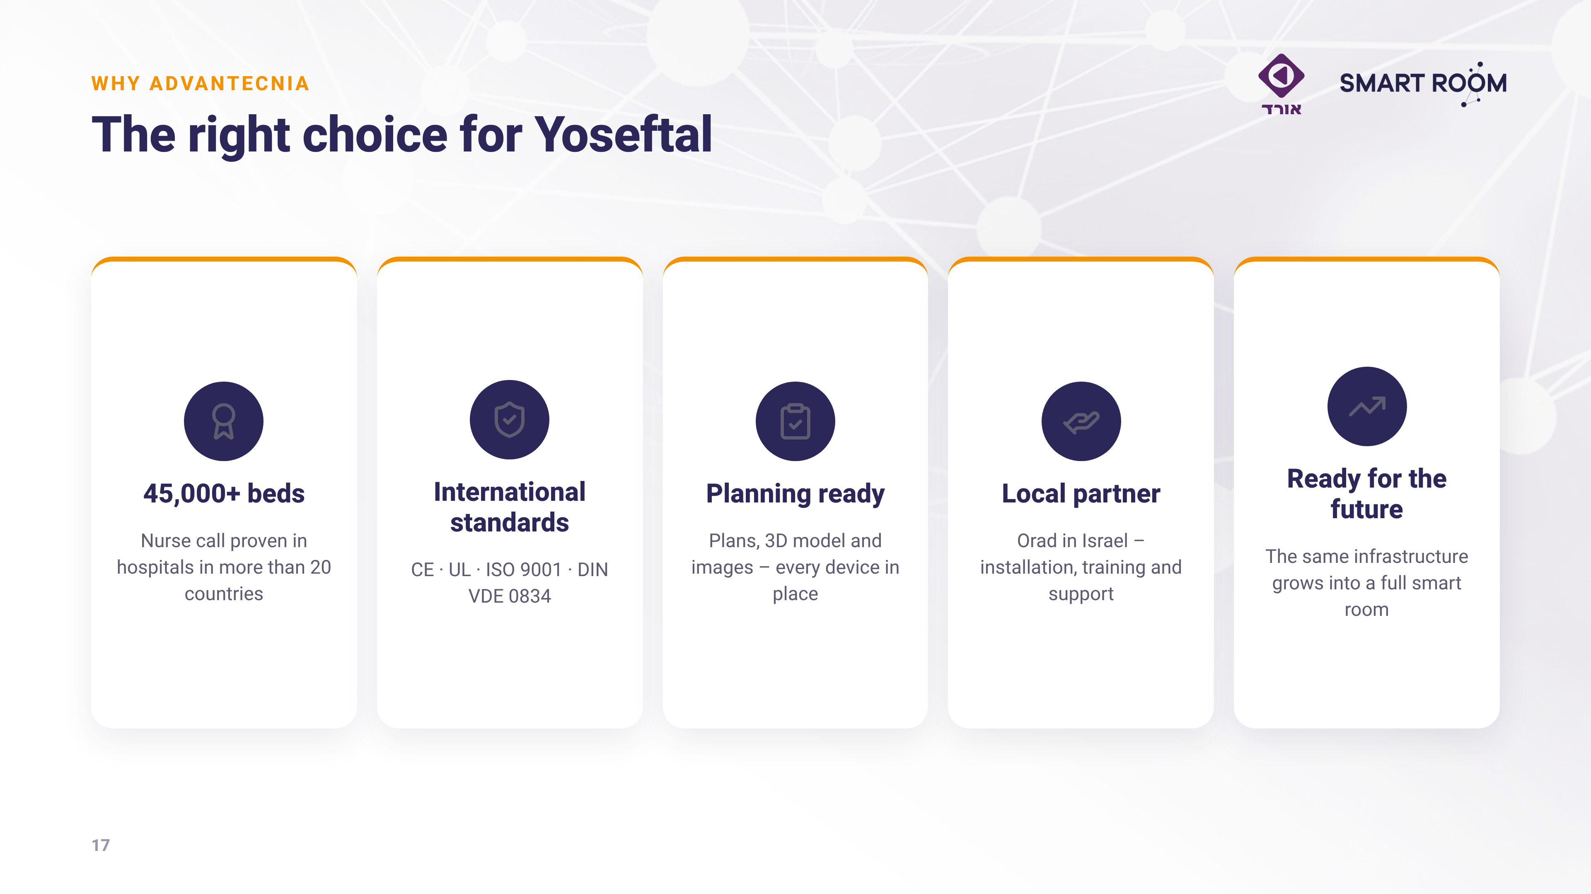
Notes:
Why Advantecnia: five reasons to choose us.

Slide 18
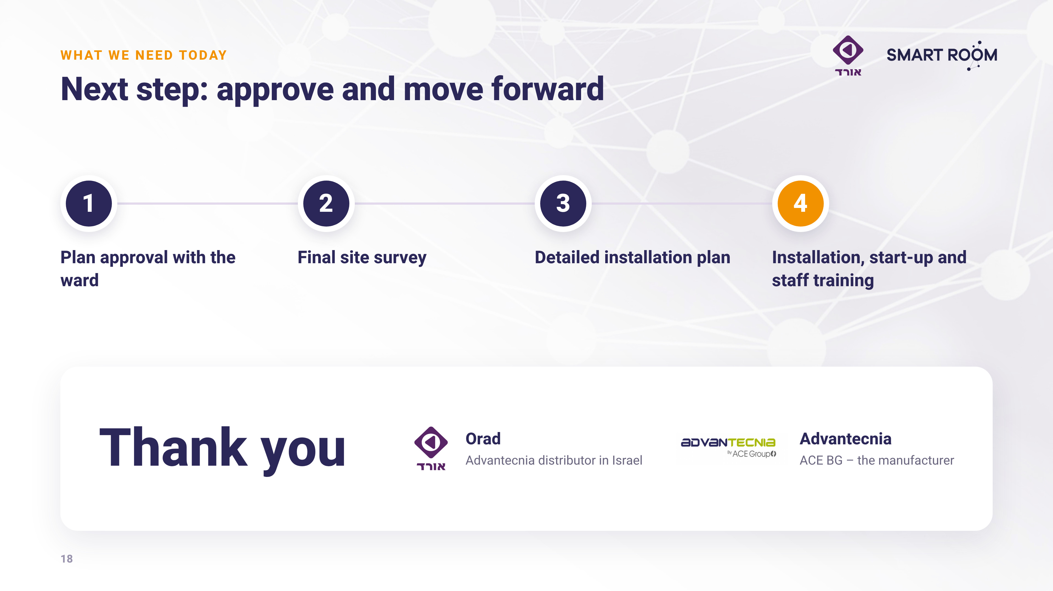
Notes:
Close: ask for approval to proceed and set the site survey date. Thank you.

Slide 19
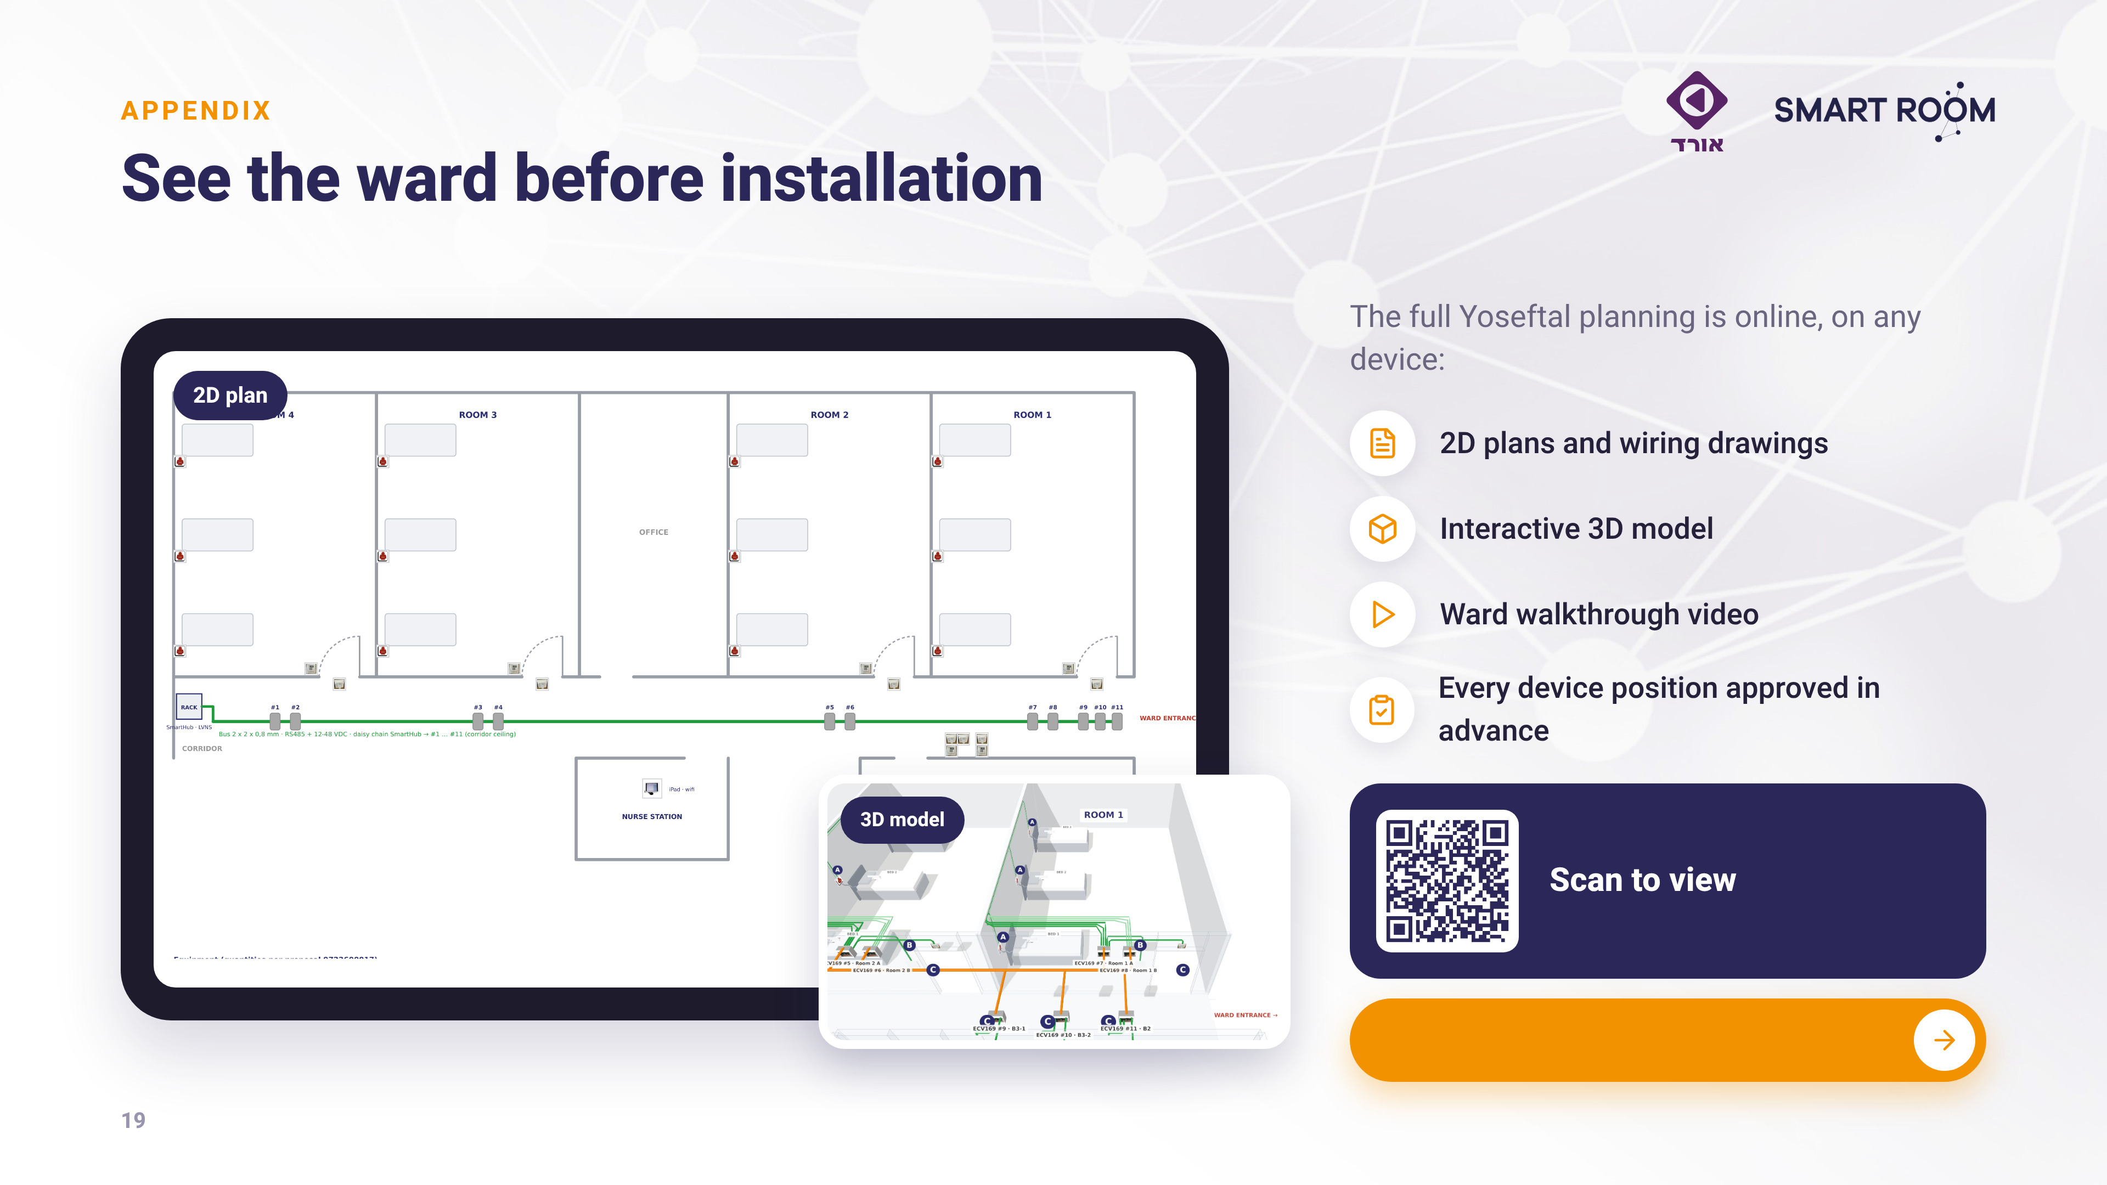


Open plans & 3D model
Notes:
Appendix (optional): QR to the plans, model and walkthrough.

