Slide 1


Yoseftal Medical Center, Eilat
Example Proposal 2
AdvantCare nurse call system
2 ward sections · 13 rooms × 3 beds (8 + 5) · 13 en-suite bathrooms · 2 nurse stations · 1 shared server
Orad – Advantecnia distributor in Israel · 26/10/2026
IMPORTANT – THIS IS NOT A REAL, FORMAL OR OFFICIAL PROPOSAL. It is an example only, prepared to support the offer that Orad must make to the end client.
Notes:
IMPORTANT – THIS IS NOT A REAL, FORMAL OR OFFICIAL PROPOSAL. It is an example only, prepared to support the offer that Orad must make to the end client.

Slide 2
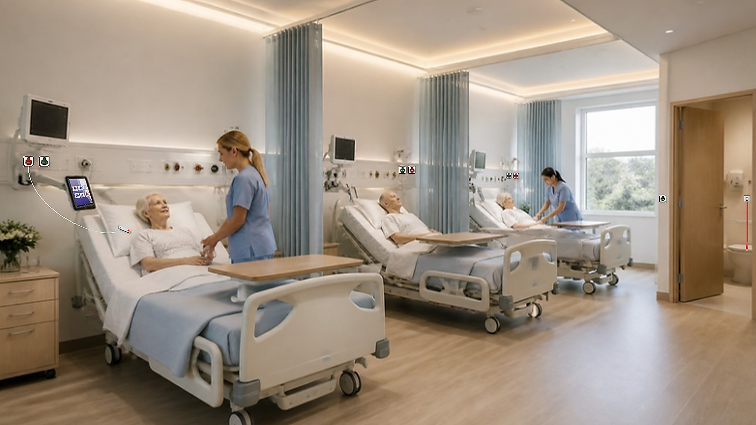
SCOPE
What the example includes
2
13
39
13
2
1
ward section(s)
rooms (3 beds each)
beds
en-suite bathrooms (toilet + shower + basin)
nurse station(s)
server (LVNS)
Each bed: red call panel with bayonet socket + pear handset 2 m.
Each room: green presence / cancel button inside by the door, 3-colour corridor light above the door.
Each bathroom: SOS pull-cord beside the toilet and beside the shower, presence / cancel button outside and a light above the door.
Room controllers (PCB ECV169) in the corridor ceiling, daisy-chained on one bus per section to the SmartHub in the section rack.
Nurse station outside the rooms with an iPad (Consola Monitor): every call, presence, history and statistics.
LVNS server + switch + UPS + rack – everything needed for the system to work.
IMPORTANT – THIS IS NOT A REAL, FORMAL OR OFFICIAL PROPOSAL. It is an example only, prepared to support the offer that Orad must make to the end client.

Slide 3
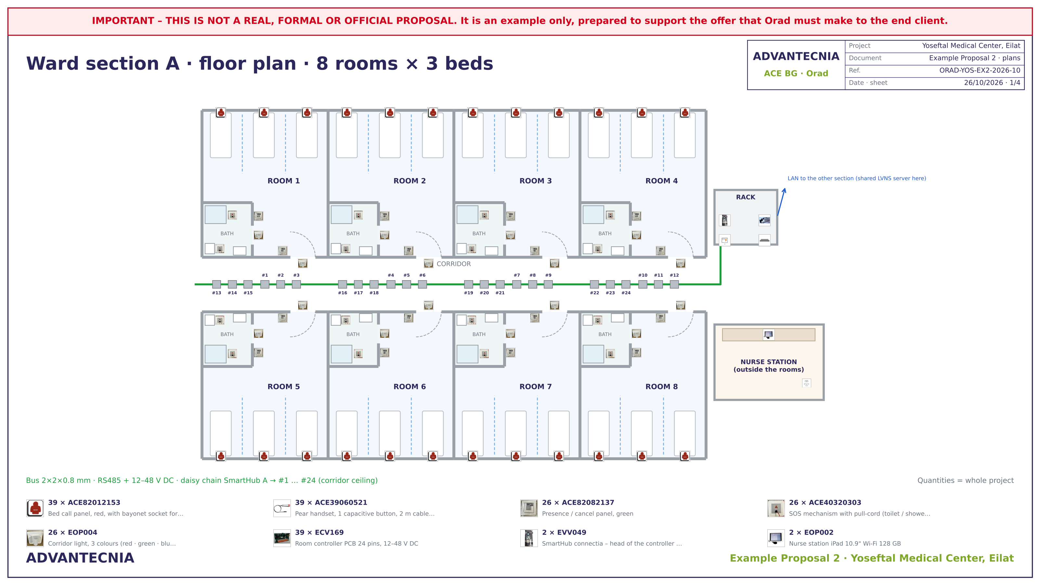
PLANS
Floor plan · ward section A
IMPORTANT – THIS IS NOT A REAL, FORMAL OR OFFICIAL PROPOSAL. It is an example only, prepared to support the offer that Orad must make to the end client.

Slide 4
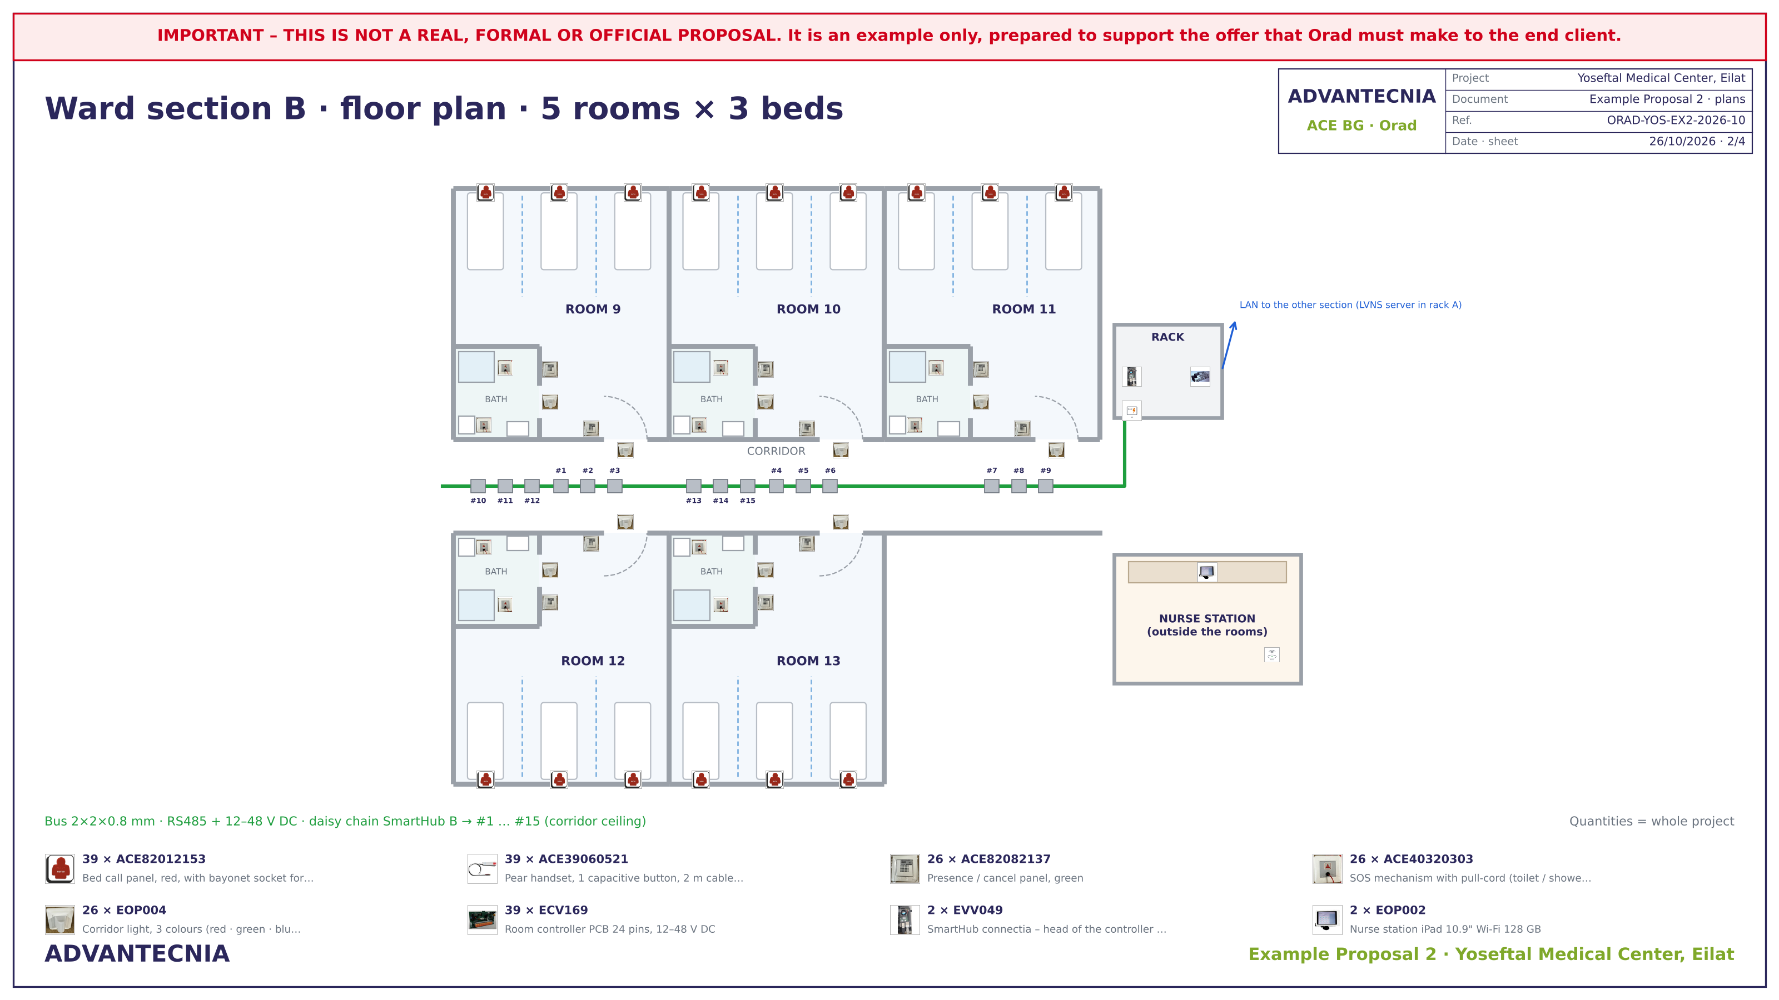
PLANS
Floor plan · ward section B
IMPORTANT – THIS IS NOT A REAL, FORMAL OR OFFICIAL PROPOSAL. It is an example only, prepared to support the offer that Orad must make to the end client.

Slide 5
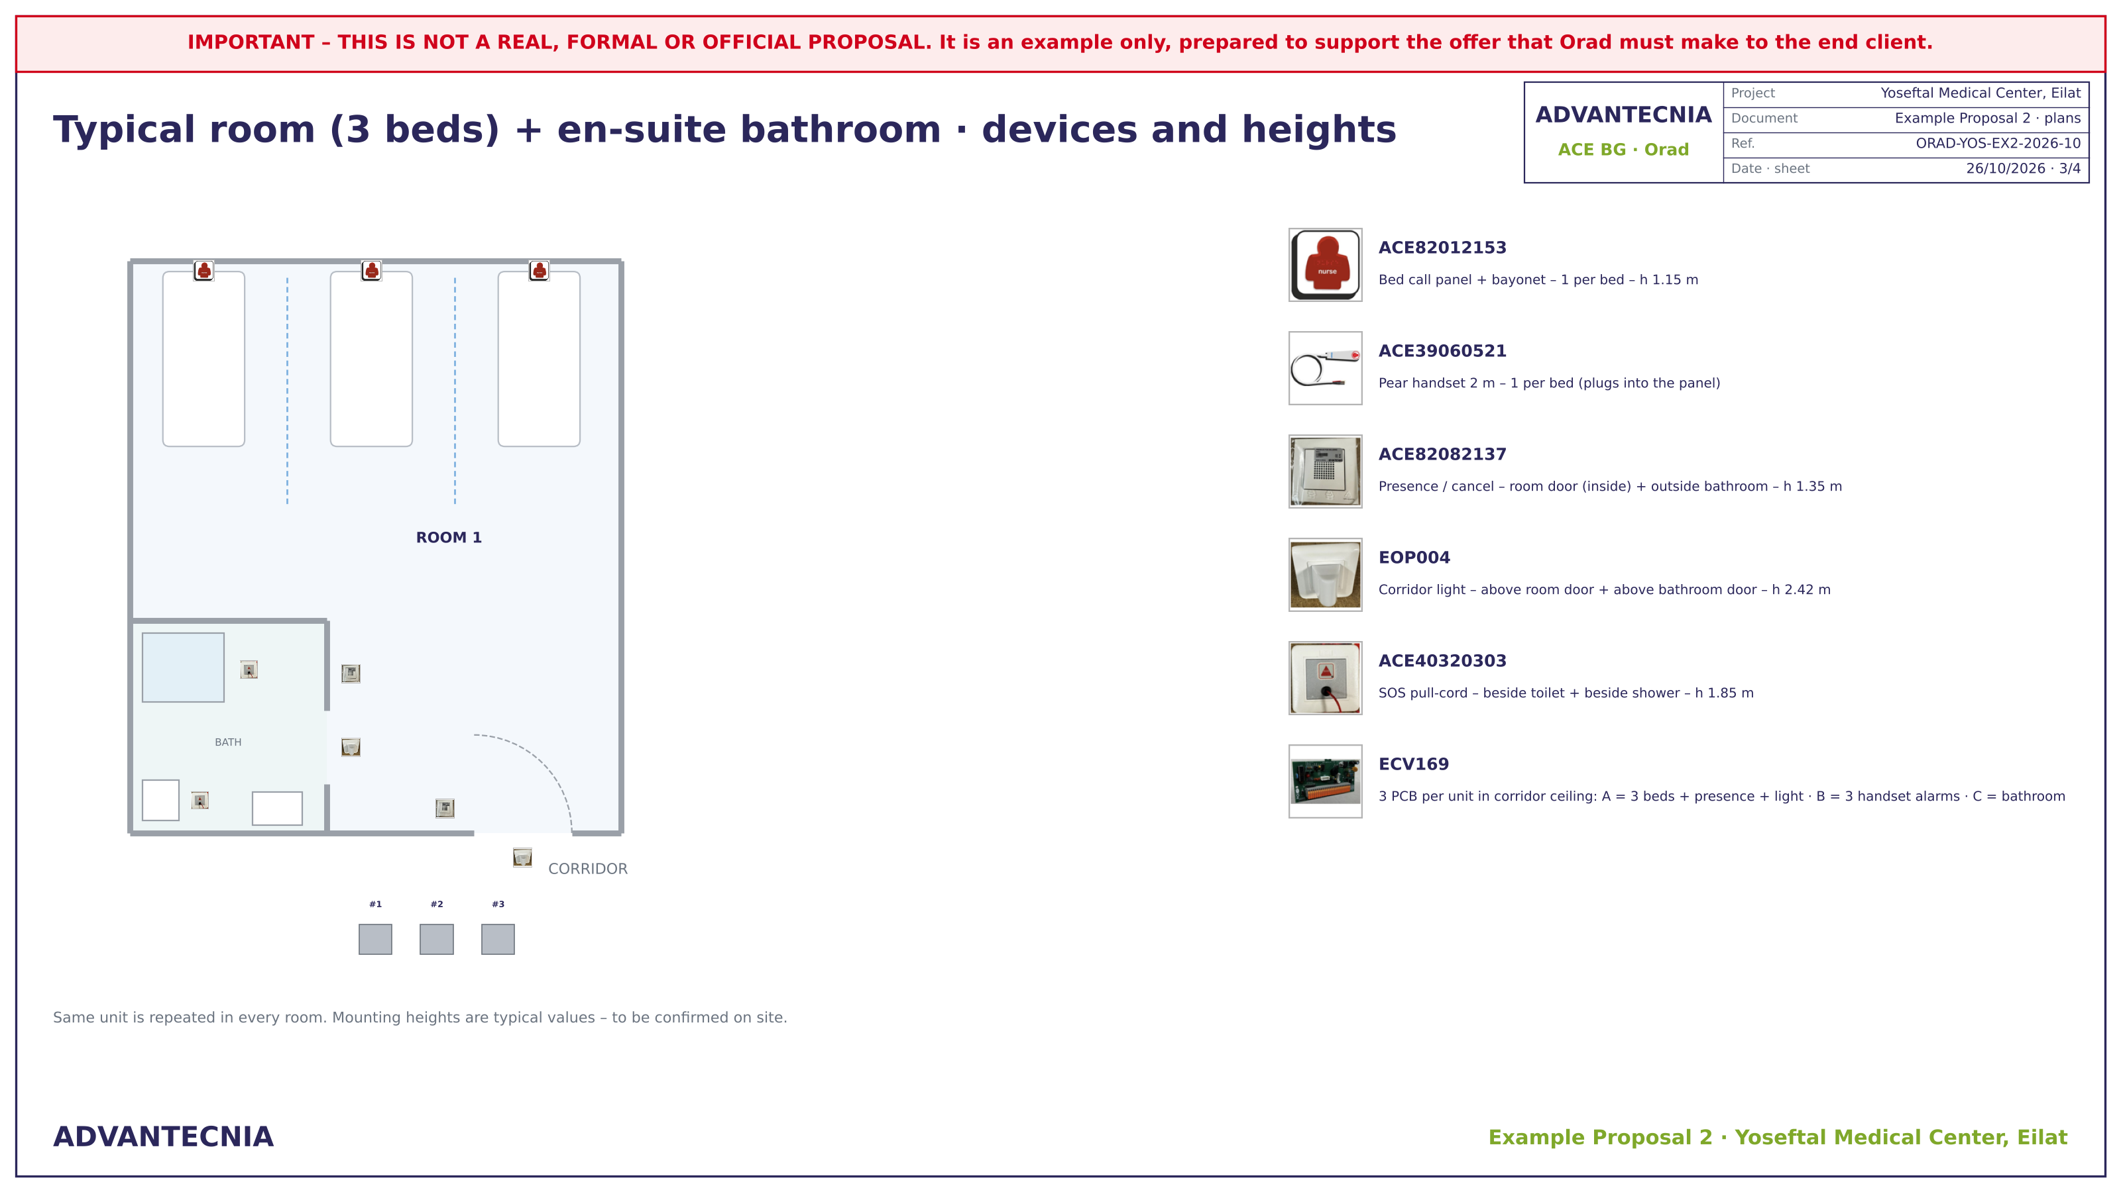
PLANS
Typical room + en-suite bathroom
IMPORTANT – THIS IS NOT A REAL, FORMAL OR OFFICIAL PROPOSAL. It is an example only, prepared to support the offer that Orad must make to the end client.

Slide 6
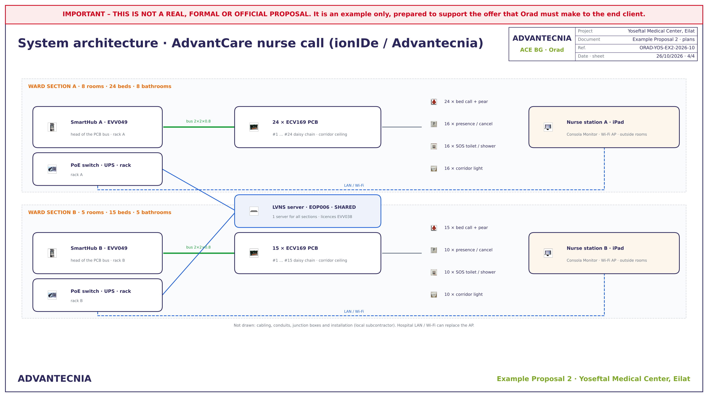
PLANS
System architecture
IMPORTANT – THIS IS NOT A REAL, FORMAL OR OFFICIAL PROPOSAL. It is an example only, prepared to support the offer that Orad must make to the end client.

Slide 7

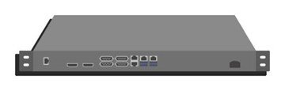

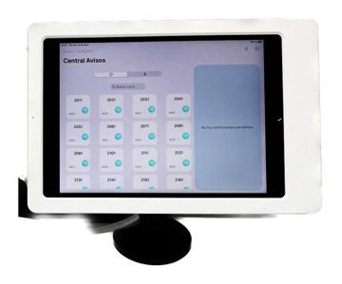
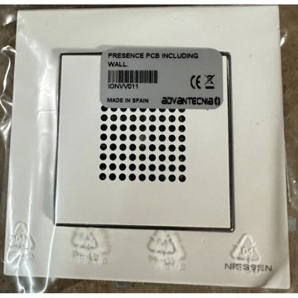
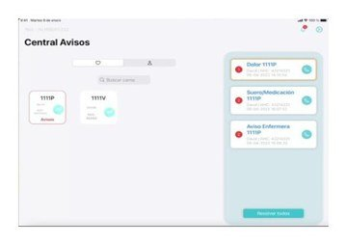
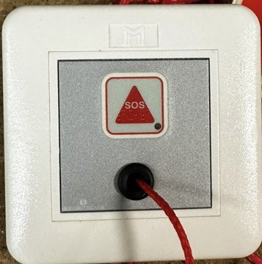
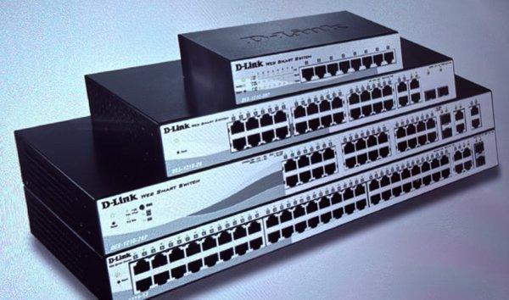
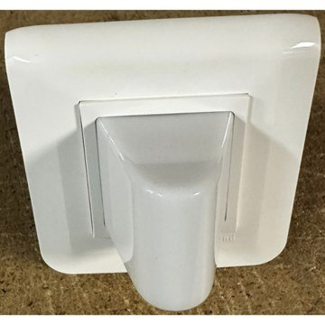
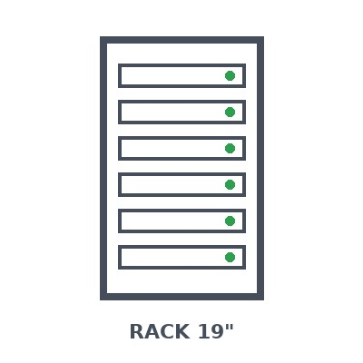
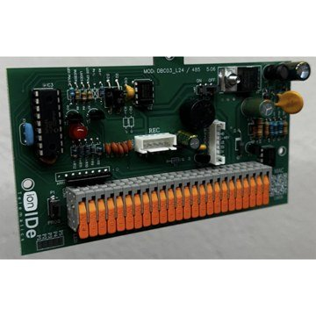

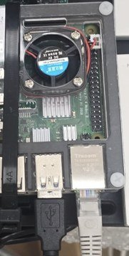
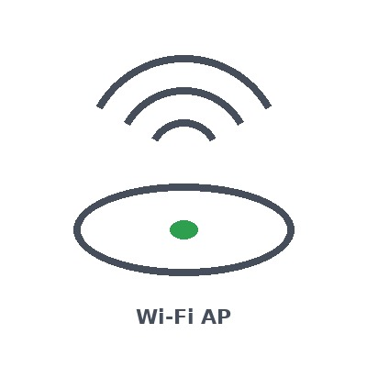
EQUIPMENT
Advantecnia devices and system components
39 ×
Bed call panel, red, with bayonet socket for pear handset
1 ×
LVNS server – local server & notifications
ACE82012153 · 3 per room × 13 rooms
EOP006 · 1 server for the whole system (shared by both sections)
39 ×
Pear handset, 1 capacitive button, 2 m cable, bayonet
2 ×
Nurse station iPad 10.9" Wi-Fi 128 GB
ACE39060521 · 1 per bed × 39 beds
EOP002 · 1 per nurse station
26 ×
Presence / cancel panel, green
2 ×
ionTab client/server licences + MDM (1st year included)
ACE82082137 · 13 rooms (by the door) + 13 bathrooms (outside)
EVV038 · 1 per ward section
26 ×
SOS mechanism with pull-cord (toilet / shower)
2 ×
PoE switch 24 ports, managed
ACE40320303 · 2 per bathroom (toilet + shower) × 13
ACESWP24P · 1 per ward section rack
26 ×
Corridor light, 3 colours (red · green · blue)
2 ×
Wall rack 19" 9U with PDU, shelf and cable management
EOP004 · 13 rooms + 13 bathrooms (above the door)
RACK9U · 1 per ward section
39 ×
Room controller PCB 24 pins, 12–48 V DC
2 ×
UPS 1500 VA online, rack mount
ECV169 · 2 per room + 1 per bathroom = 39
UPS1500 · 1 per rack
2 ×
SmartHub connectia – head of the controller bus
2 ×
Wi-Fi 6 access point, PoE, at the nurse station
EVV049 · 1 per ward section
WAP6 · 1 per nurse station
IMPORTANT – THIS IS NOT A REAL, FORMAL OR OFFICIAL PROPOSAL. It is an example only, prepared to support the offer that Orad must make to the end client.

Slide 8
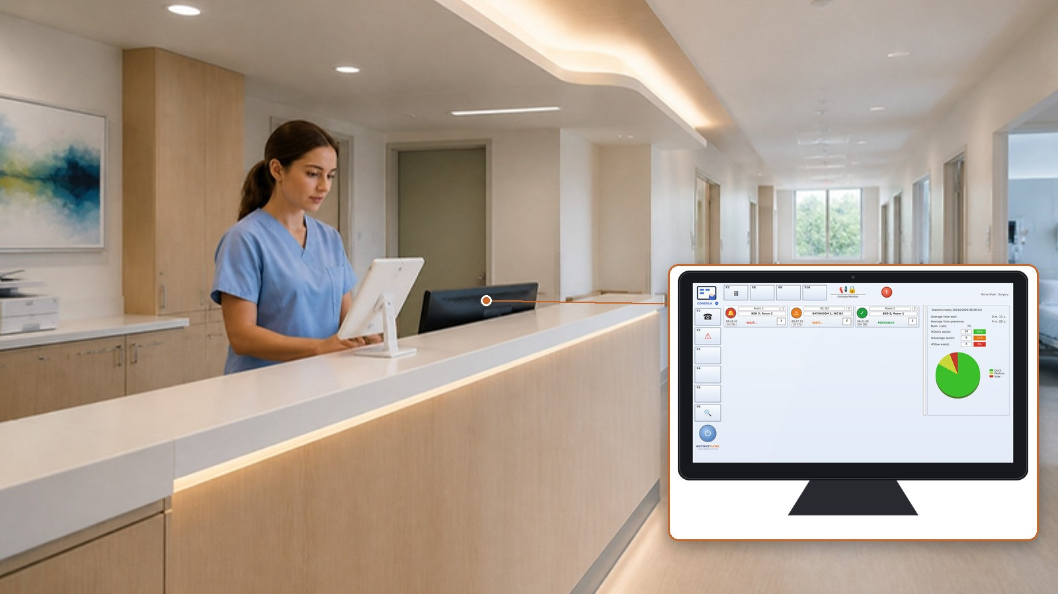
NURSE STATION
Every call in one place – outside the rooms
Consola Monitor on the nurse iPad: room, bed and type of every call
Red = call · green = nurse in the room · blue = code blue
Presence / cancel by the door closes the call
History and statistics: waiting and response times
One nurse station per section, one shared server
IMPORTANT – THIS IS NOT A REAL, FORMAL OR OFFICIAL PROPOSAL. It is an example only, prepared to support the offer that Orad must make to the end client.

Slide 9
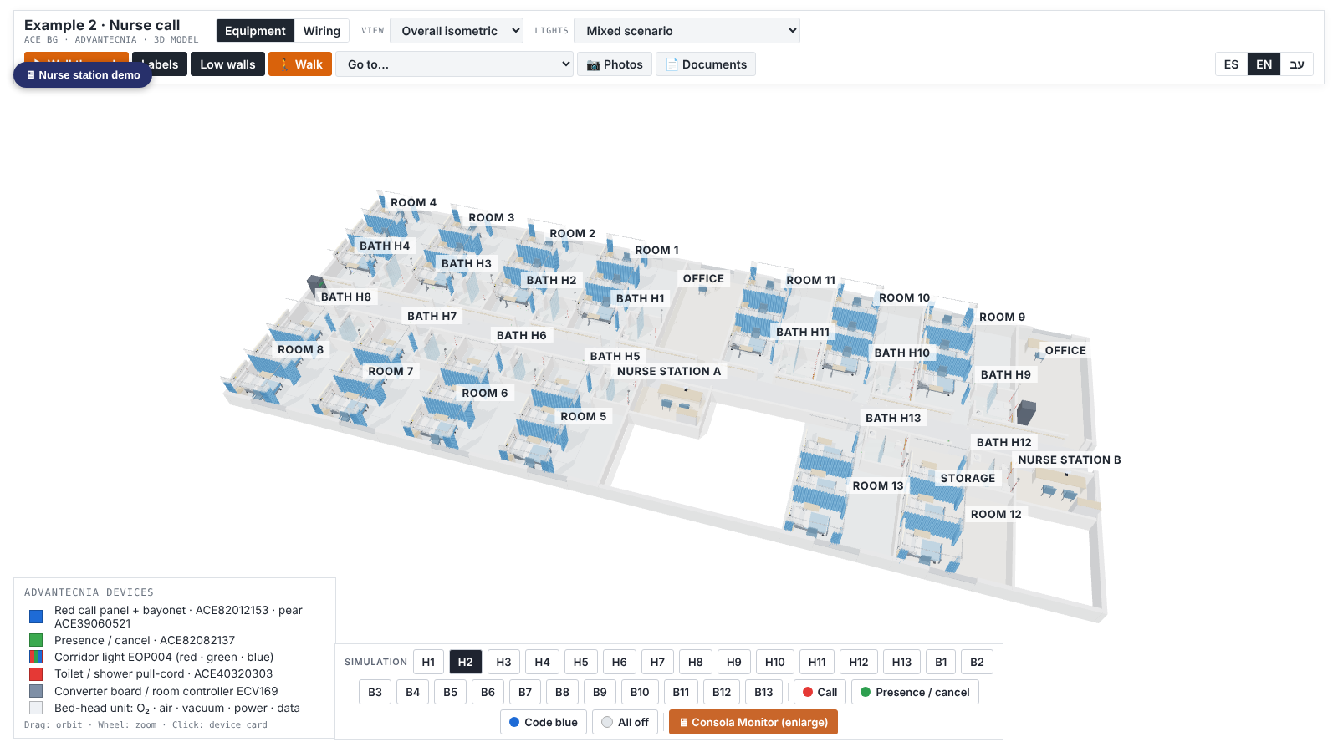

INTERACTIVE PLAN
3D model, walk-through and live simulation
3D model of the ward: equipment and wiring
Walk-through with realistic photos
Live simulation: call, presence, code blue
Consola Monitor at the nurse station
Documents: proposal, scheme, plans, BOQ
Scan to open
alexjusid-jpg.github.io/planos/yoseftal_ex2/en/
IMPORTANT – THIS IS NOT A REAL, FORMAL OR OFFICIAL PROPOSAL. It is an example only, prepared to support the offer that Orad must make to the end client.

Slide 10
NEXT STEPS
From this example to a real proposal
01
02
03
04
Consultation form
Site plans
Technical proposal
Orad offer
Orad fills in the form with the real data of the ward
Real floor plans, ceiling and cable routes
ACE BG confirms codes, quantities and prices
Orad prepares the official offer for the hospital
Yoseftal Medical Center, Eilat · ORAD-YOS-EX2-2026-10 · 26/10/2026
IMPORTANT – THIS IS NOT A REAL, FORMAL OR OFFICIAL PROPOSAL. It is an example only, prepared to support the offer that Orad must make to the end client.

