Slide 1
Sports Betting App
Alex Cersosimo, Svens Daukss, Alex Kaiser, Caleb Jordan

Slide 2
Introductions
Svens
Junior
Computer Science
Alex
Senior
Computer Science
Alex
Senior
Film w/ Computer Science Minor
Caleb
Senior
Chemistry w/ Computer Science Minor

Slide 3
Project Overview
I. Application Features
A. User Authentication and Profiles
User Login/Registration
B. Bet data Management
Odds monitoring
Bet Amounts
Real-time monitoring of bets
Historical bet performance analysis
Integration with odds API
II. Database Design
Hold user an sports betting information.
II. Technology Stack
A. Front-end
ASP.NET MVC for UI design. HTML, CSS, JavaScript for client-side interactions.
B. Back-end
ASP.NET Core for server-side logic
C. Database
AWS database (DynamoDB) for storing user profiles, bet data, and odds information

Slide 4
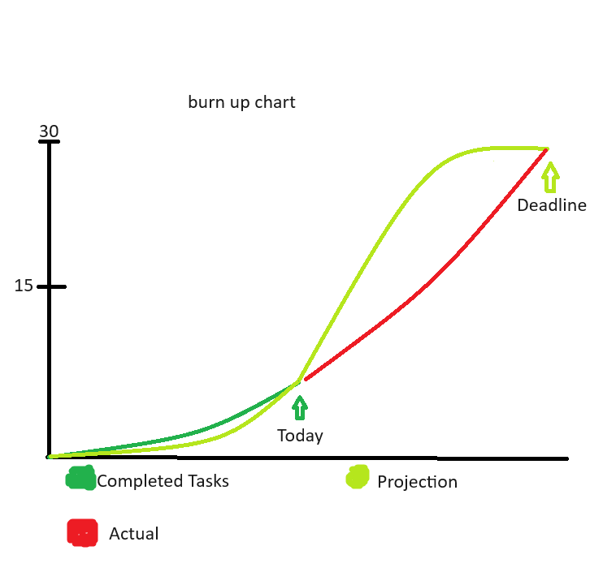
Project Timeline

Slide 5

Project Demonstration

