Slide 1
Introduction to InterMine
A flexible integrated data-warehouse

Slide 2
What is InterMine?
A data-integration system
An optimising query engine
A set of data analysis tools
A restful API
Graphical web-app components

Slide 3
What is InterMine?
A system for putting your data together with relevant external data sources
and providing a user-friendly interface to complex data-sets
and suitable basis for building upon

Slide 4
Who is/uses InterMine?
core team within the University of Cambridge, under Gos Micklem
Funded by Wellcome Trust / NIH
Used by major MODs and projects such as:
  FlyMine
  MGI
  RGD
  SGD
  Wormbase
  ZFIN
  modEncode
TargetMine
metabolicMine
MitoMiner
NSF/BBSRC Arabidopsis Portal
InterMOD

Slide 5
Why Use InterMine?
Model centred design
Query Performance
Fast builds
Rich tool set
Very flexible query system
Graduated complexity
Data Providers
Data Consumers

Slide 6
Why Use InterMine?
Data provider use case:
You have a large amount of transcription factor data from D. melanogaster experiments and would like to integrate this with GO, Uniprot and FlyBase data, and make it available to others.

Slide 7
Why Use InterMine?
Data consumer use case:
You need to transform and combine data from one type into another to answer questions, e.g. which of these human genes have orthologues in rat or mouse which would be useful in experiments, since they have appropriate expression, and are associated with suitable phenotypes?

Slide 8
Some Big Ideas
Data Types and Objects
Queries and Templates
Lists
Tools

Slide 9
Data Integration
Sequence
Pathways
Annotation
Disease
Homology
Phenotypes
Proteins
Regulation
Interactions
Expression
Your Data
Ontology

Slide 10
Data Integration
Build database from primary data-sources
Address issues of identity and conflicts
Track provenance
Loaders already exist for most data-types
Extensible

Slide 11
Query Engine
Data Tables
Object Table
Precomputed
Tables

Slide 12
Query Engine
Query
Results
SQL
Objects
Optimised SQL
Cache

Slide 13
Query Abstraction
Template
PathQuery
ObjectStore Query

Slide 14
Query Abstraction
Hide complexity from new users
Allow users to discover powerful features
Allow users to write (nearly) any query
All queries have access to same optimisation

Slide 15
Query Operators
= !=
< > <= >=

Slide 16
Query Operators
= !=
< > <= >=
CONTAINS
ISA LOOKUP
ONE OF NONE OF
OVERLAPS WITHIN DOES NOT OVERLAP

Slide 17
Query Structure
PathQueries are Graph Queries
{
from: “Gene”,
select: [ “homologues.homologue.*” ],
where: {
“Gene”: { “in”: “my list of genes” },
“goAnnotation.parents.name”: “*meiosis*”,
“homologues.homologue.proteinDomain.name”: {
“one of”: [“x”, “y”, “z”]
}
}

Slide 18
Data Analysis
Users can store lists of items
… and query over lists
… and perform statistical analysis on lists
… and send their data sets to Other Sites
… and download any results

Slide 19
Graphical User Interface
Graphical access to data out-of-the-box
Many components can be embedded

Slide 20
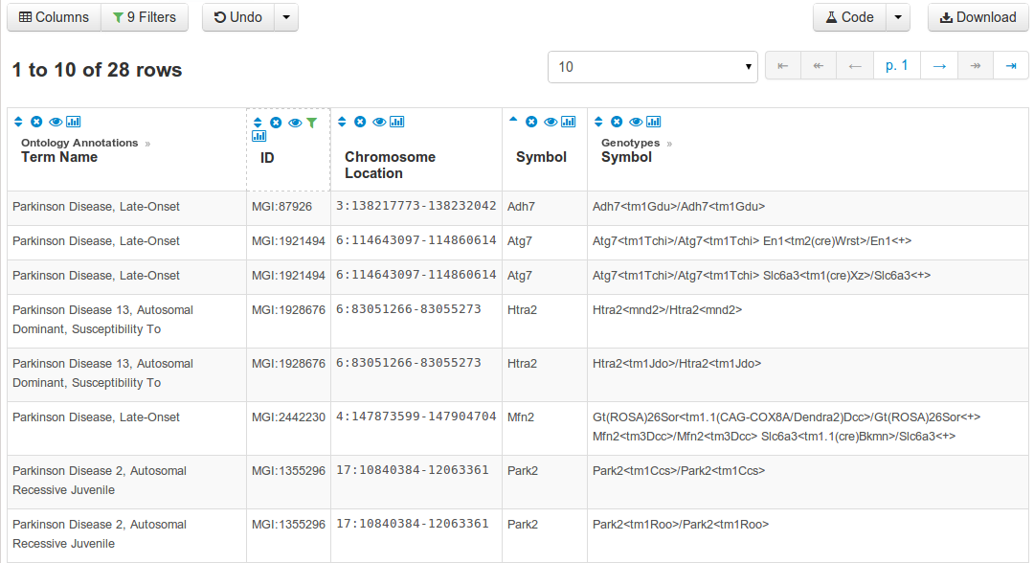
Graphical User Interface

Slide 21
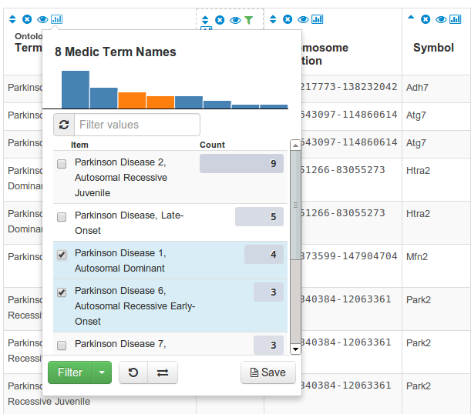
Graphical User Interface

Slide 22
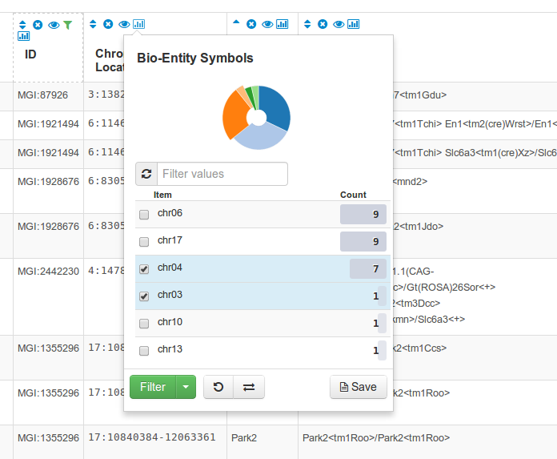
Graphical User Interface

Slide 23
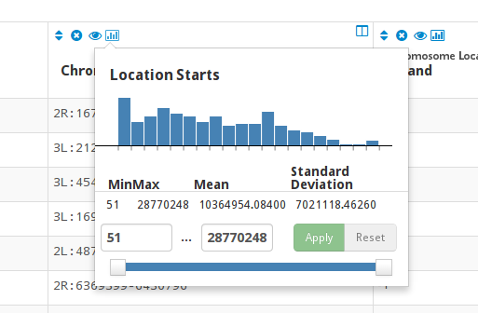
Graphical User Interface

Slide 24
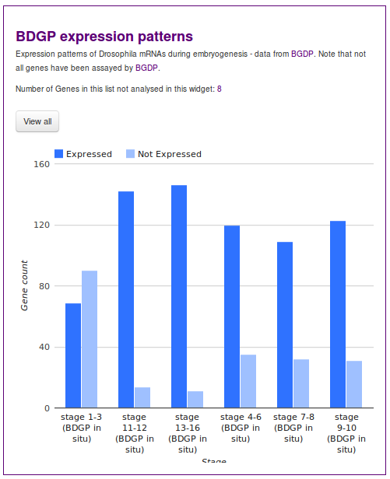
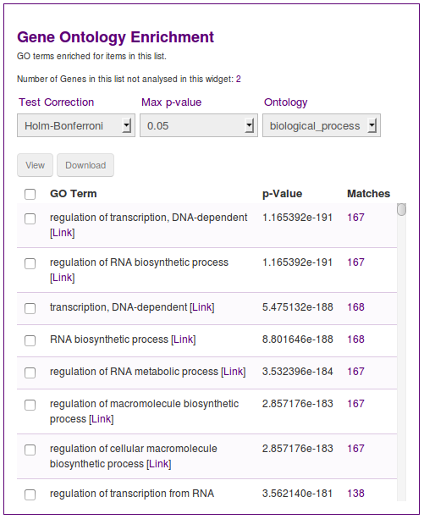
Graphical User Interface

Slide 25
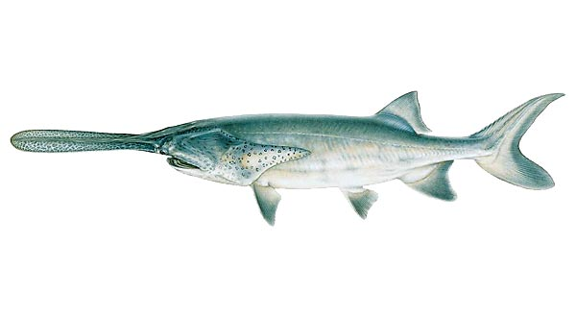
Use Cases

Slide 26
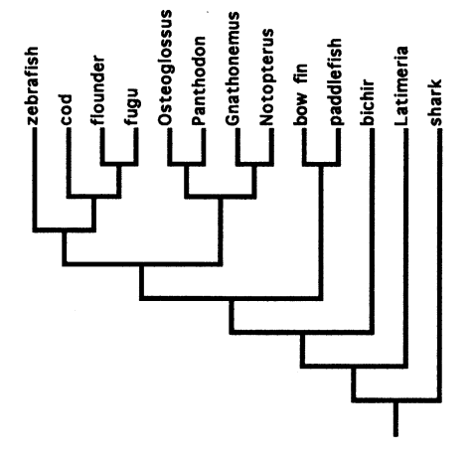
Use Cases - Paddlefish

Slide 27
Use Cases - Paddlefish
RNA-seq from Paddlefish embryo libraries from fins and operculum.
De novo transcriptome assemby of 1-e9 paired-end reads using velvet/oasis

Slide 28
Use Cases - Paddlefish
RNA-seq from Paddlefish embryo libraries from fins and operculum.
De novo transcriptome assemby of 1-e9 paired-end reads using velvet/oasis
Blastx against Zebrafish - hits stored in ZFINmine
Reads mapped back to transcripts (bowtie)
Differential expression analysis in R: ~ 900 genes
GO enrichment performed using all Blast matches as background.

Slide 29
First Class Embedding
JavaScript libraries to make embedding easy
imjs, imtables, widgets
Part of the EBI's BioJS project
  see papers published in F1000 BioJS Issue (Jan)

Slide 30
Web-Services
RESTful
TSV, XML, JSON
Queries, Lists, Summaries, Enrichment …
Libraries in Perl, Python, Ruby, Javascript, Java
Code generation
Secure, revocable authentication

Slide 31
Free and Open Source
LGPL
Built on open technologies (Java, Postgres)
Built on open standards (XML, JSON, GFF3)
Code freely available on github

Slide 32
Support and Community
Mailing list support.
Community of developers at major MODs.

Slide 33



Gos Micklem (PI)
Sergio Contrino
Joshua Heimbach
Mike Lyne
Rachel Lyne
Alex Kalderimis
Radek Štěpán
Julie Sullivan
dev@intermine.org http://www.intermine.org alex@intermine.org https://github.com/intermine

