Slide 1
Course Management Service
By: Alex Kassil

Slide 2
Quick Facts
1146 lines of code
5 Separate classes
1 enum
1 css file
1 image file
Access project at bit.ly/comp232

Slide 3
UML Diagrams and Class Relations

Slide 4
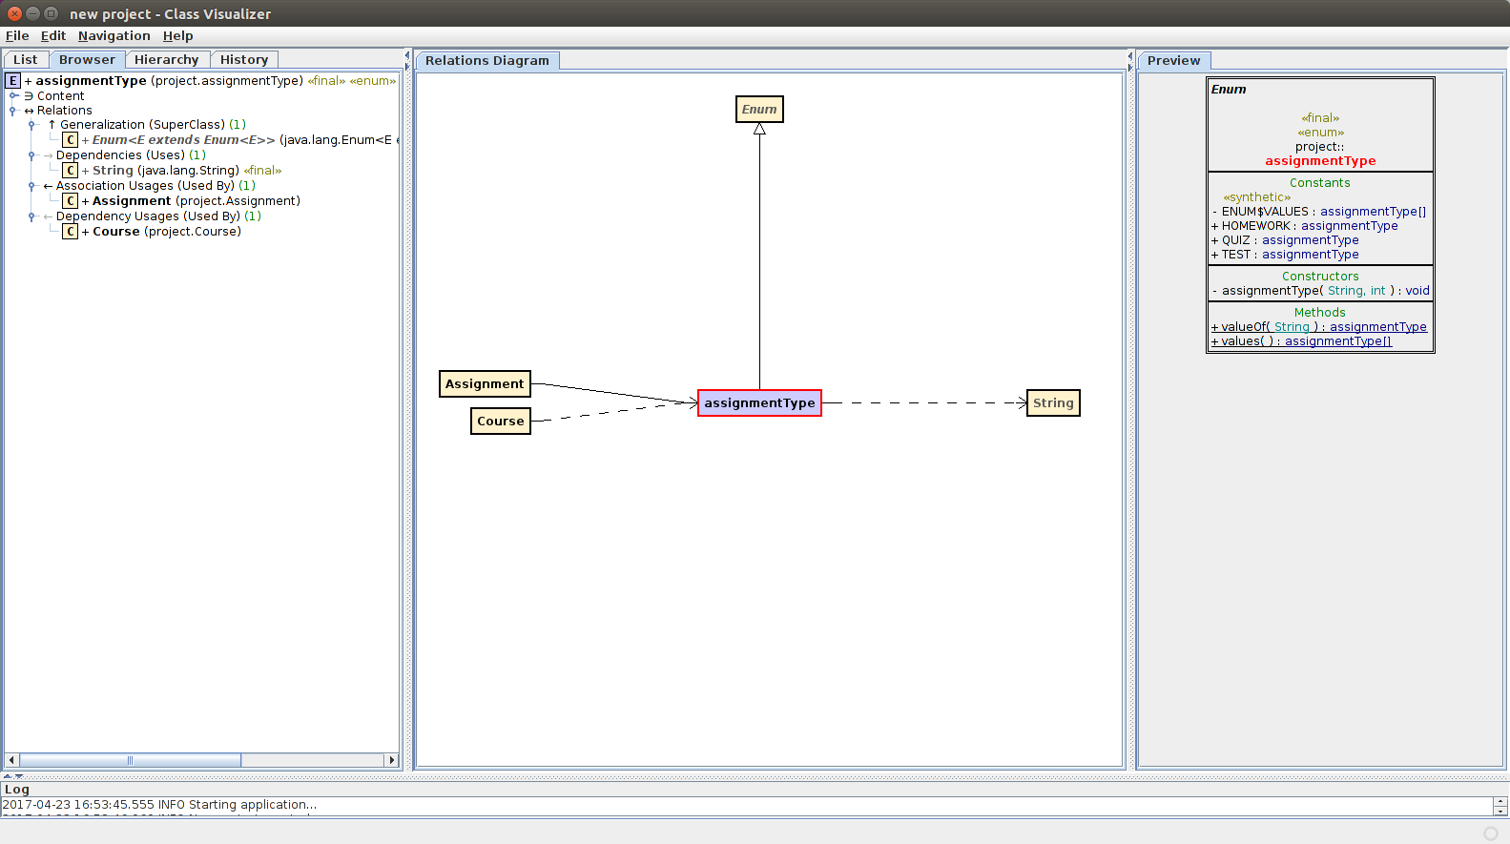

Slide 5
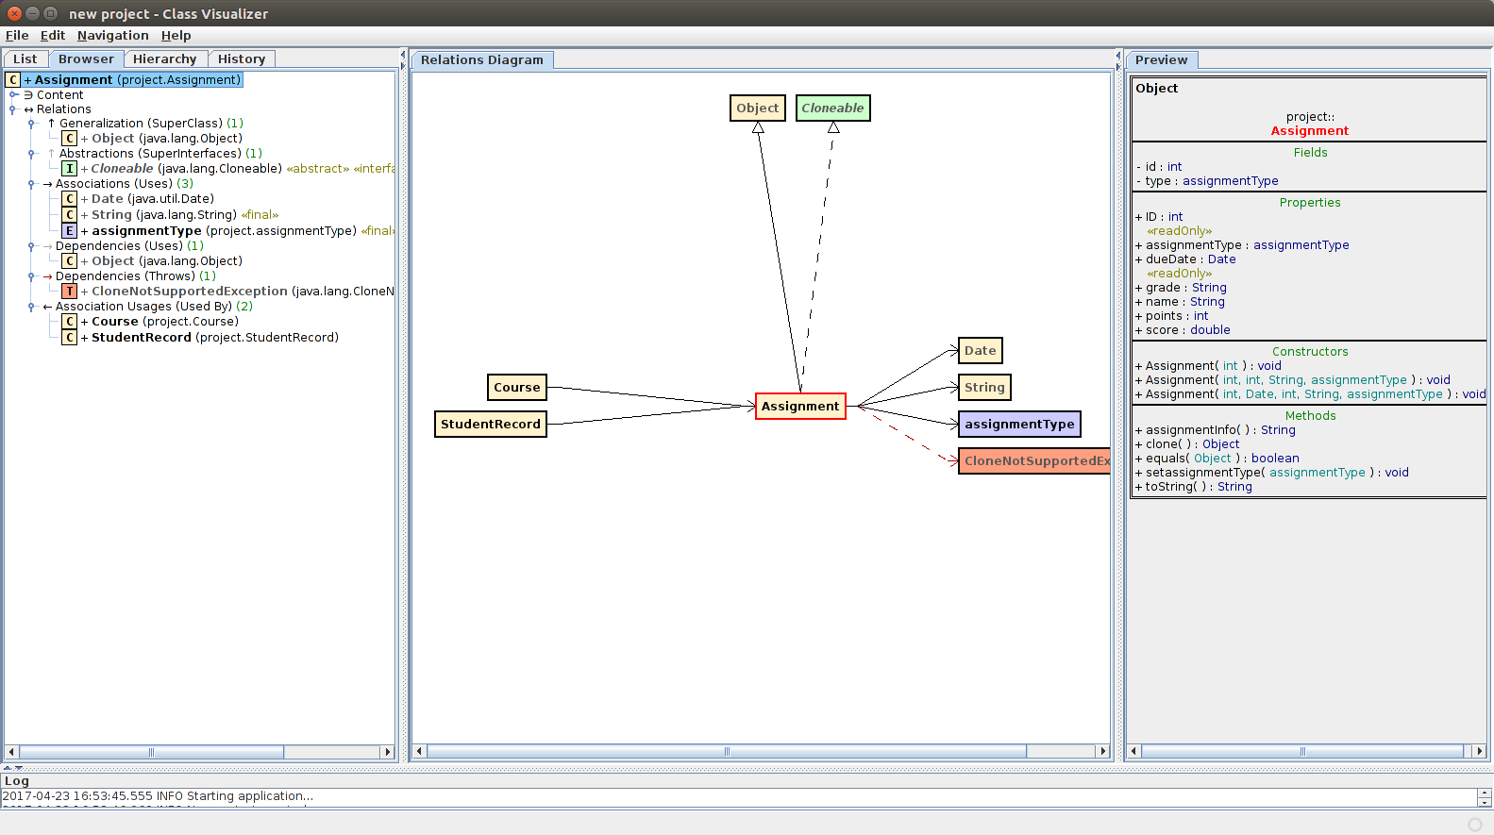

Slide 6
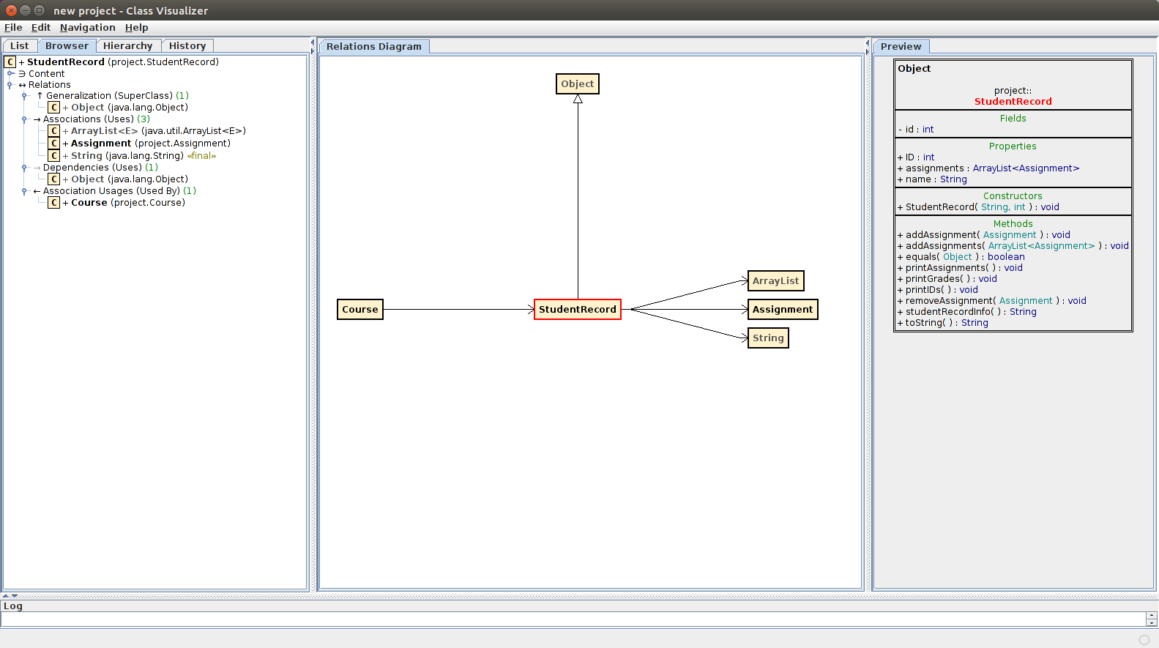

Slide 7
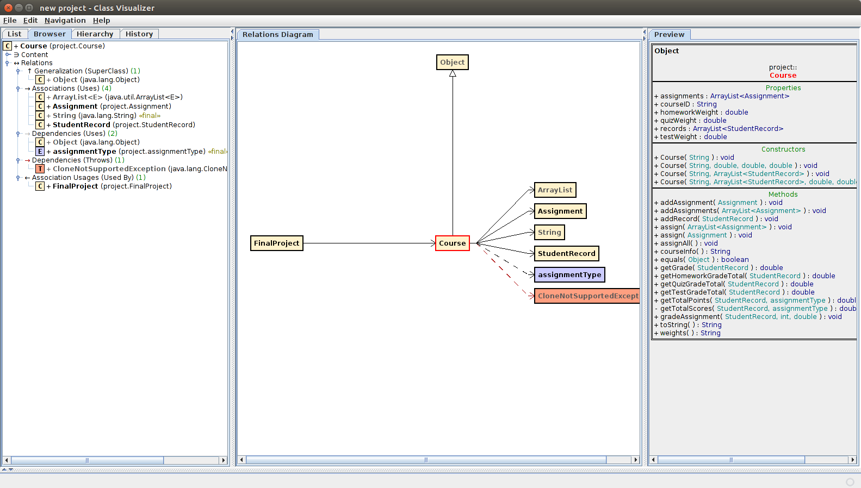

Slide 8
