Slide 1
Performance, Parallelism, and Distributed Data Analytics with Spark
David E. Culler
CS8 – Computational Structures in Data Science
http://inst.eecs.berkeley.edu/~cs88
Lecture 13
April 25, 2016

Slide 2

Computational Concepts Toolbox
Data type: values, literals, operations,
Expressions, Call expression
Variables
Assignment Statement
Sequences: tuple, list
Dictionaries
Data structures
Tuple assignment
Function Definition Statement
Conditional Statement
Iteration: list comp, for, while
Lambda function expr.
Higher Order Functions
as Values, Args, Results
Higher order function patterns
Map, Filter, Reduce
Function factories
Recursion
Linear, Tail, Tree
Abstract Data Types
Mutation
Object Oriented Programming
Classes
Iterators and Generators
Exceptions
assert, try, except, raise
Notes:
z = 1,2
x,y = 3,4
a,b = z

Slide 3
Today: Performance and Parallelism
Understanding ways of looking at performance
Complexity – asymptotic scaling
Amdahl’s Law – impact of enhancements (including parallelism)
Data analytics in the cloud – SPARK
Map / reduce paradigm
RDDs
Arrays, Key-Value, Data frames / Tables
HKN survey before lab
Lab – Hands on with DatabBricks / SPARK
Administrative
Next week review, No new homework
Final: FRIDAY, MAY 13, 2016 8-11A, Location: 306 SODA
Review session to be scheduled

Slide 4
Complexity – asymptotic analysis
Example: Matrix Multiply
How many Multiplies? Adds? Ops? How much time ?
As a function of n ?
for i in 0 to n-1:
for j in 0 to n-1:
C[i][j] = 0
for k in 0 to n-1:
C[i][j] = C[i][j] + A[i][k]*B[k][j]
We say it is O(n³) “big-O of n³ “ as an asymptotic upper bound
time(n) < c • n³, for some suitably large constant c for any instance of the inputs of size n.

Slide 5
A subtle example
What is the “complexity” of finding the average number of factors of numbers up to n?
def factors(n):
return [x for x in range(2, max(n, ceil(sqrt(n))))
if n % x == 0]
def ave_factor(n):
all_factors = map(factors, range(n))
all_lens = map(len, all_factors)
return sum(all_lens)/n
n^{1/2}
n
from timeit import default_timer as timer
def timeit(fun):
””” Rtn timer for fun(i) in secs. """
def timer_fun(i):
start = timer()
fun(i)
end = timer()
return (end-start)
return timer_fun

Slide 6
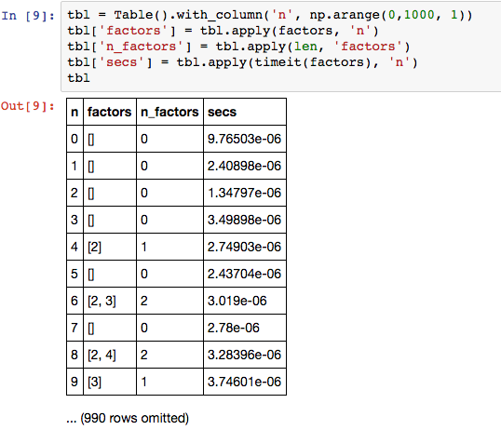
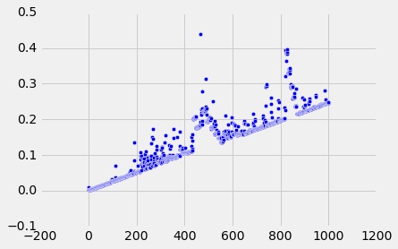
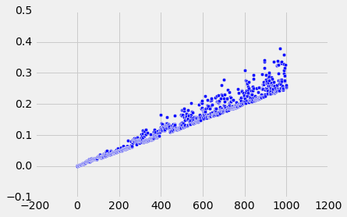
How long does factors take?

Slide 7
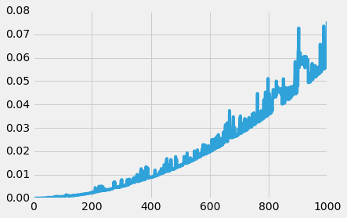
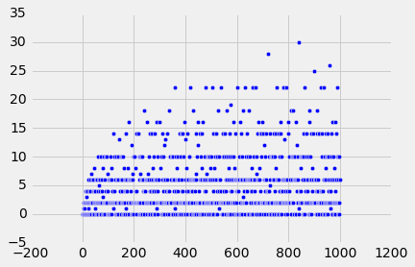
A subtle example
What is the complexity of finding the average number of factors of numbers up to n?
def factors(n):
return [x for x in range(2, max(n, ceil(sqrt(n))))
if n % x == 0]
def ave_factor(n):
all_factors = map(factors, range(n))
all_lens = map(len, all_factors)
return sum(all_lens)/n
n^{1/2}
n

Slide 8
Amdahl’s Law
Let T₁(n) be the time to execute the program serially, and
T_{p}(n) be the time with parallelism p, and
s_{n} be the fraction of the program that remains serial when parallelized
SpeedUp(n) = T₁(n) / T_{p}(n)
<= _ T₁(n)_______ < 1/s_{n}
s_{n}T₁(n) + (1-s_{n}) T₁(n)/p
Often, as the data gets large, the work that can be parallelized grows faster than the size of the data

Slide 9


Layers of Computer Systems
your python program
Application processes
Python interpreter
stdout
stdin
Provide a stable, consistent, convenient “virtualization” of the underlying hardware
files
Operating System
SW
HW
proc
mem
proc
proc
proc
disks

Slide 10
Distributed Computer Systems
Operating System
SW
HW
proc
proc
mem
proc
mem
proc
proc
proc
proc
proc
disks
disks
Internet = Network of Networks

Slide 11
Distributed Computer Systems
Browser
Web Server
Databases
Operating System
SW
HW
proc
proc
mem
proc
mem
proc
proc
proc
proc
proc
disks
disks
Internet = Network of Networks

Slide 12
In Data8
Browser
Jupyter Hub
your python notebook
Operating System
SW
HW
proc
proc
mem
proc
mem
proc
proc
proc
proc
proc
disks
disks
Internet = Network of Networks

Slide 13
… on BIG DATA
Browser
Spark Data Analytics
Operating System
SW
HW
proc
proc
mem
proc
mem
proc
proc
proc
proc
proc
disks
disks
Databases
Databases
Internet = Network of Networks

Slide 14

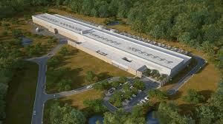
Big Data Examples
Facebook daily logs: 60 Terabytes (60,000 GB)
1,000 Genomes: 200 TB
Google web index: 10+ Petabytes (10,000 TB)
Time to read 1 TB @ 100 MB/s ? – 3 hours
Clusters – thousands of complete computer systems, networked closely
(mostly) independent failures
Engineered at massive scale

Slide 15
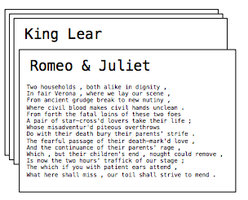
Apache Spark (from Berkeley)
Data processing system that provides a simple interface to analytics on large data
A Resilient Distributed Dataset (RDD) is a collection of values or key-value pairs
Support the operations you are familiar with
Data-Parallel: map, filter, reduce
Database: join, union, intersect
OS: sort, distinct, count
All of can be performed on RDDs that are partitioned across machines

Slide 16
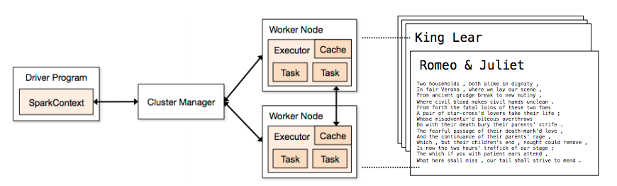
Spark Execution Model
Processing is defined centrally and executed remotely
A RDD is distributed over workers
A driver program defines transformations and actions on RDDs
A cluster manager assigns task to workers
Workers perform computation, store data, & communicate with each other
Final results communicate back to driver

Slide 17
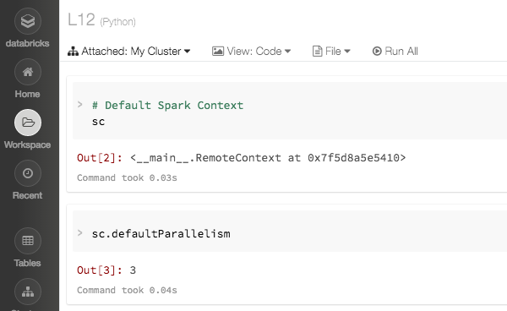
Spark Context

Slide 18
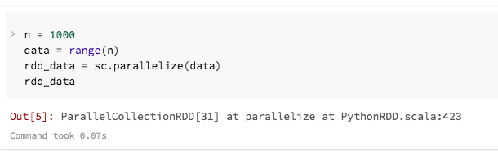
RDD of values

Slide 19
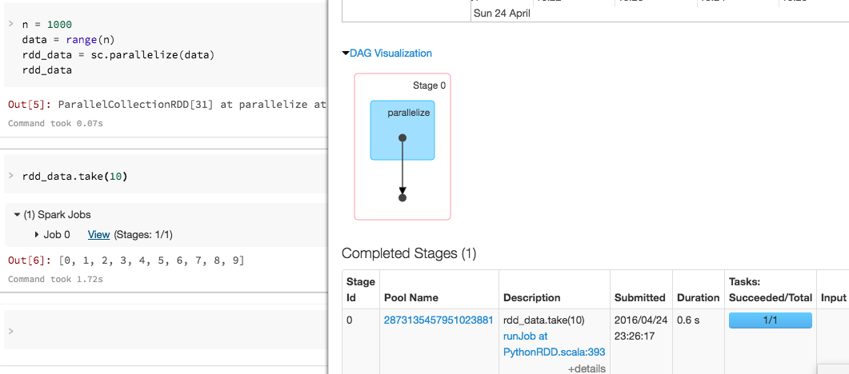
Looking at results

Slide 20
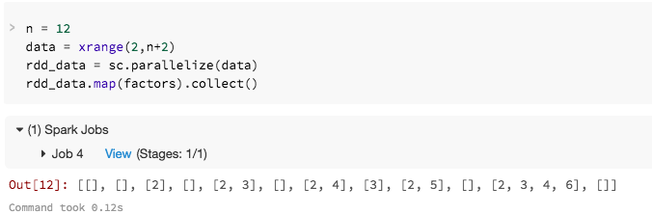
Map / Collect

Slide 21
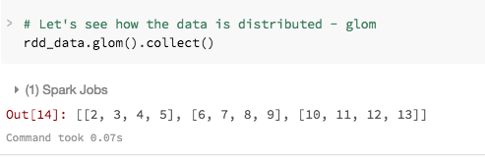
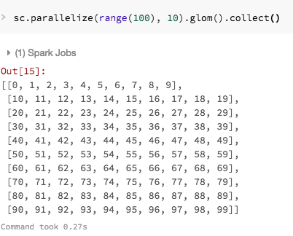
Data Distribution

Slide 22
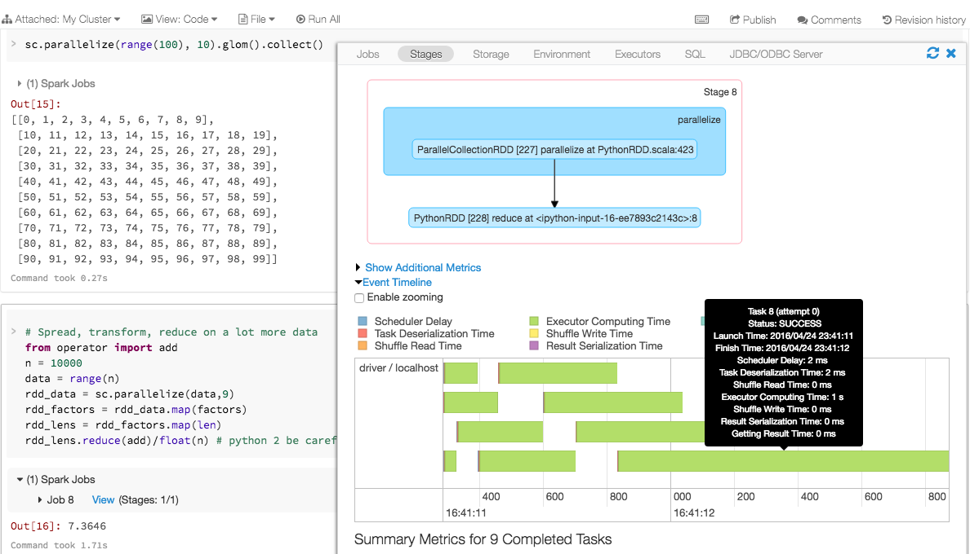
Distribute/Map/Reduce

Slide 23
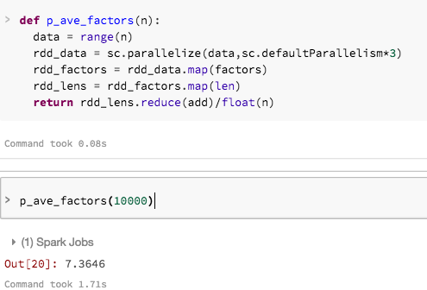
Encapsulating the Parallelism

Slide 24
Summary: RDD operations (so far)
Transformation https://spark.apache.org/docs/latest/programming-guide.html#transformations
map(fun), filter(fun)
flatMap(fun) – each item may be mapped to zero or more outputs
sample, union, intersection, distinct
join
Action
reduce(fun), collect(), count(), first(), take(n)

Slide 25
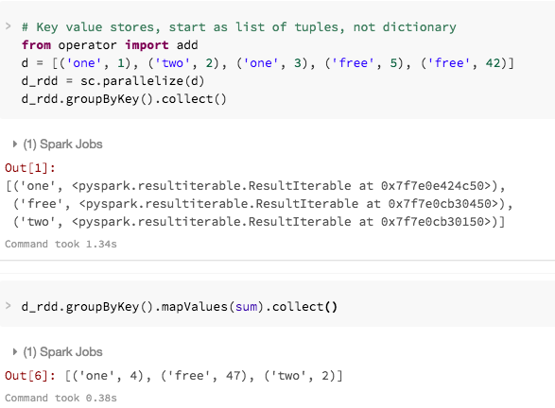
Key-value RDDs
Map the values in a group
- not add

Slide 26
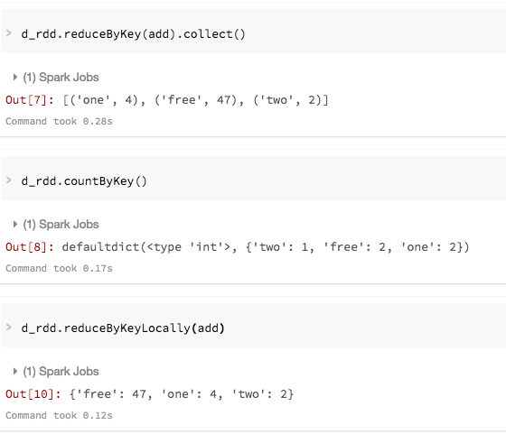
Key-Value RDD operations

Slide 27
Summary: RDD operations (cont)
Transformation https://spark.apache.org/docs/latest/programming-guide.html#transformations
map(fun), filter(fun)
flatMap(fun) – each item may be mapped to zero or more outputs
sample, union, intersection, distinct, join
groupByKey(), reduceByKey(fun), aggregateByKey, sortByKey
Action
reduce(fun), collect(), count(), first(), take(n)
takeSample
countByKey

Slide 28
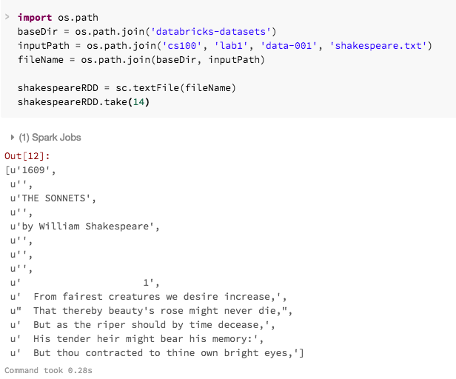
Building an RDD from a text file

Slide 29
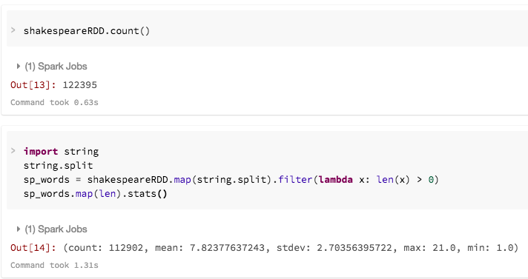
Count, Filter and stats

Slide 30
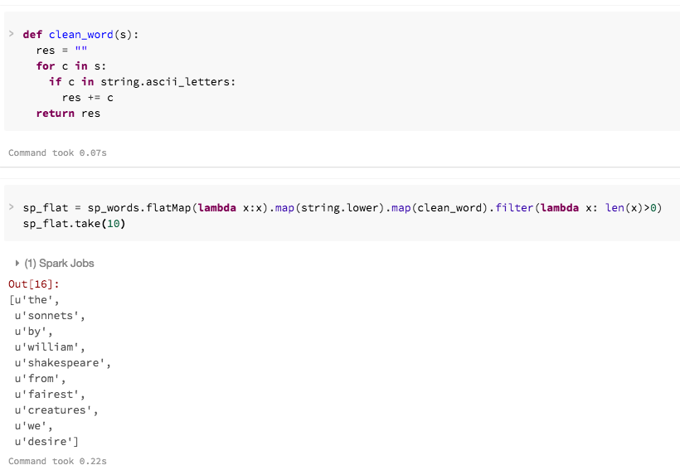
flatMap

Slide 31
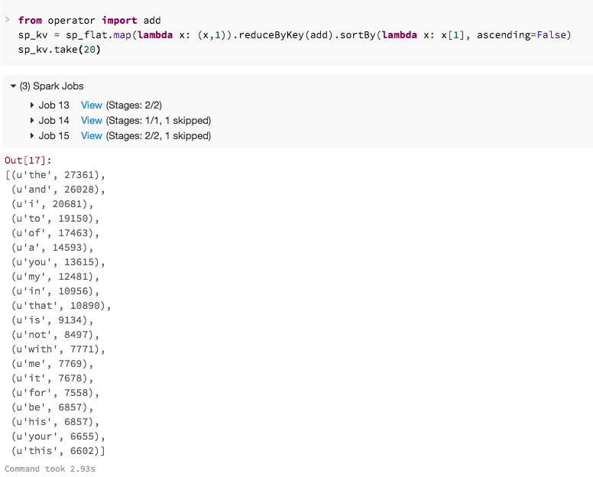
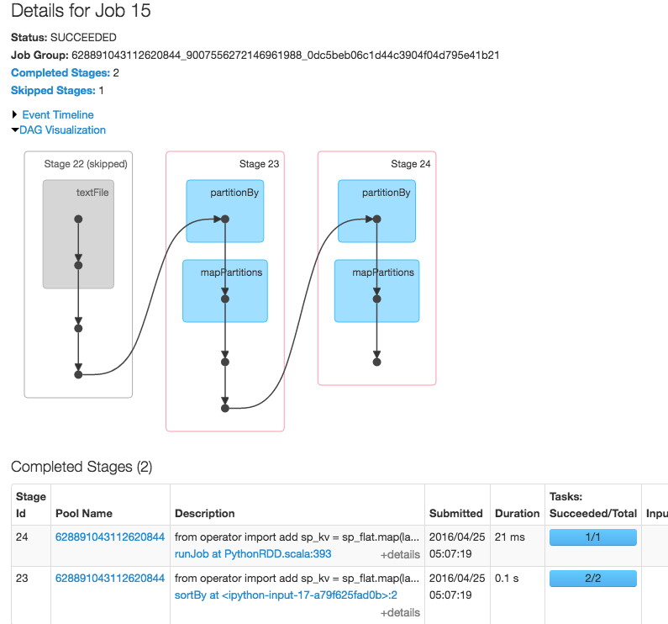
Values => Key-Value

Slide 32
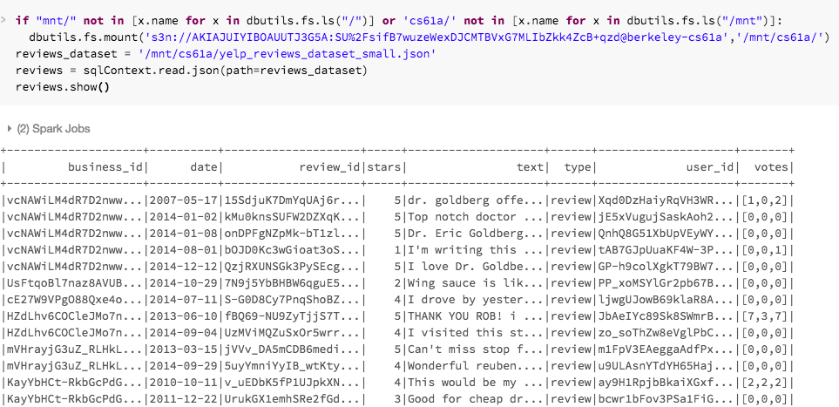
Data Frames / SQL

Slide 33
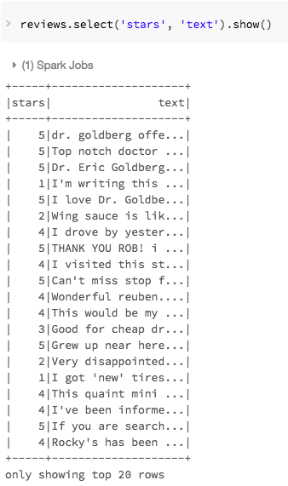
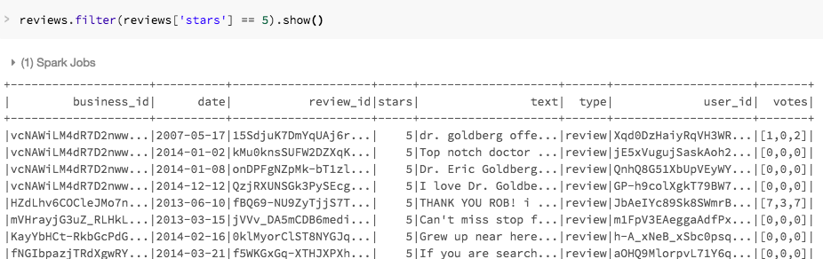
Data frames: select, filter

Slide 34
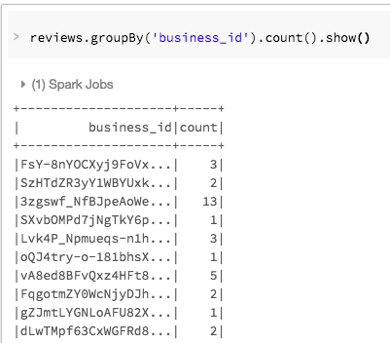
Data Frames: groupBy

Slide 35
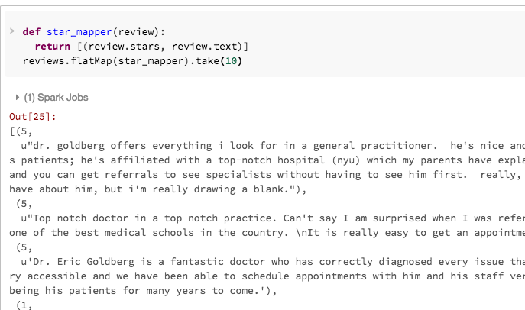
Data Frames => key-value

Slide 36
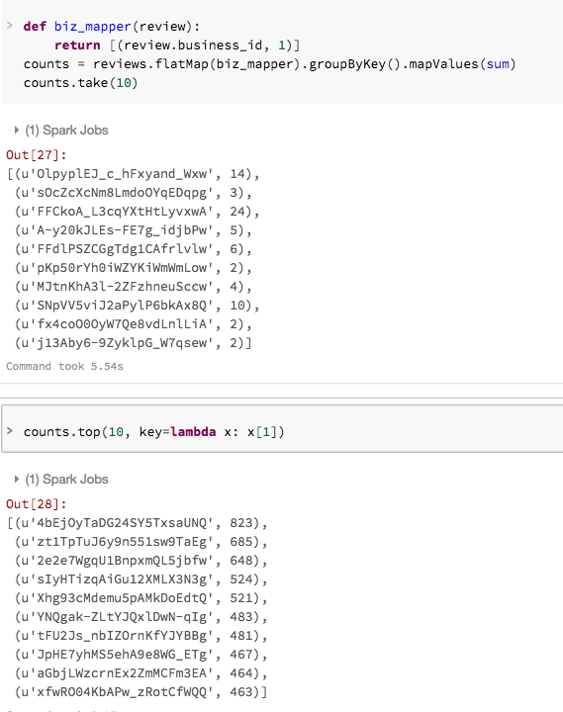
DF => map => group => reduce

Slide 37
Data Frame Operations
sqlContext.read.json(path=…)
count(), distinct(), first()
select(*cols), drop(col),
flatMap(fun), map(fun)
filter( condition ), where( condition )
groupBy(*cols)
intersect(other), join(other)
orderBy(*cols), sort(*cols)
sample()
stat, take, show
https://spark.apache.org/docs/latest/api/python/pyspark.sql.html#pyspark.sql.DataFrame

Slide 38
Summary
Performance is both about algorithmic “complexity” and implementation constants
Make the common case fast
Parallelism
Often the parallel work scales with the data
Master – Worker Model of Parallel data processing on clusters (in the cloud)
RDDs of values, key-value
Data Frame / SQL (like Tables)
New concepts: flatMap, groupBy
https://databricks-prod-cloudfront.cloud.databricks.com/public/4027ec902e239c93eaaa8714f173bcfc/3044375856741396/398677364991930/1602914200610255/latest.html

