Slide 1
Control Structures
David E. Culler
CS8 – Computational Structures in Data Science
http://inst.eecs.berkeley.edu/~cs88
Lecture 2
January 25, 2016

Slide 2
Administrative issues
Getting late enrollments into class
Your c8 account carries over
HW1 due date deferred to Wed
Labs are held in 273-5 Soda Mon 5-7
Catch-up on Lab 0 today and start Lab 1
HW2 is out
Defer due date to Tues?
Concurrent enrollment students
Need email to get account set up and OK

Slide 3
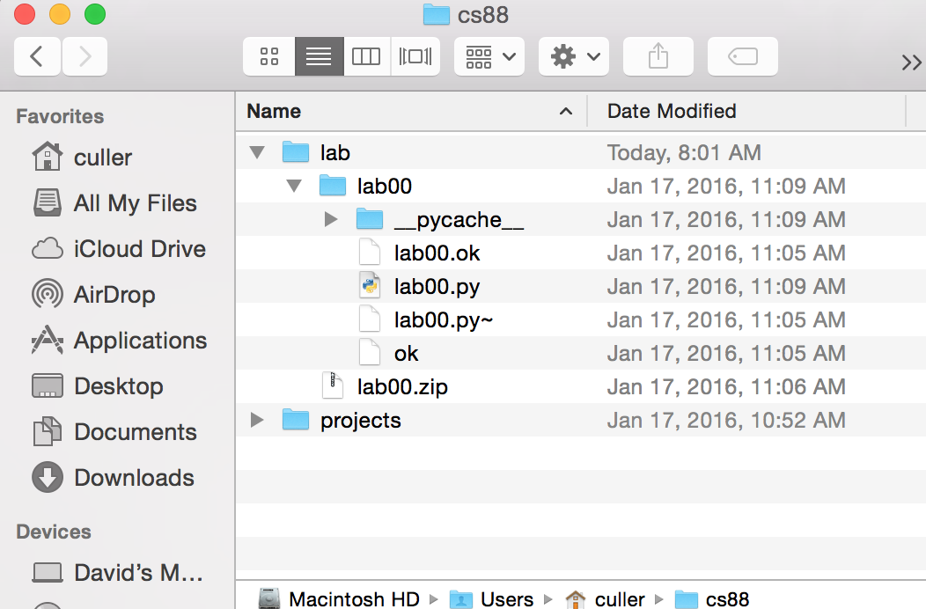
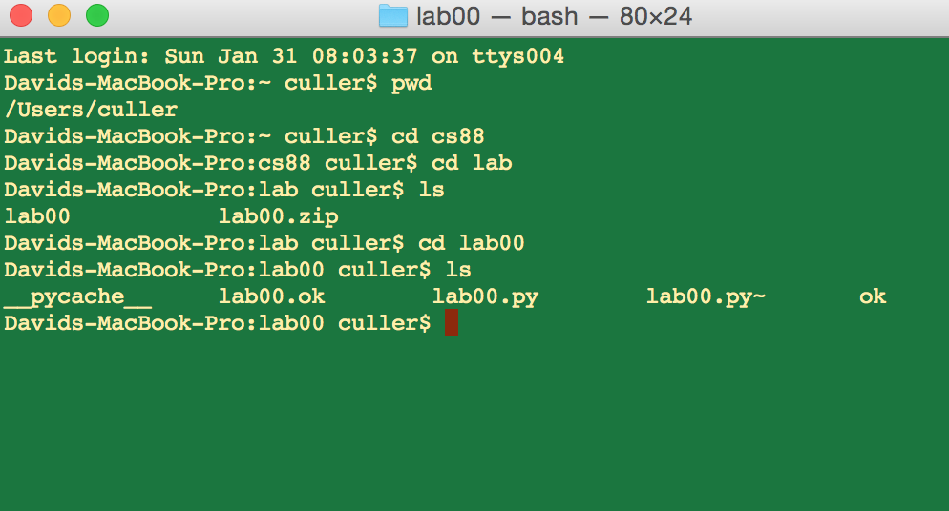
Lab0: WIMP => Program Development
Big Idea: Layers of Abstraction
The GUI look and feel is built out of files, directories, system code, etc.

Slide 4

Computational Concepts Toolbox
Data type: values, literals, operations, e.g., int, float, string
Expression 3.1 * 2.6
Call expression max(0, x)
Variables
Assignment Statement x = <expression>
Sequences: tuple, list (1,2), [3,4]
numpy.array( <object> )
Data structures
numpy.array, Table
Tuple assignment x,y = <exp>
Notes:
z = 1,2
x,y = 3,4
a,b = z

Slide 5
Computational Concepts today
Call Expressions
Function Definition Statement
Conditional Statement
Iteration: data-driven (list comprehension)
Iteration: control-driven (for statement)
Structured
Iteration: while statement
More primitive and more general
Big Idea: Software Design Patterns

Slide 6
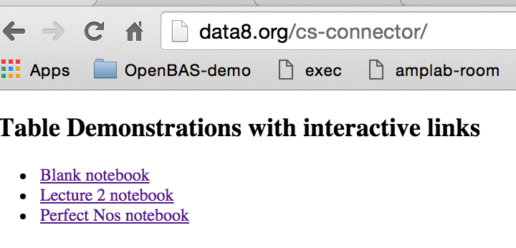
“Philosophical” Context
Perfect Numbers
A perfect number is a positive integer that is equal to the sum of its positive divisors, excluding itself.
e.g. 6 = 1 + 2 + 3
Euclid found the first 4 (the fifth found in the 1100s and 1400s
Proved N = 2^{p} – 1 is prime (Mersenne Prime) then (2^{p} – 1)2^{p-1} is even perfect
Are there an infinite number of perfect numbers?
Let’s compute some while learning computational concepts

Slide 7
Call Expressions
Evaluate a function on some arguments
What would be some useful functions?
builtin functions
https://docs.python.org/3/library/functions.html
min, max, sum
https://docs.python.org/3/library/
str
import math; help(math)

Slide 8
Defining Functions
def <function name> ( <argument list> ) :
expression
return
Generalizes an expression or set of statements to apply to lots of instances of the problem
A function should do one thing well

Slide 9
Conditional statement
Do some statements, conditional on a predicate expression
if <predicate>:
<true statements>
else:
<false statements>

Slide 10
Data-driven iteration
describe an expression to perform on each item in a sequence
let the data dictate the control
[ <expr with loop var> for <loop var> in <sequence expr > ]

Slide 11
for statement – iteration control
Repeat a block of statements for a structured sequence of variable bindings
<initialization statements>
for <variables> in <sequence expression>:
<body statements>
<rest of the program>

Slide 12
while statement – iteration control
Repeat a block of statements until a predicate expression is satisfied
<initialization statements>
while <predicate expression>:
<body statements>
<rest of the program>

