Slide 1
Exceptions & a Taste of Declarative Programming in SQL
David E. Culler
CS8 – Computational Structures in Data Science
http://inst.eecs.berkeley.edu/~cs88
Lecture 12
April 18, 2016

Slide 2

Computational Concepts Toolbox
Data type: values, literals, operations,
Expressions, Call expression
Variables
Assignment Statement
Sequences: tuple, list
Dictionaries
Data structures
Tuple assignment
Function Definition Statement
Conditional Statement
Iteration: list comp, for, while
Lambda function expr.
Higher Order Functions
as Values, Args, Results
Higher order function patterns
Map, Filter, Reduce
Function factories
Recursion
Linear, Tail, Tree
Abstract Data Types
Mutation
Object Oriented Programming
Classes
Iterators and Generators
Notes:
z = 1,2
x,y = 3,4
a,b = z

Slide 3
Today: Exception (read 4.3)
Mechanism in a programming language to declare and respond to “exceptional conditions”
enable non-local cntinuations of control
Often used to handle error conditions
Unhandled exceptions will cause python to halt and print a stack trace
You already saw a non-error exception – end of iterator
Exceptions can be handled by the program instead
try, except, raise statements
Exceptions are objects!
They have classes with constructors

Slide 4
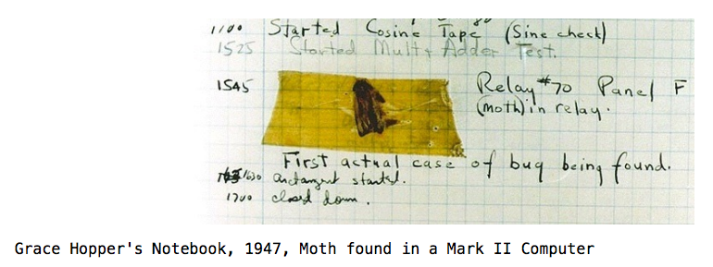
Handling Errors
Function receives arguments of improper type?
Resource, e.g., file, is not available
Network connection is lost or times out?

Slide 5
Example exceptions
>>> 3/0
Traceback (most recent call last):
File "<stdin>", line 1, in <module>
ZeroDivisionError: division by zero
>>> str.lower(1)
Traceback (most recent call last):
File "<stdin>", line 1, in <module>
TypeError: descriptor 'lower' requires a 'str' object but received a 'int'
>>> ""[2]
Traceback (most recent call last):
File "<stdin>", line 1, in <module>
IndexError: string index out of range
>>>
Unhandled, thrown back to the top level interpreter
Or halt the python program

Slide 6
Functions
Q: What is a function supposed to do?
A: One thing well
Q: What should it do when it is passed arguments that don’t make sense?
>>> def divides(x, y):
... return y%x == 0
...
>>> divides(0, 5)
???
>>> def get(data, selector):
... return data[selector]
...
>>> get({'a': 34, 'cat':'9 lives'}, 'dog’)
????

Slide 7
Exceptional exit from functions
>>> def divides(x, y):
... return y%x == 0
...
>>> divides(0, 5)
Traceback (most recent call last):
File "<stdin>", line 1, in <module>
File "<stdin>", line 2, in divides
ZeroDivisionError: integer division or modulo by zero
>>> def get(data, selector):
... return data[selector]
...
>>> get({'a': 34, 'cat':'9 lives'}, 'dog')
Traceback (most recent call last):
File "<stdin>", line 1, in <module>
File "<stdin>", line 2, in get
KeyError: 'dog'
>>>
Function doesn’t “return” but instead execution is thrown out of the function

Slide 8
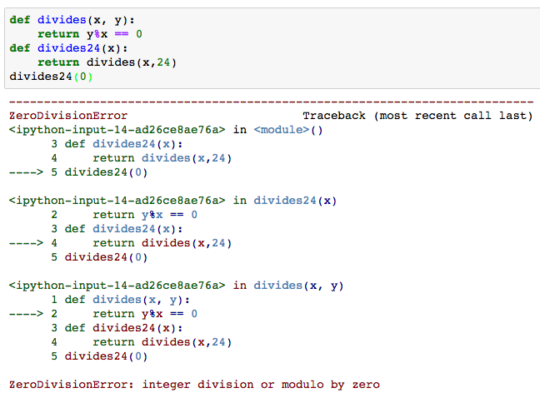
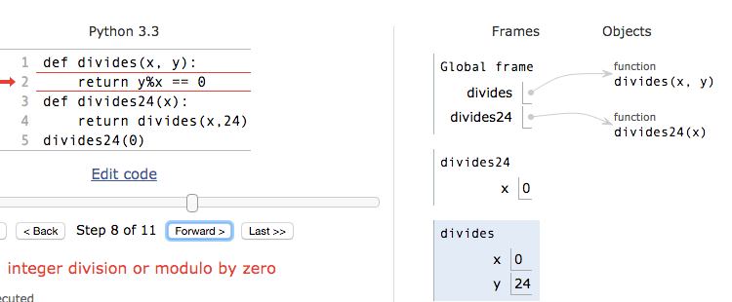
Continue out of multiple calls deep
Stack unwinds until exception is handled or top

Slide 9
Types of exceptions
TypeError -- A function was passed the wrong number/type of argument
NameError -- A name wasn't found
KeyError -- A key wasn't found in a dictionary
RuntimeError -- Catch-all for troubles during interpretation
. . .

Slide 10
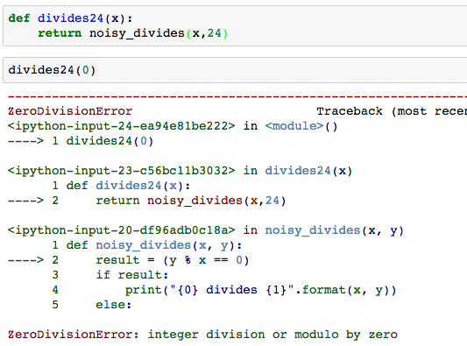
Flow of control stops at the exception
And is ‘thrown back’ to wherever it is caught

Slide 11
Assert Statements
Allow you to make assertions about assumptions that your code relies on
Use them liberally!
Incoming data is dirty till you’ve washed it
Raise an exception of type AssertionError
Ignored in optimize flag: python3 –O …
Governed by bool __debug__
assert <assertion expression>, <string for failed>
def divides(x, y):
assert x != 0, ”Denominator must be non-zero”
return y%x == 0

Slide 12
Handling Errors – try / except
Wrap your code in try – except statements
Execution rule
<try suite> is executed first
If during this an exception is raised and not handled otherwise
And if the exception inherits from <exception class>
Then <except suite> is executed with <name> bound to the exception
Control jumps to the except suite of the most recent try that handles the exception
try:
<try suite>
except <exception class> as <name>:
<except suite>
... # continue here if <try suite> succeeds w/o exception

Slide 13
Demo

Slide 14
Raise statement
Exception are raised with a raise statement\
raise <exception>
<expression> must evaluate to a subclass of BaseException or an instance of one
Exceptions are constructed like any other object
TypeError(‘Bad argument’)

Slide 15
Exceptions are Classes
class NoiseyException(Exception):
def __init__(self, stuff):
print("Bad stuff happened", stuff)
try:
return fun(x)
except:
raise NoiseyException((fun, x))

Slide 16
Demo

Slide 17
Part II – Intro to Declarative Programming

Slide 18


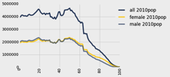
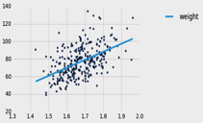
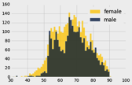
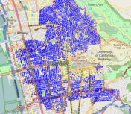
Data 8 Tables
ordered collection of labeled columns of anything
label
select, where, take, drop, group
stats, bin
sample
dict, record,tuple
pivot, pivot_bin
values
split
join
Numpy array
T[‘label’]
A single, simple, powerful data structure for all
Inspired by Excel, SQL, R, Pandas, Numpy, …

Slide 19
Database Management Systems
DBMS are persistent tables with powerful relational operators
Important, heavily used, interesting !
A table is a collection of records, which are rows that have a value for each column
Structure Query Language (SQL) is a declarative programming language describing operations on tables
column has a name and a type
row has a value for each column
Name | Latitude | Longitude
Berkeley | 38 | 122
Cambridge | 42 | 71
Minneapolis | 45 | 93
table has columns and rows

Slide 20
SQL
A declarative language
Described what to compute
Imperative languages, like python, describe how to compute it
Query processor (interpreter) chooses which of many equivalent query plans to execute to perform the SQL statements
ANSI and ISO standard, but many variants
select statement creates a new table, either from scratch or by projecting a table
create table statement gives a global name to a table
Lots of other statements
analyze, delete, explain, insert, replace, update, …
The action is in select

Slide 21
SQL example
SQL statements create tables
Give it a try with sqlite3 or http://kripken.github.io/sql.js/GUI/
Each statement ends with ‘;’
culler$ sqlite3
SQLite version 3.9.2 2015-11-02 18:31:45
Enter ".help" for usage hints.
Connected to a transient in-memory database.
Use ".open FILENAME" to reopen on a persistent database.
sqlite> select 38 as latitude, 122 as longitude, "Berkeley" as name;
38|122|Berkeley
sqlite>

Slide 22
select
Comma-separated list of column descriptions
Column description is an expression, optionally followed by as and a column name
Selecting literals creates a one-row table
union of select statements is a table containing the union of the rows
select [expression] as [name], [expression] as [name]; . . .
select 38 as latitude, 122 as longitude, "Berkeley" as name union select 42, 71, "Cambridge" union
select 45, 93, "Minneapolis";
Latitude | Longitude | Name
38 | 122 | Berkeley
42 | 71 | Cambridge
45 | 93 | Minneapolis

Slide 23
SQL: creating a named table
create table cities as
select 38 as latitude, 122 as longitude, "Berkeley" as name union
select 42, 71, "Cambridge" union
select 45, 93, "Minneapolis”;
cities:
Latitude | Longitude | Name
38 | 122 | Berkeley
42 | 71 | Cambridge
45 | 93 | Minneapolis

Slide 24
create table
SQL often used interactively
Result of select displayed to the user, but not stored
Create table statement gives the result a name
Like a variable, but for a permanent object
create table [name] as [select statement];

Slide 25
SQL: using named tables - from
create table cities as
select 38 as latitude, 122 as longitude, "Berkeley" as name union
select 42, 71, "Cambridge" union
select 45, 93, "Minneapolis";
select "west coast" as region, name from cities where longitude >= 115 union
select "other", name from cities where longitude < 115
cities:
Latitude | Longitude | Name
38 | 122 | Berkeley
42 | 71 | Cambridge
45 | 93 | Minneapolis
Region | Name
west coast | Berkeley
other | Cambridge
other | Minneapolis

Slide 26
Projecting existing tables
Input table specified by from clause
Subset of rows selected using a where clause
Ordering of the selected rows declared using an order by clause
select [columns] from [table] where [condition] order by [order] ;
select * from cities where longitude > 115 order by name;
Name | Latitude | Longitude
Cambridge | 42 | 71
Minneapolis | 45 | 93

Slide 27
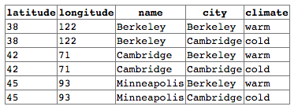
Joining tables
Two tables are joined by a comma to yield all combinations of a row from each
create table cities as
select 38 as latitude, 122 as longitude, "Berkeley" as name union
select 42, 71, "Cambridge" union
select 45, 93, "Minneapolis";
create table climates as
select "Berkeley" as city, "warm" as climate union
select "Cambridge" as city, "cold" as climate;
select * from cities, climates

Slide 28

Join / Where
create table cities as
select 38 as latitude, 122 as longitude, "Berkeley" as name union
select 42, 71, "Cambridge" union
select 45, 93, "Minneapolis";
create table climates as
select "Berkeley" as city, "warm" as climate union
select "Cambridge" as city, "cold" as climate;
select name, climate, latitude, longitude from cities, climates where name = city;

Slide 29

Aggregation and grouping
Reduction operators can be applied over groupings of rows
create table cities as
select 38 as latitude, 122 as longitude, "Berkeley" as name union
select 42, 71, "Cambridge" union
select 45, 93, "Minneapolis";
create table climates as
select "Berkeley" as city, "warm" as climate union
select "Cambridge" as city, "cold" as climate union
select "Minneapolis" as city, "cold" as climate;
select climate, min(latitude) from cities, climates where name = city group by climate;

Slide 30
Summary
Exceptions provide a way to handle unexpected cases and errors
Transfers control to enclosing handler of matching type
assert, raise <expression> , try: … except <type> as <name>
SQL a declarative programming language on relational tables
largely familiar to you from data8
create, select, where, order, group by, join
More in lab today

