Slide 1
Recursion
David E. Culler
CS8 – Computational Structures in Data Science
http://inst.eecs.berkeley.edu/~cs88
Lecture 4
Feb 22, 2016

Slide 2

Computational Concepts Toolbox
Data type: values, literals, operations,
e.g., int, float, string
Expressions, Call expression
Variables
Assignment Statement
Sequences: tuple, list
indexing
Data structures
Tuple assignment
Call Expressions
Function Definition Statement
Conditional Statement
Iteration:
data-driven (list comprehension)
control-driven (for statement)
while statement
Higher Order Functions
Functions as Values
Functions with functions as argument
Assignment of function values
Higher order function patterns
Map, Filter, Reduce
Function factories – create and return functions
Notes:
z = 1,2
x,y = 3,4
a,b = z

Slide 3
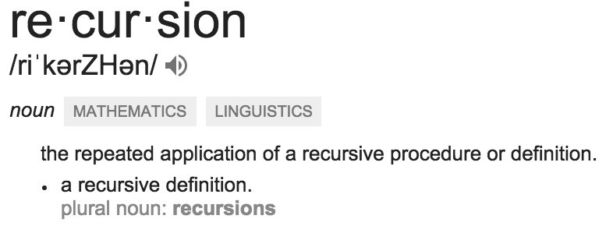
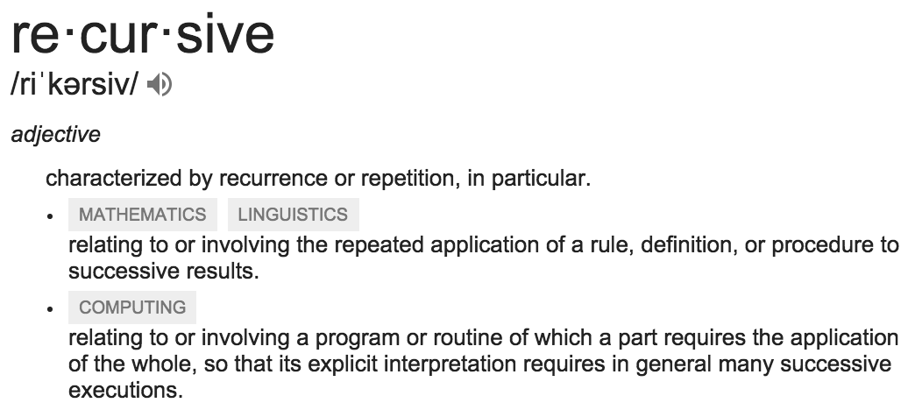
Today: Recursion
Recursive function calls itself, directly or indirectly

Slide 4
Administrative Issues
Windows conda install resolved ???
Project 1 due Wednesday
Tourney play to take place in stages
Early rounds prior to Monday 2/29
Final rounds in lab !!!
PreSeason games anyone?
Midterm Friday 3/4 5-7 pm
Review next week
HW 03 out today

Slide 5
Review: Higher Order Functions
Functions that operate on functions
A function
A function that takes a function arg
def odd(x):
return x%2
>>> odd(3)
1
Why is this not ‘odd’ ?
def filter(fun, s):
return [x for x in s if fun(x)]
>>> filter(odd, [0,1,2,3,4,5,6,7])
[1, 3, 5, 7]

Slide 6
Review Higher Order Functions (cont)
A function that returns (makes) a function
def leq_maker(c):
def leq(val):
return val <= c
return leq
>>> leq_maker(3)
<function leq_maker.<locals>.leq at 0x1019d8c80>
>>> leq_maker(3)(4)
False
>>> filter(leq_maker(3), [0,1,2,3,4,5,6,7])
[0, 1, 2, 3]
>>>

Slide 7
One more example
What does this function do?
def split_fun(p, s):
””” Returns <you fill this in>."""
return [i for i in s if p(i)], [i for i in s if not p(i)]
>>> split_fun(leq_maker(3), [0,1,2,3,4,5,6])
([0, 1, 2, 3], [4, 5, 6])

Slide 8
Recursion Key concepts – by example
1. Test for simple “base” case
2. Solution in simple “base” case
def sum_of_squares(n):
if n < 1:
return 0
else:
return n**2 + sum_of_squares(n-1)
4. Transform soln of simpler problem into full soln
3. Assume recusive solution to simpler problem
Linear recursion

Slide 9
In words
The sum of no numbers is zero
The sum of 1² through n² is n² plus the sum of 1² through (n-1)²
def sum_of_squares(n):
if n < 1:
return 0
else:
return n**2 + sum_of_squares(n-1)

Slide 10
Why does it work
sum_of_squares(3)
# sum_of_squares(3) => 3**2 + sum_of_squares(2)
# => 3**2 + 2**2 + sum_of_squares(1)
# => 3**2 + 2**2 + 1**2 + sum_of_squares(0)
# => 3**2 + 2**2 + 1**2 + 0 = 14

Slide 11
How does it work?
Each recursive call gets its own local variables
Just like any other function call
Computes its result (possibly using additional calls)
Just like any other function call
Returns its result and returns control to its caller
Just like any other function call
The function that is called happens to be itself
Called on a simpler problem
Eventually bottoms out on the simple base case
Reason about correctness “by induction”
Solve a base case
Assuming a solution to a smaller problem, extend it

Slide 12
Local variables
def sum_of_squares(n):
n_squared = n**2
if n < 1:
return 0
else:
return n_squared + sum_of_squares(n-1)
Each call has its own “frame” of local variables
What about globals?
Let’s see the environment diagrams

Slide 13
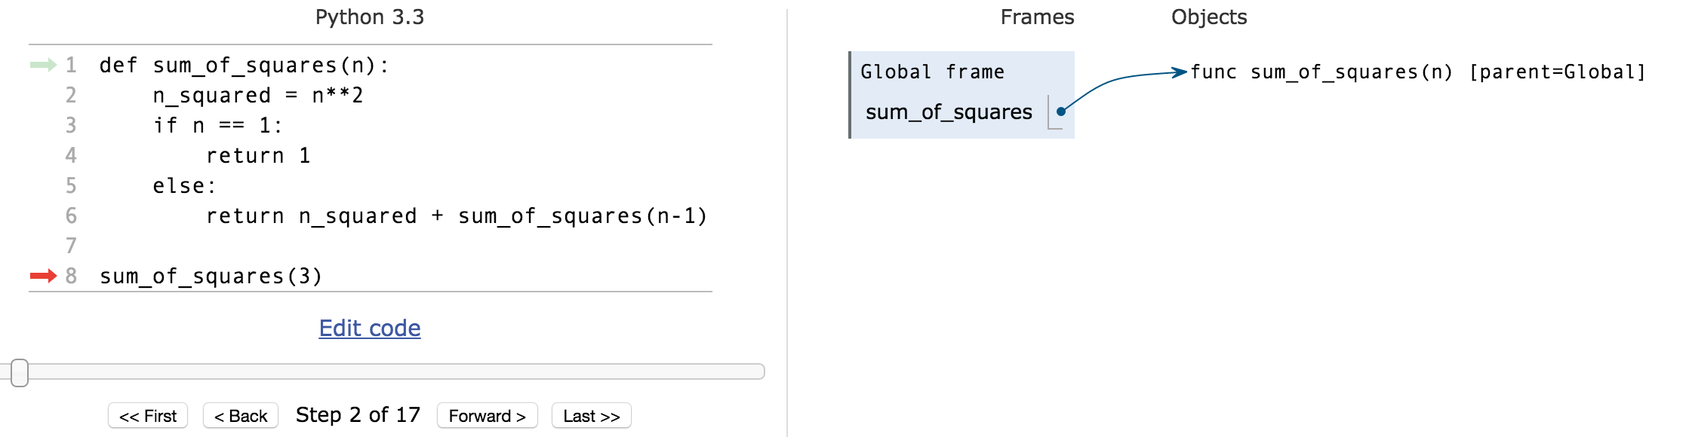
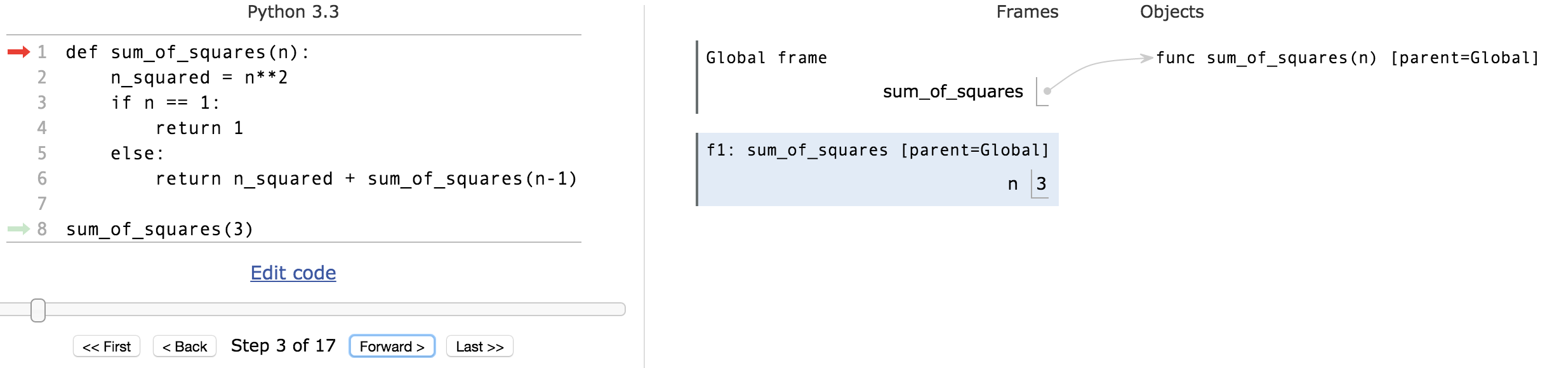
Environments Example
pythontutor.com

Slide 14
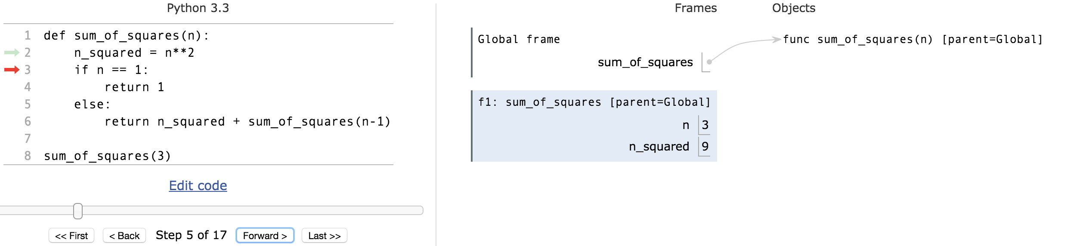
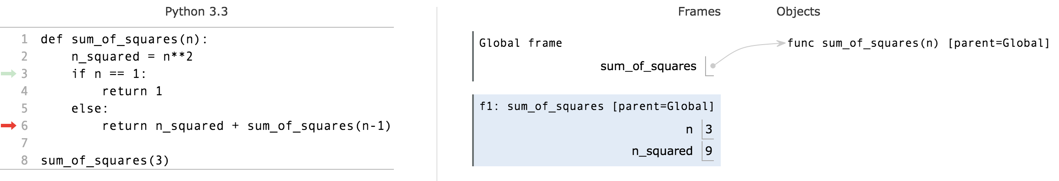
Environments Example

Slide 15
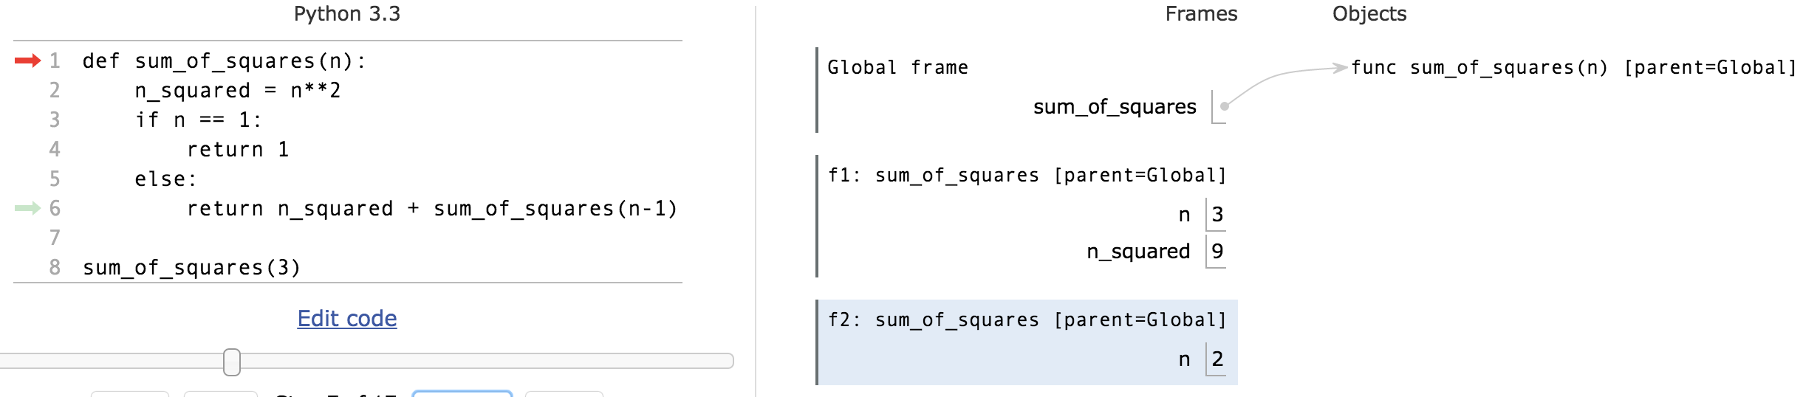
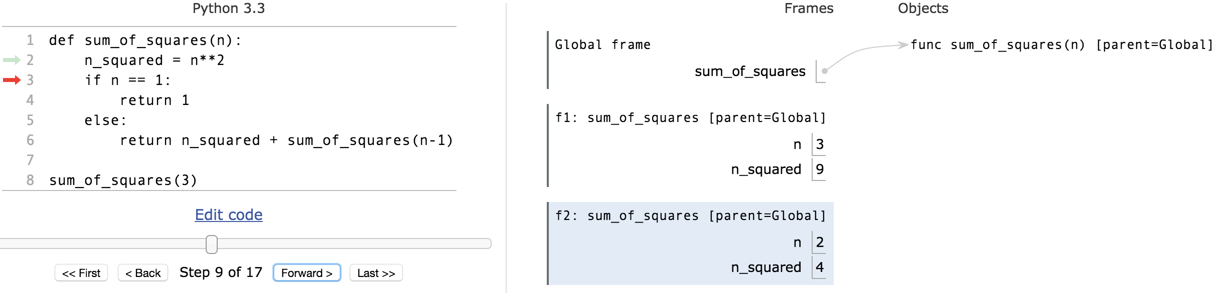
Environments Example

Slide 16
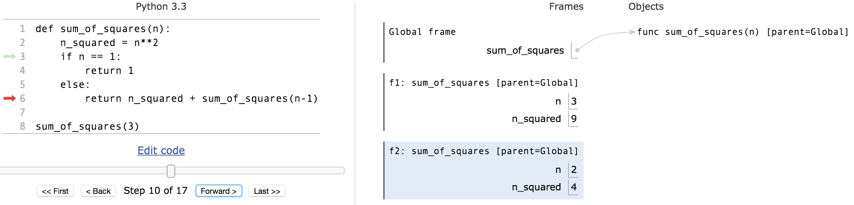
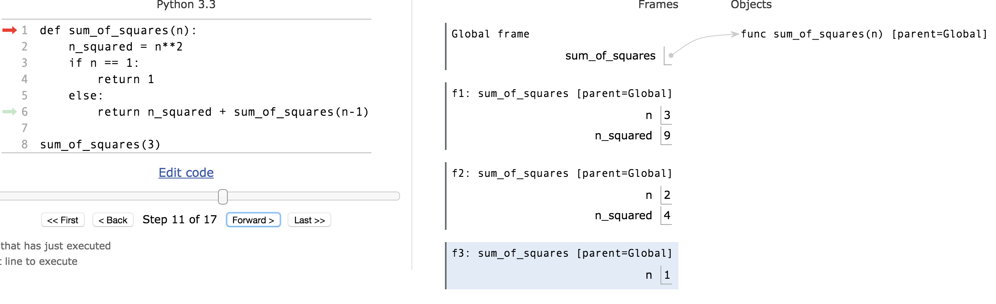
Environments Example

Slide 17
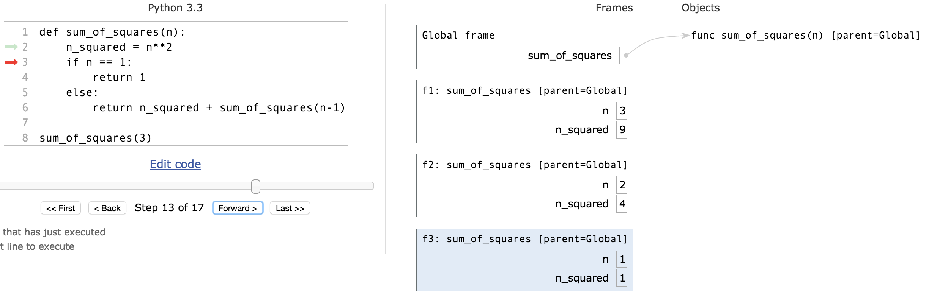
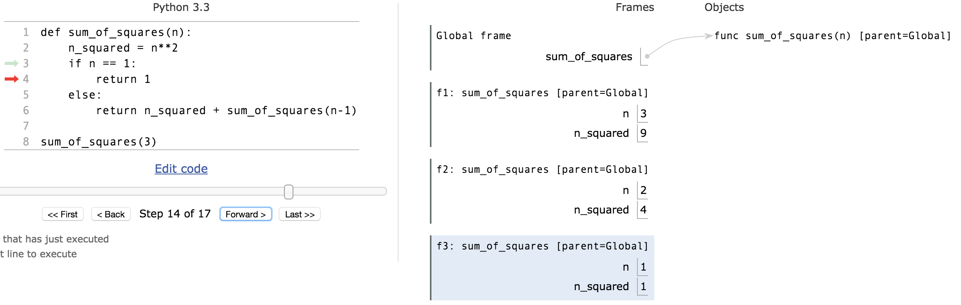
Environments Example
permlink

Slide 18
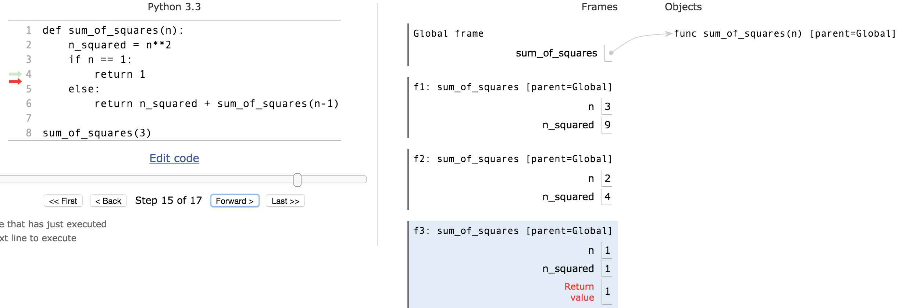
Environments Example

Slide 19
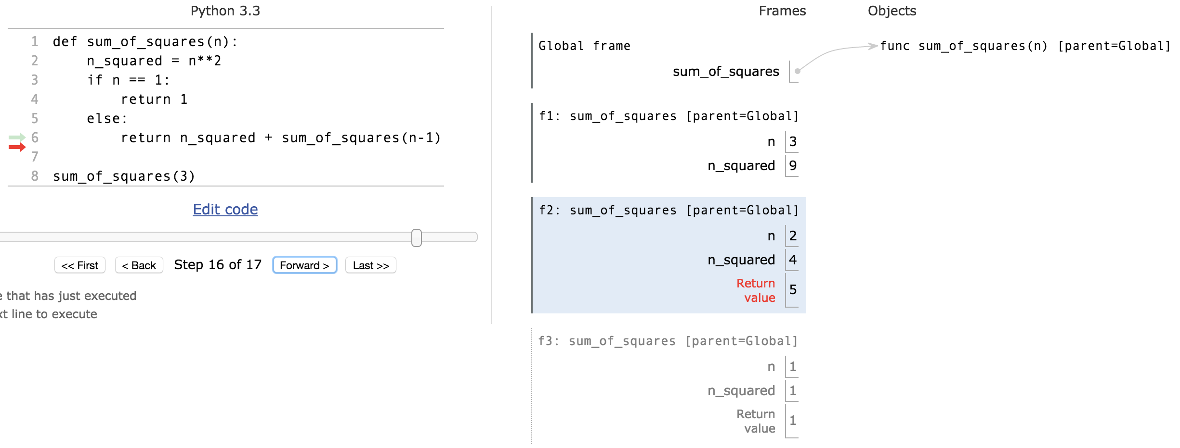
Environments Example

Slide 20
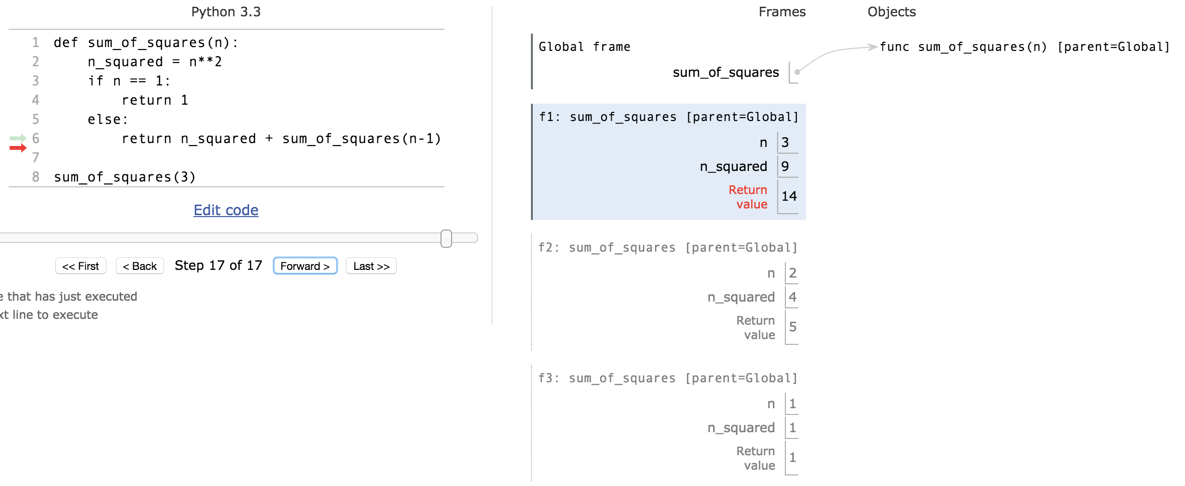
Environments Example

Slide 21
Questions
In what order do we sum the squares ?
How does this compare to iterative approach ?
def sum_of_squares(n):
accum = 0
for i in range(1,n+1):
accum = accum + i*i
return accum

Slide 22
Another Example
def first(s):
"""Return the first element in a sequence."""
return s[0]
def rest(s):
"""Return all elements in a sequence after the first"""
return s[1:]
def min_r(s):
“””Return minimum value in a sequence.”””
if len(s) == 1:
return first(s)
else:
return min(first(s), min_r(rest(s)))
Base Case
Recursive Case
Recursion over sequence length, rather than number magnitude

Slide 23
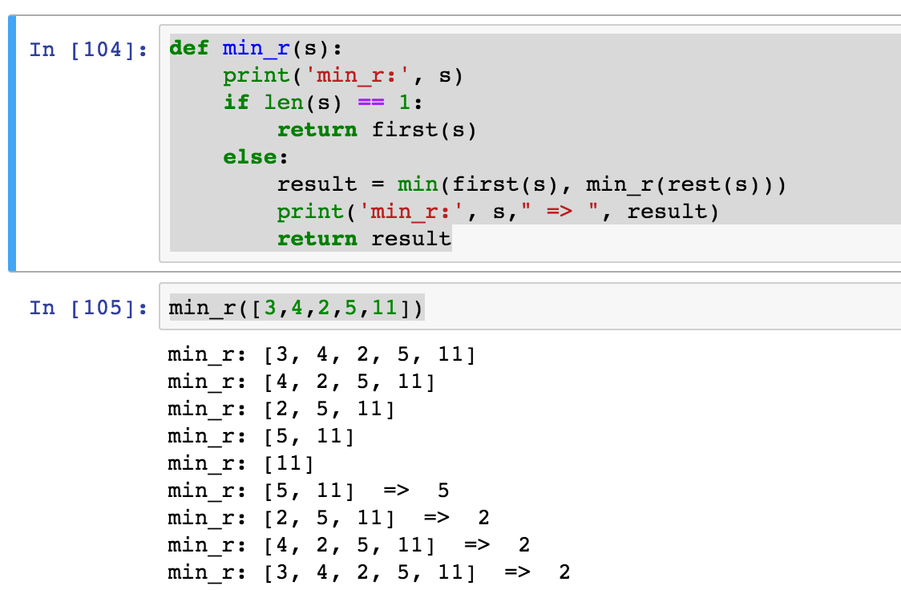
Visualize its behavior (print)
What about sum?
Don’t confuse print with return value

Slide 24
Recursion with Higher Order Fun
def map(f, s):
if not s:
return []
else:
return [f(first(s))] + map(f, rest(s))
def square(x):
return x**2
>>> map(square, [2,4,6])
[4, 16, 36]
Base Case
Recursive Case
Divide and conquer

Slide 25
Trust …
The recursive “leap of faith” works as long as we hit the base case eventually

Slide 26
How much ???
Time is required to compute sum_of_squares(n)?
Recursively?
Iteratively ?
Space is required to compute sum_of_squares(n)?
Recursively?
Iteratively ?
Count the frames…
Recursive is linear, iterative is constant !
And what about the order of evaluation ?
Linear
proportional to n
cn for some c

Slide 27
Tail Recursion
All the work happens on the way down the recursion
On the way back up, just return
def sum_up_squares(i, n, accum):
"""Sum the squares from i to n in incr. order"""
if i > n:
return accum
else:
return sum_up_squares(i+1, n, accum + i**2)
>>> sum_up_squares(1,3,0)
14
Base Case
Tail Recursive Case

Slide 28
Using HOF to preserve interface
def sum_of_squares(n):
def sum_upper(i, accum):
if i > n:
return accum
else:
return sum_upper(i+1, accum + i*i)
return sum_upper(1,0)
What are the globals and locals in a call to sum_upper?
Try python tutor
Lexical (static) nesting of function def within def - vs
Dynamic nesting of function call within call

Slide 29
Tree Recursion
Break the problem into multiple smaller sub-problems, and Solve them recursively
def split(x, s):
return [i for i in s if i <= x], [i for i in s if i > x]
def qsort(s):
"""Sort a sequence - split it by the first element,
sort both parts and put them back together."””
if not s:
return []
else:
pivot = first(s)
lessor, more = split(pivot, rest(s))
return qsort(lessor) + [pivot] + qsort(more)
>>> qsort([3,3,1,4,5,4,3,2,1,17])
[1, 1, 2, 3, 3, 3, 4, 4, 5, 17]

Slide 30
QuickSort Example
[3, 3, 1, 4, 5, 4, 3, 2, 1, 17]
[3, 1, 3, 2, 1]
[4, 5, 4, 17]
[1, 3, 2, 1]
[]
[4]
[5, 17]
[1]
[3, 2]
[]
[]
[]
[17]
[]
[]
[2]
[]
[4]
[]
[]
[1]
[]
[]
[5, 17]
[2, 3]
[4, 4, 5, 17]
[1, 1, 2, 3]
[1, 1, 2, 3, 3]
[1, 1, 2, 3, 3, 3, 4, 4, 5, 17]

Slide 31
Tree Recursion with HOF
def qsort(s):
"""Sort a sequence - split it by the first element,
sort both parts and put them back together.""”
if not s:
return []
else:
pivot = first(s)
lessor, more = split_fun(leq_maker(pivot), rest(s))
return qsort(lessor) + [pivot] + qsort(more)
>>> qsort([3,3,1,4,5,4,3,2,1,17])
[1, 1, 2, 3, 3, 3, 4, 4, 5, 17]

