Slide 1
Advanced Data Analysis I
Simple Regression
PA 541 Week 3
Michael D. Siciliano
Department of Public Administration
College of Urban Planning and Public Affairs

Slide 2
Overview
Today’s class will provide:
a look at different types of data
brief coverage of basic data handling techniques in R
a review of simple regression, and
a look at simple regression assumptions.
Note, some of the items discussed by Wooldridge in ch. 2 will not be covered this week. Rather, these items will be covered in more detail later in the semester. This includes the topics on unit of measurement and functional form that were presented in section 2.4.
At the end of class, we will spend some time working with data and running simple regressions. We will assign you to breakout rooms based on your final project groups.

Slide 3
Admin Stuff
I will post first homework this week. It will be due on February 8th.
Homework will cover data wrangling and basic regression models and interpretation.

Slide 4
Starter Question
Assume I have some outcome variable Y, and I generate 100 independent variables at random. How many of those 100 independent variables will have a significant correlation (p < .05) with Y?
About “snooping” and spurious findings.
This also highlights potential problems with “big data” and data mining.
And connects to how we understand a p-value.

Slide 5
set.seed(1827)
a.random = rnorm(50)
b.data = data.frame(replicate(100, rnorm(50)))
cor.size = vector()
for (i in 1: 100)
cor.size[i] = cor.test(a.random, b.data[,i])$estimate
cor.results = vector()
for (i in 1: 100)
cor.results[i] = cor.test(a.random, b.data[,i])$p.value

Slide 6
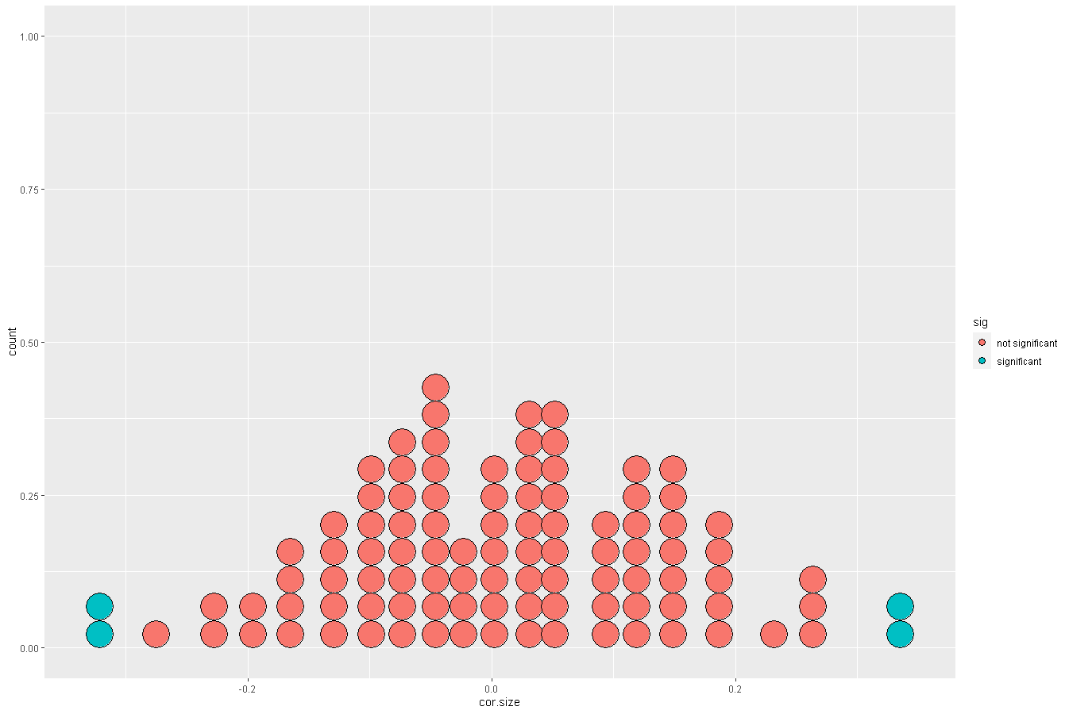

Slide 7
Types of datasets

Slide 8
Econometric/Statistical analysis requires data!
Different kinds of datasets exist and include:
Cross-sectional data
Time series data
Pooled cross-sectional data
Panel/Longitudinal data
Econometric methods depend on the nature of the data used.
Use of inappropriate methods may lead to misleading results.

Slide 9
Cross-sectional data sets
Sample of individuals, households, firms, cities, states, countries, or other units of interest at a given point of time/in a given period.
Cross-sectional observations are more or less independent.
For example, pure random sampling from a population.
Sometimes pure random sampling is violated, e.g. units refuse to respond in surveys, or if sampling is characterized by clustering.
For example, we sample students in 10 different classrooms or 10 different neighborhoods.
Cross-sectional data are typically the most commonly found data in various fields of research.
We will work with cross-sectional data for both continuos and discrete outcomes.

Slide 10
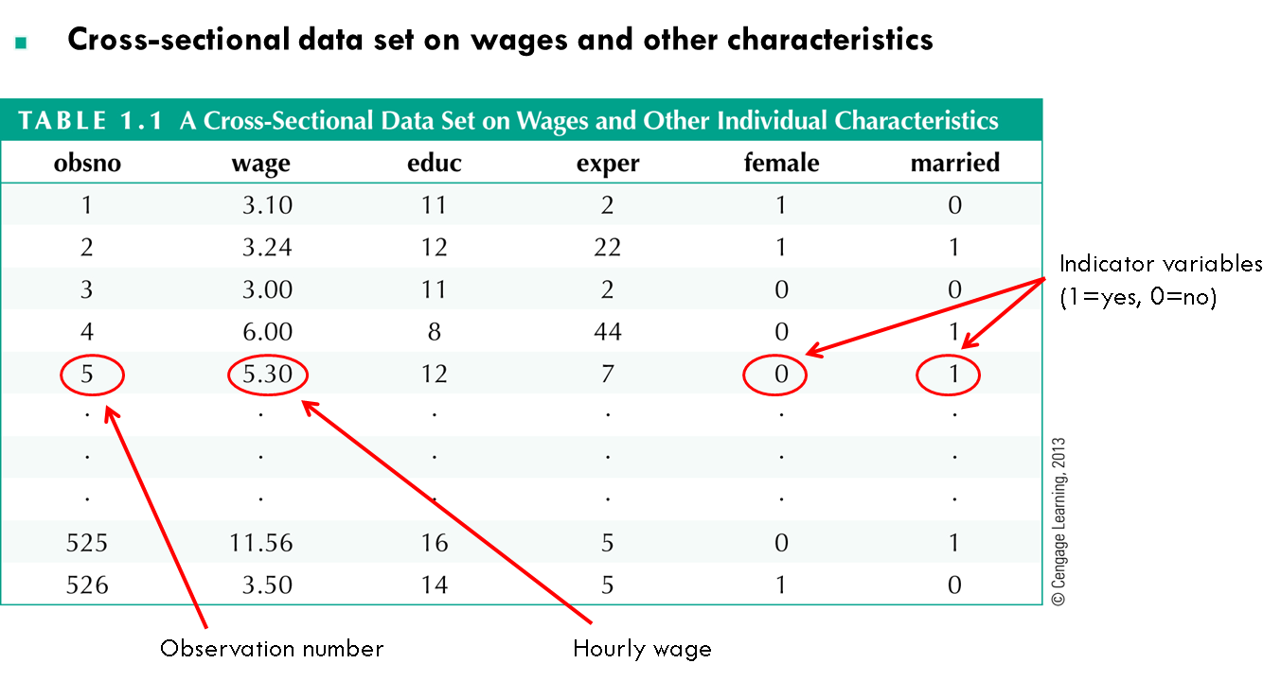

Slide 11
Time series data
Time Series data consists of observations on a variable or several variables over time. Examples of time series data include stock prices, money supply, consumer price index, gross domestic product, annual homicide rates, and automobile sales.
Because past events can influence future events and lags in behavior are prevalent in the social sciences, time is an important dimension in a time series data set. Unlike the arrangement of cross-sectional data, the chronological ordering of observations conveys important information.
The key feature that makes time series data more difficult to analyze than cross-sectional data is the fact that observations of social phenomena are rarely, if ever, assumed to be independent across time.

Slide 12
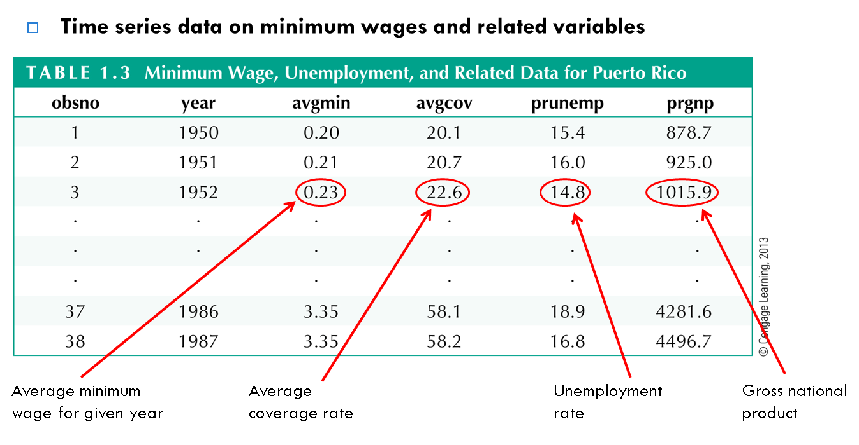

Slide 13
Pooled cross-sectional data
Pooled Cross Section have both cross-sectional and time series features. For example, suppose that two cross-sectional surveys of nonprofits are taken in the US, one in 2008 and one in 2018.
Pooling cross sections from different years is often an effective way of analyzing the effects of a new government policy. The idea is to collect data from the years before and after a key policy change.
We will look at examples of after the midterm.
A Pooled cross-section is analyzed much like a standard cross-section, except that we often need to account for differences in the variables across time.

Slide 14
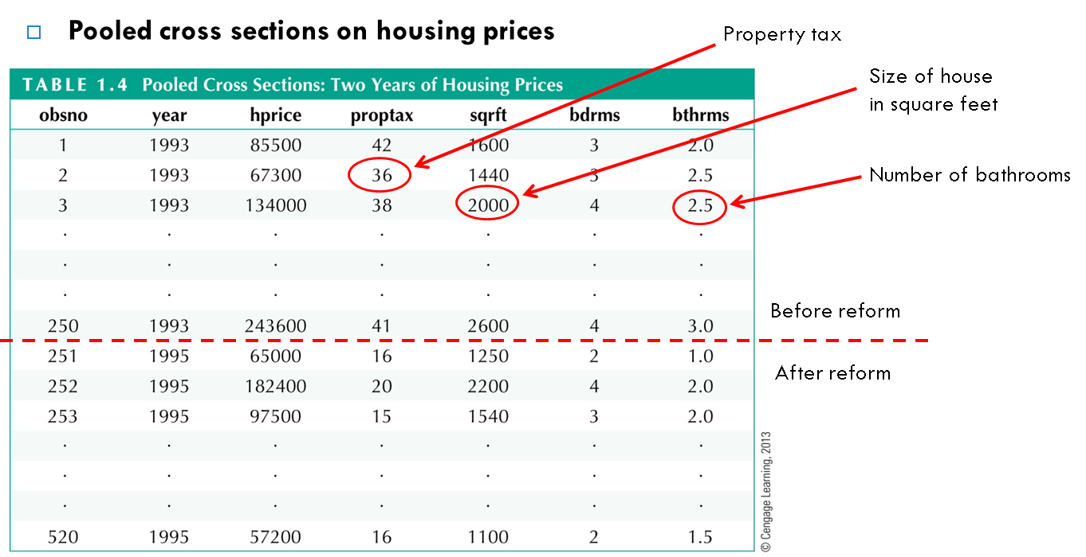

Slide 15
Panel or longitudinal data
Panel data consists of a time series for each cross-sectional member in the data set.
The key feature of panel data that distinguishes it from a pooled cross section is the fact that the same cross-sectional units (individuals, firms, counties, etc…) are followed over a given time period.
Example:
City crime statistics; each city is observed over several years
Time-invariant unobserved city characteristics may be modeled
Effect of police on crime rates may exhibit time lag
We will work with panel data and panel data models in week 14.

Slide 16
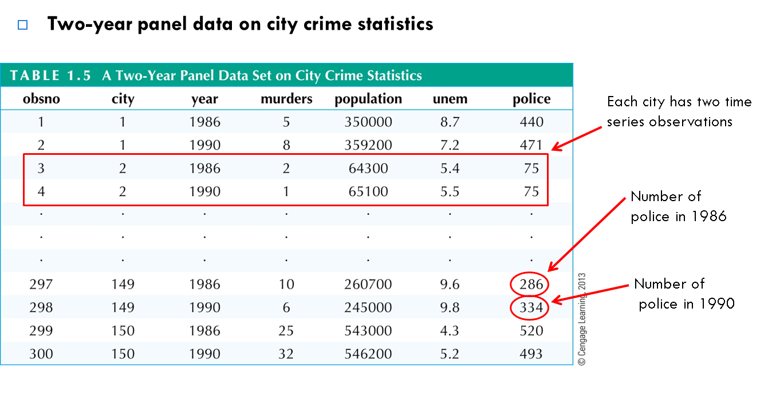

Slide 17
Data Management

Slide 18
Topics
Let’s make sure you can do the following steps in R:
Set working directory
Load packages you will need
Read in the data
Then we will go over some critical data management techniques in R such as:
Merging two dataframes
Creating new variables (already discussed with mutate)
Recoding variables
Creating a factor variable
Missing values and recoding missing values

Slide 19
Dataset we will work with: ‘pima’
Description
The National Institute of Diabetes and Digestive and Kidney Diseases conducted a study on 768 adult female Pima Indians living near Phoenix.
Format
The dataset contains the following variables:
pregnant Number of times pregnant
glucose Plasma glucose concentration at 2 hours in an oral glucose tolerance test
diastolic Diastolic blood pressure (mm Hg)
triceps Triceps skin fold thickness (mm)
insulin 2-Hour serum insulin (mu U/ml)
bmi Body mass index (weight in kg/(height in metres squared))
diabetes Diabetes pedigree function (based on relatives or siblings having diabetes)
age Age (years)
test test whether the patient shows signs of diabetes (coded 0 if negative, 1 if positive)

Slide 20
Let’s switch over to R

Slide 21
Bivariate Regression and Interpretation

Slide 22
Simple Regression
“What is the relationship between variable X and variable Y?”
We can use regression to answer this question.
Two variables X and Y may be related to each other exactly (as often in the physical sciences) or inexactly (as so often in the social sciences).
Y = a + bX where the values of the coefficients, a and b, determine the intercept and slope of the line relating X to Y.

Slide 23

Simple Regression
Y = a + bX
‘a’ is referred to as the constant or intercept term and ‘b’ is referred to as the slope. It is just the formula for a line.
Because relationships in the social science are inexact the equation is more realistically written as Y = a +bX + e where ‘e’ simply represents the presence of error.
In this class, we see it written as:
$Y_{i}= β_{0}+ β_{1}X_{i}+ e_{i}$

Slide 24

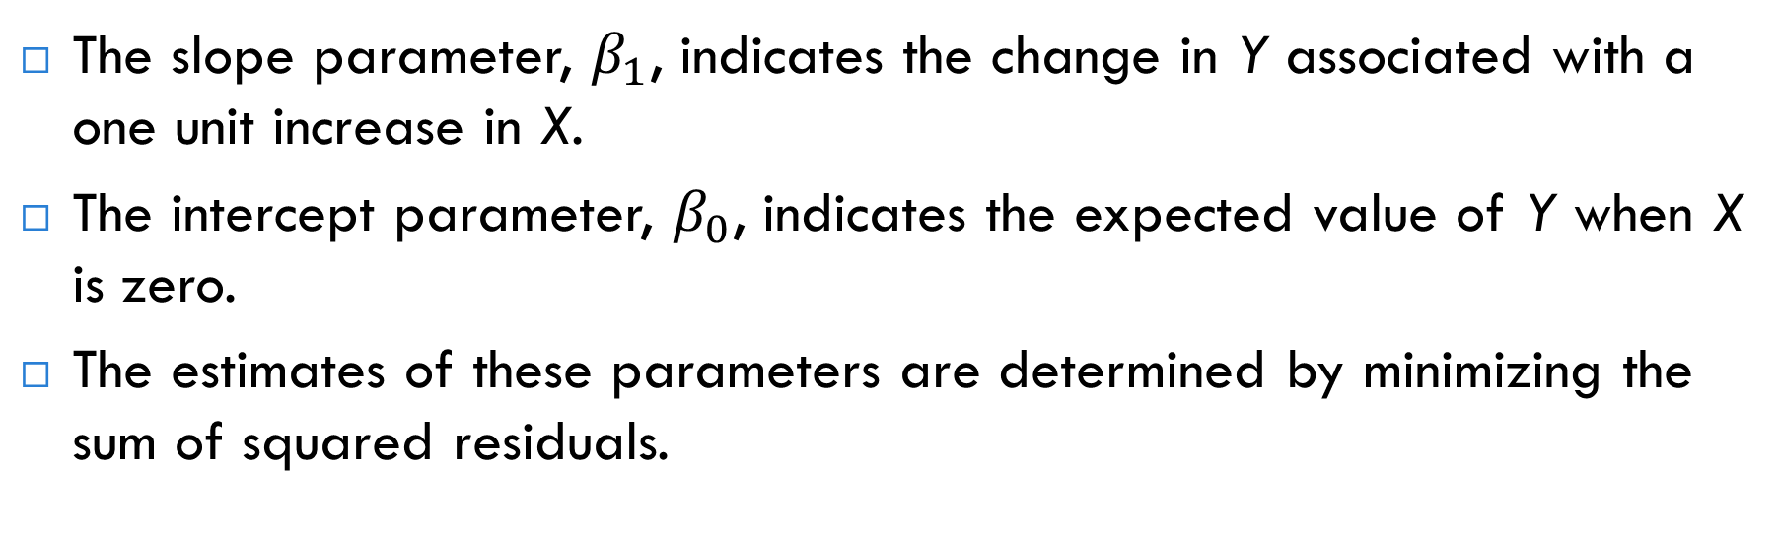
Bivariate Regression Model
$Y_{i}= β_{0}+ β_{1}X_{i}+ e_{i}$
The slope parameter, $β_{1}$, indicates the change in Y associated with a one unit increase in X.
The intercept parameter, $β_{0}$, indicates the expected value of Y when X is zero.
The estimates of these parameters are determined by minimizing the sum of squared residuals.

Slide 25
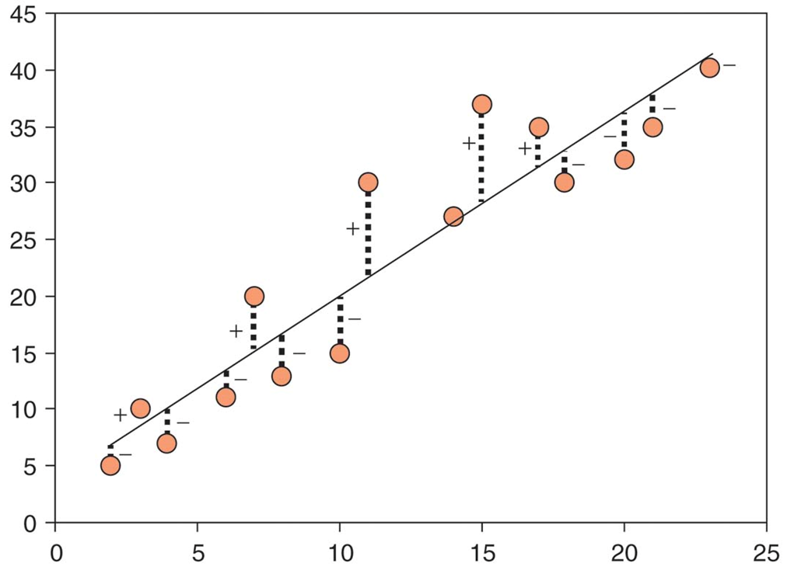
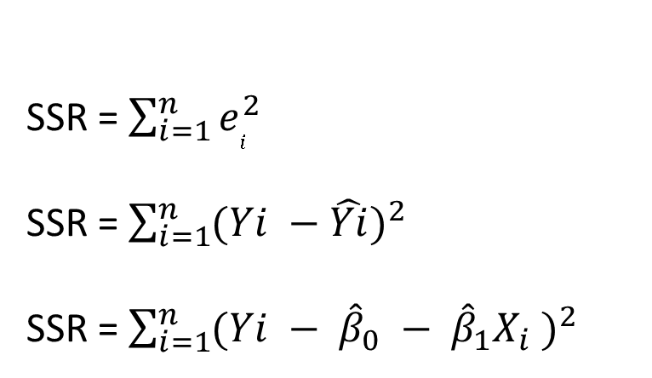
Finding the optimal values for our coefficients requires us to minimize the sum of squared residuals (this is the ordinary least squares estimate).
SSR = $\sum_{i=1}^{n}{e_{i}^{2}}$
SSR = $\sum_{i=1}^{n}{(Yi −\hat{Yi})^{2}}$
SSR = $\sum_{i=1}^{n}{(Yi − {\hat{β}}_{0} − {\hat{β}}_{1}X_{i} )^{2}}$

Slide 26
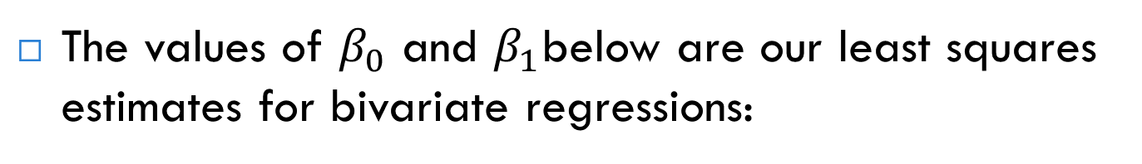

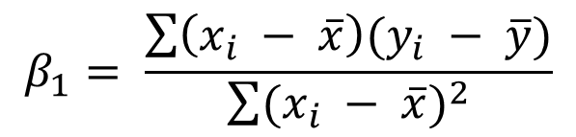
Calculating the coefficients
The values of $β_{0}$ and $β_{1}$below are our least squares estimates for bivariate regressions:
$$β_{1}= \frac{\sum{\left(x_{i} − \overline{x}\right)(y_{i} − \overline{y})}}{\sum{(x_{i} − \overline{x})^{2}}}$$
$$β_{0}= \overline{y} − β_{1}\overline{x}$$
Two things to remember about the beta-hats: they are random variables and are normally distributed (due to the CLT).

Slide 27
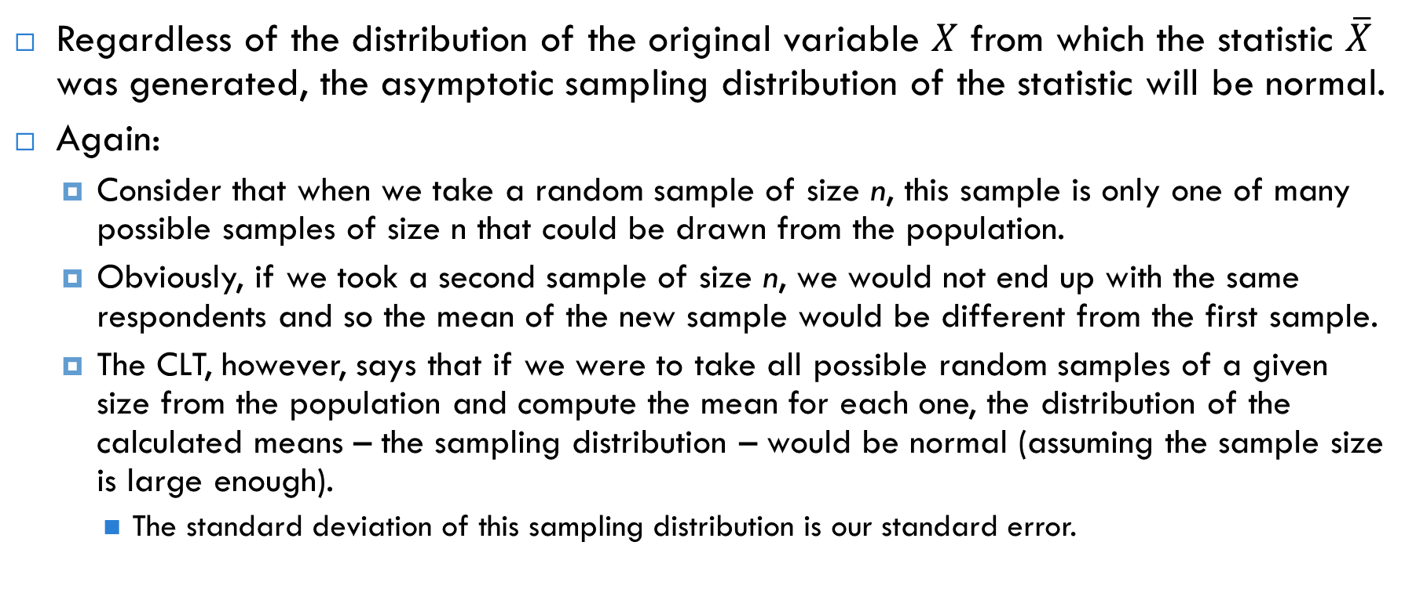
Central Limit Theorem
Regardless of the distribution of the original variable $X$ from which the statistic $\overline{X}$ was generated, the asymptotic sampling distribution of the statistic will be normal.
Again:
Consider that when we take a random sample of size n, this sample is only one of many possible samples of size n that could be drawn from the population.
Obviously, if we took a second sample of size n, we would not end up with the same respondents and so the mean of the new sample would be different from the first sample.
The CLT, however, says that if we were to take all possible random samples of a given size from the population and compute the mean for each one, the distribution of the calculated means – the sampling distribution – would be normal (assuming the sample size is large enough).
The standard deviation of this sampling distribution is our standard error.

Slide 28
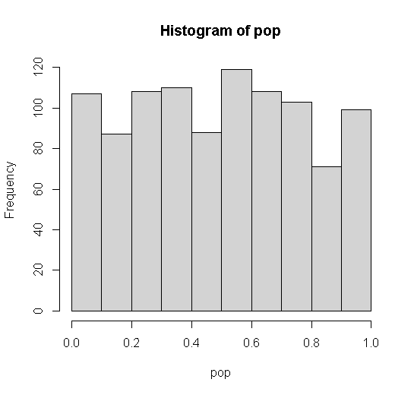
Demonstrating the CLT
pop=runif(1000, 0,1)
hist(pop)

Slide 29
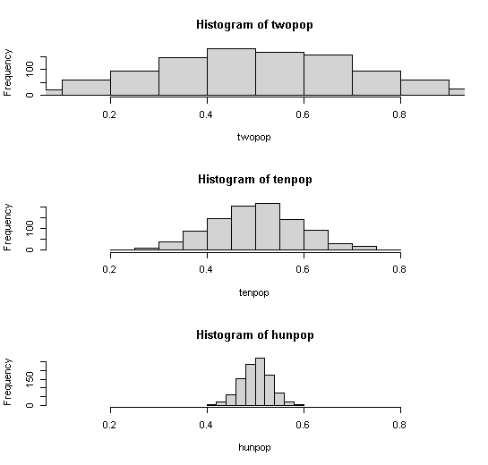
twopop=vector()
for (i in 1:1000) twopop[i]= mean(runif(2, 0,1))
tenpop=vector()
for (i in 1:1000) tenpop[i]= mean(runif(10, 0,1))
hunpop=vector()
for (i in 1:1000) hunpop[i]= mean(runif(100, 0,1))

Slide 30
Simple Regression Example
What is the relationship between CEO salary and the company’s average return on equity. Data consists of 209 observations on companies taken from Business Week in 1990.
Salary is measured in $1,000s.
ROE is defined in terms of net income as a percentage of common (shareholder) equity. Measured as a percent, not a decimal.
Dataset and discussion of data adapted from Wooldridge “Introductory Econometrics”.

Slide 31
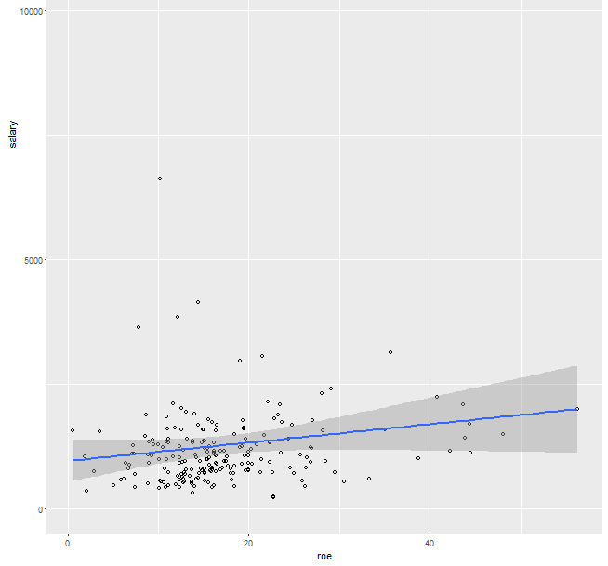
Looking at the Data Visually

Slide 32

Run a simple regression
What is the predicted salary for a CEO in a company with an ROE of 30%. 963.18 + 18.50(30) = 1,518.18 = $1,518,180
Clearly, this does not mean that any CEO in a company with an ROE of 30 will earn that salary. This is simply our prediction given our model.
There may be many other things that can impact salary.

Slide 33
Model evaluation (Pardoe 2012)
There are three standard and interrelated ways for evaluating numerically how well a simple linear regression fits our sample data.
The methods can be categorized by the type of question they were designed to answer:
Coefficient of determination (R²): How much of the variability in Y have we been able to explain with our model?
Residual or regression standard error: How close are the actual observed Y-values to the model-based fitted values?
Slope parameter (and p-value): How strong is the evidence of a linear association between Y and X?

Slide 34

1. Coefficient of determination (R²)
If we have no predictor variables, then our best guess for predicting an individual Y-value is simply the mean.
When this is our model, we can calculate the total amount of error in our model – one approach for doing this is the sum of squares total (SST).
SST is simply a measure of the amount of variability in our dependent variable. It is this variability that we hope to explain through an improved model (i.e., one that just doesn’t guess the mean).

Slide 35
Predicted Values and Residuals
When we add predictor variables to our model, we are provided with a more informed prediction of a given Y-value.
When we run a regression, we obtain a predicted or fitted value for each of our observations based on the sample of data we have collected.
By definition, each of our fitted values falls on our regression line – remember we are establishing a linear relationship between two variables.
If the residual is negative, then the observed value falls below the regression line; if it is positive, the observed value falls above the regression line.

Slide 36
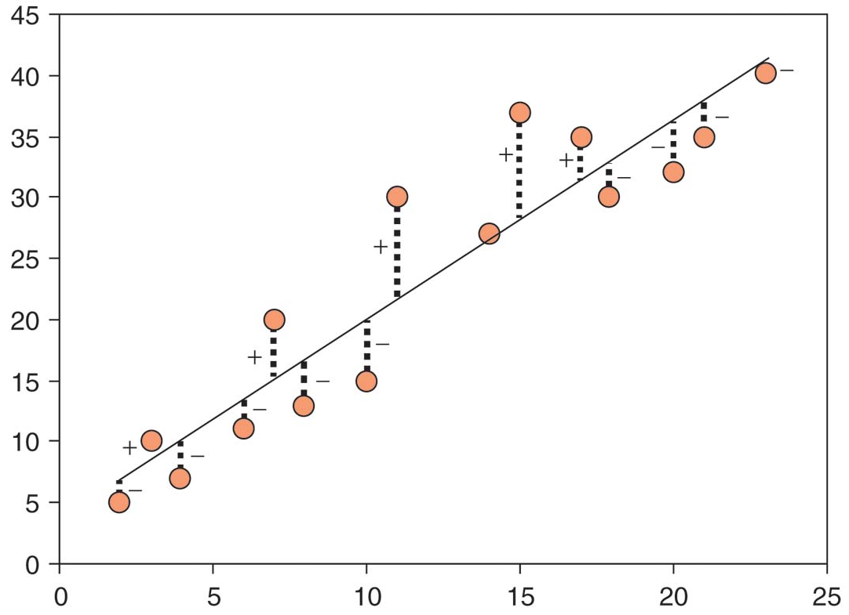
Predicted Values and Residuals cont…
Diagram taken from Andy Field’s “Discovering Statistics Using SPSS”.

Slide 37
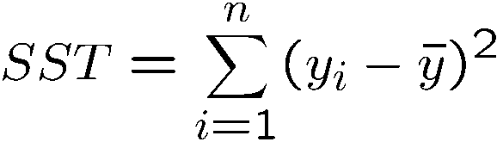
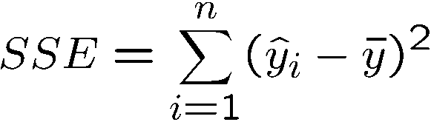
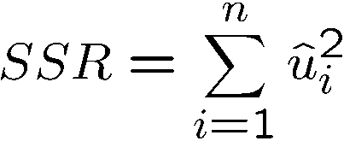
Breaking Down the Variation in The Dependent Variable
Three measures of variation in our simple regression model:
SST: Total sum of squares
SSM: Model Sum of Squares (Explained Sum of Square)
SSR: Residual Sum of Squares (Error Sum of Squares)
SST = SSM + SSR
M
Total sum of squares,
represents total variation
in dependent variable
Model/Explained sum of squares,
represents variation
explained by regression
Residual sum of squares,
represents variation not
explained by regression

Slide 38
Goodness of Fit
R-Squared of the regression is often referred to as the coefficient of determination.
R² = SSM/SST or equivalently SST-SSR / SST
R-squared is the ratio of explained variation to the total variation. In other words, it is the fraction of the sample variation in Y (salary) that can be explained by X (roe).

Slide 39
Looking at these values using the CEO data
M
Total sum of squares,
represents total variation
in dependent variable
Explained sum of squares,
represents variation
explained by regression
Residual sum of squares,
represents variation not
explained by regression

Slide 40
R-Squared in our data set
The R-square here is simply:
SSM/SST = 5166419/391732982
Firms return on equity is only explaining 1.3% of the variation in salaries among the 209 CEOs. Thus, 98.7% of the variation remains unexplained.
This lack of explanatory power is not surprising – many other characteristics of the firm and the CEO affect salary.
Note: In the social sciences low R-squares are not uncommon – especially in cross sectional data.

Slide 41
Another way to calculate the R², and where it derives its name, is the value is the square of the correlation between the fitted values and the actual values.
Correlation is often indicated with an “r”, so R² is simply the square of this value.

Slide 42

2. Residual standard error
The residual standard error (or regression standard error or root mean squared error) is the standard deviation of the observed Y values from their fitted values.
The value of s, the residual standard error, is in the same units of measurement as our dependent variable.
We can calculate a rough prediction uncertainty - approximately 95% of the observed Y-values lie within plus or minus 2s of their fitted values.

Slide 43

3. Significance of slope parameters
If a predictor variable significantly predicts the dependent variable than it should have a coefficient that is significantly different from zero. This hypothesis is tested using a t-test as noted by the output.
The t-statistic tests the null hypothesis that the value of the coefficient is zero; therefore, if it is significant, we conclude that it contributes to our ability to estimate the outcome.
How do we interpret the intercept and slope here?

Slide 44
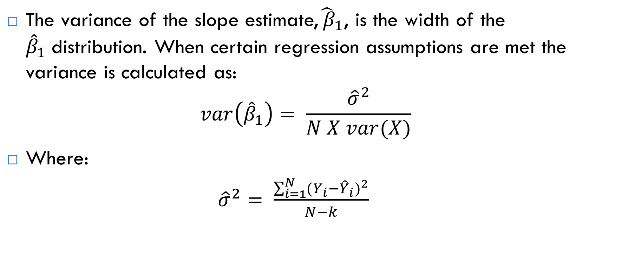
Precision of the slope estimates
The variance of the slope estimate,${\hat{ β}}_{1}$, is the width of the ${\hat{β}}_{1}$distribution. When certain regression assumptions are met the variance is calculated as: $var\left({\hat{β}}_{1}\right)= \frac{{\hat{σ}}^{2}}{N X var(X)}$
Where:
${\hat{σ}}^{2}= \frac{\sum_{i=1}^{N}{(Y_{i}−{\hat{Y}}_{i})^{2}}}{N−k}$

Slide 45
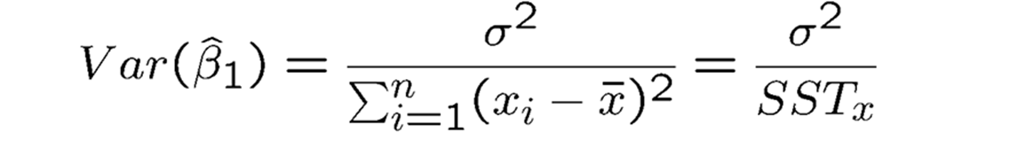
Precision of the slope estimates
Alternative formula:

Slide 46
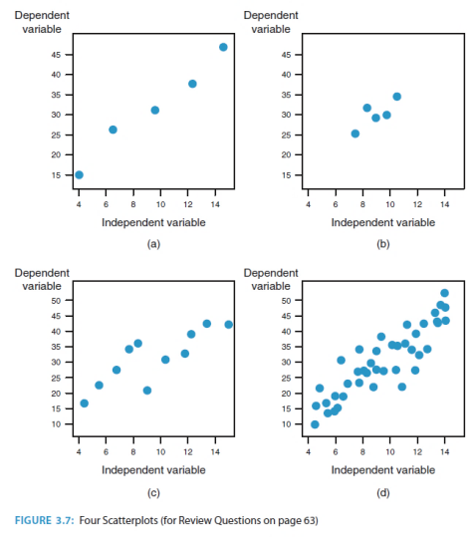
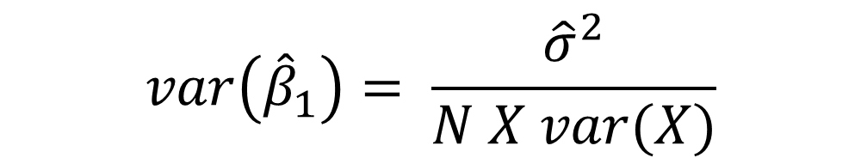
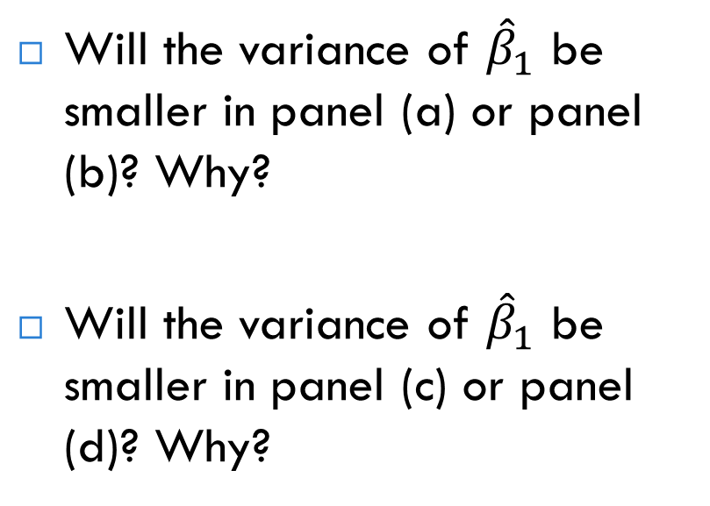
$$var\left({\hat{β}}_{1}\right)= \frac{{\hat{σ}}^{2}}{N X var(X)}$$
Will the variance of ${\hat{β}}_{1}$ be smaller in panel (a) or panel (b)? Why?
Will the variance of ${\hat{β}}_{1}$ be smaller in panel (c) or panel (d)? Why?
Bailey 2017

Slide 47
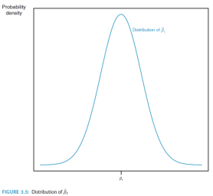
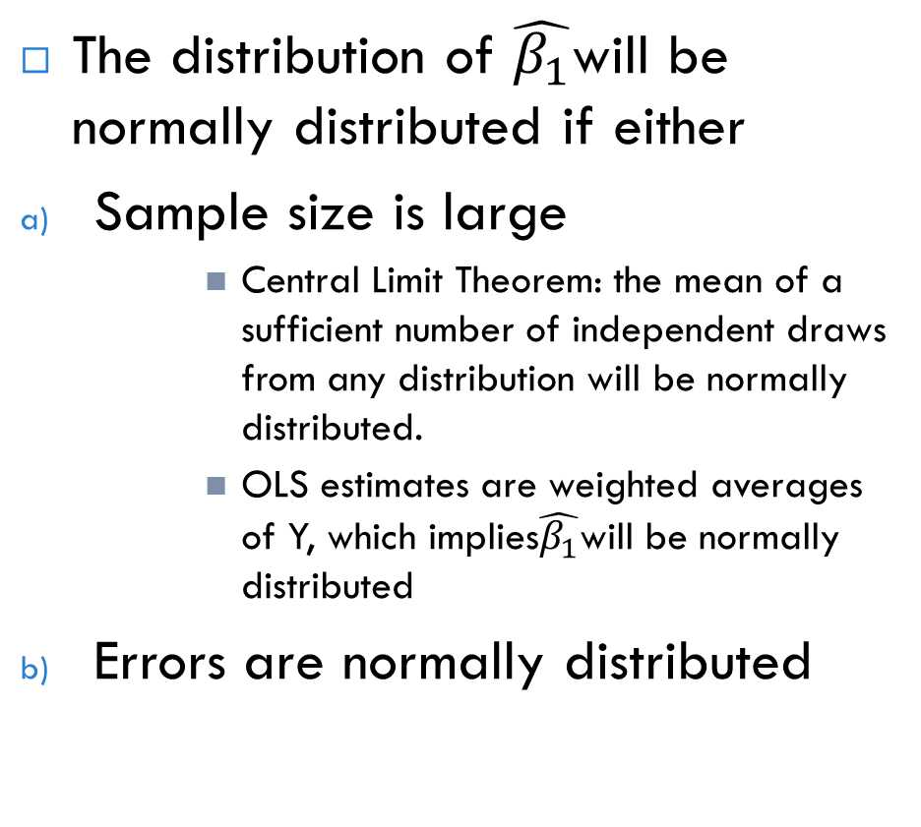
Distribution of coefficient estimates
The distribution of $\hat{β_{1}}$will be normally distributed if either
Sample size is large
Central Limit Theorem: the mean of a sufficient number of independent draws from any distribution will be normally distributed.
OLS estimates are weighted averages of Y, which implies$\hat{β_{1}}$will be normally distributed
Errors are normally distributed
Bailey 2017

Slide 48
A quick note on linear regression
In a linear model the parameters enter linearly – but the predictors themselves do not have to have a linear relationship. For example, the following is a linear model:
Y = β₀ + β₁X₁² + β₂logX₂ + β₃X₁X₂ +ε
Some relationships can be transformed to linearity.
While linear models may seem restrictive, they are quite flexible.
The predictors themselves can be transformed and combined in any way.
Linear models can handle complex datasets.
Linear models can also be curved (the relationship between X and Y does not need to be a straight line).

Slide 49
We will talk more about transformations and their interpretations later this semester.

Slide 50
Simple Regression Assumptions

Slide 51
Assumptions:
SLR.1 – Linear in parameters
SLR.2 – Data drawn from a random sample (i.e., the errors are independent - no autocorrelation in the data)
SLR.3 – Sample variation in the explanatory variable
SLR.4 – Zero conditional mean for the error term (most critical assumption of all and cannot be tested)
SLR.5 – Homoskedasticity (i.e., the errors have equal variance)

Slide 52


Standard assumptions for the linear regression model
Assumption SLR.1 (Linear in parameters)
Assumption SLR.2 (Random sampling)
In the population, the relationship
between y and x is linear
The data is a random sample
drawn from the population
Each data point therefore follows
the population equation

Slide 53
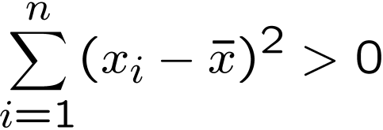

Assumptions for the linear regression model (cont.)
Assumption SLR.3 (Sample variation in explanatory variable)
Assumption SLR.4 (Zero conditional mean)
The values of the explanatory variables are not all
the same (otherwise it would be impossible to study
how different values of the explanatory variable
lead to different values of the dependent variable)
The value of the explanatory variable must contain no information about the mean of the unobserved factors

Slide 54

Assumption SLR.5 (Homoskedasticity)
The value of the explanatory variable must contain no information about the variability of the unobserved factors

Slide 55
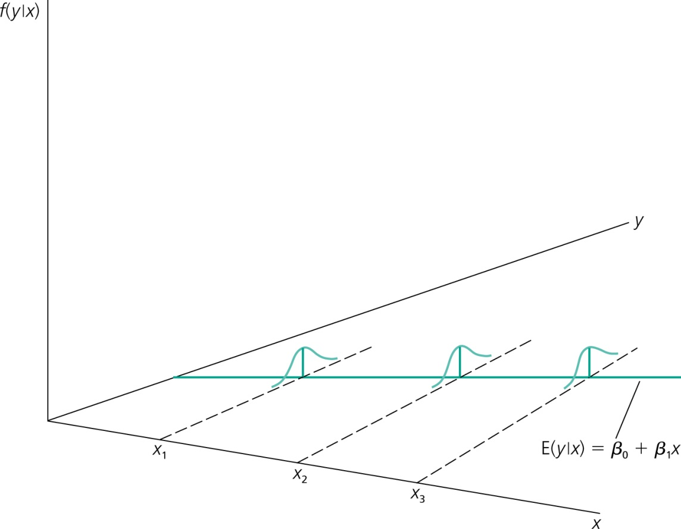
Graphical illustration of homoskedasticity
The variability of the unobserved
influences does not depend on the value of the explanatory variable

Slide 56
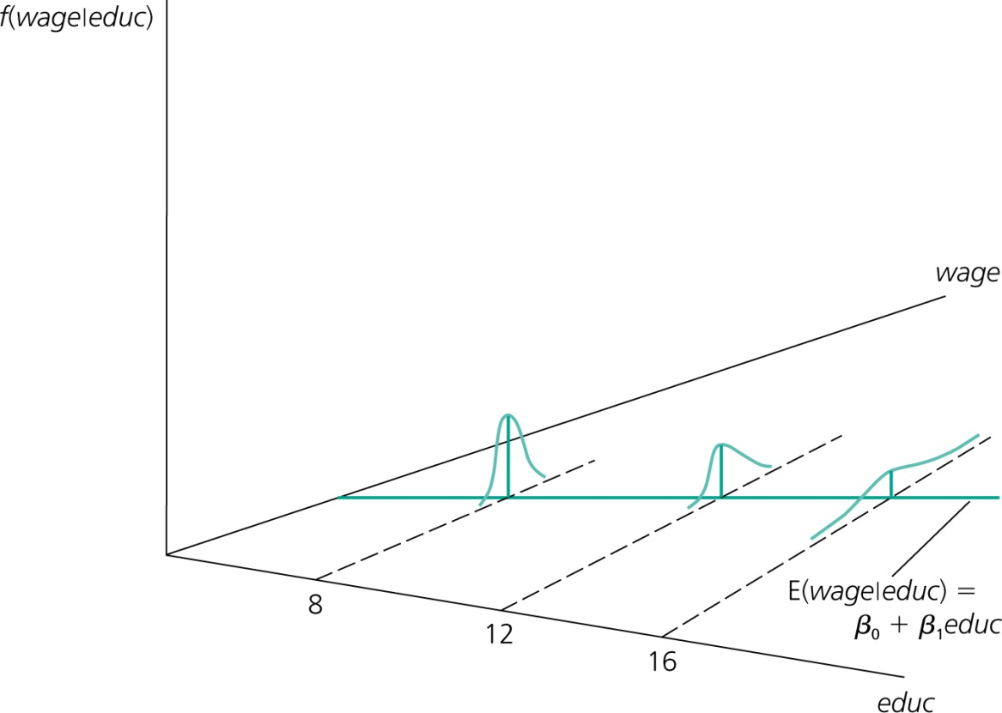
An example for heteroskedasticity: Wage and education
The variance of the unobserved determinants of wages increases
with the level of education

Slide 57
Two additional assumptions – validity and normality
According to Gelman and Hill (2007) the most important assumption of regression modeling is validity.
This means that the data you are analyzing should map to the research question you are trying to answer.
This sounds obvious but is often overlooked or ignored because it can be inconvenient. . . .

Slide 58
Normality
It is often assumed that our dependent variable needs to be normally distributed. This is not true. We want our errors to be normally distributed.
Note, we never actually see these errors as will be discussed below.
We can check and see if our residuals around the regression line are normally distributed (Cohen et al. 2003, p. 120).
Violations of the normality assumption do not lead to bias estimates of the regression coefficients.
The effect of violation of normality on significance tests and confidence intervals depends on the sample size, with problems occurring in small samples.
In large samples, nonnormality of the residuals does not lead to serious problems with the interpretation of either significance tests or confidence intervals.
However, nonnormal residuals are often an important sign of other problems in the regression model, such as model misspecification.

Slide 59
Visually inspecting regression assumptions

Slide 60
Visually inspecting regression assumptions
Through visualization we can inspect 4 key assumptions about the random errors in our model:
SLR.1 - linearity
SLR.2 – Data drawn from a random sample (i.e., the errors are independent - no serial correlation in the data)
SLR.5 – Homoskedasticity (i.e., the errors have equal variance)
Normality
SLR.4 is about variables in the error term that we do not observe and SLR.3 concerns that there is actual variance in our predictor variable.

Slide 61
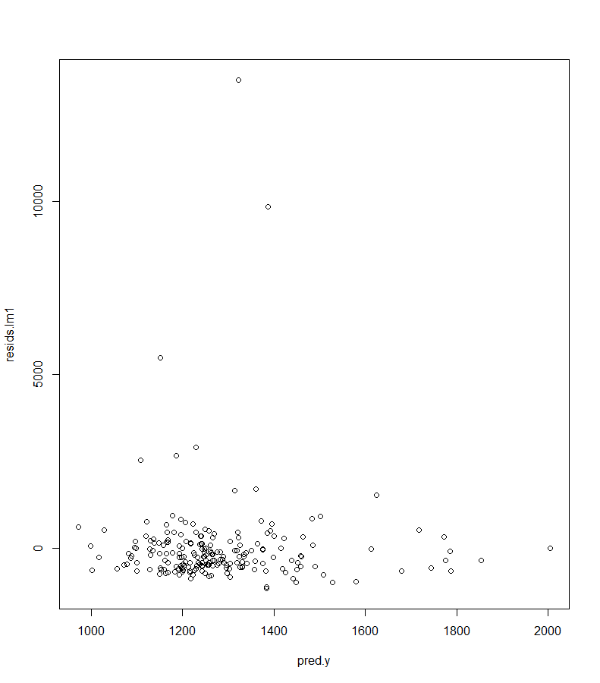
We can test the first three via a residuals versus fitted values plot.

Slide 62
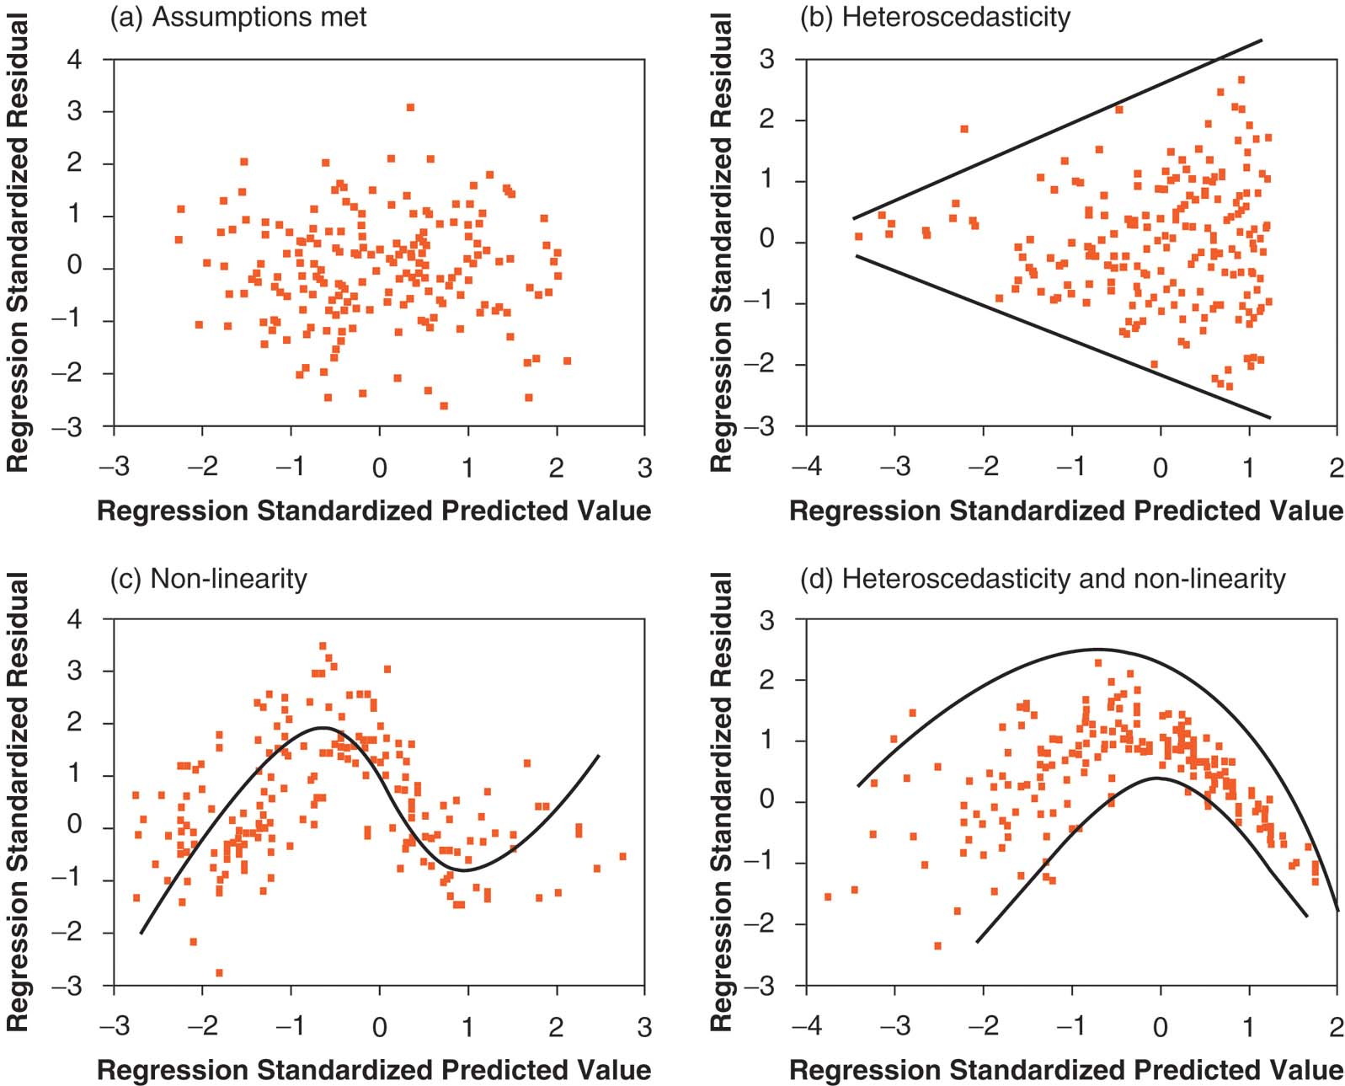
Assumption Testing – What we are looking for from residual plot
Diagram taken from Andy Field’s “Discovering Statistics Using SPSS”.

Slide 63
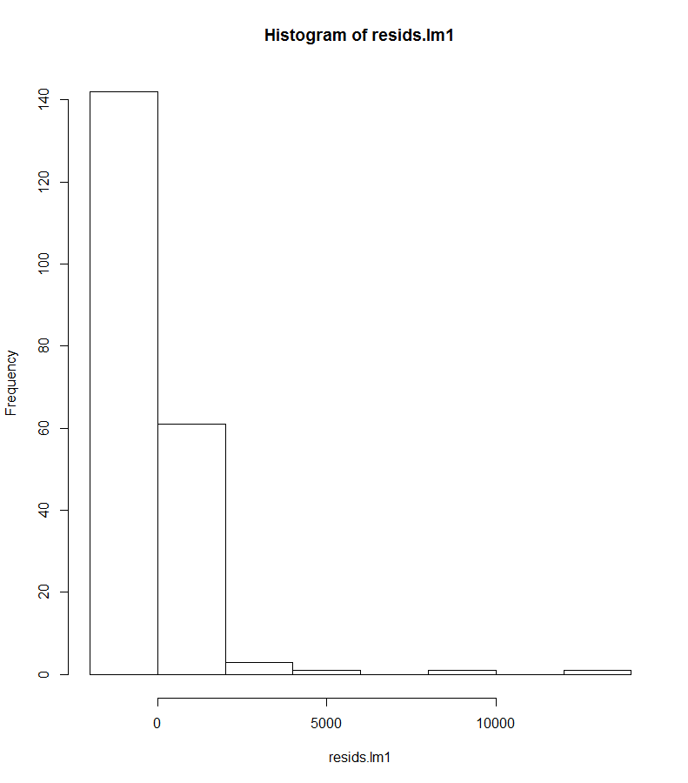
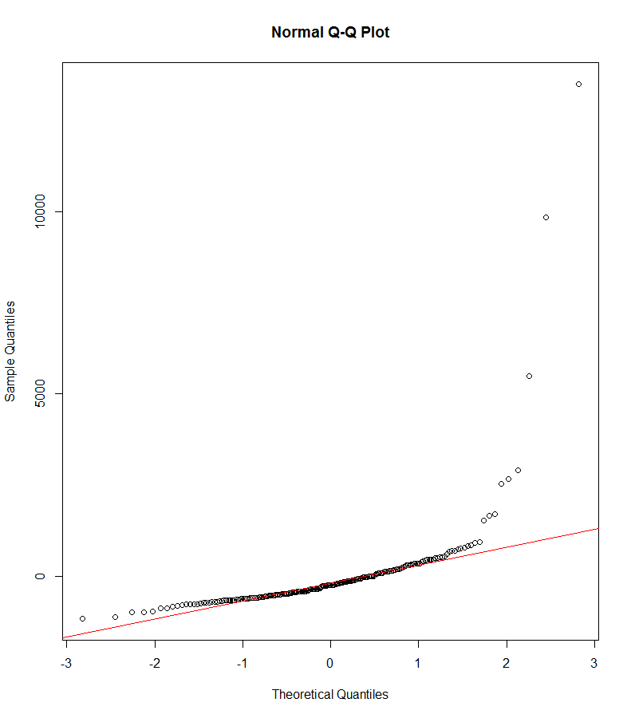
Normality is best assessed via a histogram of the residual and through a QQ-plot.

Slide 64
In Class Exercise

Slide 65

Open the data set ceosal2.RData. The variable salary is the annual compensation of CEOs in thousands of dollars and ceoten is the prior number of years a CEO has been with the firm.
Find the average salary and the average tenure (years with firm) in the sample.
How many CEOs are in their first year as CEO (that is ceoten = 0)? What is the longest tenure?
Estimate the simple regression model: Salary = B₀ + B₁(ceoten_{i}) + e_{i} What is the approximate increase in salary given one more year as a CEO.
What is the r-squared for this model – how do you interpret it?
What is the predicted salary of an individual who has 0 years with a firm; what is the predicted salary for an individual who has been with a firm for 10 years?
Create a residual versus predicted values plot – do you have any concerns regarding the regression assumptions?

