Slide 1
Advanced Data Analysis I Multiple Regression
PA 541 Week 4
Michael D. Siciliano
Department of Public Administration
College of Urban Planning and Public Affairs

Slide 2
Admin stuff
Reminder HW1 due on Feb 8th
Please be sure to check final data project groupings.
Begin to look for interesting data sets and research questions to explore.

Slide 3
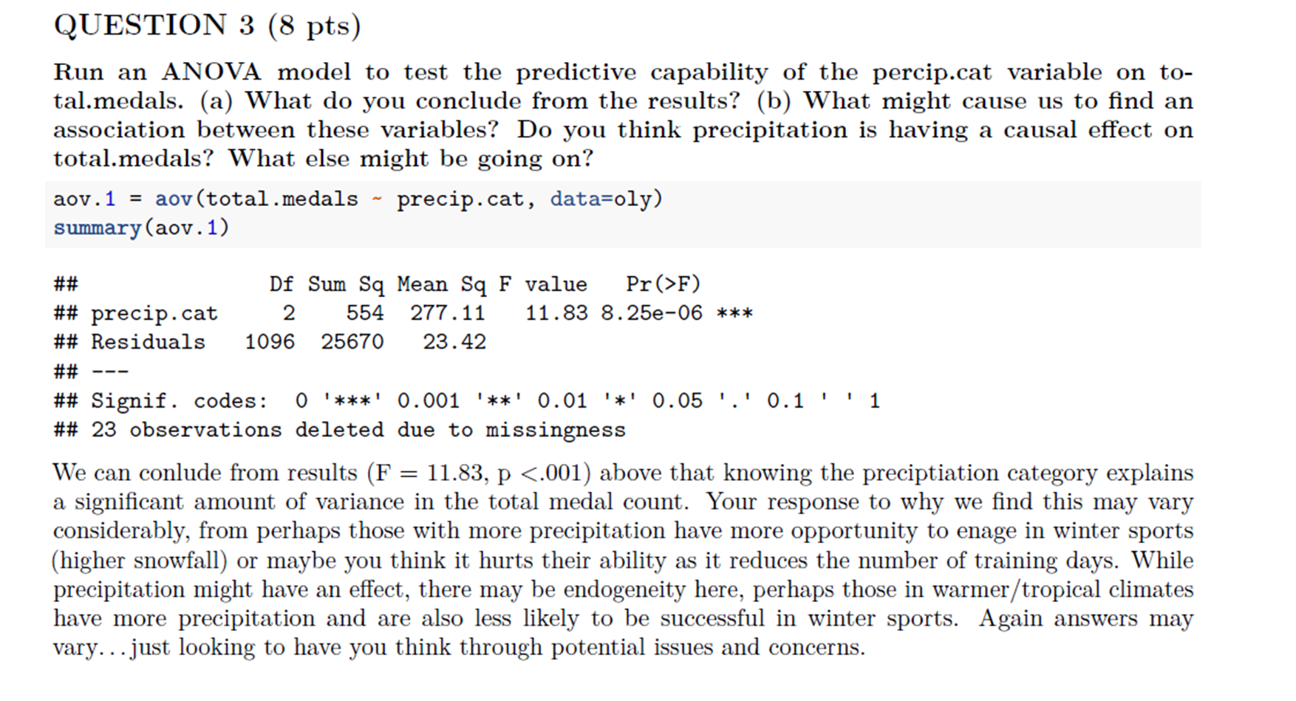

Slide 4
Today’s topics
Multiple regression analysis and interpretation
Omitted variable bias
Multiple regression assumptions
Three in-class exercises; work on HW
Again, and as noted in Wooldridge, we are holding off on dealing with interpreting log transformations and quadratics until later this semester.
We will also spend time covering multicollinearity in more detail in week 8 when we assess our regression assumptions.
For now, simply having some familiarity with these concepts is enough.

Slide 5
Beta Coefficients
Regression model
Let’s
REVIEW
Week 3
Causality
Central Limit Theorem
Merging Data
Regression Standard Error
Coefficient of Determination
Creating new variables
Statistically Significant/ p-values
Factor variables
Missing Data
Predicted Values and Residuals

Slide 6

LET’S REVIEW THE IN-CLASS EXERCISE

Slide 7
Multiple Regression
Analysis and Estimation

Slide 8
Assume one is only interested in understanding the effect of X on Y. Why is simple regression (i.e. regression with a single predictor) insufficient for understanding the effect of X on Y?

Slide 9
Why Multiple Regression?
Multiple regression allows us to specifically control for many other factors that may simultaneously affect our dependent variable.
Idea of ceteris paribus – which means “other relevant factors being equal”.
Hence, we can view the effect of a unit change in one IV on the DV while holding the change in our other IVs constant.
Our parameter estimates of B₁ and B₂ etc..have partial effect interpretations. We will return to this concept later in the lecture.

Slide 10
From Wooldridge P. 71
A simple model to explain city murder rates (murdrate) in terms of the probability of conviction (pbconv) and average sentence length (avgsen) is:
Murdrate = B₀ + B₁prbconv + B₂avgsen + u
What are some factors contained in u? Do you think the key assumption that the error has an expected mean value of zero given any values of the independent variables holds?

Slide 11
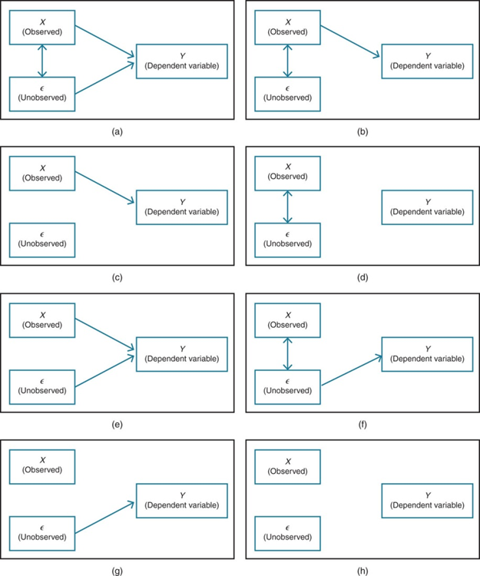
For each panel, explain whether endogeneity will cause problems for an analysis of the relationship between X and Y. For concreteness, assume X is grades in college, E is IQ, and Y is salary at age 26.
Bigger images on next slide.
Example from Bailey 2016, p. 12

Slide 14
We will be looking at examples from a dataset called ‘prestige’. This data concerns the prestige of 102 different occupations in Canada.
Variables include:
education - Average education of occupational incumbents, years, in 1971.
income - Average income of incumbents, dollars, in 1971.
women - Percentage of incumbents who are women.
prestige - Pineo-Porter prestige score for occupation. A scale that can run between 0 and 100.
census - Canadian Census occupational code.
type - Type of occupation. A factor with levels: bc, Blue Collar; prof, Professional, Managerial, and Technical; wc, White Collar.

Slide 15
Let’s look at a model
Major component of the regression output are identical to SLR. Let’s first talk about the overall predictive capacity of the model by looking at the R-squared and then we will discuss interpreting the coefficients.

Slide 16
From Last Week
Three measures of variation in our simple regression model:
SST: Total sum of squares
SSR: Residual Sum of Squares (Error Sum of Squares)
SSM: Model Sum of Squares (Regression Sum of Square)
SST = SSM + SSR

Slide 17
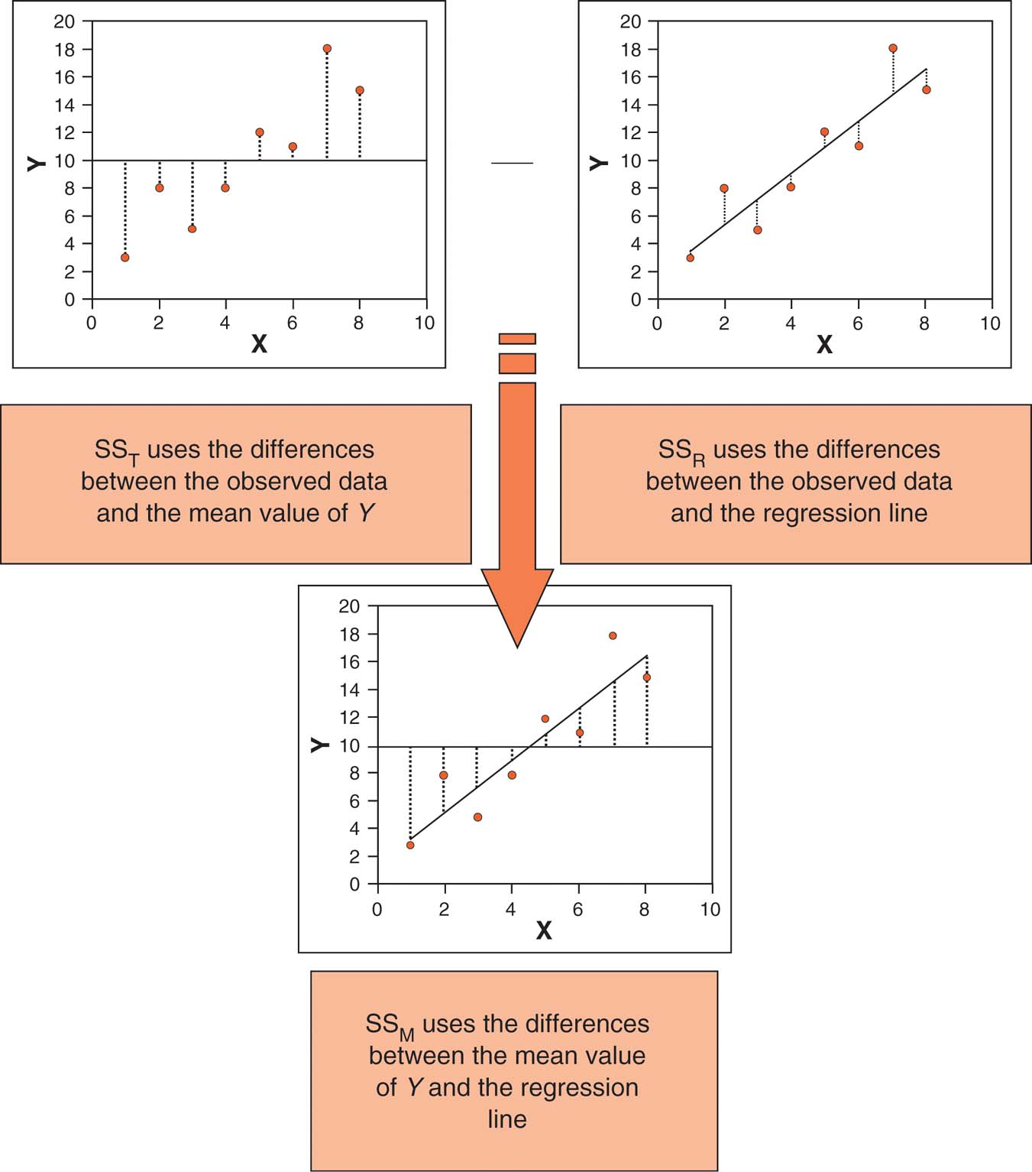
Calculating Each Value
Total Sum of Squares
Sum of Squared Residual
NOTE: Be very careful when using the terms SSE, SSR, etc…many textbooks use different forms. For example, SSR could be for “Residual” which is error or “Regression” which is explained from the model.
Sum of Squares for the Model
Diagram taken from Andy Field’s “Discovering Statistics Using SPSS”.

Slide 18
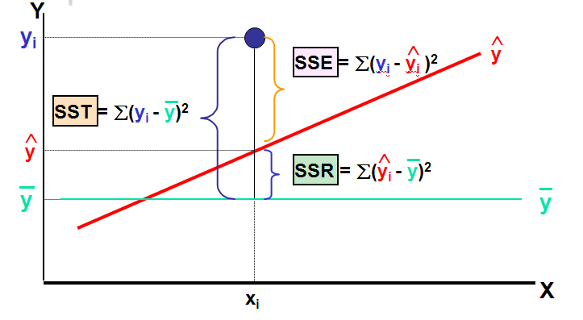
Another View of the Measures of Variation
The R here is for residual.
Note, that Wooldridge labels this the SSE, for explained sum of squares
SSR
SSM

Slide 19
A Note about Adjusted R-Squared
R² = SSM/SST or
R² = 1 – SSR/SST
R² does not decreases when a new independent variable is added to the model, even if the new variable is not an important predictor.

Slide 20
Adjusted Coefficient of Determination,
Used to correct for the fact that adding non-relevant independent variables will still reduce the residual sum of squares
(where n = sample size, K = number of independent variables)
Adjusted R² provides a better comparison between multiple regression models when different numbers of independent variables are used.
Adjusted R² penalizes excessive use of unimportant independent variables
Smaller than R²
Again, SSR is the residual sum of squares. What is left over that still needs explained.

Slide 21
Let’s go back to our output
How do we interpret the coefficients?

Slide 22
Interpreting OLS Regression Equation cont…
We can obtain the predicted change in y given changes in x₁ and x₂. Note, that the intercept has nothing to do with changes in y.
In particular when x₂ is held constant, so that the change in x₂ = 0 then:
, holding x₂ constant
The key point is that by including x₂ in our model, we obtain a coefficient on x₁ that controls for the effect of x₂ on our dependent variable.
Similarly, , holding x₁ constant.

Slide 23
Thinking more deeply about the ‘partialling out’ interpretation
Partialling out interpretation of multiple regression
One can show that the estimated coefficient of an explanatory variable in a multiple regression can be obtained in two steps:
1) Regress the explanatory variable on all other explanatory variables
2) Regress Y on the residuals from this regression
Why does this procedure work?
The residuals from the first regression is the part of the explanatory variable that is uncorrelated with the other explanatory variables
The slope coefficient of the second regression therefore represents the isolated effect of the explanatory variable on the dependent variable

Slide 24
Visual representation of partialling out
Consider the Venn Diagram below:
R-squared for this situation is A+B+C+D+E
Area A comes unequivocally from IV1; area C unequivocally from IV2; and area E unequivocally from IV3.
However, there is ambiguity regarding B and D. Both areas could be predicted from either of two IVs. To which IV should the contested areas be assigned?
DV
IV2
IV1
IV3
A
B
C
D
E
Note: the following discussion draws on Tabachnick and Fidell “Using Multivariate Statistics” 5th Ed, Ch. 5.

Slide 25
Standard Multiple Regression
In the standard model all IVs are entered into the regression equation simultaneously; each one is thus assessed as if it had entered the regression after all other IVs had been entered.
Each IV is evaluated in terms of what it adds to prediction of the DV that is different from the predictability afforded by all other IVs.

Slide 26
Using standard multiple regression IV1 “gets credit” for area A, IV2 gets credit for area C, and IV3 gets credit for area E. That is, each IV is assigned only the area of its unique contribution. The overlapping areas, B and D, contribute to the r-squared, but are not assigned to any of the individual IVs. The effects of the other variables have been partialled out.
DV
IV2
IV1
IV3
A
B
C
D
E

Slide 27
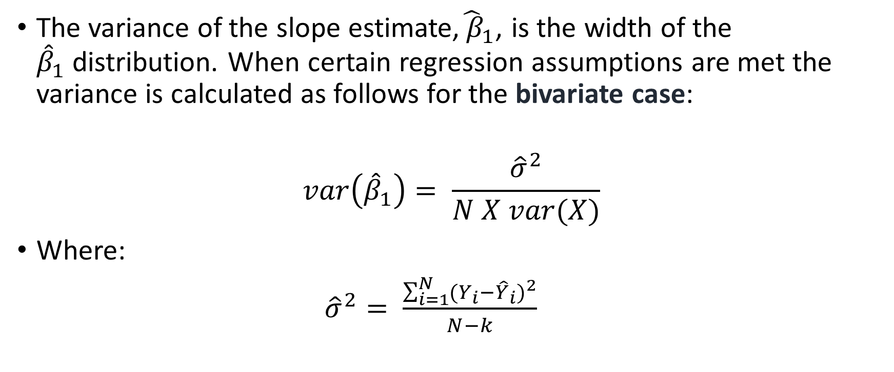
Precision of the slope estimates
The variance of the slope estimate,${\hat{ β}}_{1}$, is the width of the ${\hat{β}}_{1}$distribution. When certain regression assumptions are met the variance is calculated as follows for the bivariate case:
$$var\left({\hat{β}}_{1}\right)= \frac{{\hat{σ}}^{2}}{N X var(X)}$$
Where:
${\hat{σ}}^{2}= \frac{\sum_{i=1}^{N}{(Y_{i}−{\hat{Y}}_{i})^{2}}}{N−k}$

Slide 28
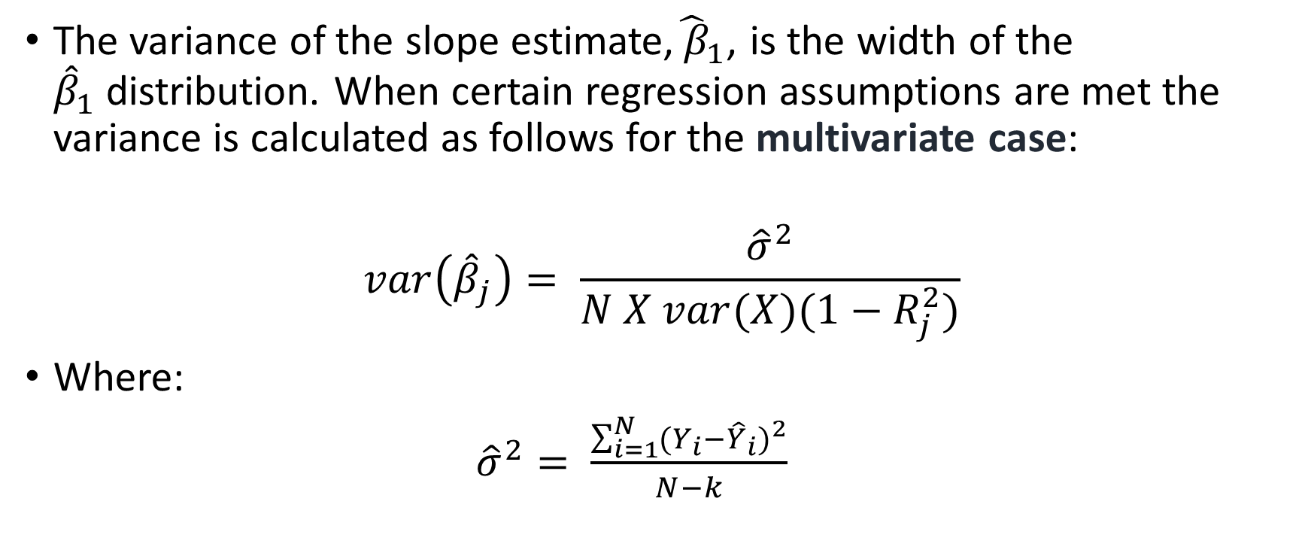
Precision of the slope estimates
The variance of the slope estimate,${\hat{ β}}_{1}$, is the width of the ${\hat{β}}_{1}$distribution. When certain regression assumptions are met the variance is calculated as follows for the multivariate case:
$$var\left({\hat{β}}_{j}\right)= \frac{{\hat{σ}}^{2}}{N X var(X)(1−R_{j}^{2})}$$
Where:
${\hat{σ}}^{2}= \frac{\sum_{i=1}^{N}{(Y_{i}−{\hat{Y}}_{i})^{2}}}{N−k}$

Slide 29
Omitted variable bias
What happens when we fail to include a variable in our model that should be there?
Also, what happens when we add a variable into our model that shouldn’t be there?

Slide 30
Model misspecification
Recall, that we never know the true model.
When interpreting our parameter estimates and making inferences based on our model, we assume that it has been properly specified.
This is noted by the regression assumption that each independent variable is uncorrelated with the error term.

Slide 31
Model Specification cont…
For instance, if the true model is
And we run
Then the error term is now composed of both the true error in the model (or what Berry (1993) terms free will or the intrinsic randomness in human behavior) plus the omitted variable. If the omitted variable is theoretically correlated with the included variable, then there is concern over our assumption of independence between predictors and error term (SLR.4/MLR.4). We will see why this is a concern in a few slides.

Slide 32
Model Specification cont…
Two types of model specification issues:
We include an irrelevant variable in our model (this is often termed overspecifying the model).
We exclude a relevant variable from our model (this is often termed underspecifying the model).

Slide 33
Including an Irrelevant Variable
For instance, suppose the true model is:
y = β₀ + β₁x_{1i} + β₂x_{2i} + μ_{i}
And we estimate:
y = β₀ + β₁x_{1i} + β₂x_{2i} + β₃x_{3i} + ε_{i}
Hence, we developed a model that included a variable that has no partial effect on our dependent variable.
More specifically, β₃ = 0, indicating that x₃ has no effect on y after x₁ and x₂ have been controlled for. (Note: x₃ may or may not be correlated with x₁ and x₂; all that matters is that once x₁ and x₂ are controlled for, x₃ has no effect on y).
What are the consequences?

Slide 34
Including an Irrelevant Variable
Including one or more irrelevant variables in a multiple regression model, or overspecifying the model, does not affect the unbiasedness of the OLS estimators. Does this mean that it is harmless to include irrelevant variables? No. Including irrelevant variables can have undesirable effects on the variances of OLS estimators (Wooldridge, 2013, p. 88).

Slide 35
Example of including an irrelevant variable
Let’s create a variable that is drawn completely at random…thus it should not be in our model because it should not be related to our dependent variable.

Slide 36
Excluding a Relevant Variable
Assume the true population model is:
wage = β₀ + β₁educ_{i} + β₂income_{i} + μ_{i}
And due to some reason we specify and run the model:
wage = β₀ + β₁educ_{i} + ε_{i}.
So now our residual term, ε, is made up of μ (the true model error) and β₂income.
What are the consequences?

Slide 37
Excluding a Relevant Variable
What are the consequences?
When we exclude a variable that should be in our model we potentially bias our parameter estimates, something referred to as omitted variable bias.
Under what conditions do we face these consequences?
As long as the omitted variable and the variable included in the model are correlated & and omitted variable affects the dependent variable, omitted variable bias is present. If the two variables are uncorrelated, there is no bias.
Think of our Venn diagrams.

Slide 38
Take a second to draw the Venn Diagram to represent what happens when only 1 of the 2 conditions for omitted variable bias are present.

Slide 39
What to Do about Omitted Variable Bias
The main thing we can do is attempt to understand the direction of the bias. On previous slide. From before, the true model was:
wage = β₀ + β₁educ_{i} + β₂income_{i} + μ_{i}
And we estimated:
wage = β₀ + β₁educ_{i} + ε_{i}.
If we believe that income has a positive correlation with wage and also that it is positively correlated with education, then the omitted variable bias is positive.

Slide 40
Direction of Omitted Variable Bias
If the true population model is:
wage = β₀ + β₁educ_{i} + β₂income_{i} + μ_{i}
And due to some reason we specify and run the model:
wage = β₀ + β₁educ_{i} + ε_{i}.
The direction of the omitted variable bias in β₁ can be determined from the table below.
 | Corr(x₁,x₂) >0 | Corr(x₁,x₂) <0
B₂>0 | Positive bias | Negative bias
B₂<0 | Negative bias | Positive bias

Slide 41
Some Econometric Terminology
Upward bias occurs when
Downward bias occurs when
Biased toward zero refers to instances when is closer to zero than
Therefore, if the true beta is positive, then the estimated beta is biased toward zero if it has a downward bias.
If the true beta is negative, then the estimated beta is biased toward zero if it has an upward bias.

Slide 42


Example of Omitted Variable Bias
True Model
Omitted Variable Model
How do we explain what is happening to the coefficient on education?

Slide 43

Omitting relevant variables: the simple case
Let’s look at an example from the text
True model (contains x₁ and x₂)
Estimated model (x₂ is omitted)

Slide 44

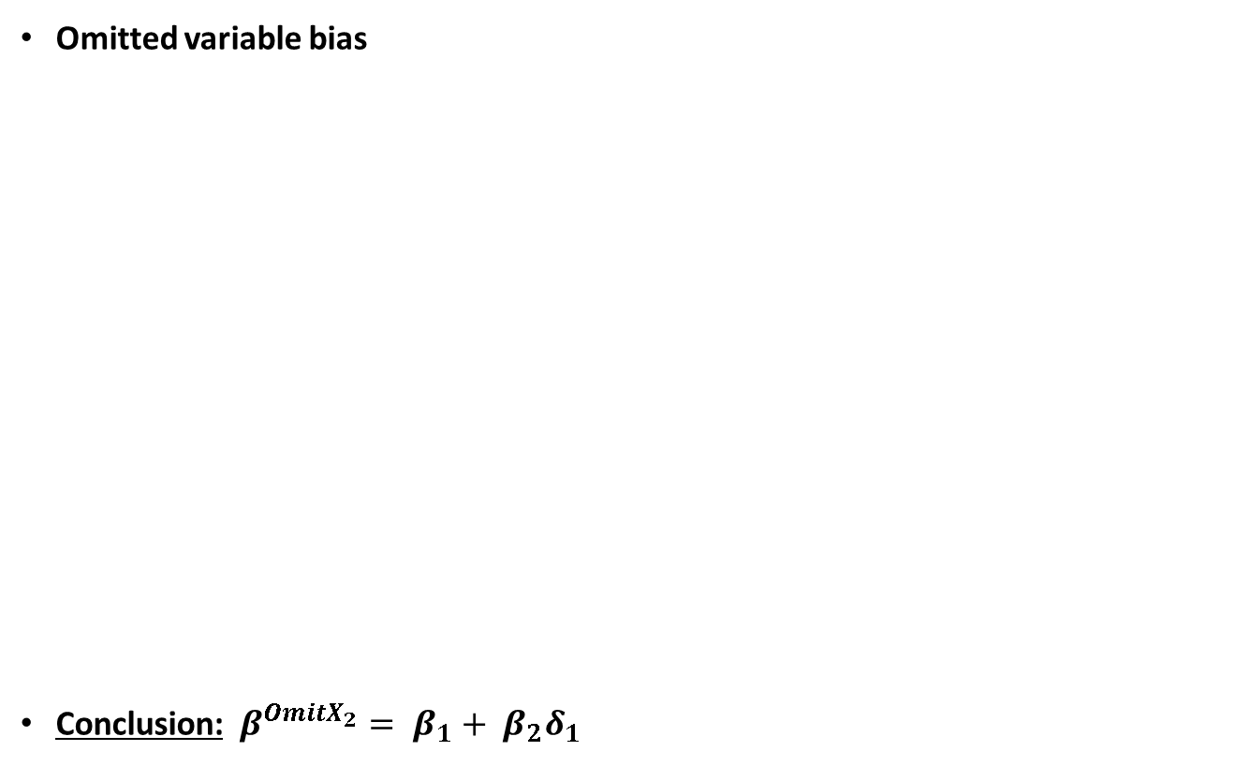
Example from the text…
Again, here is the ‘true’ model
Omitted variable bias
Conclusion: $β^{OmitX_{2}}= β_{1}+ β_{2}δ_{1}$
If x₁ and x₂ are correlated, assume a linear regression relationship between them
If y is only regressed
on x₁ this will be the estimated intercept
If y is only regressed
on x₁, this will be the estimated slope on x₁
error term

Slide 45


Example from the text cont…
Example: Omitting ability in a wage equation
When is there no omitted variable bias?
If the omitted variable is irrelevant or uncorrelated
Will both be positive
The return to education will be overestimated because . It will look
as if people with many years of education earn very high wages, but this is partly
due to the fact that people with more education are also more able on average.

Slide 46
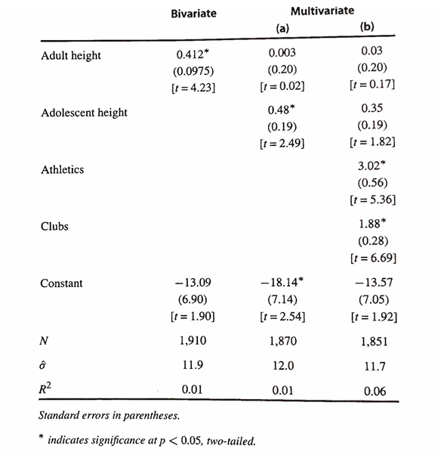

Another example of omitted variable Bias (Bailey 2016)

Slide 47
Another example of omitted variable Bias (Bailey 2016)

Slide 48
Another example of omitted variable Bias (Bailey 2016)

Slide 49
Multiple regression assumptions

Slide 50
From last week
Assumptions:
SLR.1 – Linear in parameters
SLR.2 – Data drawn from a random sample (i.e., the errors are independent - no autocorrelation in the data)
SLR.3 – Sample variation in the explanatory variables
SLR.4 – Zero conditional mean for the error term
SLR.5 – Homoskedasticity (i.e., the errors have equal variance)
Normality of the error term
Validity (i.e. data maps to research question)

Slide 51
MLR Assumptions
MLR. 1 - Linear in parameters
MLR. 2 - Data drawn from a random sample (i.e., the errors are independent - no autocorrelation in the data)
MLR.3 - No perfect collinearity (no exact linear relationship among the independent variables)
MLR.4 - Zero conditional mean for the error term
MLR.5 - Homoskedasticity (i.e., the errors have equal variance)
Normality of the error term
Validity (i.e. data maps to research question)

Slide 52
In Class Exercises

Slide 53
1. Using the prestige dataset regress prestige on education, income, and women.
Prove to yourself that the coefficient on education is the partialled out effect of education on prestige.
Two steps needed to do this:
1) Regress the explanatory variable on all other explanatory variables
2) Regress Y on the residuals from this regression
Complete computer exercises C1 and C2 in Wooldridge. I have them posted on the following slide if you don’t have your text.

Slide 54
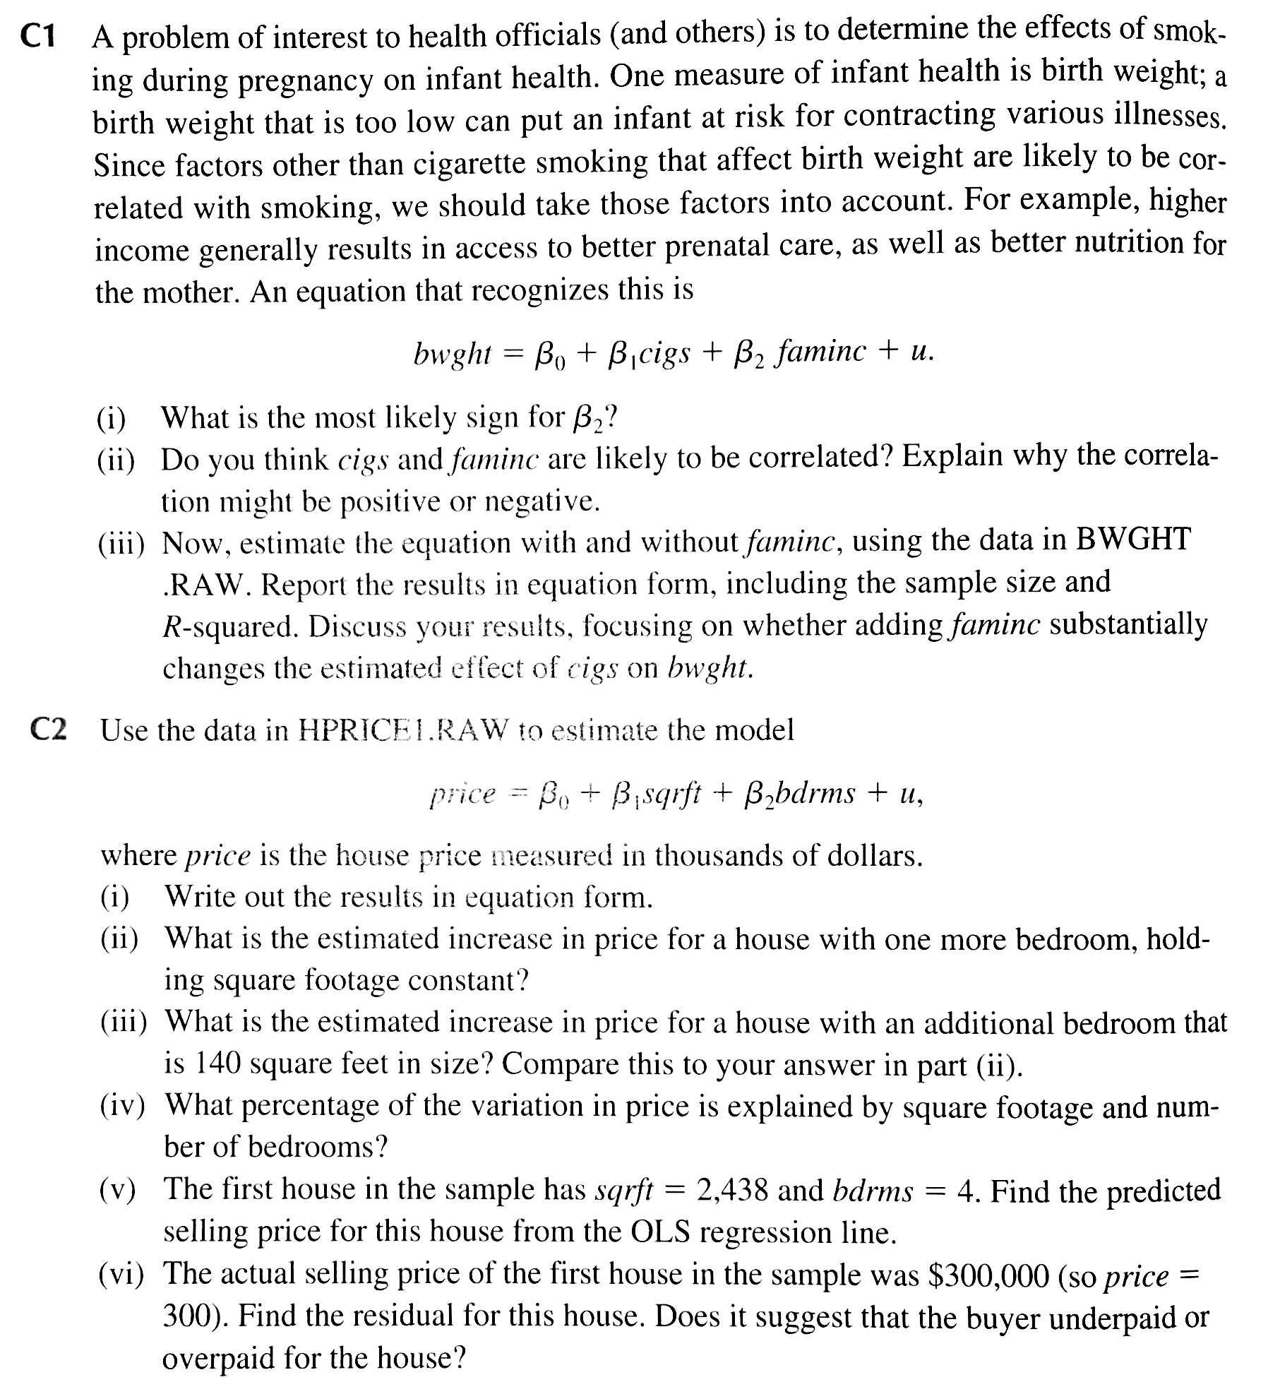
Note, the required datasets are on Blackboard as R datasets

