Slide 1
Advanced Data Analysis I Testing hypotheses about model parameters
PA 541 Week 5
Michael D. Siciliano
Department of Public Administration
College of Urban Planning and Public Affairs

Slide 2
Today’s topics
Review omitted variable bias (and quickly review in-class exercise).
Statistical inference
Practical significance versus statistical significance
Identifying the “importance” of a predictor
Testing one-sided alternatives
Testing the equality of regression coefficients
Testing multiple linear restrictions

Slide 3
Starter Question
DV
IV2
IV1
IV3
Think back to your, perhaps painful, memories of our Venn Diagram last week and our discussion of omitted variable bias?
Within this context, why is running an experiment so useful in understanding the relationship between X and Y.
A
B
C
D
E

Slide 4
Interpreting Beta Coefficients
Model Specification
Let’s
REVIEW
Week 4
Causality
Why Multiple Regression?
Endogeneity
P-values
Omitted Variable Bias
Including Irrelevant Predictors
Ceteris Paribus
Bias Toward Zero
Partialling Out

Slide 5
It is always easier to justify a coefficient after the fact….
Consider this example (Watts 2011)
Watts discusses the fact that many people don’t see what sociology or other social sciences can tell us about the world that an intelligent person couldn’t figure out on their own. Here is an example.
Paul Lazarsfeld was writing about the The American Soldier, a published study on 600,00 servicemen during and after WWII.
He listed several findings that were claimed to be representative of the report.
Ex. Men from rural backgrounds were usually in better spirits during their army life than soldiers from city backgrounds.
Why?

Slide 6
Aha, you might have said, that makes perfect sense.
Rural men in the 1940s were accustomed to harsher living standards and more physical labor than city men, so naturally they had an easier time adjusting.
Why did we need a vast and expensive study to tell me what I could have figured out on my own?
However, each of the findings that Lazarsfeld listed was in fact the exact opposite of what the study had actually found.
It was actually city men and not rural men who were happier during their army life.
Of course, had one been given this finding originally he/she could have just as easily reconciled it by saying:
City men are more used to working in crowded conditions and in corporations with chains of command, strict standards of clothing, defined social norms, may have seen more violence, etc…
That finding is obvious, why did I need a big expensive study to tell me that?

Slide 7
Review Omitted Variable Slides
From last week

Slide 8

Omitting relevant variables: the simple case
Let’s look at an example from the text
True model (contains x₁ and x₂)
Estimated model (x₂ is omitted)

Slide 9

Example from the text…
Again, here is the ‘true’ model
Omitted variable bias
Conclusion: All estimated coefficients will be biased
If x₁ and x₂ are correlated, assume a linear regression relationship between them
If y is only regressed
on x₁ this will be the estimated intercept
If y is only regressed
on x₁, this will be the estimated slope on x₁
error term

Slide 10
Omitted variable bias occurs when both of the following conditions are met
The omitted variable affects the dependent variable.
The omitted variable is correlated with the included independent variable

Slide 11
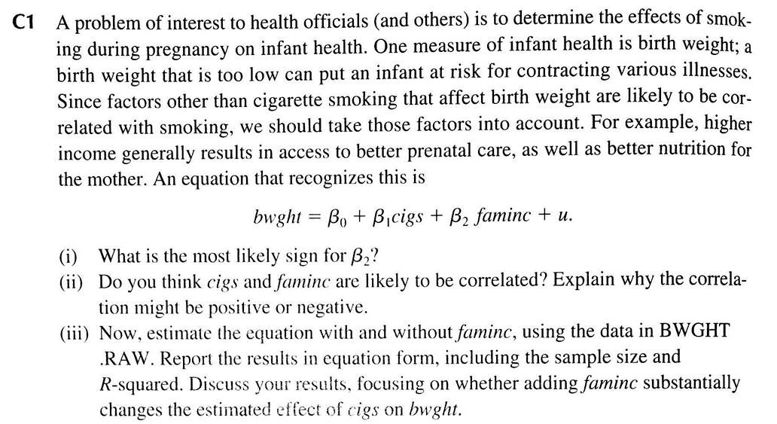
Let’s look at part of the in-class exercise

Slide 12
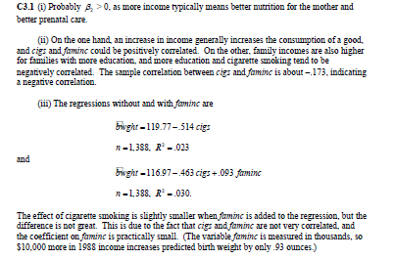
Answer to C1

Slide 13
Statistical Inference

Slide 14
Statistical Inference
Statistical inference in the regression model
Hypothesis tests about population parameters
Construction of confidence intervals
Sampling distributions of the OLS estimators
We already know their expected values and their variances
However, for hypothesis tests we need to know their distribution
In order to derive their distribution we need additional assumptions
Assumption about distribution of errors: normal distribution
Note: only really need this assumptions for small samples

Slide 15


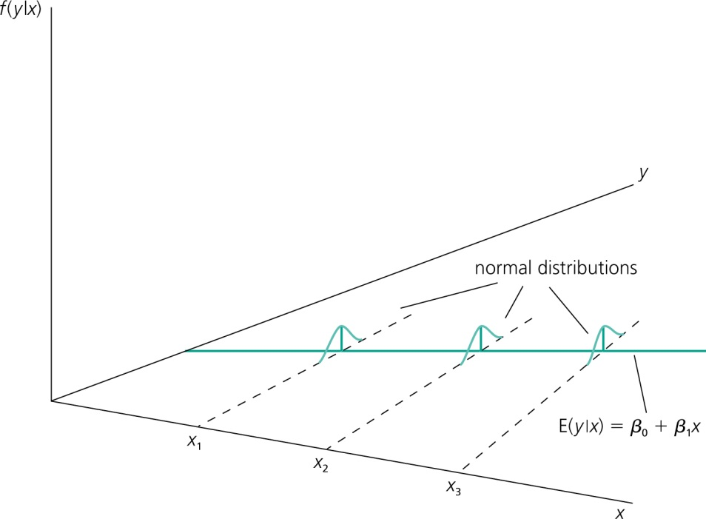
Assumption MLR.6 (Normality of error terms)
independently of
It is assumed that the unobserved
factors are normally distributed around the population regression function.
The form and the variance of the distribution does not depend on
any of the explanatory variables.
It follows that:

Slide 16
Discussion of the normality assumption
The normality of the error term can be examined through the residuals
We did this by looking at a histogram of the residuls as well as a qq-plot.
At least the distribution should be close to normal
Small deviations from normality are not a problem
In many cases, normality is questionable or impossible by definition (i.e. the distribution can take on only take on certain values)

Slide 17
Discussion of the normality assumption (cont.)
Examples where normality cannot hold:
Wages (nonnegative; also: minimum wage)
Number of arrests (takes on a small number of integer values)
Unemployment (indicator variable, takes on only 1 or 0)
In some cases, normality can be achieved through transformations of the dependent variable (e.g. use log(wage) instead of wage)
We will be discussing transformations in the coming weeks and models for non-normal variables later in the semester.

Slide 18


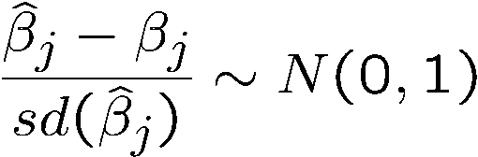

Terminology
Theorem 4.1 from Wooldridge (Normal sampling distributions)
Gauss-Markov assumptions
Classical linear model (CLM) assumptions
Under assumptions MLR.1 – MLR.6:
The estimators are normally distributed around the true parameters
The standardized estimators follow a standard normal distribution

Slide 19
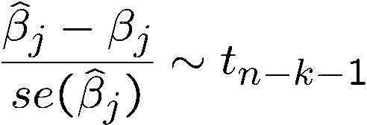

Testing hypotheses about a single population parameter
Theorem 4.1 (t-distribution for standardized estimators)
Null hypothesis
Under assumptions MLR.1 – MLR.6:
If the standardization is done using the estimated standard deviation (= standard error), the normal distribution is replaced by a t-distribution
Note: The t-distribution is close to the standard normal distribution if n-k-1 is large.
The population parameter is equal to zero, i.e. after controlling for the other independent variables, there is no effect of x_{j} on y

Slide 20
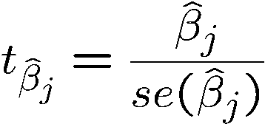
The t-statistic will be used to test the above null hypothesis. The farther the estimated coefficient is away from zero, the less likely it is that the null hypothesis holds true. But what does „far“ away from zero mean?
t-statistic (or t-ratio)
Distribution of the t-statistic if the null hypothesis is true
Goal: Define a rejection rule so that, if it is true, H₀ is rejected only with a small probability (= significance level, e.g. 5%)
This depends on the variability of the estimated coefficient, i.e. its standard deviation. The t-statistic measures how many estimated standard deviations the estimated coefficient is away from zero.

Slide 21
Again, if we return to our model from last week, we see that we have an estimate for the coefficient, an estimate for the st. error and from those we produce the t-statistic that allows us to test for significance at a specified level.

Slide 22
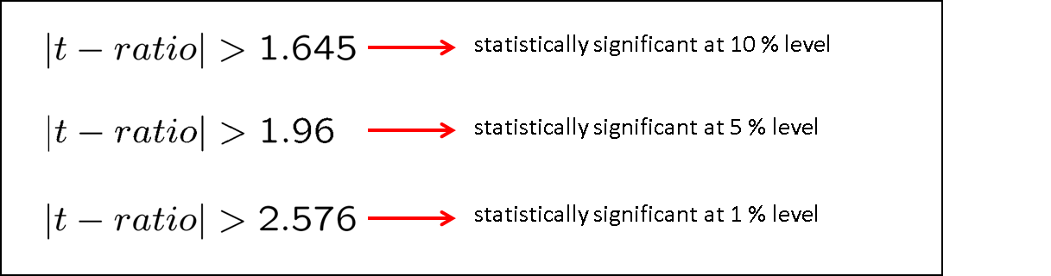
Statistically significant variables in a regression
If a regression coefficient is different from zero in a two-sided test, the corresponding variable is said to be statistically significant
If the number of degrees of freedom is large enough so that the normal approximation applies, the following rules of thumb apply:

Slide 23
Practical versus statistical inference
Roughly speaking, a coefficient is significant if it is more than 2 standard errors away from zero.
When it is statistically significant, then we can be fairly confident that the direction of its effect is stable, and not just an artifact of the sample.
To help assess practical significance we need to know the range of our variable and its unit of measurement.
Remember, the coefficient tells us the impact on the dependent variable when the independent variable changes by 1.

Slide 24
For certain variables 1 could be more than the entire range (say if the variable is the fraction of something) or 1 could be a very small increase (say if we measured GDP in dollars as opposed to millions of dollars).
Thus, we can’t look only at the coefficient to get a sense of its importance. We need to look at the range, and then we need to consider:
What size gain (or decrease) in Y makes a significant impact?
What portion of the range of X, do we need to move to obtain that size gain in Y.
From a policy standpoint, is it practical to think we could move X that far?

Slide 25
Testing one-sided alternatives

Slide 26
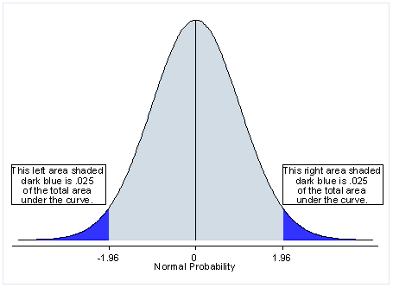
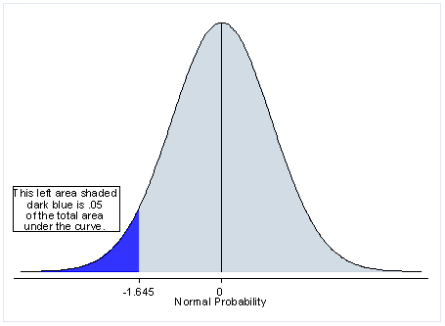
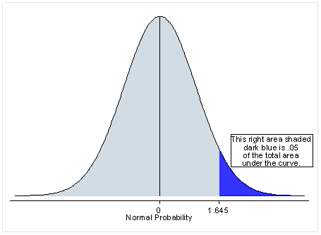
Two-tailed test – if using a 5% significance level, a two-tailed test allots half of your alpha in each tail.
One-tailed test – if using a 5% significance level, a one-tailed test allots all of your alpha to testing significance in one direction.

Slide 27
When should you use a one tailed test?
Using a one-tailed test clearly provides more power to detect an effect. Because of this, you may be tempted to use it if you have a hypothesis regarding the direction of the effect of X on Y.
However, one-tailed tests are rarely used.
It precludes your ability to find significance in the other direction.
Readers/reviewers are skeptical if they see a one-tail test that is just on the border of significance.
You should never choose to do a one-tailed test after you observed a non-significant two-tailed test.

Slide 28
Obtaining a one-tailed test in R
Statistical packages, like R, report two-tailed tests. Because t-distribution is symmetric about zero, we can derive one-tailed p-values from the two-tailed test.
We can divide the p-value by 2, assuming we hypothesized a positive coefficient for roe. Thus, the significance of a one-tailed test would be .0489.

Slide 29
Hypothesis Testing About Multiple Coefficients
1. Testing the equality of regression coefficients
2. Testing exclusion restrictions

Slide 30
1. Testing the equality of regression coefficients

Slide 31
Testing the equality of regression coefficients
When might we care that two regression coefficients in our model are equal?
Perhaps, as Wooldridge did, we want to know if time spent at different types of higher ed institutions provides the same return.
Perhaps we want to compare hours of professional development in different programs and their impact on job performance.
Maybe I want to compare if time spent working on R has the same impact on your grade as time spent reading Wooldridge.
You may have a model with different variables for race and you want to test the equivalence of the effect of Black or Hispanic.
There may be plenty of reasons you care about the equality of two regression coefficients.

Slide 32


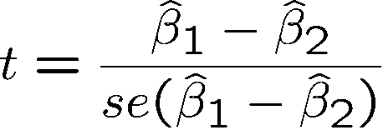
Let’s revisit the example from the reading this week…
Testing hypotheses about a linear combination of parameters
Example: Return to education at 2 year vs. at 4 year colleges
Years of education at 2 year colleges
Years of education at 4 year colleges
Test against .
A possible test statistic would be:
The difference between the estimates is normalized by the estimated standard deviation of the difference. The null hypothesis would have to be rejected if the statistic is „too negative“ to believe that the true difference between the parameters is equal to zero.

Slide 33
Impossible to compute with standard regression output because
Usually not available in regression output

Slide 34



Alternative method
Define and test against .
Insert into original regression
a new regressor (= total years of college)

Slide 35

Estimation results
This method works always for single linear hypotheses
Total years of college
Fail to reject the null at the 5% level, but we do reject the null at the 10% level

Slide 36
Let’s look at another example and two ways to make the comparison.
The Data: Duncan Dataset available in the ‘car’ package (similar to our prestige data from last week)
This data frame contains the following columns:
Type - Type of occupation. A factor with the following levels: prof, professional and managerial; wc, white-collar; bc, blue-collar.
Income - Percent in occupation earning $3500 or more in 1950.
Education - Percent in occupation in 1950 who were high-school graduates.
Prestige - Percent of raters in NORC study rating occupation as excellent or good in prestige
Question, does the percentage of highly paid employees and the percentage of highly educated employees equally effect the prestige of a job?

Slide 37
Here is the model with income and education
We cannot make any claim about the equality of the coefficients on income and education based on this output.

Slide 38
Approach 1- Wooldridge version
Here we see no evidence that income’s effect is different from education’s effect
Again, here is the approach used by Wooldridge.
Create a combined term (income + education).
Check the significance of the coefficient on the variable of interest (income).

Slide 39
Approach 2 – Use an R function
Same value as in previous slide
The linearHypothesis() function allows you to set and test a variety of restrictions.
Here we see that we get identical results to our previous method.

Slide 40
2. Testing exclusion restrictions

Slide 41
Testing exclusion restrictions
There will be times when you wish to test multiple hypotheses about the population parameters.
You may want to know if a restricted version of the model is “just as good” as the unrestricted version.
These are known as nested models and can be easily tested.
Variables of interest to you may be highly correlated such that no single individual predictor is significant. In this case you may wish to test their joint significance.
If found jointly significant you can think about dropping a variable or creating a composite variable.
Let’s first look at the example from the Wooldridge text and then I’ll walk us through another example with a separate dataset.

Slide 42

Testing multiple linear restrictions: The F-test
Testing exclusion restrictions
Salary of major league baseball player
Years in
the league
Average number of
games per year
Batting average
Home runs per year
Runs batted in per year
against
Test whether performance measures have no effect/can be exluded from regression.

Slide 43
Estimation of the unrestricted model
None of these variables is statistically significant when tested individually
Idea: How would the model fit be if these variables were dropped from the regression?

Slide 44
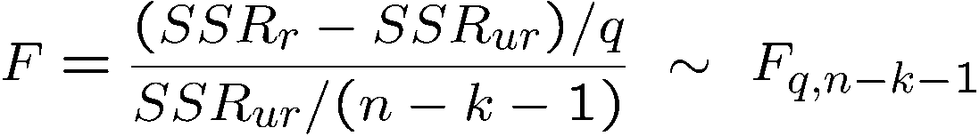
Estimation of the restricted model
Test statistic
The sum of squared residuals necessarily increases, but is the increase statistically significant?
Number of restrictions
The relative increase of the sum of squared residuals when going from
H₁ to H₀ follows a F-distribution (if
the null hypothesis H₀ is correct)

Slide 45
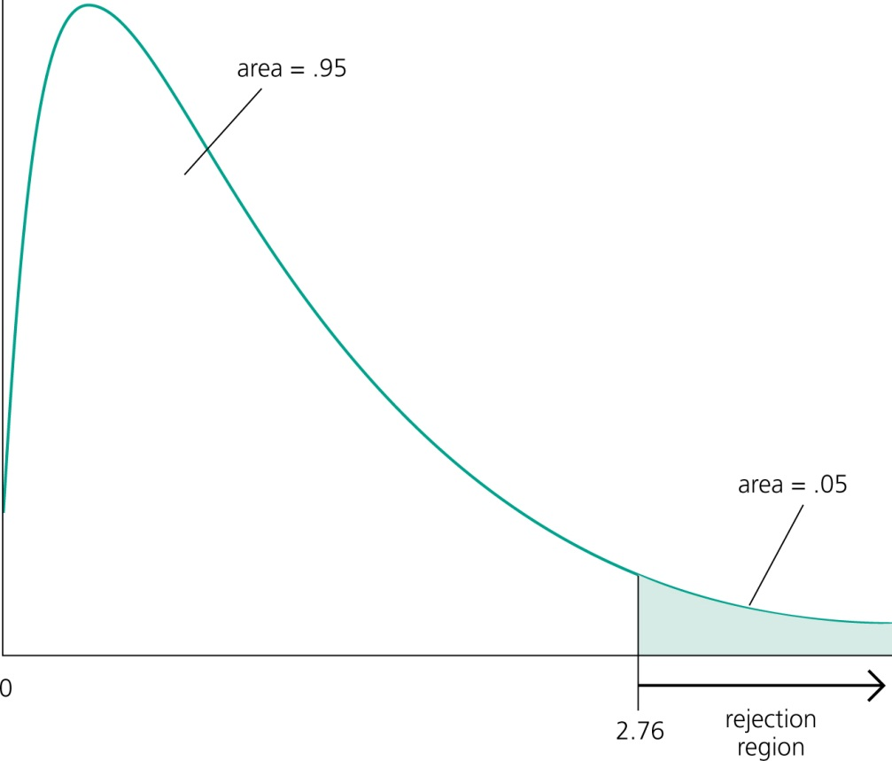
Rejection rule (Figure 4.7)
A F-distributed variable only takes on positive values. This corresponds to the fact that the sum of squared residuals can only increase if one moves from H₁ to H₀.
Choose the critical value so that the null hypothesis is rejected in, for example, 5% of the cases, although it is true.

Slide 46
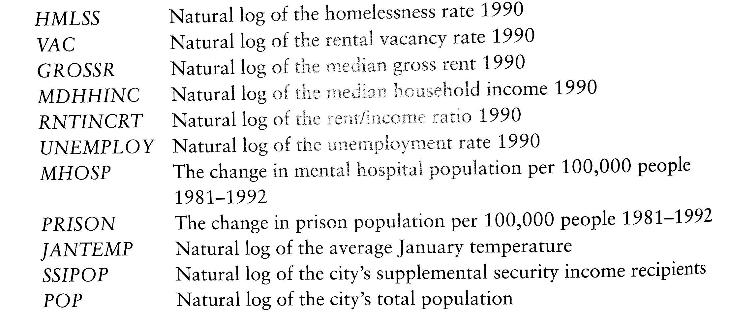
Let’s look at another example…
The rise of homelessness is often attributed to the release of a large number of individuals from mental hospitals during the 1980s. Housing economists, however, have painted a more complex picture, pointing to the housing market conditions and economic circumstances as significant contributors to the problem. This dataset will allow us to explore some of these factors based on data in 273 urban areas. Saved as “homeless1.dta”

Slide 47
Here is our ‘full’ model
In this model we are using median gross rent, the number of SSI recipients in the city, the unemployment rate, and the change in the mental hospital population.
Note: all IVs and DVs are logged. When this is the case we can interpret the coefficient as the percentage change in Y given a 1% change in X
Now, we may be surprised that unemployment and the number of individuals receiving SSI was not significant.
We can test their joint significance with the F-test.

Slide 48
Take a few minutes to you to calculate the F-statistic given the output on following slide.
Also, look up the critical value in an F-table. Note, you will need to know the numerator and denominator degrees of freedom.

Slide 50
An alternative approach in R
We used anova() before to get or sums of squares for our regression and to look at the overall f-test for model significance.
When given a sequence of objects (such as to lm objects), anova tests the models against one another in the order specified.
Here we see it is comparing our restricted model against our unrestricted model.

Slide 51
In class exercises

Slide 52
In-class Exercise: Analysis of Global COVID-19 Data
See the end of this week’s script.
Read in the 'cov2.csv' data. This dataset contains information for 190 countries on a number of variables related to COVID-19 cases, deaths, and vaccinations. The data come from https://ourworldindata.org/coronavirus.
The data also contains information on the population, percentage of the population over 65, gdp per capita, as well as information on a number of relevant health factors. The data are current as February 1st, 2021.
See the associated codebook for a full description of each variable along with its associated source.

