Slide 1
Advanced Data Analysis I Interactions and Qualitative Predictors
PA 541 Week 7
Michael D. Siciliano
Department of Public Administration
College of Urban Planning and Public Affairs

Slide 2
Admin Stuff
Optional Lab on the 26th at 3pm.
Homework 2: Due on March 1st at 3pm.
On the horizon:
Week 8: Non-linear relationships. Checking the validity of regressions assumptions.
Week 9: Midterm
Week 10: Model specification and data issues. Log Models. Data screening and cleaning. Methods for handling outliers and missing data.
Week 11: Spring Break

Slide 3
This week’s lecture
Introduction to interactions and ways to visualize interaction effects
Note: I will briefly review quadratics next week and log models in week 10.
Regression modeling and interpretation with qualitative predictors
Interpreting interactions with qualitative predictors
Wooldridge also discussed binary dependent variables in ch. 7 – this is a topic we will tackle under generalized linear models and logistic regression after the midterm.

Slide 4
Model Interpretation and Interaction effects

Slide 5
Start with a simple model
Let’s start with just a null model, a model with no predictors.
How do we interpret the intercept?
No R-squared is printed here, why? What do you suspect the value to be?

Slide 6
Let’s add a single predictor variable to examine the main effect of education on wages.
How do we interpret the intercept now? Why is it negative?
How do we interpret education?

Slide 7
Let’s also look at the main effect of experience, shown here in model 3.
How do we interpret the intercept in model 3?
Why did the effect of education change?
How much of an increase in explanatory power did adding experience have?

Slide 8
Centering variables
Given the lack of an interpretable intercept, let’s center our two predictor variables.
For each variable, what makes sense as a centering point?
Let’s construct two new variables and rerun the models:

Slide 9
Why didn’t the slope coefficients change for education and experience?
How do we interpret the intercept now?

Slide 10
Interaction terms
In the previous examples, we were only looking at the main effects of each of our predictors.
This implicitly assumes that the effect of education on wages is the same across all levels of experience (or vice versa).
But what if the effect of education varies at different levels of experience?
This idea that the effect of one predictor may be dependent on another predictor is often termed moderation and can be explored through interaction terms.
Examples of interactions in your area of study? Or one’s you have read about in other research?

Slide 11
Moderator: name for a variable that moderates or changes the effect of another variable
Paul Johnson calls this a ‘Moderated Slope Model’
X2
X1
Y
An interaction effect is said to exist when the effect of the independent variable on the dependent variable differs depending on the value of a third variable, called the moderator variable (Jaccard and Turrisi, 2003).

Slide 12
Let’s write out our standard regression model with two variables.
Now add an interaction.
Let’s regroup the terms and we see X1’s slope depends on X2

Slide 13
B₃ shows us the interaction effect
B₁ and B₂ often referred to as the simple main effects or the conditional main effects of x1 and x2.
This term is used because the effects of say x1 is only interpretable when the value of x2 = 0. Thus, we see another reason centering is important, especially with interaction effects.

Slide 14
Let’s add an interaction term to our model
Note: I’m using tenure now instead of experience as the interaction effects were more pronounced. For this example, let’s assume education is the moderator.
How do we interpret each of the parameters?

Slide 15
As noted by Hoffman (2015), some textbooks have suggested the main effects should not be interpreted when they are included in an interaction.
However, this is not true, they can and should be interpreted, especially because they were included in an interaction.
The trick is to interpret the main effects correctly and the correct way is to do so conditionally on their interacting predictor.
Thus, the effects are simple (conditional) main effects that apply only when the interacting predictor is 0.
This is why we need/want to have a meaningful zero value for our predictors.
Recall, we can regroup our variables to show that the effect of X1 on Y depends on the value of X2. In the regrouped from, the simple main effect is easier to see.
$$Y_{i}= B_{0}+ {(B}_{1}{+ B_{3}{X2}_{i})X1}_{i}+ B_{2}{X2}_{i}+ e_{i}$$

Slide 16
What is the effect of tenure at the following levels of education
High School Only
College Degree
To answer this question, we first need to specify the value of education for which we want understand the relationship between tenure and wages.
Let’s look high school only and add it into our equation:
Wages = 4.66 + .43educ12 + .19tenure + .02edu12*tenure
Wages = 4.66 + .43(0) + .19tenure + .02(0)tenure
Wages = 4.66 + .19tenure
What about for those with a college degree
Wages = 4.66 + .43educ12 + .19tenure + .02educ12*tenure
Wages = 4.66 + .43(4) + .19tenure + .02(4)tenure
Wages = 6.38 + .27tenure
It is clear here that education level moderates the size of the tenure effect. Tenure has a larger impact on wages for those with higher levels of education.

Slide 17
Graphing interactions
It is often useful, for both you and your audience, to see a graphical display of interaction effects.
How might you do this for a continuous by continuous interaction, such as the one we explored above?
Can you draw a diagram of what the output may look like?

Slide 18
One approach, which we will use, is to plot three regression lines for the regression of wages on tenure at three levels of education (low, medium, high).
Choosing the levels is up to you. One useful approach is to use the mean as well as 1 standard deviation above and below the mean. But since we are working with education it may make more sense to look at those with no education, a high school degree, and a college degree.

Slide 19
Here’s one approach for doing this in R:

Slide 20
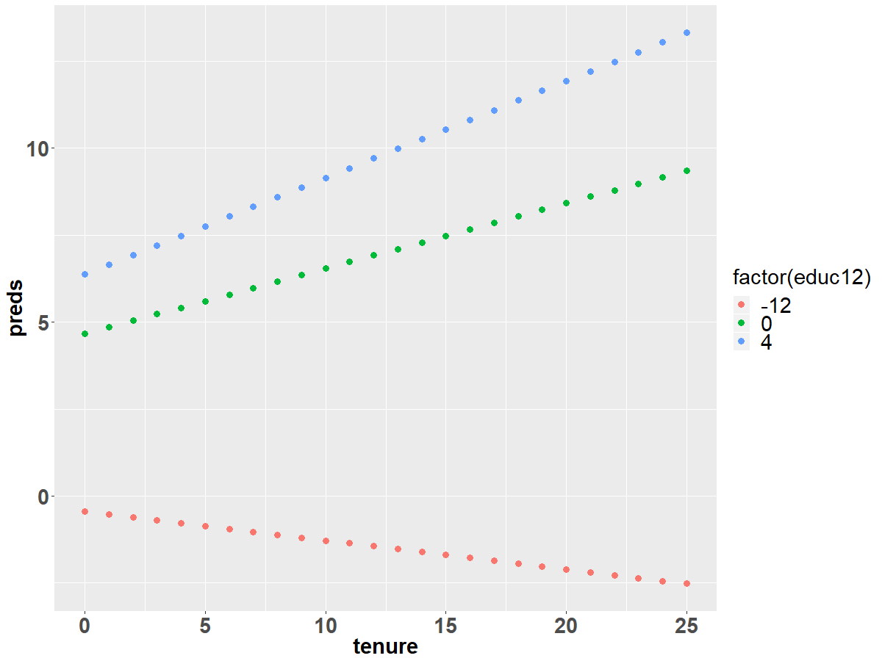

Slide 21
ggeffects Package
In the script for today, I also show you how to use the ggeffects package for making effects plots.
Basically same approach, but helpful when you have more complex models, need to control for other variables, etc…

Slide 22
Qualitative Predictors

Slide 23
Incorporating Qualitative Data
Up until this point our work with regression has solely focused on continuous variables as IVs and DVs. For instance, we used a CEO’s tenure to predict salary.
Our analyses have been constrained by our use of continuous variables and many real-world applications will involve discrete variables.
Regression can easily incorporate discrete or categorical values as regressors (i.e. ordinal and nominal level data).

Slide 24
For example…
You may want to know if there are significant differences in earnings based on gender?
You may want to know if jail sentences for drug addicts differ by race?
You may want to know if organizations in different sectors are more likely to engage in collaborative relationships.
You may want to know if public service motivation differs by level of government.
In each of the examples above, the key independent variable can only take on only a limited number of values.

Slide 25
Let's take the first example on gender and earnings
Individuals in our dataset will be placed into two categories: male or female (data was collected prior to considerations of gender identity).
If we created a variable that only took on these two values in a regression, it is termed a dummy variable. Dummy variables are also known as indicator variables, binary variables, dichotomous variables, or qualitative variables.

Slide 26
Descriptive Stats
How do we interpret the min and max values for earnings and male?
How do we interpret the mean?

Slide 27
Consider the following model:
Where:
y_{i} = hourly wage of a worker
D_{i} = 1 if the worker is a man
D_{i} = 0 otherwise (worker is a woman)
To understand what the model tells us we need to examine the expected value of hourly wages conditional on the value of D_{i}.
Mean earnings for women: E(y_{i}|D=0) =
=
Mean earnings for men: E(y_{i}|D=1) =
=

Slide 28
Interpreting the model
The intercept term, α₀, is the mean hourly earnings of female workers.
The slope term, α₁, is the difference between the mean hourly wage of men and the mean hourly wage of women.
Thus, the sum of α₀ + α₁ is the mean hourly wage of male workers.
A test for significance of the difference between male and female wages is a test of the null hypothesis that α₁ = 0.

Slide 29
Regression Output
What is the estimated earnings for female workers? For male workers? Is the difference significant?
Also, it is important to consider what dummy variables do not tell us. They do not tell us the reasons for the differences we find.

Slide 30
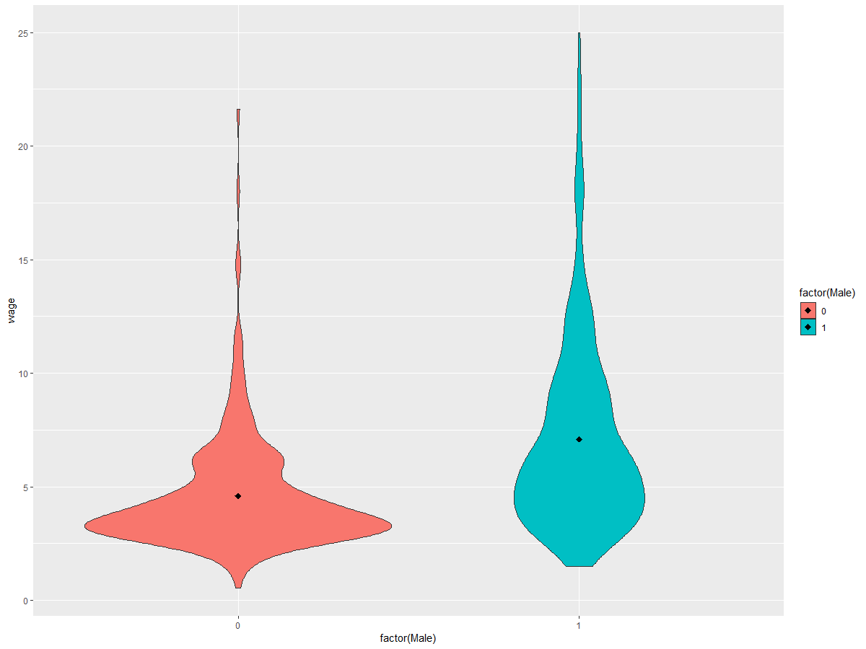

Slide 31
a₀ + a₁
a₀
Slope (a₁)

Slide 32
What happens if we switch the dummy variable to indicate female?

Slide 33
Base Category
When creating dummy variables for gender, the category that is assigned the value of zero is termed the base category (also termed the omitted or reference category).
Any interpretation of the meaning of the coefficient on the dummy variable in the regression must be done relative to the base category. So, choose your base category wisely, especially when the you have more than two categories.
If you make a new variable for each category, you just exclude the variable you want as the base from your model.
Ex. For gender, you would make a single indicator for male.
If you are using factors, then you can set your base as follows: relevel(“varname”, ref = “base”)

Slide 34
Adding a continuous variable to our model – years of experience
How do we interpret this model?
Mean earnings of women: E(y_{i}|x_{i}, D=0) =
Mean earnings of men: E(y_{i}|x_{i}, D=1) =
So, just as before, the average difference in earnings of men and women is α₁.
Also, note that the slope of years of work experience is the same for both males and females. (The model specifies that it is).

Slide 35
Running the regression
How do we interpret the intercept? How do we interpret the coefficient on male?
Is there a significant difference between male and female earnings when controlling for years of experience?

Slide 36
Looking at this relationship graphically
Because α₁ does not equal zero, there is a difference in the intercept term between males and females. The increase in earnings based on experience is the same for both male and female and so the lines are parallel.
Earnings
Male Earnings
Female Earnings
} α₁
} α₀
Years of Experience

Slide 37
The Dummy Variable Trap
The process to create dummy variables in R is fairly easy. We simply take the categorical variable and set it to a factor. R will automatically incorporate the factor into your model and create the appropriate number of dummy variables.
You could also do this by hand and create a new binary variable for each category that indicates if that observation is of that type. The examples we use follow this approach as it is more transparent when first learning to use qualitative variables.
Categories for dummy variables should be mutually exclusive

Slide 38
The dummy variable trap occurs when we attempt to run a regression with both a dummy variable indicating female and a dummy variable indicating male. While this may make sense at first, it creates a situation of exact multicollinearity. For example, if D1 is a male indicator and D2 is female indicator:
Then for every observation in the dataset: D_{2i} = 1-D_{1i}
As a general rule of thumb, if a dummy variable has m categories, you can have at most m-1 dummy variables in your regression. This forces one category to be the base category. In our previous example, female was the base category (more on this later).

Slide 39
Running a regression with dummy variable trap
Where D₁ is an indicator for male and D₂ is an indicator for female
R drops one of the regressors and runs the model with only one dummy variable

Slide 40
Incorporating Qualitative Variables with More than Two Categories
Many categorical variables have more than just two categories.
Consider our earnings example; suppose we wanted to split observations based on region in the United States.
The impact of region on hourly earnings could be modeled as.
Where:
y_{i} = average hourly wages
X_{i} = years of work experience
D_{1i} = 1 if lives in the south, 0 otherwise
D_{2i} = 1 if lives in west, 0 otherwise
D_{3i} = 1 if lives in north-central, 0 otherwise
Other is the base category (i.e. north-east)
Note that we had 4 region categories, so we included 3 dummy variables

Slide 41


Visual Representation of Region Model
D1i = 1 if lives in the south
D2i = 1 if lives in west
D3i = 1 if lives in north-central
Earnings
North Central
West Earnings
South Earnings
Other Earnings
} α₁
α₃
α₂
} α₀
Visual not matched to actual regression results.
Years of Experience

Slide 42
Expected Values of Region Model
D1i = 1 if lives in the south
D2i = 1 if lives in west
D3i = 1 if lives in north-central
Mean Hourly Wage of other:
E(y_{i}|x_{i},D₁=0,D₂=0,D₃=0) = α₀ + βx_{i}
Mean Hourly Wage of south:
E(y_{i}|x_{i},D₁=1,D₂=0,D₃=0) = (α₀ + α₁) + βx_{i}
Mean Hourly Wage of west:
E(y_{i}|x_{i},D₁=0,D₂=1,D₃=0) = (α₀ + α₂) + βx_{i}
Mean Hourly Wage of north-central:
E(y_{i}|x_{i},D₁=0,D₂=0,D₃=1) = (α₀ + α₃) + βx_{i}

Slide 43
Output from Region Model
How do we interpret each parameter estimate? How do we interpret the hypothesis tests when we use a qualitative variable with more than two categories? In other words, what is the null hypothesis for ‘south’?

Slide 44
Quick Exercise: Create Model, Graph, and Expected Values
Take out a piece of paper and write a model to predict hourly wages based on education (some highshcool, highschool grad, college) and experience (a continuous variable).
Write the regression model, draw a graph representing your model (and the hypothesized effects), and then develop the expected value equations for each category.

Slide 45
Allowing Slopes to Vary by Group
The previous slides have focused on allowing the intercept term to vary across different groups. This is interesting from both a policy and theoretical standpoint. But, as you may have noticed, we have forced the coefficients on our continuous variable to be the same for each group.
Going back to our original gender model, we may want to test the hypothesis that not only does the intercept term differ by gender, but also the returns to earnings from work experience.

Slide 46
Varying Slopes Model
Where:
y_{i} = hourly wage of a worker
D_{i} = 1 if the worker is a man; D_{i} = 0 otherwise (worker is a woman)
X_{i} = years of experience
The term D_{i}x_{i} means “D_{i} times X_{i}”; this is the interaction.
If the worker is a women, this product is always zero.
If the worker is a man, then D_{i} = 1, which means that D_{i}x_{i} = x_{i}. So basically, is there an additional effect of being a male on the slope of experience.

Slide 47
Varying Slopes Model Cont…
What are the expected values for our new model and how does the interaction affect our interpretation?
Mean Earnings of Women:
E(y_{i}|x_{i}, D = 0) = α₀ +β₁x_{i}
Mean Earnings of Men:
E(y_{i}|x_{i}, D=1) = (α₀ +α₁) + (β₁ +β₂)x_{i}
In this model, the difference in intercept term between men and women is α_{1.}
The difference in the slope of work experience between men and women is β_{2.}

Slide 48
Graphic Representation of Model
If both α₁ > 0 and β₂ > 0 then our model could be visualized as below
Male Earnings
Slope = β₁ + β₂
Female Earnings
} α₁
Slope = β₁
} α₀

Slide 49
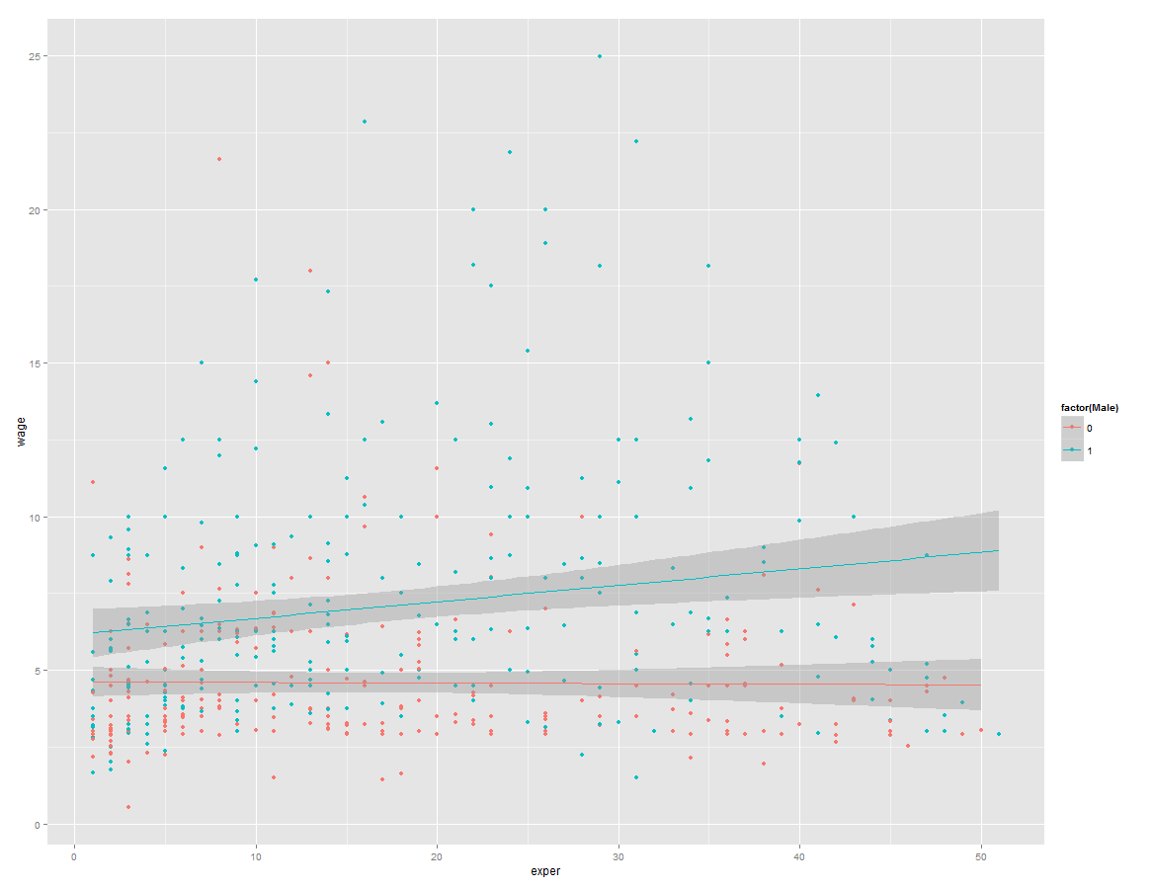
Plotting the actual data:
ggplot(data=wages, aes(x=exper, y=wage, colour=factor(Male))) +
geom_point() + stat_smooth(method="lm")

Slide 50
Output for Varying Slopes Model
How do we interpret the coefficients for each variable?
What do we conclude about the interaction?
What is the predicted wage for a male with 10 years of experience?

Slide 51
Using Two Categorical Variables
In a previous example, we developed models that included qualitative variables that had two or more categories.
It is possible to develop a model that has multiple qualitative variables.
We could expand our gender model to include a variable that includes both the gender of and the race of each observation.

Slide 52
Two Categorical Variable Model
Where
y_{i} = hourly wage of a worker
D_{1i} = 1 if the worker is a man, 0 otherwise
D_{2i} = 1 if white, 0 otherwise
X_{i} = years of experience
Based on the dummy variables there are four possible groups: white males, non-white males, white females, and non-white females. Each group will have a different intercept term.
Which group is our base group?

Slide 53
Conditional Expectations for Each Group
Mean earnings of non-white women
E(y_{i}|x_{i}, D₁=0, D₂=0) = α₀ + βx_{i}
Mean earnings of non-white men
E(y_{i}|x_{i}, D₁=1, D₂=0) = (α₀ + α₁) + βx_{i}
Mean earnings of white women
E(y_{i}|x_{i}, D₁=0, D₂=1) = (α₀ + α₂) + βx_{i}
Mean earnings of white men
E(y_{i}|x_{i}, D₁=1, D₂=1) = (α₀ + α₁ + α₂) + βx_{i}
What are the null hypotheses being tested in this model?
Remember:
D1 is dummy for gender (1 = male)
D2 is dummy for race (1 = white)

Slide 54
Output from Two Categorical Variable Model

Slide 55
Interaction Effects in a Two Categorical Variable Model
Original Model
Where
y_{i} = hourly wage of a worker
D_{1i} = 1 if the worker is a man, 0 otherwise
D_{2i} = 1 if white, 0 otherwise
X_{i} = years of experience
In this model we assume that the impact on earnings for being a male, α1, is the same for both whites and non-whites. We may believe however, that the impact may be larger for non-whites than for whites.
We also assume that the impact on earnings for being white, α2, is the same for both men and women. We may believe however, that the impact may be larger for women than for men.
Thus, we have implicitly imposed some constraints on our model based on its specification. In a sense, this is the reverse problem of the dummy variable trap. Here we have two terms to represent four groups.
How can we remove such constraints? We can incorporate an interaction term.

Slide 56
Interaction Term
The interaction term we added to the model is D_{1i} times D_{2i}.
We now have a different interpretation for white men since that is the only group where D_{1i}D_{2i} = 1. Now we have three terms in our model and can say something about each specific group.
Let's write out the expected earnings for each group.

Slide 57
Conditional Expectations for Each Group
Mean earnings of non-white women
E(
Mean earnings of non-white men
E(
Mean earnings of white women
E(
Mean earnings of white men
E(
What are the null hypotheses being tested in this model?
Remember:
D1 is dummy for gender (1 = male)
D2 is dummy for race (1 = white)

Slide 58
Output from Categorical Interaction Model

Slide 59
We interpret the coefficient on ‘male’ as the impact on earnings for being male relative to being a non-white female. Thus, it is the difference between non-white women and non-white men
We interpret the coefficient on ‘white’ as the impact on earnings for being a white female relative to being a non-white female. Here the difference in earnings between white women and non-white women is 0.406.
What about the difference in earnings between white males and non-white females? The difference is the sum of the coefficients on ‘male’, ‘white’, and ‘Male:white’.
Lastly, what is the difference in earnings between white males and non-white males?

Slide 60
In-Class Exercises

Slide 61
Using the ‘wages’ dataset we used above, run a model predicting wage, by educ, exper, white, male, and tenure.
Interpret the results.
What is the expected wage of a white, female, with 8 years of educ, and 0 years of exper and tenure?
What is the expected wage of a white, female, with 9 years of educ, and 0 years of exper and tenure?
Create an interaction effect between tenure and white.
Interpret the results.
Draw a diagram by hand displaying the results of the interaction (regardless of whether or not the interaction is significant).

