Slide 1
Advanced Data Analysis I Nonlinear Relations & Regression Assumptions
PA 541 Week 8
Michael D. Siciliano
Department of Public Administration
College of Urban Planning and Public Affairs

Slide 2
Topics
Review (i) interactions and (ii) qualitative predictors
Non-linear relationships: quadratics (will discuss log models after the midterm)
Review our regression assumptions
Learn how to test for and correct heteroskedasticity and multicollinearity
Let’s put what we have learned into practice with a case study

Slide 3
Admin
Next Week: Midterm
Two-sided sheet of hand-written notes allowed (honor system)
No other materials can be used during the exam.
You will submit your note sheet with your exam.
Midterm will be taken during class time. Designed to be finished in about 2 hours; but you have the full three hours to complete if needed.
Midterm will cover the first 8 weeks of class. Interpretation only; no coding.
Will post answer key to HW 2 this week

Slide 4
On the Horizon
Week 9: Midterm
Week 10: Model specification and data issues. Log Models. Data screening and cleaning. Methods for handling outliers and missing data.
Week 11: Spring Break
Week 12: Logistic Regression
Week 13/14: Panel Data

Slide 5

Starter Question
Someone commented on this article: “Correlation is not causation.” Does that old quip apply here?

Slide 6
Review Interactions

Slide 7
A model with an interaction
Educ
Tenure
Hourly Wage
How do we interpret each of the coefficients in the model? (assume education is the moderator)
Does this mean that tenure is not important?

Slide 8
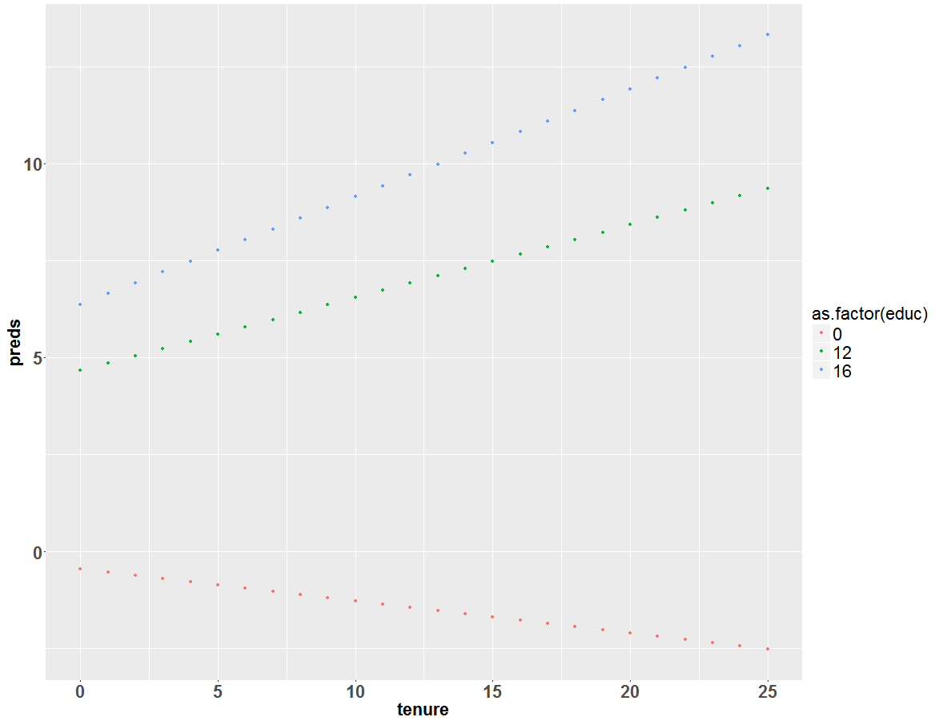
Uncentered model visually…

Slide 9
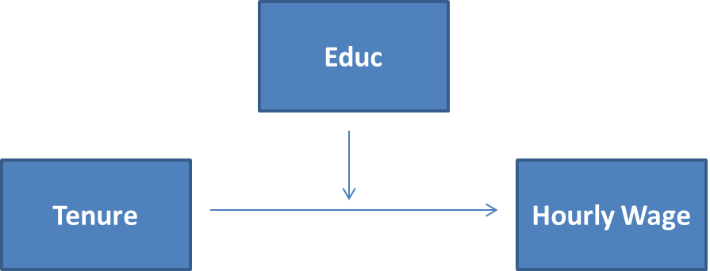
With education centered
What happened to the intercept?

Slide 10
With education centered cont.
Why is the slope of educ and educ12 the same?

Slide 11
With education centered cont.
What happened to the effect of tenure?

Slide 12
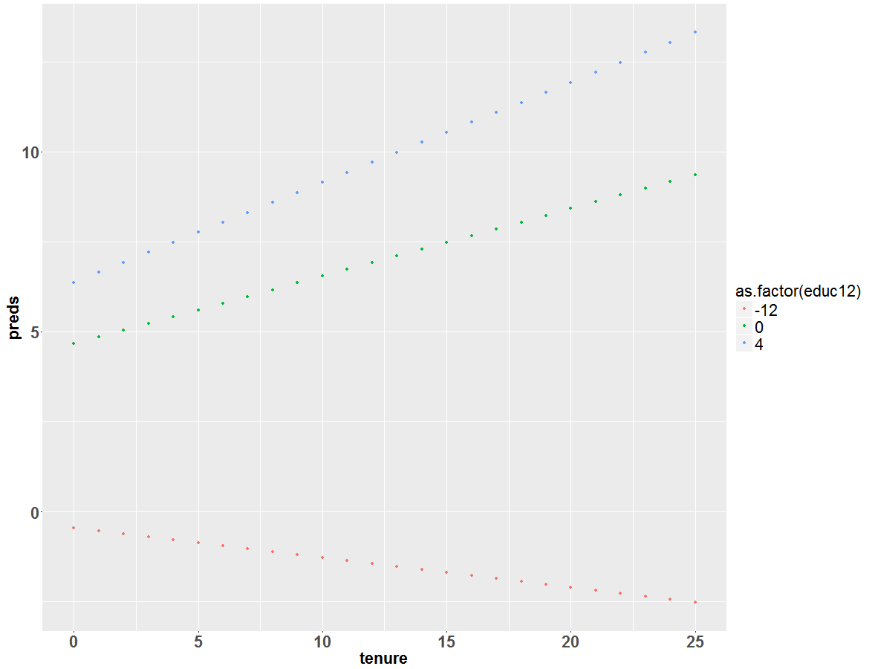
Centered model visually…

Slide 13
Is there any difference?
What is the effect of an additional year of tenure for someone with a highschool education?
Centered Model: just the slope of tenure = 0.188
Uncentered Model: -.0829 + .022542*12 = 0.188

Slide 14
Two takeaways:
Be careful to avoid concluding that a variable involved in an interaction is not important based on its simple main effect.
Generally best to center predictor variables if there is an interest in interpreting simple main effects (especially if the zero point is outside the relevant range).

Slide 15
Review: Categorical predictors

Slide 16
Two Categorical Variable Model
Where
y_{i} = hourly wage of a worker
D_{1i} = 1 if the worker is a man, 0 otherwise
D_{2i} = 1 if white, 0 otherwise
X_{i} = years of experience
Based on the dummy variables there are four possible groups: white males, non-white males, white females, and non-white females. Each group will have a different intercept.
Which group is our base group?

Slide 17
Model with no interactions
Mean earnings of non-white women
E(y_{i}|x_{i}, D₁=0, D₂=0) = α₀ + βx_{i}
Mean earnings of non-white men
E(y_{i}|x_{i}, D₁=1, D₂=0) = (α₀ + α₁) + βx_{i}
Mean earnings of white women
E(y_{i}|x_{i}, D₁=0, D₂=1) = (α₀ + α₂) + βx_{i}
Mean earnings of white men
E(y_{i}|x_{i}, D₁=1, D₂=1) = (α₀ + α₁ + α₂) + βx_{i}
What is the difference in earnings between males and females for nonwhite? For white?
D1 is dummy for gender, where female = 0, male =1
D2 is dummy for race, where nonwhite = 0 white = 1

Slide 18
Model with interactions
Mean earnings of non-white women
E(y_{i}|x_{i}, D₁=0, D₂=0) = α₀ + βx_{i}
Mean earnings of non-white men
E(y_{i}|x_{i}, D₁=1, D₂=0) = (α₀ + α₁) + βx_{i}
Mean earnings of white women
E(y_{i}|x_{i}, D₁=0, D₂=1) = (α₀ + α₂) + βx_{i}
Mean earnings of white men
E(y_{i}|x_{i}, D₁=1, D₂=1) = (α₀ + α₁ + α₂ + α₃) + βx_{i}
What is the difference in earnings between males and females for nonwhite? For white?
D1 is dummy for gender, where female = 0, male =1
D2 is dummy for race, where nonwhite = 0 white = 1

Slide 19
Output from Two Categorical Variable Model

Slide 20
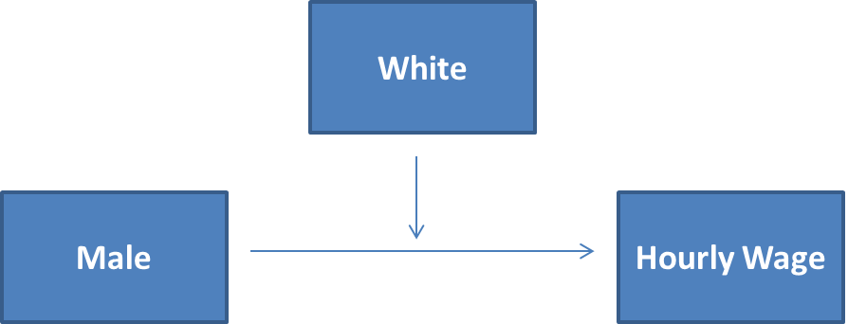
Output from Categorical Interaction Model

Slide 21
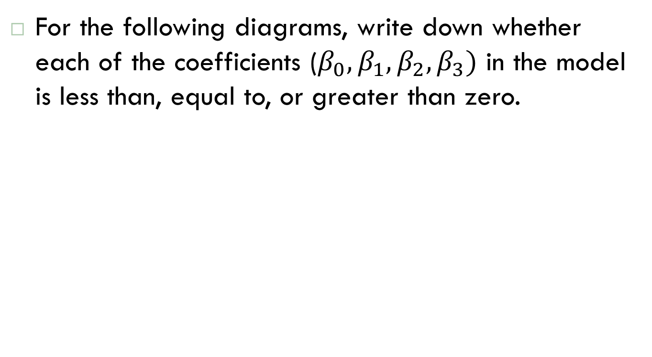
Review Question
For the following diagrams, write down whether each of the coefficients ($β_{0}, β_{1},β_{2},β_{3})$ in the model is less than, equal to, or greater than zero.

Slide 22
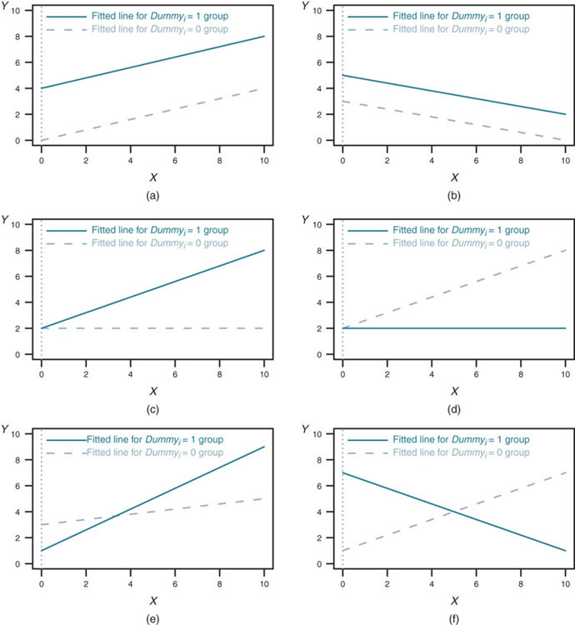
Ex. From Bailey2016, p. 194
$$Y_{i}=β_{0}+β_{1}X_{1}+β_{2}{Dummy}_{i}+β_{3}{Dummy}_{i}∗X_{i}+ e_{i}$$

Slide 23
Non-linear relationships

Slide 24
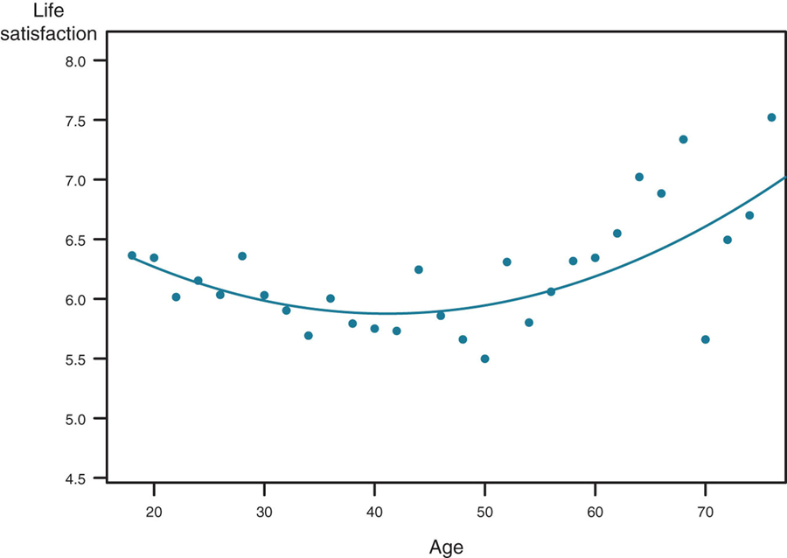
Can we still use linear models?
Image from Bailey 2016, p. 208

Slide 25
Quadratic Regression Model
Quadratic models may be considered when the scatter diagram takes on one of the following shapes:
Y
Y
Y
Y
X₁
X₁
X₁
X₁
β₁ < 0
β₁ > 0
β₁ < 0
β₁ > 0
β₂ > 0
β₂ > 0
β₂ < 0
β₂ < 0
β₁ = the coefficient of the linear term
β₂ = the coefficient of the squared term

Slide 26
Quadratic Regression Model
Quadratic models may be considered when the scatter diagram takes on one of the following shapes:
Y
Y
Y
Y
X₁
X₁
X₁
X₁
β₁ < 0
β₁ > 0
β₁ < 0
β₁ > 0
β₂ > 0
β₂ > 0
β₂ < 0
β₂ < 0
β₁ = the coefficient of the linear term
β₂ = the coefficient of the squared term

Slide 27
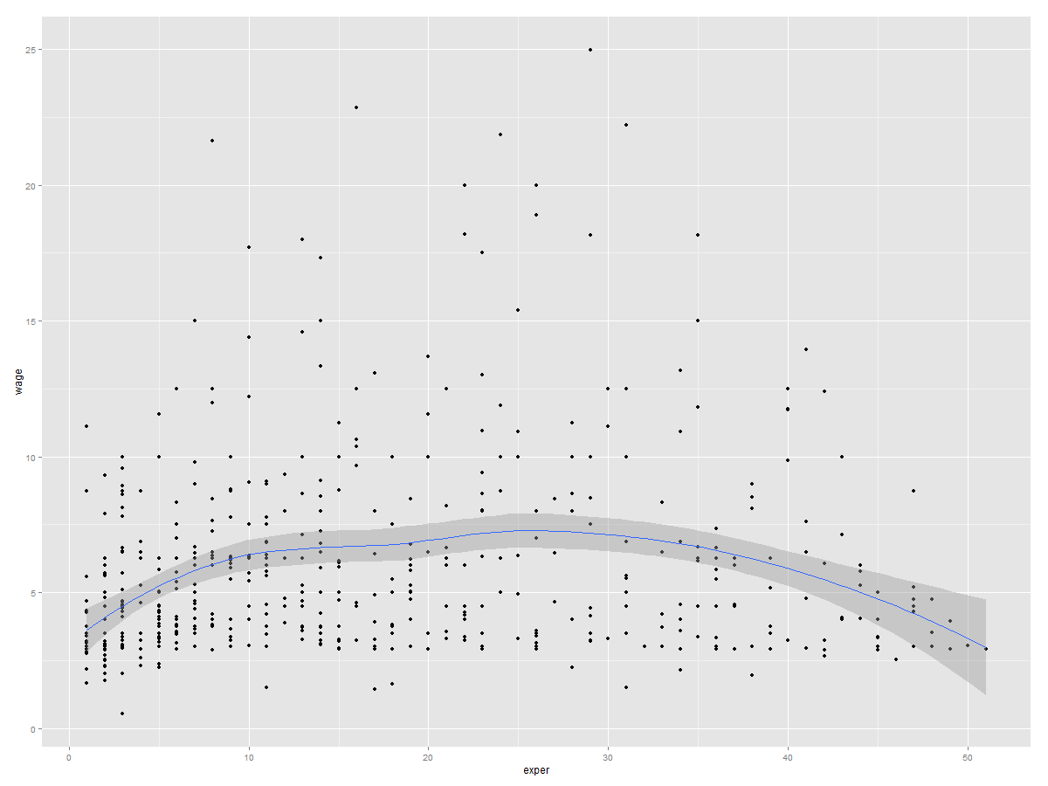
Wage and experience
ggplot(data = wage, aes(x=exper, y=wage)) + geom_point() + stat_smooth()
Here is a scatterplot of wage versus experience.
Provides justification for considering a squared term in a model.

Slide 28
How do we interpret the results?

Slide 29
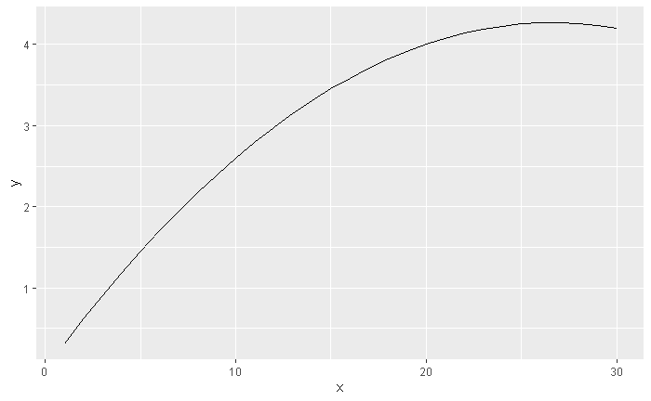
Interpreting the Slope Coefficients
The results on the previous slide indicate that the effect of experience on wage decreases as experience increases. Thus, there are diminishing marginal effects.
Therefore, the relationship between experience and wage is not fixed. Specifically, the slope decreases as experience increases.

Slide 30
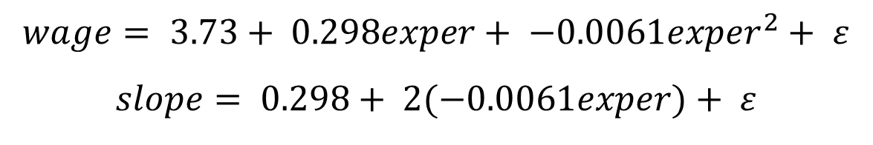
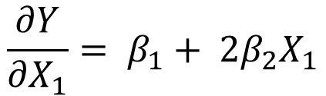
Interpreting the Slope Coefficients
Remember that our slope is simply the change in y divided by the change in x. We can calculate, at any value of experience, the slope of the relationship between experience and wage by taking the first derivative.
$$wage= 3.73+ 0.298exper+ −0.0061{exper}^{2}+ ε$$
$$slope= 0.298+ 2(−0.0061exper)+ ε$$
$$\frac{∂Y}{{∂X}_{1}}= β_{1}+ {2β}_{2}X_{1}$$
In General:

Slide 31
Interpreting Slope Coefficients
So, we see the first year of experience (going from 0 to 1) is worth
.298 + 2*-.0061*0 = 0.298
The second year of experience (going from 1 to 2) is worth less
.298 + 2*-.0061*1 = 0.286
Going from 10 to 11 years of experience is even less
.298 + 2*-.0061*10 = 0 .176
We can also use the regression equation directly and just plug in the values...there is no need to use calculus.
.298*10 + -.0061*(10^2) = 2.37
.298*11 + -.0061*(11^2) = 2.5399
2.539 - 2.37 = approx .17; very close to what we got above

Slide 32
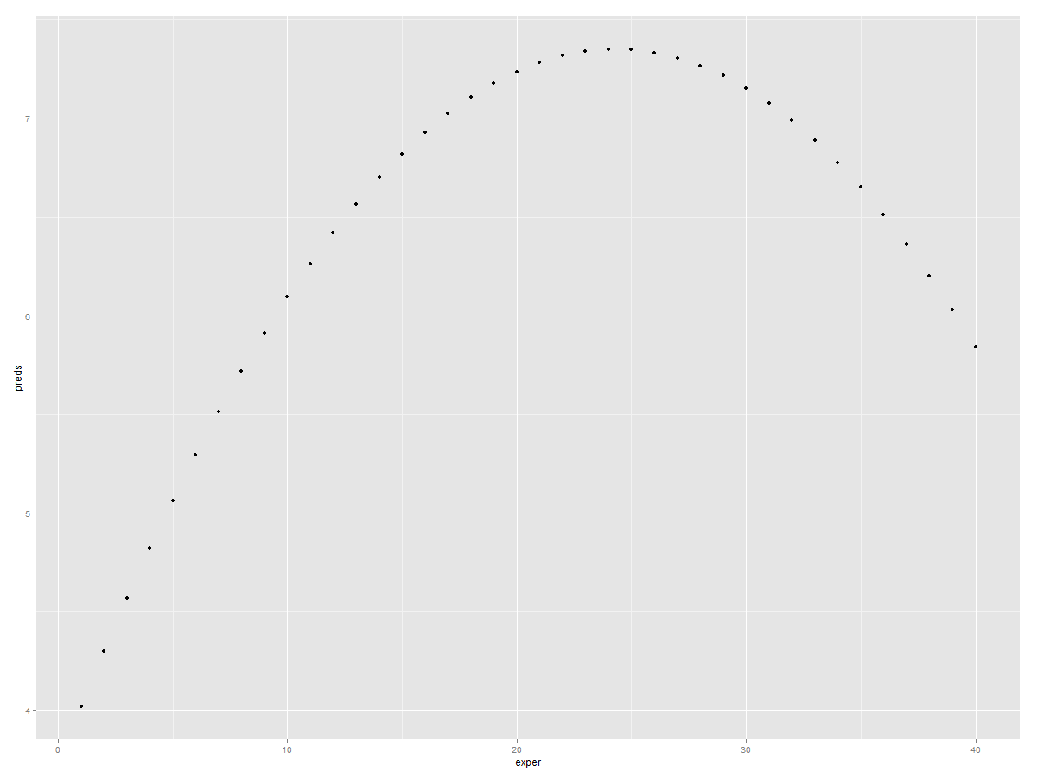
Plot the predicted relationship

Slide 33
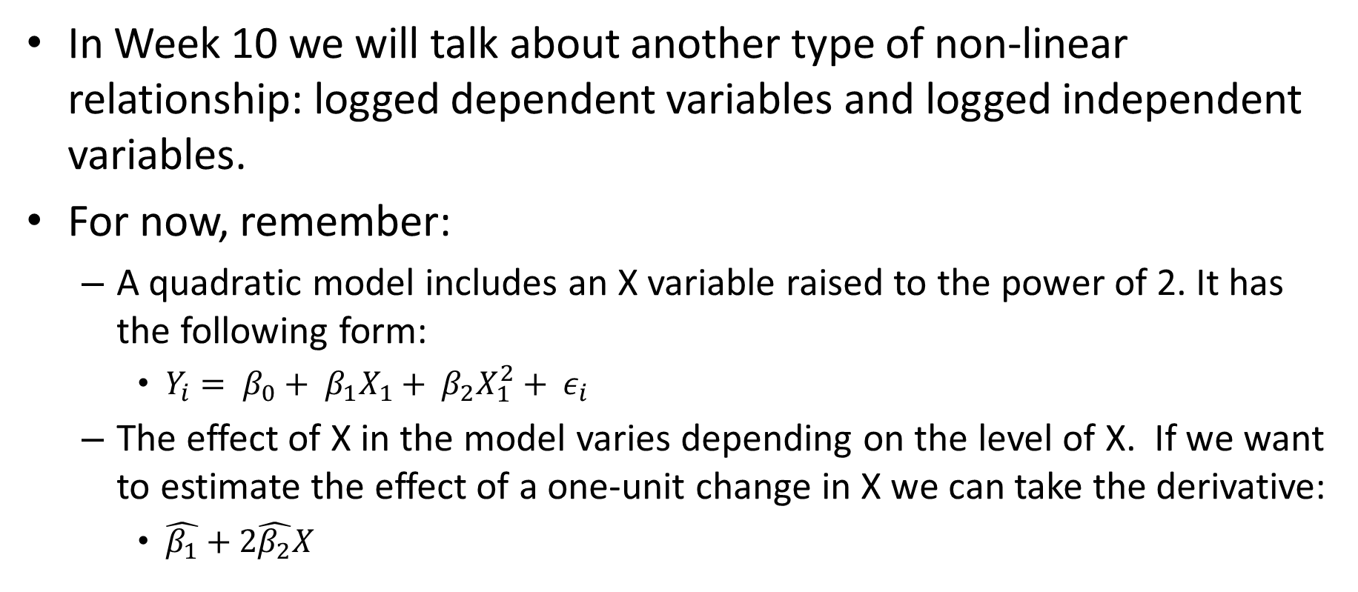
In Week 10 we will talk about another type of non-linear relationship: logged dependent variables and logged independent variables.
For now, remember:
A quadratic model includes an X variable raised to the power of 2. It has the following form:
$Y_{i}= β_{0}+ β_{1}X_{1}+ β_{2}X_{1}^{2}+ ε_{i}$
The effect of X in the model varies depending on the level of X. If we want to estimate the effect of a one-unit change in X we can take the derivative:
$\hat{β_{1}}+2\hat{β_{2}}X$

Slide 34
Testing Regression Assumptions

Slide 35
MLR Assumptions
MLR. 1 - Linear in parameters
MLR. 2 - Data drawn from a random sample (i.e., the errors are independent - no autocorrelation in the data)
MLR.3 - No perfect collinearity (no exact linear relationship among the independent variables)
MLR.4 - Zero conditional mean for the error term
MLR.5 - Homoskedasticity (i.e., the errors have equal variance)
MLR. 6 - Normality of the error term
Validity (i.e. data maps to research question)

Slide 36
Assumption: Homoskedasticity
One of the assumptions of the regression model is homoskedasticity; meaning that the variance in the disturbance term is equal regardless of the values of the predictor variables.
However, as we have discussed, it is quite possible that the residual variance does in fact vary across observations. When this occurs, we state that our errors are heteroskedastic.

Slide 37
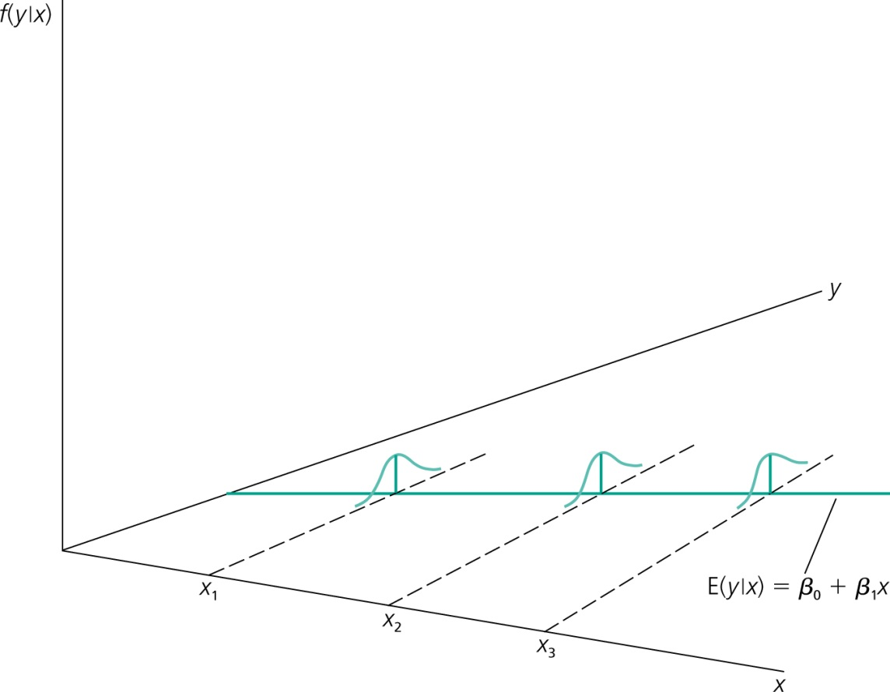
Graphical illustration of homoskedasticity
The variability of the unobserved
influences does not dependent on the value of the explanatory variable

Slide 38
OLS Estimation when Homoskedasticity is violated
What happens to our estimators when we have heteroskedastic errors:
β estimates are unbiased. This is true because the assumption necessary to show that our β values are unbiased estimates of the population parameters is that the four first assumptions are met. Heteroskedasticity only violates the assumption of the variance of the residuals, not the expected value. Hence, applying OLS will continue to yield unbiased estimates.
However, the variances of our estimates will be incorrect. Therefore, inferences drawn with the standard OLS variance formulas (t-tests, F-tests) will be incorrect.

Slide 39
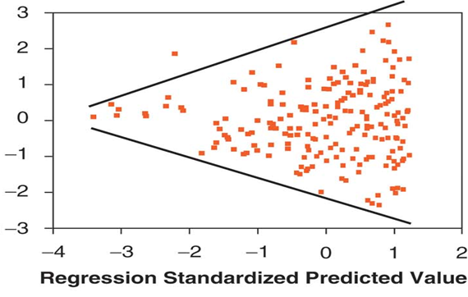
Detecting Heteroskedasticity
We have already gone through the informal procedures to test the assumption of homoskedasticity; namely checking the relationship between our IVs and the DV and checking the residual plots.

Slide 40
Detecting Heteroskedasticity cont..
A formal test for heteroskedasticity is the Breusch-Pagen test.
Assume that the other regression assumptions have been met. We can test to see whether any of the independent variables are significant predictors of our residuals (or more specifically, the square of our residuals).

Slide 41
Detecting Heteroskedasticity cont..
This should make intuitive sense; if some of our IVs are correlated with the squared-residuals, then the variance of the disturbance term is not independent of our observations (hence, in violation of our assumption).
We can simply examine the F-statistic from the regression of our squared residuals on our predictors to test this assumption; if it is significant, we fail to meet the assumption of homogeneity.
Significance here means that our predictor variables can explain the size of our residuals.

Slide 42
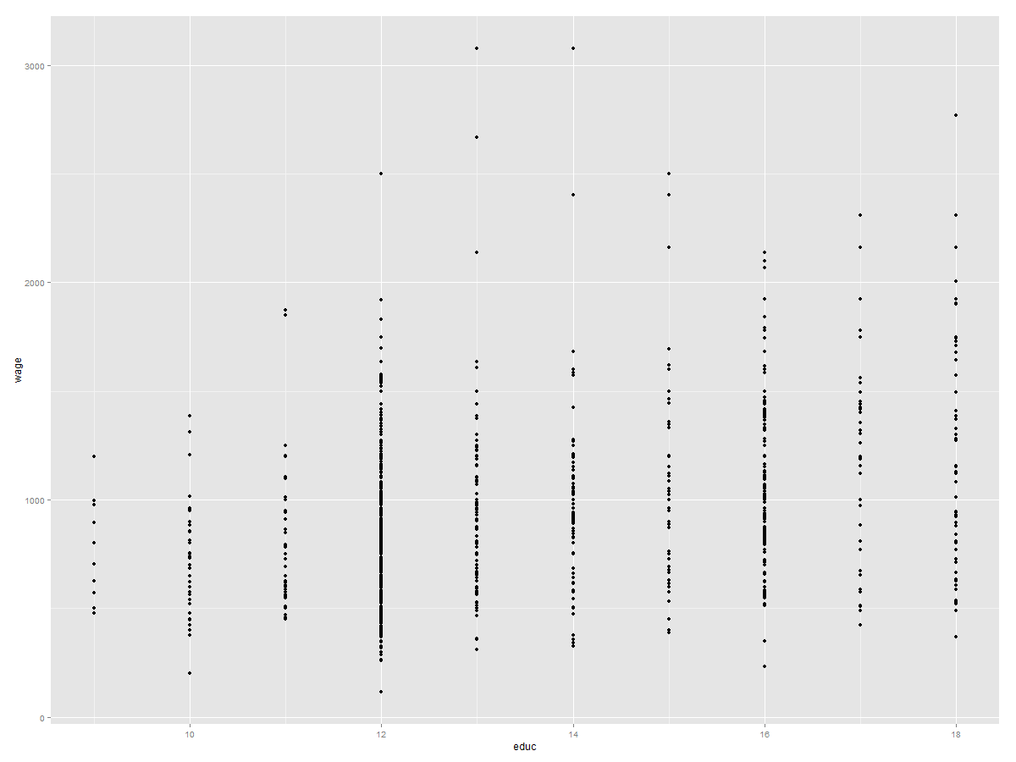
Detecting Heteroskedasticity cont…
Using the same dataset from above, we can run the model: wage_{i} = β₀ + β₁educ_{i} + ε_{i}
We know from previous discussions that education tends to have a heteroskedastic relationship with wages/income.

Slide 43
Testing for Heteroskedasticity
Add a new variable to your dataset that is the square of the residuals from your regression model.
Run a second regression of those squared residuals on education.
ε_{i}²= β₀ + β₁educ_{i} + u_{i}
Check the overall F-test. If none of the independent variables (or in this case, just education) can explain the square of the residual then we have met the assumption of homoskedasticity.

Slide 44
Output from Breusch-Pagan Test
What do we conclude?

Slide 45
Dealing With Heteroskedasticity
Once we have transformed variables and dealt with potential omitted variables, and still find heteroskedasticity in our data, how do we deal with it?
Clearly, we need to be able to adjust our methods to allow us to draw correct inferences.
Remember that the variances of our estimates are incorrect and not the point estimates themselves.

Slide 46
White’s Heteroskedasticity-Consistent Variances. Basically, since our estimates are unbiased when heteroskedasticity is present, we simply need to adjust our variance estimates to draw correct inferences.
Using the OLS estimates along with “White Standard Errors” or more properly “heteroskedasticity consistent (HC) standard errors” has become standard practice among empirical researchers.

Slide 47
HC standard errors in R
Correcting our standard errors in the presence of heteroskedasticity is straightforward in R.
We simply run our intended regression and obtain the results.
We know (i) that our coefficients are unbiased, but (ii) that our standard error estimates are not valid. We can correct for the standard errors after the fact.

Slide 48
Here we see that the estimates of our standard errors are slightly larger, but not large enough to change the significance levels of our predictor.

Slide 49
When we have heteroskedasticity we can:
Respecify the model
Use HC standard errors

Slide 50
Assumption: No Perfect Multicollinearity
The regression assumption is actually that there is no perfect multicollinearity (sometimes referred to as singularity).
In this section, we will deal with the issues that arise when multicollinearity exists.
As we have seen before R will not run models with perfect multicollinearity (it will just drop one of the violating variables).
Again, multicollinearity (i.e., something less than perfect multicollinearity) does not violate our regression assumptions, but its presence impacts our model.
As Wooldridge states: “the problem of multicollinearity is not really well-defined” as there is no absolute number at which multicollinearity becomes an issue.

Slide 51
Multicollinearity
Though not well defined, all else being equal, it is better to estimate β_{j} when there is less correlation between x_{j} and the other independent variables.
If high multicollinearity is present, often we can try to drop other independent variables from the model. Though as we saw with our discussion on omitted variable bias, dropping relevant variables leads to its own set of problems.

Slide 52
Why Multicollinearity is Problematic
Mertler and Vannatta (2010) state:
Multicollinearity causes difficulty when attempting to determine the importance of individual IVs because the individual effects are confounded due to overlapping information.
Multicollinearity increases the variances of the regression coefficients; thus increasing the likelihood of a type II error (accepting the null when it should be rejected).

Slide 53
Multicollinearity, Tolerance, and the Variance Inflation Factor (VIF).
We already know that one way to identify multicollinearity is to look at a simple correlation matrix. While effective, this method often misses some more subtle forms of multicollinearity.
Ex: If you used verbal GRE score, math GRE score, and total GRE score.
An alternate method is to use tolerance and the VIF.
Tolerance is a measure of the collinearity among the predictor variables. Tolerance values range from 0 to 1, where values close to zero indicate multicollinearity.
Tolerance and VIF are related by the simple equation: Tolerance = 1/VIF. Therefore, like tolerance, the VIF indicates whether a predictor has a strong linear relationship with other predictor(s).

Slide 54
Calculating VIF
The calculation of VIF is straightforward. It is simply (1/(1-R_{j}²). Where R_{j}² is the just r-squared from the regression model where predictor j is the dependent variable and the remaining predictors are the IVs.
Hence, this model is estimating the amount of variance in one IV that can be predicted by the other IVs.
No hard and fast rules for what value of VIF is cause for concern. However, Myers (1990) suggests that a value of 10 is the point at which to worry.
Menard (1995) suggests that values above 5 are worthy of concern. Again, the problem is not well-defined.

Slide 55
Obtaining Collinearity Diagnostics
First of all, as we just saw, the diagnostic measures are intuitive and simple to calculate “by hand”.
Second of all, R can produce these measures for us.
Let's look at obtaining these values through both methods.

Slide 56

Collinearity Diagnostics cont…
Assume we want to run the following model:
wage = β₀ + β₁educ_{i} + β₂exper_{i} + μ_{i}
To obtain collinearity diagnostics we would run the following model and save the r-squared:
educ_{i} = β₀ + β₂exper_{i} + μ_{i}
Then we simply calculate the VIF: 1/(1-.2075) = 1.26
$$var\left(\hat{β_{j}}\right)= \frac{σ^{2}}{N var(X_{j})(1−R_{j}^{2})}$$

Slide 57
Collinearity Diagnostics cont…
The output for collinearity diagnostics in R. Note, it is the same value that we calculated earlier.
As noted by Mertver and Vannata (2010) two ways to deal with multicollinearity are to drop the problem variable or to create a single new composite variable using the correlated IVs.
The square root of the VIF, is the factor by which the standard errors are inflated due to multicollinearity. Thus, a VIF of 4, means that the standard errors are double the size they would be if the predictors were all independent of one another.
If we had more than 2 predictors, each would have its own, different, VIF statistic.

