Slide 1
Advanced Data Analysis I Generalized Linear Models and Logistic Regression
PA 541 Week 12
Michael D. Siciliano
Department of Public Administration
College of Urban Planning and Public Affairs

Slide 2
Admin Stuff
HW 3 will be available tonight. Will not be due for two weeks (April 12th).
Remember, all labs are also recorded if you are unable to attend.

Slide 3
Starter Question

Slide 4
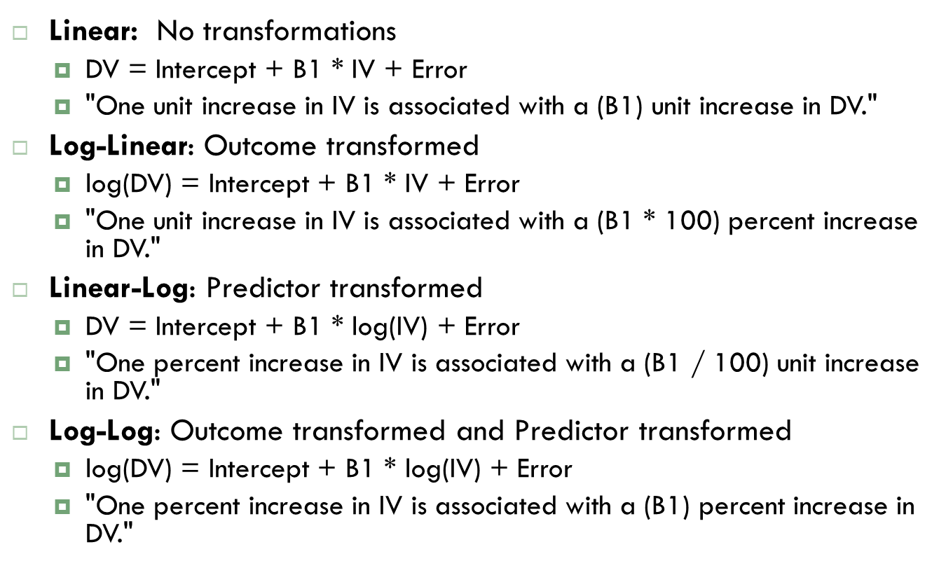

Slide 5
Generalized Linear Models

Slide 6
How do we model data when…
The response variable is:
Count data expressed as proportions
Binary data indicating success/failure
Data on time to arrival or number of occurrences
The error structure is:
Strictly bounded (as in proportions)
Unable to lead to negative fitted values (as with counts)
We will use a large class of statistical models known as generalized linear models (GLMs).

Slide 7
Generalized Linear Models
All linear models are comprised of three components
A random or stochastic component that specifies the conditional distribution of the response variable, y, given the predictors (up until now we have assumed a normal distribution for y).
A systematic component; a linear function of the regressors, called the linear predictor.
And a link function (g) that translates from the scale of the response variable to the scale of the linear predictor. So that the conditional mean is equal to the linear combination of the regressors.

Slide 8
More on the link function
For the OLS models, the link function is direct (and is referred to as the identity function).
Because the direct link assumes that the expected value can take on any value from positive to negative infinity it is not appropriate for all models.
For example, the mean of a binary outcome variable must be between 0 and 1. Therefore, we need a link function that allows us to translate from the scale of the response to the scale of the linear predictor.

Slide 9
Link function cont…
For GLMs we apply a function (g) to the conditional mean of the response so the outcome can be modeled as a linear combination of the regressors.
Reversing this relationship produces the inverse-link function and returns the outcome on the scale of the original response variable:

Slide 10
Again, in linear regression, the transformation is the identify (that is, g(u) = u) and the data distribution is normal, with standard deviation σ, estimated from the data.
In logistic regression, the transformation is the logit link, g(u) = log[u/(1-u)] and models the log odds. It is appropriate when the data distribution is defined by the probability for binary data and thus bounded between 0 and 1.

Slide 11
Linear probability and logistic regression models

Slide 12
Linear Probability and Logistic Regression Models
These models can be used to predict membership in a group or category of outcome for individual cases:
Disease or no disease
Graduate or drop out
Married or single
Drug use or no drug use
Took public transit today or did not
Company closed or open
Profits or no profits
War or no war
Employed or unemployed
Two Questions we will look at today:
What is the probability of falling during a ski run based on the difficulty of the run and the season.
What is the likelihood of being rejected for a loan based on race, bankruptcy status, and loan amount?

Slide 13
Linear Probability Model
The OLS regression model places no restriction on the values of the independent variables – we can use continuous, dichotomous, categorical, squared variables, etc…
The dependent variable, however, is assumed to be continuous. Because our independent variables contain no restrictions on their values, Y is presumably free to vary between ± infinity.
When our dependent variable is restricted to two values (zero or one) then the violation of this assumption warrants special attention. Which we will give it…but not just yet.

Slide 14
Linear Probability Model
Typically, when we have a continuous dependent variable, we interpret β_{j} as the impact of a one unit change of x_{j} on y (holding everything else constant).
What happens to our interpretation when the dependent variable is binary as y only changes from zero to one or from one to zero?

Slide 15
Linear Probability Model cont…
In previous classes, we discussed conditional expectation and denoted it as:
When we have a binary dependent variable expectation changes to probability:
Thus, Prob[y_{i}=1|x₁,x₂,…x_{k}] is the conditional probability of success. (We typically denote 1 as success and 0 as failure)

Slide 16
Linear Probability Model cont…
Based on the previous slide, β_{j} can be interpreted as the impact of a one unit change in x_{j} on the probability that y equals one (holding all else constant).
Given this definition, we are still able to apply the OLS regression models we have been using when we have binary dependent variables (though as we will see there are some problems with this).

Slide 17
Linear Probability Example
Suppose we are interested in predicting loan rejections by banks. I run the following model:
Where
Reject = 1 if loan was rejected
Pubrec = 1 if person had previously filed for bankruptcy
Black = 1 if person is black
Hisp = 1 if person is Hispanic
Loanprc = is the amount of the loan divided by the price of the house
(typically ranges between 0 and 1, where 1 means you are asking for a loan equivalent to the full price of the house)

Slide 18
Example cont…
How do we interpret each parameter estimate?
For bankruptcy, the results indicate that someone who has filed for bankruptcy in the past has an increase in the probability of being rejected for a loan of .298.

Slide 19
Example cont…
Since the coefficients are estimates of the impact of a one unit change in the regressors on the probability that y equals one, we can interpret the predicted outcome as the predicted probability that outcome equals one for the individual.
What is the probability that a person who is (i) black, (ii) never filed for bankruptcy, and (ii) is asking for a loan amount that is twice the amount of the house, will be rejected?

Slide 20
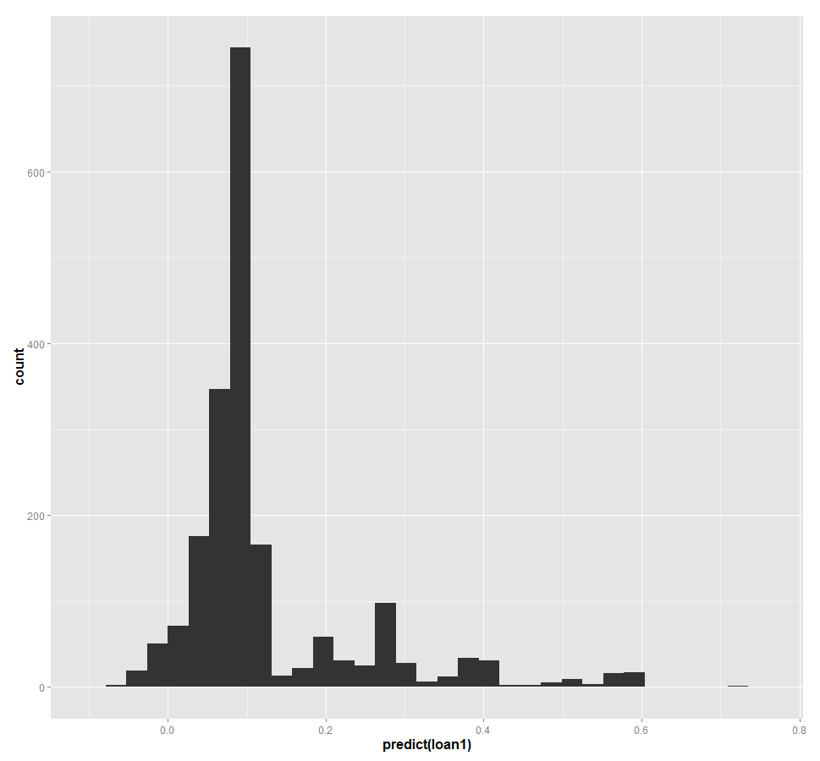
Predicted Probabilities
Here is a histogram of our models predicted probability for each individual.

Slide 21
Issues with Linear Probability Models
Generally speaking, linear probability models do not constrain our predicted probabilities between zero and one.
This aspect of linear probability models raises concern for some researchers. Hence, we will look at logistic regression models.
However, the linear probability model is still used by many researchers due to its simplicity and ease of interpretation.
There are other statistical issues related with the linear probability model that we will discuss as well.

Slide 22
Why Logistic Regression

Slide 23
First, it is important to note that there are other approaches to modeling binary data.
These include:
Probit – link is based on the normal cumulative distribution function
Complementary log-log – whose link is log(-log(1-p))
However, as argued by Faraway (2014), Hilbe (2016) and others, the logit link offers several advantages:
The mathematics are simpler
It is easier to interpret

Slide 24
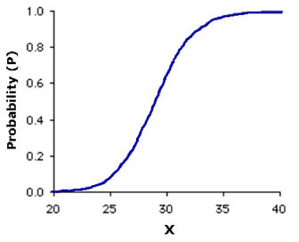
Logistic Regression
Problems with linear probability models (Following slides draw from Pampel 2000)
As we just saw, it does not restrict predicted values to fall between zero and one. This is a boundary problem.
Assumption of linearity: with a floor and ceiling, it seems logical that a one unit change in an IV on predicted probability of success would be smaller near the floor or ceiling
One solution is to truncate the range
What are some examples where this form makes more sense?

Slide 25
Logistic Regression
Problems with linear probability models cont…
Violation of the assumption of normality: Linear regression assumes a normal distribution of the error term around the predicted Y values associated with each X value. Because Y can only take on two values, the residual can only take on two values. To illustrate, the residuals take the value of:
1-(β₀ + β₁X_{i}) when Y_{i} equals 1, and
0 - (β₀ + β₁X_{i}) when Y_{i} equals 0
Even in the population, the distribution of errors for any X value cannot be normal when a distribution has only 2 potential values.

Slide 26
Logistic Regression
Problems with linear probability models cont…
Violation of the assumption of homoskedasticity
Variances are not equal across all levels of the IV. The regression error term varies as a function of X.

Slide 27
Transforming Probabilities into Logits (Pampel 2000)
Given the floor and ceiling problem of linear regression on binary dependent variables we need a transformation (i.e. a link function) to allow for decreasing effects of X on Y as the predicted value of Y approaches the floor or ceiling.
There are many non-linear functions that could represent such a relationship – the logistic or logit transformation is used because of its desirable properties and relative simplicity.

Slide 28
Transforming Probabilities into Logits
Each observation has a probability of experiencing some event defined as P_{i}. Since, we only observe the outcome as either 1 or 0, P_{i} is never actually observed and therefore must be estimated.
Given this probability, the logit transformation involves two steps:
Take the ratio of P_{i} to 1-P_{i}; which is the odds of experiencing the event.
Take the natural logarithm of the odds.
L_{i} = ln[P_{i}/(1-P_{i})] this is the logged odds or logit

Slide 29
Why the Logit Transformation is Useful
Odds express the likelihood of an occurrence relative to the likelihood of nonoccurence. Thus, like probabilities it has a lower limit of zero, but has no upper bound or ceiling. As the probability gets closer to 1, the odds become an increasingly large number. To illustrate the relationship between probabilities and odds:
P_{i} | 0.01 | 0.1 | 0.2 | 0.3 | 0.4 | 0.5 | 0.6 | 0.7 | 0.8 | 0.9 | 0.99
1-P_{i} | 0.99 | 0.9 | 0.8 | 0.7 | 0.6 | 0.5 | 0.4 | 0.3 | 0.2 | 0.1 | 0.01
Odds | 0.01 | 0.11 | 0.25 | 0.43 | 0.67 | 1.00 | 1.50 | 2.33 | 4.00 | 9.00 | 99.00

Slide 30
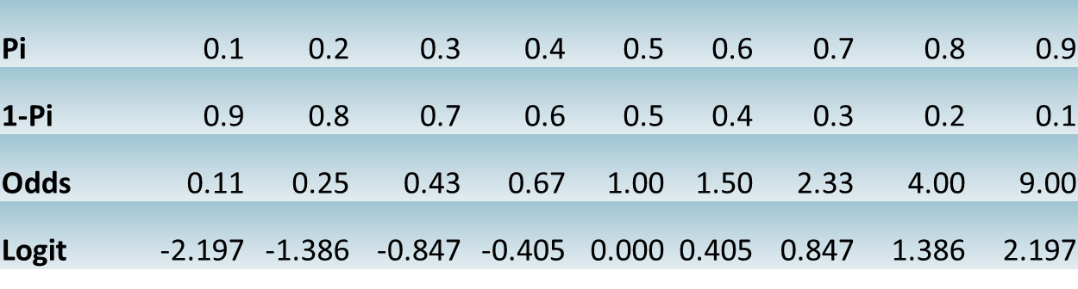
Why the Logit Transformation is Useful cont…
Taking the natural log of the odds eliminates the floor (just as transforming probabilities into odds eliminating the ceiling). When using the natural log:
Odds above 0, but below 1, produce negative numbers
Odds equal to 1 produces 0; and
Odds above 1 produces positive numbers

Slide 31
Properties of Logits:
No upper or lower boundary – the odds eliminate the upper boundary of probabilities, and logged odds eliminates the lower boundary of probabilities
The logit transformation is symmetric around the midpoint of probability of .5. The logit when P_{i} = .5 is zero. Probabilities below .5 produce negative logits (because the odds are less than one) and probabilities above .5 produce positive logits (because the odds exceed one)
The same change in probability results in different changes in logits. Thus, as P_{i} approaches 0 or 1, the same change in probability translates into greater change in the logged odds.
Pi | 0.1 | 0.2 | 0.3 | 0.4 | 0.5 | 0.6 | 0.7 | 0.8 | 0.9
1-Pi | 0.9 | 0.8 | 0.7 | 0.6 | 0.5 | 0.4 | 0.3 | 0.2 | 0.1
Odds | 0.11 | 0.25 | 0.43 | 0.67 | 1.00 | 1.50 | 2.33 | 4.00 | 9.00
Logit | -2.197 | -1.386 | -0.847 | -0.405 | 0.000 | 0.405 | 0.847 | 1.386 | 2.197

Slide 32
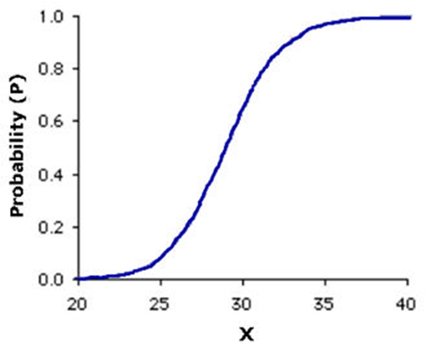
Thus…the linear relationship between X and the logit implies a nonlinear relationship between X and the original probability.
Such that a one unit change in the logit results in smaller differences in probabilities at high and low levels than at levels in the middle.
Logit | -3 | -2 | -1 | 0 | 1 | 2 | 3
Pi | 0.047 | 0.119 | 0.269 | 0.5 | 0.731 | 0.881 | 0.953
Change | --- | 0.0720 | 0.1500 | 0.2310 | 0.2310 | 0.1500 | 0.0720

Slide 33

The Logistic Regression Equation
The linear relationship between the predictors and the logit of the outcome implies non-linear relationships with the probabilities.
The linear relationship between the predictors and the logit is defined as:
Where P_{i} is just the predicted probability. Thus, this is the logged odds.

Slide 34


Obtaining Probability from Logits
To express the probabilities rather than the logit as a function of X, first take the exponent of each side of the equation. Note that the logarithm of a number as an exponent equals the number itself: Exp (ln(X)) = X
Solving for Pi gives the following formula:

Slide 35

Side Note
The equation on the previous slide:
Is often shown in the equivalent form of:

Slide 36
Logistic Transformation
Image from: www-personal.umich.edu/~kwelch/510/2007/handouts/LogisticRegression.ppt

Slide 37


Logistic Regression Equation
The linear regression equation is the logit or log of the odds.
The dependent variable is the natural log of the probability of being in one group divided by the probability of being in another.
The procedure used for estimating the coefficients is maximum likelihood; the goal of this procedure is to find the best linear combination of predictors to maximize the likelihood of obtaining the observed frequencies.
Stated differently, “maximum likelihood estimates are those parameter estimates that maximize the probability of finding the sample data that actually have been found” (Hox, 2002).
I will have a brief discussion on MLE to start next week…

Slide 38
Let’s walk through a simple example
Assume we want to predict the probability of falling on a ski run (0=not falling, 1=falling). The predictors in the equation will be difficulty of the run (ordered from 1 to 5 and will be treated as continuous) and a categorical variable for season (1=winter, and 0 for other).

Slide 39
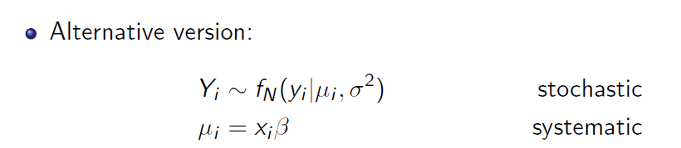
But first…back to our definition of a statistical model
A statistical model is a formal representation of the process by which a social system produces output.
Here we observe people falling or not falling on a ski run. We represent this process by a bernoulli distribution.

Slide 40
Logistic Regression in R
Logistic regression, as mentioned above, is a type of generalized linear model. These models are usually fit through the glm() function in R.
The function follows a similar format to our lm() calls from last week:
glm(formula, family=family(link=function), data=), where the probability distribution (family) and corresponding default link function (function) are as follows:
Family | Default Link Function
Binomial | (link = “logit”)
Gaussian | (link = “identity”)
Gamma | (link = “inverse”)
Poisson | (link = “log”)
Quasipoisson | (link = “log”)
…and several others

Slide 41
Our Model of Falling While Skiing

Slide 42
Interpreting the coefficients – Logged Odds
The logistic coefficients, β, for the predictors correspond to our OLS regression coefficients. They are often termed logistic regression coefficients, log odds-ratios, or logit coefficients. These coefficients can be used to construct prediction equations and hence generate predicted values (which we will do in the larger example below).
We can say then, that a one unit increase on the predictor variable increases the log odds (or logit) of the dependent variable by β.
For example, based on the output for our simple skiing data, increasing the difficulty of the ski run from 1 to 2 increases the log odds of falling by 1.569.
The beta coefficients can vary between plus and minus infinity. A value of zero indicates that the given explanatory variable does not affect the logit.

Slide 43
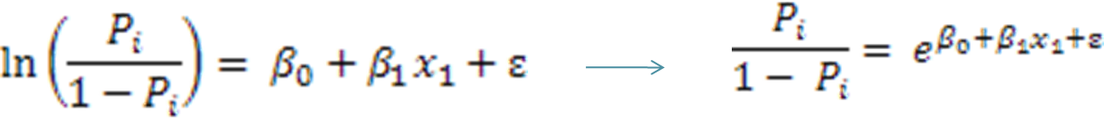
To help improve the interpretability of our results, we can exponentiate the coefficients.

Slide 44
Interpreting the Coefficients - Odds
The odds ratio, Exp(B) has a more straightforward interpretation. This value is simply the ratio of the odds for two groups where one group has a value on one of the predictor variables that is one unit larger than the other group.
For example, β is 1.569 in our example, then the corresponding odds ratio (e^{β}) is 4.801. Hence, we can say that when the difficulty of the ski run increases by one unit, the odds of falling are 4.8 times greater.
odds ratio = exp(β) so 4.801 = exp(1.569) β = ln(odds ratio) so 1.569 = ln(4.801)

Slide 45
More on the Odds Ratio
What is an odds ratio?
From Tabachnick and Fidell p. 462: An odds ratio has a very clear intuitive understanding in a 2X2 table; it is the odds of an outcome for cases in a particular category of a predictor divided by the odds of that outcome for the other category of the predictor.

Slide 46
Odds Ratio Example
Suppose that the outcome is hyperactivity in a child and the predictor is familial history of hyperactivity.
Odds are 15:5 or 3:1 for hyperactivity in a child with familial history; odds are 9:150 (or 3:50) for a child without familial history. The odds ratio is just the ratio of these odds.
Odds ratio is (15/5) / (9/150) = 50
Thus, children with a familial history of hyperactivity are 50 times more likely to be hyperactive than those without a familial history.
If we think of child hyperactivity as the DV, and familial history as the IV, going from no familial history (0) to familial history (1) increases the odds of hyperactivity in the child by 50 times.
 |  |  | Familial History
 |  |  | yes | no
Child |  | yes | 15 | 9
Hyperactivity |  | no | 5 | 150

Slide 47
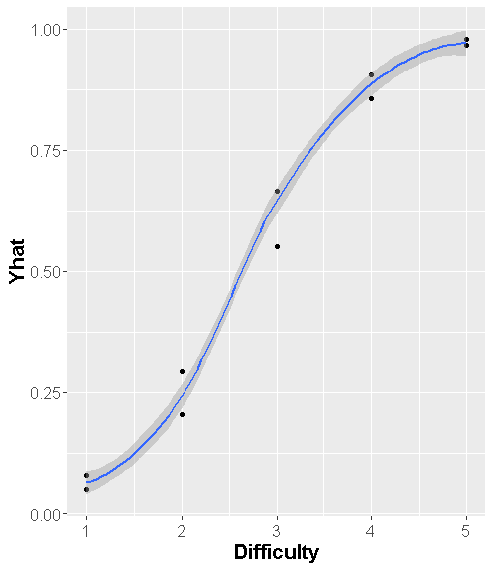
Probability interpretation
We will talk more about this in our next example, but let me show you one option for linking a unit change to a change in probability. [Note, this relationship is nonlinear and so only holds at particular values of X]
One approach for interpretability is to hold all other predictors at the mean and calculate and the change in probability if the variable of interest moves by 1.

Slide 48
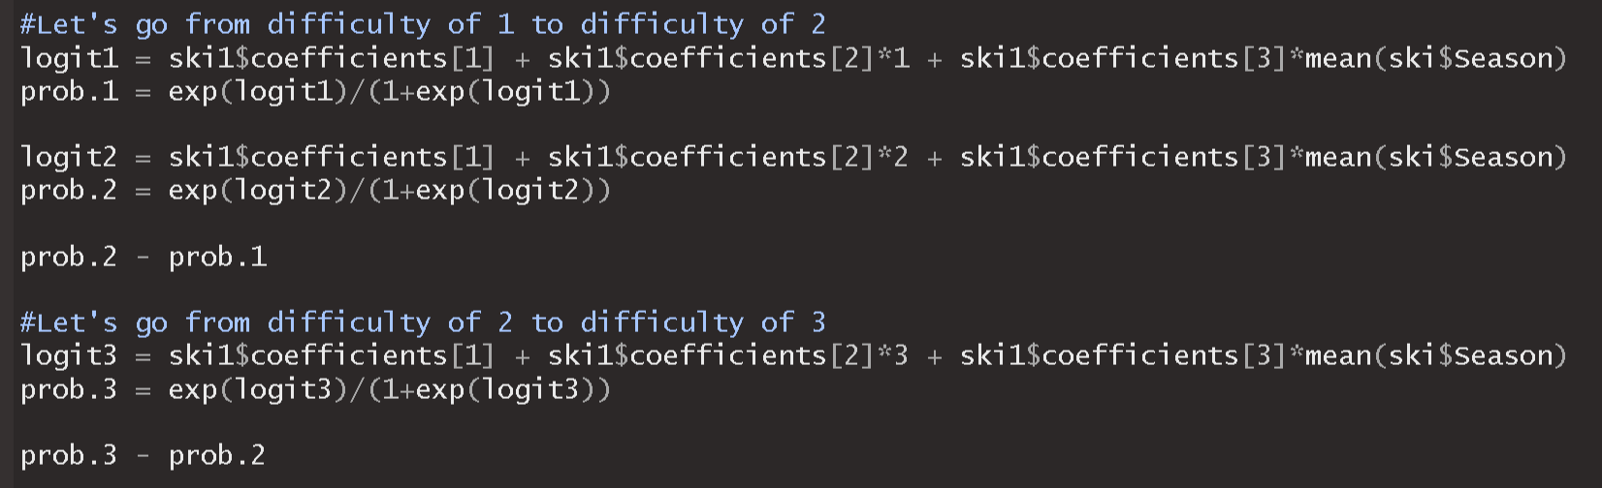
###
prob.2 – prob.1 = .184
prob.3 – prob.2 = .365

Slide 49
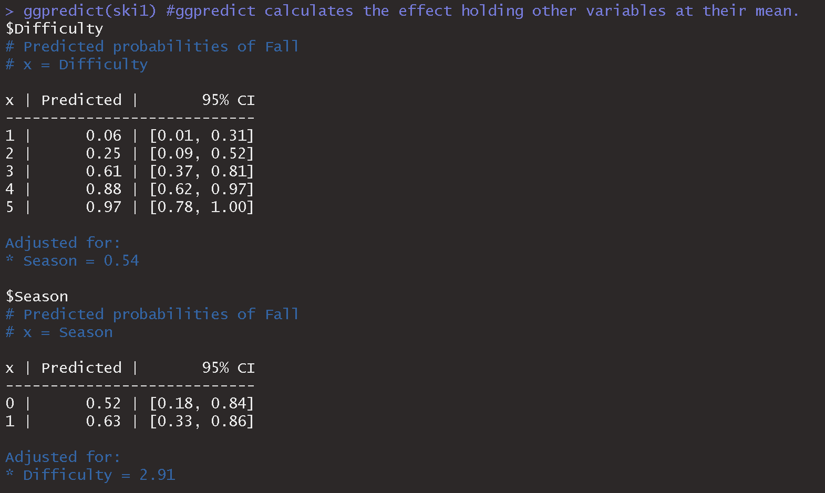
The ggefects package automates this idea and provides predicted probability at different levels of your independent variables

Slide 50
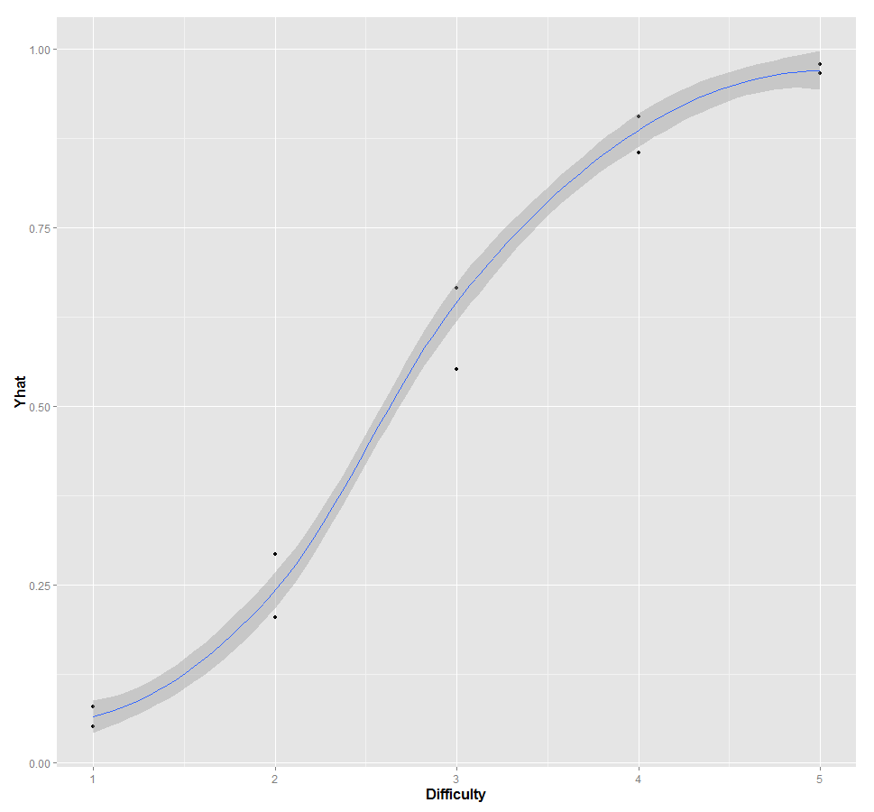
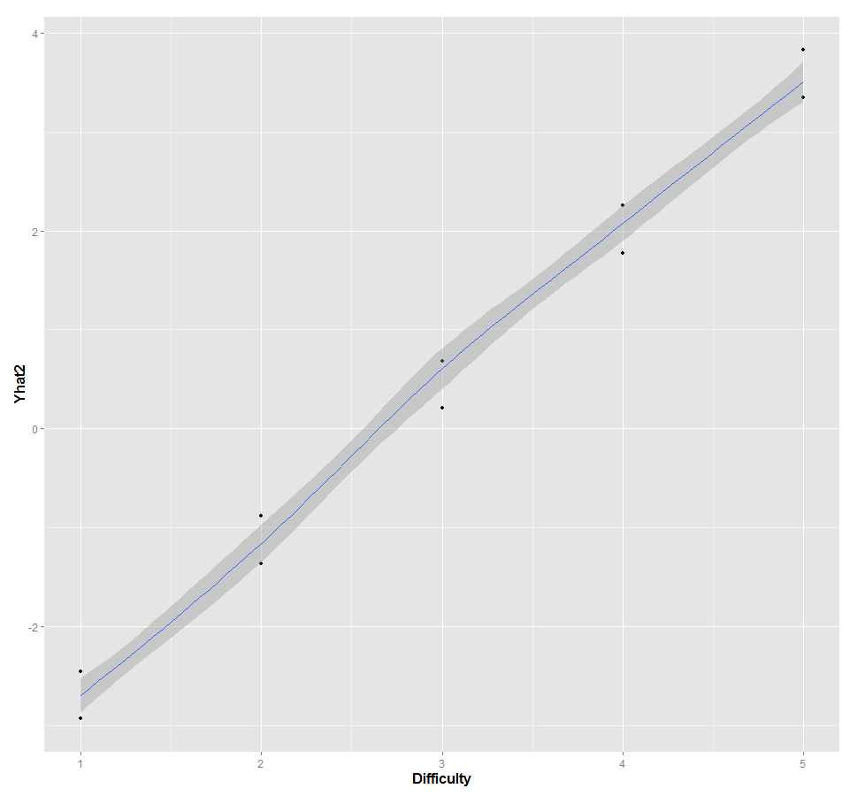
A few visualizations

Slide 51
Another example of Logistic Regression

Slide 52
Logistic Regression Example II
Return to our loan example, where we were interested in predicting loan rejections by banks via the following model:
Where
Reject = 1 if loan was rejected
Pubrec = 1 if person had previously filed for bankruptcy
Black = 1 if person is black
Hisp = 1 if person is Hispanic
Loanprc = is the amount of the loan divided by the price of the house
However, we are no longer running a linear probability model, and so we would write our logistic regression model as:

Slide 53
Interpreting the Coefficients – Logged Odds
Logged Odds: Again, these coefficients have the exact same interpretation as in OLS regression except that the units of the DV are now in logged odds.
Note that these Betas can be negative – but in our example all predicators are positively related with the DV, loan rejection.

Slide 54
Interpreting the Coefficients - Odds
Odds: As stated before, a coefficient of 1 leaves the odds unchanged (i.e. it has no effect). A coefficient greater than 1 increases the odds of occurrence and a coefficient less then 1 decreases the odds of occurrence. The greater the distance from one in either direction, the greater the impact of the predictor variable.
So for pubrec, compared to an individual who never filed for bankruptcy, an individual with at least one filing has an increase in odds of loan rejection by 5.6 times.

Slide 55
Interpreting the Coefficients – Odds cont…
It is important to remember that the odds have a multiplicative effect. Lets assume a white person’s odds of rejection based on a set of predictors is 3:1. Thus, if we took those same predictors for a black person, the odds of rejection would be 3*3.471 = 10.413:1.
Based on this, when we divide the odds of someone who is white by someone who is black (as long as the other predictors are the same) then the result is just Exp(B). More specifically, 10.413/3 = 3.471. Thus, the coefficient shows the ratio of odds for a one unit increase in the independent variable.
So, if you wanted to calculate the change in odds for increasing loanprc by one and going from 0 to 1 on pubrec, you need to multiply 8.499*5.639. So the odds increase by 47.9.

Slide 56
Interpreting the Coefficients – Odds cont…
Let’s look at this one other way.
Assume we have two people:
Person A: No public record, white, and asking for a loan of 75%.
Person B: Public record, white, and asking for a loan of 75%.
$$\frac{{Odds}_{x1=1, x2=0, x3=0, x4=.75}}{{Odds}_{x1=0, x2=0, x3=0, x4=.75}}=\frac{exp⁡(β_{0}+ β_{1}+ β_{4}∗.75)}{exp⁡(β_{0}+ β_{4}∗.75)}=exp⁡(β_{1})$$

Slide 57
Probability Interpretations
Logistic coefficients are most often interpreted in terms of odds (as we have been doing).
However, it is possible to convert logits back to probabilities. We can calculate the predicted probability for any observation using the output.
To do so, think back to the equations used to transform probabilities into logged odds. We now need to take the inverse to get probabilities again. [recall our discussion on GLMs]
Take a look at the to excel file on Blackboard!!

Slide 58
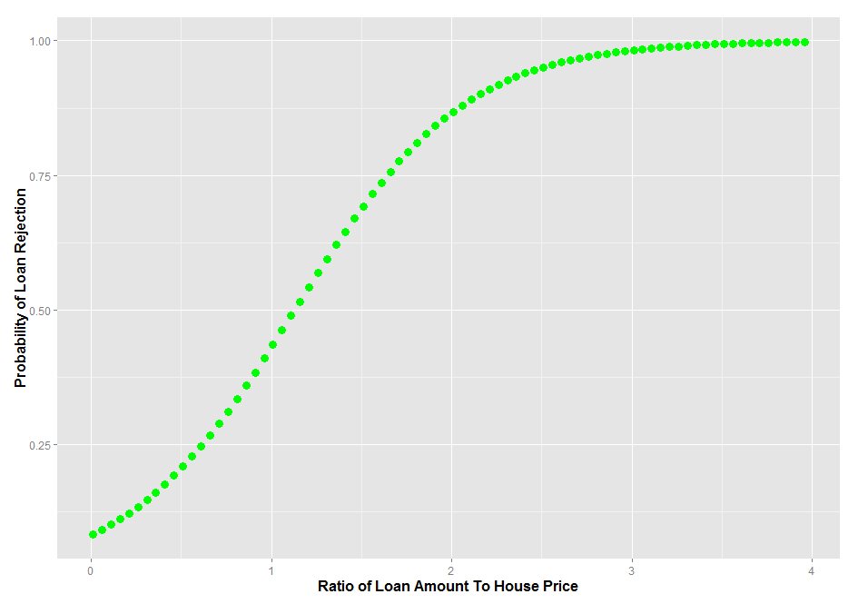
A helpful tool for interpretation/ presentation of results
Create a new dataset and only vary one of the variables of interest, say loan amount. Use that dataset to produce new predicted values and then plot those predicted values against the predictor you varied.

Slide 59
In class exercise

Slide 60
In class exercise
Load the ski data from blackboard
Run a logistic regression predicting falling based on difficulty and season. (Note, consider difficulty as a continuous variable).
Answer the following:
Calculate the increase in odds for falling on a slope in winter of difficulty 1 versus difficulty 2.
Calculate the increase in odds for falling on a slope in winter of difficulty 1 versus difficulty 3. Calculate the increase in odds for falling in a season other than winter of difficulty 1 versus difficulty 3.
Calculate the predicted probability for falling in winter on a slope of difficulty 2 and difficulty 5.

