Slide 1
Advanced Data Analysis I Panel Data Part 1
PA 541 Week 13
Michael D. Siciliano
Department of Public Administration
College of Urban Planning and Public Affairs
Notes:
<number>

Slide 2
Remaining coursework
Week 13/14 – Panel Data
Week 15 – Intro to DAGs & Review for Final
Week 16 – Final Exam (similar format to midterm)
Homework 3 is due April 12th: Covers non-linear relationships, logistic regression, and first part start of today’s lecture.
Final Papers are due May 5th (for those who have chosen to submit)
Notes:
<number>

Slide 3
Today’s lecture
Review logistic regression; go over in-class exercise from last week
Overview of MLE
Pooled Cross-Sectional Analysis
Basic Difference in Difference Models
Notes:
<number>

Slide 4
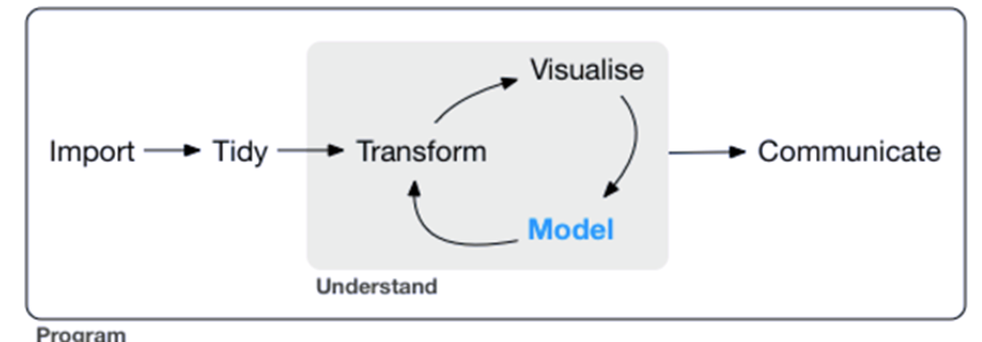
A look back
Notes:
<number>

Slide 5
Odds Ratio
Link Function
Let’s
REVIEW
Week 12
Logit
Endogeneity
GLMs
Linear Probability Models
Exponentiated coefficients
Notes:
<number>

Slide 6
Review Logistic Regression
Notes:
<number>

Slide 7
Interpreting the Coefficients – Logged Odds
Logged Odds: Again, these coefficients have the exact same interpretation as in OLS regression except that the units of the DV are now in logged odds.
Note that these Betas can be negative – but in our example all predicators are positively related with the DV, loan rejection.
Notes:
<number>

Slide 8
Interpreting the Coefficients - Odds
Odds: As stated before, a coefficient of 1 leaves the odds unchanged (i.e. it has no effect). A coefficient greater than 1 increases the odds of occurrence and a coefficient less then 1 decreases the odds of occurrence. The greater the distance from one in either direction, the greater the impact of the predictor variable.
So for pubrec, compared to an individual who never filed for bankruptcy, an individual with at least one filing has an increase in odds of loan rejection by 5.6 times.
Notes:
<number>

Slide 9
Interpreting the Coefficients – Odds cont…
It is important to remember that the odds have a multiplicative effect. Lets assume a white person’s odds of rejection based on a set of predictors is 3:1. Thus, if we took those same predictors for a black person, the odds of rejection would be 3*3.471 = 10.413:1.
Based on this, when we divide the odds of someone who is white by someone who is black (as long as the other predictors are the same) then the result is just Exp(B). More specifically, 10.413/3 = 3.471. Thus, the coefficient shows the ratio of odds for a one unit increase in the independent variable.
So, if you wanted to calculate the change in odds for increasing loanprc by one and going from 0 to 1 on pubrec, you need to multiply 8.499*5.639. So the odds increase by 47.9.
Notes:
<number>

Slide 10
Interpreting the Coefficients – Odds cont…
Let’s look at this one other way.
Assume we have two people:
Person A: No public record, white, and asking for a loan of 75%.
Person B: Public record, white, and asking for a loan of 75%.
$\frac{{Odds}_{x1=1,x2=0,x3=0,x4=.75}}{{Odds}_{x1=0,x2=0,x3=0,x4=.75}}=\frac{exp⁡\left(β_{0}+β_{1}+β_{4}∗.75\right)}{exp⁡\left(β_{0}+β_{4}∗.75\right)}=exp⁡\left(β_{1}\right)$
Notes:
<number>

Slide 11
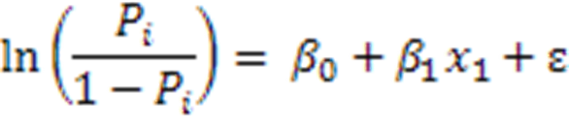
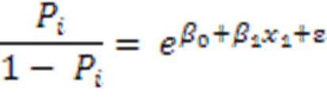
Why effects (with regard to odds) are multiplicative in logistic regression
Note that exp(2+3) = exp(2) * exp(3)
So if the coefficient on x1 is 1.2. Then, we can say a 1 unit increase in x1 increases the logit by 1.2.
We can also say the a 1 unit increases multiplies the odds by 3.3. As exp(1.2) = 3.3.
So, if the odds of success were 10:1 before. The one unit increase results in 33:1 odds. Hence, much more likely to occur.
Notes:
<number>

Slide 12
Probability Interpretations
Logistic coefficients are most often interpreted in terms of odds (as we have been doing).
However, it is possible to convert logits back to probabilities. We can calculate the predicted probability for any observation using the output.
To do so, think back to the equations used to transform probabilities into logged odds. We now need to take the inverse to get probabilities again. [recall our discussion on GLMs]
Take a look at the to excel file on Blackboard!!
Notes:
<number>

Slide 13
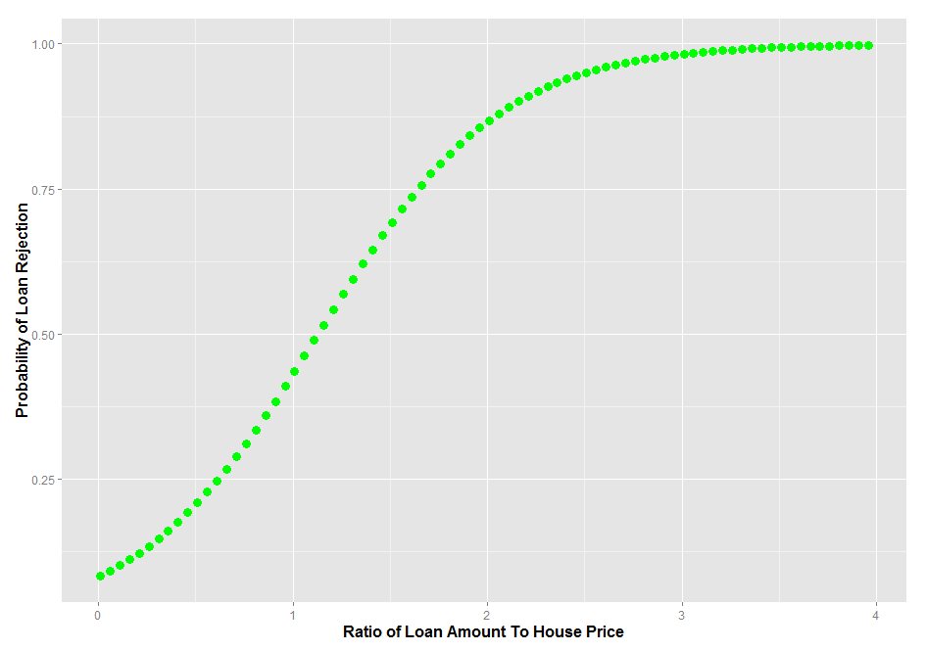
A helpful tool for interpretation/ presentation of results
Create a new dataset and only vary one of the variables of interest, say loan amount. Use that dataset to produce new predicted values and then plot those predicted values against the predictor you varied.
Notes:
<number>

Slide 14
Starter Question: Interpreting Odds with Interaction Terms
Using the same loan dataset, I created an interaction between black and loanprc. How do we interpret this interaction term?
Notes:
<number>

Slide 15
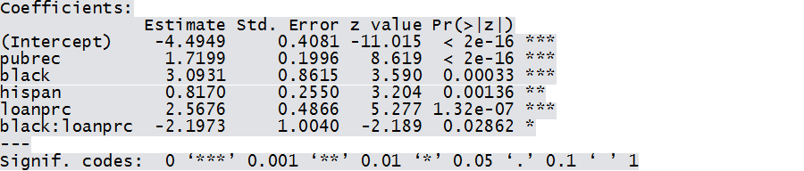
Interpreting Odds with Interaction Terms
How do we interpret this interaction term?
When we include interactions, the Beta coefficient must be adjusted to include the interaction term. So for black individuals loanprc = 2.568 + -2.197 and for all others loanprc = 2.568. To calculate the odds ratio we need to exponentiate these values. Exp (2.568 – 2.197) = 1.449 and the Exp (2.568) = 13.040.
What do these results tell us?
Notes:
<number>

Slide 16
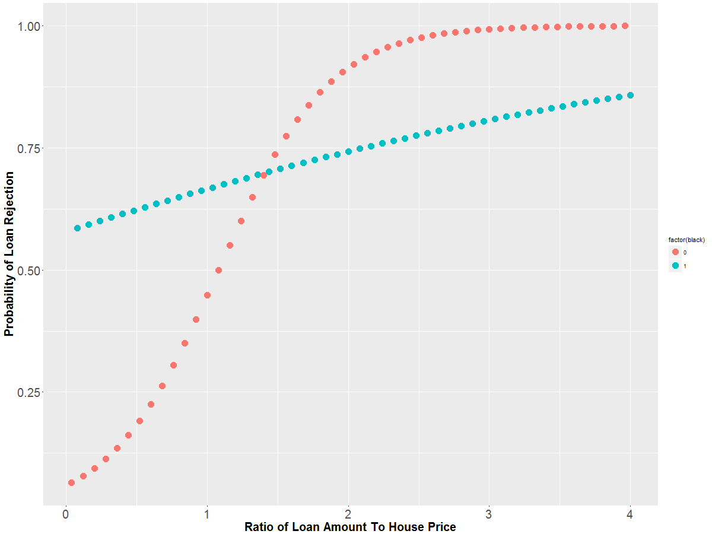

Slide 17
In class exercise
Load the ski data from blackboard
Run a logistic regression predicting falling based on difficulty and season. (Note, consider difficulty as a continuous variable).
Answer the following:
Calculate the increase in odds for falling on a slope in winter of difficulty 1 versus difficulty 2.
Calculate the increase in odds for falling on a slope in winter of difficulty 1 versus difficulty 3. Calculate the increase in odds for falling in a season other than winter of difficulty 1 versus difficulty 3.
Calculate the predicted probability for falling in winter on a slope of difficulty 2 and difficulty 5.
Notes:
<number>

Slide 18
A quick look at maximum likelihood estimation
Notes:
<number>

Slide 19
Probability and Statistics
In probability the parameters are known and they control the behavior of a random variable via a model.
We use the known parameters to estimate the probability of certain future events occurring.
In statistics (probability in reverse) the random variables (or the data) are known, and they are used to estimate the unknown parameters that gave rise to them via a model.
Notes:
<number>

Slide 20
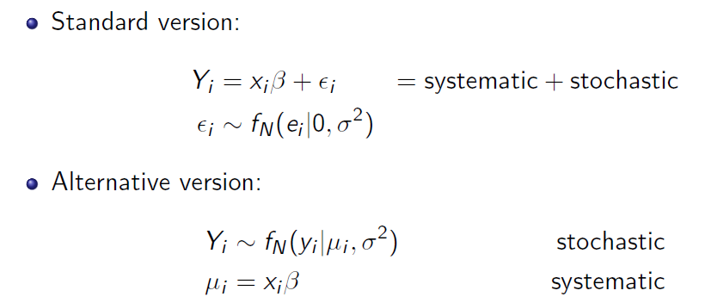
What are statistical models?
A statistical model is a formal representation of the process by which a social system produces output.
Equivalent notation (King 1998)
Notes:
<number>

Slide 21
Maximum Likelihood Estimation
Maximum likelihood estimation (MLE) finds estimates of model parameters that are most likely to give rise to the pattern of observations in the sample data.
We will look at the mechanics of how this is done. This is simply to help you gain a more intuitive sense of what is happening when you run generalized linear models in R and where the MLE comes from.
Notes:
<number>

Slide 22
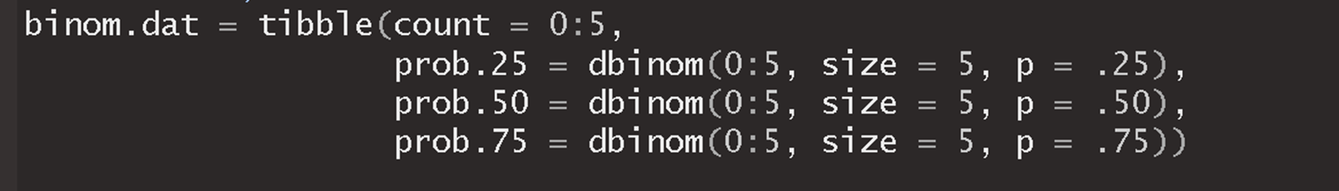
Looking at possible distributions
Say we are interested in the prevalence of bullying across different sixth grade classrooms. Because any given classroom can have bullying or not, we can consider a binomial probability distribution.
Notes:
<number>

Slide 23
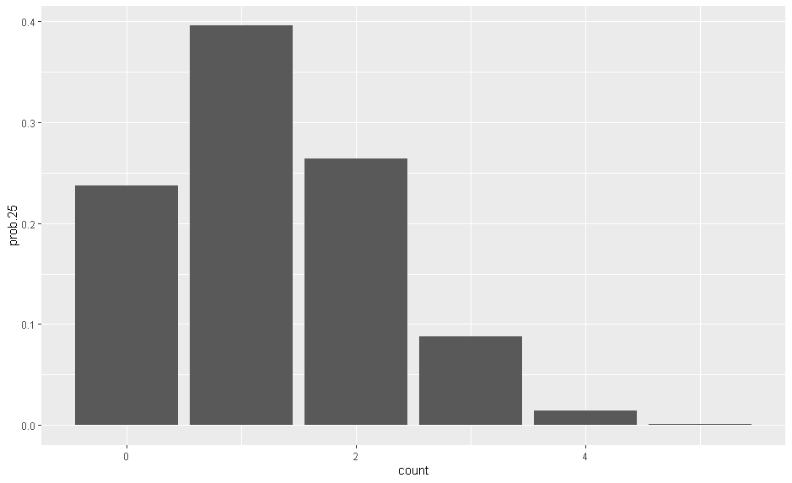
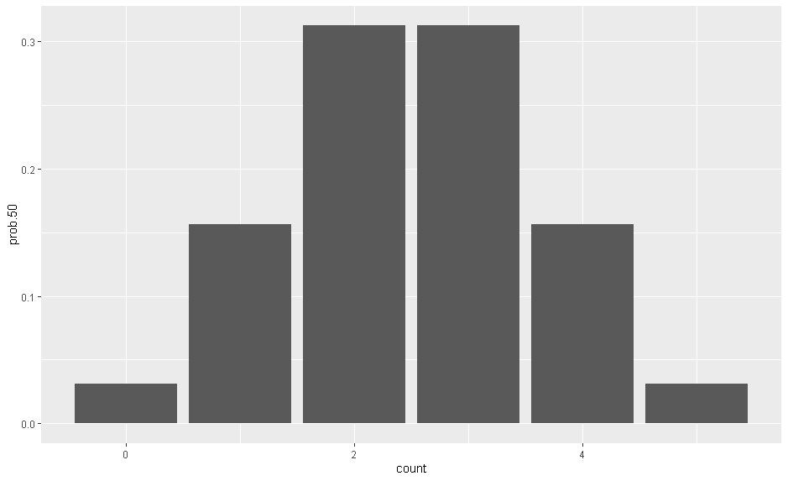
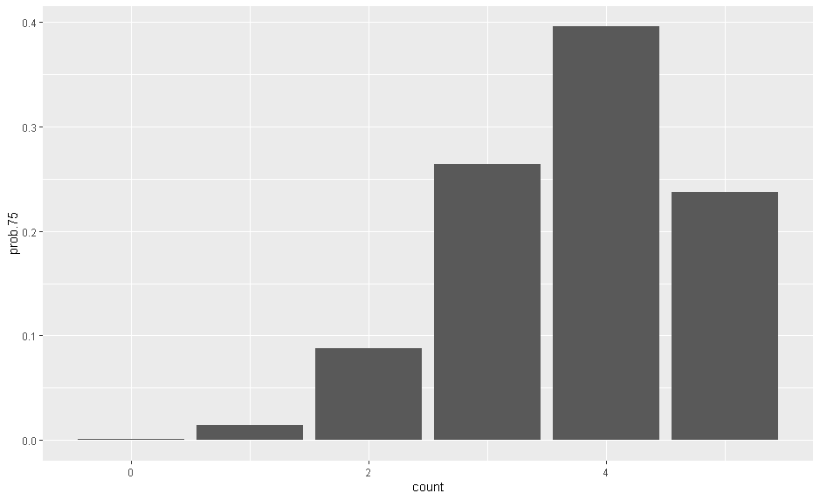
p = .25 p = .50 p = .75
The plots tell us the probability of observing any given count of bullying for each of three probability distributions.
Notes:
<number>

Slide 24
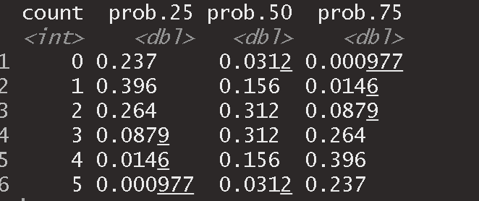
Go get some data
Let’s go to five classrooms and observe if bullying is present or not.
Say we observe the following - Y: {1,0,0,1,1}
Which distribution (out of the three we looked at) gives us the highest probability of observing this data?
Notes:
<number>

Slide 25
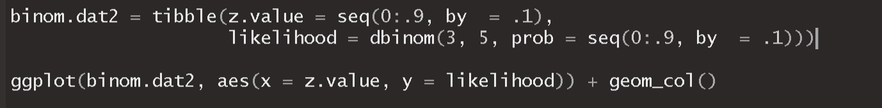
We know the binomial distribution with a parameter of .5 is better than the other two, but what about other possible values for the parameter?

Slide 26
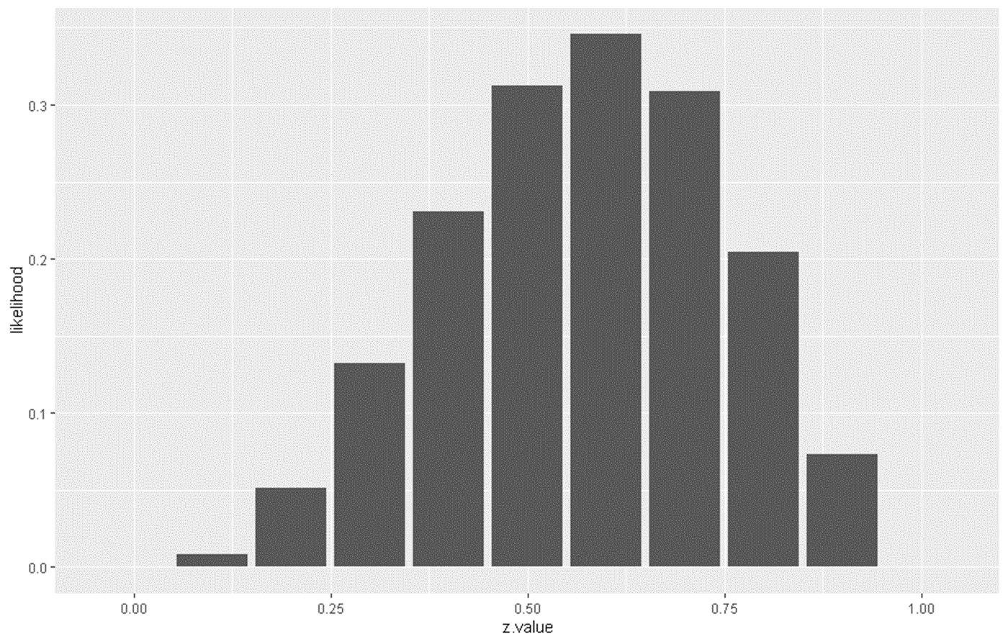
This plot now shows us the probability of finding 3 classrooms with bullying out of 5 observations for 10 different values of the parameter.
This is the essence of maximum likelihood.
Likelihood is simply the extent to which a sample provides support for a given parameter value.
Notes:
<number>

Slide 27
The Likelihood Function
Let’s suppose again that we have the following data on a binary outcome Y: {1,0,0,1,1}
We assume that Y is distributed Bernoulli with a constant probability across our observations.
The model we propose is:
Notes:
<number>

Slide 28
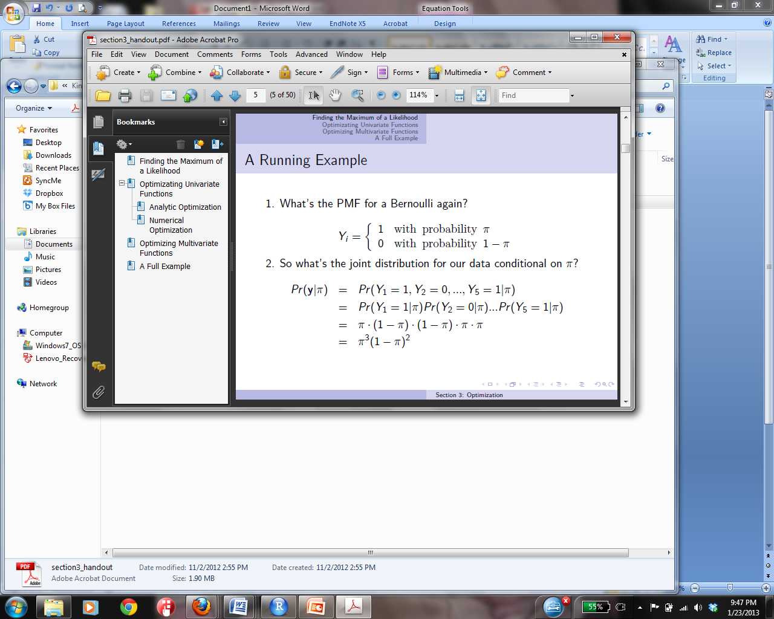
We know that:
So, the joint distribution of our data Y: {1,0,0,1,1} is:

Slide 29
According to the theory of likelihood:
We take the log of the equation for computational purposes and get:
Notes:
<number>

Slide 30
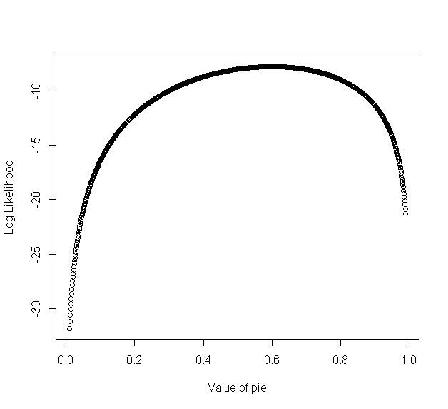
Maximizing the Function
We want to find the point when the above function is maximized.
Notes:
<number>

Slide 31
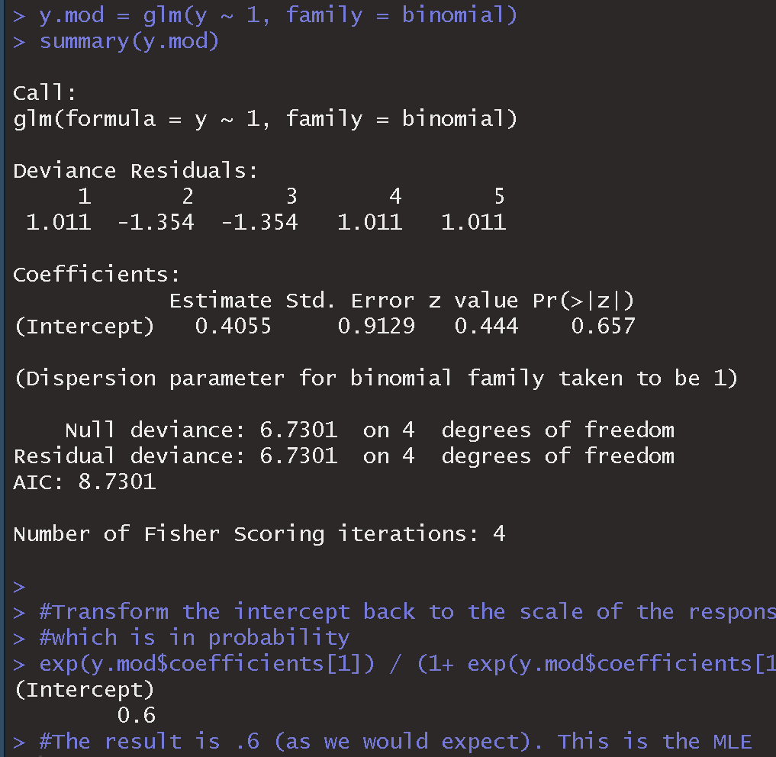
Run a logistic regression model
We will examine this is below, but note the residual deviance is 6.73. This value is simply -2 times the loglikelihood.
-2 * (3*log(.6) + 2*log(1-.6)) = 6.37
Notes:
<number>

Slide 32
Let’s look at an example using our Ski data from last week.
Coefficients:
Estimate Std. Error z value Pr(>|z|)
(Intercept) -4.4990 1.5300 -2.941 0.003276 **
Difficulty 1.5688 0.4761 3.295 0.000984 ***
Seasonwinter 0.4773 1.0141 0.471 0.637861
---
Signif. codes: 0 ‘***’ 0.001 ‘**’ 0.01 ‘*’ 0.05 ‘.’ 0.1 ‘ ’ 1
(Dispersion parameter for binomial family taken to be 1)
Null deviance: 48.263 on 34 degrees of freedom
Residual deviance: 26.470 on 32 degrees of freedom
AIC: 32.47
Number of Fisher Scoring iterations: 5
Notes:
<number>

Slide 33

Log-Likelihood – Assessing the Model
The log-likelihood is therefore based on summing the likelihood associated with the observed outcomes. It is akin to the residual sum of squares in multiple regression as it is an indicator of how much unexplained information there is after the model has been fitted.
Large values of the log-likelihood indicate poorly fitted models.
Recall that the ln(1) = 0
Log-likelihood allows us to compare two models by computing the difference in their log-likelihoods.
In the model summary output for some software you will see -2 log likelihood or deviance, thus it is simply the formula above multiplied by -2. This is done because it allows us to compare models based on the chi-square statistic. In R it is just called the deviance.
Notes:
<number>

Slide 34
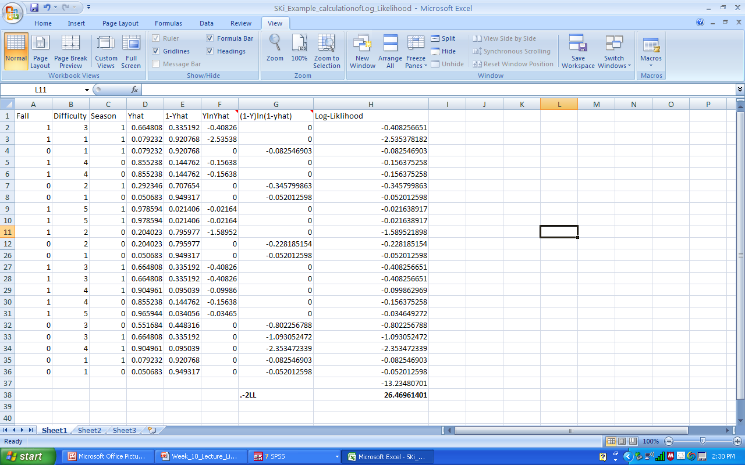
Calculating -2LL by Hand
Notes:
<number>

Slide 35
Comparing Models Using Log-Likelihood (likelihood ratio test)
Models must be nested to be compared. This means that all of the predictors in the smaller (restricted) model must also be in the bigger (unrestricted) model.
Taking the difference in the -2LL (or deviance) for the models (smaller model (restricted model) – bigger model(unrestricted model)) produces a test statistic that is distributed as a chi-square with df equal to the difference in the number of predictors.
For example, in our dataset for falling when skiing if we ran a model with just the constant and difficulty as a predictor we would get a -2LL of 26.692 then:
Notes:
<number>

Slide 36

Comparing Models Using Log-Likelihood
So basically, we are testing whether or not season added to our ability to predict falling. (While not the most interesting example, it can be easily extending to include multiple predictors as we did in the baseball example using the F-test and the residual sum of squares between the restricted and unrestricted models. Thus, you can think of this chi-square test as comparing the reduction in the sum of the residuals when moving from a restricted model (smaller model) to an unrestricted model (larger model).
Degrees of freedom for the χ² critical value is determined by the difference in in degrees of freedom between the big and small model. Thus, in our case the degrees of freedom for the big model is 3 (1 for each predictor and the constant) and the small model has 2 df (the constant and only 1 predictor).
The critical value at α = .05, with 1 df is 3.84 and so we fail to reject the null and conclude that the model will all of the independent variables does not predict better than the one with only difficulty as the independent variable. An expected result given the lack of statistical significance for season.
Notes:
<number>

Slide 37
Let’s look at another example of the likelihood ratio test
We can use the likelihood ratio test to compare nested models and also single predictors. When sample sizes are small, the likelihood ratio test is often preferred to the Wald statistic or the z-test. Let’s take a look at how the likelihood ratio test works.
We will examine the significance of the interaction term from our model predicting loan rejections.
Thus we need to run two models:
One model with the interaction (larger, or unrestricted model)
Another model without the interaction (smaller, or restricted model)
Notes:
<number>

Slide 38
Unrestricted model with the interaction
Restricted model with no interaction

Slide 39
Notes:
<number>

Slide 40
Pooled cross sectional data

Slide 41
Independently pooled cross section
Surveys like the General Social Survey (GSS) or the Current Population Survey (CPS) are repeated at regular intervals with a random sample of individuals each year.
Pooling multiple years together gives us an independently pooled cross section.
Notes:
<number>

Slide 42
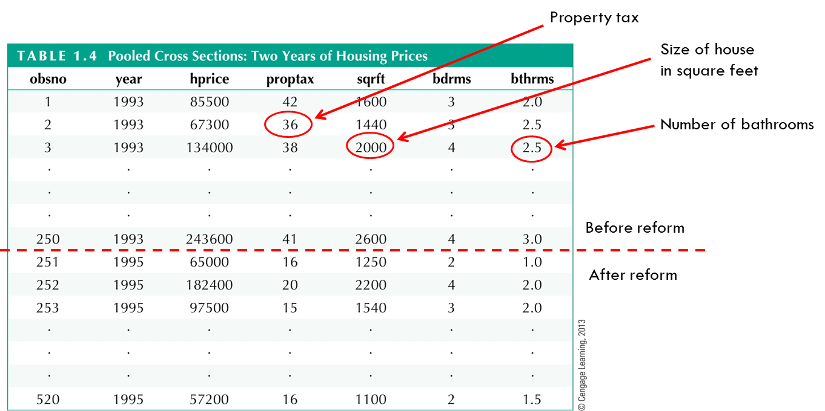
Pooled cross sections on housing prices
Notes:
<number>

Slide 43
Advantages of pooling cross-sectional data
Researchers can generate more precise parameter estimates by including more observations.
Pooling is beneficial:
When the sample size in any given year is small.
The effect being examined is too small to discern using a sample from a single year, but additional data will produce a statistically significant result.
When researchers want to assess if outcomes change over time or if the coefficients in the model change over time.
Notes:
<number>

Slide 44
Statistical issues with pooling
Only minor statistical issues are raised:
Populations may have different distributions in different years.
We can allow the intercept to vary across different time periods by including dummy variables for years [just as we have done for gender or race].
These year dummy variables may be of substantive interest to the researcher.
Error variance may change over time
We already know how to deal with this - use robust standard errors.
Notes:
<number>

Slide 45
An example from Wooldridge
Using GSS data from 1972-1984 we will estimate the number of kids being born.
Question of interest: after controlling for other observable factors, what has happened to fertility rates overtime?
Notes:
<number>

Slide 46
Obs: 1129
1. year 72 to 84, even
2. educ years of schooling
3. meduc mother's education
4. feduc father's education
5. age in years
6. kids # children ever born
7. black = 1 if black
8. east = 1 if lived in east at 16
9. northcen = 1 if lived in nc at 16
10. west = 1 if lived in west at 16
11. farm = 1 if on farm at 16
12. othrural = 1 if other rural at 16
13. town = 1 if lived in town at 16
14. smcity = 1 if in small city at 16
15. y74 = 1 if year = 74
16. y76
17. y78
18. y80
19. y82
20. y84
21. agesq age^2
The data on Number of Kids Born

Slide 47
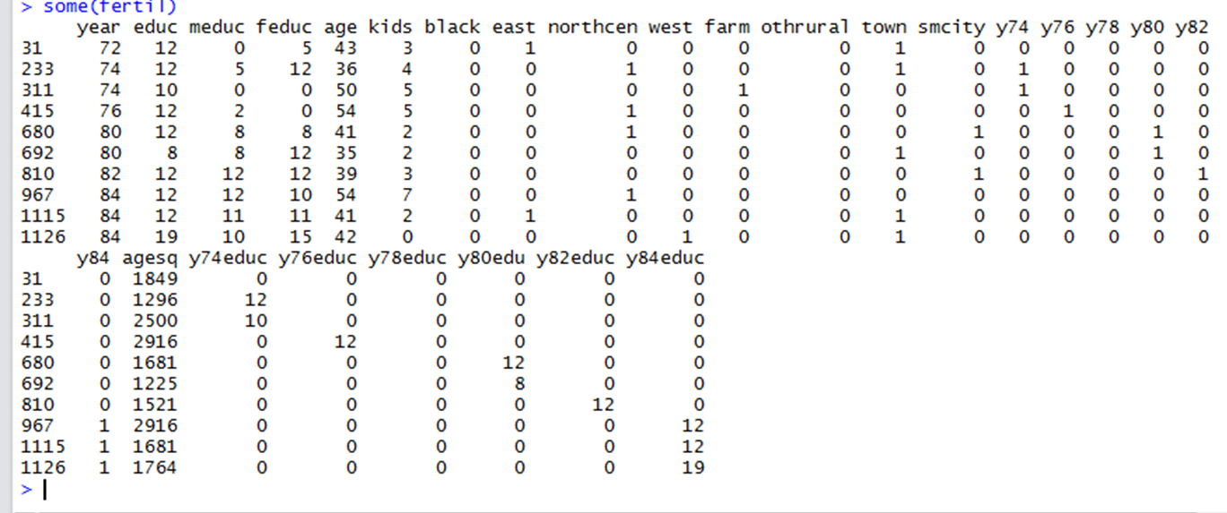
Data structure
Notes:
<number>

Slide 48
Key variables by year
Therefore, one reason fertility may have declined may not simply be due to behavioral changes but rather changes in population characteristics that are associated with fertility.
Notes:
<number>

Slide 49
Model Output
Here we examine whether fertility decisions have changed over time after controlling for other factors that affect fertility.
Year dummy variables are included to capture time effects of fertility.
What can we say about fertility rates overtime?
What about education – what is the difference in average number of children between a high school educated and a college educated mother?
Notes:
<number>

Slide 50
Some things to consider
ONE: There may be heteroskedasticity in the error term underlying the estimated equation.
We can test for this using the Breush-Pagan test.
Using robust standard errors to correct for heteroskedasticity is generally a good approach when pooling cross sectional data.
TWO: The model assumes that the effect of the explanatory variable has remained constant. This may not be true and may be of substantive interest to the researcher.
This is another reason to pool cross-sectional data. It allows us to determine whether or not the coefficients in the model have changed over time.
Notes:
<number>

Slide 51
ONE: Let’s test and deal with heteroskedasticity
Notes:
<number>

Slide 52
TWO: Let’s deal with non-constant effects
Education’s impact on the number of children
Does the impact of education change overtime?
In our previous model, the effect of education was constant across time. Why? – Because we modeled it that way.
If we are interested in the changes in education’s impact:
What are we asking specifically?
How can we test for this?
Notes:
<number>

Slide 53
What is the difference in the effect of education between year 1972 and 1984?
Notes:
<number>

Slide 54
Policy analysis with pooled Cross sections - Difference-in-Difference
Notes:
<number>

Slide 55
Policy Analysis with Pooled Cross Sections
We can use this type of analysis to analyze the impact of policy changes on outcomes of interest.
An empirical example from Wooldridge
Discussion of building a garbage incinerator in North Andover began in 1978 and construction began in 1981. Residents were concerned for the effect of the incinerator on housing prices.
We will look at data on the price of houses sold in 1978 versus 1981. The hypothesis is that the price of houses located near the incinerator would fall relative to the price of more distant houses.
Two main variables: rprice - housing price in 1978 dollars and near – a dummy variable indicating if the house is within three miles of the incinerator.
Notes:
<number>

Slide 56
Begin with a Naïve analysis
We can simply use the 1981 data and regress the housing price on near.
How do we interpret the intercept? The coefficient on nearinc?
Does this imply that the incinerator is causing lower home prices?
What else could be going on?
Notes:
<number>

Slide 57
Using the 1978 data
When we run the same model with just the 1978 data we find a similar effect. Thus, even before there was talk of an incinerator the home values near the site were less.

Slide 58
So what now?
How can we tell if the incinerator is actually depressing housing values. The key is to look at how the coefficient on nearinc changed between 1978 and 1981.
The effect of nearinc was much larger in 1981
30,688 – 18,824 = 11,864
This value often referred to as the difference-in-differences estimator.
We can test if this is significant by running the following model pooling the data over both years:
Notes:
<number>

Slide 59
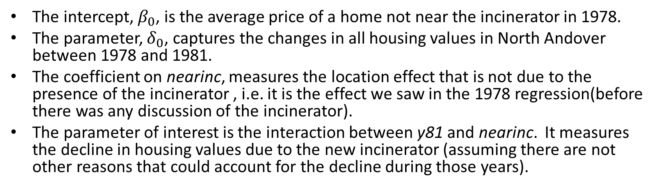
$rprice=β_{0}+δ_{0}y81+β_{1}nearinc+δ_{1}y81∗nearinc+u$
The intercept, , is the average price of a home not near the incinerator in 1978.
The parameter, , captures the changes in all housing values in North Andover between 1978 and 1981.
The coefficient on nearinc, measures the location effect that is not due to the presence of the incinerator , i.e. it is the effect we saw in the 1978 regression(before there was any discussion of the incinerator).
The parameter of interest is the interaction between y81 and nearinc. It measures the decline in housing values due to the new incinerator (assuming there are not other reasons that could account for the decline during those years).
Notes:
<number>

Slide 60
We actually do not find that the incinerator was significant, however, if we add controls to the model, such as the age of the house, number of rooms, size of the plot etc… the effect is significant. Again, we always need proper model specification.
Notes:
<number>

Slide 61
Why the difference in difference estimator works
It operates as a natural experiment. An exogenous event that changes the way the entities being studied operate.
In such experiments, there is a control group that is not affected by the policy change and a treatment group that is.
Note, because assignment was not random, we need data at two time points (one prior and one after the policy change) to assess impact.
Notes:
<number>

Slide 62
Difference in Differences cont…
The regression model for the difference in differences estimator is the same as the categorical interaction model we discussed the other week.
In the above interaction model, we had four separate groups, white men, white women, non-white men and non-white women
In the D-in-D model we still have four groups: control group before policy change, control group after policy change, experimental group before policy change and experimental group after policy change.
Notes:
<number>

Slide 63
Another Example
Assume we are interested in whether an AIDS prevention program in Pennsylvania was effective and we had data on a random sample of residents at two time points (one before and one after the program).
Simply looking at the before and after rates of HIV/AIDS in Pennsylvania will not work if all US states were experiencing decreases in AIDS cases.
To overcome this issue, suppose you have second state (say New Jersey) with data on AIDS from corresponding time points that is arguably very similar except it was not exposed to the same policy program. But obviously, this state was still exposed to the changes in the economic and social conditions of the northeast US.
The differences in changes between these two groups, the differences in differences, can be more confidently related back to the policy change.
Notes:
<number>

Slide 64
Difference in Differences cont…
The regression model can be written as follows:
Where
Y_{i} = outcome of interest
T_{i} = 1 if in the treatment group, 0 otherwise
After_{i} = 1 if after the policy change, 0 otherwise
Notes:
<number>

Slide 65
Difference in Differences cont…
We can look at the conditional expectations to understand how we interpret the regression coefficients.
Mean outcome of control group before policy
E(y_{i}|T=0, AFTER=0) = α₀
Mean outcome of control group after policy
E(y_{i}|T=0, AFTER=1) = α₀ + α_{A}
Mean outcome of treatment group before policy
E(y_{i}|T=1, AFTER=0) = α₀ + α_{T}
Mean outcome of treatment group after policy
E(y_{i}|T=1, AFTER=1) = α₀ + α_{T} + α_{A} + α_{DD}
Notes:
<number>

Slide 66
Difference in Differences cont…
How do we interpret the coefficient on α_{DD?}
The change in the expected value of the outcome for the control group before and after the policy change is:
E(y_{i} | T=0, After=1) – E(y_{i} | T=0, After = 0)
= (α₀ + α_{A}) - α₀
= α_{A}
The change in the expected value of the outcomes for the treatment group before and after the policy change is:
E(y_{i} | T=1, After = 1) – E(y_{i} | T=1, After = 0)
= (α₀ + α_{T} + α_{A} + α_{DD}) – (α₀ + α_{T})
= α_{A} + α_{DD}
The difference in difference is simple: (α_{A} + α_{DD}) – α_{A} = α_{DD}
Note: that the before-after change for the treatment group consists of two parameters, which is why we cannot use just this difference to identify the effect of the policy. There are two things going on, the societal change and the policy change.
Notes:
<number>

Slide 67
In Class Exercise

Slide 68
In Class Exercise – Pooled Cross-Sectional Analysis
Using the cps_inclass dataset, build a single regression model to assess:
Whether the gender gap in wages has increased or decreased between 1978 and 1985
Whether the return to education has changed between 1978 and 1985.
Include in your model the other following variables: y85 + exper + expersq + union
The variables in the cps dataset are as follow:
1. educ years of schooling
2. south =1 if live in south
3. nonwhite =1 if nonwhite
4. female =1 if female
5. married =1 if married
6. exper age - educ - 6
7. expersq exper^2
8. union =1 if belong to union
9. lwage log hourly wage
10. age in years
11. year 78 or 85
12. y85 =1 if year == 85
Notes:
<number>

