Slide 1
Advanced Data Analysis I Panel Data Part 2
PA 541 Week 14
Michael D. Siciliano
Department of Public Administration
College of Urban Planning and Public Affairs
Notes:
1

Slide 2
Overview
The slides and script will discuss:
Panel data (sometimes called longitudinal data or time-series-cross-section)
First Differencing Methods (FD)
Fixed Effects Transformation (FE) or the “within” method.
Dummy Variable Fixed Effects Regression
Example Datasets used in lecture are from Wooldridge chapters 13 and 14.
Notes:
1

Slide 3
In Class Exercise – Pooled Cross-Sectional Analysis
Using the cps_inclass dataset, build a single regression model to assess:
Whether the gender gap in wages has increased or decreased between 1978 and 1985
Whether the return to education has changed between 1978 and 1985.
Include in your model the other following variables: y85 + exper + expersq + union
The variables in the cps dataset are as follow:
1. educ years of schooling
2. south =1 if live in south
3. nonwhite =1 if nonwhite
4. female =1 if female
5. married =1 if married
6. exper age - educ - 6
7. expersq exper^2
8. union =1 if belong to union
9. lwage log hourly wage
10. age in years
11. year 78 or 85
12. y85 =1 if year == 85
Notes:
3

Slide 4

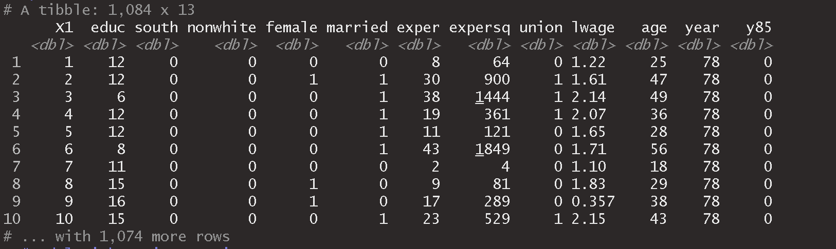

Slide 5
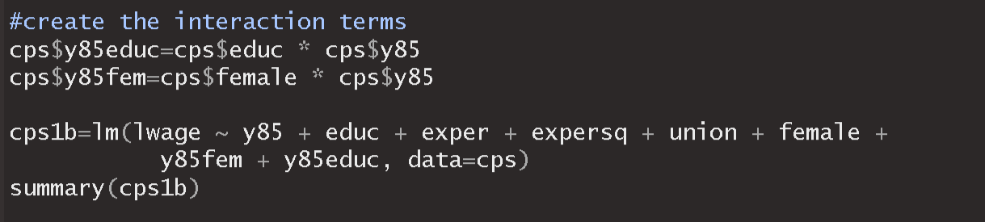

Slide 6
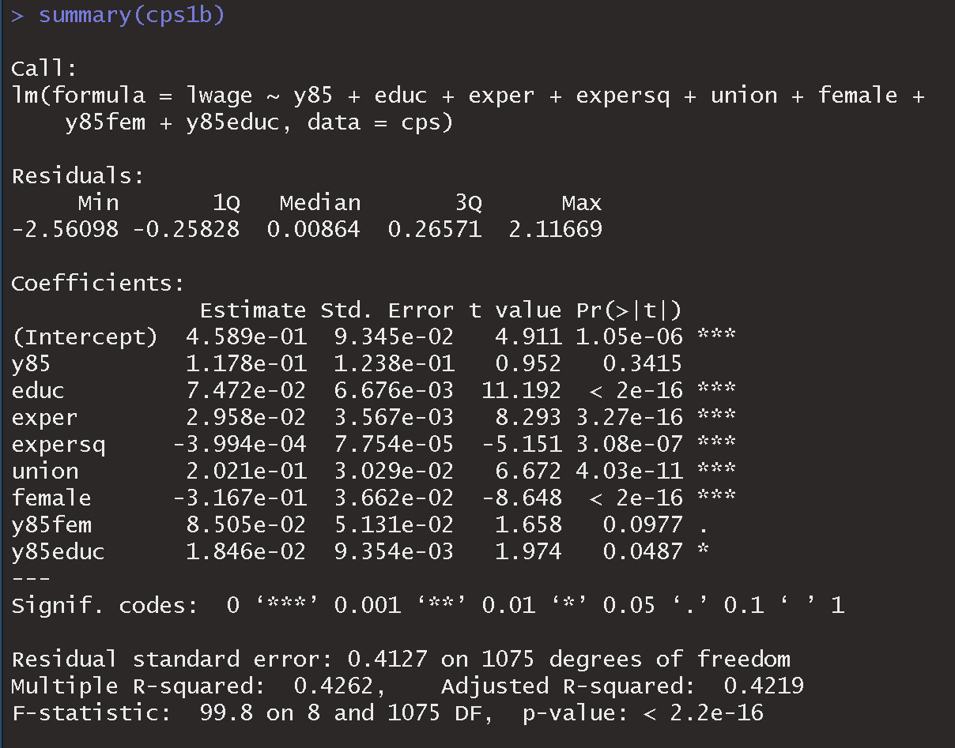
Notes:
3

Slide 7
Panel data
Notes:
3

Slide 8
Image from Bailey (2016)
Notes:
3

Slide 9
Image from Bailey (2016)

Slide 10
Image from Bailey (2016)
Notes:
3

Slide 11
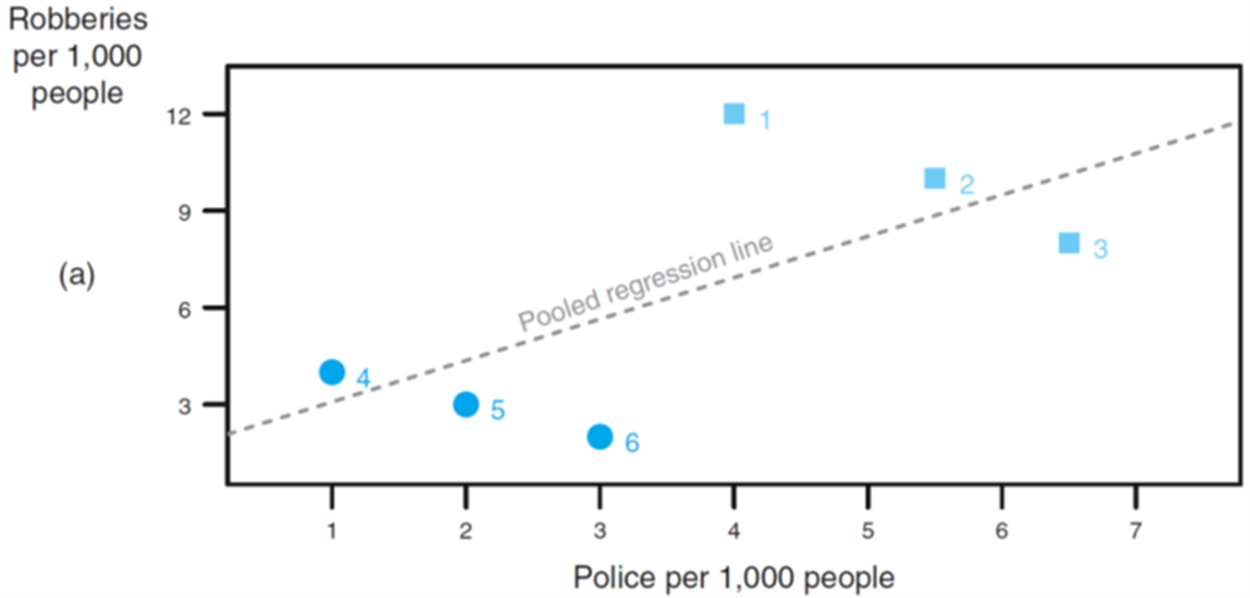
In a pooled model a common source of endogeneity is that the specific units (here cities) have different baseline levels of crime and these levels are correlated with our independent variables. Thus, cities with higher crime also tend to have more police. This creates a positive correlation in the pooled model.
Notes:
3

Slide 12

Example: Test scores
What is in the error term?
Are there any stable unit-specific elements in the error term?
Are the stable unit-specific element in the error term correlated with the independent variable?
Bailey (2016)
Notes:
3

Slide 13
Pooled Cross Section versus Panel Data
Pooled Cross Section Data
Random samples taken at different time points…thus pulling produces one large random sample with a time element.
Time dummy variables can be used to capture structural change over time and can be interacted with other variables.
Observations across different time periods provide an opportunity to evaluate the effect of policies or programs.
Panel Data
Unlike pooled cross-sectional data, panel data contains cross sections of the same individuals/units at different points in time.
This structure allows us to analyze more complicated models that we may believe more accurately reflect the real world.
The main benefit, as we will see, is our ability to account for unobserved heterogeneity.
Notes:
3

Slide 14
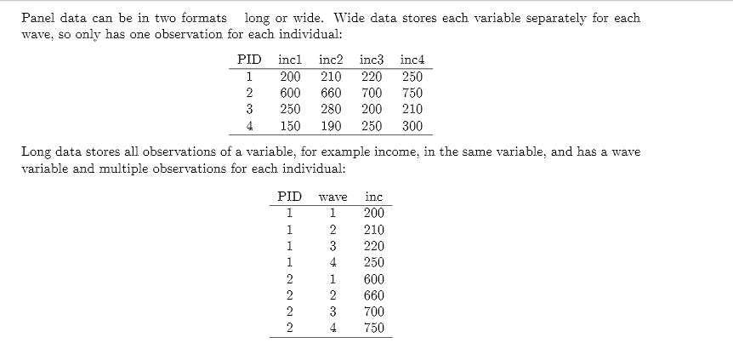
Structure of Panel Data
For a quick tutorial on how to do this in R using the new pivot_wider and pivot_longer functions go to: https://tidyr.tidyverse.org/articles/pivot.html
I also have examples in the script we can look at.
Notes:
3

Slide 15
Types of Panel Data Methods
Fixed effects estimation
First Difference methods
Fixed effects estimation or within transformation
Dummy variable fixed effects model
Longitudinal Multilevel Models/Random effects estimation are not covered in this course.
Notes:
15

Slide 16
1. Panel Data and First Differencing
Notes:
16

Slide 17
Two period panel data analysis - Unobserved effects model
What is the effect of unemployment on crime?
We have a dataset with two years of data, 1982 and 1987, that contains crime rate and unemployment rate information for 46 cities.
First, let’s look at the effect of unemployment on crime from the 1987 cross section.
Notes:
16

Slide 18
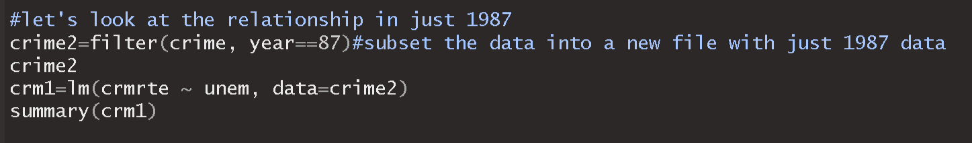
If we interpret this causally, it implies an increase in unemployment rate lowers the crime rate. The coefficient is not statistically significant…we have, at best, found no link between crime and unemployment.
Note this is just 1987 data.
Notes:
18

Slide 19
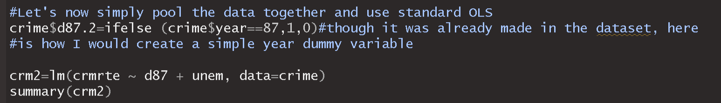
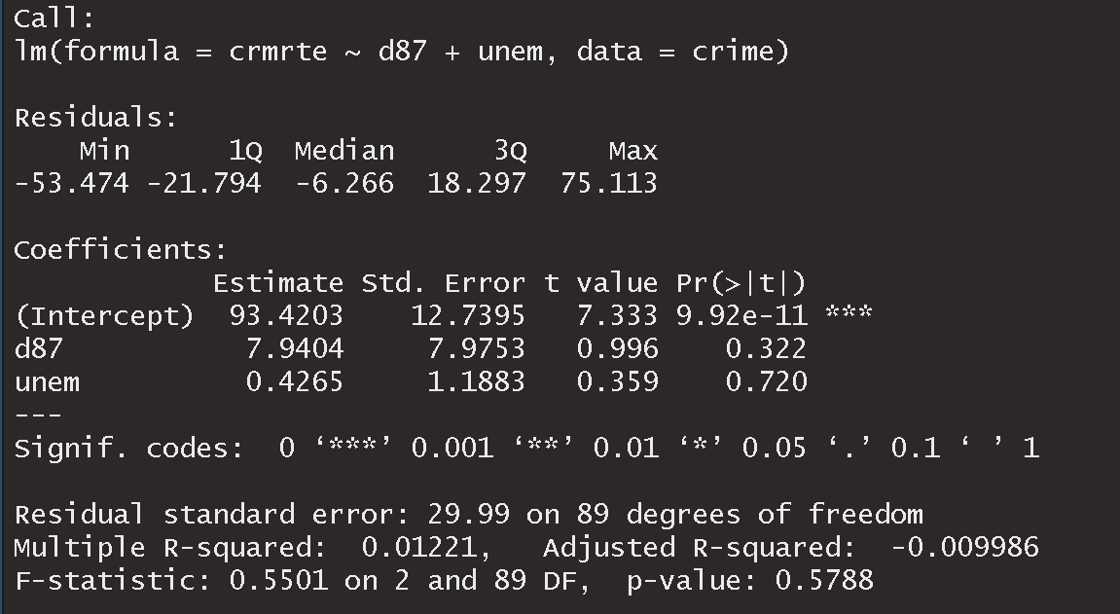
Notes:
18

Slide 20
An alternative way to use panel data is to view the unobserved factors affecting the dependent variable as consisting of two types: those that are constant and those that vary over time.
Letting i denote the cross-sectional unit and t the time period, we can write:
Notes:
18

Slide 21
In the notation, i denotes the person, firm, city, etc… and t denotes the time period.
The variable d2_{t} is a dummy variable which equals zero when t=1 and one when t = 2; it does not change across i, which is why it has no i subscript.
As you can see the intercept is allowed to vary overtime.
The variable a_{i} captures all unobserved time constant factors that affect y_{it}. This is referred to as an unobserved effect or fixed effect. You might also see a_{i} referred to as unobserved heterogeneity.
Notes:
21

Slide 22
An unobserved effects model
In this model, a_{i} captures all factors affecting city crime rates that do not change overtime. We can think of it as the unobserved city effect; something about the city that is a fixed difference from other cities (location, transit, education level, demographics…while some of these may change, they may be roughly constant over the observed time period).
How should we estimate the effect of unemployment given our two years of panel data?
Notes:
22

Slide 23
One approach, as we just saw, is to just pool the data together and use OLS.
In order to produce a consistent estimator we must assume the unobserved effect, a_{i} is uncorrelated with x_{it}. Note that since a_{i} is not measured, it becomes part of the error term – this is often referred to as a composite error.
Notes:
23

Slide 24
As long as a_{i} is correlated with our regressor, we have unobserved heterogeneity in our model.
In our crime example, we believe that the unmeasured city factors that influence the crime rate are correlated with the unemployment rate.
The availability of observations of the same individuals as multiple time points allows us to overcome this heterogeneity bias. This is a key reason for collecting and analyzing panel data.
Because a_{i} is constant overtime, we can difference the data across the two years.
Notes:
23

Slide 25
Analyzing our data with pooled OLS we have:
If we look at the equation for each time period (i.e. when t=2 and when t =1):
If we subtract the second equation from the first
Which can be rewritten as
This is the first differenced equation. It is just a cross-sectional equation, but each variable is differenced overtime.
Note, that a_{i} is no longer in the equation.
Notes:
25

Slide 26
First differenced results
We now find a positive and statistically significant effect on unemployment.
What does the intercept tell us?
Notes:
26

Slide 27
The costs of differencing our data
Though the first differences approach allows us to control for unobserved effects, it can also:
Reduce the variation in the explanatory variables as we are only looking at changes within each unit of observation. Variables such as education which change very infrequently (if at all) for adult full-time workers are difficult to estimate with such a model since there is little variation in ∆x_{i}.
Any predictors, such as race or gender, which do not change overtime are dropped from the model as the difference score for each person is 0 and thus there is no variation at all.
Notes:
26

Slide 28
2. Panel data and Fixed effects estimation
Notes:
28

Slide 29
Fixed effects estimation
We saw that first-differencing yields unbiased parameter estimates by eliminating the time-constant fixed effect, a_{i.}
However, there is an alternative method known as the fixed effects transformation that can be used to estimate the model (and this tends to be much more commonly seen in published research).
In this method we time demean the data on y_{it}, x_{it}, and the error term.
This approach is also referred to as the within effect estimator.
Notes:
29

Slide 30
Fixed effects estimation
For the fixed effects transformation we begin with a single explanatory variable for each observational unit i:
For each i we average this equation over time:
Then subtract the second equation from the first:
Note, since we can think of a_{i} as individual intercept terms, we do not need to have an overall intercept term.
Or
Notes:
30

Slide 31
Fixed effects transformation
Here we have time demeaned data. Notice, as with first differencing, the a_{i} is removed.
A general time-demeaned equation for each i will be:
This estimator is also known as the within estimator, because all of the variation in the dependent and independent variables are within each cross-sectional unit.
Notes:
31

Slide 32
The primary assumption remains that the error term is uncorrelated with the regressors.
As with the first differenced estimator, the coefficients on any regressor that remains constant over time cannot be estimated.
Applying OLS to this model leads to unbiased parameter estimates – though we need to adjust our degrees of freedom to get correct standard errors. For this reason, and to allow the software to time demean the data for us, fixed effects regression models are available in most statistical packages.
Notes:
32

Slide 33
Panel data methods in R
Need the plm package.
As with Stata, you need to define the cross-sectional and time elements of our data. We do this with the pdata.frame() function.
p.mom = pdata.frame(mom, index=c("id", "year"))
Here, we are telling R that the dataset ‘mom’ should be stored as a panel data frame and that the group and time variables are called ‘id’ and ‘year’ respectively.
To model either FE or FD we use the function plm () and indicate model = “within” or model = “fd”.
mod3 = plm(lnhr ~ lnwg, data=p.mom, model="within")
Let’s look at a dataset and run a fixed effect model.
Notes:
33

Slide 34
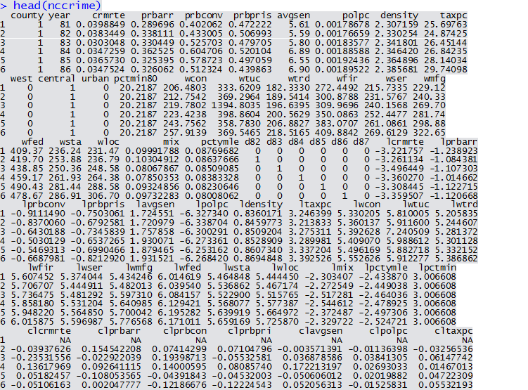
Crime related data for 90 counties in North Carolina
Notes:
33

Slide 35
Apply the Fixed Effects Transformation to our North Carolina Crime Data
We likely have concerns with our standard errors given the clustering in the data.
Notes:
35

Slide 36
Cluster-Robust Standard Errors
Clustered errors occur for several reasons.
You may have multilevel structures based on a stratified sampling design (e.g., kids in schools).
Another is panel data; model errors in panel data may be correlated across different time periods for a given individual.
When clustered errors are not controlled for, and we instead rely on the “default” settings, we often obtain misleadingly small standard errors, large t-stats, and low p-values (Cameron and Miller 2013).
One way to control for this is to estimate the regression model and then post-estimation obtain “cluster-robust” standard errors.
Notes:
35

Slide 37
Cluster-Robust for OLS models using the lm function in R
There is a new package called ‘multiway’ that allows you to control for clustering in your data.
As mentioned above, you estimate your regression as usual, and then adjust the standard errors afterward. This is the same approach we used to deal with heteroskedasticity.
As we will see below, to implement we:
m1.vcovCL = cluster.vcov(mod1, mom$id)
coeftest(mod1, m1.vcovCL)
‘id’ is the variable in the dataset ‘mom’ that we want to cluster on. Mod1 is the model for which we want to adjust the standard errors.
Notes:
35

Slide 38
Cluster-Robust in plm package
The multiway package accepts lm and glm objects. Models run with the plm package are of class ‘plm’ and ‘panelmodel’ and cannot be passed to the multiway function.
This is not a problem as the plm package has its own function to deal with clustering.
coeftest(mod1b,vcov=vcovHC(mod1b, cluster="group"))
Similar to the multiway package, we are updating the var-cov matrix directly in the coeftest() call and we specify the clustering as “group”. Recall that in plm we created a pdata.frame that indicated what our grouping variable was (in this case ‘id’).
Notes:
35

Slide 39
Let’s use lm and plm to replicate some results
Cameron and Trivedi (2005, p. 708-710) run several different models exploring the relationship between hours and wages.
They were interested in the responsiveness of labor supply to changes in wages. They note that the standard textbook model of labor supply suggests that for people already working the effect of a wage increase on labor supply is ambiguous, with an income effect pushing in the direction of less work offsetting a substitution effect in the direction of more work.
Cross-section analysis of adult males finds a relatively small positive response.
However, it is possible that this association is spurious.
Panel data can help identify the relationship.
Notes:
35

Slide 40
The data
Notes:
35

Slide 41
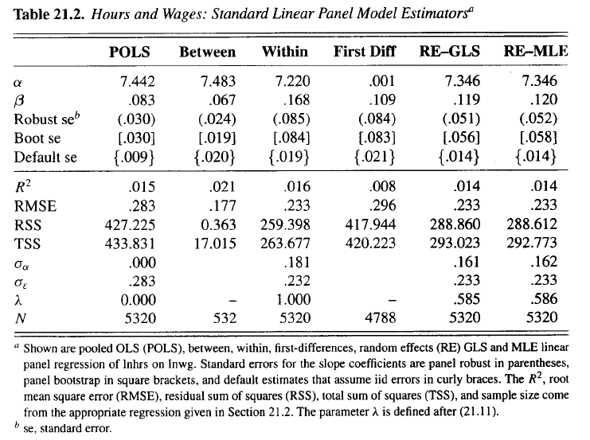
Their results
We will use lm to replicate the POLS, and plm to replicate POLS, within, and First Diff columns.
Notes:
35

Slide 42

Pooled OLS
Here we find the same estimate for the coefficient and the default se.
This standard error is likely wrong due to clustering. We will implement cluster-robust standard errors. Note these errors are also robust to heteroskedasticity.
Notes:
35

Slide 43
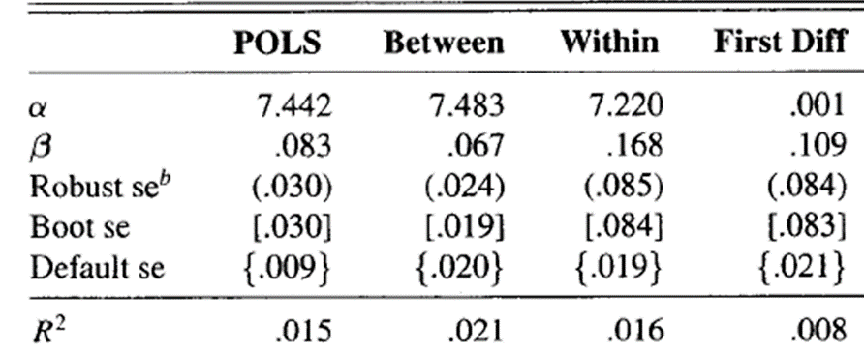
We can also run pooled OLS model directly in the plm package, and use their vcovHC function to correct the standard errors.
Notes:
35

Slide 44
Within
Here we ran a fixed effects model with the default standard errors and then used the vocHC function to produce the cluster-robust standard errors.
Notes:
35

Slide 45
Cameron and Trivedi use Stata to produce their results and Stata by default provides a constant term in their panel model output.
The intercept that they report for the ‘within’ model is actually the average of the individual intercepts.
You can see for yourself by calling:
mean(fixef(mod3)) = 7.219892
Notes:
35

Slide 46
First Differenced
Notes:
35

Slide 47
3. Panel Data and Dummy variable regression
Notes:
35

Slide 48
Dummy variable regression
The traditional view of a fixed effects model is to assume that the unobserved effect, a_{i}, is a parameter to be estimated for each i.
Thus, in the following equation, a_{i} is the intercept for each observational unit.
The dummy variable regression resolves the fixed effects problem by including a dummy variable for each cross-sectional unit and then applying OLS to the model.
Clearly, we cannot do this with cross-sectional data. There would be N+k parameters to estimate only N observations. Therefore, we need at least two time periods.
$y_{it}=β_{1}x_{it}+a_{i}+u_{it},t=1,2,….T$
Notes:
48

Slide 49
Estimating an intercept for each i is simple. Just add a dummy variable for each i.
The dummy method gives us the exact same beta estimates as we would get from the time demeaned model and the standard error and other statistics are identical.
By including the individual intercept terms, a_{i}, we have removed the variation that exists between the individual units and are left with only the within individual variation.
The R-squared for this model is generally high because we are including a dummy for each cross-sectional unit which may explain much of the variation in the data.
Note: We can use OLS on dummy variable regression and obtain correct standard errors as the df are properly adjusted due to the addition of a dummy variable for each cross-sectional unit.
Notes:
49

Slide 50
Example of the NC Crime model with dummy variables
Notes:
49

Slide 51

Limits to Fixed Effect Models
Fixed effect models cannot estimate coefficient on variables that do not vary for each unit.
De-meaned model shows why:
Example: in a panel data of individual opinion over time, a fixed effect model cannot estimate a coefficient on gender or race because for each individual in the panel, gender and race do not vary.
Notes:
49

Slide 52
Variables that are fixed within unit
We cannot estimate:
Crime_{it} = β₀ + β₁Police_{it}+ β₂North_{i} + α_{i} + ε_{it}
We can, however, estimate
Crime_{it} = β₀ + β₁Police_{it}+ β₂ (Police_{it} x North_{i}) + α_{i} + ε_{it}

Slide 53
Let’s Walk through another example
Notes:
49

Slide 54
Traffic fatalities and state beer taxes (Jackman 2010)
Panel data set examining the link between traffic fatalities and beer taxes in the lower 48 states from 1982 to 1988.
The dependent variable is the vehicle fatality rate (annually per 10,000 people).
When we plot the data by state we can see that there is wide variation in the rates across states.
Notes:
49

Slide 55
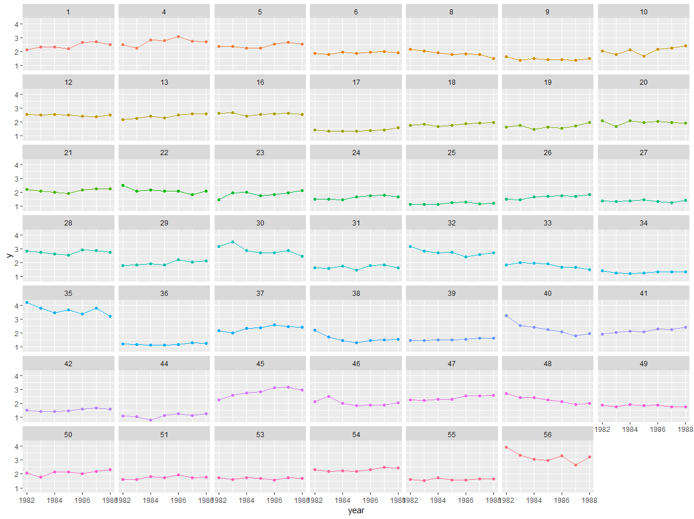
Notes:
49

Slide 56
Let’s begin with a naïve OLS estimate of the effect of beer tax on fatalities
fatality_{it} = b₀ + b₁beertax_{it} + e_{it}
When we ignore the possible between-state heterogeneity, we get a surprising result.
Notes:
49

Slide 57
Model using Fixed Effects
When we properly deal with the unobservable fixed effects for each state we see a striking difference in the estimated effect of the beer tax.
Notes:
<number>

Slide 58
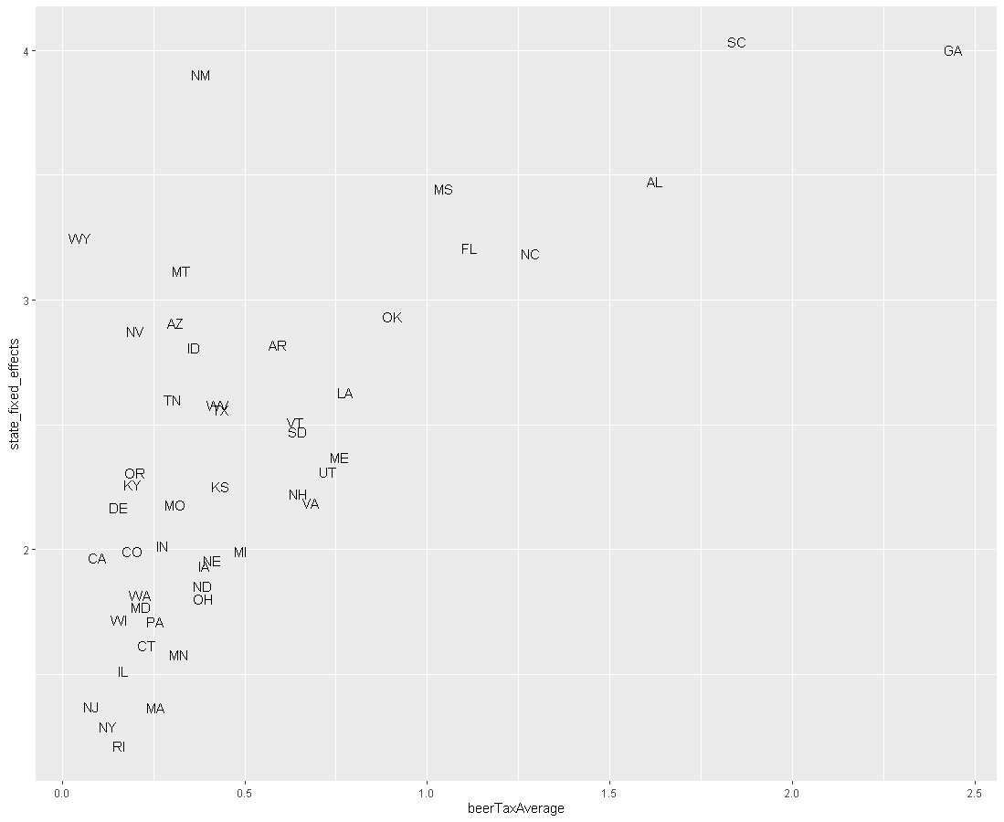
Notes:
<number>

Slide 59
Time for you to practice
I have posted practice questions to this week’s folder on Blackboard.
The questions come directly from a prior methods comprehensive exam.
Also good practice for those doctoral students planning to take a methods exam.

