Slide 1

Federal College Aid and Rising Tuition: Project Methodology
Alexander Keeney

Slide 2

Research Topic
The Higher Education Act of 1965 introduced, among other things, Pell Grants and Federal Stafford Student Loans.
Federal Student Aid, while initially intended to increase college affordability for low-income students and families, may have actually increased the cost of attendance at colleges and universities.
A College Board Study has shown that cost of attendance rises more when federal student aid grows.

Slide 3

Hypothesis
H₀: Increases in the maximum federal student aid amounts are not related to cost of attendance at US Post-Secondary Education Institutions.
H₁: Increases in the maximum federal student aid amounts are positively related to cost of attendance at US Post-Secondary Education Institutions.

Slide 4


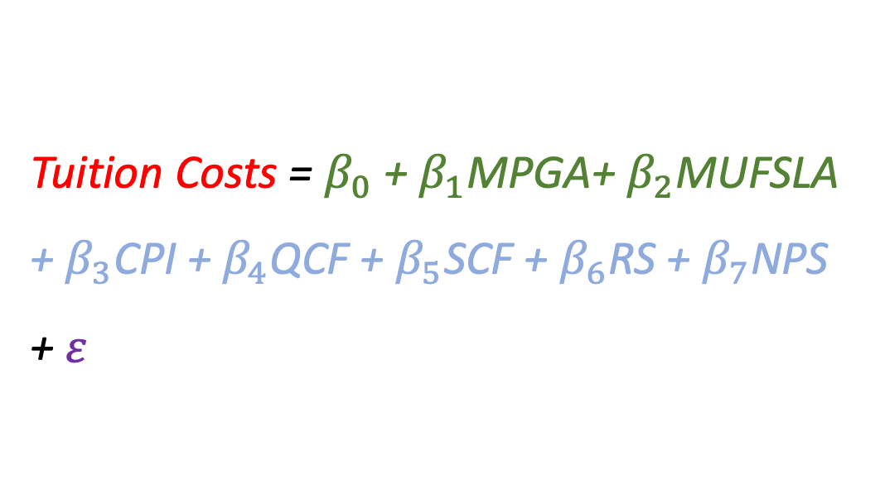
Estimating Model
Tuition Costs = $β_{0}$ + $β_{1}$MPGA+ $β_{2}$MUFSLA + $β_{3}$CPI + $β_{4}$QCF + $β_{5}$SCF + $β_{6}$RS + $β_{7}$NPS + $ε$

Slide 5
Variable Descriptions
Variable Name | Definition | Intervention/ Control | Estimated Effect(+/-) | Data Source
Maximum Pell Grant Amount | The largest grant available to students | Intervention | + | Collegeboard.org
Maximum undergraduate Federal Student Loan Amount | The Limit on Federal Student loans for Undergraduate students per semester. | Intervention | + | Unknown
CPI | Consumer Price Index | Control | + | BLS
QCF | Quality Control Factor | Control | + | Unknown
SCF | State Control Factor | Control | +/- | Unknown
Residency Status | 0 = Non - resident 1 = In-state resident | Control | - | University/college general information
Nonprofit status | 0 = For-profit 1 = Nonprofit | Control | +/- | University/college general information
Public Status | 0 = Private 1 = Public | Control | - | University/college general information

