Slide 1

CM20315 - Machine Learning
Prof. Simon Prince
6. Fitting models

Slide 2
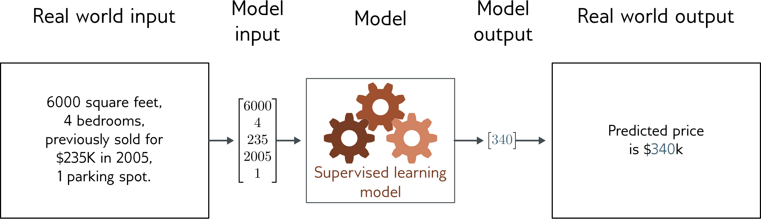
Regression
Univariate regression problem (one output, real value)
Fully connected network

Slide 3
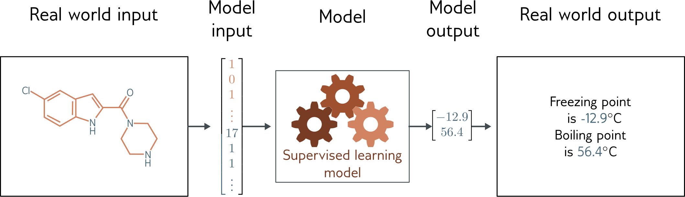
Graph regression
Multivariate regression problem (>1 output, real value)
Graph neural network

Slide 4
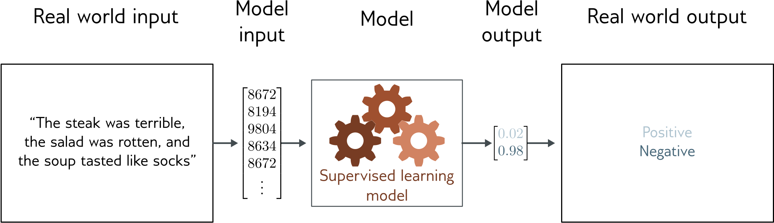
Text classification
Binary classification problem (two discrete classes)
Transformer network

Slide 5
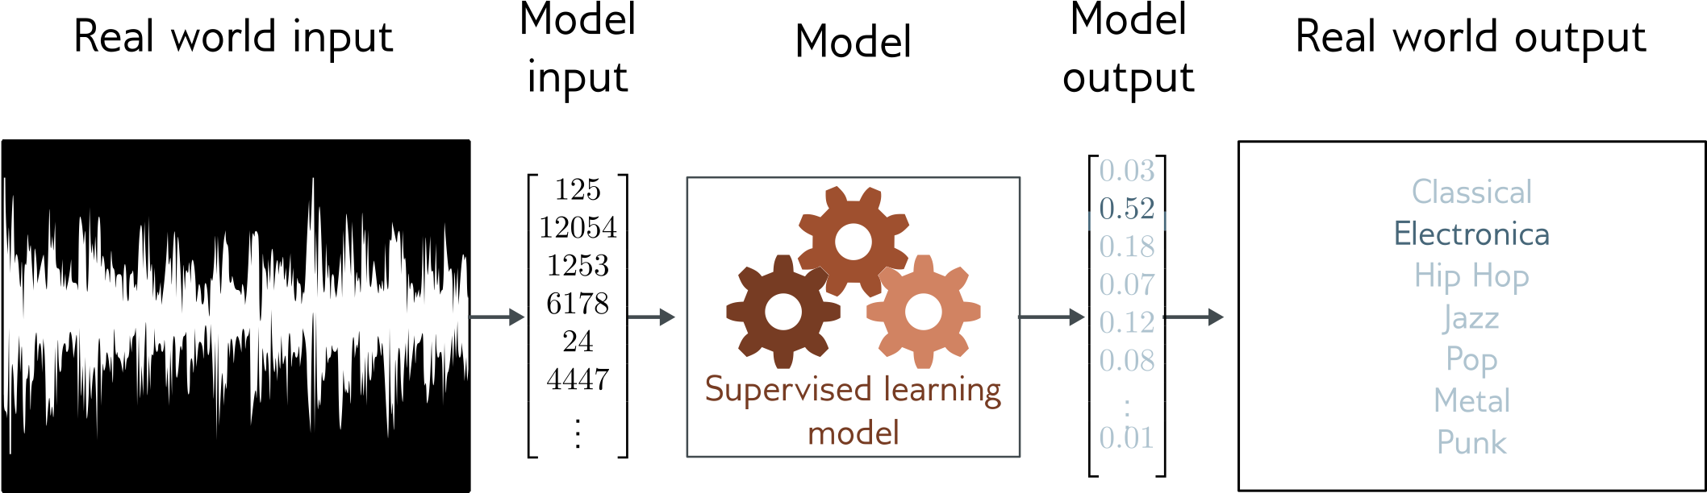
Music genre classification
Multiclass classification problem (discrete classes, >2 possible values)
Convolutional network

Slide 6
Loss function
Training dataset of I pairs of input/output examples:
Loss function or cost function measures how bad model is:
or for short:
Returns a scalar that is smaller when model maps inputs to outputs better

Slide 7
Training
Loss function:
Find the parameters that minimize the loss:
Returns a scalar that is smaller when model maps inputs to outputs better

Slide 8
Example: 1D Linear regression loss function
Loss function:
“Least squares loss function”

Slide 9
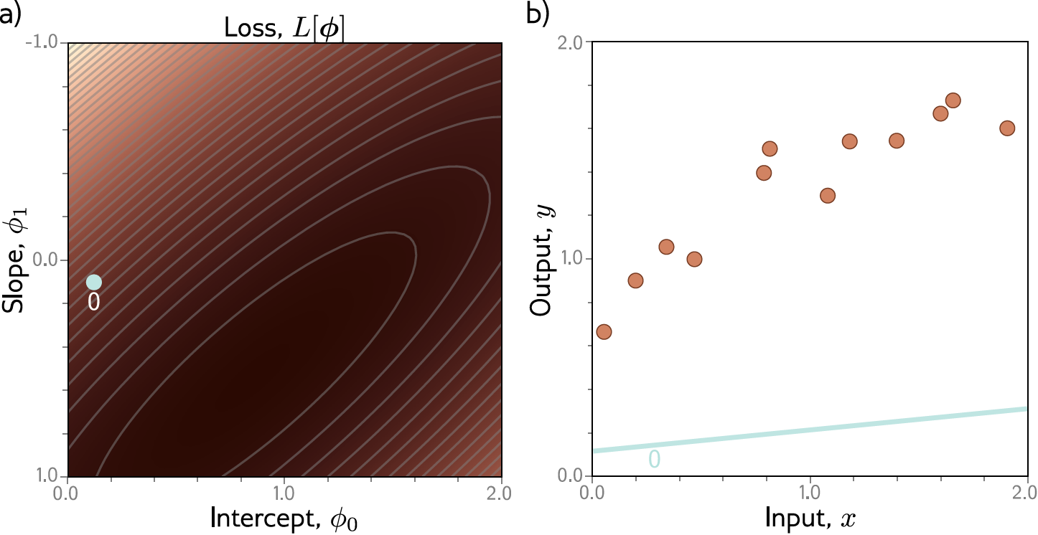
Example: 1D Linear regression training

Slide 10
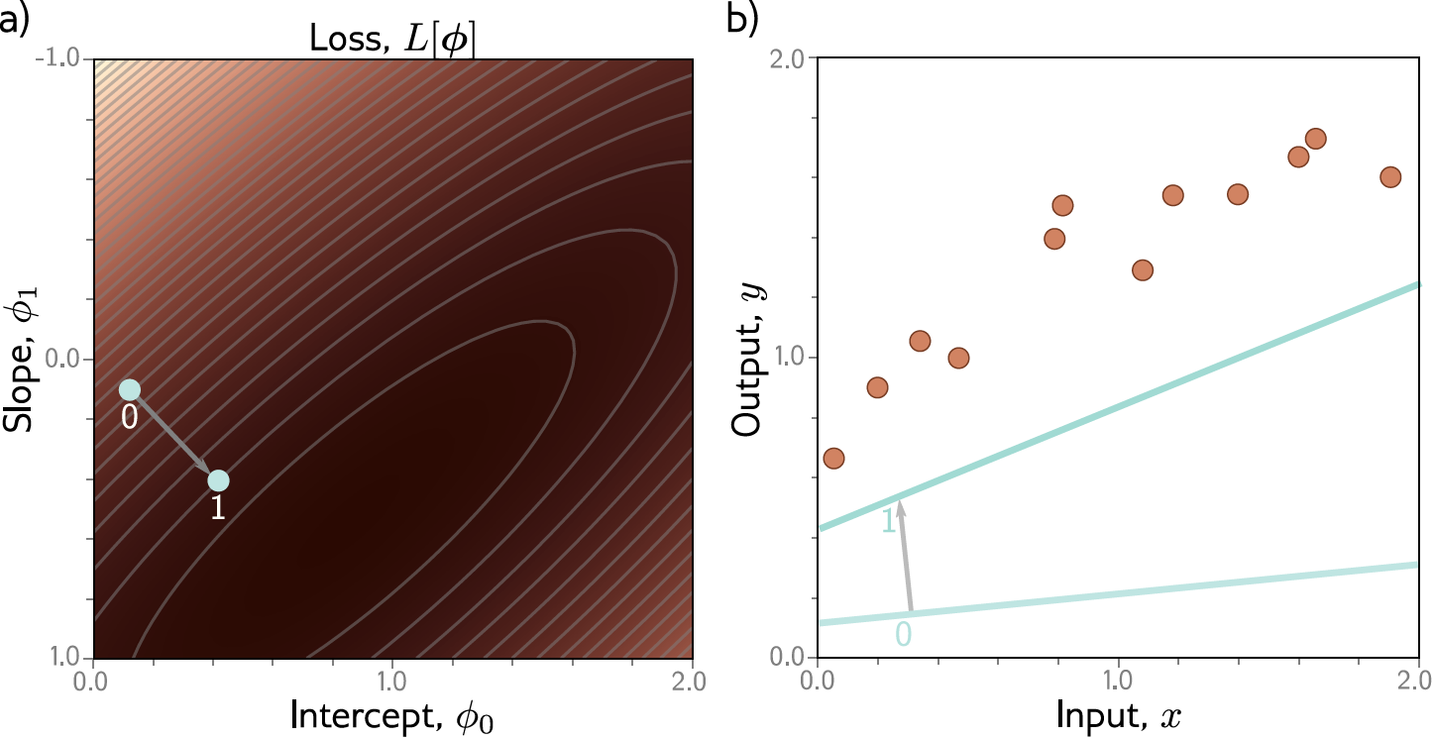
Example: 1D Linear regression training

Slide 11
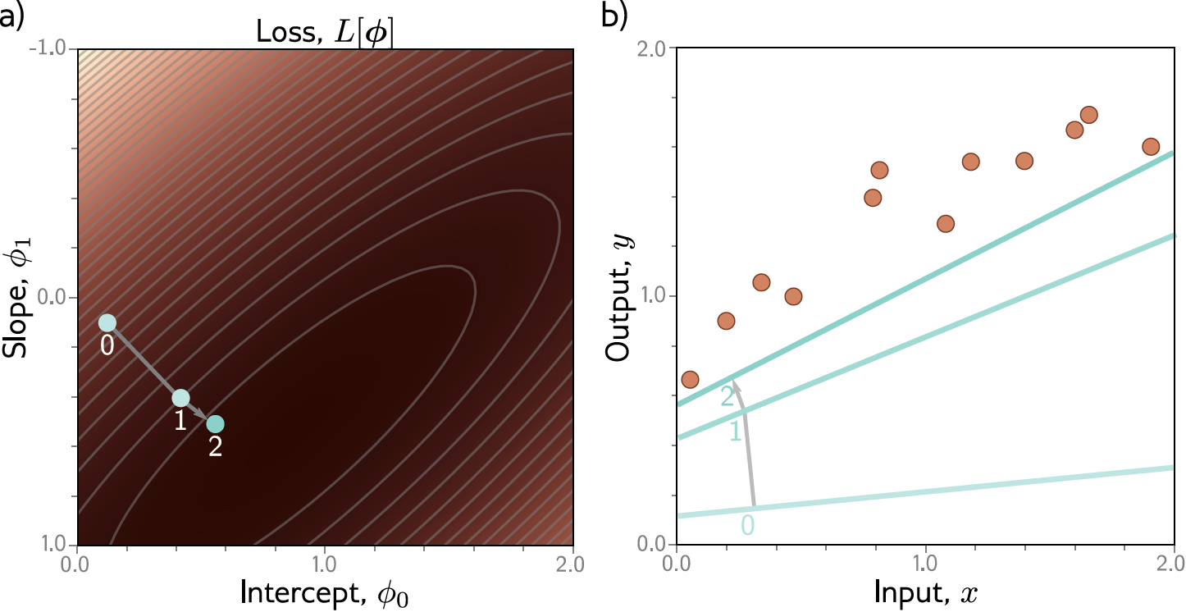
Example: 1D Linear regression training

Slide 12

Example: 1D Linear regression training

Slide 13
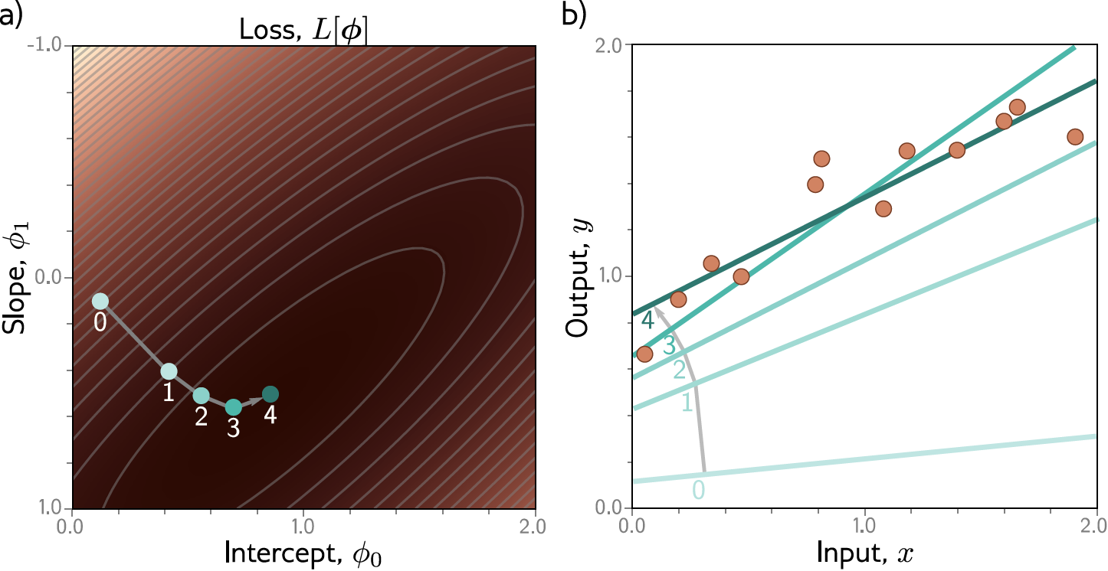
Example: 1D Linear regression training
This technique is known as gradient descent

Slide 14
Fitting models
Maths overview
Gradient descent algorithm
Linear regression example
Gabor model example
Stochastic gradient descent
Momentum
Adam

Slide 15
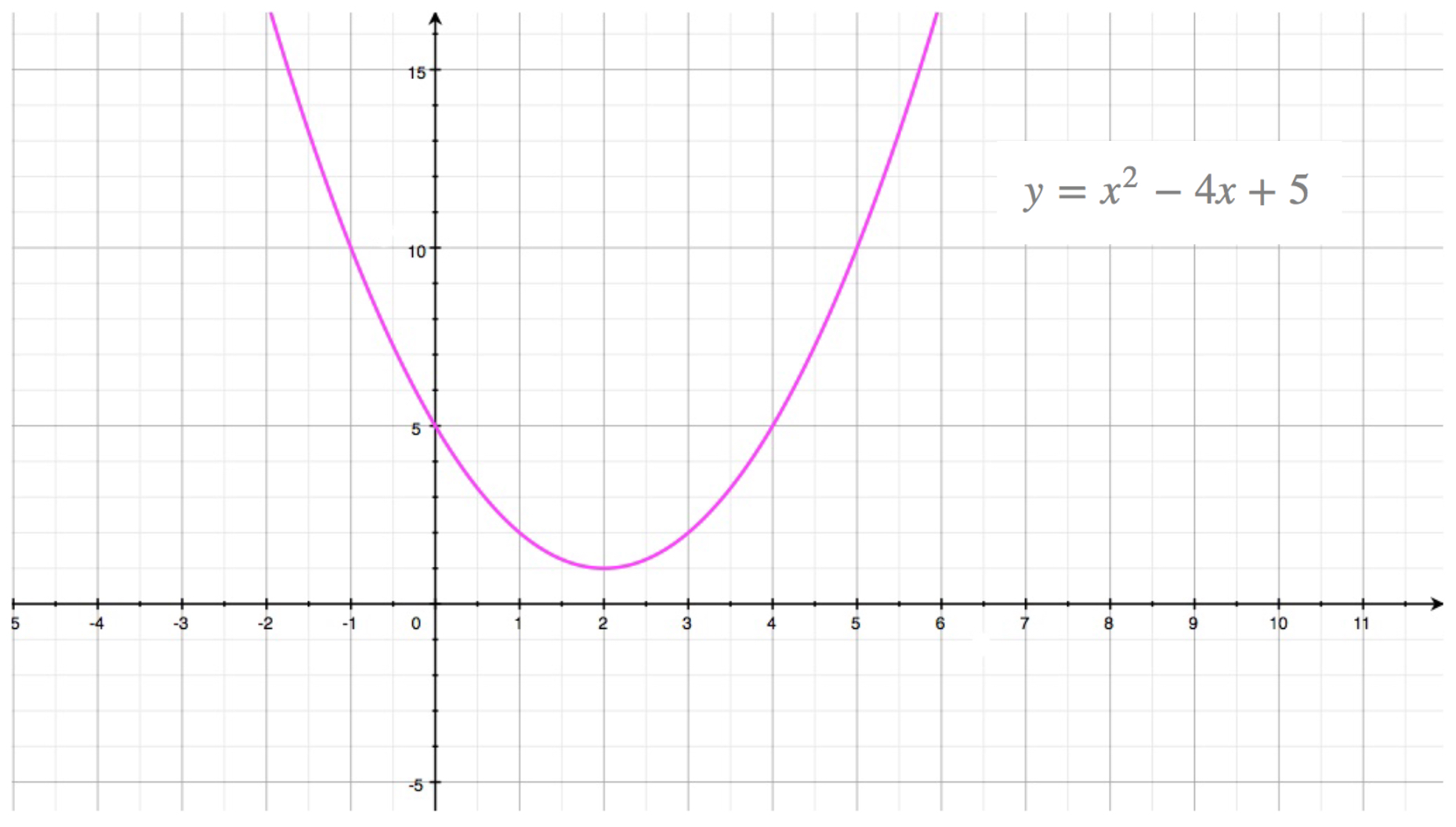

Slide 21
Fitting models
Maths overview
Gradient descent algorithm
Linear regression example
Gabor model example
Stochastic gradient descent
Momentum
Adam

Slide 22
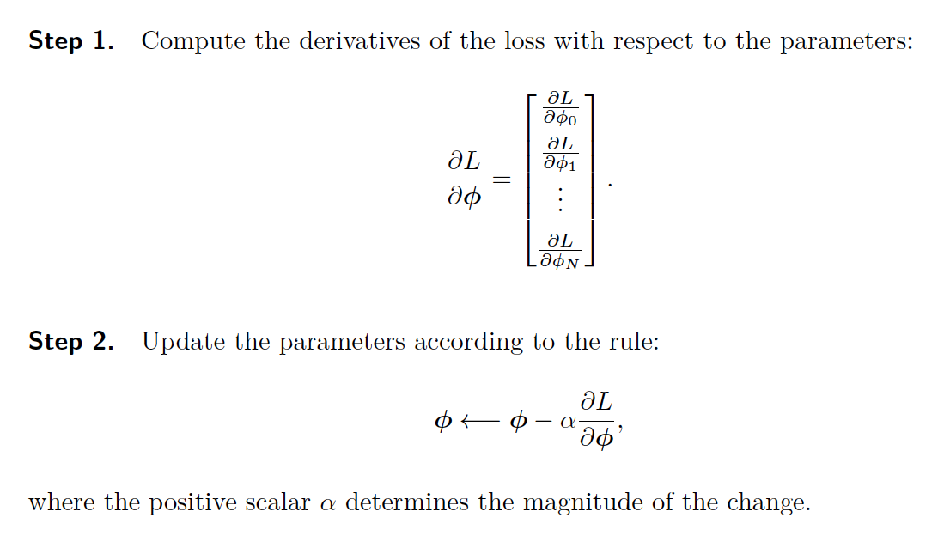
Gradient descent algorithm

Slide 23
Fitting models
Maths overview
Gradient descent algorithm
Linear regression example
Gabor model example
Stochastic gradient descent
Momentum
Adam

Slide 24
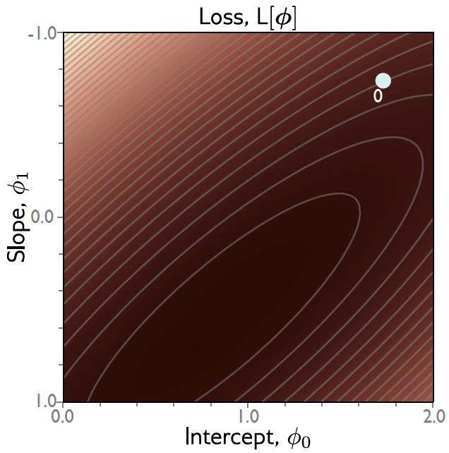
Gradient descent
Step 1: Compute derivatives (slopes of function) with
Respect to the parameters

Slide 25
Gradient descent
Step 1: Compute derivatives (slopes of function) with
Respect to the parameters

Slide 26
Gradient descent
Step 1: Compute derivatives (slopes of function) with
Respect to the parameters

Slide 27

Gradient descent
Step 1: Compute derivatives (slopes of function) with
Respect to the parameters

Slide 28


Gradient descent
Step 1: Compute derivatives (slopes of function) with
Respect to the parameters
Step 2: Update parameters according to rule
$α$ = step size or learning rate if fixed

Slide 29


Gradient descent
Step 1: Compute derivatives (slopes of function) with
Respect to the parameters
Step 2: Update parameters according to rule
$α$ = step size

Slide 30
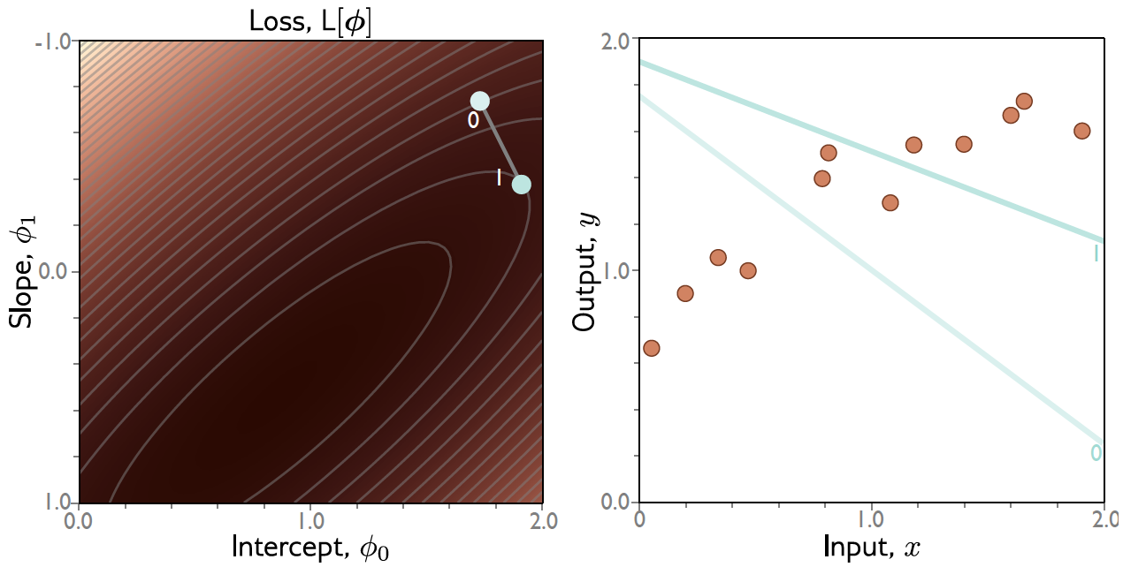
Gradient descent

Slide 31

Gradient descent
Step 1: Compute derivatives (slopes of function) with
Respect to the parameters
Step 2: Update parameters according to rule
$α$ = step size

Slide 32

Gradient descent
Step 1: Compute derivatives (slopes of function) with
Respect to the parameters
Step 2: Update parameters according to rule
$α$ = step size

Slide 33
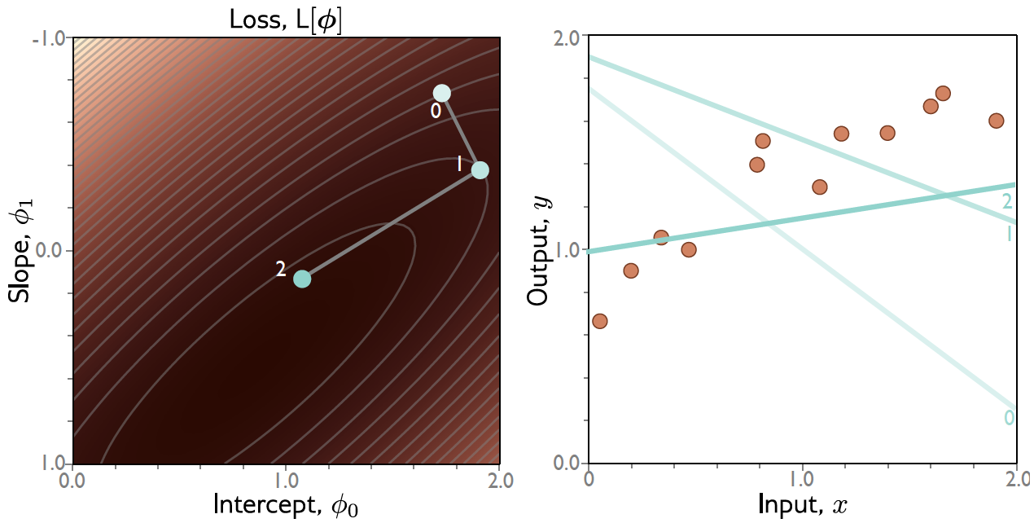
Gradient descent

Slide 34
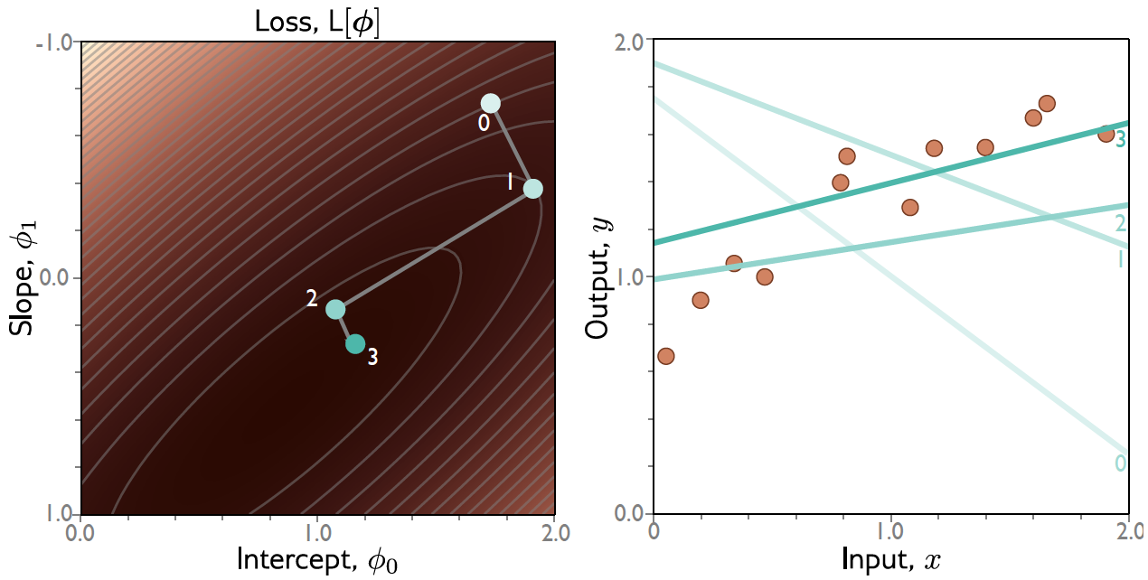
Gradient descent

Slide 35
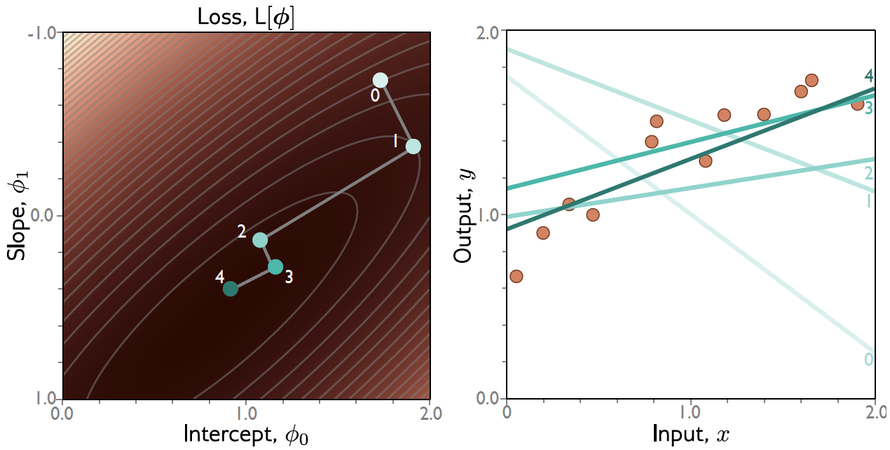
Gradient descent

Slide 36
Line Search
Step 1: Compute derivatives (slopes of function) with
Respect to the parameters
Step 2: Update parameters according to rule
$α$ = step size

Slide 37
Line Search (bracketing)

Slide 38
Line Search (bracketing)

Slide 39
Line Search (bracketing)

Slide 40
Gradient descent

Slide 41
Convex problems
Non convex
Convex
Non-Convex

Slide 42
Convex problems
Non convex
Convex
Non-Convex
Test for convexity is that 2nd derivative is positive everywhere

Slide 43
Convexity in higher dimensions
Test for convexity is that determinant of Hessian (2nd derivative matrix) is positive everywhere.

Slide 44
Fitting models
Maths overview
Gradient descent algorithm
Linear regression example
Gabor model example
Stochastic gradient descent
Momentum
Adam

Slide 45
Gabor model

Slide 46
Gabor model

Slide 47
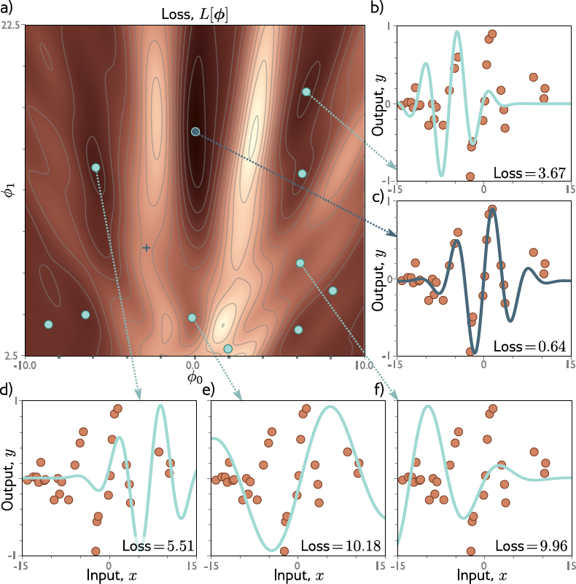

Slide 48
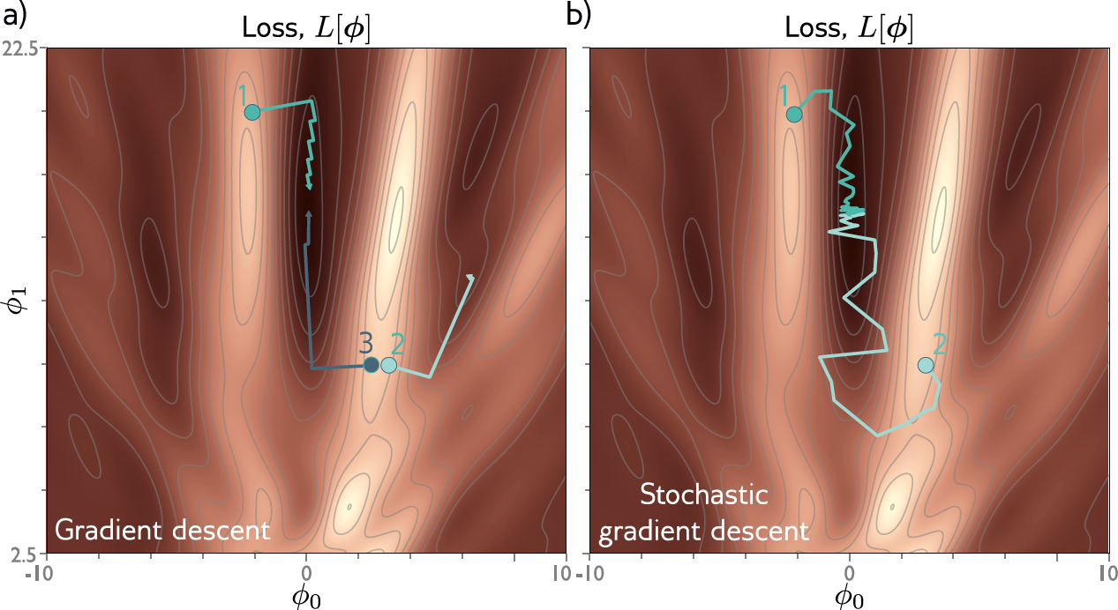
Gradient descent gets to the local minimum if we start in the right “valley”
Otherwise, descent to a local minimum
Or get stuck near a saddle point

Slide 49
Fitting models
Maths overview
Gradient descent algorithm
Linear regression example
Gabor model example
Stochastic gradient descent
Momentum
Adam

Slide 50
IDEA: add noise
Stochastic gradient descent
Compute gradient based on only a subset of points – a mini-batch
Work through dataset sampling without replacement
One pass though the data is called an epoch

Slide 51
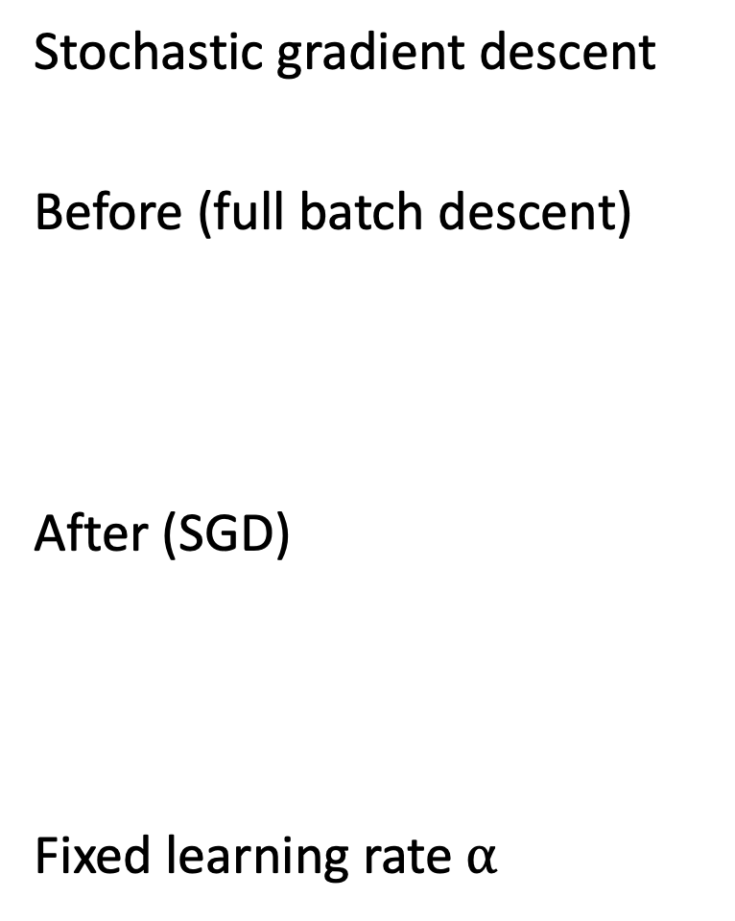
Stochastic gradient descent
Before (full batch descent)
After (SGD)
Fixed learning rate $α$

Slide 53
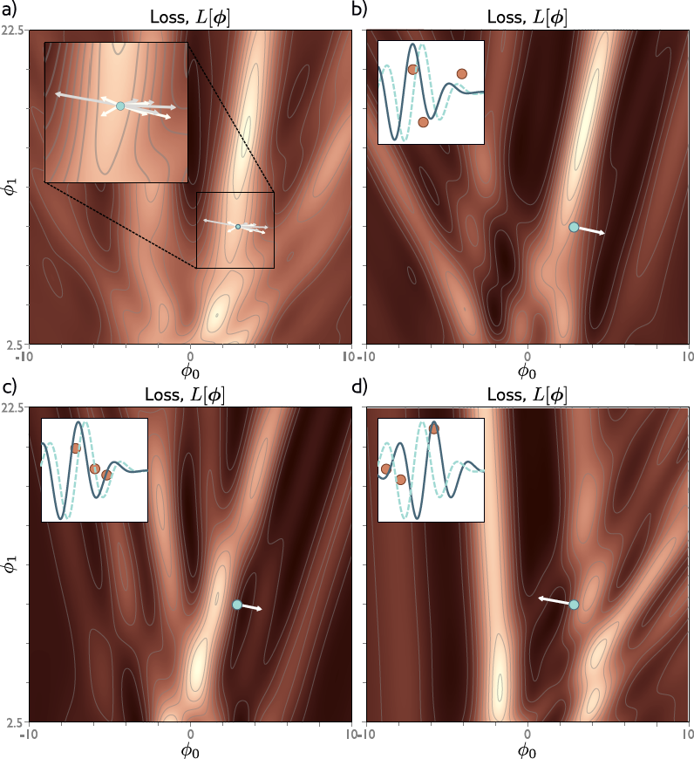

Slide 54
Properties of SGD
Can escape from local minima
Adds noise, but still sensible updates as based on part of data
Uses all data equally
Less computationally expensive
Seems to find better solutions
Doesn’t converge in traditional sense
Learning rate schedule – decrease learning rate over time

Slide 55
Fitting models
Maths overview
Gradient descent algorithm
Linear regression example
Gabor model example
Stochastic gradient descent
Momentum
Adam

Slide 56
Momentum
Weighted sum of this gradient and previous gradient

Slide 57
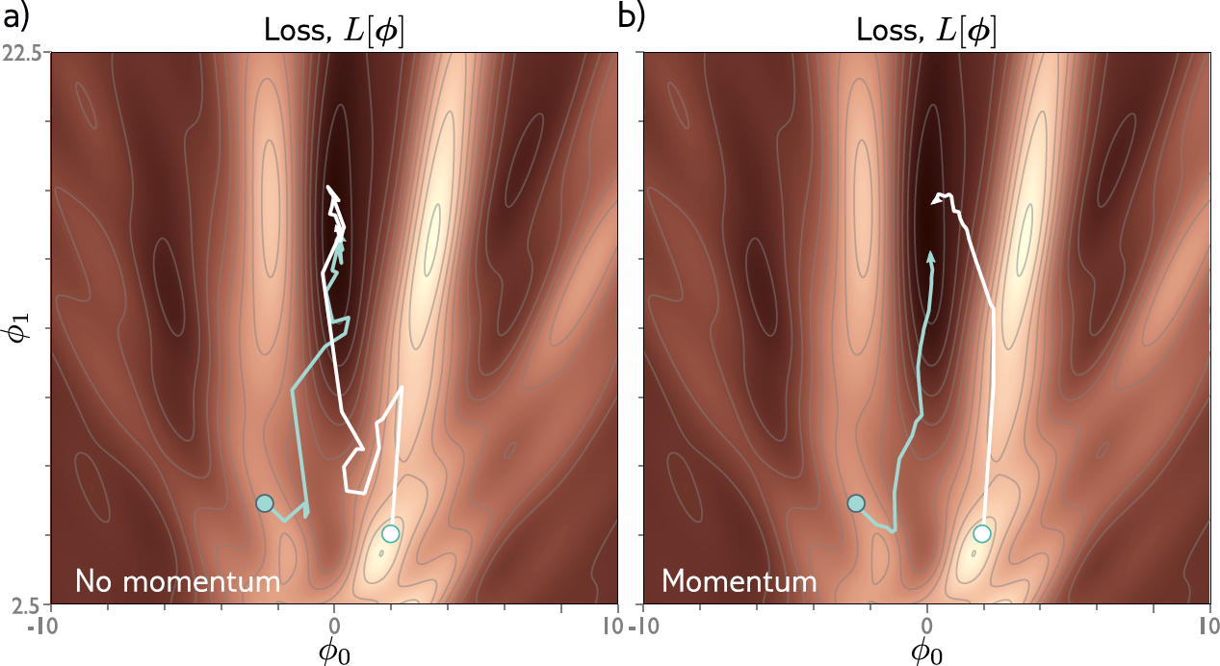

Slide 58
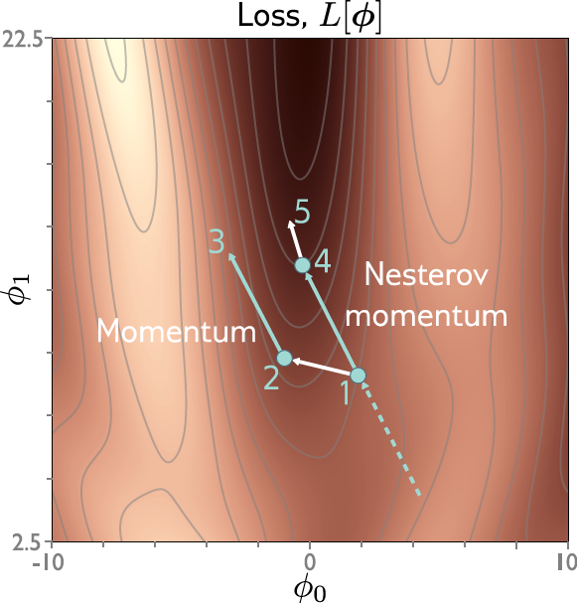
Nesterov accelerated momentum
Momentum is kind of like a prediction of where we are going
Move in the predicted direction, THEN, measure the gradient

Slide 59
Fitting models
Maths overview
Gradient descent algorithm
Linear regression example
Gabor model example
Stochastic gradient descent
Momentum
Adam

Slide 60
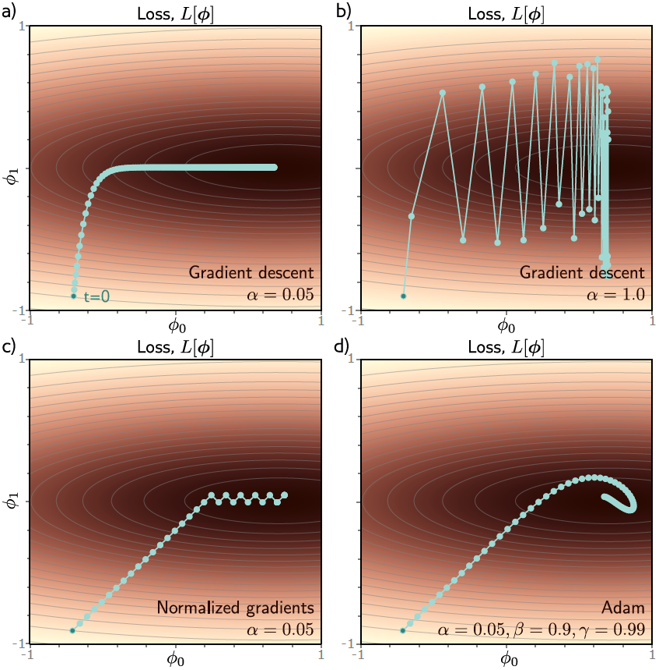
Adaptive moment estimation (Adam)

Slide 61
Normalized gradients
Measure mean and pointwise squared gradient
Normalize:

Slide 62
Normalized gradients
Measure mean and pointwise squared gradient
Normalize:

Slide 63
Adaptive moment estimation (Adam)
Compute mean and pointwise squared gradients with momentum
Moderate near start of the sequence
Update the parameters

Slide 64
Adaptive moment estimation (Adam)

Slide 65
Hyperparameters
Choice of learning algorithm
Learning rate
Momentum

