Slide 1

CM20315 - Machine Learning
Prof. Simon Prince
10. Convolutional networks #1

Slide 2
Convolutional networks
Networks for images
Invariance and equivariance
1D convolution
Convolutional layers
Channels
Receptive fields
Convolutional network for MNIST 1D

Slide 3
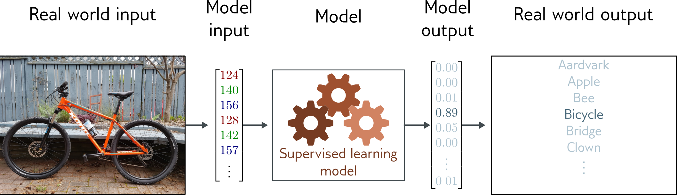
Image classification
Multiclass classification problem (discrete classes, >2 possible classes)
Convolutional network

Slide 4
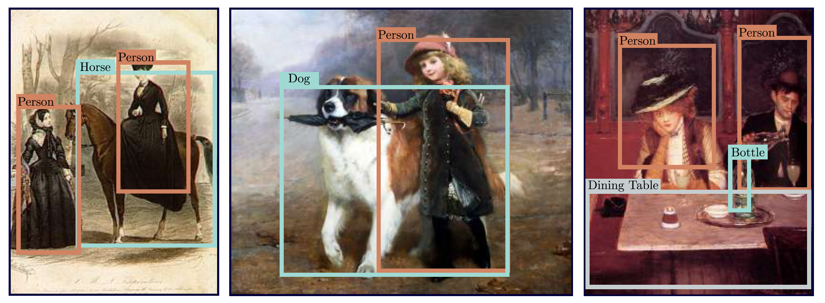
Object detection

Slide 5
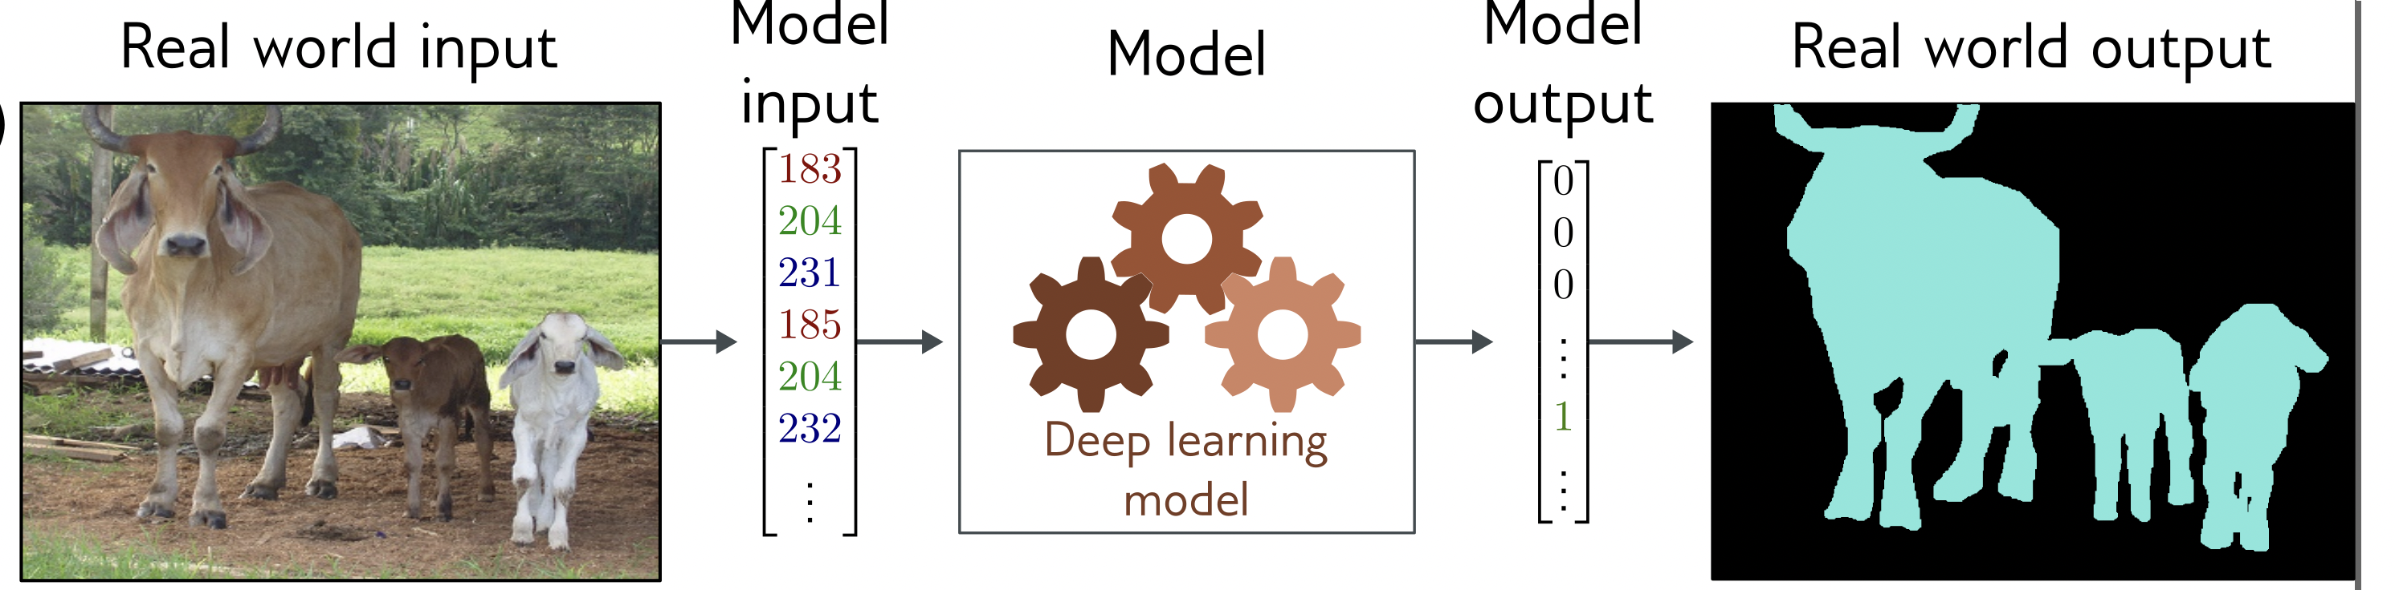
Image segmentation
Multivariate binary classification problem (many outputs, two discrete classes)
Convolutional encoder-decoder network

Slide 6
Networks for images
Problems with fully-connected networks
Size
224x224 RGB image = 150,528 dimensions
Hidden layers generally larger than inputs
One hidden layer = 150,520x150,528 weights -- 22 billion
Nearby pixels statistically related
But could permute pixels and relearn and get same results with FC
Should be stable under transformations
Don’t want to re-learn appearance at different parts of image

Slide 7
Convolutional networks
Parameters only look at local image patches
Share parameters across image

Slide 8
Convolutional networks
Networks for images
Invariance and equivariance
1D convolution
Convolutional layers
Channels
Receptive fields
Convolutional network for MNIST 1D

Slide 9
Invariance
A function f[x] is invariant to a transformation t[] if:
i.e., the function output is the same even after the transformation is applied.

Slide 10
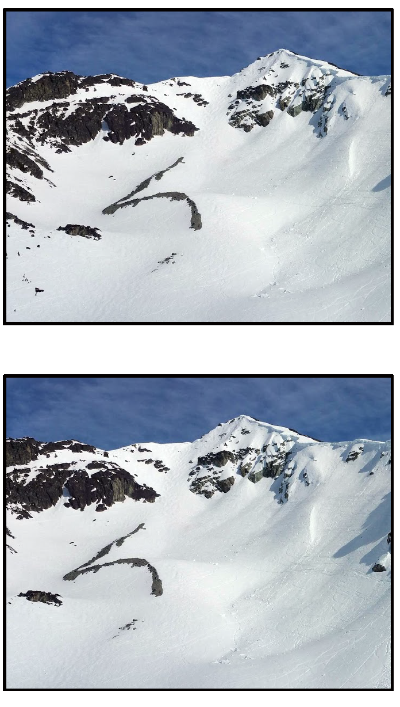
Invariance example
e.g., Image classification
Image has been translated, but we want our classifier to give the same result

Slide 11
Equivariance
A function f[x] is equivariant to a transformation t[] if:
i.e., the output is transformed in the same way as the input

Slide 12
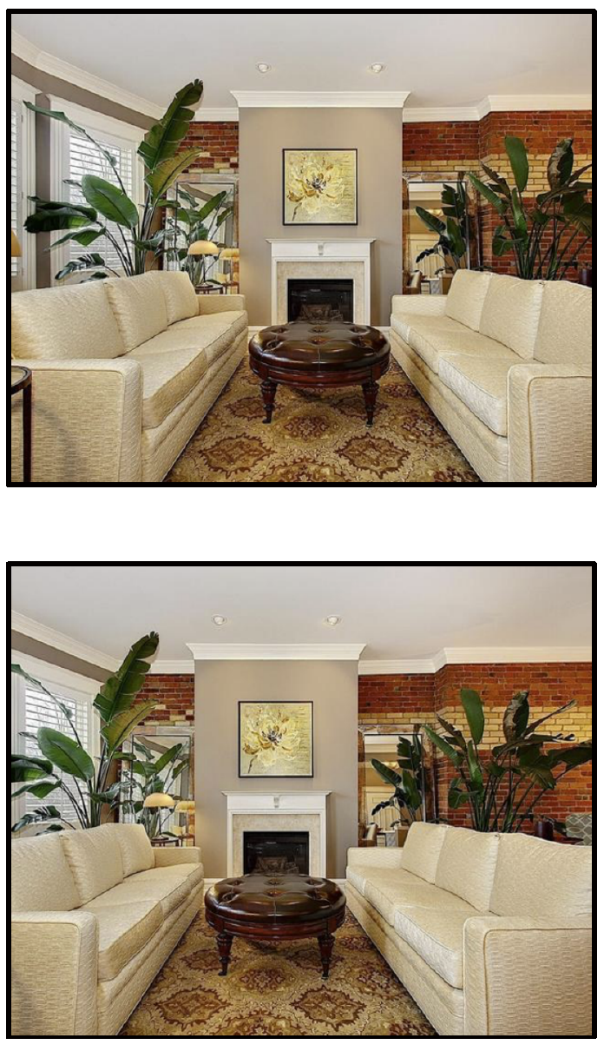
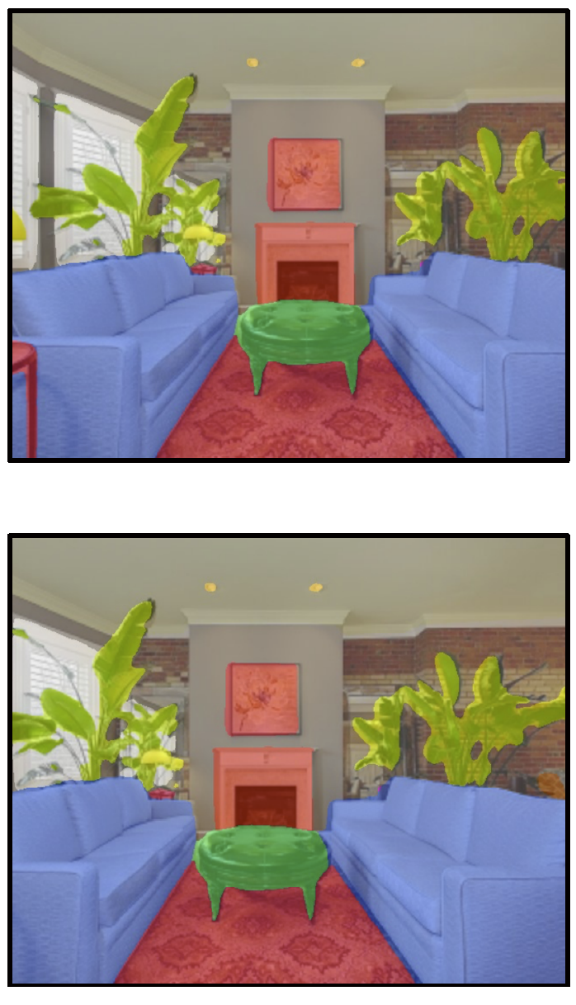
Equivariance example
e.g., Image segmentation
Image has been translated and we want segmentation to translate with it

Slide 13
Convolutional networks
Networks for images
Invariance and equivariance
1D convolution
Convolutional layers
Channels
Receptive fields
Convolutional network for MNIST 1D

Slide 14
Convolution* in 1D
Input vector x:
Output is weighted sum of neighbors:
Convolutional kernel or filter:
Kernel size = 3
* Not really technically convolution

Slide 15
Convolution with kernel size 3

Slide 16
Convolution with kernel size 3

Slide 17
Convolution with kernel size 3
Equivariant to translation of input

Slide 18
Zero padding
Treat positions that are beyond end of the input as zero.

Slide 19
“Valid” convolutions
Only process positions where kernel falls in image (smaller output).

Slide 20
Stride, kernel size, and dilation
Stride = shift by k positions for each output
Decreases size of output relative to input
Kernel size = weight a different number of inputs for each output
Combine information from a larger area
But kernel size 5 uses 5 parameters
Dilated or atrous convolutions = intersperse kernel values with zeros
Combine information from a larger area
Fewer parameters

Slide 25
Convolutional networks
Networks for images
Invariance and equivariance
1D convolution
Convolutional layers
Channels
Receptive fields
Convolutional network for MNIST 1D

Slide 26
Convolutional layer

Slide 27
Special case of fully-connected network
Convolutional network:
Fully connected network:

Slide 28

Special case of fully-connected network
Convolutional network:
3 weights, 1 bias
Fully connected network:
$D^{2}$ weights, D biases

Slide 29
Special case of fully-connected network
Fully connected network

Slide 30
Special case of fully-connected network
Fully connected network
Convolution, kernel 3,
stride 1, dilation 0

Slide 31
Special case of fully-connected network
Fully connected network
Convolution, size 3, stride 1,
dilation 0, zero padding
Convolution, size 3, stride 1,
dilation 0, zero padding

Slide 32
Question 1
Kernel size?
Stride?
Dilation?
Zero padding / valid?

Slide 33
Question 2
Kernel size?
Stride?
Dilation?
Zero padding / valid?

Slide 34
Question 3
Kernel size?
Stride?
Dilation?
Zero padding / valid?

Slide 35
Convolutional networks
Networks for images
Invariance and equivariance
1D convolution
Convolutional layers
Channels
Receptive fields
Convolutional network for MNIST 1D

Slide 36
Channels
The convolutional operation averages together the inputs
Plus passes through ReLU function
Has to lose information
Solution:
apply several convolutions and stack them in channels
Sometimes also called feature maps

Slide 37
Two output channels, one input channel

Slide 38
Two output channels, one input channel

Slide 39
Two input channels, one output channel

Slide 40

How many parameters?
If there are${ C}_{i}$ input channels and kernel size K
If there are${ C}_{i}$ input channels and ${ C}_{o}$ output channels

Slide 41
Convolutional networks
Networks for images
Invariance and equivariance
1D convolution
Convolutional layers
Channels
Receptive fields
Convolutional network for MNIST 1D

Slide 42
Receptive fields

Slide 43
Receptive fields

Slide 44
Receptive fields

Slide 45
Receptive fields

Slide 46
Convolutional networks
Networks for images
Invariance and equivariance
1D convolution
Convolutional layers
Channels
Receptive fields
Convolutional network for MNIST 1D

Slide 47
MNIST 1D Dataset

Slide 48
MNIST-1D results for fully-connected network

Slide 49
Convolutional network
Four hidden layers
Three convolutional layers
One fully-connected layer
Softmax at end
Total parameters = 2050
Trained for 100,000 steps with SGD, LR = 0.01, batch size 100

Slide 50
MNIST-1D convolutional network

Slide 51
Fully connected network
Exactly same number of layers and hidden units
All fully-connected layers
Total parameters = 150,185

Slide 52
Performance

Slide 53
MNIST 1D Dataset

Slide 54
Why?
Better inductive bias
Forced the network to process each location similarly
Shares information across locations
Search through a smaller family of input/ouput mappings, all of which are plausible

