Slide 1

CM20315 - Machine Learning
Prof. Simon Prince
10. Convolutional networks #2

Slide 2
Convolution #2
2D Convolution
Downsampling and upsampling, 1x1 convolution
Image classification
Object detection
Semantic segmentation
Residual networks
U-Nets and hourglass networks

Slide 3
2D Convolution
Convolution in 2D
Weighted sum over a K x K region
K x K weights
Build into a convolutional layer by adding bias and passing through activation function

Slide 4
2D Convolution

Slide 5
2D Convolution

Slide 6
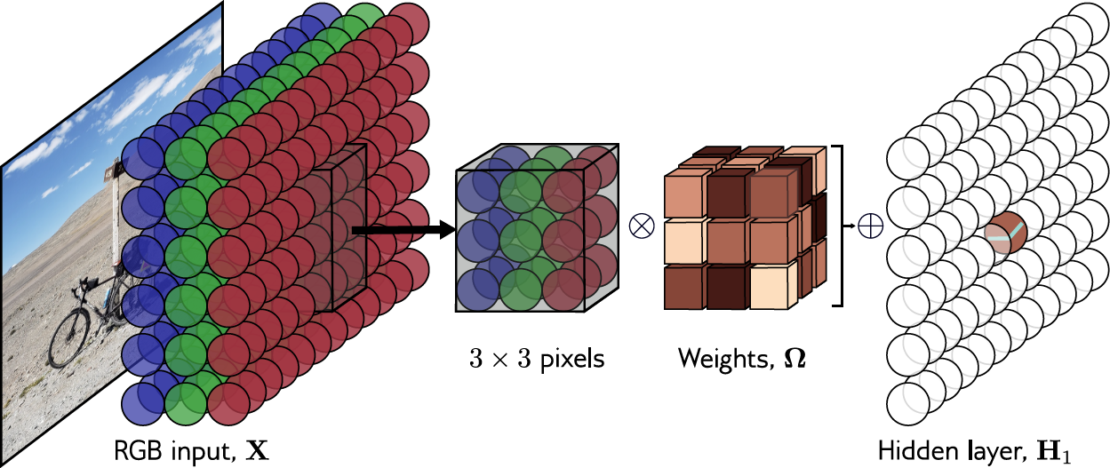
Channels in 2D convolution
Kernel size, stride, dilation all work as you would expect

Slide 7

How many parameters?
If there are${ C}_{i}$ input channels and kernel size K x K
If there are${ C}_{i}$ input channels and ${ C}_{o}$ output channels

Slide 8
MNIST-1D convolutional network

Slide 9
Convolution #2
2D Convolution
Downsampling and upsampling, 1x1 convolution
Image classification
Object detection
Semantic segmentation
Residual networks
U-Nets and hourglass networks

Slide 10
Downsampling
Sample every other position (equivalent to stride two)

Slide 11
Downsampling
Sample every other position (equivalent to stride two)
Max pooling
(partial invariance to translation)

Slide 12
Downsampling
Sample every other position (equivalent to stride two)
Max pooling
(partial invariance to translation)
Mean pooling

Slide 13
Upsampling
Duplicate

Slide 14
Upsampling
Duplicate
Max-upsampling

Slide 15
Upsampling
Duplicate
Max-upsampling
Bilinear interpolation

Slide 16
Transposed convolutions
Kernel size 3, Stride 2 convolution

Slide 17
Transposed convolutions
Kernel size 3, Stride 2 convolution
Transposed convolution

Slide 18
1x1 convolution
Mixes channels
Can change number of channels
Equivalent to running same fully connected network at each position

Slide 19
Convolution #2
2D Convolution
Downsampling and upsampling, 1x1 convolution
Image classification
Object detection
Semantic segmentation
Residual networks
U-Nets and hourglass networks

Slide 20
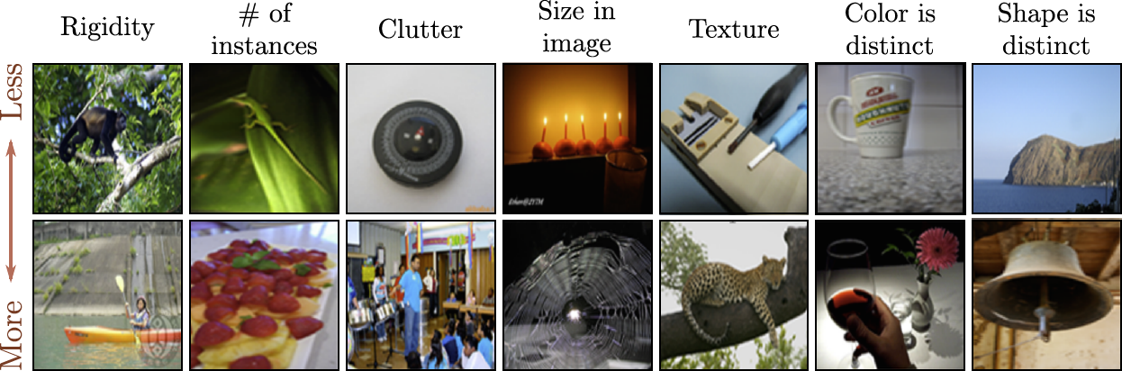
ImageNet database
224 x 224 images
1,281,167 training images, 50,000 validation images, and 100,000 test images
1000 classes

Slide 21
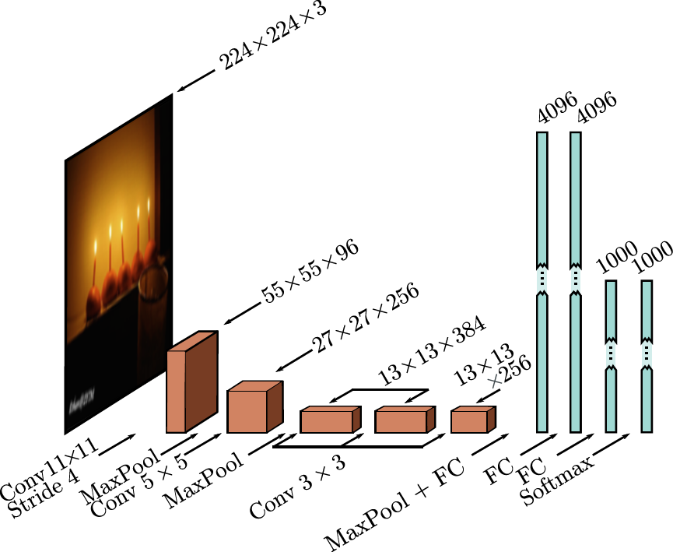
AlexNet (2012)
Almost all the 60 million parameters
parameters are in fully connected layers

Slide 22
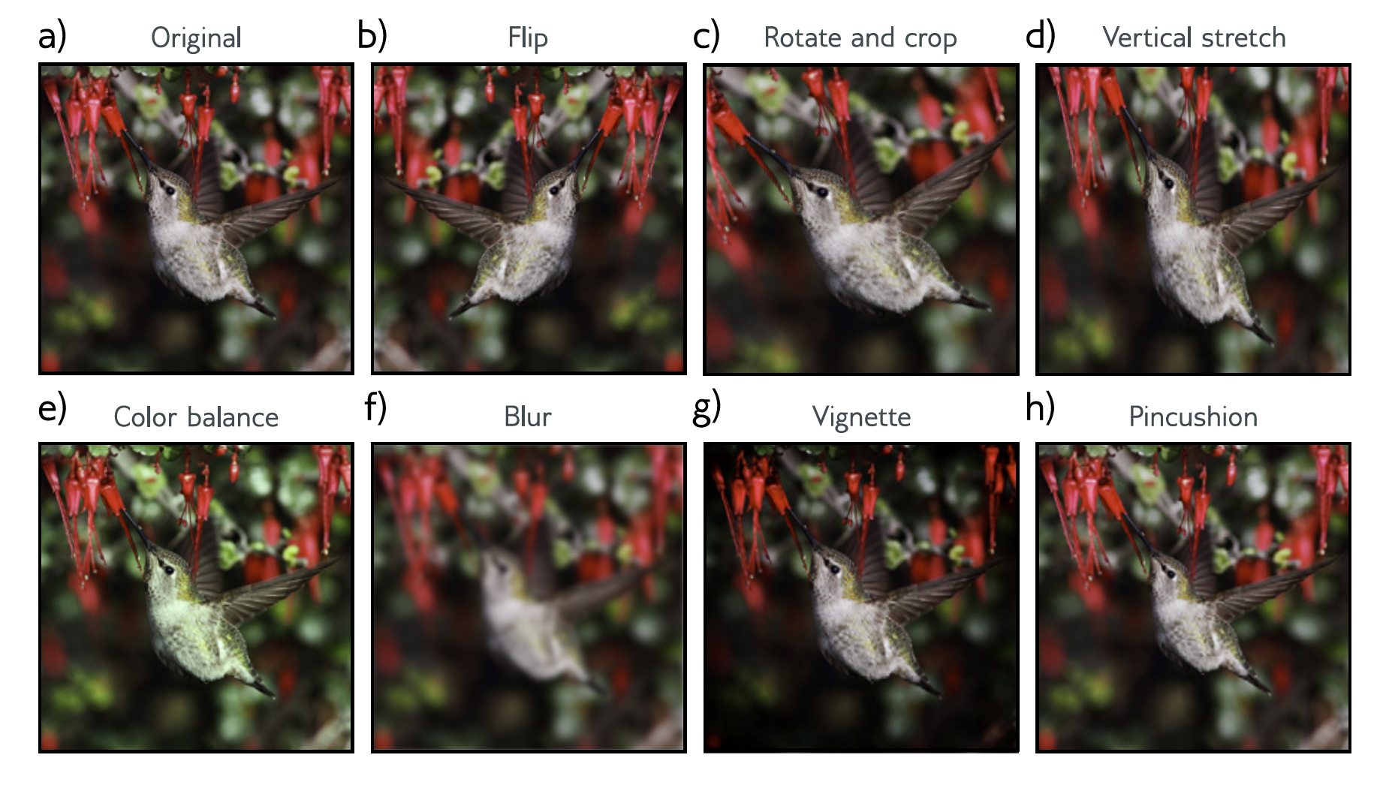
Data augmentation
Data augmentation a factor of 2048 using (i) spatial transformations and (ii) modifications of the input intensities.

Slide 23
Dropout
Dropout was applied in the fully connected layers

Slide 24
Details
At test time average results from five different cropped and mirrored versions of the image
SGD with a momentum coeﬀicient of 0.9 and batch size of 128.
L2 (weight decay) regularizer used.
This system achieved a 16.4% top-5 error rate and a 38.1% top-1 error rate.

Slide 25
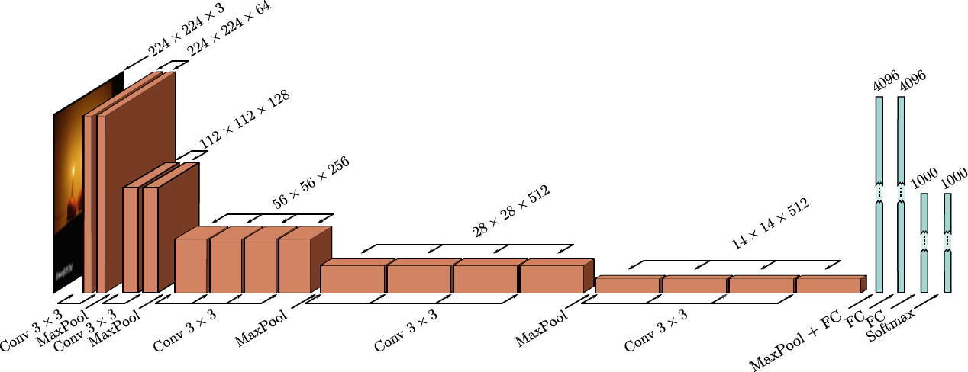
VGG (2015)

Slide 26
Details
19 hidden layers
144 million parameters
6.8% top-5 error rate, 38.1% top-1 error rate

Slide 27
ImageNet History

Slide 28
Convolution #2
2D Convolution
Downsampling and upsampling, 1x1 convolution
Image classification
Object detection
Semantic segmentation
Residual networks
U-Nets and hourglass networks

Slide 29
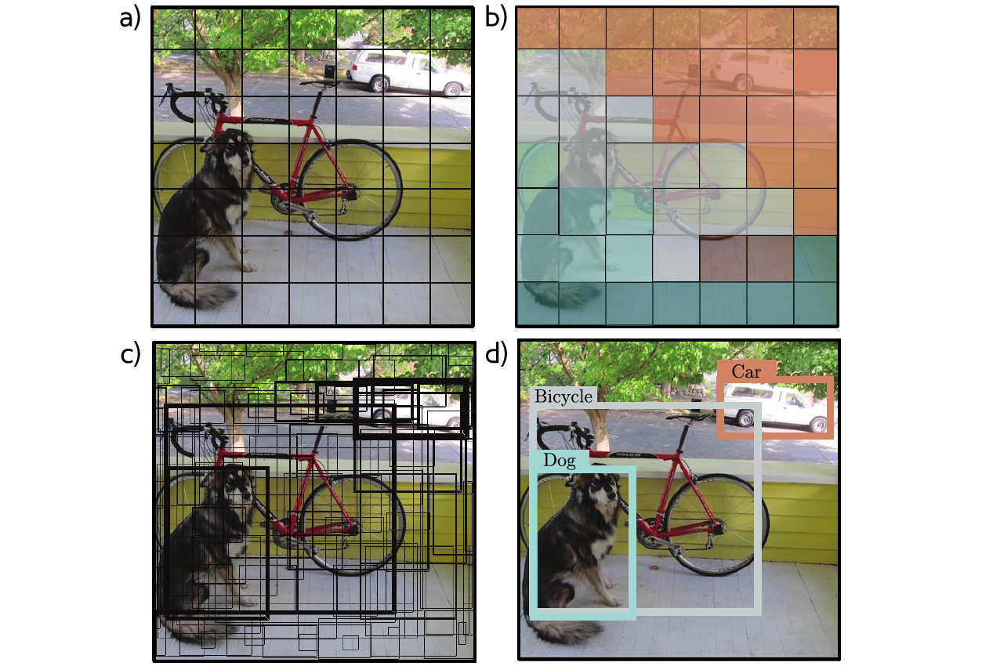
You Only Look Once (YOLO)
Network similar to VGG (448x448 input)
7×7 grid of locations
Predict class at each location
Predict 2 bounding boxes at each location
Five parameters –x,y, height, width, and confidence
Momentum, weight decay, dropout, and data augmentation
Heuristic at the end to threshold and decide final boxes

Slide 30
Object detection (YOLO)

Slide 31
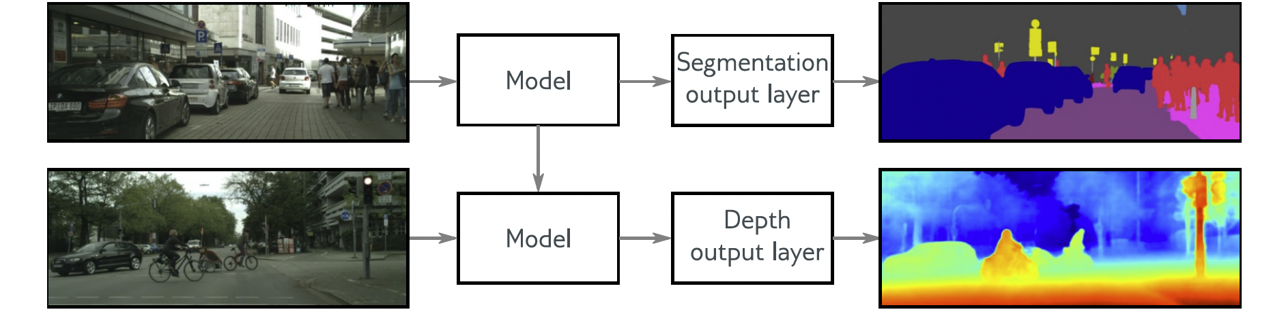
Transfer learning
Transfer learning from ImageNet classification

Slide 32
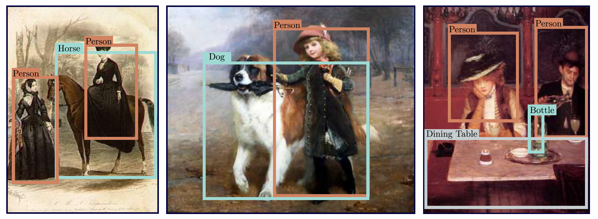
Results

Slide 33
Convolution #2
2D Convolution
Downsampling and upsampling, 1x1 convolution
Image classification
Object detection
Semantic segmentation
Residual networks
U-Nets and hourglass networks

Slide 34
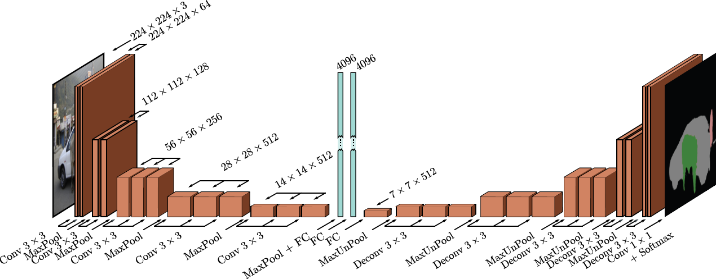
Semantic Segmentation (2015)
Encoder Decoder

Slide 35
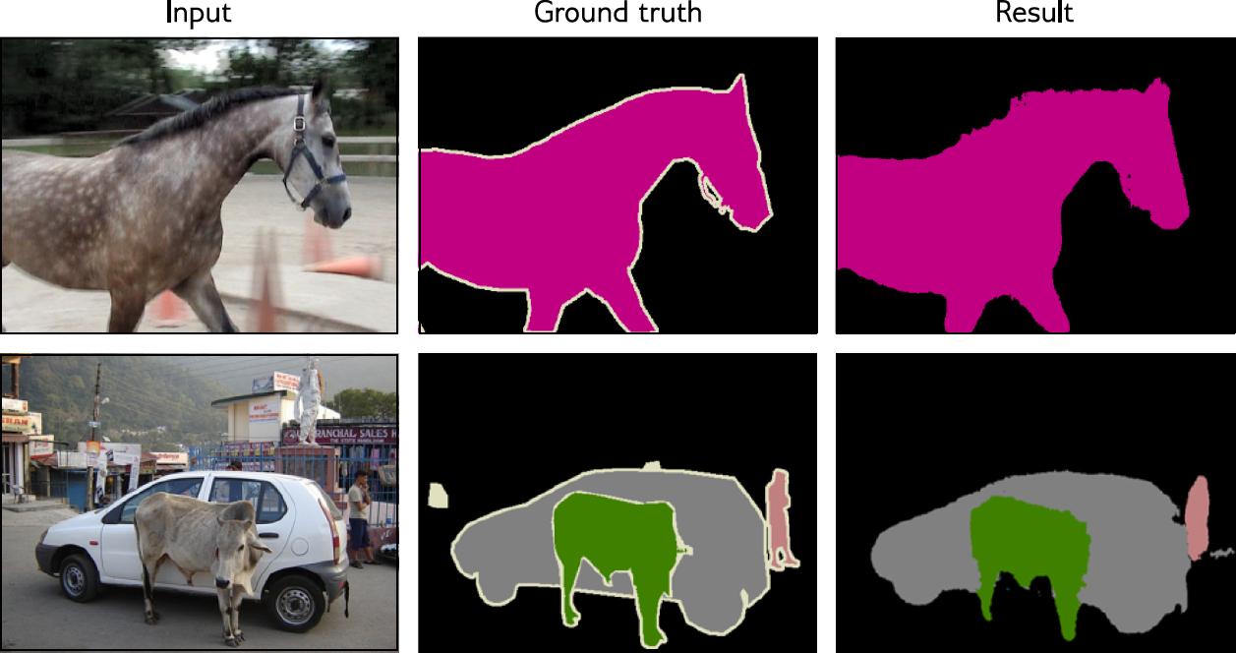
Semantic segmentation results

Slide 36
Convolution #2
2D Convolution
Downsampling and upsampling, 1x1 convolution
Image classification
Object detection
Semantic segmentation
Residual networks
U-Nets and hourglass networks

Slide 37
CIFAR Image classification for deeper networks

Slide 38
Regular network:

Slide 39
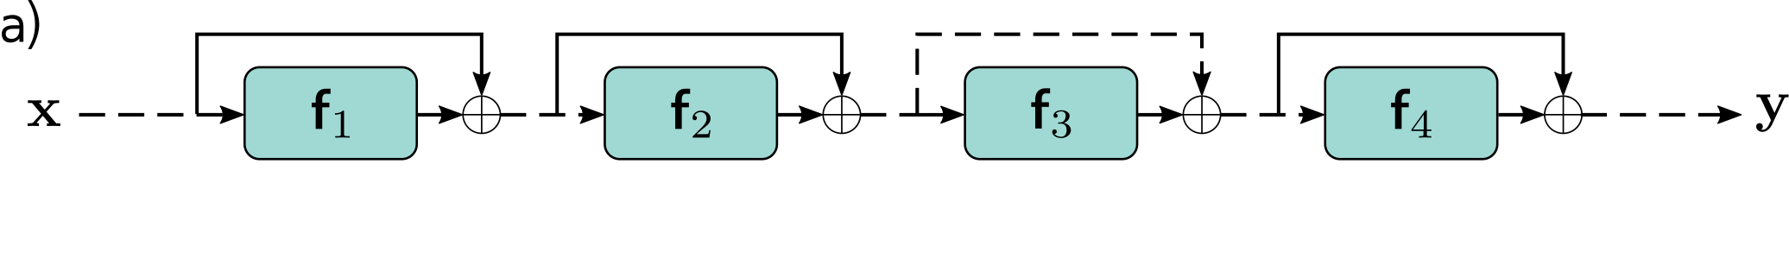
Regular network:
Residual network (2016):

Slide 40
Order of operations is important
+ Batch Norm

Slide 41
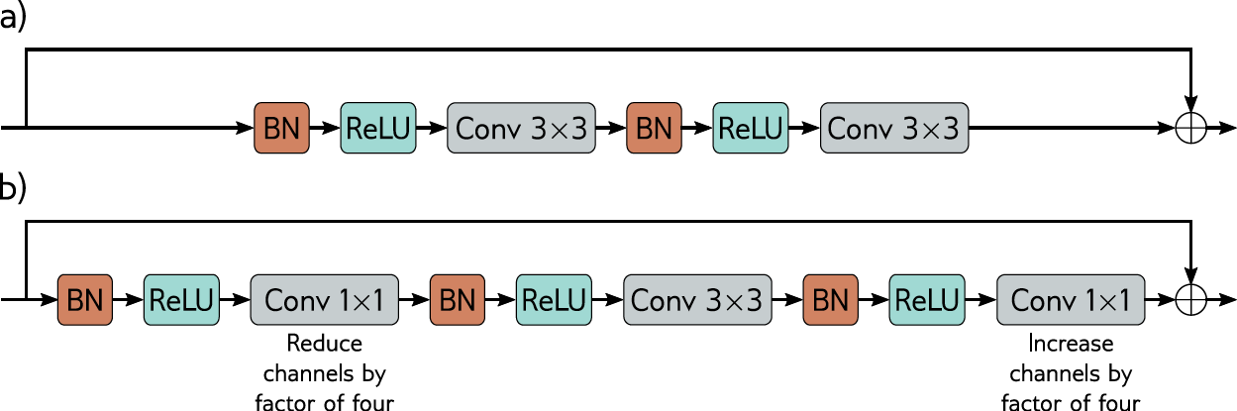
Resnet Block

Slide 42
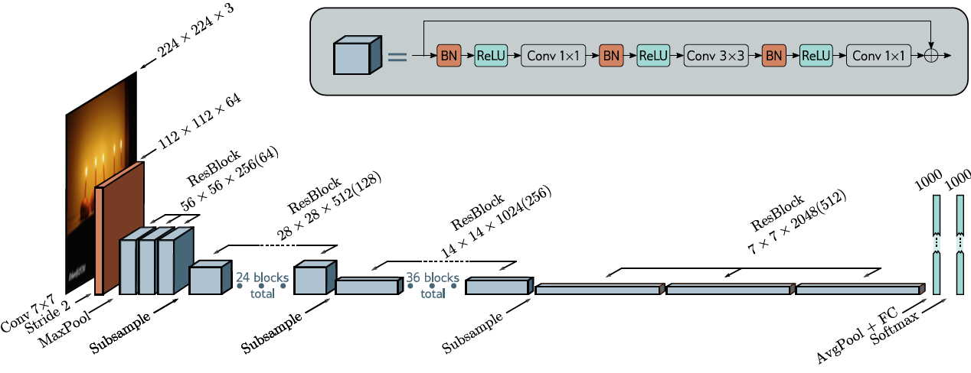
Resnet 200 (2016)

Slide 43
ImageNet History

Slide 44
Convolution #2
2D Convolution
Downsampling and upsampling, 1x1 convolution
Image classification
Object detection
Semantic segmentation
Residual networks
U-Nets and hourglass networks

Slide 45
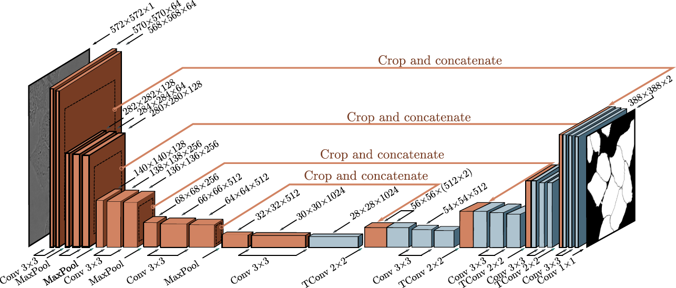
U-Net (2016)

Slide 46
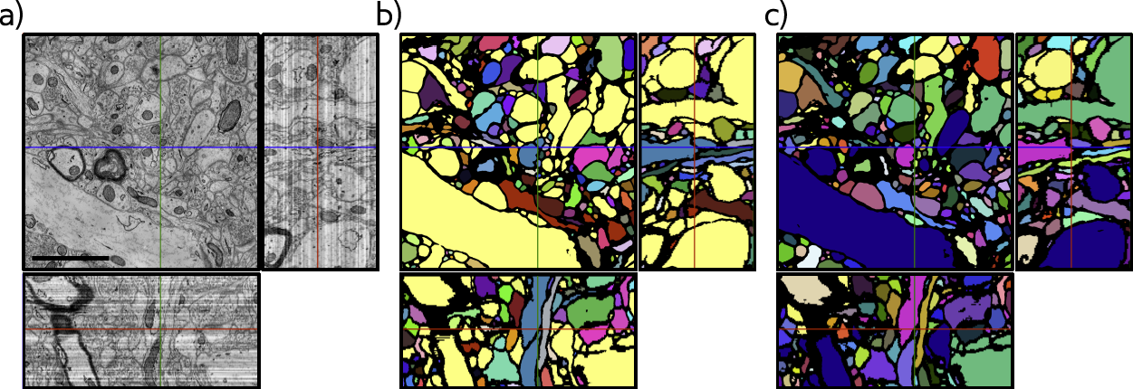
U-Net Results

Slide 47
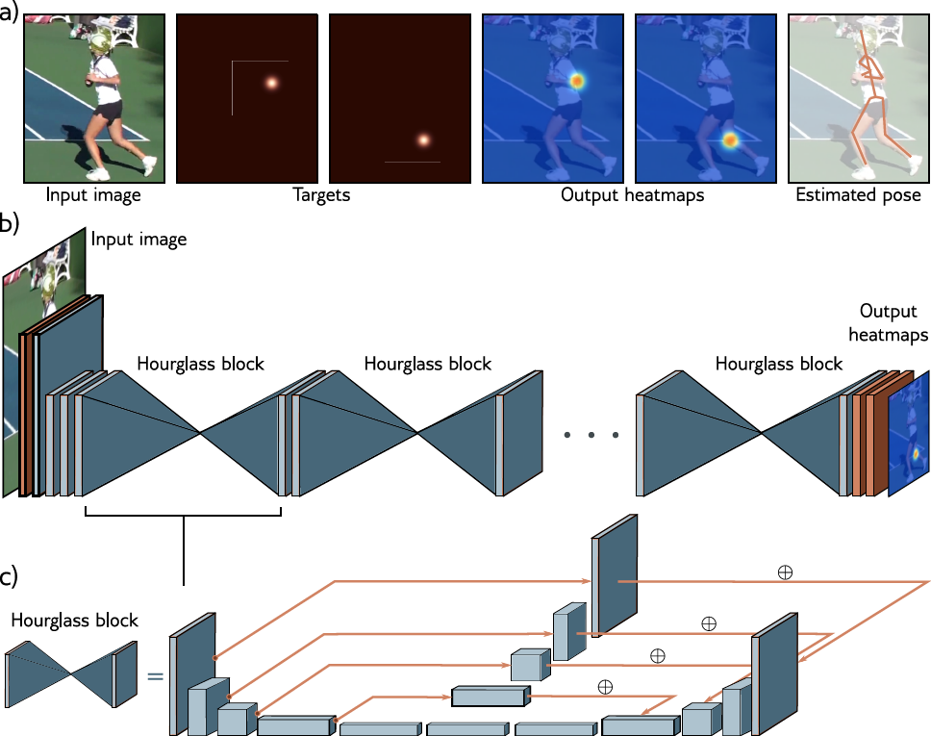
Stacked hourglass networks (2016)

