Slide 1
Introduction
Introducing… MindSpark Games!​
Our web application allows users to play from a choice of two games – ‘Guess the word’ and ‘Maths Racing Game’. ​
‘Guess the word’ – Users pick from a category and difficulty, then have 6 guesses to guess the correct word using hints from previous guesses such as letters contained in the word.​
‘Maths Racing Game’ – Users pick from a difficulty level, then have 100 seconds to answer as many math equations correct as possible to maximise your score.​
Users can play as a guest or make an account.​
If they choose to make an account, they can then save their scores on a global leaderboard – Best streak for Guess the word and High score in Maths racing Game.​

Slide 2
Aim and Scope
The Aim of this program is to make a useable/user friendly educational kids game website with the purpose of:
  Engaging the correct demographic positively
  Make education more fun
  Improving kids' problem solving and core skills
The scope of our program is:
  Having a fully functioning global leaderboard for each game with the users best score above it.
  Have a fully functioning “wordle” type minigame
  Have a fully functioning quickfire maths racing game against a computer opponent (Will be allocated a random score).
  Have functionality for users to able to create an account and see their account on the website.

Slide 3
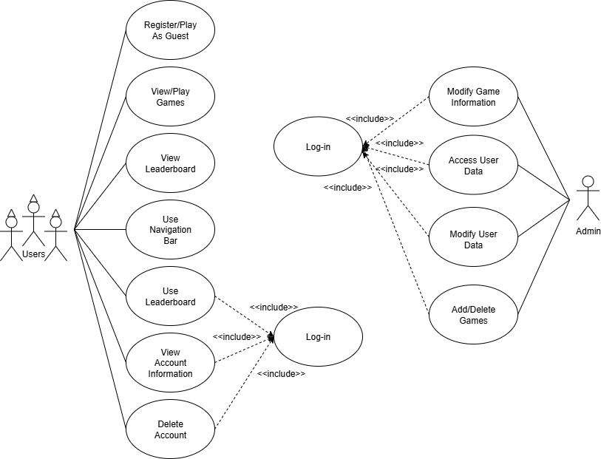
Use Case Diagram

Slide 4
Requirements
Functional Requirements for Users
  The system must:
    Ask the user whether the user wants to sign in/create account or play as a guest.
    display a catalogue of games for the user.
    Have an interactive leaderboard for the user.
    Allow users to delete their account.
    Allow users to view/change their account information.
    Allow users to play every available game.
Functional Requirements for Admins
  The system must allow admins to:
    Log-in/log out of the system.
    View and modify games and leaderboard data.
    Access user data.
    Alter user data, per request.
Non-Functional Requirements
  The system should:
    Respond to user requests within 2 seconds under normal operation conditions.
    Give user feedback when clicking buttons.
    Be responsive on different devices.
    Be kid-friendly.
    Be secure.
    Be available 24/7.

Slide 5
Tools/Techniques to be used
Front End
  HTML, CSS – Structure and formatting for our database.
  JavaScript and jQuery – Code our games with various methods and implement interactive features for the user.
  React – Implemented for interactivity and organisation.
  AJAX – Retrieve data from the back end, allowing users to change difficulty without refreshing the page.
Back End
  NodeJS – Help set up the database, connect MySQL to JavaScript and for any dependencies for react.
  MySQL – This will store user, leaderboard and difficulty (questions and answers) data.
  JSON – Store local cookies.
Techniques
  We will use relative units (e.g. rem, vw, vh) and @media queries to ensure the website is responsive.
  Transition and transform to make a smooth user experience.
  Use flex and grid box layouts to make the website organised and responsive.
  Use icons instead of images for faster load times and reusability.

Slide 6
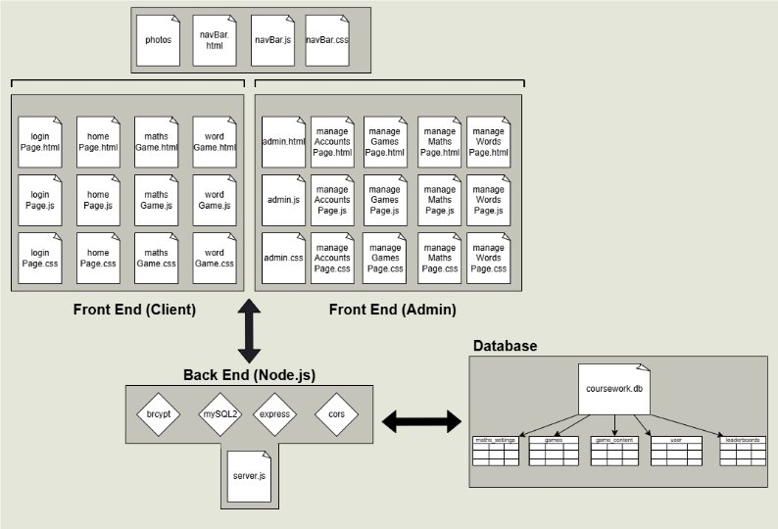
High Level Architecture

Slide 7
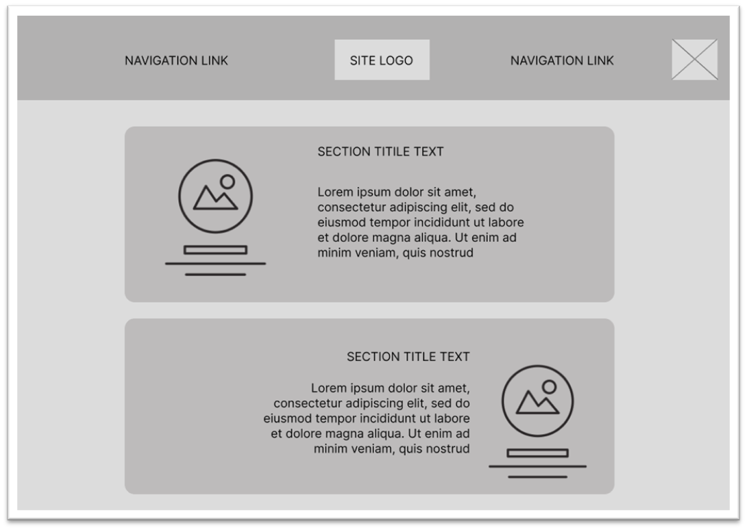
Home page Wireframe

