Slide 1

Deez Queez
By Alexandre Kharlamov Melissa Bangloy
Joshua Gould
Daniel Li
Aldebaraan Canedo

Slide 2
Project Overview

Slide 3
Description
Deez Queez is a learning platform that helps teachers create, distribute, and schedule quizzes and exams in a simple and fast way, with several types of questions giving flexibility to teachers of all professions.

Slide 4
Tech Stack
Back-end
-JavaScript Node.JS
Front-end
-Vanilla JavaScript
-HTML/CSS
Database
-PostgreSQL
Server OS
-Debian 12

Slide 5
Project showcase

Slide 6
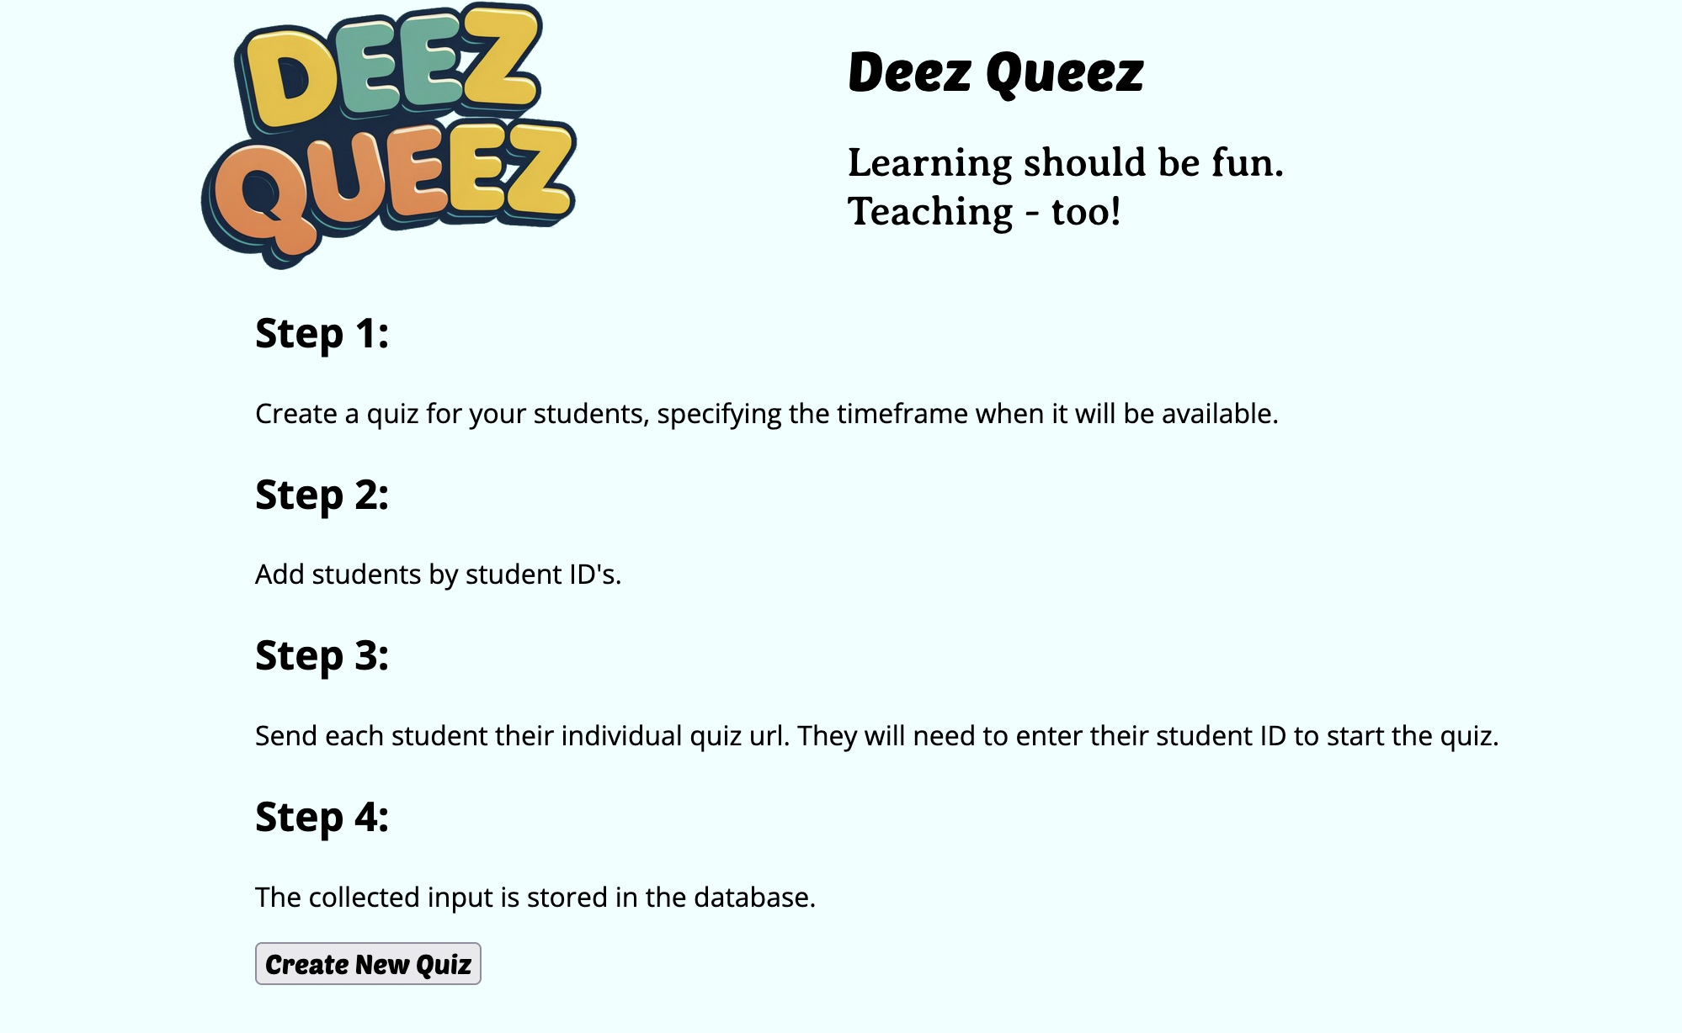
Instructions
Simple instructions to create and publish a quiz or exam.

Slide 7
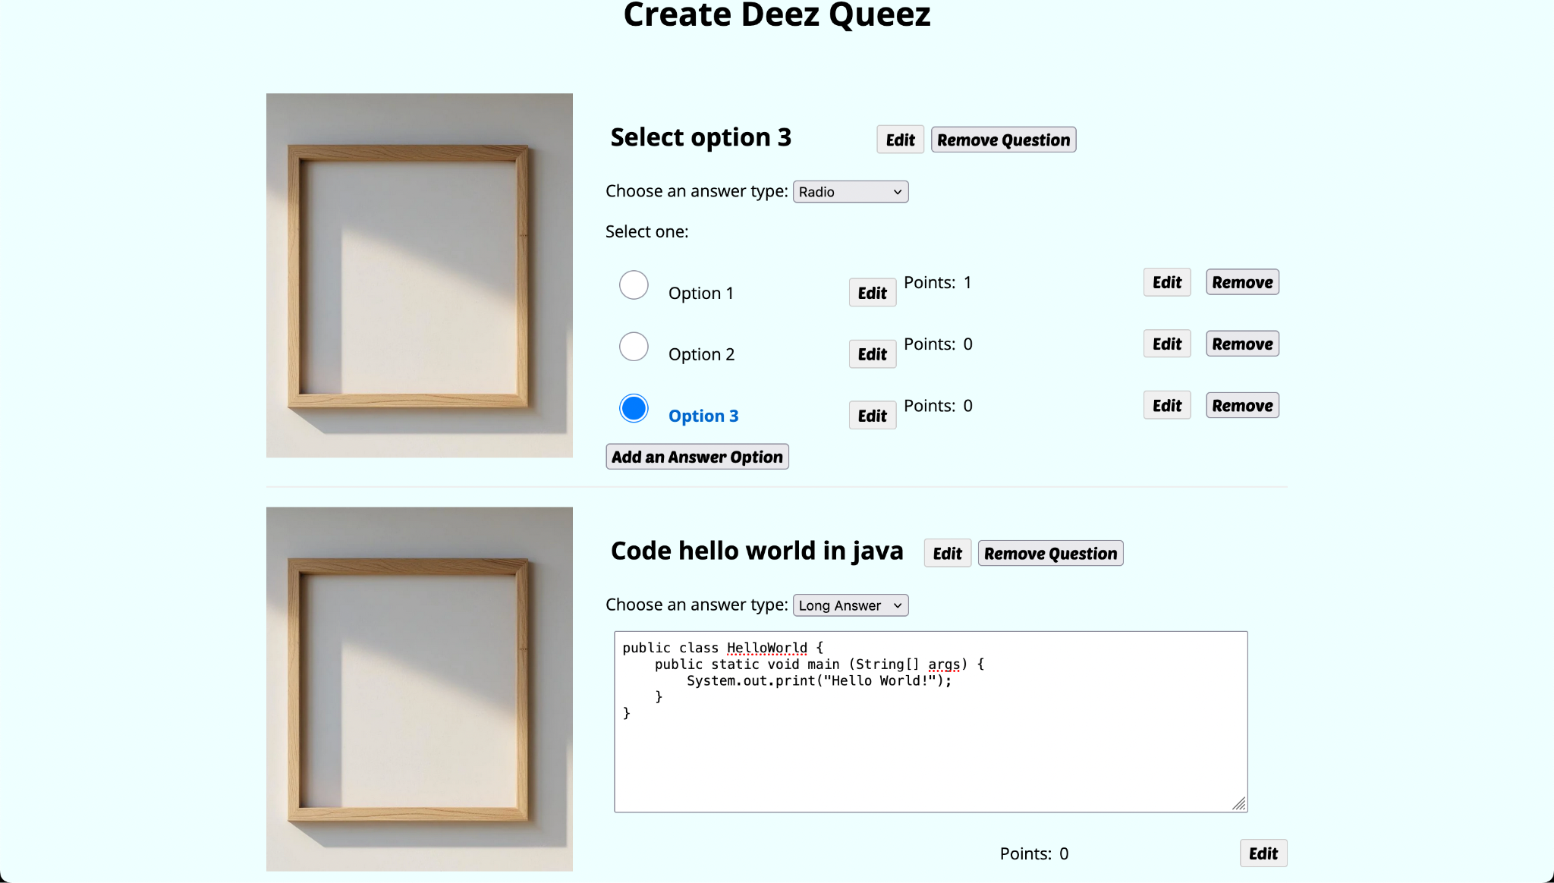
Flexible Question Types
From multiple choice questions to coding challenges.

Slide 8
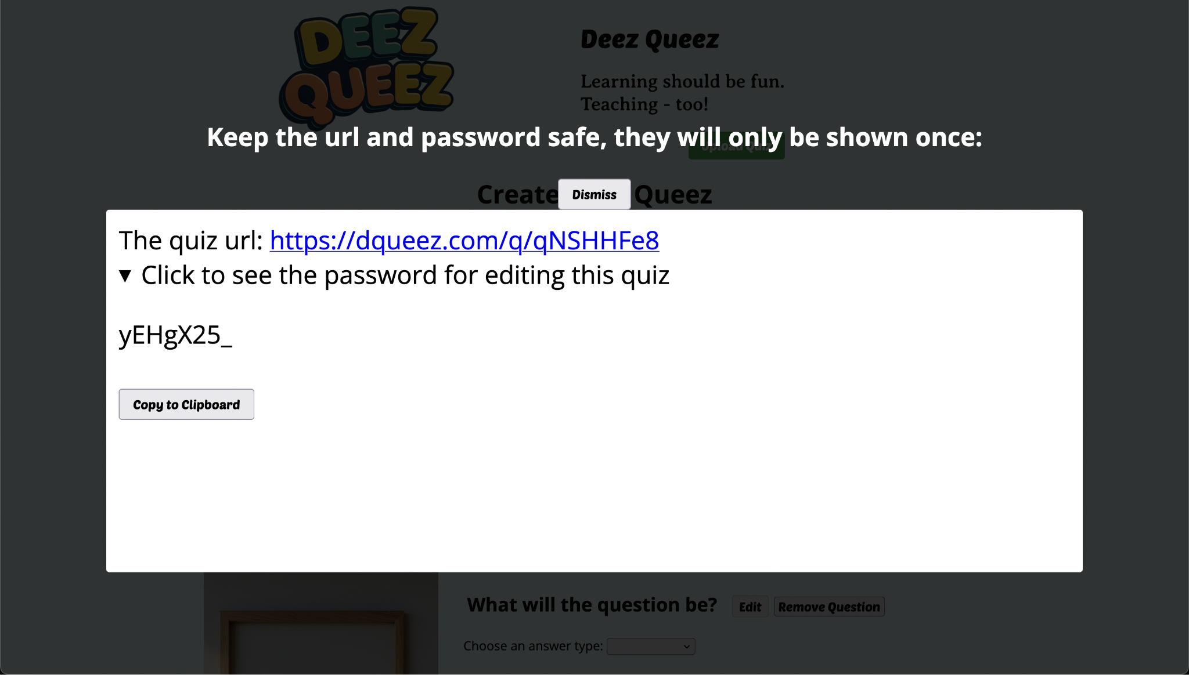
Controlled Access
After saving the quiz in the server, a password will be generated to limit the access.

Slide 9
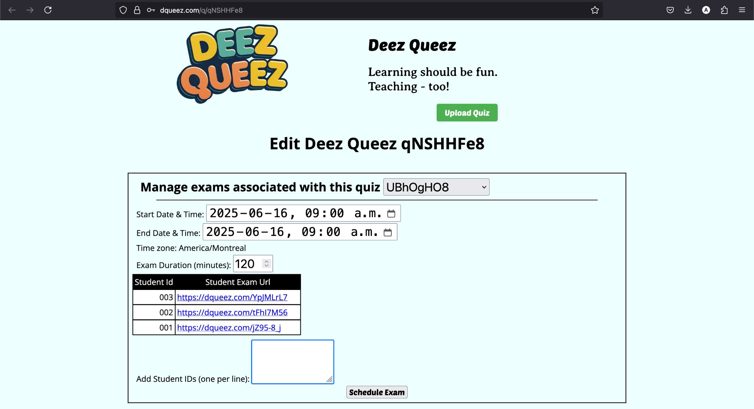
Easy Deployment
After saving the quiz, just schedule it and deploy it

Slide 10
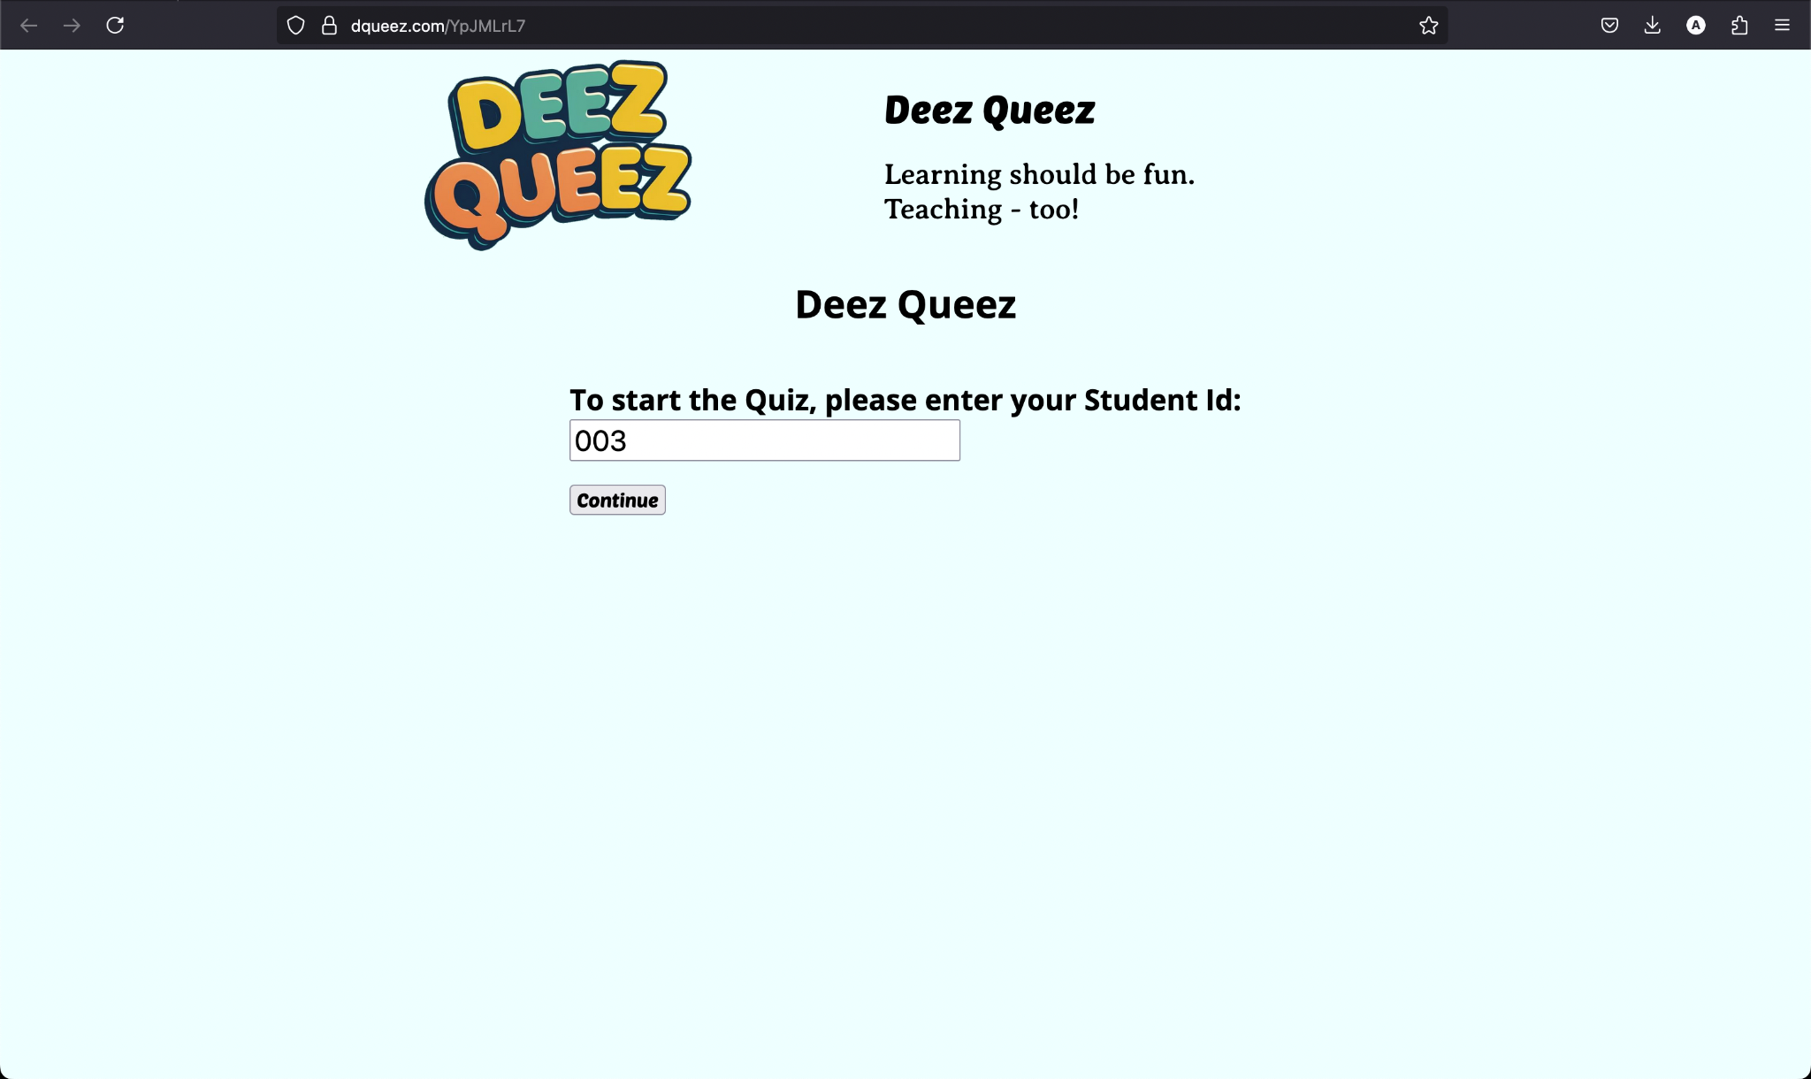
Student Access View
Once the quiz is deployed the student can access it by requesting their personalized URL that was auto generated during the deployment phase.

Slide 11
Pivotal points

Slide 12
Back-end Framework change
Changed from Python Flask to Node.JS due to the familiarity with the JavaScript ecosystem.
Result
Easier deployment process
Task Delegation
Without defined roles we struggle to efficiently assign task.
Result
Better integration of team members

