Slide 1


CDSS Hackathon
September 29th 2018
KNOWLEDGE
TRUMPS ALL
With the recent explosion in fake and politically motivated news it is of paramount importance that individuals analyze their sources of information.
Alex Kim, Jacob Klein,
Patrick Lewis, Thompson Bliss
LEARN MORE

Slide 2





PROJECT OVERVIEW
Business
Understanding
Data
Wrangling
Deployment
Modelling
Ask important questions, define objectives for the problem
Gather & combine data sources, remove inconsistencies from the data
Design, train and evaluate machine learning models
Package and deploy solution, communicate results to stakeholders
Notes:
Mention CRISP-DM methodology

Slide 3
PARAMETER IMPORTANCE
TOOLS USED:
Jupyter Notebook (prototyping)
NLTK (n-grams)
Newspaper3k (data scraping)
Pandas (Data Wrangling)
NodeJS / ExpressJS (front end)
Google App Engine (website Hosting)
Google Cloud Functions (cloud based Python code)
Google Cloud Language (sentiment analysis)
GGPlot2 (Visualizations)
Sentiment
Publication
Emotion Magnitude
Keyword N-grams

Slide 4
DEMO

Slide 5
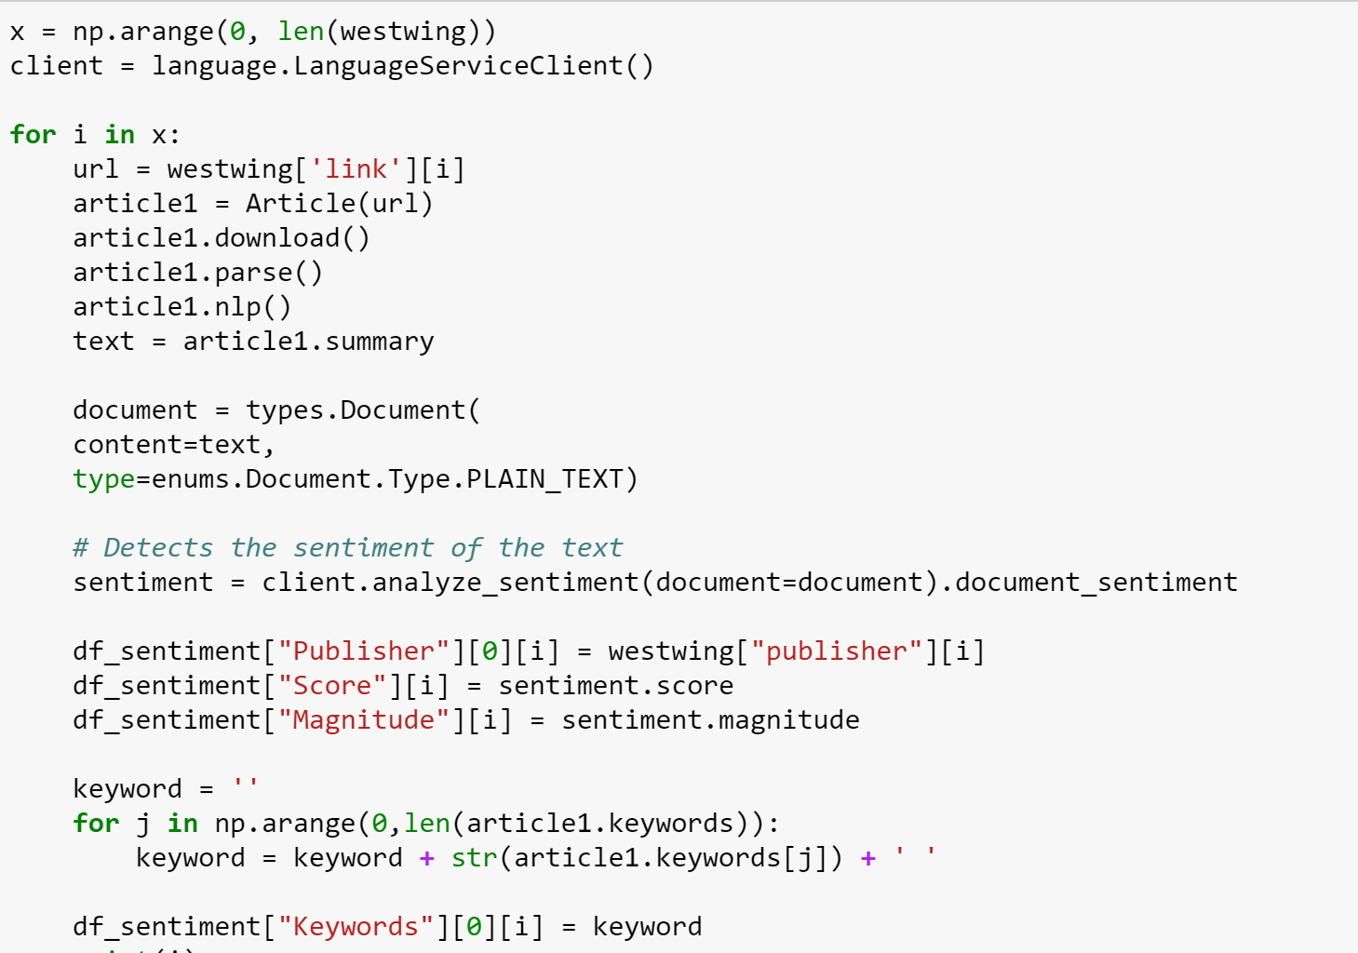
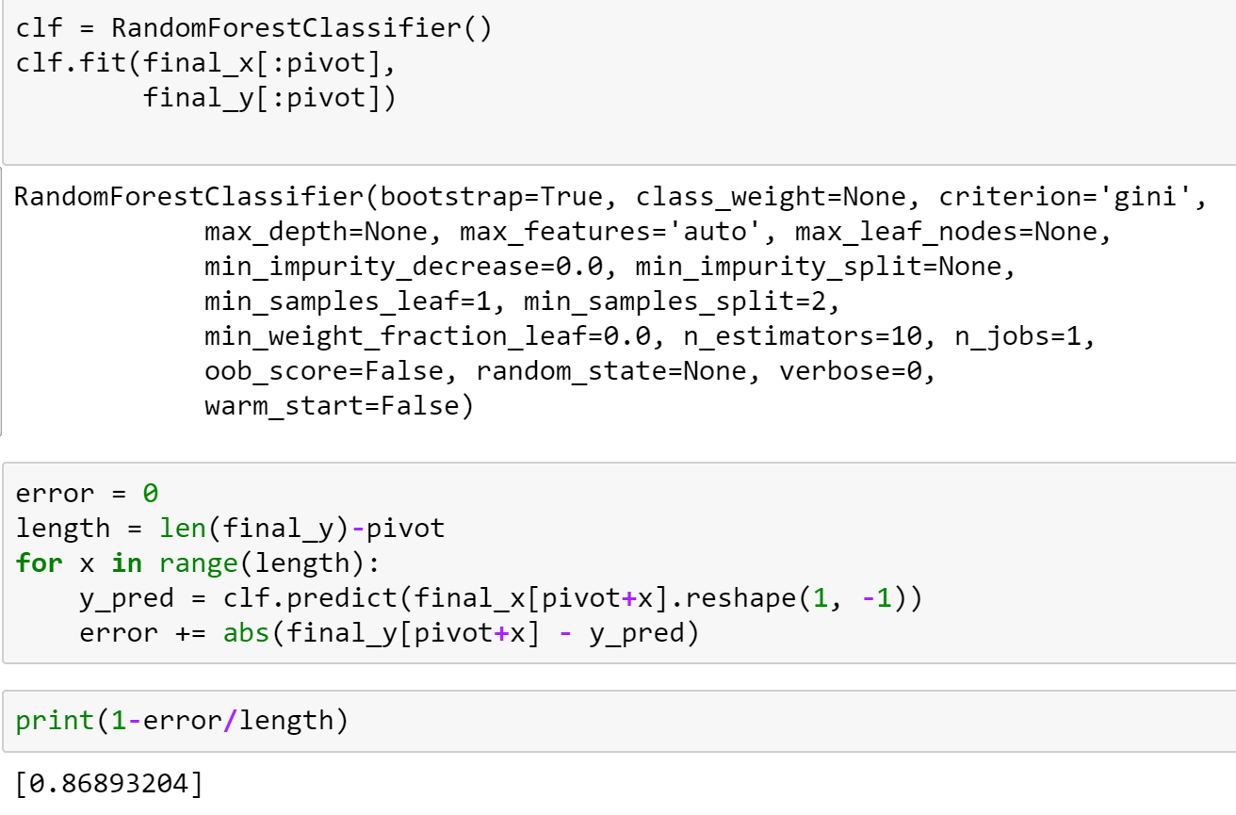
Downloading article data, parsing and extract keywords & sentiment
Random Forest Classification
86.9% Accuracy of a 50/50 split dataset

Slide 6
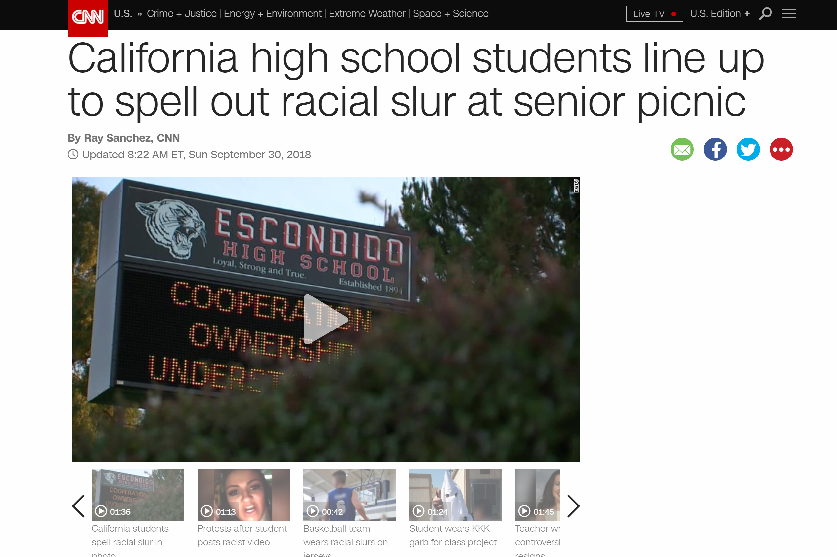

Slide 7
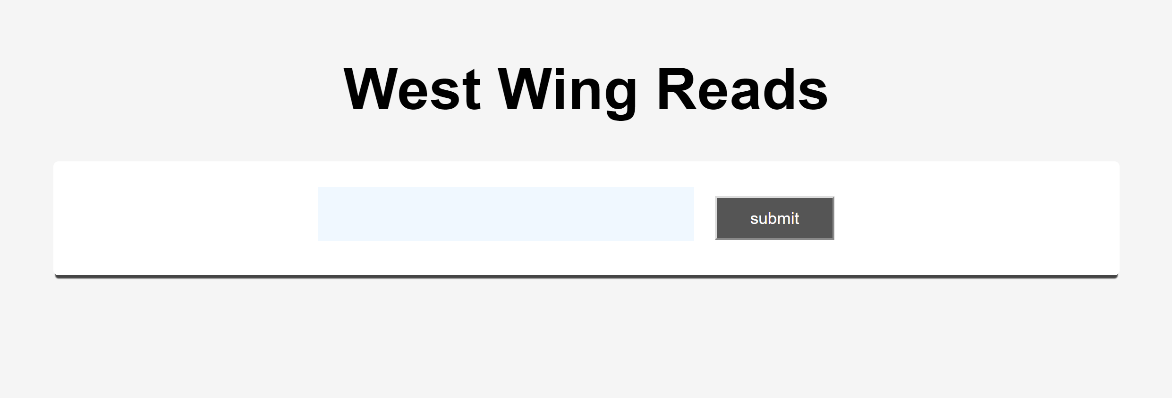

Slide 8
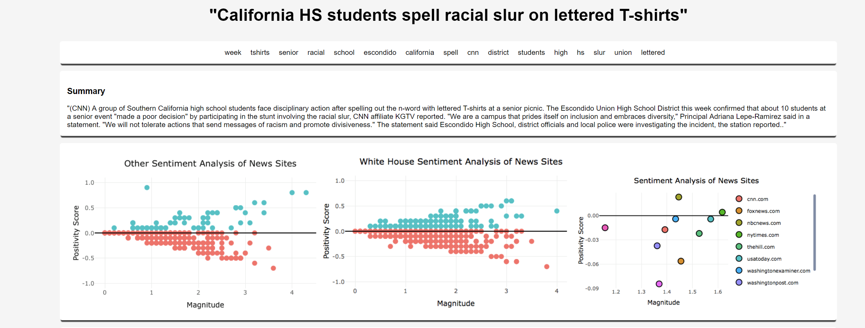

Slide 9
