Slide 1
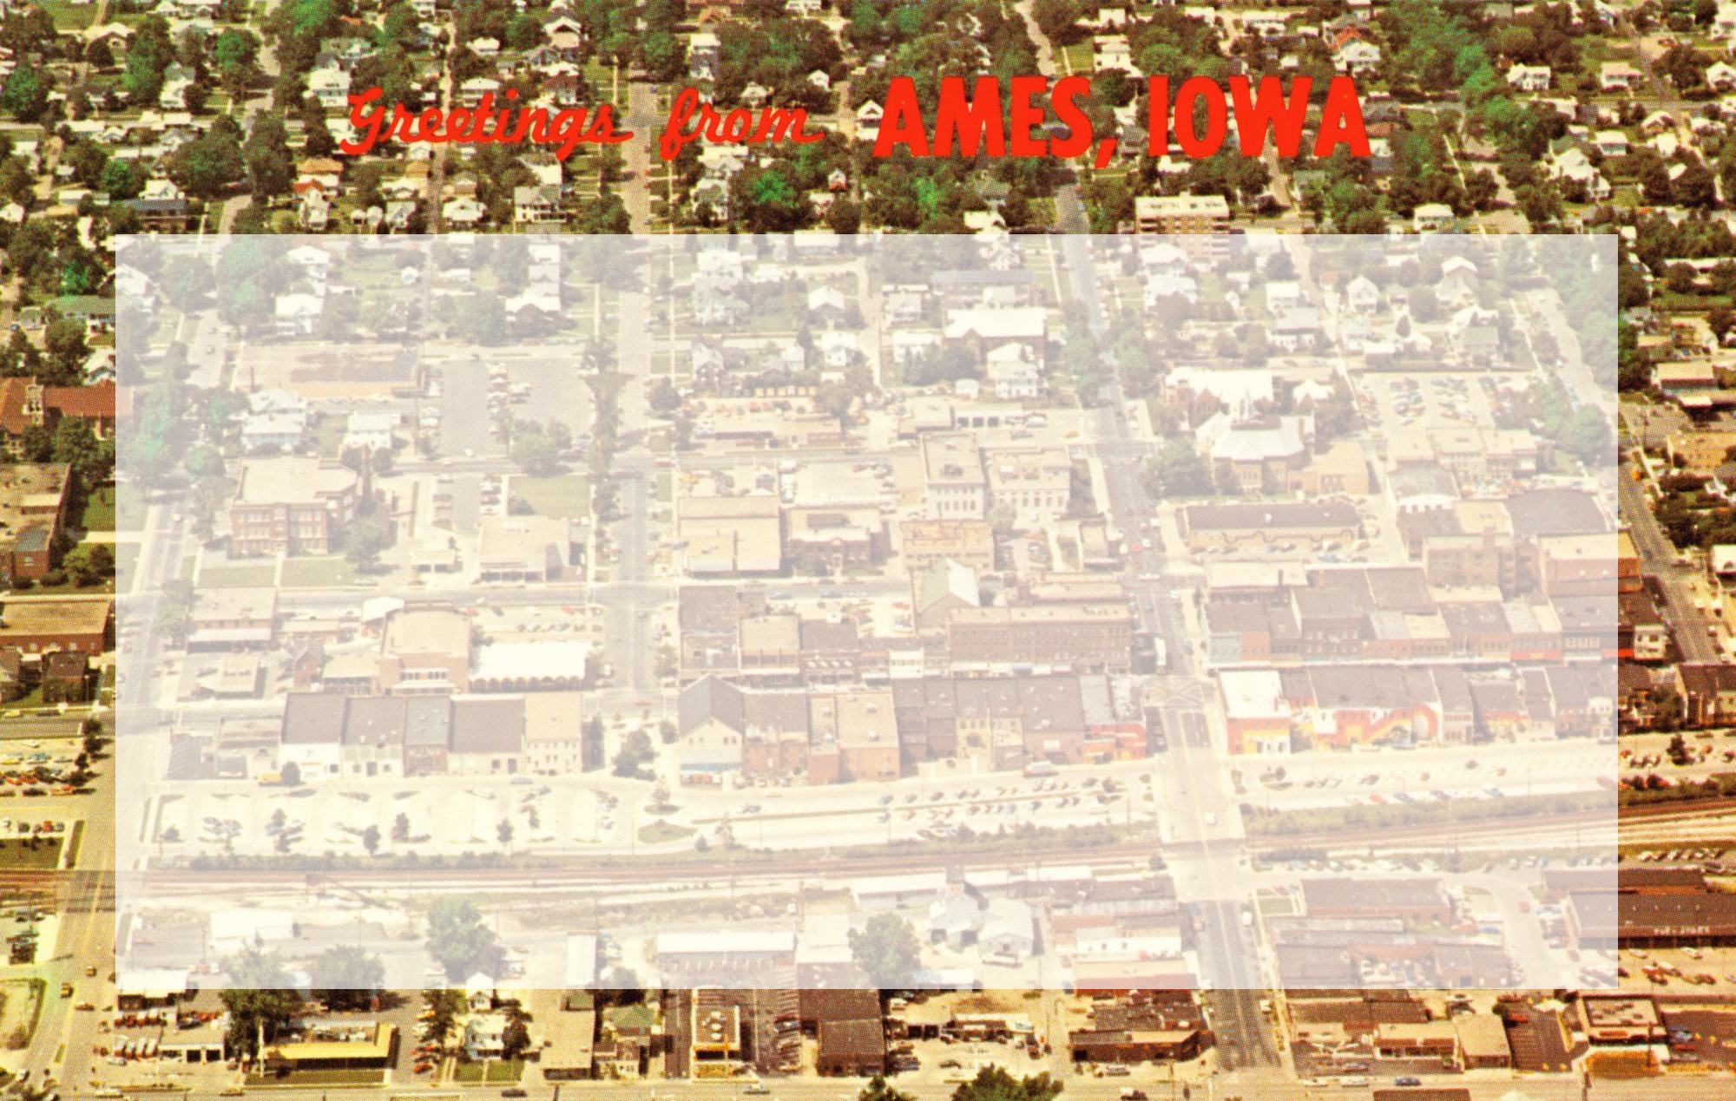
Can we predict home sale prices?
A case study from Ames, IA
Alexander Klapheke • DSI Project 2 • April 10, 2020
Background image source: Ames History Museum

Slide 2
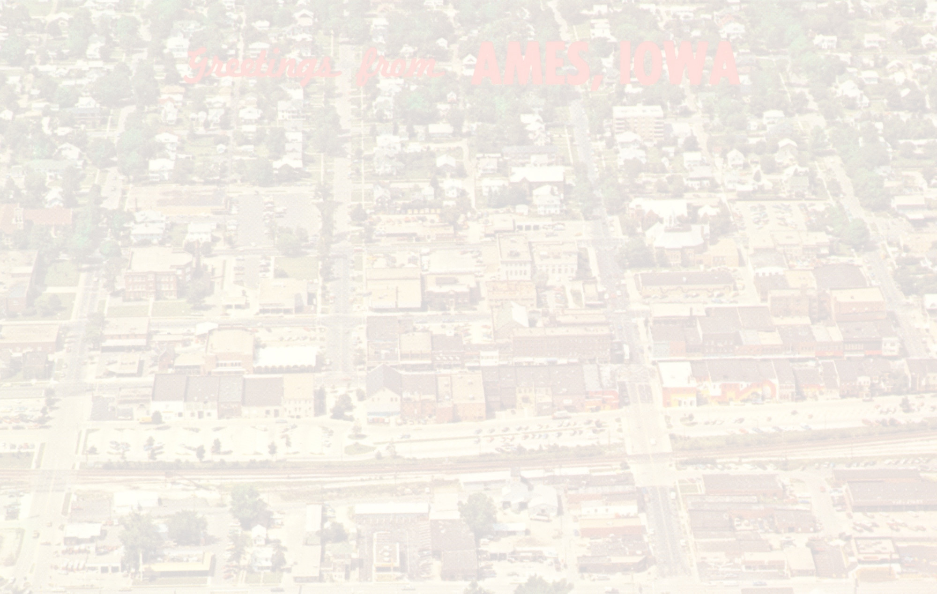
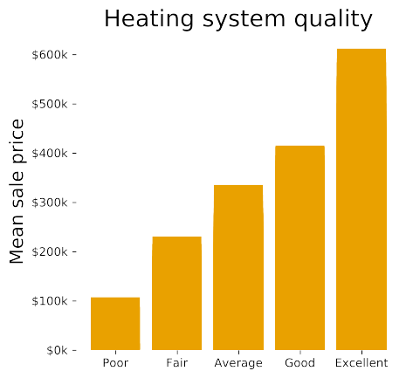
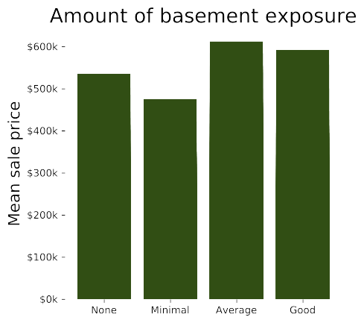
Some data correlate better with sale price than others.

Slide 3
Among the strongest effects:
Ceteris paribus, raising… | …by… | …raises average sale price by:
Lot area | 1 acre (43,560 ft²) | 28.1%
Above-grade living area | 100 ft² | 74.8%
Finished basement area | 100 ft² | 19.1%
No. full baths in basement | 1 | 18.4%
Overall quality score | 1 (out of 10) | 9.3%

Slide 4
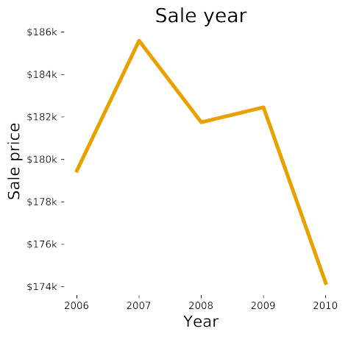
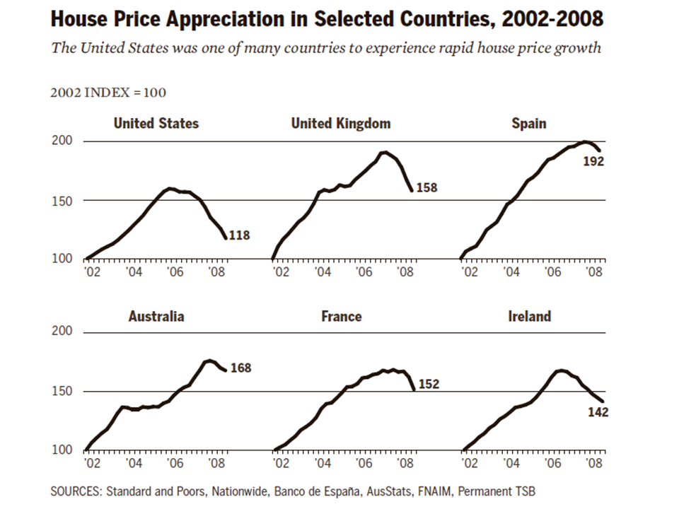
Due to the ’08 crisis, sales in successive years decrease by an average of 3.5%.
Graph from the Financial Crisis Inquiry Commission

Slide 5
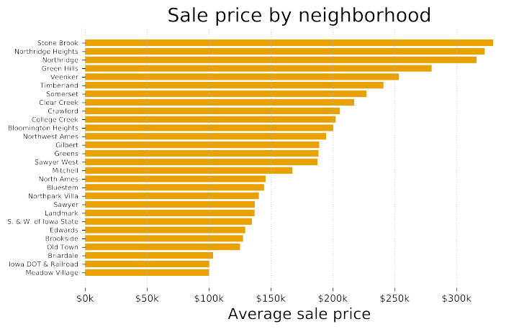
Although location (location location) has a big impact on sale price…

Slide 6
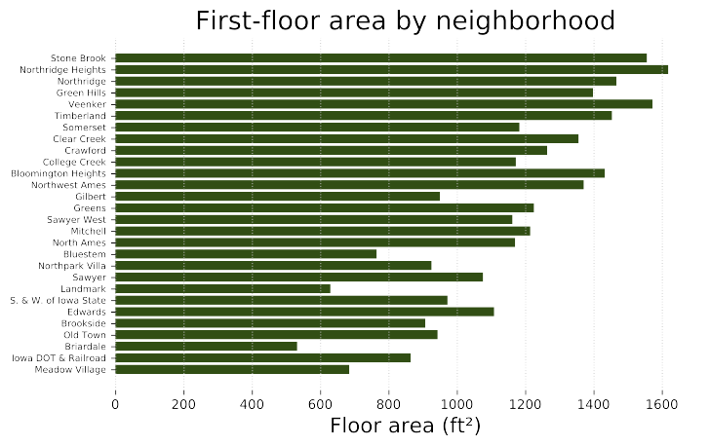
…it correlates with other features, so the model doesn’t consider it.

Slide 7
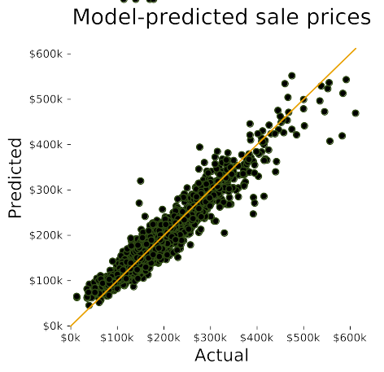
The final model accounts for 86% of the variation in sale prices.

Slide 8
If we want to generalize this model…
…to other cities:
Neighborhood is not considered, but;
“Quality” factors like “overall quality” (1–10) must be calibrated to other assessors’ judgments.
…to other periods:
The “sale year” factor must be adjusted so as
not to consider the ’08 subprime crisis.

