Slide 1
Three Fires Council – COVID 19 Camp Operations Plan Camp Freeland Leslie

Slide 2
Background & Objectives
Risk Management & Camping Committee’s Assessment and Planning
Objectives of our COVID-19 Strategy
Prevent spread through a layered mitigation strategy
Isolate suspected cases

Slide 3
Layered Mitigation Strategy
Preventative Screening
Concentric Group Circles or “Cohorts”
Social Distancing
Masks
Enhanced Cleaning Protocols

Slide 4
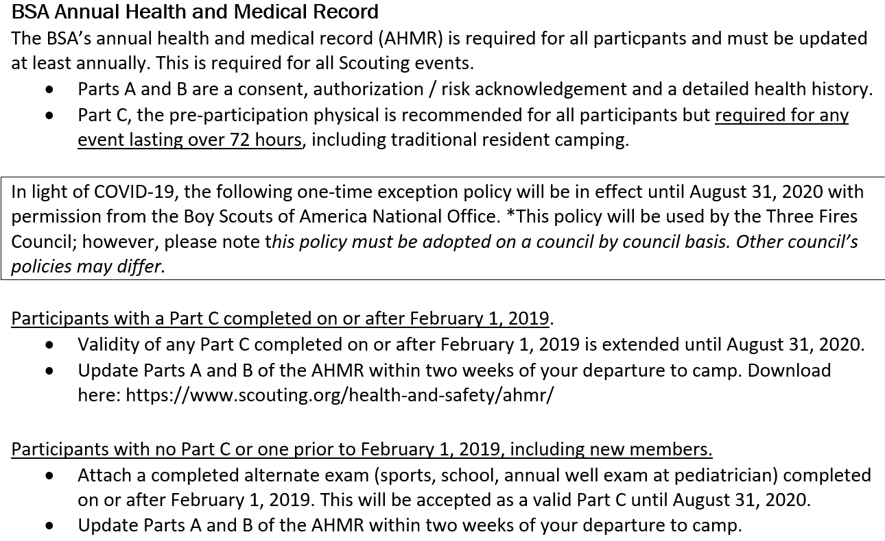
Preventative Screening BSA Medical Form

Slide 5
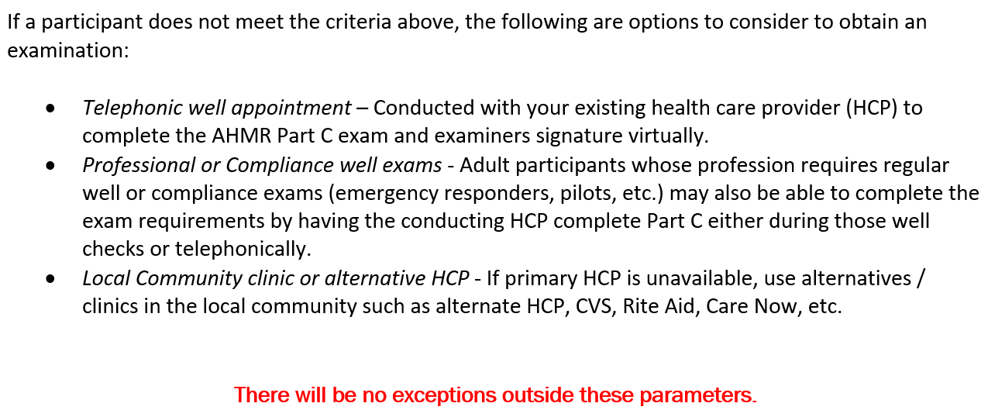
Preventative Screening BSA Medical Form

Slide 6
Preventative Screening High Risk Individuals
Information from the Centers for Disease Control and Prevention (CDC) states that older adults and people of any age who have serious underlying medical conditions are at higher risk for severe illness from COVID-19.
If you are in this group we recommend you consider staying home. If you decide to participate, please ensure you have approval from your health care provider prior to attending camp.

Slide 7

Preventative Screening High Risk Individuals
Based on what we know now, those at high-risk for severe illness from COVID-19 are:
People 65 years and older
People who live in a nursing home or long-term care facility
People of all ages with underlying medical conditions, particularly if not well controlled, including:
People with chronic lung disease or moderate to severe asthma
People who have serious heart conditions
People who are immunocompromised
Many conditions can cause a person to be immunocompromised, including cancer treatment, smoking, bone marrow or organ transplantation, immune deficiencies, poorly controlled HIV or AIDS, and prolonged use of corticosteroids and other immune weakening medications
People with severe obesity (body mass index [BMI] of 40 or higher)
People with diabetes
People with chronic kidney disease undergoing dialysis
People with liver disease

Slide 8
Preventative Screening Pre Arrival
Everyone attending camp should self-monitor for symptoms as published by the Centers for Disease Control and Prevention starting 14 days prior to your camps first day.
Pre-departure, leaders should utilize the Three Fires Council decision tree (shown in later slide) to assess any symptomatic individuals.
Individuals who have symptoms published by the Centers for Disease Control and Prevention should stay home.
Parents and leaders will be asked to sign an affidavit stating they have been symptom free prior to camp.

Slide 9
Preventative Screening Arrival
Units will be assigned an arrival time and entry gate. Only one unit should be in the parking lot at a time.
Staff will conduct a screening using the decision tree car by car. Once cleared, the unit will be permitted to continue the check-in process.
Any symptomatic individuals will be isolated in a quarantine area outside of our health lodge. Individuals will be given the opportunity to be re-checked later in the day. If symptom free they will be allowed to rejoin their unit.

Slide 10
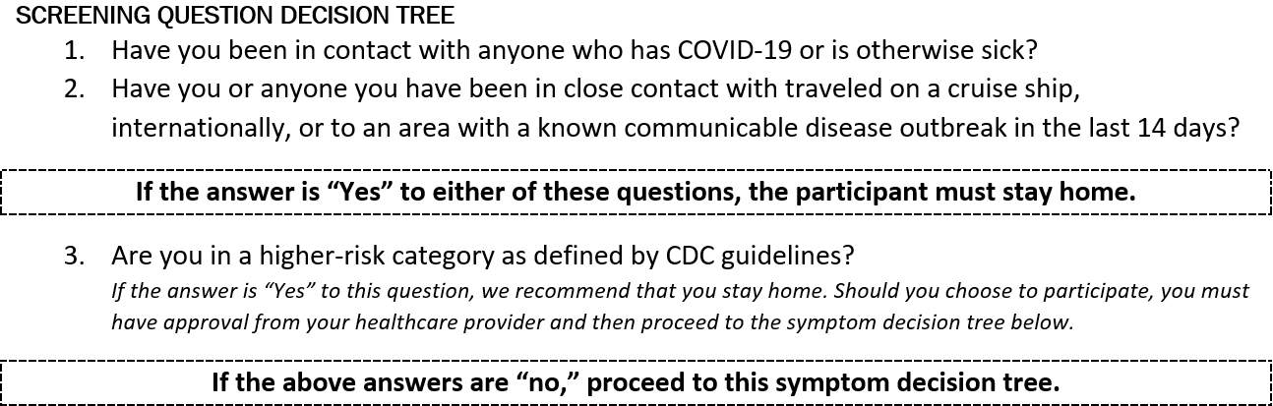
Preventative Screening Decision Tree

Slide 11
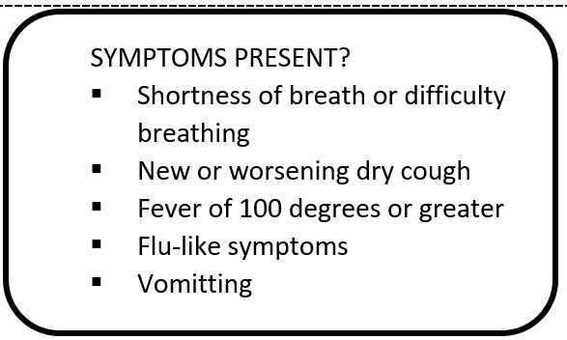
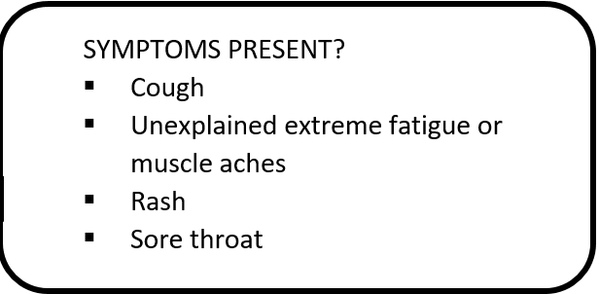
Preventative Screening Decision Tree – Isolate If…
Any one symptom is present
Or any two symptoms are present

Slide 12
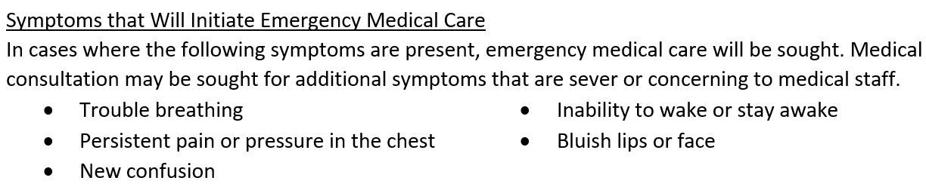
Preventative Screening Decision Tree

Slide 13
Preventative Screening Positive Test
Once a positive test result has been received for a Scout or Leader, the above points are off and the entire Troop must be quarantined with zero contact with anyone outside of their Cohort.
Contact tracing would begin and the Health Department would be requesting our data on who the individual has been in contact with. The Troop can depart camp at any time and head home without issue.
Notification of a positive case would be communicated to all potentially exposed individuals.

Slide 14
Concentric Group Circles
The American Camping Association’s Field Guide for Camps on Implementation of CDC Guidance states, “Consistent with experience from 2009-2010 H1N1 and in concert with guidance provided by Centers for Disease Control and Prevention (CDC) in 2010 on April 16, 2020; and on May 14, 2020; and the American Academy of Pediatrics (AAP); policies to maintain small group sizes, limit mixing of groups, and restrict large gatherings at camps are recommended. Limiting mixing of groups can be combined with a public health approach of establishing and maintaining “concentric group circles” for infection prevention and control. Infection spread can be slowed and more easily contained in smaller groups; when larger groups are required, it is beneficial if they consistently are comprised of the same constituent smaller groups, thereby limiting the number of potential contacts for each camper.”

Slide 15
Concentric Group Circles
Cohort
Staff
Troop
Patrol

Slide 16
Social Distancing & Face Coverings
Social distancing should be practiced at all times to the extent possible. Social distancing is defined by the Centers for Disease Control as 6 feet between yourself and those around you. In cases where social distancing is not possible a mask must be properly worn to cover the mouth and nose.
Each camper and leader will be issued a “Buff” to utilize as a face covering. You are welcome to use alternative coverings as well.
The CDC defines a close contact as someone who was within 6 feet of an infected person for at least 15 minutes starting from 48 hours before illness onset until the time the patient is isolated. (Centers For Disease Control And Prevention. (April 29, 2020). Contact Tracing : Part Of A Multipronged Approach To Fight The Covid-19 Pandemic)

Slide 17
Cleaning Procedures
Full Time Staff Member Dedicated to Sanitation – Sanitation Commissioner
Responsible for Staff Sanitation Training
Responsible for Quality Checks
Responsible for Overall Sanitation Schedule Development and Implementation

Slide 18
Cleaning Procedures
Program Areas & Equipment
Areas will be cleaned/disinfected prior to use and between Cohorts
Program equipment in Program Areas will be cleaned/disinfected prior to use and between Cohorts

Slide 19
Cleaning Procedures
Restrooms & Showers
Deep cleaning will take place daily (washing/disinfecting all walls, floors, shower curtains, fixtures, etc.)
High touch points will be cleaned/disinfected three times per day
Units Will Not Be Responsible for Camp Shower House/Washroom Cleaning Assignments
Staff Will Clean and Disinfect Campsite Kybos Between Cohorts

Slide 20
Cleaning Procedures
Handwashing Stations and Sanitizer Dispensers
Sinks in Campsites, Scoutcraft, Shooting Sports, Visitor Privy, East Shower House
All Above Listed Sinks Will Have Go-Jo Antibacterial Soap Dispenser
Sanitizer Dispensers/Pump Bottles in Program Areas

Slide 21
Cleaning Procedures
What Troops Should Bring to Clean in the Campsite
EPA Approved Disinfectants for Kybo Sink and Toilet Surfaces as Well as Troop Food Preparation Areas
Soap to Clean Cloth Masks
Clothesline to Dry Cloth Masks
Clean Cloth Towels/Rags
Nitrile Gloves for Cleaning Activities
Extra Hand Sanitizers
Disposable & Biodegradable Plates, Cups, and Cutlery
Water Bottles (no water coolers in program areas this year)

Slide 22
Cleaning Procedures
Loaned Camp Equipment and Items Not Available
No Camp Equipment Will be Available for Issue (tents, dining flies, cots, patrol boxes, cooking gear, dutch ovens, water jugs, etc.)
Drinking Fountain – East Shower House
Campsite and Program Area Bubblers
Water Coolers in Program Areas

Slide 23
Program Changes
Revised Program Plan
Program Rotation by Cohorts
Adult help will be needed in program areas
Downtime
First Year Camper Program
Camp chairs

Slide 24
Merit Badges/ Activities Offered
Scoutcraft
Search and Rescue
Wilderness Survival
Camping
Ecology
Environmental Science, Fish and Wildlife Management, Mammal Study, and Weather
Aquatics
Canoeing, Kayaking, Swimming, Stand-up Paddleboard, Instructional swim, Advanced Safety Afloat/ Safe Swim Defense
Shooting Sports
Archery, Shotgun, and Rifle

Slide 25
Merit Badges/ Activities Offered
Stagecraft
Communications, Chess, and Game Design
New Frontiers
Leatherwork, Wood Carving, Space Explorations, and Engineering
Eagles Nest
Emergency Preparedness, First Aid, and Personal Fitness
Nature Hike

Slide 26
Program Changes
No Camp-wide Assemblies
Campfire Plan
Leader Dinner & Pig Roast
Chapel Service
OA
Trading Post
Program Kits
Scheduled Times & Mobile Cart
Custom T-shirts (Order by Sunday)

Slide 27
Program Changes Visitors
BSA Policy Youth Protection Policy states that all aspects of the Scouting program are open to observation by parents and leaders. While we will not prevent a parent or leader from observing the program in accordance with this policy, we do ask that visitors be kept to essential purposes only. Visitors will will be screened based on our Screening Decision Tree.

Slide 28
Payment Schedule Modifications
Payment Schedule Modifications
We recognize that payment at this time may be difficult for various reasons. Our early registration prices will be valid up to three weeks prior to the camp of your choice and late fees are being eliminated. If your family could use help with payment this year, don’t hesitate to complete a campership (financial assistance) application. Troops with an existing registration at another camp that are seeking alternative plans for the summer will be given the early bird price.

Slide 29
Refund Policy Modifications
Refund Policy Modifications
Our regular refund policy states all refunds must be requested 30 days prior to camp. Having an accurate attendance count reduces waste when purchasing camper shirts, patches, and program supplies. In light of COVID-19 we are reducing our “no penalty” refund timeframe to 14 days prior to camp. Additionally, anyone requesting a camp fee refund due to COVID-19 will be eligible for a full refund, including their deposit if applicable as long as the request is made 14 days prior to your camp session. If you do opt to not attend camp this summer, we encourage you to consider rolling over your fees to 2021 or using some portion of your fees to make a donation to the Three Fires Council.

Slide 30
Additional Recommended Items to Bring
Additional Items to Bring to Camp - Individual
Extra hand sanitizer or hand wipes as desired
Personal facemasks if desired
Camp chair
Personal tent (recommended for those camping overnight)
Additional Items to Bring to Camp – Troop (CFL)
Sanitizing solution to clean common areas in campsite
Rags to clean common areas in campsite
Extra hand sanitizer as desired
Non-aerosol disinfectant spray
Downtime activities

