Slide 1
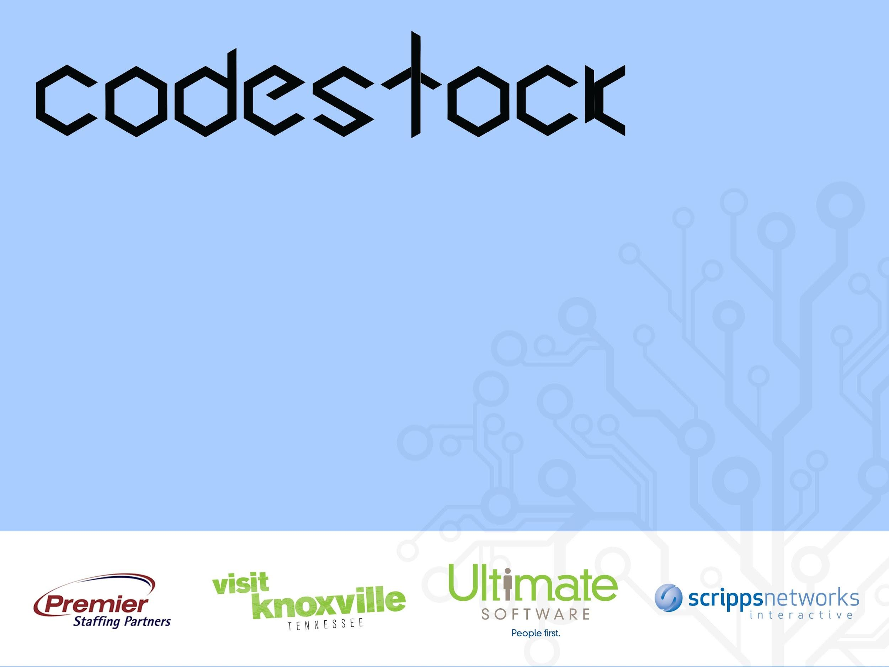
Exploring Serverless Architectures w/ AWS Lambda
Alex Klibisz, Codestock 2016, Knoxville, TN
Notes:
Hi everyone, thanks for coming out to codestock and for picking this talk.
My name is Alex Klibisz. Today we’re going to be looking serverless architectures.

Slide 2
Intro
Alex Klibisz
Computer Science at UTK
Web development, machine learning
Used AWS Lambda for StudyLoop
@alexklibisz, alex.klibisz.com
Alex Klibisz | Codestock 2016
Notes:
Very briefly a little about myself.
I’m a senior and a half at UT. I started Fall 2012 and I’ll be graduating this Fall, 2016.
Over the past few years my primary interests have been in web development, and this year I’ve gotten deeper into machine learning.
This past December and January I worked a lot with AWS Lambda and the serverless framework building a mobile app that we later launched at UT.

Slide 3
Goals
Understand pros and cons of serverless architectures.
Use the “serverless” framework for a productive workflow.
Architect a small application (with code).
Alex Klibisz | Codestock 2016
Notes:
My goals for today are to:
Go over some of the pros and cons of using serverless systems.
Use the “serverless” framework (formerly known as JAWS) to make the AWS Lambda workflow much simpler and more productive.
Architect a simple, but non-trivial application.
I found when getting started with Lambda, the toughest parts were the workflow and understanding how the various AWS services can fit together. Once you understand a few patterns and anti-patterns, you can move more quickly. Hopefully I can help you guys skip that initial confusion with this material today.

Slide 4
Agenda
Why serverless apps?
What is AWS Lambda?
AWS Lambda pitfalls
Serverless framework
Serverless framework demo
Use-cases, tools, and libraries
Alex Klibisz | Codestock 2016
Notes:
Let’s just briefly cover today’s talking points:
What is Lambda (2 min)
Why serverless apps? (2 min)
Lambda pitfalls (5 min)
Serverless framework (5 min)
Serverless framework demo (30 min)
Related tools (10 min)

Slide 5
Why Serverless?
Serverless: caring less about the server
Accommodate inconsistent loads
Save money (pay by execution time)
Save time (reduced server configuration, monitoring)
Alex Klibisz | Codestock 2016
Notes:
So lets go through some of the high-level goals of serverless apps.
First, the term “serverless” generally means that someone else is running the server as a service that is abstracted away from you. Obviously, it’s tough to put an app online without a server for your application and content. So when we refer to serverless, it’s simply a way of abstracting away the server.
Assuming your application fits, the serverless paradigm gives you a few nice advantages:
You can accommodate an inconsistent load. There are obviously services that will scale additional servers given traffic increases, but in my experience it’s much simpler for small teams to just know this will be done for you in the background.
Continuing from the first point, a service like AWS Lambda allows you to pay only for the time your code is executing. If your loads are inconsistent, this is nice because you don’t pay to have VPS’s running idle.
This depends on the use-case, but in my experience serverless services like Lambda or Firebase eliminate much of the time spent figuring out how to deploy your app, how to spin up servers, and how to monitor your servers running 24/7.

Slide 6
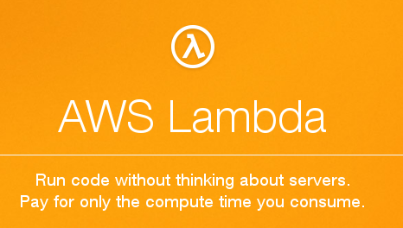
What is AWS Lambda?
Platform offered by AWS.
Functions in Java, Python, Node.js.
Respond to events in AWS.
Pay for execution time.
See Docs: Lambda Pricing Details
Alex Klibisz | Codestock 2016
Notes:
Let’s jump into Lambda specifically now.
AWS Lambda is a service that was introduced around November 2014.
Lambda lets you write functions in Java, Python, and Node.js.
The functions are configured to be triggered by various events in AWS.
You then pay only for the time your functions run, and you have no absolute ceiling as to how often they can execute. Specifically, you pay in increments of 100 milliseconds execution time. The first 1 million requests in a month are free. After that, you pay 20 cents per million requests and an additional variable amount based on the execution time and memory usage.
The pricing structure is a little convoluted like most AWS services, so you can’t really estimate unless you specifically understand your use case. That being said, you can be confident that you don’t pay for time when your servers are just spinning, so that’s certainly a positive when you start out.

Slide 7
Event Source
S3, API Gateway, Kinesis, etc.
Payload describing event
Lambda Function
Load, execute, exit
Logs, stdout
AWS Cloudwatch
Alex Klibisz | Codestock 2016
Notes:
Here’s a simple diagram just to reiterate how this works.
You configure your function to execute based on various events that can happen within AWS.
Then the function gets passed a payload describing the event that occurred. This is generally in JSON.
And your function is loaded into a server each time, executed, and exits. There’s actually benefit in pushing up minified code so that it gets loaded and executed faster.
Your logs and stdout get written to AWS cloudwatch for every execution.

Slide 8
Event Sources
S3
DynamoDB
Kinesis
Simple Notification Service
Simple Email Service
Cognito
CloudFormation
Cloudwatch
AWS Config
Echo
API Gateway
See Docs: Event Examples
Alex Klibisz | Codestock 2016
Notes:
Here are most of the AWS services that can be set up as event sources for lambda functions.
For example, you can execute a function each time a file is added to an S3 bucket. The AWS docs give you some sample events as JSON for you to use while writing the functions.
http://docs.aws.amazon.com/lambda/latest/dg/eventsources.html

Slide 9
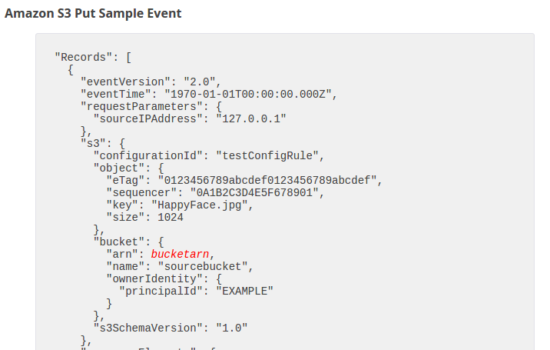
Notes:
And here is a sample payload for an S3 PUT event. You get a lot of information and then you just parse out the pieces you need for your function to do its job.

Slide 10
AWS Lambda Pitfalls
Tedious deployment process
Unfamiliar testing methodology
Runtime environment restrictions
No persistent state or file system
Latency while functions are loaded to execute
… Not a silver bullet
Alex Klibisz | Codestock 2016
Notes:
Obviously there are no silver bullets, and lambda by itself does have some issues in my opinion.
The deployment workflow is very tedious. You actually have to upload a zip file with all of your code each time you redeploy a function.
You have to find new ways to test your functions. For example, if you want to be really thorough you would have to find ways to mock the AWS events that trigger your functions.
You have some runtime environment restrictions. For a while, Lambda was way behind on the Node.js version, but they’ve recently updated to the LTS. If your logic depends on some very specific native libraries then lambda might not work for you. But they do have things like ImageMagick available in the runtime environment.
You don’t have any persistent state or file system between function executions. So the notion of a “session” is pretty much out of the question. Although some would argue this is a good thing because it forces you to decouple code.
And there is some latency while your functions load and execute. If you’re authenticating to services or databases outside AWS, then you’ll see a noticeable hit in the function’s execution time.

Slide 11
So we need tooling.
Notes:
So you have a very powerful platform with some pitfalls. Not too surprisingly, the result is that tooling gets created for this platform.

Slide 12
Serverless Framework
Released as JAWS ~ May 2015, later Serverless
CLI application, runs locally
Open-source, written in Node.js
Automated configuration (cloud formation, regions, environments)
Create, deploy Node.js, Python Lambda functions
Run simple tests locally
Map functions to endpoints and events
Plugins ecosystem
Alex Klibisz | Codestock 2016
Notes:
The specific tool I’ll introduce today is called the Serverless Framework.
It’s a CLI application that you run locally to interact with AWS Lambda
The Serverless project was initially released as the Jaws framework, a little over a year ago. They renamed it to Serverless a few months after that.
It’s open source, on github, and implemented in Node. So it’s easy to just install from NPM and get going.
The first significant thing that serverless does for you is automate API Gateway configuration and handle using multiple AWS regions, which is a lot of work to maintain manually. In fact all of the API calls that serverless makes for you while setting up a project take about 3 to 5 minutes to execute.
After that it automates the deployment of Node.js and Python lambda functions. I know that examples for node.js functions are much more common and I haven’t actually used it with python.
From the CLI you can run simple tests locally by mocking the payload that your function takes.
Serverless uses configuration files in JSON to wire up API gateway endpoints and AWS events to your handler functions.
Finally, there is a growing plugin ecosystem. For example, you would install a plugin to enable cross origin requests to your API endpoints.

Slide 13
Serverless Caveats
Prioritizes HTTP API use-cases
Counterintuitive response statuses (error returns a 200 status)
Complexity for multiple developers
Quickly evolving = breaking changes, documentation falls behind
Alex Klibisz | Codestock 2016
Notes:
There are some caveats worth addressing.
First, serverless prioritizes API-centric applications. They fairly recently started adding support for AWS events, but I found the documentation was not great yet.
This is more of an API Gateway quirk, but by default if your function errors out or throws exceptions, you still get 200 response. There is a way to change this behavior with your endpoint configurations but it isn’t simple unfortunately.
Finally, the code is evolving quickly, which is nice, but the documentation is limited. There were a couple cases where my questions were answered on the Serverless slack community.

Slide 14
Serverless Demo

Slide 15
“Lambda Albums”
Static site hosted on S3
Upload images via Lambda endpoints
Store images, thumbnails on S3
Render SEO-friendly static galleries to S3
Inspired by article Making static websites less static: S3 cloud, AWS Lambda, and a rough one-day hack - airpair.com
www.lambda-albums.xyz
Alex Klibisz | Codestock 2016
Notes:
So let’s jump into the demo now, I called it “Lambda Albums”.
I’ll do a little explaining here before we start coding.
It’s a static site and web app hosted on S3.
The user creates an album and uploads images.
The images get stored both fullsize and as thumbnails.
And then we render static galleries including the images. This is important for a few reasons:
Requesting the images in an album from an endpoint would be more expensive because more function calls are made.
Generating and serving a complete static page is SEO-friendly. So this pattern would fit well for a content-heavy public-facing site.

Slide 16
Let’s see it in action.
Alex Klibisz | Codestock 2016

Slide 17
POST /album
name
function album
Create S3 folder with this name
POST /image
albumName,name, image
function image
Create thumbnail, store image in S3
Event: S3 PUT
function album-builder
Render album page with all images.
Notes:
Here is a high-level overview of the three functions that we need to create this simple application.
We have an endpoint for POSTing an album. We just give the album name as JSON and the function simply creates an S3 folder with the name.
We have an endpoint for POSTing an image. We pass the albumName, the image name, and the image itself as base64. The handler function creates a smaller thumbnail and stores both the image and thumbnail in S3.
Finally we have a function album-builder that gets fired on an S3 PUT. When the image endpoint handler stores the image in S3, this function will re-render the album page with all of the images in the album. It’s important that this be a separate function to avoid race conditions when uploading multiple files and to make the response time faster for the image endpoint.
So if anyone has questions about this set up right now, go ahead and let me know. I want to make sure you’re not confused before I show code….

Slide 18
Let’s see the code.
Alex Klibisz | Codestock 2016
Notes:
Alright, so let’s jump into the code.

Slide 19
Use-cases (educated opinions)
Good: fire-and-forget interaction with AWS services
Log, stream, media processing
Document generation
Sending notifications
Bad: realtime or low-latency constraints
Alex Klibisz | Codestock 2016
Notes:
So now we have an idea for how you can work with Serverless to make Lambda a little less painful.
I’ll briefly touch on some use-cases where I think that Lambda works well and doesn’t work well.
In general, if you have any sort of fire-and-forget computation that interacts with AWS services, Lambda is at least a good place to start. If you read online, some common use cases are for processing logs and streams from AWS Kinesis, processing media uploads like we did, and generating documents, also similar to what we did.
Also, if you have a part of your application that is experimental, or you’re not sure yet how it fits into your codebase, Lambda is a good place to do some prototypes and then you may eventually move this back into your existing codebase.
On the other hand, if you have a use case that requires realtime or very low-latency computation, I think Lambda is a poor fit. I’ve heard some rumors about them adding socket support, but I’m not exactly sure how that would work yet.
For me specifically, there was a case where lambda has failed in the past when working on StudyLoop.
We were using Firebase as our primary data store
Uploading images from an app into firebase as base64 strings
Proxying the change in firebase to lambda functions
Lambda function resizes the base64, stores in S3
Authenticates with Firebase, saves the URL back to Firebase.
…. Too many steps, too slow
Transfering the base64 image from Firebase into the Lambda function, then authenticating against firebase to store the URL of the uploaded image was too slow.

Slide 20
Other Tools, Libraries
Apex: run Go and other non-supported languages
Zappa: serverless python web services
Shep: node.js on AWS lambda
Claudia Bot Builder: bots for FB messenger, skype, etc.
LambCI: continuous integration on AWS Lambda
Alex Klibisz | Codestock 2016
Notes:
Again, tooling is a big thing for AWS Lambda right now. The programming interface is clunky, so people try to make up for it in open-source. I listed some other tools that you can check out here.
(Ad-lib talk about the tools)

Slide 21
Exploring Serverless Architectures, CodeStock 2016
Alex Klibisz
@alexklibisz, alex.klibisz.com
Slides and code: alex.klibisz.com/pages/talks

