Slide 1
Kinect Facial Recognition
Alex Kohler

Slide 2

Overview
•Implement a method to identify multiple people utilizing the Kinect API
•”Train” a program to identify
people
Notes:
Alongside Zhen doing some dynamic joint analysis, we both fit into Matt’s program in identifying people.

Slide 3
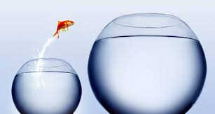
What’s the bigger picture?
•By combining the ability to recognize somebody by facial features and their movements, we have a good baseline for identifying people.

Slide 4
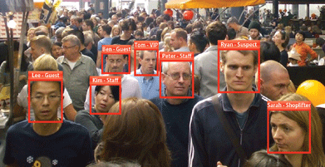
So what?
•Various security applications
•Attendance
•Powerful when coupled with other biometrics
Notes:
Why is this useful?
You meet many people of the same… let’s say height, however, you do not often meet people with the same face
Various security applications - is this person bad? Have they done bad things in the past? Maybe we should take a closer look at them.
Attendance - who came to class today?

Slide 5
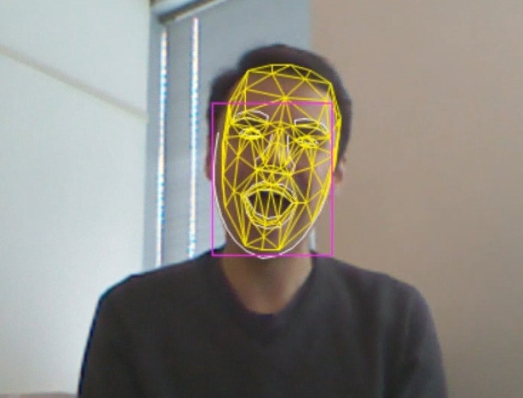
How?
•Facial features library
•Mesh representation
Notes:
With Kinect 2 came some much improved support for facial features
Mesh representation - up to 121 points

Slide 6
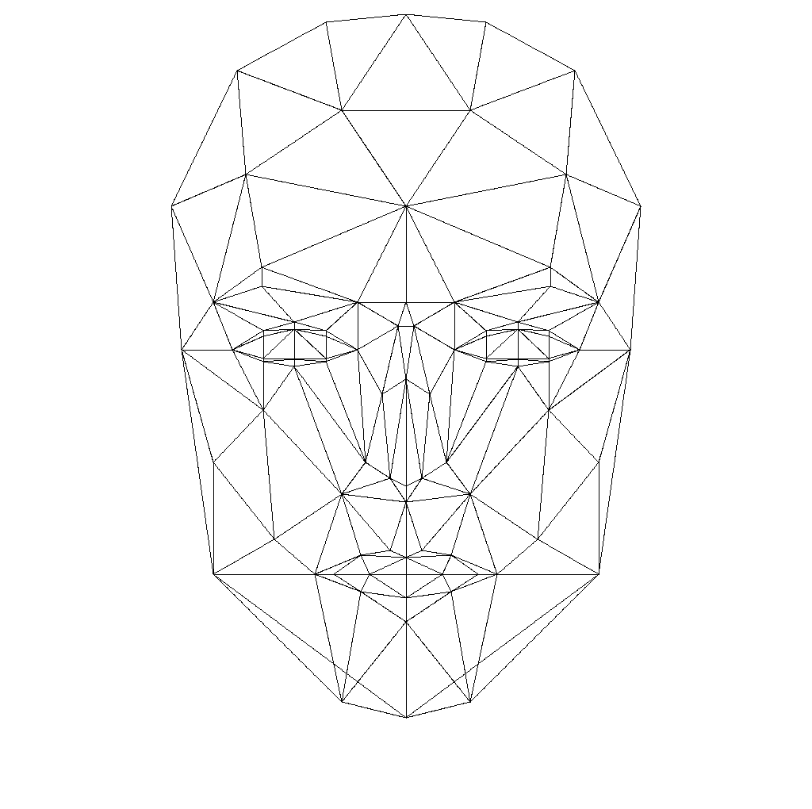
(Current) Sources of Truth
•(Currently) 5 Joints
Left/Right corners of mouth, left/right eyes, nose
So what?
•Facial “Features”
Glasses, smiling, eyes opened/closed
Notes:
Currently using 5 joints - left/right corners of your mouth, left/right eyes, nose. It is possible to support up 121 points for a mesh representation of the face, which will eventually make for much more accurate tracking
A baseline identification is simply the relative distance between these points. Since these joints are only tracked in 2d, they must be converted to 3 dimensions to find proper distances
We all look different, and while our eye color, hair color all play a part, so too does the symmetry and layout of our face.

Slide 7

Training/Testing
•Plan is to have 2 stages, one for training one for testing
Notes:
One program to “train”, e.g. add people and their respective data so they will be recognized by the testing phase
One program to “test”, e.g. identify people based on previous data collected

Slide 8
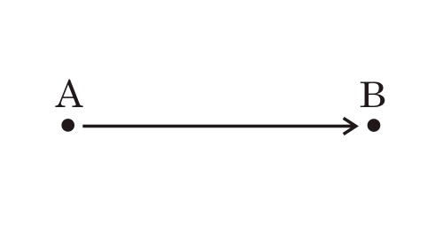
Stage One: Identification
•Process Joint data - “Training”
▶Relative distances
▶Caveats
▶Solutions
Notes:
Processing joint data - converting 2d coordinates to 3d and then find relative distances between eyes, mouth, ec…
proper margin of error

Slide 9

Stage Two: Classification
•Analyze data with Weka
•Eventually use as a means of identification

Slide 10

Goal
•Fully functioning,
accurate means of identification

