Slide 1
Summer Internship Project WB2UART
Aleksandar Komazec Jul’15/Oct’11

Slide 2
Agenda
Introduction – agenda
DUT description
Verification Environment description
Wishbone UVC description
Uart Asynchronous Receiver Transmitter UVC description
Realization (checkers, coverage)
Tests (test scenarios, waveform, sequences, found bugs)
Conclusion

Slide 3
DUT description (1/3)
The UART (Universal Asynchronous Receiver/Transmitter) core provides serial communication capabilities, which allow communication with modem or other external devices, like another computer using a serial cable and RS232 protocol.
Use :
Modems
Printers (RS232 is still widely used for older printers in the workplace)
Cameras
And so on

Slide 4
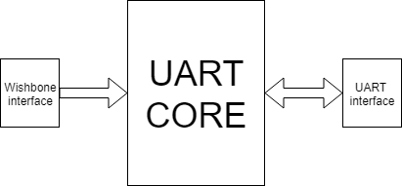
DUT description (2/3)
2 interfaces :
Wishbone interface
UART interface
Features
WISHBONE interface in 32-bit or 8-bit data bus modes (selectable)
FIFO only operation
Modem communication (Not covered by Verification)
Debug Interface in 32-bit data bus mode

Slide 5
DUT description (3/3)
Registers
Receiver Buffer (Receiver FIFO output )
Transmitter Buffer (Transmit FIFO input )
Interrupt enable Register (Enable/Mask interrupts generated by the UART )
Interrupt Identification Register (Get interrupt information)
Fifo Control Register (Control FIFO options )
Line Control Register(Control connection )
Modem Control Register (Controls modem)
Line Status Register (Status information )
Modem Status Register (Modem Status )
Divisor Latches (Provide baud rate )
Debug 1 (First debug register)
Debug 2 (Second debug register)

Slide 6
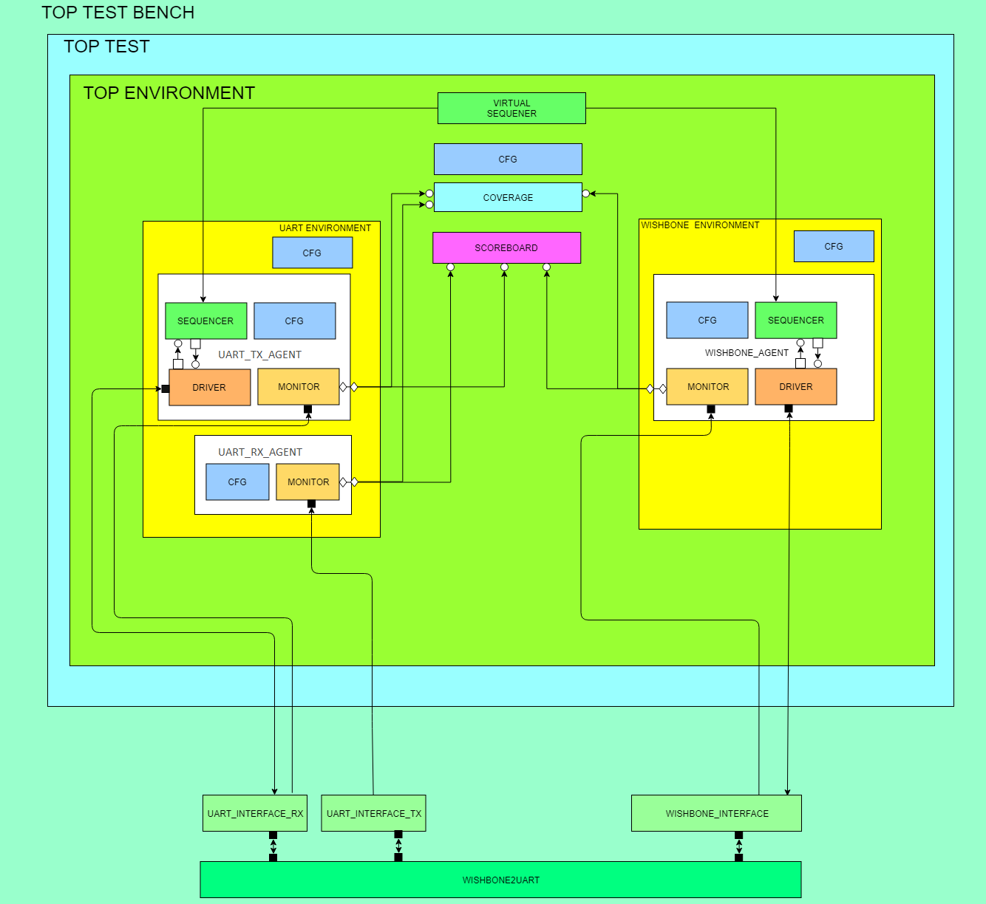
Verification Environment description (1/2)

Slide 7
Verification Environment description (2/2)
Verification Environment consists of:
Top test bench
Tests
Top Environment
Virtual Sequencer
Top configuration
Coverage
Scoreboard
2 UVCs (Wishbone and UART)

Slide 8
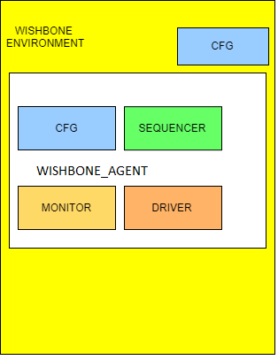
Wishbone UVC description (1/2)
Wishbone UVC consists of
Wishbone Envrionment
Wishbone Configuration
Wishbone agent
Wishbone agent consists of
Wishbone agent configuration
Wishbone sequencer
Wishbone driver
Wishbone monitor
Wishbone agent can be master or slave. It depends on configuration field (mas_slv can be MASTER_E or SLAVE_E)

Slide 9
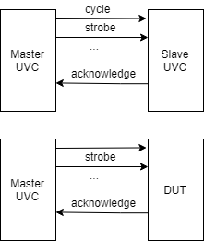
Wishbone UVC description (2/2)
Slave UVC is used to test protocol rules
Master UVC initiates transaction by setting cycle,strobe. Other signals are followed by set strobe.
UVC Slave responds to strobe signal by setting acknowledge signal.
Master UVC is used to :
Configure DUT (Set registers in duts)
Write data into Fifo Transmitter
Read data from Fifo Receiver

Slide 10
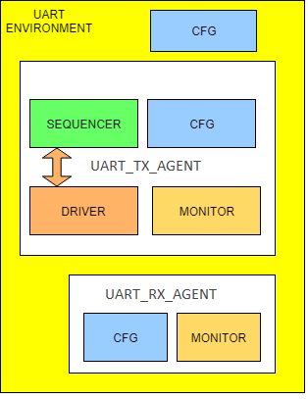
Uart Asynchronous Receiver Transmitter UVC description (1/2)
UART UVC consists of
UART Envrionment
UART Configuration
UART agents (TX and RX agents)
UART TX agent consists of
UART agent configuration
UART sequencer
UART driver
UART monitor
UART RX agent consists of
UART agent configuration
UART monitor

Slide 11
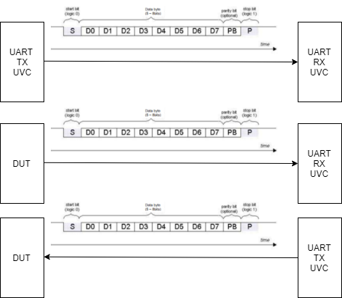
Uart Asynchronous Receiver Transmitter UVC description (2/2)
Testing UVC to UVC in order to check functionality.
UART RX UVC is used to monitor output from Fifo Transmitter that is placed in DUT.
UART TX UVC is used to write data into Fifo Receiver that is placed in DUT.

Slide 12
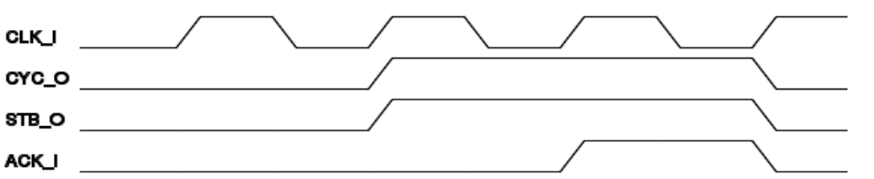
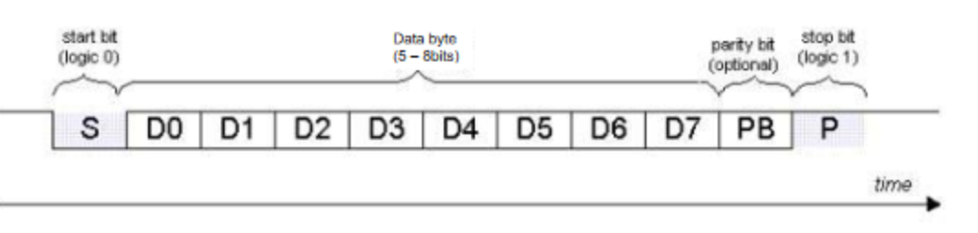
Realization(1/3) Checkers
Wishbone protocol checkers
Protocol checkers, implemented in interface:
Checking whether address,data, command,sel are valid during active strobe signal
Checking whether Cycle signal is active during the whole transfer
Acknowledge responds to strobe changes.
UART protocol checkers
All bits in the word must be valid (0 or 1)

Slide 13
Realization(2/3) Checkers
Register checkers
Check read-only access
Check write read access
Check reset value
DUT checkers
There are checkers related to DUT functionality.
Checkers implemented in Scoreboard :
Compare input Fifo Transmitter data to its output
Compare input Fifo Receiver data to its output

Slide 14
Realization(3/3) Coverage
DUT coverage
This part is not implemented.
In order to cover automatically many different combinations of scenarions this part is very important.
Some of coverage that need to be implemented :
Cover UART word format (number of bits (5,6,7,8), number of stop bits (1, 1.5, 2), enable/disable parity, parity type …)
Cover which interrupts have been activated.
Cover which error indicators have been activated
Receiver Fifo trigger levels

Slide 15
Test scenarions(1/4)
Tests scenarios:
wb2uart_fifo_wr_rd_test_tc
wb2uart_register_access_test_tc
Virtual sequences:
wb2uart_virtual_wr_rd_seq
wb2uart_virtual_register_access_seq
wb2uart_virtual_dut_config_seq (This virtual sequence is used to configure DUT and it is called from other virtual sequences )

Slide 16
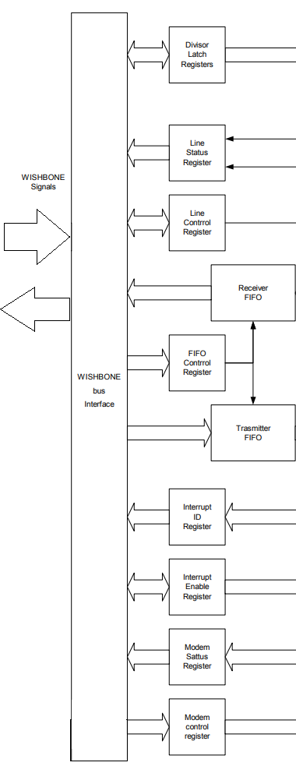
Test scenarions(2/4)
wb2uart_register_acces_ test_tc runs wb2uart_virtual_register_access_seq
A scenario is implemented in this virtual sequence
Purpose of this scenario is to read and write value of the register
Found bugs are :
The clock in the DUT top module stays unconnected with another instantiated module.
The reset in DUT top modules has been connected reversely with other modules.
For Line Control Register address was set as 9. But it is 3 according to UART spec.

Slide 17
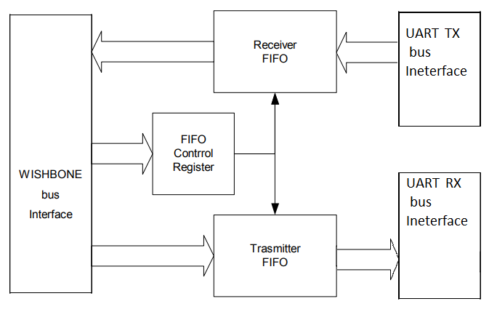
Test scenarions(3/4)
wb2uart_fifo_wr_rd_test_tc runs wb2uart_virtual_fifo_wr_rd_seq.
The Purpose of this scenario is to fill Transmitter Fifo and Receiver Fifo. Then read data from Transmitter and Receiver Fifos in order to compare data from Wishbone bus and data from UART bus.

Slide 18
Test scenarions(4/4)
Bugs that are found during this test :
Number of data bits on tx bus was 5 despite the configuration field that changes number of data bit (5,6,7,8)
Wrong UART_FIFO_DEPTH define (It was set to 1, instead of 16). This define is used for incrementing a counter that points to the current Transmitter Fifo address.
Wrong Length of stop bits. Length of 2 and 1 stop bits were the same.
Wrong value of stop bits. In DUT it was set as 0, but according to the spec, it is set as 1.
Wrong parity value. Data was 0000 0011 and the type of parity was even, as a result, parity bit was high which is incorrect.
Wrong stick parity. When the type of parity is set to even, this bit must be 0, when type of parity is set to odd, this bit must be 1.

Slide 19
Conclusion
Great verification plan, and verification architecture can ease producing verification environment.
Modern tools help engineers to track, find and fix bugs
UVM is a great tool in building an universal verification environment.

Slide 20
Q&A
THANK YOU!

