Slide 1
Ensemble Selection from Libraries of Models
Rich Caruana
Alexandru Niculescu-Mizil
Geoff Crew
Alex Ksikes
Department of Computer Science, Cornell University

Slide 2
Ensemble Methods
Ensemble: a collection of models whose predictions are combined by weighted averaging or voting.
Usually one chooses the best single model.
A necessary and sufficient condition: “Ensemble of classifiers to be more accurate than any of its individual members is if the classifiers are accurate and diverse”. Dietterich (2000).
Bagging: train models on bootstrap samples of the training set.
Boosting: force new models attend to those points that are difficult to classify.
  Model of one type, ensemble optimized to the metric of the training algorithm.
Ensemble Selection: greedy forward stepwise selection from a library of models to build ensembles that are optimized to the given performance metric.

Slide 3
Libraries of Models
Generate diverse set of models using many different parameter settings for each learning algorithm:
  Support vector machines (SVMs)
  Artificial neural nets (ANNs)
  K Nearest neighbor (KNN)
  Decision trees (DT)
  Boosted stumps (BST-STMP)
  Bagging with decision trees (BAG-DT)
  Boosting with decision trees (BST-DT)
Do not determine what parameters yield best performance when training models.
All models are added to the library no matter how good or bad they are.

Slide 4
Ensemble Selection (overview)
Similar to forward feature selection.
Add to the ensemble the model in the library that maximizes the ensemble’s performance to the error metric on a hillclimb set.
Models are added to the ensemble by averaging their predictions with the models already in the ensemble.
  Adding a model to the ensemble is very fast.
  Allows us to optimize the ensemble to any performance metric (even metric on which we do not how to optimize individual models for).
Library is generated using any learning methods for any parameters (no parameter selection).
Ensemble selection uses the same hillclimb set to perform both parameter and model selection.

Slide 5
Ensemble Selection (Details)
When combining thousands of models the greedy forward selection procedure tends to overfit.
Three modifications to the greedy forward selection procedure.
Performance drops because best model in library have been used and selection must now add models that hurt ensemble.
1) Selection with replacement: allows models to be re-selected.
  adds models that were added before rather than hurt the performance of the ensemble.
  Fine tune ensembles by weighting models.
  Flattens the learning curve so that the peak is not missed.

Slide 6
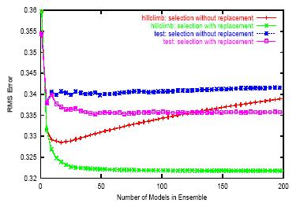
With replacement vs without replacement.

Slide 7
Ensemble Selection (Details)
Forward selection overfits early in selection when ensembles are small.
2) Sorted Initialization: put the best N models in the ensemble.
  Form a strong initial ensemble.
As the number of models in library increases, chances of finding combinations of models that overfit increases.
3) Bagged Ensemble Selection: drawing random sample of models from the library and selecting from that sample.
  Reduces the number of models selection can choose from.

Slide 8
Experiments
Comparing ES:
  best single model, average of all models, Bagging, Boosting, Bayesian model averaging and Stacking with model regression.
Experiments on seven tests problems:
  Adult, Covertype, Letter.p1, Letter.p2 … from UCI Repository
Using ten performance metric:
  Accuracy, RMS, mean cross-entropy, lift, precision/recall F-score, average precision, ROC area, a measure of probability calibration.
  Home made metric:
  SAR = (ACC + ROC + (1-RMS)) / 3
Train set of 4000 examples to generate the model libraries, 1000 examples for the hillclimb set, large final test set.

Slide 9
Results
To allow averaging across problems and metrics, convert performances to a normalized [0,1] scale.
  1 is best performance seen for any model on the final test set.
  0 is the baseline performance.
Converted problems to binary problems.
  Many metric we consider are only defined for binary problems.

Slide 10
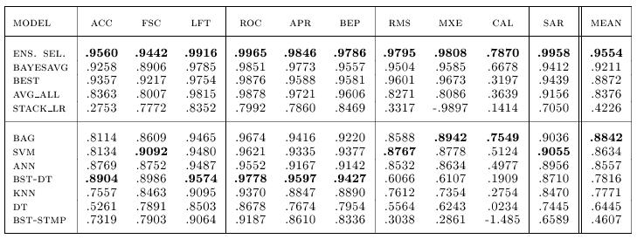
Results

Slide 11
Results
Ensemble Selection outperforms the other ensemble methods on all 10 of the 10 metrics on the 7 seven test problems.
Two reasons:
  Ensemble selection is able to optimize the ensemble differently for each performance metric.
  Overfitting serious problems when combining thousands of models. Modification of the greedy search method contributes to ES excellent performance.

Slide 12
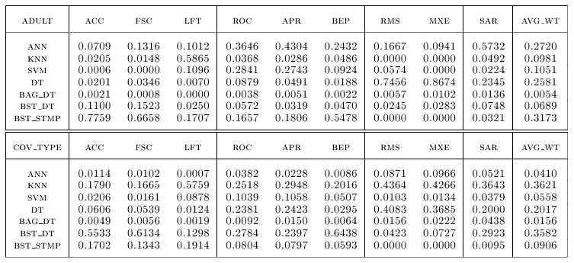
Diversity of Models (aggregate weight given to different type of models in the ensembles)

Slide 13
Discussion and future work
Ensemble Selection does not require any extra validation set than the one that would have been used for model selection.
  uses a hillclimb set for parameter selection, model selection, and ensemble creation.
Ensemble selection is efficient
  only requires averaging of model’s predictions with ensemble predictions.
  Runs in O(D*M*K) where D is the size of the hillclimb set, M is number of models to choose from, and K number of steps of forward selection.
Ensemble Selection builds a diverse set of models optimized for any given performance metric.
Experiments on seven test problems and ten performance metric show that ES consistently finds ensemble that outperform other models (including models trained with Bagging and Boosting)

Slide 14
Article at www.cs.cornell.edu/~caruana/caruana.icml04.crc.ps

